Slide 1


Project Cost
Management
Prepared by
Dr. Hoda Metwally
PMG 213
Introductory lecture

Slide 2



Project Cost
Management
Introductory lecture
PMG 213
Prepared by
Dr. Hoda Metwally
www.midocean.ae

Slide 3

Project Cost
Management
Introductory lecture
PMG 213
Prepared by:
Dr. Hoda Metwally
www.midocean.ae

Slide 4


Dr. Hoda Metwally
PhD Degree in Accounting
Faculty of Business- Ain Shams University.
Experience in teaching Accounting.

Slide 5

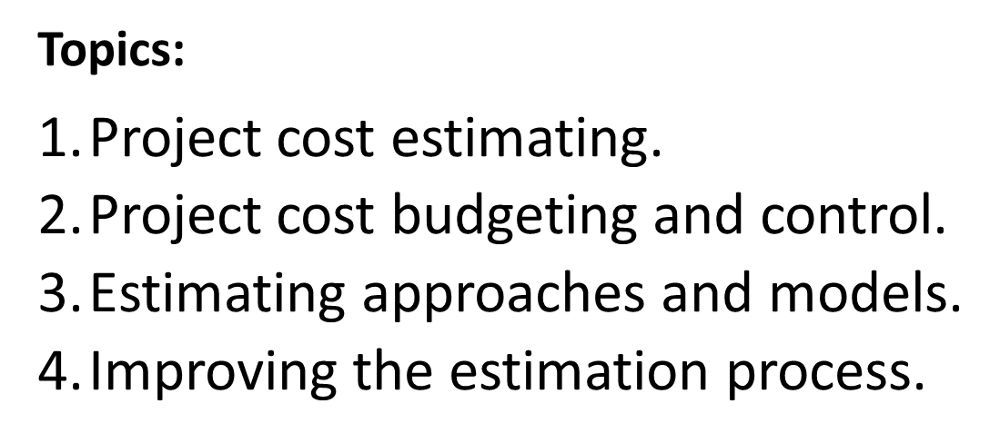

Slide 6
5-Value management.
6-Time and cost change management.
7-Impact of cost‐estimation changes on project.

Slide 7
Learning Outcomes:
● Analyze the project’s goals and select an appropriate cost‐estimation approach.
● Prepare a cost estimate and analyze staff resources, cost drivers, contingency costs, and management reserves.
● Establish a cost baseline by applying the cost budgeting process.

Slide 8
● Analyze project performance by applying the cost control process.
● Evaluate types of resource costs necessary to draw up a complete cost estimate, and determine the accounting category of each, such as direct, indirect, capital, and operating.
● Managing changes in a project.

Slide 9
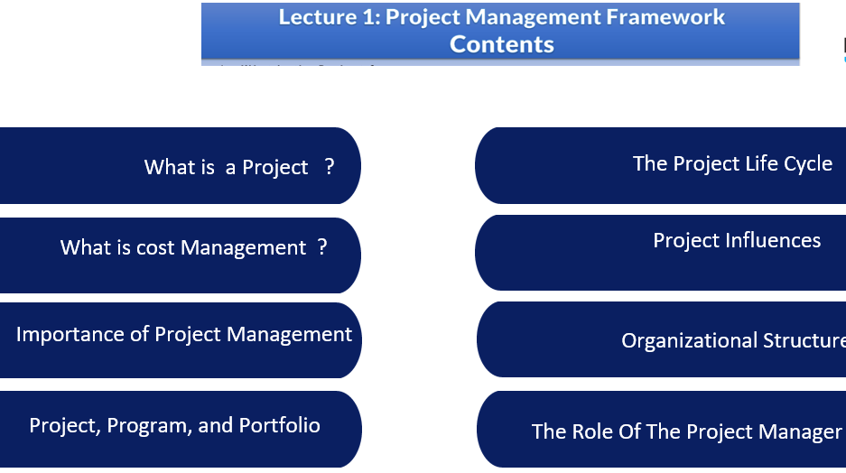

Slide 10
What is a Project?
Temporary effort undertaken to create a unique service or product or result.
Temporary means has a definite beginning and a definite ending.
Unique means different design , different location ,different circumstances….etc.

Slide 11
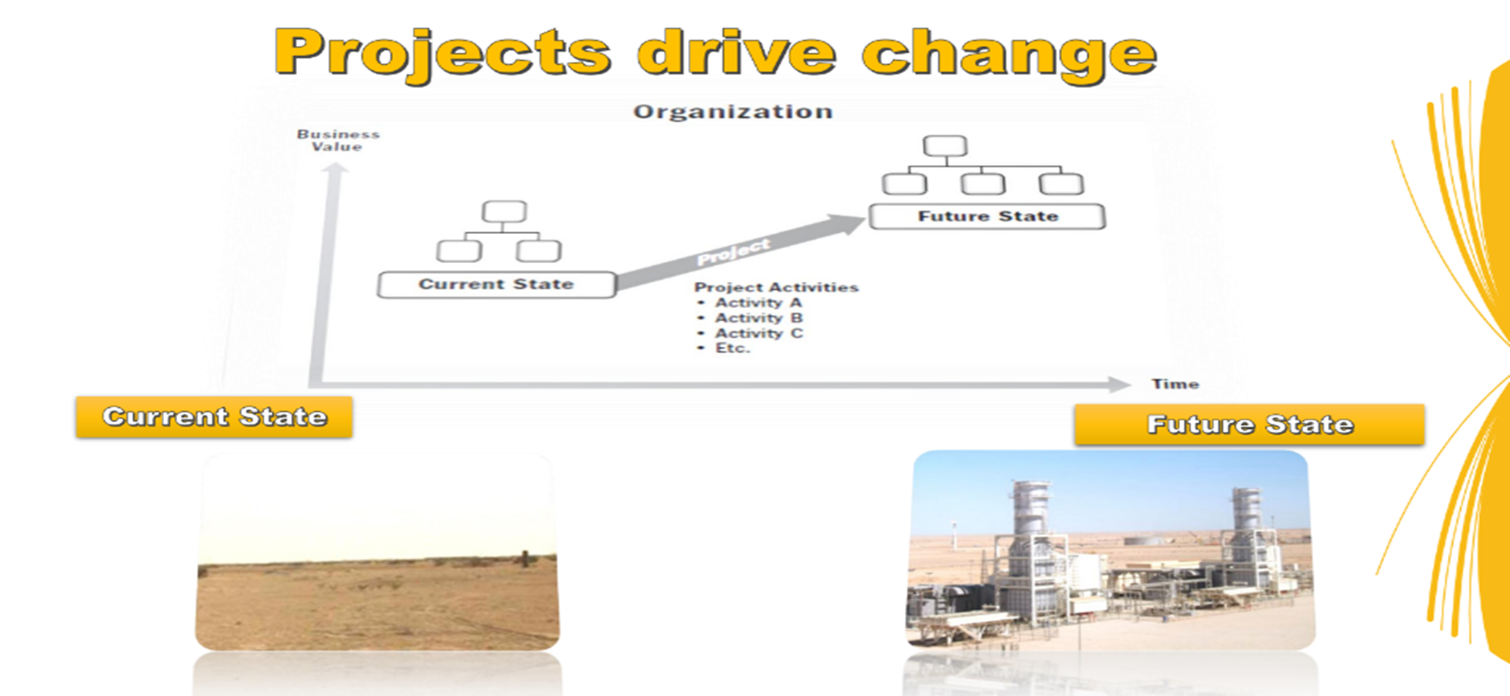

Slide 12
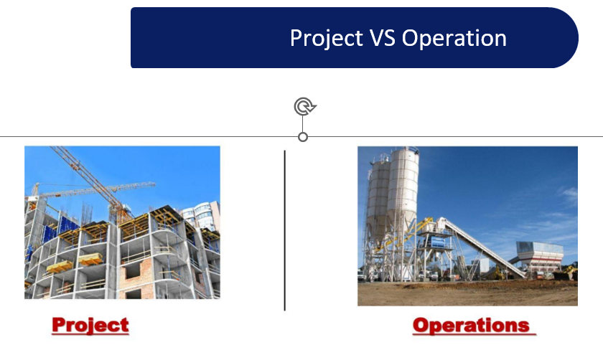

Slide 13
Cost Management :
Is the process of planning and controlling the budget of a business .
Budget:
Is a spending plan based on income and expenses. It‘s an estimate of how much money will be made and spent in a definite future time.

Slide 14
Cost management is a form of management accounting that helps businesses to avoid exceeding the budget with more accurate forecasts of expenditures.

Slide 15
Stages of Cost Management:
1-Set up:
A stage in which managers determine what is included in the cost management plan. It identifies the stakeholders , tools and data structure needed to track costs.

Slide 16
2-Resource planning:
This stage identifies the resources needed to complete the project (ex: materials, assets staff). It determines resource allocation including the amount of the resource needed for how long and how it will be allocated. (resources are allocated to tasks).

Slide 17
3- Budgeting and cost estimation:
In this stage the project scope is refined, the cost and duration of each task are estimated and a budget is created.

Slide 18
4- Cost control:
As the project progresses as managers track how costs differ from estimated budget and take corrective actions must be taken to reduce these deviations.
So in this stage costs are monitored , reported , controlled and adjusted .

Slide 19



Thank You

