Slide 1

The Cultures of New Media
Prepared by
Dr. Mohamed Owies
Lecture No.8
The Cultures of New Media

Slide 2


Lecture 8
The content of Lecture 8
The lecture 8 sheds light on a number of important topics, including the following:
Mobile Culture
Mobile culture vs mobile culture?
Monitorial Citizens
Citizens Journalism
You and Citizen Media
Citizens Journalism VS Traditional Journalism

Slide 3
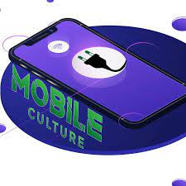
Lecture 8
Mobile Culture
The history of the digital society can be divided into different phases or periods in many ways.
The first is to see it in terms of four critical technologies that were introduced during its development. First, the widespread use of computers among ordinary people.

Slide 4
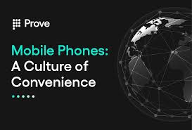
Lecture 8
Mobile Culture
Second, bringing the Internet to a broad, global audience.
Third, the evolution of Web 2.0 technology, user-generated content, and social networking.
Fourth, mobile devices with universal access to wireless networks - laptops, tablets, and most importantly, cell phones.

Slide 5
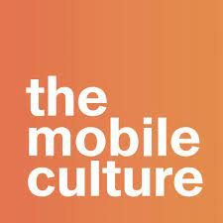
Lecture 8
Mobile Culture
It started as part emergency services tool, part science fiction fantasy, the cell phone entered the broader consumer market during the 1990s, was introduced as a lifestyle accessory to businessmen and celebrities and evolved into an enduring and accepted present. Granted a joint object in the early 2000s.

Slide 6

Lecture 8
Mobile Culture
Cell phones have changed the standards of daily life for huge numbers of people globally, to the extent that the mobile phone can be considered a “social change agent” (Nur Allah 2009:19). This is at least in the sense that the number of things we do to carry out everyday tasks and communicate with others are done in very different ways by society after - than it was before - mobile digital communications. This development happened quickly. In the early 1990s, having a mobile phone was something rather unusual or at least a little weird.
.

Slide 7
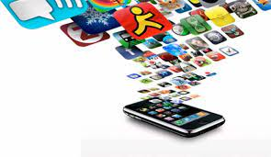
Lecture 8
Mobile Culture
There have already been several significant changes, and as a result, the cell phone has changed Communication has rapidly emerged as a specialized area of research Societal transformations have been planned and said to be the result of the cell phone

Slide 8
Lecture 8
Mobile Culture
The organizational structure of a business is in a state of flux; Relationships between teens and parents - And among teenagers - they change. New forms of distancing and intimacy are taking shape, and Various struggles for status and power turned to new ground.

Slide 9
Lecture 8
Mobile Culture
The effects of cell phone communications may be small. Sometimes, the effects are just too much More transformation and change of our social community in its essence.

Slide 10
Lecture 8
Mobile Culture
while cell phones, in their early incarnations in the 1980s and 1990s, allowed for talking To — as well as texting to — people in other places, their evolution hasn't stopped there.

Slide 11
Lecture 8
Mobile Culture
Rainie and Wellman (2012) showed that this was due to a different affinity. Technological advances in the mid to late 2000s. Computer technology is getting better; data storage Mobile communication has been improved and has become easier and cheaper due to new ways of managing radio spectrum.
These developments gradually led to the invention of the type most common today Cell phone.

Slide 12
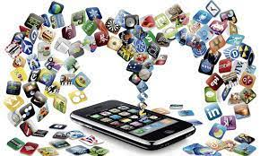
Lecture8
Mobile Culture
Smartphones are light and versatile gadgets with advanced technology built in Cameras and a whole ecosystem of apps that most of us carry around in our pockets today.
Countless surveys of people's use of mobile media have shown how social sharing works, such as Like sending and posting photos and videos, and accessing social media services, they have been doing this steadily

Slide 13
Lecture8
Mobile Culture
become more and more important as mobile activities. Many people today cannot imagine that living without their smartphones, and we use our mobile devices for an increasing number of Different things: talking, texting, listening to music, taking photos, making video calls, accessing
Web, get directions and other location-based information, play games, watch videos, etc.

Slide 14

Lecture 8
Mobile Culture
Since cell phones are often interpreted and discussed in terms of their novelty, the adoption is often seen as part of youth culture, with young adults being mobile pioneers.
In line with this, a study by communication scientist Rich Laing (2002) showed that there is Certain cell phone cultures among teens. This culture b Extensive use of cell phones, both using text messages to maintain social contact

Slide 15
Lecture 8
Mobile Culture
communication, humorous banter to tie the group together, physical decoration, and setting devices themselves using themes, jewels, ringtones, wallpapers and icons, And that was in the early 2000s
The cell phone is changing “from being a tool for young people to something more social Communication tool for girls.

Slide 16

Lecture 8
Mobile culture vs mobile culture?
With mobile technologies increasingly entwined in our daily lives, there are two main ways the cell phone can blend into culture. The first is when mobile devices are used in a way that reflects pre-existing cultural practices or social patterns. This was interestingly discussed in a CNN article about mobile etiquette around the world.

Slide 17
Lecture 8
Mobile culture vs mobile culture?
The second is that the use of mobile technologies and the activities that occur within them are creating entirely new digital cultures. Between online communities of interest, brand loyalty, phone decoration or personalization, text messaging trends, and social media usage, cell phones are in a culture of their own.

Slide 18
Lecture 8
Mobile culture vs mobile culture?
Mobile is an important channel to reach consumers today. They account for 10% of all internet traffic, and Mashable reports that number is growing. It is an actionable platform. Mobile customers are much more interactive than online customers, meaning they are and will remain active, as long as the interactions are simple and intuitive. The advantage of mobile media is that you can reach the consumer on the go - anytime, anywhere.

Slide 19
Lecture 8
Mobile culture vs mobile culture?
Measurement: The growth of marketing and budgets in most industries is gradually beginning to shift to other digital channels, particularly mobile devices (smartphones and tablets), making testing and optimization essential components of any successful online marketing initiative.

Slide 20
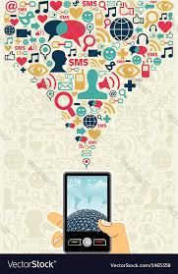
Lecture 8
Mobile culture vs mobile culture?
Video: Streaming video has grown in popularity, but due to the smaller screens of smartphones and tablets, retargeting a TV ad does not take full advantage of the potential benefits of this medium. It is essential for brands/agencies to create videos specifically with mobile devices in mind

Slide 21
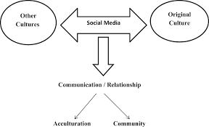
Lecture 8
Mobile culture vs mobile culture?

Slide 22
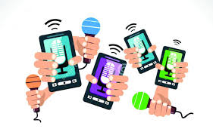
Lecture 8
Monitorial Citizens
Another aspect of how society and the public are changing in the age of the internet and social media relates to news reporting and journalism.
First, the development of new platforms, and the emergence of new audience behaviors, have changed the context of news production and the conditions under which media companies and journalists operate.

Slide 23
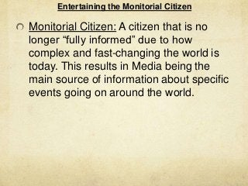
Lecture 8
Monitorial Citizens
They increasingly have to adopt new editorial workflows, adapt to altered practices for news gathering, and to speeded-up the production cycle.
In digital society, one must see news production as a collective effort between journalists and members of the public. Today’s participatory media culture has brought about a change of the relationship between news media and their audiences from being about one-way communication to being increasingly dialogical.
People in digital society can be described as monitorial citizens.

Slide 24
Lecture 8
Monitorial Citizens
Now, a new contract is needed: a commitment that reframes the traditional consumer-producer relationship into one of co-creation, with journalists and communities working together to produce this essential public good.

Slide 25
Lecture 8
Monitorial Citizens
Journalism is a powerful institution that bears a critical responsibility in our society. Monitorial citizens have told they are willing to share that responsibility in order to become more informed, engaged people — but journalists have yet to show their willingness to share that power in order to create a more effective, engaged journalism rooted in the public interest. Evolving from the “community journalism” movement of the 1950s, the “public journalism” school of the 1990s and the “citizen journalism” trend of the 2000s, a new kind of civic media can and should empower people to become knowledgeable information gatherers and distributors, and uplift them as trusted voices in their own communities.

Slide 26
Lecture 8
Citizens Journalism
Journalism researcher Michael Schudson (1999: 310–311) has introduced this concept: Monitorial citizens scan (rather than read) the informational environment in a way so that they may be alerted on a very wide variety of issues for a very wide variety of ends and maybe mobilized around those issues in a large variety of ways […] The monitorial citizen engages in environmental surveillance more than information-gathering.

Slide 27
Lecture 8
Citizens Journalism
citizen journalism, journalism that is conducted by people who are not professional journalists but who disseminate information using Web sites, blogs, and social media. Citizen journalism has expanded its worldwide influence despite continuing concerns over whether citizen journalists are as reliable as trained professionals. Citizens in disaster zones have provided instant text and visual reporting from the scene.
Swirling in the background of these developments was a debate over whether the term citizen journalism was itself accurate.

Slide 28
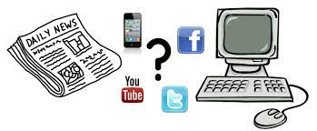
Lecture 8
Citizens Journalism VS Traditional Journalism
Both the term and the practice crystallized in South Korea, where the online entrepreneur Oh Yeon-ho declared in 2000 that “every citizen is a reporter.” Oh and three South Korean colleagues started an online daily newspaper in 2000 because, he said, they were dissatisfied with the traditional South Korean press. Unable to afford the costs of hiring professionals and printing a newspaper, they started OhmyNews, a Web site that used volunteers to generate its content. In a speech on the site’s seventh anniversary, Oh, the firm’s president and CEO, noted that the news site began with 727 citizen reporters in one country and by 2007 had grown to 50,000 contributors reporting from 100 countries.

Slide 29
Lecture 8
Citizens Journalism VS Traditional Journalism
Since then the Internet has spawned thousands of news sites and millions of bloggers. Traditional news media, while battling declining readership and viewership, leapt into the fray with their own Web sites and blogs by their own journalists, and many newspapers invited readers to contribute community news to their Web sites. Some groups started their own “hyperlocal” online news sites to cover happenings in their neighbourhoods or specialized topics of interest that were not reported by larger media organizations.

Slide 30
Lecture 8
Citizens Journalism VS Traditional Journalism
Dan Gillmor, founder and director of the Center for Citizen Media and author of the book We the Media: Grassroots Journalism by the People, for the People (2004), also rejected any single definition for the transformation in news that had begun in the late 1990s. He called this era “a time of incredible exploration” because of the participation of access to inexpensive and ubiquitous publishing tools.

Slide 31
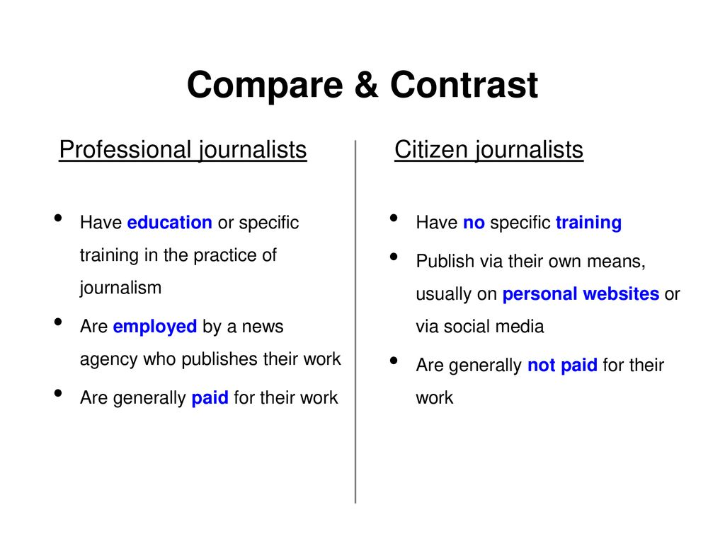
Lecture 8
Citizens Journalism VS Traditional Journalism

Slide 32
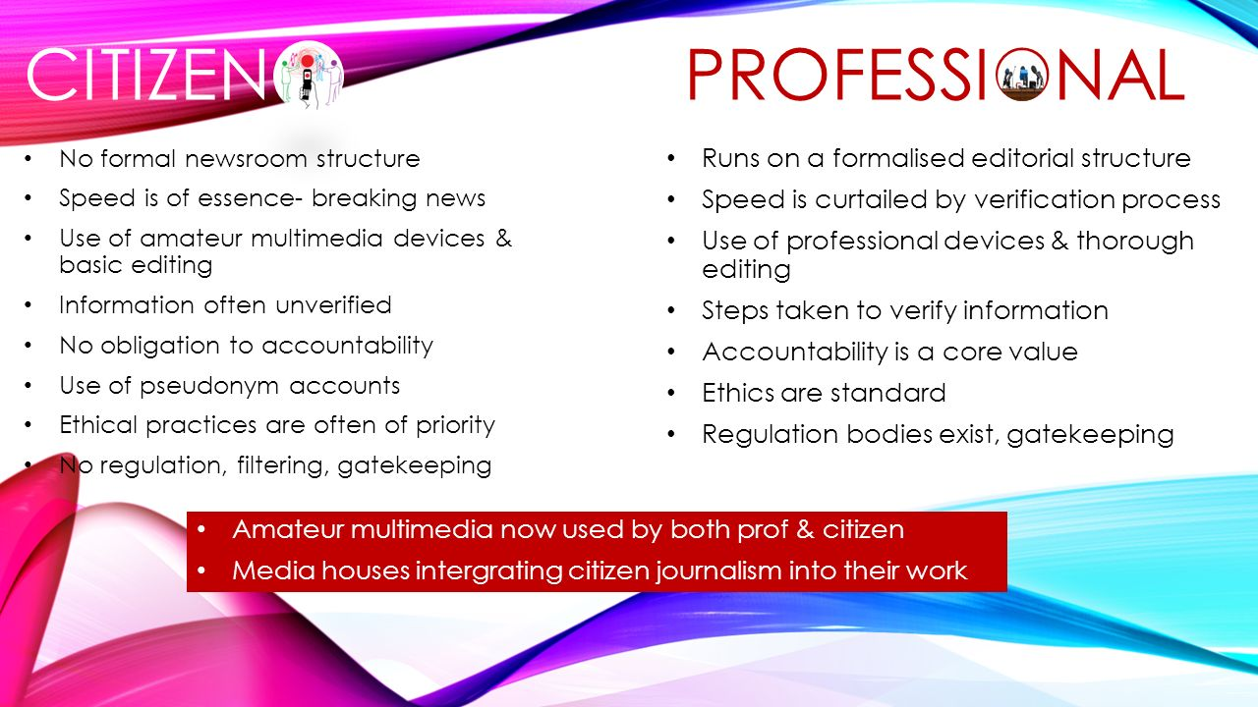
Lecture 8
Citizens Journalism VS Traditional Journalism

Slide 33
Lecture 8
Citizens Journalism
People today, in other words, are in constant connection with a number of streams of information. By way of a passive–active form of citizenship, they can stay informed, networked, and ready for action.
In his 2002 book Smart Mobs, Rheingold envisions such a future. what has become known as citizen journalism.

Slide 34
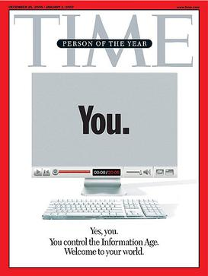
Lecture 8
Citizens Journalism
The cover of Time Magazine's Dec. 25 issue proclaims that you — users who are transforming the Internet — are the person of the year for 2006.

Slide 35
Lecture 8
You (Time Person of the Year)
"You" was the official choice for Time's Person of the Year in 2006. The magazine set out to recognize the millions of people who anonymously contribute user-generated content to websites such as YouTube, MySpace, Facebook, Wikipedia and other wikis, and the multitudes of other websites featuring user contribution.

Slide 36
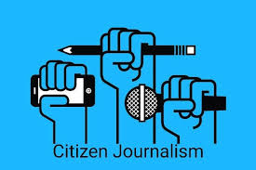
Lecture 8
Citizens Journalism
Obviously, digitally networked communication and user-created content in times of crisis have contributed largely in shaping citizen journalism into what it is today.
Journalism researcher Stuart Allan (2009: 18) cites the aftermath of the South Asian tsunami of December 2004 as a defining moment, as the first-person accounts documented with mobile and digital cameras — many of them posted online — became a unique addition to the coverage that mainstream journalism was able to provide.

Slide 37
Lecture 8
Citizens Journalism
Citizen journalism is about the capacity, largely afforded by digital technology, of ordinary people to bear witness to and comment on things that happen in the world, big or small.
It has developed from those occasions when ‘ordinary people’ find themselves in situations that urge them to temporarily enter the role of a journalist, communicating what goes on around them.

Slide 38
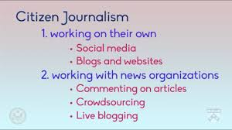
Lecture 8
Citizens Journalism

Slide 39
Lecture 8
Citizens Journalism
And as digital technology and the internet has increasingly made it possible for people to act upon such impulses, citizen journalism as an emergent genre has contributed, in recent years, to a transformation of journalism from being seen as a domain exclusive to professional participants.

Slide 40
Lecture 6
Thank You

