Slide 1

Prepared by
Dr. Hamada I. AbdulWakel
Lecture 2
CYB615
Network Programming

Slide 2
Module2: Network Programming using
Python

Slide 3


Lecture 2
Agenda
Service Oriented Architecture (SOA).
Application Program Interface (API).
Wire Protocol Formats.
API Modules in Python.

Slide 4
Lecture 2
Service Oriented Architecture (SOA)
As the data/service becomes useful, multiple applications want to use the information/application.
Use services from other applications (non-homogeneous systems).
Main Idea:
  Services are provided to the other components by application components, through a communication protocol over a network.

Slide 5
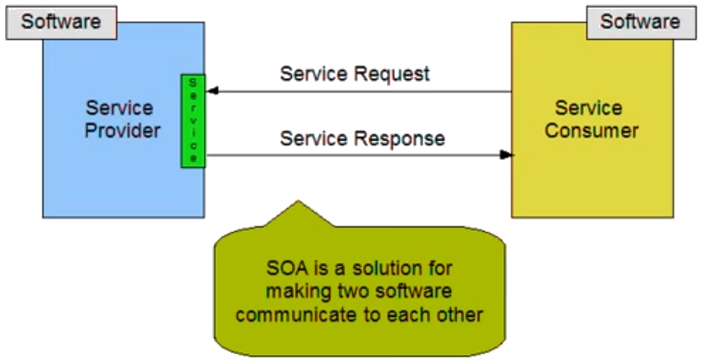
Lecture 2
Service Oriented Architecture (SOA)
Cont'd

Slide 6
Lecture 2
Service Oriented Architecture (SOA)
Cont'd
Services publish the "rules" applications must follow to make use of the service.
SOA is a stage in the evolution of application development and/or integration. It defines a way to make software components reusable using the interfaces.
SOA is an architectural approach in which applications make use of services available in the network.

Slide 7
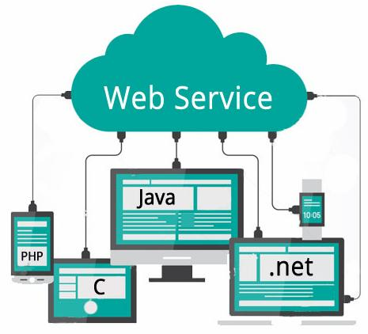
Lecture 2
Web Service
A service offered by an electronic device to another electronic device, communicating
with each other via the Internet.
Web service is a function that can be accessed by
other programs over the web.

Slide 8
Lecture 2
Application Program Interface (API)
An interface that defines interactions between multiple software applications.
It defines the kinds of calls or requests that can be made, how to make them, the data formats that should be used, the conventions to follow, etc.
API says: "If you do this, we will give you the data in this way".

Slide 9
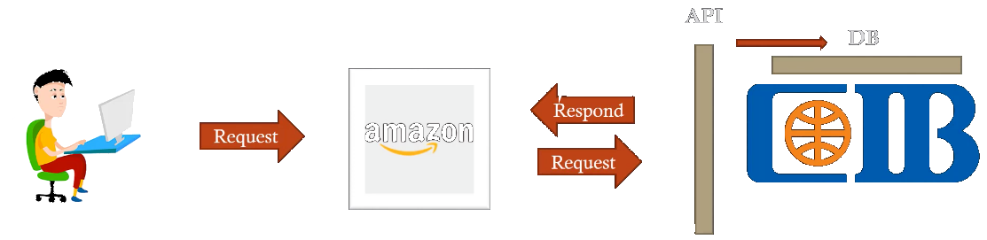
Lecture 2
SOA Service Example: Flow of The Process
Retrieving a credit card statement online.
Reservation in a hotel.
Car renting.

Slide 10
Lecture 2
API Unify The Format
We need to unify the format between programs so that program can expect this format and thus extract the information from it easily.
A wire protocol refers to a way of getting data from point to point.
Python program uses a dictionary data structure
PHP program uses an array data structure
Data written in wire protocol

Slide 11
Lecture 2
HTTP Protocol
A protocol is a set of rules that all parties follow , so that we can predict each other's behavior.
HTTP is a set of rules that allow browsers to retrieve documents from the servers over the Internet.
  The Request/Response Cycle.
request
Machine
A
Machine
B
response

Slide 12
Lecture 2
eXtensible Markup Language (XML) Wire Format
<car>
<type>
Mercedes
</type>
<color>
Black
</color>
</car>
Python program uses a dictionary data structure
PHP program uses an array data structure

Slide 13
Lecture 2
JavaScript Object Notation (JSON) Wire Format
Python program uses a dictionary data structure
{
"type": "Mercedes",
"color": "Black"
}
PHP program uses an array data structure

Slide 14
Lecture 2
JSON Reading Example
Code:
import json
data = '''
{ "name": "Hamada", "phone": 123123,
"email": { "value": "hamada.ac.ae", "hide": "yes"} }'''
info = json.loads(data)
print("Name:", info["name"])
print("Email", info["email"]["value"])

Slide 15
Lecture 2
Web Page Accessing & Reading
Web pages are full of original, high-quality content that could be used for different reasons.
URL parts:
  Protocol part.
  Host name part.
  Port number part.
  Path part.
  Querystring.
  Fragment.

Slide 16
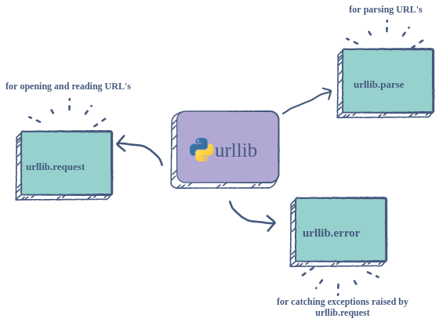
Lecture 2
URLLIB Module
Urllib is a Python package that allows you to access, and interact with, websites using their URL’s (Uniform Resource Locator).

Slide 17
Lecture 2
URLLIB Sub-modules
Urllib.request
  Using it with urlopen() to open the specified URL.
Urllib.parse
  Used to split into its components such as the protocol scheme used, the network location netloc and the path to the webpage.
Urllib.error
  Used to catch exceptions encountered from url.request.
Urllib module install.
pip install urllib3

Slide 18
Lecture 2
URLLIB Description
Code:
#import urllib #print(dir(urllib))
from urllib import request
#print(dir(request))
resp = request.urlopen('https://www.wikipedia.org')
print(type(resp)); print(dir(resp)); #print(resp.code);
#print(resp.length); #print(resp.peek()) #page as binary
#data = resp.read(); #print(type(data))
#html = data.decode(); #print(type(html))
#print(html) #page as html code

Slide 19
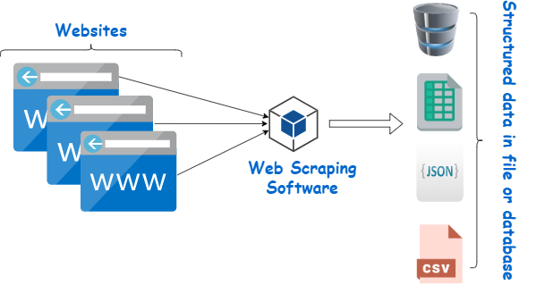
Lecture 2
Web Scraping
A web scraping software will automatically load, crawl and extract data from multiple pages of websites based on your requirement.

Slide 20
Lecture 2
Web Scraping using URLLIB Example
Code:
from urllib.request import urlopen
file_handler = urlopen('http://data.pr4e.org/romeo.txt')
my_count = dict()
for line in file_handler:
words = line.decode().split()
for word in words:
my_count[word] = my_count.get(word, 0) + 1
print(my_count)

Slide 21
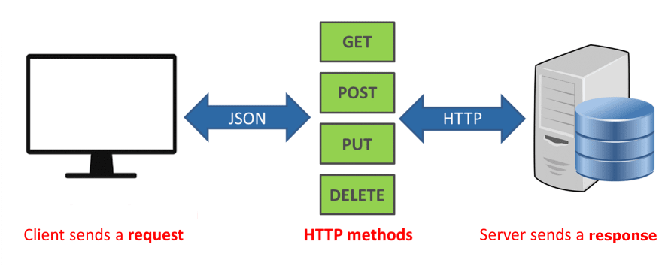
Lecture 2
Requests Module
The de facto standard for making HTTP requests in Python.
It abstracts the complexities of making requests behind a beautiful, simple API so that you can focus on interacting with services and consuming data in your application.

Slide 22
Lecture 2
Requests Module
Cont'd
One of the most common HTTP methods is GET. The GET method indicates that you’re trying to get or retrieve data from a specified resource.
To install the requests library, use PyPi.
pip install requests

Slide 23
Lecture 2
TVmaze.com API Example
Code:
import requests, json, pprint
url = "https://api.tvmaze.com/singlesearch/shows"
params = {"q":"the flash"} #use this to get specific data
response = requests.get(url, params)
if response.status_code == 200:
#print(response.text) #without json
data = json.loads(response.text)
#print(data) #without pprint
#pprint.pprint(data)

Slide 24
Lecture 2
TVmaze.com API Example
Cont'd
if response.status_code == 200:
data = json.loads(response.text)
name = data['name'] #to get specific data from json
premiered = data['premiered']
summary = data['summary']
print(f"{name} premiered on {premiered}.")
print(summary)
else:
print(f"Error: {response.status_code}")

Slide 25
THANK YOU

