Slide 1



Introduction to Security Operations
Lecture 9
HCIA-Security
Prepared by
Dr. Abdelrhman Ahmed

Slide 2
Chapter
09
Forward
• In the current information age, security is the foremost concern of global enterprises. The threat of cyber attacks and data breach means security operations are a necessity to ensure the safe and continuous use of
enterprise services. These slides describe the basic concepts and prerequisites of security operations.

Slide 3
Chapter
09
Objectives
• Upon completion of this course, you will be able to:
□ Learn the concepts related to security operations
□ Learn the content of security operations

Slide 4
Chapter
09
Concept of Security Operations
• In the initial stage of enterprise information security construction, the enterprise's priority is to purchase a series of security devices and deploy them at each protocol layer to ensure the stable running of services.
• As security issues frequently occur, effective security operations cannot be achieved solely through security devices. Successful security operations are the combination of resources, processes, and management, to ensure the secure and stable running of enterprise services.

Slide 5
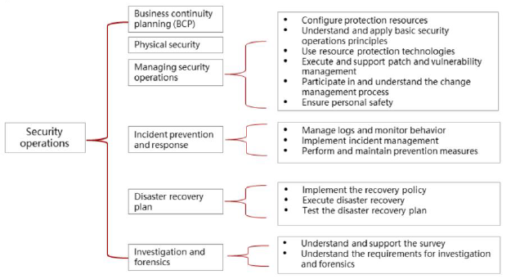
Chapter
Basic Conditions for Security Operations
09
• Security operations involve various requirements. The following lists the basic operations conditions for
security operations.

Slide 6
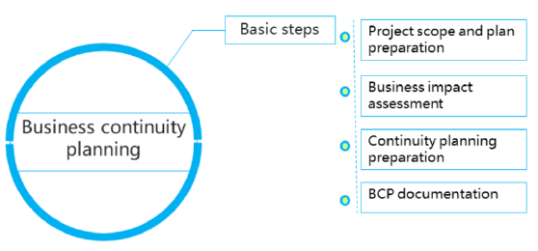
Chapter
09
Business Continuity Planning

Slide 7
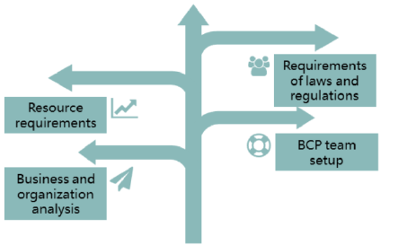
Chapter
Project Scope and Plan
09
• Any process or plan must be formulated based on the actual business scale and nature of the organization, complying with the corporate culture and relevant laws. The following lists the specific requirements for the non-rated project scope at the initial stage of the plan.

Slide 8
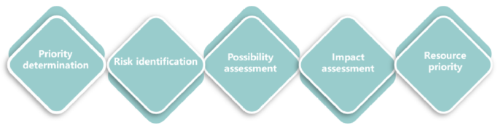
Chapter
09
Business Impact Assessment
• Business Impact Assessment identifies which resources can sustain the development of the organization. It also evaluates threats to resources, the likelihood of each threat, and their potential impact on businesses. Business Impact Assessment consists of:

Slide 9
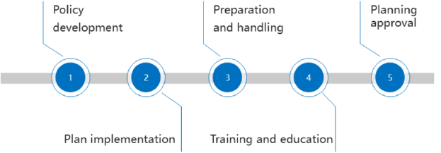
Chapter
Continuity Planning Preparation
09
• Two phases are mainly used to determine the BCP working process and protect the limited sequence of business assets. In the continuity planning preparation phase, focus is on the development and implementation of the continuity policy, and the following tasks are involved:

Slide 10
Chapter
09
BCP Documentation
• BCP documentation provides BCP personnel with guidance in the event of an emergency. In addition, the document records the modification history and provides reference for subsequent handling of similar incidents or document modification. The document must contain the following information:
□ Objectives of the continuity planning
□ Importance statement
□ Statement of organization responsibilities
□ Declaration of urgency and time limit
□ Risk assessment
□ Acceptable risk/Risk mediation
□ Major record plan
□ Guidelines for responding to emergencies
□ Maintenance
□ Tests and exercises

Slide 11
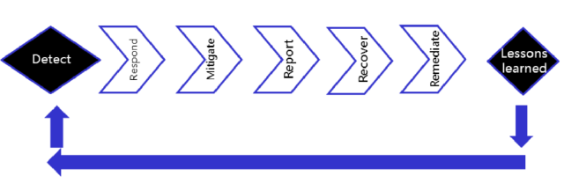
Chapter
09
Incident Response Management
• Not all threats can be prevented, but BCP provides process guidance for handling emergencies and responding to threat incidents as soon as possible to minimize the impacts on organizations.

Slide 12
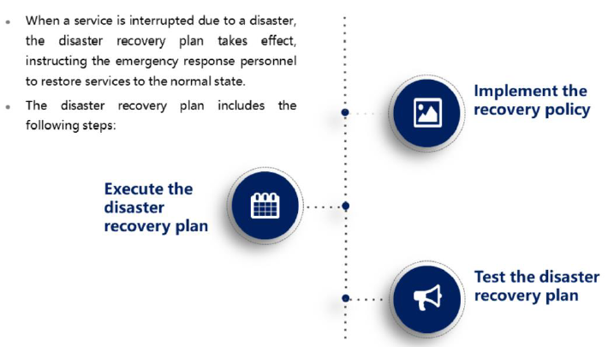
Chapter
09
Disaster Recovery Plan

Slide 13
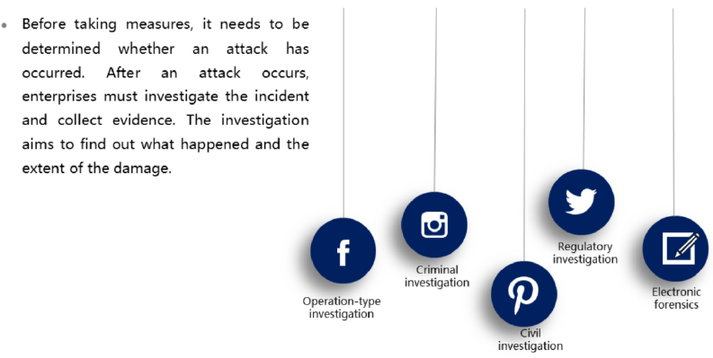
Chapter
09
Investigation

Slide 14
Chapter
09
Evidence
• In order to successfully prosecute a crime, sufficient evidence must be provided to prove the crime. Evidence types include:
□ Physical evidence
□ Documentary evidence
□ Verbal evidence
• Evidence must be acceptable:
□ Evidence must be related to the determination of facts.
□ Evidence must be related to the event
□ Evidence must be legally obtained.
• Evidence type:
□ Physical evidence: objective evidence, such as objects
□ Documentary evidence: written content, such as computer logs
□ Verbal evidence: witnesses' testimony

Slide 15
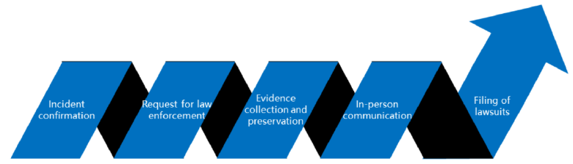
Chapter
09
Investigation and Forensics Process

Slide 16



Thank You

