Slide 1



Information Systems
Prepared by Dr. Amjad Qtaish
IT372
Information Systems
Orientation Lecture

Slide 2




Information Systems (IT372)
Information Systems
Dr. Amjad Qtaish
Faculty of Informatics
Midocean University
Orientation show عرض توجيهي

Slide 3

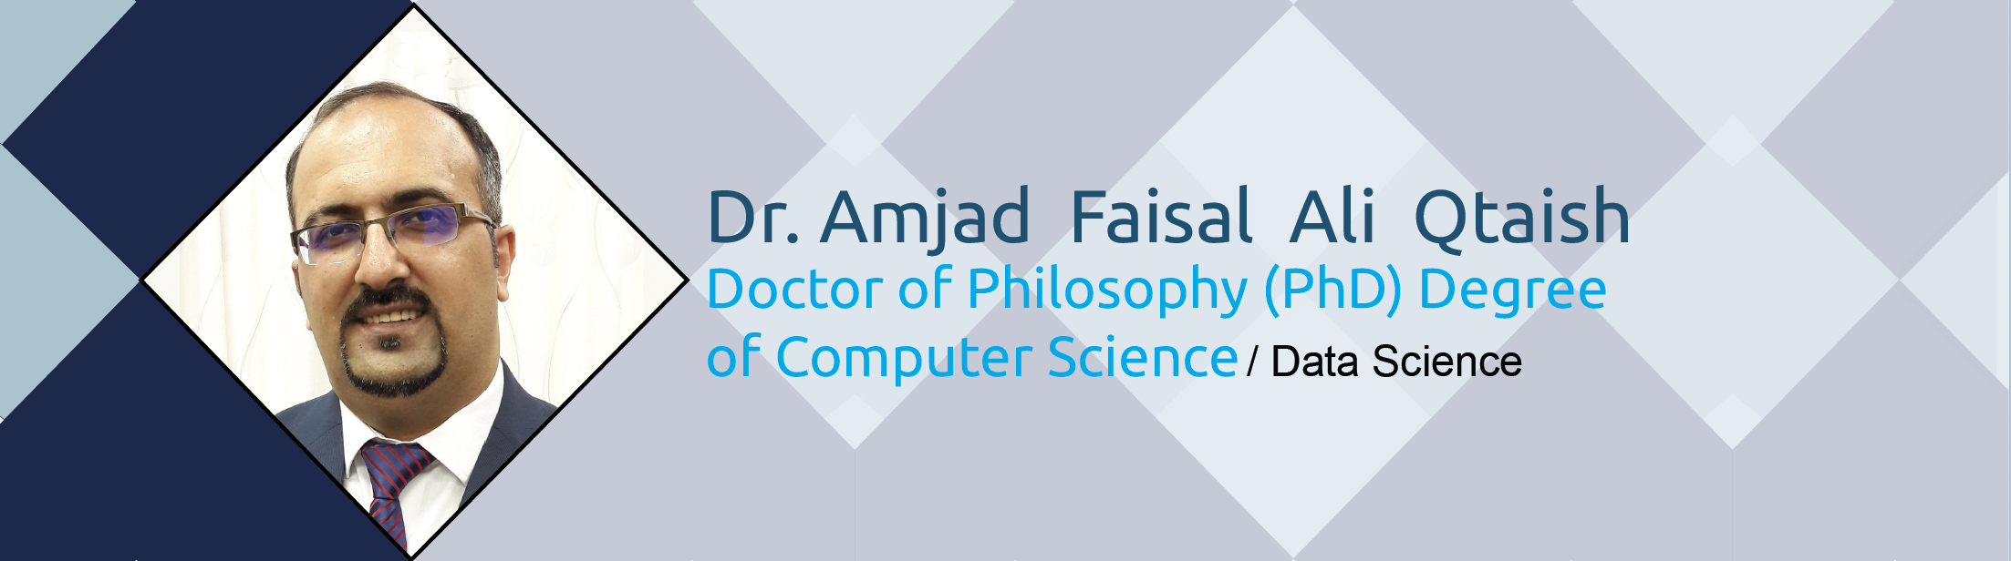
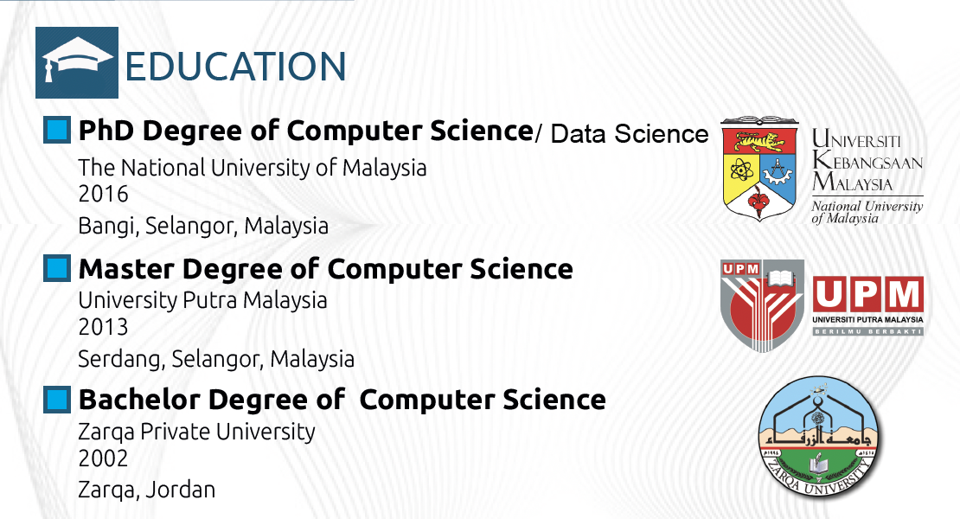
Who am I?
Information Systems, Dr. Amjad Qtaish

Slide 4
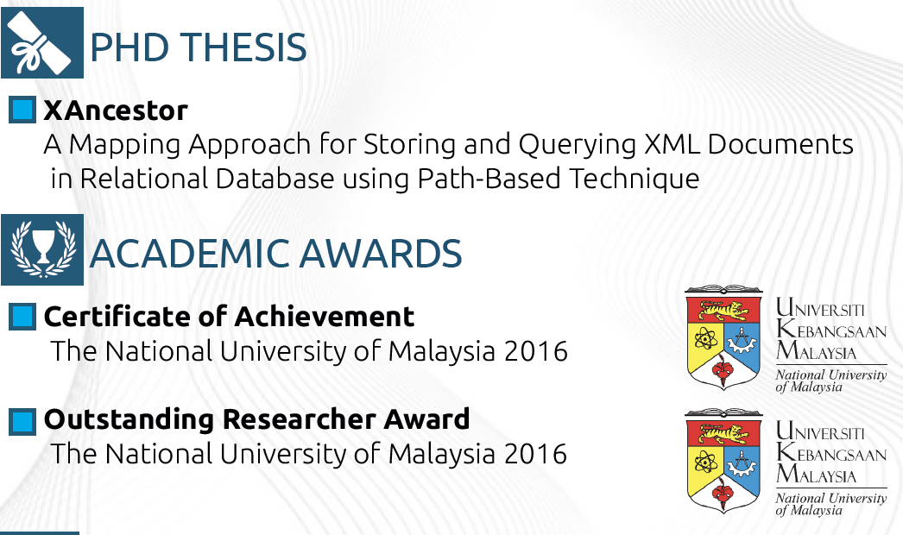
Who am I?
Information Systems, Dr. Amjad Qtaish

Slide 5
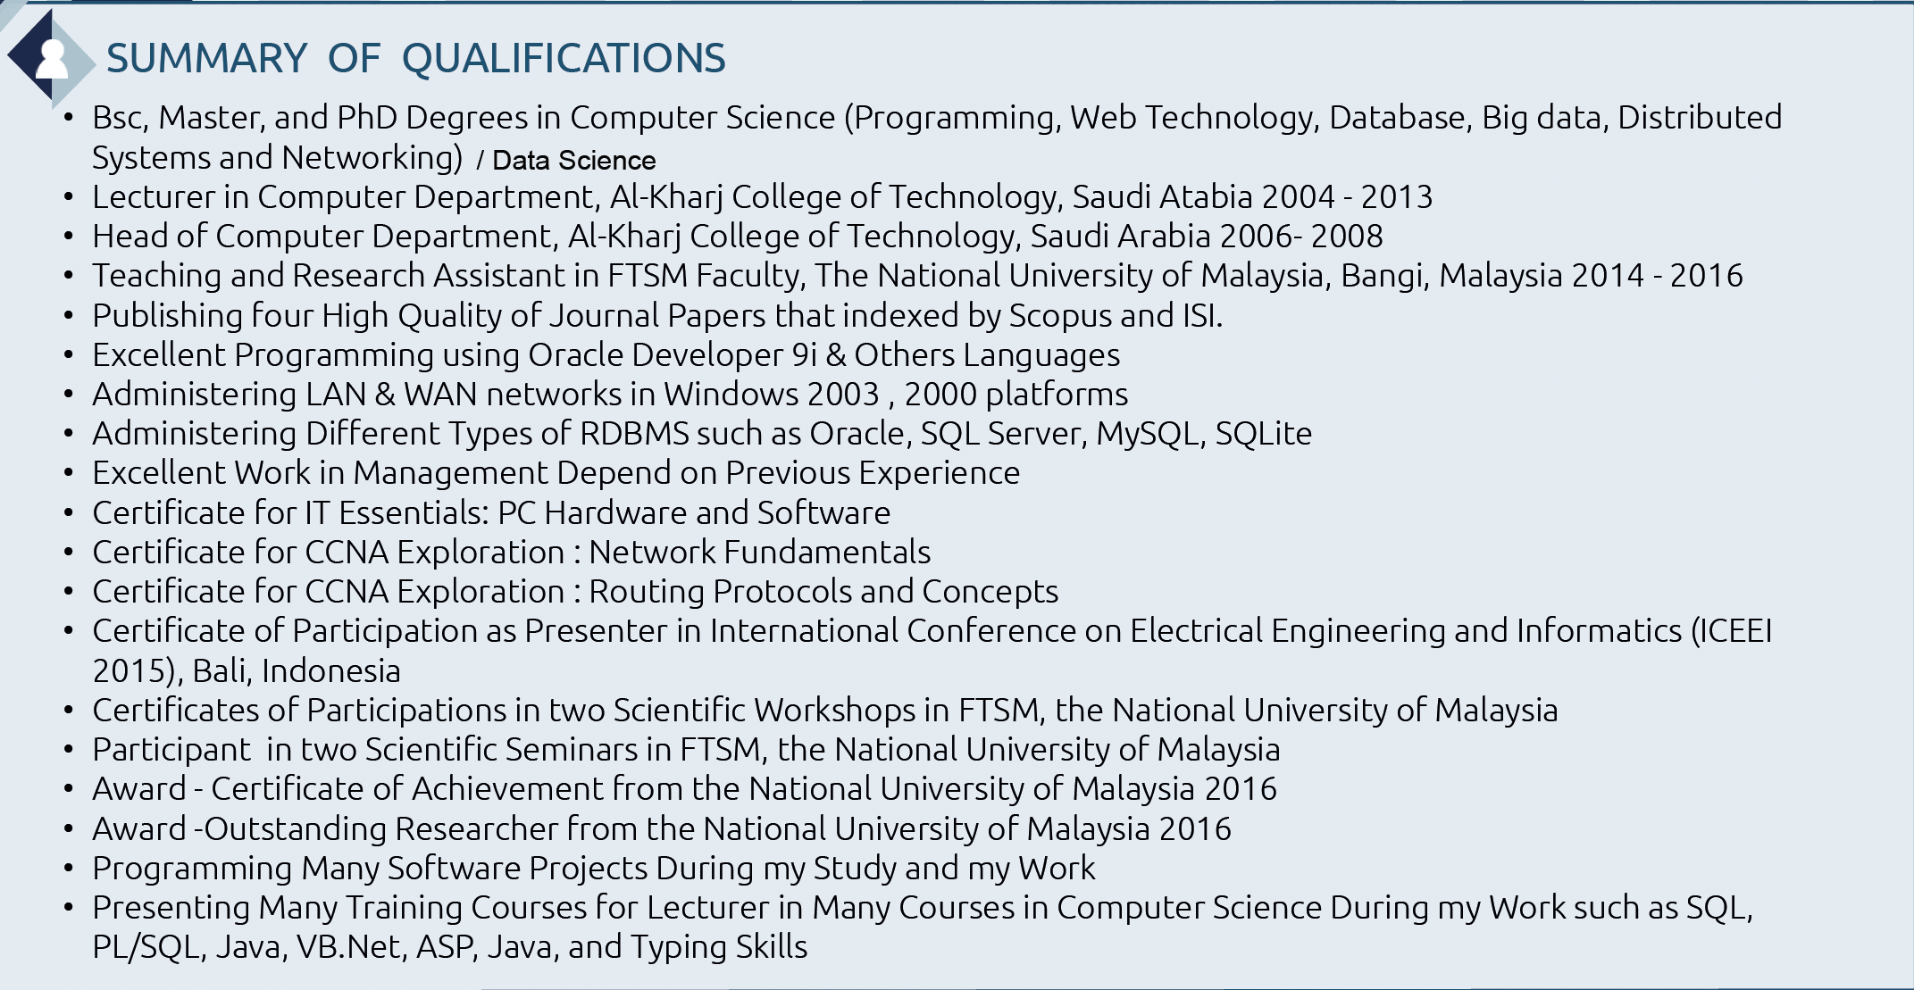
Who am I?
Information Systems, Dr. Amjad Qtaish

Slide 6



My Contact Information
  Office hours
  Discussion Time (Wednesday at 9:00 PM) every week
  More about me:
https://scholar.google.com/citations?user=JejNDrcAAAAJ&hl=en
https://www.scopus.com/authid/detail.uri?authorId=56720387400
https://orcid.org/0000-0001-5210-7086
Information Systems, Dr. Amjad Qtaish

Slide 7

The course that will be taught
Information Systems
Information Systems
Information Systems, Dr. Amjad Qtaish

Slide 8
Importance of Information Systemsأنظمة المعلومات وأهميتها
يقدم هذا المقرر مقدمة عن أنظمة المعلومات وتكنولوجيا المعلومات ومفاهيم تطوير أنظمة المعلومات وبرامج التطبيق. كما تحدد الأنواع الأساسية لأنظمة معلومات الأعمال والخطوات الرئيسية لعملية تطوير الأنظمة وبعض الاستراتيجيات المستخدمة لخفض التكاليف أو تحسين الخدمة. كما تشرح كيفية استخدام المعلومات في المنظمات وكيف تمكن تكنولوجيا المعلومات من تحسين الجودة والالتزام بالمواعيد والميزة التنافسية. كما تحدد المزايا التنافسية وأنواع الأدوار والوظائف والوظائف المتاحة في أنظمة المعلومات.
This course provides an introduction to information systems and information technology, information systems development concepts, and application software. It identifies the basic types of business information systems, the major steps of the systems development process and some of the strategies employed to lower costs or improve service. It explains how information is used in organizations and how IT enables improvement in quality, timeliness, and competitive advantage. It also defines the competitive advantages, types of roles, functions, and careers available in IS.
Information Systems, Dr. Amjad Qtaish

Slide 9
Primary Goal of This Course
يهدف هذا المقرر الى تعليم الطلبة على كيفية التعامل مع البيانات والمعلومات وإدارتها في المنظمات التجارية وفهم معنى "أنظمة المعلومات والتكنولوجيا" وتأثيراتها على المنظمات وأنواع أنظمة المعلومات التجارية المختلفة ودورة حياة تطوير هذه الأنظمة. كما يهدف أيضا الى تعليم الطلبة عن أجهزة الكمبيوتر المختلفة والبرامج وأنواع مختلفة من شبكات الكمبيوتر وكيفية التعامل مع الأنظمة الخبيرة، نظم المعلومات الجغرافية، والتجارة الإلكترونية .
This course aims to teach students how to deal with and manage data and information in business organizations and understand the meaning of "information systems and technology" and their effects on organizations and the different types of business information systems and the life cycle of developing these systems. It also aims to teach students about different computers and programs and different types of computer networks and how to deal with expert systems, geographic information systems (GIS), and e-commerce.
Information Systems, Dr. Amjad Qtaish

Slide 10
What This Course is About
The course will help students to gauge understanding in :
  Overview of Information Systems in Organizations (Introduction to Information Systems, How Businesses use Information Systems)
  Information Technology Infrastructure (Hardware and Software, IT and Emerging Technologies, Telecommunications, Internet and Wireless technology, Databases and Information Management)
  Business Information Systems (Electronic and Mobile Commerce, Enterprise Systems, Information and Decision Support Systems, Knowledge Management)
  Systems Development (Managing Projects, Investigation and Analysis, Systems Development Cycle)
  IS in Business and Society (Social and Ethical Issues in IS)
Information Systems, Dr. Amjad Qtaish

Slide 11
Units of Course Contents
Module | Course Unit | No.of. Weeks | Contact Hours
1 | Lecture 1: Introduction to Information Systems | 1st | 3
2 | Lecture 2: Hardware, Software, and Emerging Technologies | 2nd | 3
3 | Lecture 3: Databases and Information Management | 3rd | 3
4 | Lecture 4: Telecommunications, Internet and Wireless Technology | 4th | 3
5 | Lecture 5: Electronic and Mobile Commerce, Enterprise Systems | 5th | 3
6 | Lecture 6: Information and Decision Support Systems | 6th | 3
7 | Lecture 7: Investigation and Analysis | 7th | 3
8 | Lecture 8: Knowledge Management, Information System Project Management | 8th | 3
9 | Lecture 9: Design And Implementation, Social and Ethical Issues in IS | 9th | 3
10 | Lecture 10: expert ‎systems (ES), Geographic information system (GIS) | 10th | 3
Information Systems, Dr. Amjad Qtaish

Slide 12
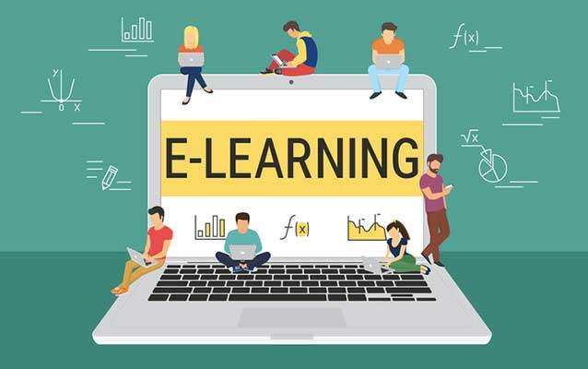
Teaching Methodology
منهجية التدريس
Recorded Lectures
المحاضرات المسجلة
Live Sessions
جلسات وحلقات النقاش
References
المراجع المعتمدة للمقرر الدراسي
Virtual Labs
المعامل الأفتراضية
Information Systems, Dr. Amjad Qtaish

Slide 13

Study System
Information Systems, Dr. Amjad Qtaish
Cybersecurity Fundamentals, Dr. Redhwan M. A. Saad
www.midocean.ae

Slide 14

Course Information - Evaluation
  Assessment Method:
Short Exam
  80% marks
    Count of short Exam 10 (Weekly)
    8 Marks for each of short Exam.
  20% marks
  Final Examination
Information Systems, Dr. Amjad Qtaish

Slide 15
Learning Outcomes
After completion of this course, the students should be able to:
Have understanding of the Information Systems and its associated concepts
Able to recognize the importance and use of various Information and Communication Technologies (ICTs)
Able to analyse decision making process
Have understanding of the various types of Information Systems
Have knowledge of the system development
Appreciate the social and ethical considerations of MIS within organizations
Information Systems, Dr. Amjad Qtaish

Slide 16
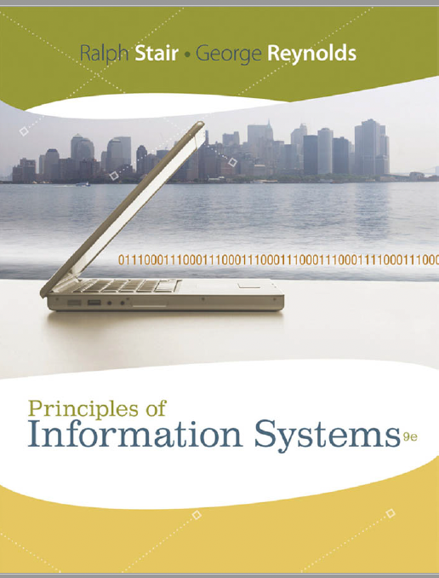
Learning Resources:
Credit Hours:
3 credit hours.
  Required Textbook:
  Principles of Information Systems (A Managerial Approach) by Ralph Stair, George Reynolds. Ninth Edition.
  Essential References:
  Introduction to Information Systems (Supporting and Transforming Business) by R. Kelly Rainer Jr., Brad Prince, Casey Cegielski. Fifth Edition
Information Systems, Dr. Amjad Qtaish

Slide 17

Information Systems
Thank You

