Slide 1


Project Planning
Lecture 5
PMG202
Project Planning- Quality management
Prepared by
Lec. Dina ElWakkad
www.midocean.ae

Slide 2


www.midocean.ae

Slide 3
Project Planning
www.midocean.ae

Slide 4
Project Planning
Once a project is selected for execution, the structural project planning approach prescribes that the project get planned in detail prior to the actual start of the project.
Project planning consists of 4 main stages:
Risk Management
Quality Management
Human Resource Management
The Project Schedule, and budget
www.midocean.ae

Slide 5

Learning Outcomes
At the end of this chapter, students should be able to:
Define the term quality.
Explain why quality is important
Identify the determinants of quality.
Describe the quality requirements.
www.midocean.ae

Slide 6
The concept of total quality management
www.midocean.ae

Slide 7
The concept of total quality management
The total quality management is a course of action that attempts to increase an organization's ability to compete through continuous improvement of its products, services, people, processes, and work environment.
www.midocean.ae

Slide 8
The importance of quality management
www.midocean.ae

Slide 9
The importance of quality management
Quality is associated with productivity and production improvement
It is comprehensive in all fields
Develop leadership and management skills for future leaders
Increase work and reduce waste or loss
Optimal use of material and human resources
www.midocean.ae

Slide 10
The principles of quality management
www.midocean.ae

Slide 11
The principles of quality management
The principles on which quality management is based are:
Focus on identifying the needs and expectations of beneficiaries and striving to achieve them
Emphasize that improvement and development is a continuous process
Focus on teamwork, not individual
Make decisions objectively based on facts and data analysis
Enabling workers and motivating them to take responsibility and giving them confidence to perform work.
www.midocean.ae

Slide 12
Quality management objectives
www.midocean.ae

Slide 13
Quality management objectives
A change in the quality of performance
Motivation for excellence, showing creativity
Develop work methods
Improving workers' skills and capabilities
Strengthening loyalty to work in institutions
Encouraging participation in the activities and events of the project
Improve work environment
www.midocean.ae

Slide 14
Quality Control Vs Quality Assurance
www.midocean.ae

Slide 15
Quality control (QC)
It is the group of activities and efforts exerted by all employees that allow achieving the standard levels of quality
It is a process in which the outputs are evaluated based on specific criteria, and then the necessary corrective actions are taken to correct the output of the project when the service or product does not achieve those criteria.
www.midocean.ae

Slide 16
Quality assurance (QA)
It is the process through which a specific and regular plan is developed to prevent any problems in the quality of the product or service.
The plan includes:
  defining product or service specifications,
  continuous review and follow-up of product performance,
  monitoring and examination.
Quality assurance requires a quality management system
www.midocean.ae

Slide 17
Quality assurance (QA)
Requirements for achieving quality assurance
Full commitment of senior and middle management to implement plans and continuous development
All project employees are convinced of the work strategy and play a major role in achieving quality and ensuring its continuity to achieve the objectives
Spreading and adopting a culture of quality in society
www.midocean.ae

Slide 18
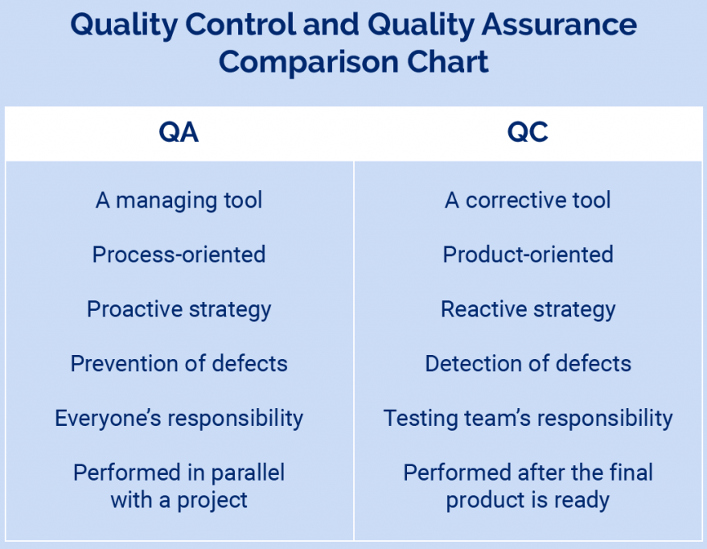
QC Vs QA
www.midocean.ae

Slide 19
Elements of integrated quality control
www.midocean.ae

Slide 20
Elements of integrated quality control
Develop service specifications according to customers’ wants
Quality control of raw materials
Adjust the quality of service during operation
Quality control of the final product/service (outputs)
Quality control of product/service after sales
Quality management and represents all the administrative aspects related to raising and improving the quality level (training, motivation, marketing---etc.)
www.midocean.ae

Slide 21
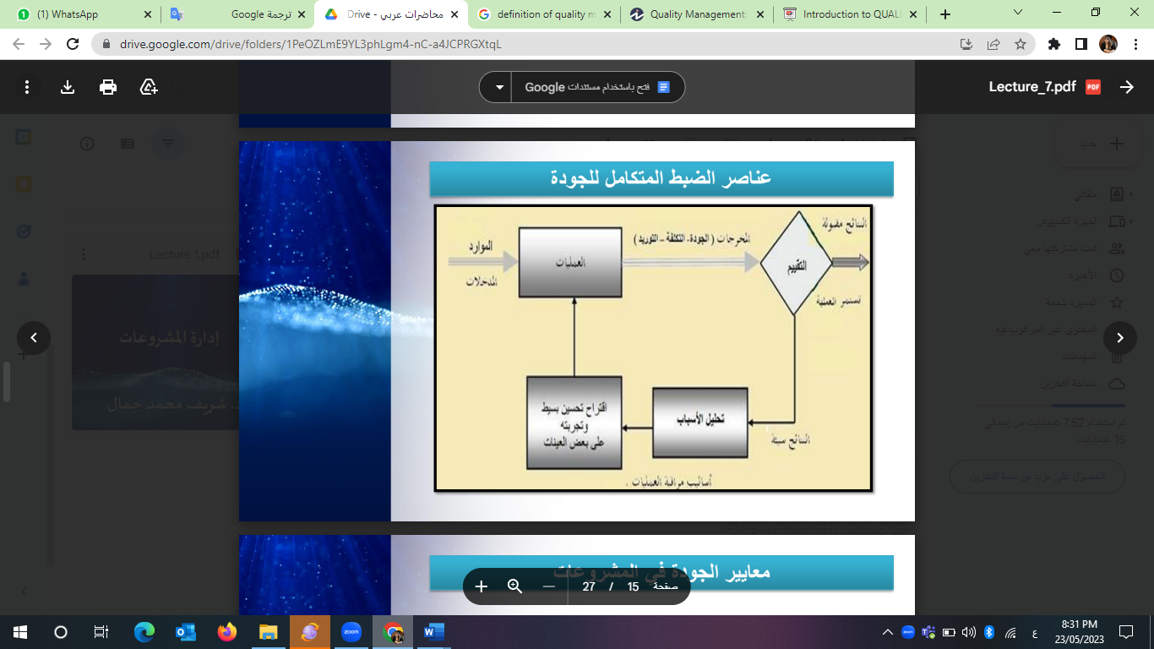
Elements of integrated quality control
www.midocean.ae

Slide 22
Quality Policy
www.midocean.ae

Slide 23
Quality Policy
It is a policy or framework that directs the practices and behavior necessary to achieve quality in the system.
This policy should be applied by all members of a particular system on a regular and continuous basis.
The quality policy should include:
The organizational structure of quality in the establishment, including: the rules and responsibilities that regulate work
How to determine the (customer's) need, impressions and satisfaction with the product or service
www.midocean.ae

Slide 24
Quality Policy
Elements of the quality policy:
The institution seeks to meet the client's needs, considering the technical (specialization) and economic (cost) sides, through:
Provide quality management system and work method or system operation
Ensure that inputs meet specified performance and efficiency standards
Systematic implementation of error prevention as well as continuous improvement over time in the project
www.midocean.ae

Slide 25
Project quality standards
www.midocean.ae

Slide 26
Project quality standards
Input
Examples of the elements that are focused on to ensure the quality of inputs in the project:
Quality of project selection and development
The quality of the human resources in the project
Quality of preparation of infrastructure and equipment
Quality of training programs
www.midocean.ae

Slide 27
Project quality standards
Input
Elements of focus to ensure the quality of project selection and development include:
The selection criteria should be specific
That the training content for building the capacities of institutions be appropriate and interconnected with the vision and mission of the project
www.midocean.ae

Slide 28
Project quality standards
Input
The elements that are focused on to ensure the quality of human resources and the selection of those responsible for the implementation of the project are as follows:
Criteria for hiring, evaluation and classification
Professional development and rehabilitation
Retain of project staff
www.midocean.ae

Slide 29
Project quality standards
Input
Elements of focus to ensure the quality of infrastructure and equipment include:
Basic equipment (buildings - communications - services)or computers
Networks (electricity - water - sewage - natural gas)or the internet
Technical support
Providing financial support for services
www.midocean.ae

Slide 30
Project quality standards
Input
Elements that focus on ensuring the quality of training programs include:
Shifting from focusing on standard training to focusing on application and learning while providing what guarantees the quality of training and learning, including:
Cooperate with project partners and experts to choose effective training content
Measuring the effectiveness of the training through the opinion of the trainees before and after the end of the training
Measuring the suitability of training for the labor market
www.midocean.ae

Slide 31
Project quality standards
Output
o Existence of qualified projects for sustainability
o The presence of trainees capable of learning
o The presence of community development by raising the level of awareness and income
www.midocean.ae

Slide 32
Project quality standards
Output
Output evaluation:
Evaluating the project outputs in the light of the objectives achieved using direct and indirect methods, for example:
o Measuring the extent to which trainees benefit from the training content
o Measuring the employment rate compared to training
o A questionnaire from the recruitment institutions about the performance of the trainees who were hired
www.midocean.ae

Slide 33
Summary
The concept of total quality management
The importance of quality management
The principles on which quality management is based
Quality management objectives
Quality control vs quality assurance
Quality policy
Project quality standards
www.midocean.ae

Slide 34

www.midocean.ae

Slide 35
Questions
The total quality management is in---- Planning phase Execution phase Initiation phase Closure phase
-------------is a course of action that attempts to increase an organization's ability to compete through continuous improvement of its products, services, people, processes, and work environment Total Quality management Risk management Human resources management Budget management
www.midocean.ae

Slide 36
Questions
-------------is the group of activities and efforts exerted by all employees that allow achieving the standard levels of quality Quality Control Quality assurance Quality Risk All answers are correct
----------- is the process through which a specific and regular plan is developed to prevent any problems in the quality of the product or service Quality assurance Quality Control Quality Risk All answers are correct
www.midocean.ae

Slide 37
Questions
Quality assurance is-------- All answers are correct. A management tool. Prevention of defects Everyone’s responsibility.
Quality Control is-------- A corrective tool A management tool. Prevention of defects Everyone’s responsibility.
www.midocean.ae

Slide 38
Questions
Elements of the quality policy are: All answers are correct Provide quality management system and work method or system operation Ensure that inputs meet specified performance and efficiency standards Systematic implementation of error prevention
Example of the elements that are focused on to ensure the quality of inputs in the project is--- Quality of project selection and development the training content for building the capacities of institutions Criteria for hiring, evaluation and classification Retain of project staff
www.midocean.ae

Slide 39
Questions
Elements of focus to ensure the quality of infrastructure and equipment include: All answers are correct Basic equipment Networks Technical support
Project quality standards for outputs include------- All answers are correct Measuring the extent to which trainees benefit from the training content Measuring the employment rate compared to training A questionnaire from the recruitment institutions about the performance of the trainees who were hired
www.midocean.ae

Slide 40
Questions
Retain of project staff is part of: The elements that are focused on to ensure the quality of human resources Elements of focus to ensure the quality of project selection and development Elements of focus to ensure the quality of infrastructure and equipment All answers are incorrect.
-------- is a policy or framework that directs the practices and behavior necessary to achieve quality in the system Quality Policy Quality management Quality task Quality regulation
www.midocean.ae

Slide 41
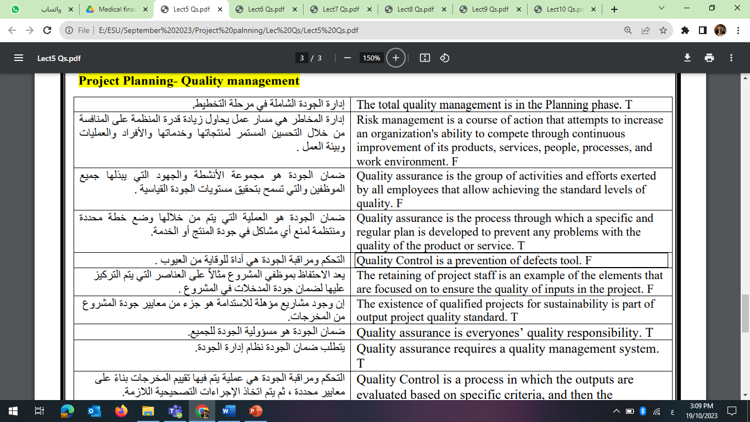
Questions
www.midocean.ae

Slide 42
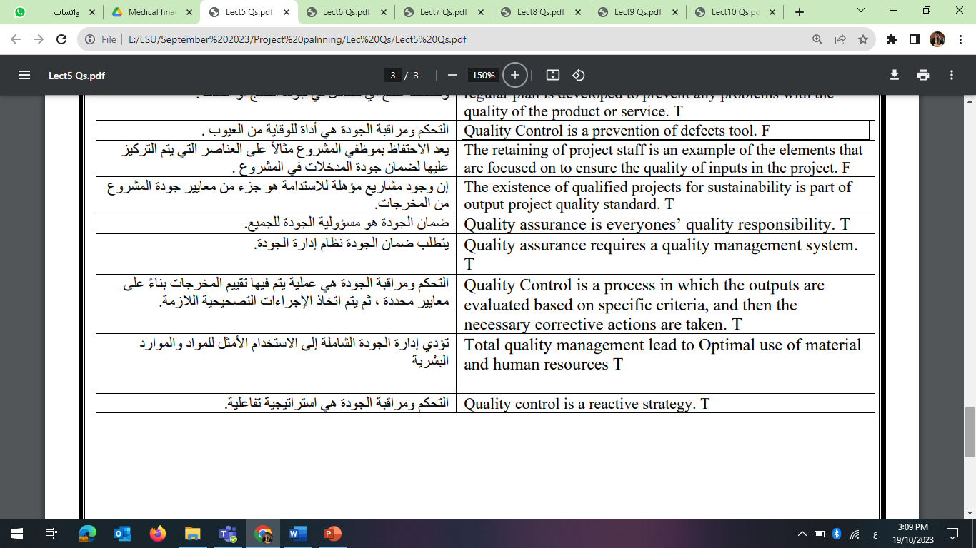
Questions
www.midocean.ae

Slide 43


Thank You

