Slide 1





Interaction Design (DGM 729)
Prepared by
Dr. Mohamed Owies
Lecture 1
Interaction Design (DGM 729)

Slide 2



Interaction Design
Interaction Design

Slide 3




Lecture 1
Content
This Lecture will include the following points:
Defining User experience
Categories of the user's experience jobs
Where UX Comes From?
UX and UI: What’s the Difference?
Where UX Professionals Come From?

Slide 4


Lecture 1
Defining User experience:
User experience is a famously messy thing to describe. Many people have offered their own definitions, and yet no single one has prevailed as the clear favorite. UX, it turns out, is a controversial concept.
This is probably because “user experience” is a general term that describes not only a professional practice but also a resulting outcome.

Slide 5

Lecture 1
Defining User experience:
To be a user experience designer means to practice a set of methods and techniques for researching what users want and need, and to design products and services for them. Through good UX, you are trying to reduce the friction between the task someone wants to accomplish and the tool that they are using to complete that task.
The resulting user experience that someone has is determined by a multitude of factors so vast that no one person, team, or even technology can claim to be responsible for it.

Slide 6
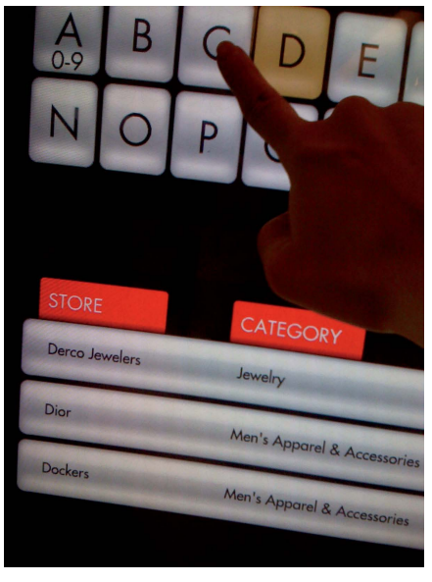
Lecture 1
Defining User experience:
Often, the term user experience refers to people’s encounters with digital products, like software or a Web app.
In a simple working definition, you might say that a user experience is the overall effect created by the interactions and perceptions that someone has when using a product or service (see Figure 1).
User experience is not just restricted to what you do on your phone or your laptop. This shopping mall the directory has an interactive user experience, which impacts how easily shoppers can find what they are looking for in their physical environment.
Figure 1

Slide 7
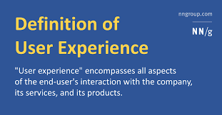
Lecture 1
Defining User experience:
User experience is a fancy term for what people often describe with words like “love” or “hate”; or phrases such as, it’s “easy to use”.
You may recognize user-friendly as a term that has worked its way into popular usage. For example, when someone says a product is user-friendly, he is basically referring to the user experience. Given that we transact so much of our lives through technology, how easy or difficult it is to use is what really matters. And that’s what user experience is all about.

Slide 8
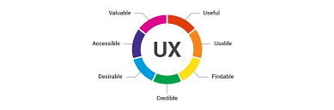
Lecture 1
Defining User experience:
As a field of professional practice, user experience encompasses several disciplines. The main contributors are user research and user experience design. User research is about understanding users and their needs, and user experience design is about designing a user’s interactions with a product from moment to moment.
Lots of user experience professionals have one of those titles, but it’s also common to see people mixing and matching these terms into inventive but nonstandard titles like “user experience architect” or “user interaction designer.”

Slide 9
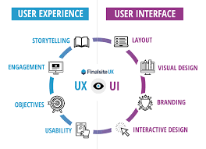
Lecture 1
What’s in a Name?
You’ll find UX (user experience), XD (experience design), and UE (user experience, again). Although the acronyms differ, they pretty much mean the same thing. Things get a little trickier when you start talking about the subdisciplines that make up UX.
Being a somewhat new field, the user experience community hasn’t done a great job of standardizing its job titles yet. A quick scan of user experience job postings will unearth a grab bag of titles: UX designer, UI designer, user researcher, customer experience researcher, interaction designer, information architect, user experience architect, usability engineer, graphic designer, visual designer, Web designer, copywriter, tech writer, content strategist, design strategist—and infinite permutations on all of the above.

Slide 10
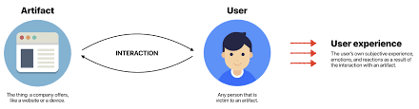
Lecture 1
Categories of the user's experience jobs
- Interaction Design or Information Architecture.
Someone who designs the structure and detailed interactions of an application or product. interaction designers focus on screens, detailed interactions, and workflows, whereas information architects focus on information structures, controlled and uncontrolled metadata, and ultimately, findability. However, both roles share a fundamental goal: designing how a user moves through a complex information system from moment to moment.

Slide 11
Lecture 1
Categories of the user's experience jobs
- Visual Design:
Someone who focuses on the visual layer of an application or product (color palette, typography, hierarchy of information, and visual elements). Although layout of screens and pages is typically considered to be the interaction designer’s job, a good visual designer will also have a point of view on layout. If the interaction designer is like the architect, the visual designer is like the interior designer.
Figure 1

Slide 12

Lecture 1
Categories of the user's experience jobs
- User Research.
Someone who conducts research into user needs and behavior. This could be qualitative (for example, one-on-one interviews with a handful of people to gain a rich understanding of their motivations and experiences). This could also be quantitative (for example, sampling large pools of people to uncover broad trends in attitudes, behaviors, pain points, and the like). The research usually spans up-front discovery of user needs all the way through to product validation and usability testing. If the interaction designer is like the architect and the visual designer is like the interior designer, the researcher is like the demographer that uncovers who really lives in this place and what important factors characterize them.

Slide 13
Lecture 1
Categories of the user's experience jobs
- Content Strategy or Copywriting.
Someone who thinks strategically about the role of content across the entire product. This person considers what messages are being delivered to users, how the language should be framed, what the voice and tone of the product is, and how and when the content will be created (and by whom).
This person makes sure that all in-product content is consistent, on brand, and contributes to a unified experience. Basically, the content strategist sets the tone for the tenor of conversations that take place here. What topics do people talk about? What’s the local dialect? What stories get told? How do the people who live here ultimately communicate with each other?
Figure 1

Slide 14
Lecture 1
Categories of the user's experience jobs
Most UX teams of one act as generalists, blending some or all of the above roles together. If you see the title user experience designer, it’s usually one of those catchall roles.
But there are other disciplines that certainly contribute to the resulting experience that a user has with a product, even if they may not fit as snugly into the job description of a user experience designer. These disciplines include visual design, content strategy, copywriting, business analysis, product management, project management, analytics, search engine marketing and optimization, brand marketing, and even engineering.
Figure 1

Slide 15
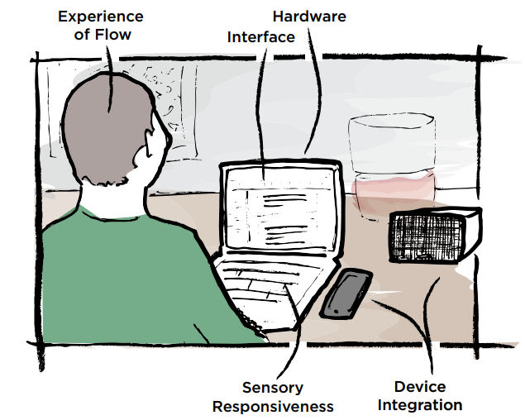
Lecture 1
An Example
Personally, I think it’s easier to understand UX when you think about what it’s like to actually use a product. For example, right now I’m sitting in front of my computer, hopping around within the operating system and keying from my word processing program to my email program to my music program.
Figure 2

Slide 16
Lecture 1
An Example
My perception of each of those programs is impacted by how it looks, how it functions, and how well it serves its purpose in the personal need that it satisfies. (Helping me write a book; managing my personal and professional communications; and listening to some tunes that keep me tapping my feet as I work, respectively). In any of these programs, a thousand little decisions were made by someone—or more probably, many “someones”—to create what I experience as the flowing, seamless experience of working (see Figure 2).
Figure 2

Slide 17
Lecture 1
An Example
And that’s just the software. My user experience is also impacted by the physical hardware of my computer: How big and bright the screen is, and whether it feels like “enough” to help me effectively use the hodgepodge of programs for which this laptop is intended. The tactile feel of the touchpad as I scroll down long Web pages. The satisfying clickety-clack of fingers tapping their way across the keys. These are all user experiences, too.
Without better alternatives, users will try to hack together their own solutions. But the companies who make the products we love do a better-than-average job thinking about the complexities of the user experience.
Figure 2

Slide 18
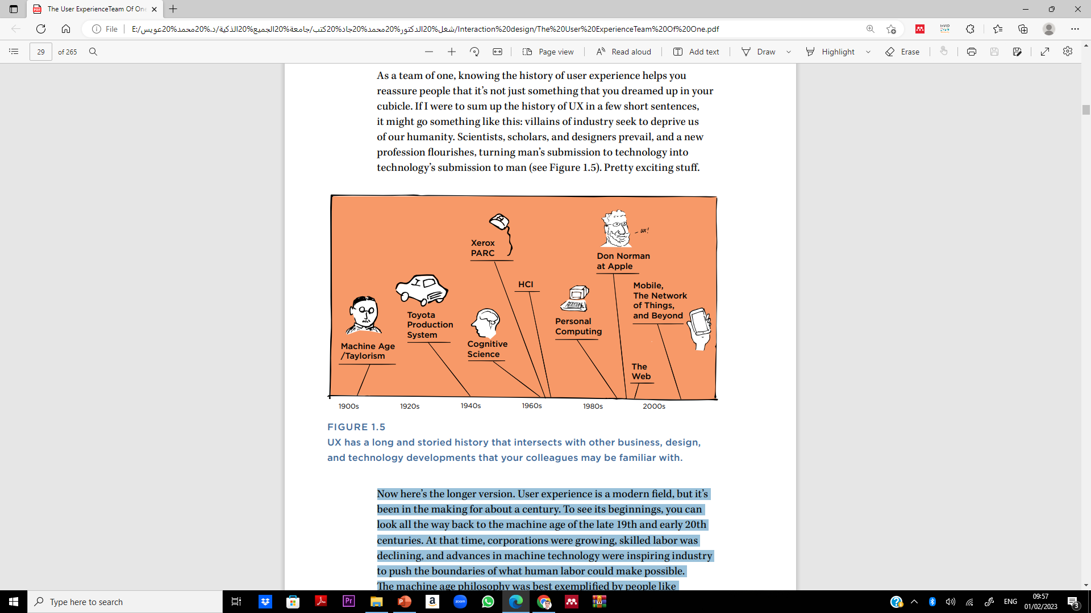
Lecture 1
Where UX Comes From
As a team of one, knowing the history of user experience helps you reassure people that it’s not just something that you dreamed up in your cubicle.
If I were to sum up the history of UX in a few short sentences, it might go something like this: villains of industry seek to deprive us of our humanity. Scientists, scholars, and designers prevail, and a new profession flourishes, turning man’s submission to technology into technology’s submission to man (see Figure 3)
Figure 3
UX has a long and storied history that intersects with other business, design, and technology developments

Slide 19
Lecture 1
Where UX Comes From
Now here’s the longer version. User experience is a modern field, but it’s been in the making for about a century. To see its beginnings, you can look all the way back to the machine age of the late 19th and early 20th centuries. At that time, corporations were growing, skilled labor was declining, and advances in machine technology were inspiring industries to push the boundaries of what human labor could make possible.
The machine age philosophy was best exemplified by people like Frederick Winslow Taylor and Henry Ford, who both pioneered ways to make human labor more efficient, productive, and routinized.
Figure 3
UX has a long and storied history that intersects with other business, design, and technology developments

Slide 20
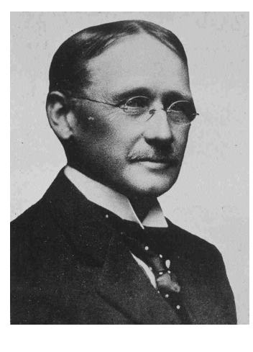
Lecture 1
Where UX Comes From
But they were criticized for dehumanizing workers in the process and treating people like cogs in a machine. Still Taylor’s research into the efficiency of interactions between workers and their tools was an early precursor to much of what UX professionals think about today.
The first half of the 20th century also saw an emerging body of research into what later became the fields of human factors and ergonomics.
Motivated by research into aeromedics in World War I and World War II, human factors focused on the design of equipment and devices to best align with human capabilities.
Figure 4
Frederick Winslow Taylor, the father of Scientific Management, pejoratively known as Taylorism.

Slide 21
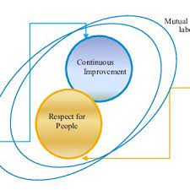
Lecture 1
Where UX Comes From
By the mid-20th century, industrial efficiency and human ingenuity were striking a more harmonious relationship at places like Toyota, where the Toyota Production System continued to value efficiency, but treated workers as key contributors to a continually improving process. One of the core tenets of the Toyota philosophy was “respect for people,” and it resulted in involving workers in troubleshooting and optimizing the processes that they were a part of. As one example, workers at Toyota factories could pull a rope called the Andon Cord to stop the assembly line and give feedback if they saw a defect or a way to improve the process.

Slide 22
Lecture 1
Where UX Comes From
Around the same time, industrial designer Henry Dreyfuss wrote Designing for People, a classic design text that, like the Toyota system, put people first.
In it, Dreyfuss described many of the methods that UX designers employ today to understand and design for user needs. In Designing for People, Henry Dreyfuss writes “when the point of contact between the product and the people becomes a point of friction, then the [designer] has failed.
On the other hand, if people are made safer, more comfortable, more eager to purchase, more efficient—or just plain happier—by contact with the product, then the designer has succeeded.”

Slide 23
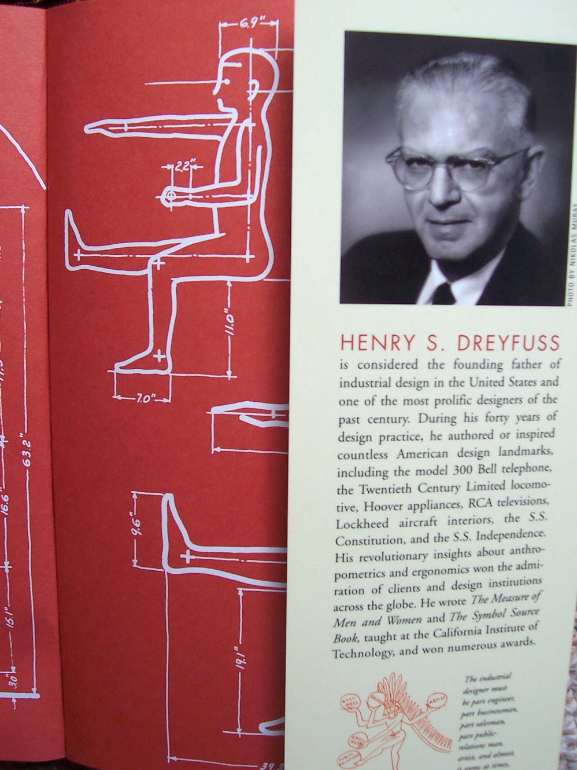
Lecture 1
Where UX Comes From

Slide 24

Lecture 1
Where UX Comes From
At the same time, some interesting parallel movements were taking shape. small handful of academics were doing research into what we now describe as cognitive science.
As a discipline, cognitive science combined an interest in human cognition (especially human capacity for short-term memory) with concepts such as artificial and machine intelligence. These cognitive scientists were interested in the potential of computers to serve as a tool to augment human mental capacities.
Many early wins in the design of computers for human use came from PARC, a Xerox research center founded in the early 1970s to explore innovations in workplace technology.
PARC (Palo Alto Research Center; formerly Xerox PARC) is a research and development company in Palo Alto, California.

Slide 25
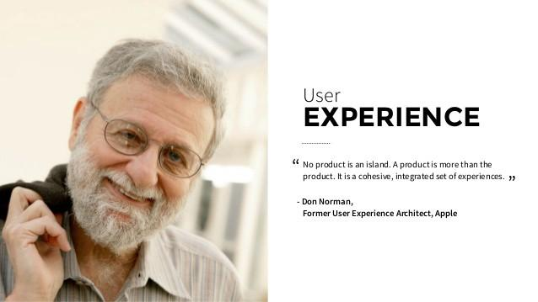
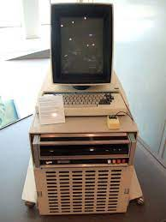
Lecture 1
Where UX Comes From
PARC’s work in the mid-70s produced many user interface conventions that are still used today—the graphical user interface, the mouse, and computer-generated bitmap graphics. For example, PARC’s work greatly influenced the first commercially available graphical user interface: the Apple Macintosh.
The term user experience probably originated in the early 1990s at Apple when cognitive psychologist Donald Norman joined the staff. Various accounts from people who were there at the time say that Norman introduced user experience to encompass what had theretofore been described as human interface research.

Slide 26
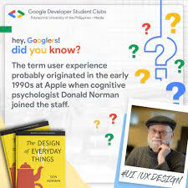
Lecture 1
Where UX Comes From
He held the title User Experience Architect, possibly the first person to ever have UX on his business card. Norman actually started out in cognitive psychology, but his writing on the cognitive experience of products, including technological products, made him a strong voice to lead and inspire a growing field (see Figure 5).
According to Don Norman, “I invented the term because I thought Human Interface and usability were too narrow: I wanted to cover all aspects of the person’s experience with a system, including industrial design, graphics, the interface, the physical interaction, and the manual.

Slide 27
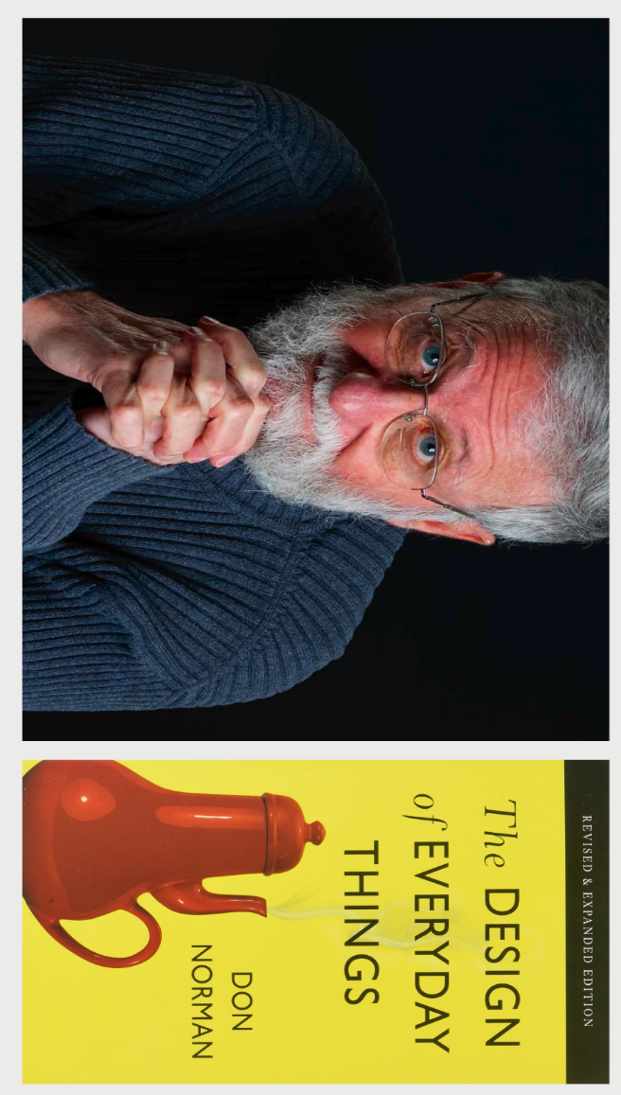
Lecture 1
Where UX Comes From
He held the title User Experience Architect, possibly the first person to ever have UX on his business card. Norman actually started out in cognitive psychology, but his writing on the cognitive experience of products, including technological products, made him a strong voice to lead and inspire a growing field.
According to Don Norman, “I invented the term because I thought Human Interface and usability were too narrow: I wanted to cover all aspects of the person’s experience with a system, including industrial design, graphics, the interface, the physical interaction, and the manual.

Slide 28
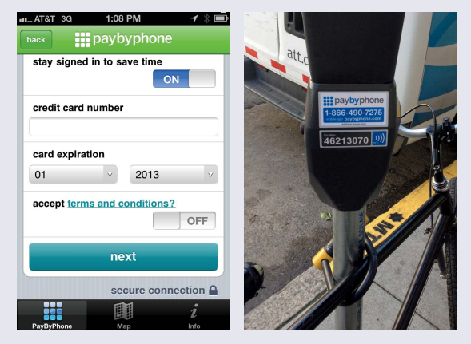
Lecture 1
UX and UI: What’s the Difference?
You may find that the average person is more familiar with the term UI than UX. UI refers to the user interface, or the screen through which a person interacts with a computer or device. Because most people have used computers at one time or another and have had encounters with UIs that were both good and bad, they often have some idea of what a UI is, and why it matters.
UX, on the other hand, is a more intangible concept that encompasses not just UI, but also the hardware, the user’s context of use, and the user’s goals and motivations.
Figure 5
With the PayByPhone service, the user interface is just one part of the overall user experience.

Slide 29
Lecture 1
UX and UI: What’s the Difference?
That’s a lot harder to cram into one mental picture. To explain the difference to others, it can be helpful to provide a tangible example. For example, PayByPhone is a service that integrates with parking meters to solve a basic problem: paying for parking even if you don’t have change.
The picture on the left in Figure is the app’s user interface, or UI. The picture on the right conveys some sense of the broader user experience of needing to pay for your parking, discovering that there’s an alternative way to pay, and then trying to figure out how to do it.
Figure
With the PayByPhone service, the user interface is just one part of the overall user experience.

Slide 30
Lecture 1
UX and UI: What’s the Difference?
With the rise of personal computing in the 1980s and then the Web in the 1990s, many of these trends converged on each other. Graphical user interfaces, cognitive science, and designing for and with people became the foundation for the field of human-computer interaction (HCI).
Suddenly, more people had access to computers and, along with it, a greater need to understand and optimize their use of them. HCI popularized concepts like usability and interaction design, both of which are important forebears to user experience.
Figure
With the PayByPhone service, the user interface is just one part of the overall user experience.

Slide 31
Lecture 1
UX and UI: What’s the Difference?
In the Internet bubble of the mid and late-1990s, new jobs with titles like “Web designer,” “interaction designer,” and “information architect” began cropping up. As people became more experienced in these roles, a deeper and more nuanced understanding of the field of user experience began to develop.
Today, user experience is a rapidly growing field, with undergraduate and graduate level programs being developed to train future generations of professionals to design products for the people who use them.
Figure
With the PayByPhone service, the user interface is just one part of the overall user experience.

Slide 32

Lecture 1
Where UX Professionals Come From
The field of user experience grew primarily out of human factors and usability—both fields with very strong ties to the world of software development. As a result, people often connect UX with user interface design. This isn’t completely inaccurate, but it’s just one part of the story.
Increasingly, UX doesn’t even have to involve a technical product. Service designers, industrial designers, physical space designers, and those people who are designing for an increasingly networked world are all working on the same basic problem. How can they design flowing experiences that respect, empower, and delight real people? So does that mean that anyone can be a user experience team of one?

Slide 33

Lecture 1
Where UX Professionals Come From
Not necessarily. Certain backgrounds are better grooming for user experience than others. You’re a good candidate for user experience work if you have past experience in one or more of these areas:
Web or software design and development:
This is a natural one. Many of the elder statesmen of the UX world started out as Webmasters or Web designers.

Slide 34
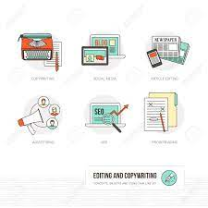
Lecture 1
Where UX Professionals Come From
Editing, journalism, or copywriting:
This field is also a common pathway into user experience because it is fundamentally about how people consume and make sense of content. That’s true whether it’s in print or digital. People with this background are naturals at thinking about the reader’s needs and perspectives, which translates directly into the user’s point of view. These folks also think a lot about how voice, tone, and structure influence a reader’s perceptions and experiences with a medium.

Slide 35
Lecture 1
Where UX Professionals Come From
Graphic or print design:
The user experience is impacted by decisions that are made at every level of the product. But when end users think of the product, they usually think of the parts that they can see and interact with—the visible, surface level. Graphic and print designers are trained to think about how people see and respond to layers of visual information. They have the ability to create designs that convey practical information, while also evoking a desired emotional reaction. People with this skill know how to design for understanding, as well as meaning, which is a very user-centered ethos.

Slide 36
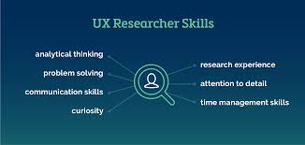
Lecture 1
Where UX Professionals Come From
Research, sociology, anthropology, and psychology:
Understanding and empathizing with the user’s perspective is a vital foundation for user experience design. People with this background know how to conduct studies or experiments to uncover what people really do and why. That can be harder than it seems. It’s very easy for the observer to unconsciously change the behavior of the observed. But sociologists and anthropologists have rigorous methods and techniques for getting at what people really do. They also have the ability to turn a dizzying array of observations and data points into broader themes and ultimately meaning. These themes and their significance become the foundation upon which user experience design decisions are made.

Slide 37
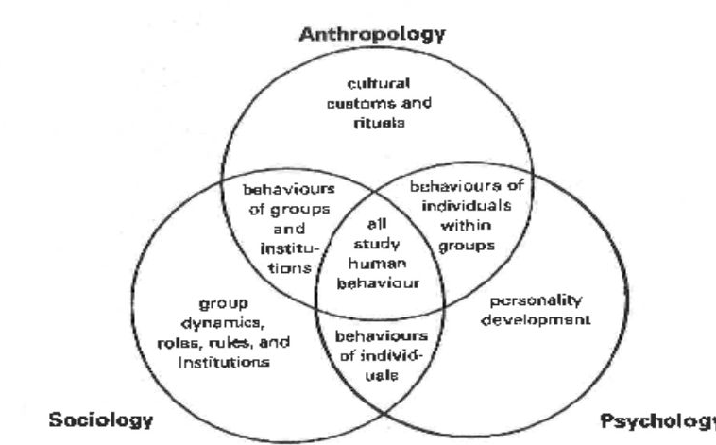
Lecture 1
Where UX Professionals Come From
Research, sociology, anthropology, and psychology:

Slide 38
Lecture 1
Where UX Professionals Come From
Engineering:
Engineers and developers write the code and build the systems that make the experience real. That moment when a flat concept on a page becomes a working, functioning, interactive thing is like making life. It’s incredibly rewarding. It also enables them to see and understand how it will feel and function for the end-user. And sometimes, it doesn’t feel or function like they thought it would. So they iterate and adjust. Engineers are skilled at jumping back and forth between the two mindsets that make this possible:
the maker’s mindset and the tester’s mindset. This cycle of making and adjusting and making and adjusting is the fundamental flow of user experience design.

Slide 39
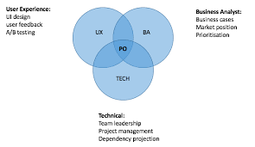
Lecture 1
Where UX Professionals Come From
Product management and business analysis:
People in these roles are often the bridge between many different parties who contribute to product design. Consequently, they have one of the broadest views of the ins and outs of the product. That holistic perspective often enables them to envision where the weak points are—not just from the perspective of the project plan or the business goals, but also the user experience.

Slide 40

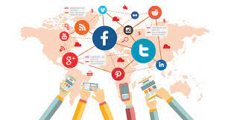
Lecture 1
Thank You

