Slide 1


College of Humanities
Master of Financial
Technology-
FinTech
Business Analysis
FNT613
First Lecture
Prepared By:
Dr. Abeir Moussa

Slide 2



Business Analysis
1st Lecture
FNT613
Prepared By:
Dr. Abeir Moussa
www.midocean.ae

Slide 3


Introduction to Business Analysis and The Competencies of a Business Analyst
Week2
Chapter1
www.midocean.ae

Slide 4

Learning Objectives
Know the origins, and development of business analysis
Understand the scope of business analysis work
Understand the role and responsibilities of a business analyst
Know the business analysis maturity model
Understand the Professionalism and business analysis
Know the future of business analysis
Know the personal qualities and knowledge of a business analyst
www.midocean.ae

Slide 5
WHAT IS BUSINESS ANALYSIS?
INTRODUCTION
Business analysis is a crucial discipline that helps organizations identify and solve business problems. It involves understanding the needs of stakeholders, analyzing processes, and recommending solutions to improve efficiency and achieve business goals. Business analysts play a vital role in bridging the gap between business objectives and technology solutions.
www.midocean.ae

Slide 6
WHAT IS BUSINESS ANALYSIS?
THE ORIGINS OF BUSINESS ANALYSIS
The roots of business analysis can be traced back to the early days of industrialization when businesses started to realize the need for systematic analysis and improvement of their operations. However, it was not until the mid-20th century that the discipline of business analysis began to take shape.
In the early days, business analysis was primarily focused on improving manufacturing processes and increasing productivity. Techniques such as time and motion studies were used to analyze workflows and identify bottlenecks. The goal was to optimize operations and reduce costs.
www.midocean.ae

Slide 7
WHAT IS BUSINESS ANALYSIS?
1. THE DEVELOPMENT OF BUSINESS ANALYSIS
The impact of outsourcing
Competitive advantage of using IT
Successful business change
The importance of the business analyst
Business analysts as internal consultants
www.midocean.ae

Slide 8
WHAT IS BUSINESS ANALYSIS?
1. THE DEVELOPMENT OF BUSINESS ANALYSIS
The impact of outsourcing
The outsourcing business model has undoubtedly been a catalyst for the development of the business analysis function as more and more organizations recognize the importance of business representation during the development and implementation of IT systems.
www.midocean.ae

Slide 9
WHAT IS BUSINESS ANALYSIS?
1. THE DEVELOPMENT OF BUSINESS ANALYSIS
Competitive advantage of using IT
parallel development that has helped to increase the profile of business analysis and define the business analyst role, has been the growing recognition that three factors need to be present in order for the IT systems to deliver competitive advantage.
First, the needs of the business must drive the development of the IT systems;
second, the implementation of an IT system must be accompanied by the necessary business changes, and
third, the requirements for IT systems must be defined with rigor and accuracy.
The traditional systems analyst role operated primarily in the last area; today’s business challenges require all three areas to be addressed.
www.midocean.ae

Slide 10
WHAT IS BUSINESS ANALYSIS?
1. THE DEVELOPMENT OF BUSINESS ANALYSIS
Successful business change
During the last few years, organizations have adopted a broader view – from IT projects to business change programs.
Figure 1.1 shows a typical business change lifecycle.
The early part of the business change lifecycle – Alignment and Definition – is concerned with the analysis of the organization, its business needs and requirements in order to determine new ways of working that will improve the organization's efficiency and effectiveness.
www.midocean.ae

Slide 11
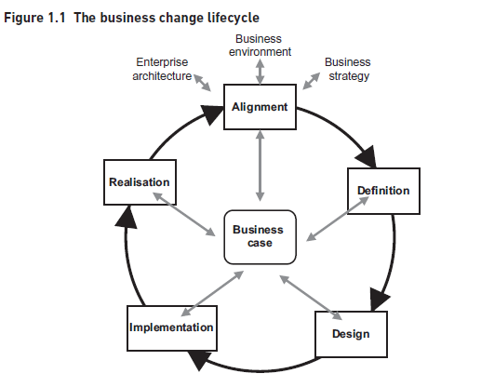
WHAT IS BUSINESS ANALYSIS?
Successful business change cont.
www.midocean.ae

Slide 12
WHAT IS BUSINESS ANALYSIS?
1. THE DEVELOPMENT OF BUSINESS ANALYSIS
The importance of the business analyst
The analysis work falls within the remit of business analysis yet, in many organizations, a coherent approach to business change, that includes business analysts in the business change lifecycle, is still awaited.
These factors have led directly to the development of the business analyst role. Having identified the relevance of the business analyst role needs to recognize the potential this can offer, particularly in a global economic environment where budgets are limited and waste of financial resources unacceptable.
The importance of using investment funds wisely and delivering the business benefits predicted for business change initiatives, has becoming increasingly necessary to the survival of organizations.
www.midocean.ae

Slide 13
WHAT IS BUSINESS ANALYSIS?
1. THE DEVELOPMENT OF BUSINESS ANALYSIS
Business analysts as internal consultants
Many organizations use external consultants to provide expert advice throughout the business change lifecycle. Consequently, there have been increasing numbers of business analysts working as internal consultants over the last decade.
www.midocean.ae

Slide 14
WHAT IS BUSINESS ANALYSIS?
2. THE SCOPE OF BUSINESS ANALYSIS WORK
The range of analysis activities
Discussions with several hundred business analysts, across a range of business forums, have established that business analysis roles do not always accurately represent the range of responsibilities that business analysts are capable of fulfilling.
The range of analysis activities One way in which we can consider the business analyst role is to examine the potential extent of analysis work.
www.midocean.ae

Slide 15
WHAT IS BUSINESS ANALYSIS?
2. THE SCOPE OF BUSINESS ANALYSIS WORK
For example, consultants may specialize in strategic analysis but also get involved in business process redesign to make a reality of their strategies, and good systems analysts have always understood the need to understand the overall business context of the systems they are developing.
Figure 1.2 shows three areas that might be considered to be within the province of the business analyst.
www.midocean.ae

Slide 16
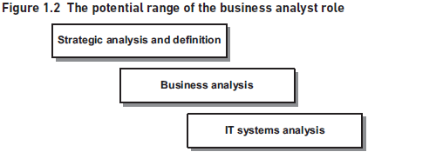
WHAT IS BUSINESS ANALYSIS?
2. THE SCOPE OF BUSINESS ANALYSIS WORK cont.
The range of analysis activities
www.midocean.ae

Slide 17
WHAT IS BUSINESS ANALYSIS?
THE SCOPE OF BUSINESS ANALYSIS WORK cont.
The range of analysis activities
-Strategic analysis and definition
Some business analysts may be required to undertake strategic analysis and identify business transformation actions, but it is more likely that they will have a role to play in supporting this activity.
However, business analysts are expected to have access to information about their organization's business strategy and be able to understand it, as their work will need to support the execution of this strategy.
The use of IT to enable business improvements and the opportunities presented by technology will need to be considered during any strategy analysis and the business analysts are the specialist team that should be able to advise on the use of technology to drive business change.
Given these issues, while strategic analysis work is not core to business analysis, business analysts will need a good understanding of how strategy is developed and the impact upon the work of the IT and business change functions.
www.midocean.ae

Slide 18
WHAT IS BUSINESS ANALYSIS?
2. THE SCOPE OF BUSINESS ANALYSIS WORK cont.
The range of analysis activities
- IT systems analysis
There is the traditional IT discipline called systems analysis. The systems analyst role has been in existence for over 40 years although the term ‘systems analyst’ tends to be used less often these days.
They have identified that modelling process and data requirements for the IT system is not part of the role of the business analyst and have separated the business analysis and IT teams into different departments, expecting the IT department to carry out the detailed IT systems modelling and specification.
www.midocean.ae

Slide 19
WHAT IS BUSINESS ANALYSIS?
2. THE SCOPE OF BUSINESS ANALYSIS WORK cont.
The range of analysis activities
- IT systems analysis
Other organizations differentiate between IT business analysts and business analysts, with those in IT often performing a role more akin to that of a systems analyst.
In order to do this, the business analysts need a detailed understanding of IT systems and how they operate, and must be able to use the approaches and modelling techniques that fell within the concern of the system analyst role.
www.midocean.ae

Slide 20
WHAT IS BUSINESS ANALYSIS?
2. THE SCOPE OF BUSINESS ANALYSIS WORK cont.
The range of analysis activities
- IT systems analysis
The essential difference here is that a business analyst is responsible for considering a range of business options to address a particular problem or opportunity. Instead, an IT business analyst or systems analyst works within a defined scope and considers options for the IT solution.
This is particularly the case where an Agile approach has been adopted for a software development project. the business analyst will work closely with the end users and development team to clarify the detailed requirements as they evolve during the development process.
www.midocean.ae

Slide 21
WHAT IS BUSINESS ANALYSIS?
2. THE SCOPE OF BUSINESS ANALYSIS WORK
The range of analysis activities
- Business analysis
Realizing business analysis
Taking a holistic approach
Agile systems development
Supporting business change
www.midocean.ae

Slide 22
WHAT IS BUSINESS ANALYSIS?
2. THE SCOPE OF BUSINESS ANALYSIS WORK
The range of analysis activities
- Business analysis
If the two analysis disciplines described before define the limits of analysis work, the gap in the middle is straddled by business analysis.
Business analysts will usually be required to investigate a business system where improvements are required but the range and focus of those improvements can vary considerably.
In such a case, they would need to recommend actions that would overcome a problem or achieve business benefits. Perhaps it is more likely that the study is broader than this and requires investigation into several issues, or ideas regarding increased efficiency or effectiveness.
The analysts would need to make recommendations for business changes and these would need to be supported by a rigorous business case.
Also, the business analyst may be asked to focus specifically on enhancing or replacing an existing IT system in line with business requirements.
www.midocean.ae

Slide 23
WHAT IS BUSINESS ANALYSIS?
In this case the analyst would deliver a requirements document defining what the business requires the IT system to provide.
Where an Agile approach is to be used, the business analyst may also be involved in prioritizing the requirements and identifying those to be input into the next development iteration.
In this case, the analyst will need to have wide-ranging skills not only in analysis but also in stakeholder relationship management, and they will also require extensive business domain knowledge.
In such situations, techniques such as stakeholder analysis, business process modelling and requirements engineering may all be required in order to identify the actions required to improve the business system.
www.midocean.ae

Slide 24
WHAT IS BUSINESS ANALYSIS?
2. THE SCOPE OF BUSINESS ANALYSIS WORK
The range of analysis activities
- Business analysis
- Realizing business analysis
Analyzing business situations, and identifying areas for business improvement, is only part of the process; the analyst may also be required to help develop a business case in order to justify the required level of investment and ensure any risks are considered.
Organizations are placing increasing emphasis upon ensuring that there is a rigorous business case to justify the expenditure on business improvement projects.
However, defining the business case is only part of the picture – the focus on the management and realization of these business benefits, once the solution has been delivered, is also growing.
.
www.midocean.ae

Slide 25
WHAT IS BUSINESS ANALYSIS?
2. THE SCOPE OF BUSINESS ANALYSIS WORK
The range of analysis activities
- Business analysis
- Taking a holistic approach
Although the business analyst performs a key role in supporting management’s exploitation of IT to obtain business benefit, this has to be within the context of the entire business system.
Hence, all aspects of the operational business system need to be analyzed if all of the opportunities for business improvement are to be uncovered.
The POPIT model in Figure 1.3 shows the different views that must be considered when identifying areas for improving the business system.
www.midocean.ae

Slide 26
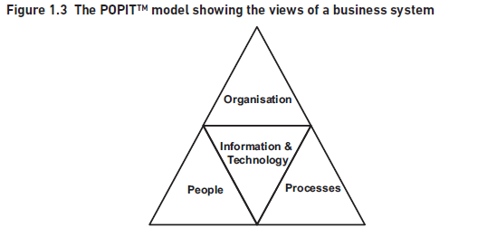
WHAT IS BUSINESS ANALYSIS?
Taking a holistic approach
www.midocean.ae

Slide 27
WHAT IS BUSINESS ANALYSIS?
-Taking a holistic approach
The POPIT model shows the different aspects, and the correspondences between them, that business analysts need to consider when analyzing a business system. For each area, we might consider the following:
The processes – are they well defined and communicated? Is there good IT support or are there several ‘work- arounds’ in existence? Does the process require documents to be passed around the organization unnecessarily? Is there the potential for delays or the introduction of errors?
The people – do they have the required skills for the job? How motivated are they? Do they understand the business objectives that they need to support?
www.midocean.ae

Slide 28
WHAT IS BUSINESS ANALYSIS?
- Taking a holistic approach- POPIT model
The organization – is there a supportive management style? Are jobs and responsibilities well defined? Is there collaborative cross-functional working?
The information – do the staff have the information to conduct their work effectively? Are managers able to make decisions based on accurate and timely information?
The technology – do the systems support the business as required? Do they provide the information needed to run the organization?
www.midocean.ae

Slide 29
WHAT IS BUSINESS ANALYSIS?
-Taking a holistic approach- POPIT model Cont.
We need to examine and understand all of these areas to discover where problems lie and what improvements might be possible, if the business system is to become more effective.
It is often the case that the focus of a business analysis or business change study is primarily on the processes and the IT support.
It is vital that the business analyst is aware of the broader aspects relating to business situations such as the culture of the organization and its impact on the people and the working practices.
Business analysis places an emphasis on improving the operation of the entire business system.
www.midocean.ae

Slide 30
WHAT IS BUSINESS ANALYSIS?
-Taking a holistic approach- POPIT model Cont.
The focus should be on business improvement, rather than on the use of automation per se, resulting in recommendations that improve the business.
These solutions may be superseded by longer term, possibly more costly solutions, but the focus on the business has ensured that the immediate needs have been met.
www.midocean.ae

Slide 31
WHAT IS BUSINESS ANALYSIS?
-Agile systems development
Agile is a software development approach which emerged in the late 1990s in the wake of approaches such as Rapid Application Development (RAD), and the Dynamic System Development Method (DSDM).
The use of such approaches evolved as a reaction to the linear waterfall lifecycle, with its emphasis on completing a stage before moving on to the next stage.
www.midocean.ae

Slide 32
WHAT IS BUSINESS ANALYSIS?
-Agile systems development cont.
We are discovering better ways of developing software by doing it and helping others do it. Through this work we have come to value:
Individuals and interactions over processes and tools
Working software over comprehensive documentation
Customer collaboration over contract negotiation
Responding to change over following a plan
www.midocean.ae

Slide 33
WHAT IS BUSINESS ANALYSIS?
-Agile systems development cont.
In essence, where a business analyst is working on a project where an Agile software development approach has been adopted, the analyst will be involved in supporting the business users in clarifying, elaborating and prioritizing the requirements during the development process.
While some early business analysis work will have been required to discover the problems to be addressed and define the business requirements, at a solution level the more detailed requirements will be elaborated during time boxed iterations where collaborative teams comprising users, analysts and developers work together to develop part of the software required product.
www.midocean.ae

Slide 34
WHAT IS BUSINESS ANALYSIS?
-Supporting business change
One aspect may concern the business acceptance testing – a vital element if business changes are to be implemented smoothly.
The business analyst’s involvement in business acceptance testing can include work such as developing test scenarios and working with the business users as they apply the scenarios to their new processes and systems.
Further, the implementation of business procedure manuals and user guides;
Training business staff in the use of the new processes and IT systems;
Defining job roles and writing job role descriptions;
Providing ongoing support as the business staff begin to adopt the new, unfamiliar, approaches.
www.midocean.ae

Slide 35
WHAT IS BUSINESS ANALYSIS?
3. THE ROLE AND RESPONSIBILITIES OF A BUSINESS ANALYST
Although there are different role definitions, depending upon the organization, there does seem to be an area of common ground where most business analysts work.
These core responsibilities are:
Investigate business systems taking a holistic view of the situation; this may include examining elements of the organization structures and staff development issues as well as current processes and IT systems
Evaluate actions to improve the operation of a business system.
Again, this may require an examination of organizational structure, and staff development needs to ensure that they are in line with any proposed process redesign and IT system development.
www.midocean.ae

Slide 36
WHAT IS BUSINESS ANALYSIS?
3. THE ROLE AND RESPONSIBILITIES OF A BUSINESS ANALYST cont.
Therefor, the core business analyst role should be defined as:
An advisory role which has the responsibility for investigating and analyzing business situations, identifying and evaluating options for improving business systems, elaborating and defining requirements, and ensuring the effective implementation and use of information systems in line with the needs of the business.
www.midocean.ae

Slide 37
WHAT IS BUSINESS ANALYSIS?
3. THE ROLE AND RESPONSIBILITIES OF A BUSINESS ANALYST cont.
Some business analysis roles extend into other areas, these areas are:
Strategy implementation – here the business analysts work closely with senior management to help define the most effective business system to implement elements of the business strategy.
Business case production – most of senior business analysts usually do this, typically with assistance from Finance specialists.
Benefits realization – the business analysts carry out post-implementation reviews, examine the benefits defined in the business case and evaluate whether or not the benefits have been achieved.
www.midocean.ae

Slide 38
WHAT IS BUSINESS ANALYSIS?
3. THE ROLE AND RESPONSIBILITIES OF A BUSINESS ANALYST cont.
The rationale seeks to explain why business analysis is so important for organizations in today’s business world and imposes responsibilities that business analysts must recognize and accept.
The rationale for business analysis is:
Root causes not symptoms
Business improvement not IT change
Options not solutions
Feasible, contributing requirements not meeting all requests
The entire business change lifecycle not just requirements definition
Negotiation not avoidance
www.midocean.ae

Slide 39
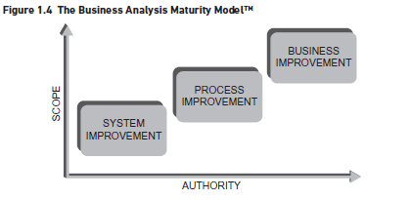
WHAT IS BUSINESS ANALYSIS?
4. THE BUSINESS ANALYSIS MATURITY MODEL
The Business Analysis Maturity Model (BAMM) shown in Figure 1.4 was developed by Assist Knowledge Development Ltd to represent the development and maturity of business analysis.
www.midocean.ae

Slide 40
WHAT IS BUSINESS ANALYSIS?
4. THE BUSINESS ANALYSIS MATURITY MODEL cont.
The business analysts have come from different backgrounds – some from IT, many from business areas – and have brought different skills and knowledge to their business analysis teams.
The BAMM uses two axes: the scope of the work allocated to the business analyst and the authority level of the business analyst.
The level of authority of the business analyst can also vary considerably, from a limited level of authority to the ability to influence and guide at senior management level.
www.midocean.ae

Slide 41
WHAT IS BUSINESS ANALYSIS?
4. THE BUSINESS ANALYSIS MATURITY MODEL cont.
The first level is where the business analysis work is concerned with defining the requirements for an IT system improvement.
The next level is where the business analysis work has moved beyond a specific IT development so that the analysts work cross-functionally to improve the business processes that give rise to the requirements.
Here, the business analysis work is concerned with improving the business and working with senior management to support the delivery of value to customers.
www.midocean.ae

Slide 42
WHAT IS BUSINESS ANALYSIS?
4. THE BUSINESS ANALYSIS MATURITY MODEL cont.
These levels of maturity apply to three perspectives on business analysis: the individual analysts, the business analysis community within an organization, and the business analysis profession as a whole.
If we consider the BAMM in the light of the Capability Maturity Model Integration (CMMI), we can see that the five levels of the CMMI apply at each level.
www.midocean.ae

Slide 43
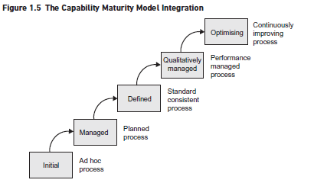
WHAT IS BUSINESS ANALYSIS?
4. THE BUSINESS ANALYSIS MATURITY MODEL (BAMM)
The Capability Maturity Model Integration (CMMI)
www.midocean.ae

Slide 44
WHAT IS BUSINESS ANALYSIS?
4. THE BUSINESS ANALYSIS MATURITY MODEL (BAMM)
- The Capability Maturity Model Integration (CMMI)
An organization that is developing its Business Analysis Practice may employ business analysts who are chiefly employed on requirements definition work.
By contrast, an organization that has employed business analysts for some time may have analysts that can work at all three levels of the BAMM.
The analysts working at the Business Improvement level may have a defined process, standards and measures that are managed for each assignment.
These business analysts are working at the Managed level of the CMMI.
Figure 1.6 shows a possible approach to this maturity assessment.
www.midocean.ae

Slide 45
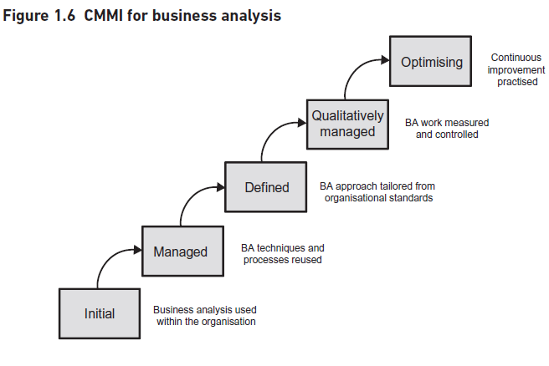
WHAT IS BUSINESS ANALYSIS?
The BAMM in the light of the CMMI = The CMMI for Business Analysis
www.midocean.ae

Slide 46
WHAT IS BUSINESS ANALYSIS?
5. PROFESSIONALISM AND BUSINESS ANALYSIS
Business analysis has developed a great deal over the last 25 years, to the extent that it is often referred to as a ‘profession’ and many practitioners view themselves as having a career in business analysis. The factors that support professionalism in business analysis are as follows:
Qualifications
Standards
Continuing Professional Development
Professional Body
www.midocean.ae

Slide 47
WHAT IS BUSINESS ANALYSIS?
5. PROFESSIONALISM AND BUSINESS ANALYSIS
-Qualifications :
Many business analysts hold qualifications such as the BCS International Diploma in Business Analysis or the IIBA, CBAP, or CCBA certifications.
The seniority of some business analysts has also been recognized by the introduction of the Expert BA Award offered by the BA Manager Forum.
www.midocean.ae

Slide 48
WHAT IS BUSINESS ANALYSIS?
5. PROFESSIONALISM AND BUSINESS ANALYSIS
-Standards:
Organizations typically have templates for documents and standardize on modelling techniques such as those provided by the Unified Modeling Language.
Books such as this one are also used in many organizations as a foundation for standards of business analysis practice.
-Continuing Professional Development:
Recognition of the need for the continuing development of skills and knowledge in order to retain the professional status.
www.midocean.ae

Slide 49
WHAT IS BUSINESS ANALYSIS?
5. PROFESSIONALISM AND BUSINESS ANALYSIS
Professional Body:
A body with responsibility for defining technical standards and the code of conduct, promoting the profession and carrying out remedial action where necessary.
This may require the removal of members where they do not reach the standard required by the code of conduct.
www.midocean.ae

Slide 50
WHAT IS BUSINESS ANALYSIS?
6. THE FUTURE OF BUSINESS ANALYSIS
As technology continues to evolve, business analysis is also expected to undergo significant changes. Some future trends in business analysis include:
Agile Business Analysis:
Agile methodologies, such as Scrum and Kanban, are becoming increasingly popular in business analysis. These methodologies emphasize iterative and collaborative approaches to requirements gathering and solution design.
Data Analytics:
With the rise of big data and advanced analytics, business analysts are expected to have a stronger focus on data analysis and interpretation.
www.midocean.ae

Slide 51
WHAT IS BUSINESS ANALYSIS?
6. THE FUTURE OF BUSINESS ANALYSIS
Artificial Intelligence:
AI-powered tools and techniques are likely to play a more significant role in business analysis, automating repetitive tasks and providing insights from large datasets.
Business Process Automation:
Business analysts will need to understand and leverage automation technologies to optimize business processes and improve efficiency.
www.midocean.ae

Slide 52

INTRODUCTION
A business analyst is responsible for identifying business needs, eliciting requirements, and defining solutions to address those needs. They act as a liaison between stakeholders, such as business users, project managers, and IT teams. The role requires a combination of technical knowledge, analytical skills, and effective communication.
THE COMPETENCIES OF A BUSINESS ANALYST
www.midocean.ae

Slide 53
This part includes:
THE COMPETENCIES OF A BUSINESS ANALYST
THE RIGHT SKILLS FOR THE RIGHT SITUATION
HOW CAN I DEVELOP MY SKILLS?
INDUSTRY SKILLS FRAMEWORKS
INDUSTRY QUALIFICATIONS
THE COMPETENCIES OF A BUSINESS ANALYST
www.midocean.ae

Slide 54
THE COMPETENCIES OF A BUSINESS ANALYST
THE COMPETENCIES OF A BUSINESS ANALYST
PERSONAL QUALITIES
BUSINESS KNOWLEDGE
PROFESSIONAL TECHNIQUES
www.midocean.ae

Slide 55
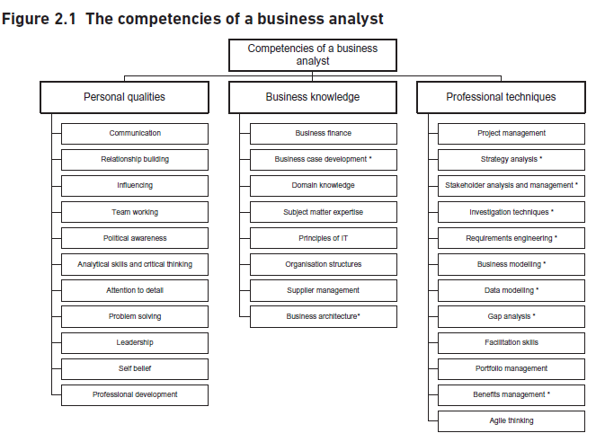
THE COMPETENCIES OF A BUSINESS ANALYST
www.midocean.ae

Slide 56
THE COMPETENCIES OF A BUSINESS ANALYST
THE RIGHT SKILLS FOR THE RIGHT SITUATION
A key task for the management of business analysts is to ensure that there is a good fit between the skills needed for the analysis to be carried out. Putting a junior analyst in a situation where higher level skills are required can be demotivating and the reverse is also true where an analyst is over-skilled for the work.
www.midocean.ae

Slide 57
THE COMPETENCIES OF A BUSINESS ANALYST
HOW CAN I DEVELOP MY SKILLS?
The first step in developing as a business analyst is to understand the skills required of a business analyst in your organization.
Your HR department or line management may be able to provide an outline definition of the requirements for the business analyst role; there may be an internal career development framework available that sets out the skill requirements for different roles and grades.
www.midocean.ae

Slide 58
THE COMPETENCIES OF A BUSINESS ANALYST
HOW CAN I DEVELOP MY SKILLS?
Essentially, there are four ways in which business analysts can develop their competencies:
Training
Self-study
Workplace experience
Industry engagement- The International Institute for Business Analysis (IIBA)
www.midocean.ae

Slide 59
THE COMPETENCIES OF A BUSINESS ANALYST
INDUSTRY SKILLS FRAMEWORKS
Skills Framework for the Information Age (SFIA) is the major framework setting out the definition of skills, and levels of competence, for the information systems industry. The framework includes six categories of skill including strategy and architecture, business change, and solution development, and implementation.
SFIA is owned and maintained by The SFIA Foundation, a not-for-profit organization.
SFIA is used worldwide in all sectors of industry and government as the preferred framework for defining the skills required of IT professionals.
www.midocean.ae

Slide 60
THE COMPETENCIES OF A BUSINESS ANALYST
INDUSTRY QUALIFICATIONS
There are two examination bodies offering professional qualifications in Business Analysis in the UK. These are BCS and IIBA.
BCS, The Chartered Institute for IT
BCS offers a range of certifications for business analysts covering the subjects of business analysis, change management and consultancy.
The International Institute of Business Analysis (IIBA)
It has created the Certified Business Analysis Professional (CBAP), a designation awarded to candidates who have successfully demonstrated sufficient experience in business analysis and have passed the IIBA, CBAP examination.
www.midocean.ae

Slide 61
Conclusion
Business analysis is a critical discipline that helps organizations identify and solve business problems. It requires a combination of technical knowledge, analytical skills, and effective communication. By understanding the needs of stakeholders, analyzing processes, and recommending solutions, business analysts contribute to the success and growth of organizations. Despite the challenges, the future of business analysis looks promising, with trends such as Agile methodologies, data analytics, and artificial intelligence shaping the field.
www.midocean.ae

Slide 62


The End of Lecture
Thank You

