Slide 1

PMG 622
Agile Project Management
ZOOM MEETING: 03 (23-09-21)
Everyone’s Smart
University
دكتور مهندس استشاري ادارة المشروعات
Eng. Dr. Akram Mustafa Suliman Ali,
PhD. AU, BEng. & MSc. AAST, CEng CMarEng MIMarEST, PE, PMP®,
ASQ CSSBB, ISO Lead Auditor, NDT Level II,

Slide 2
Lecture 02 - Quiz 01
An approach that provides finished deliverables that the customer may be able to use immediately.
Incremental Lifecycle
Predictive life cycle
Iterative life cycle
Agile life cycle

Slide 3
Lecture 02 - Quiz 02
Predictive life cycle:
A more traditional approach, with the bulk of planning occurring upfront, then executing in a single pass; a sequential process
True
False

Slide 4
Lecture 02 -Quiz 03
Agile life cycle:
An approach that is both iterative and incremental to refine work items and deliver frequently.
True
False

Slide 5


How course is delivered and how to study
Primary Course Delivery Method:
  LECTURE
How to study:
  Print material;
  watch video and
  take notes

Slide 6
Lecture 1 : An introduction to agile
Lecture 2: Life Cycle Selection
Lecture 3: Implementing Agile: Creating an Agile Environment
Lecture 4: Implementing Agile: Delivering in an Agile Environment [1/2]

Slide 7
Scrum roles, artifacts & ceremonies
SCRUM ARTIFICATS
  Product Backlog
  Sprint Backlog
  Increment
SCRUM CERMONIES
  Sprint Planning.
  Daily Scrum.
  Sprint Review.
  Sprint Retrospective.
SCRUM ROLES
  Product Owner
  Development Team Members
  Scrum Master

Slide 8


Slide 9
The agile mindset
Agile is a mindset defined by values, guided by principles and manifested through many different practices.
Agile practitioners select practices based on their needs.
Notes:
It is worth noting that while the term “agile” became popularized after the Manifesto, the approaches and techniques being used by project teams today existed before the Agile Manifesto by many years and, in some cases, decades.

Slide 10
Characteristics of Four Categories of Life Cycles

Slide 11
Attributes of Successful Agile Teams [1/2]
Attribute | Goal
Dedicated people | Increased focus and productivity Small team, fewer than ten people
Cross-functional team members | Develop and deliver often Deliver finished value as an independent team Integrate all the work activities to deliver finished work Provide feedback from inside the team and from others, such as the product owner
Colocation or ability to manage any location challenges | Better communication Improved team dynamics Knowledge sharing Reduced cost of learning Able to commit to working with each other

Slide 12
Attributes of Successful Agile Teams [2/2]
Attribute | Goal
Mixed team of generalists and specialists | Specialists provide dedicated expertise and generalists provide flexibility of who does what Team brings their specialist capabilities and often become generalizing specialists, with a focus specialty plus breadth of experience across multiple skills
Stable work environment | Depend on each other to deliver Agreed-upon approach to the work Simplified team cost calculations (run rate) Preservation and expansion of intellectual capital

Slide 13
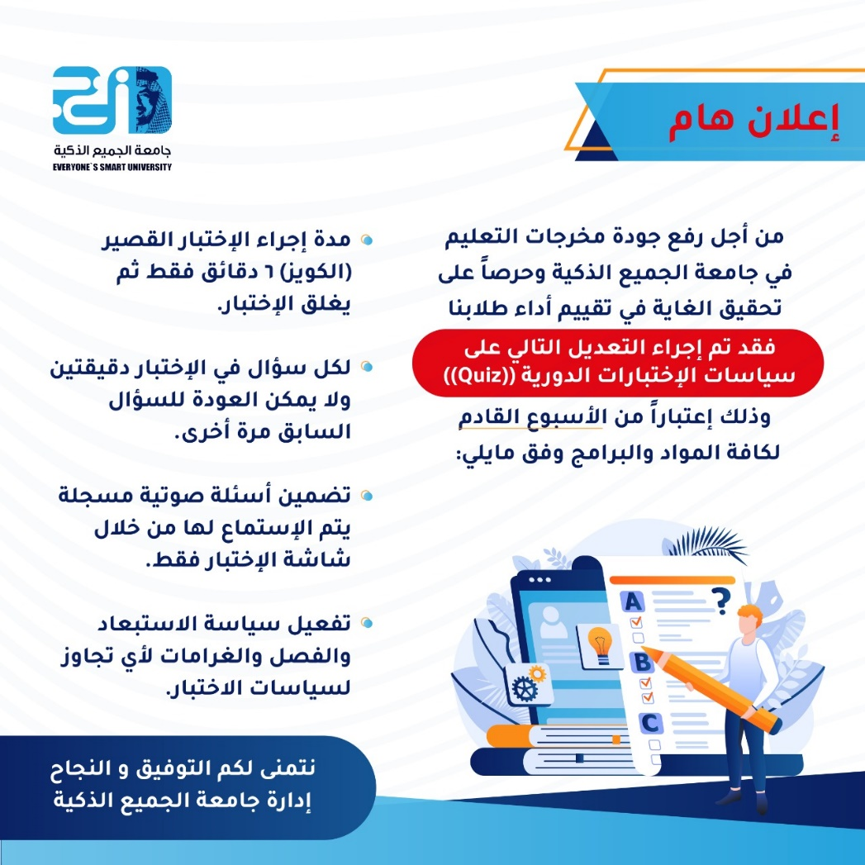
First assignment

Slide 14
SERVANT LEADERSHIP EMPOWERS THE
TEAM

Slide 15


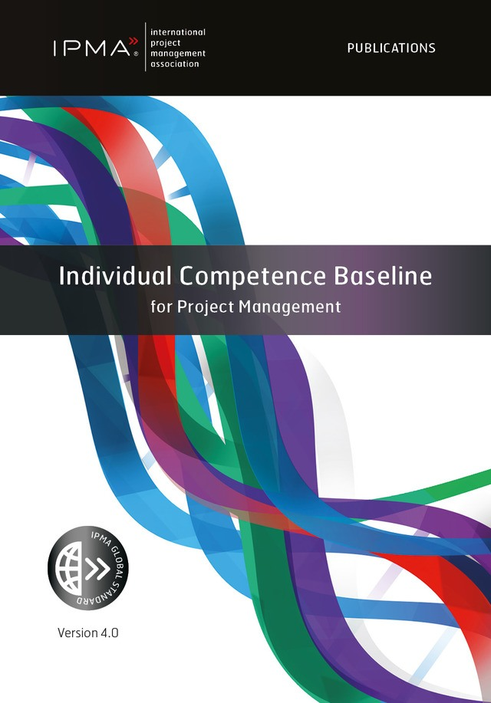

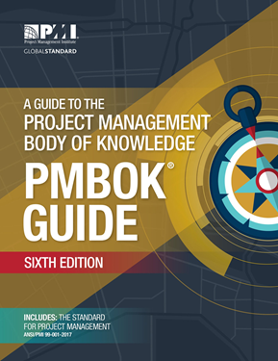
Your main reference material
PMBOK (6th ed.) & Agile Practice Guide
الدليل المعرفي لادارة المشروعات
دليل ممارسة الاسلوب الرشيق
IPMA – ICB4 – In Agile World

Slide 16
SERVANT LEADERSHIP
Servant leadership is the practice of leading through service to the team, by focusing on understanding and addressing the needs and development of team members in order to enable the highest possible team performance
The role of a servant leader is to facilitate the team's discovery and definition of agile.
Servant leaders practice and radiate agile
Servant leadership = facilitative skills

Slide 17
Servant leaders approach project work in this order:
Purpose. Work with the team to define the “why” or purpose so they can engage and coalesce around the goal for the project. The entire team optimizes at the project level, not the person level.
People. Once the purpose is established, encourage the team to create an environment where everyone can succeed. Ask each team member to contribute across the project work.
Process. Do not plan on following the “perfect” agile process, but instead look for the results. When a cross-functional team delivers finished value often and reflects on the product and process, the teams are agile. It does not matter what the team calls its process

Slide 18
INTERPERSONAL SKILLS VERSUS TECHNICAL SKILLS
Team members emphasize their interpersonal and emotional intelligence skills—not just technical skills.
Everyone on the team works to exhibit more initiative, integrity, emotional intelligence, honesty, collaboration, humility, and willingness to communicate in various ways so that the entire team can work together well.
The team needs these skills so they can respond well to changes in project direction and technical product changes. When everyone can adapt to the work and to each other, the entire team is more likely to succeed

Slide 19
servant leadership: enables project leaders to become more agile
Promoting self-awareness;
Listening;
Serving those on the team;
Helping people grow;
Coaching vs. controlling;
Promoting safety, respect, and trust; and
Promoting the energy and intelligence of others

Slide 20
SERVANT LEADER RESPONSIBILITIES
Manage relationships to build communication and coordination within the team and across the organization
These relationships help the leaders navigate the organization to support the team
This kind of support helps to remove impediments and facilitates the team to streamline its processes
Because servant leaders understand agile and practice a specific approach to agile, they can assist in fulfilling the team's needs

Slide 21
SERVANT LEADERS PAVE THE WAY FOR OTHERS’ CONTRIBUTION
In agile, the team manages its work process and its work product.
Servant leaders work to fulfill the needs of the teams, projects, and organization.
The servant leader focuses on paving the way for the team to do its best work.
The servant leader influences projects and encourages the organization to think differently.
Notes:
Servant leaders may work with facilities for a team space, work with management to enable the team to focus on one project at a time, or work with the product owner to develop stories with the team.
Some servant leaders work with auditors to refine the processes needed in regulatory environments, and some servant leaders work with the finance department to transition the organization to incremental budgeting.

Slide 22
examples of the responsibilities a servant leader may have:
Educate stakeholders around why and how to be agile
Support the team through mentoring, encouragement, and support.
Advocate for team members training and career development.
Help the team with technical project management activities like quantitative risk analysis.
Celebrate team successes and support and bridge building activities with external groups.
Create upward spirals of appreciation and good will for increased collaboration.

Slide 23
ROLE OF THE PROJECT MANAGER IN AN AGILE ENVIRONMENT
Some agile practitioners think the role of a project manager is not needed, due to self-organizing teams taking on the former responsibilities of the project manager.
However, pragmatic agile practitioners and organizations realize that project managers can add significant value in many situations. The key difference is that their roles and responsibilities look somewhat different.

Slide 24
PROJECT MANAGERS USE SERVANT LEADERSHIP
When working on an agile project, project managers shift from being the center to serving the team and the management.
In an agile environment, project managers are servant leaders, changing their emphasis to coaching people who want help, fostering greater collaboration on the team, and aligning stakeholder needs.
As a servant leader, project managers encourage the distribution of responsibility to the team: to those people who have the knowledge to get work done.

