Slide 1



Supply Chain
Management
Prepared by Dr. Tarek Mohamed
MGM 660
Lecture One

Slide 2
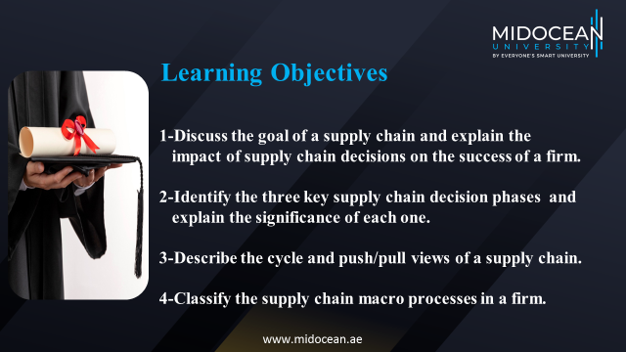

Slide 3
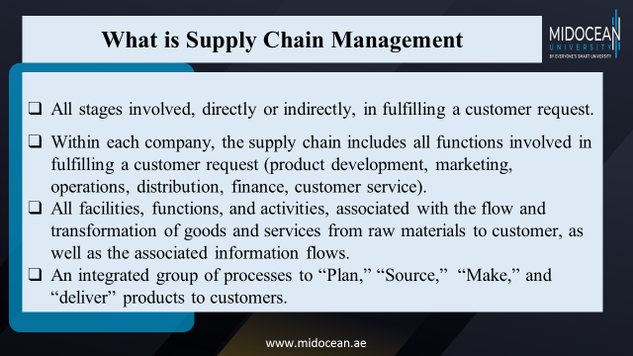

Slide 4
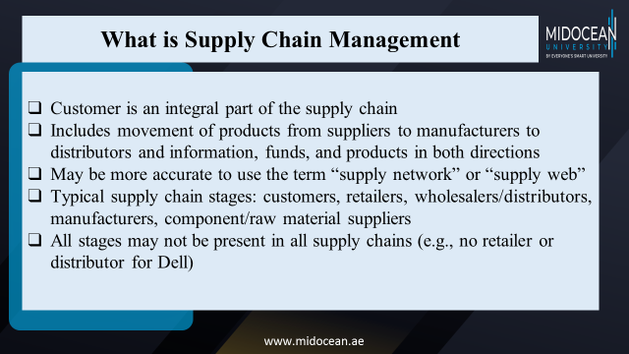

Slide 5
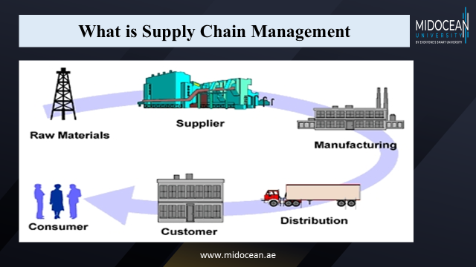

Slide 6
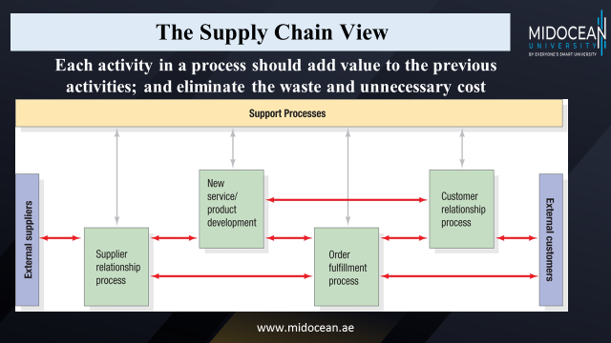

Slide 7

What is a Supply Chain?
P&G manufacturing plant receives raw materials from a variety of suppliers. For example, the packaging material may come from Tenneco packaging, while Tenneco receives raw materials to manufacture the packaging from other suppliers.
FIGURE 1-1
Notes:
Notes:
Supply chain involves everybody, from the customer all the way to the last supplier.
Key flows in the supply chain are - information, product, and cash. It is through these flows that a supply chain fills a customer order. The management of these flows is key to the success or failure of a firm. Give Dell & Compaq example, Amazon & Borders example to bring out the fact that all supply chain interaction is through these flows.

Slide 8
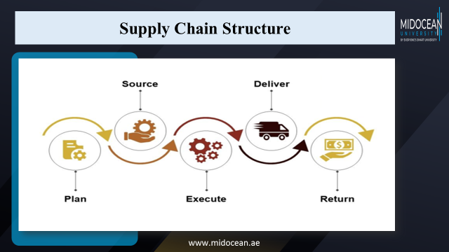

Slide 9
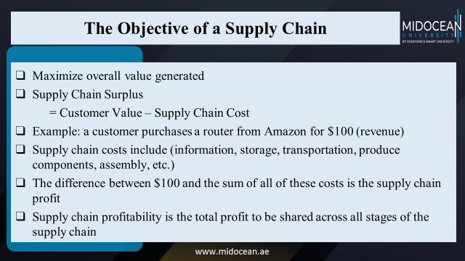

Slide 10
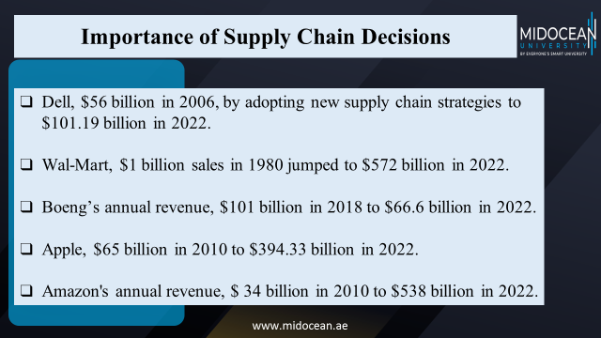

Slide 11
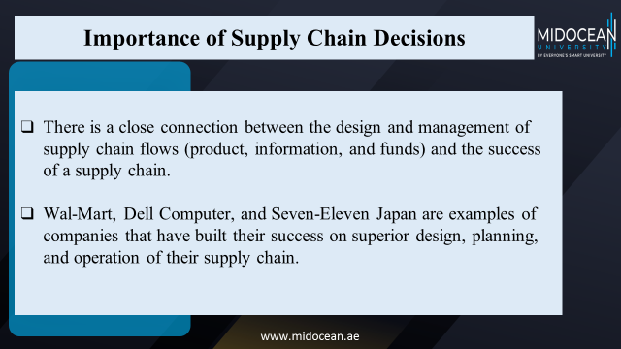

Slide 12
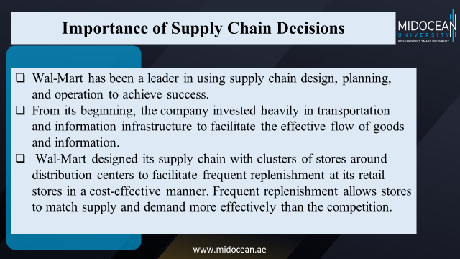

Slide 13
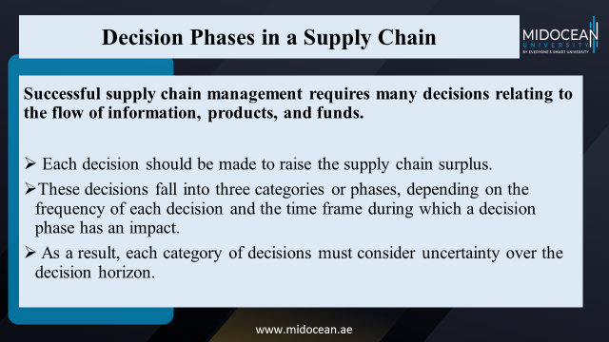

Slide 14
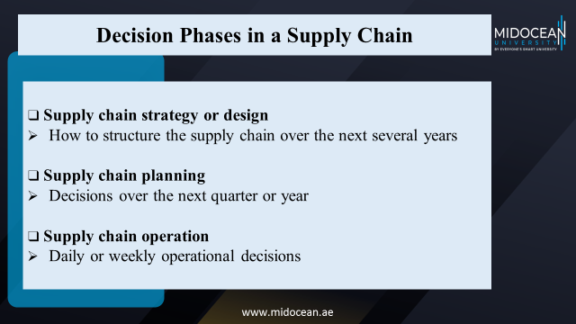

Slide 15
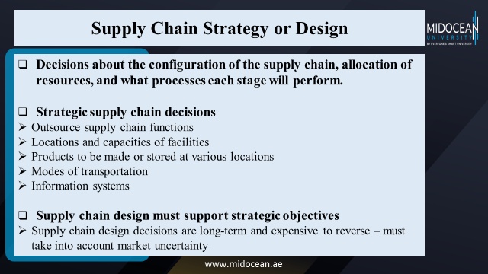

Slide 16
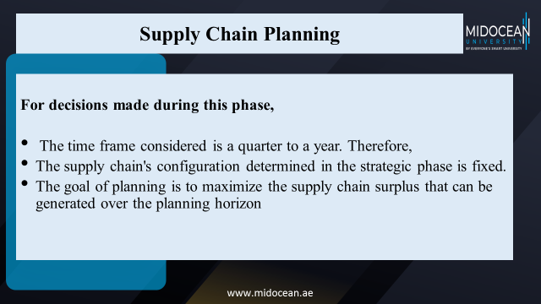

Slide 17
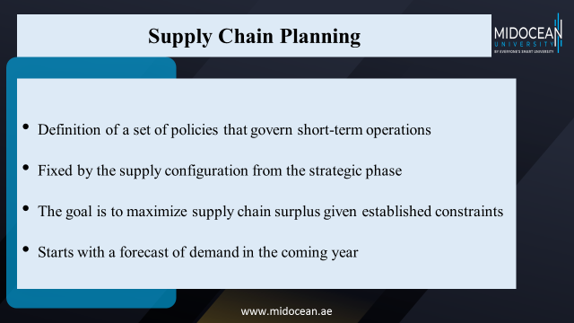

Slide 18
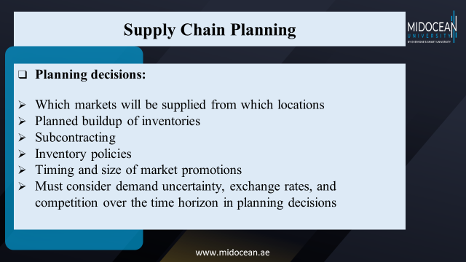

Slide 19
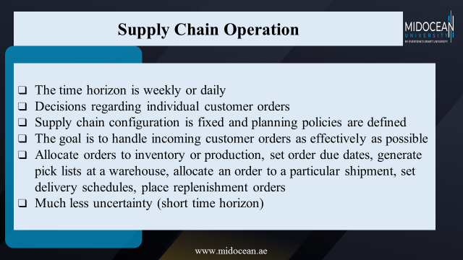

Slide 20
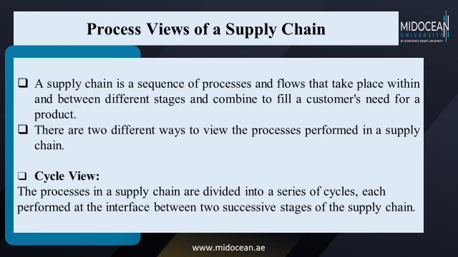

Slide 21
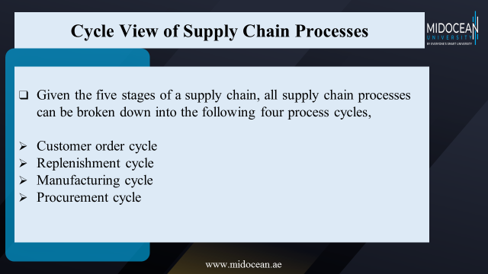

Slide 22
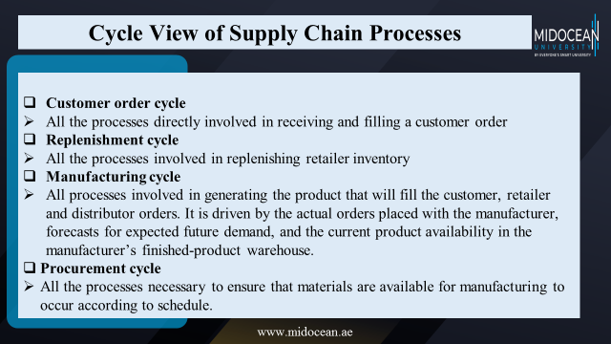

Slide 23
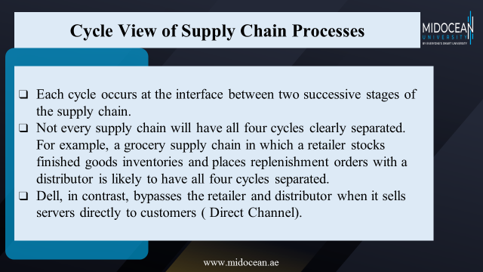

Slide 24

Cycle View of Supply Chain Processes
Customer
Customer Order Cycle
Retailer
Replenishment Cycle
Distributor
Manufacturing Cycle
Manufacturer
Procurement Cycle
Supplier
www.midocean.ae

Slide 25
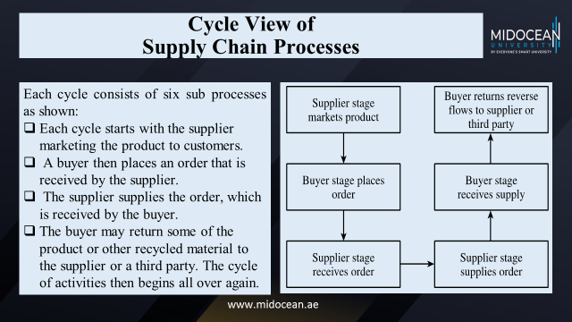

Slide 26
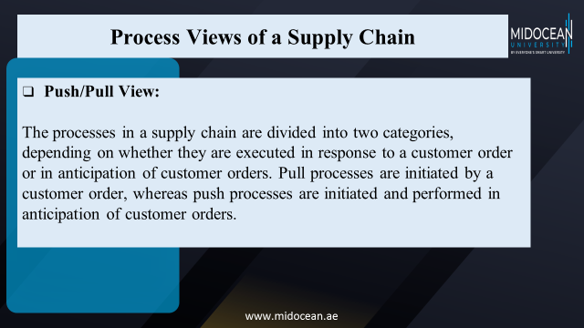

Slide 27
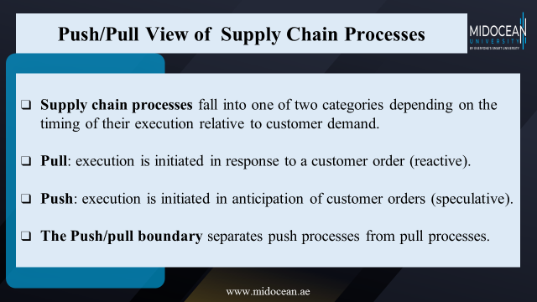

Slide 28
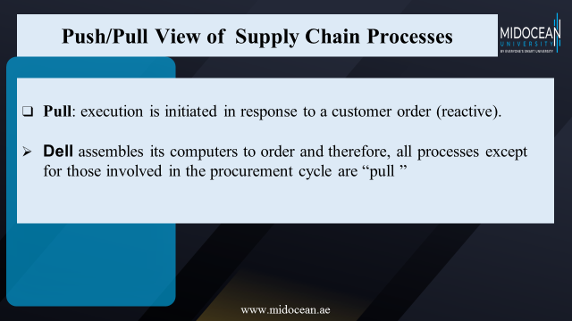

Slide 29
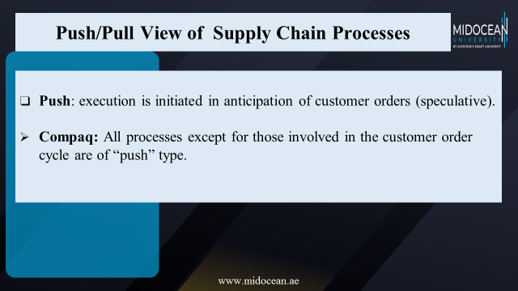

Slide 30
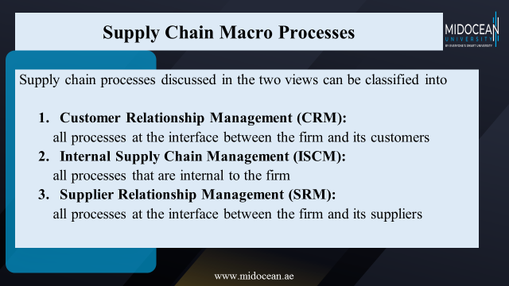

Slide 31
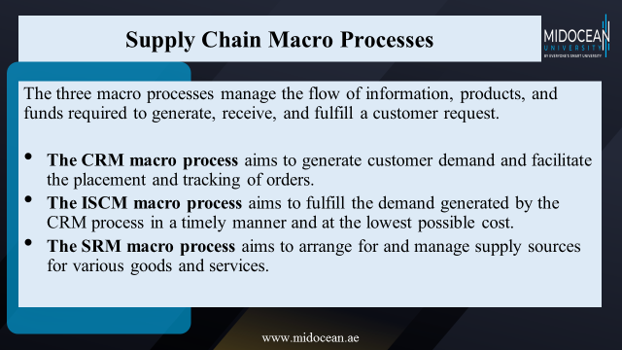

Slide 32
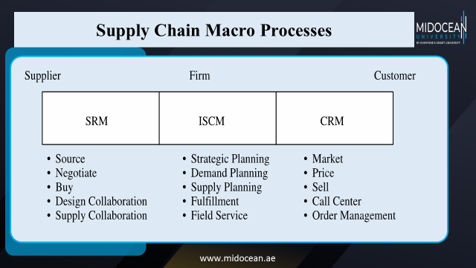

Slide 33

Summary of Learning Objectives
Discuss the goal of a supply chain and explain the impact of supply chain decisions on the success of a firm.
Identify the three key supply chain decision phases and explain the significance of each one.
Describe the cycle and push/pull views of a supply chain.
Classify the supply chain macro processes in a firm.
www.midocean.ae

Slide 34
Essential Reference
Supply Chain Management-
Strategy, Planning and Operation,
Sixth Edition,
Sunil Chopra and Peter Meindl,
Pearson Education Limited.
Chapter One.
www.midocean.ae

Slide 35



Thank You

