Slide 1

Digital Consumer Behavior
Prepared by Dr. Noha El Aswad
Lecture 4
MKT713_
Master of Digital Marketing

Slide 2


Chapter
01
Buying, Having, Being
CONSUMER BEHAVIOR, 10e
Michael R. Solomon

Slide 3
Chapter
01
Chapter Objectives
When you finish this chapter, you should understand why:
Consumers use products to help them define their identities in different settings.
Consumer behavior is a process.
Marketers need to understand the wants and needs of different consumer segments.

Slide 4
Chapter
01
Chapter Objectives (continued)
The Web is changing consumer behavior.
Consumer behavior relates to other issues in our lives.
Many different types of specialists study consumer behavior.
There are two major perspectives that seek to understand and study consumer behavior.

Slide 5
Chapter
01
Lecture objectives
When you finish this lecture, you should understand:
The rest of Learning Objective 2
Quick revision on Learning Objective 1&2
Types of Buying Decision Behavior
Adopter Categories for New Products
Types of buyers

Slide 6
Chapter
01
Quick revision of learning objective 1&2
Learning Objective 1
Consumers use products to help them define their identities
Consumers segmented by demographics and psychographics
Consumers understood in part based on their consumption communities and reference groups.
The concept of consumption community

Slide 7
Chapter
01
Quick revision of learning objective 1&2
Learning Objective 1
Consumer identity theory
Brands target consumers using market segmentation strategies.
Consumers may choose brands that match with their own identities.
Consumer behavior: the study of the processes involved when individuals or groups select, purchase, use, or dispose of products, services, ideas, or experiences to satisfy needs and desires.

Slide 8
Chapter
01
Quick revision of learning objective 1&2
Learning Objective 2
Consumer behavior is a process.
Consumer behavior is an ongoing process
The exchange
Expanded view

Slide 9
Chapter
01
Quick revision of learning objective 1&2
Learning Objective 2
A consumer
The purchaser and the user of a product
Stages in the Consumption Process
Consumers’ Impact on Marketing Strategy 1/3
Consumers Are Different! How We Divide them Up.1/2
Factors and trends shaping consumer behavior

Slide 10
Chapter
01
Types of Buying Decision Behavior
Complex buying behavior
Habitual buying behavior
Variety-seeking buying behavior
Dissonance-reducing buying behavior

Slide 11
Chapter
01
Types of Buying Decision Behavior
1-Complex buying behavior ( buying a mobile or laptop) 1/3
Consumer buying behavior in situations characterized by high consumer involvement in a purchase and significant perceived differences among brands.

Slide 12
Chapter
01
Types of Buying Decision Behavior
1-Complex buying behavior ( buying a mobile or laptop) 2/3
Consumer may be highly involved when the product is expensive, risky, and purchase infrequently.
Typically, the consumer has much to learn about the product category.

Slide 13
Chapter
01
Types of Buying Decision Behavior
1-Complex buying behavior ( buying a mobile or laptop) 3/3
This buyer will pass through a learning process:
  Developing beliefs about the product
  Attitudes
  Making a thoughtful purchase choice
Marketers must understand the behavior of high-involvement consumer.

Slide 14
Chapter
01
Types of Buying Decision Behavior
2-Dissonance-Reducing buying behavior (diamond ring) 1/3
Consumer buying behavior in situation characterized by high consumer involvement in a purchase but few perceived differences among brands.

Slide 15
Chapter
01
Types of Buying Decision Behavior
2-Dissonance-Reducing buying behavior (diamond ring) 2/3
Consumer are high involved with an expensive, risky, and infrequent purchase, but see little differences among brands.
Buyers may shop around, relatively quickly, and respond primarily to what is available or to a good price.

Slide 16
Chapter
01
Types of Buying Decision Behavior
2-Dissonance-Reducing buying behavior (diamond ring) 3/3
After purchase, consumer might experience post-purchase dissonance (after sale discomfort) when they notice certain disadvantages of the purchased brand or hear favorable things about brands not purchased.
To counter such dissonance, the marketer’s should provide evidence and support to help consumer feel good about their brand choices.

Slide 17
Chapter
01
Types of Buying Decision Behavior
3-Habitual buying behavior (loaf of bread)1/2
Consumer buying behavior in situation characterized by low consumer involvement in a purchase and few perceived differences among brands.

Slide 18
Chapter
01
Types of Buying Decision Behavior
3-Habitual buying behavior (loaf of bread)2/2
Consumer appear to have low involvement with most low cost, frequently purchased products.
Consumer do not search extensively for information about brands, they passively receive information as they watch television, ad repetition creates brand familiarity.

Slide 19
Chapter
01
Types of Buying Decision Behavior
4-Variety-seeking buying behavior (buy a cookie)1/2
Consumer buying behavior in situation characterized by low consumer involvement in a purchase but significance differences among brands.

Slide 20
Chapter
01
Types of Buying Decision Behavior
4-Variety-seeking buying behavior (buy a cookie)2/2
In such a cases, consumers often do a lot of brand switching, simply to try something different.
Brand switching occurs for the sake of variety rather than because of dissatisfaction.

Slide 21
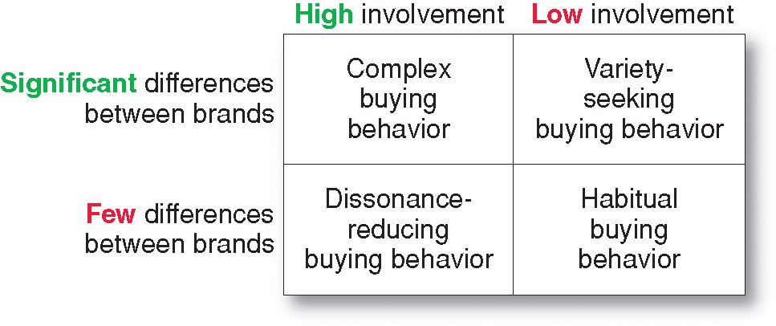
Chapter
01
Types of Buying Decision Behavior
Four Types of Buying Behavior
This figure shows the Four Types of Consumer Buying Behavior based on the degree of buyer involvement and the degree of differences among brands

Slide 22
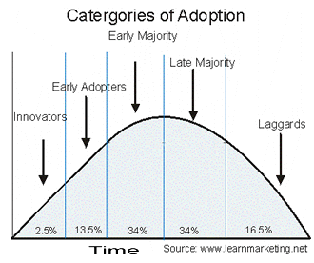
Chapter
01
Adopter Categories for New Products 1/8

Slide 23
Chapter
01
Adopter Categories for New Products 2/8
Consumers are divided into 5 adopter categories based on their behavioral patterns and values. The 5 adopter categories, in order of their speed of uptake, are:
1. Innovators
2. Early Adopters
3. Early Majority
4. Late Majority
5. Laggards

Slide 24
Chapter
01
Adopter Categories for New Products 3/8
Customer adoption patterns are important to understanding how to market new product for adoption. Without a clear understanding of what each type of adopter values it can be difficult, if not impossible to target them through marketing.

Slide 25
Chapter
01
Adopter Categories for New Products 4/8
1-Innovators
Innovators are the first customers to try a new product. They are, by nature, risk takers and are excited by the possibilities of new ideas and new ways of doing things.
It’s also important to realize that innovators are comfortable with the risks that they take. They are aware that some products that they adopt will not deliver the benefits that are promised or will fail to win mass market appeal.

Slide 26
Chapter
01
Adopter Categories for New Products 5/8
1-Innovators
Innovators are the first customers to try a new product. They are, by nature, risk takers and are excited by the possibilities of new ideas and new ways of doing things.
It’s also important to realize that innovators are comfortable with the risks that they take. They are aware that some products that they adopt will not deliver the benefits that are promised or will fail to win mass market appeal.

Slide 27
Chapter
01
Adopter Categories for New Products 5/8
2-Early Adopters
Early adopters are the second phase of product purchasers following innovators. These tend to be the most influential people within any market space and they will often have a degree of “thought leadership” for other potential adopters. They may be very active in social media and often create reviews and other materials around new products that they strongly like or dislike.

Slide 28
Chapter
01
Adopter Categories for New Products 6/8
3-Early Majority
As a product begins to have mass market appeal, the next class of adopter to arrive is the early majority. This class of adopter is reasonably risk averse and wants to be sure that their, often more limited, resources are spent wisely on products.

Slide 29
Chapter
01
Adopter Categories for New Products 7/8
4-Late Majority
The late majority tend to put their resources towards tried and tested solutions only and are risk-averse.

Slide 30
Chapter
01
Adopter Categories for New Products 8/8
5-Laggards
Laggards are last to arrive at the adoption party and their arrival is typically a sign that a product is entering decline. Laggards value traditional methods of doing things and highly averse to change and risk.

Slide 31
Chapter
01
Types of buyers
The Socializer
The Director
The Relator
The Thinker

Slide 32
Chapter
01
Types of buyers
The 4 Buyer Types are a way of profiling your entire audience and identifying how your warmed-up leads like to be sold to based on their internal buying psychology.

Slide 33
Chapter
01
Types of buyers
You can think of buying psychology as an invisible checklist of wants, needs, and proof your reader needs to see written out on the page before feeling confident enough to pull out their credit card and make a purchase.

Slide 34
Chapter
01
Types of buyers
1) The Socializer
The Socializer loves getting to know the personality behind the business. When it comes to the know/like/trust factor, they’re all about the LIKE. They run their most important decisions by their peer group because their opinions are the ones that matter to them most.
The brands and businesses they follow all carry a similar vibe or aesthetic. They like feeling like a part of a brand family and being a part of a community.

Slide 35
Chapter
01
Types of buyers
Attract The Socializer:
Tell them your brand story
Let your brand voice demonstrate your personality.
Speak to them directly so it feels like you’re building a rapport or peer relationship.
Use imagery and brand photography to illustrate your story.
Tell them how your product or service will elevate their own brand or business as a result.

Slide 36
Chapter
01
Types of buyers
2) The Director
The Director is a big picture thinker who is able to consume information quickly. they’re likely to make their decision while reading the top half of your sales or services page.
Goal-oriented and competitive, they're looking for partners and solutions that will help them overcome a challenge with the least resistance or the most certainty possible.

Slide 37
Chapter
01
Types of buyers
Attract The Director:
Keep your copy shorter at the top of the page and keep paragraphs to 2-3 sentences in length.
Focus your headers on the “What” not the “Why”.
Use infographics or pricing tables to convey lots of information quickly.
Present data, facts, or quantitative testimonials (“I saw 200% growth…) to demonstrate your expertise or ROI.

Slide 38
Chapter
01
Types of buyers
3) The Relator
The Relator is highly empathetic, highly intuitive, and doesn’t like to be put into a box. They focus their attention on the emotional costs of their problems. They need to feel assured that a brand or business understands their problems and is focused on helping them find a unique solution that will improve their day-to-day life.
When it comes to the know/like/trust factor, they’re all about TRUST. They’re looking for high-touch solutions that will solve both a business and a lifestyle problem.

Slide 39
Chapter
01
Types of buyers
Attract The Relator:
Offers areas of flexibility: payment plans, optional add-ons, or customizable features.
Use call-out sections to make it clear you feel what they feel — you understand their problems and know the way out.
Use quality-of-life testimonials (Ex: "I was finally able to release myself from FOMO and build a business that matched my values.)
Use case studies to paint the before-and-after picture and provide social proof.
Use images that focus on human faces (particularly yours) to build trust.
Use statements, rather than questions in your headers.
Speak to how your product or service will affect The Relator’s outer circle (their employees, partners, and family.)

Slide 40
Chapter
01
Types of buyers
4-The Thinker
The Thinker needs to know every single detail about a product or service before making a commitment. They have perfectionist tendencies. They tend to follow a very logical thought process, weighing the pros and cons of every situation before handing over their credit card details or reaching out for a consult.
When it comes to the know/like/trust factor they are all about TRUST. They need to be assured that moving forward is the absolute right decision because you are the absolute authority. Thinkers will read every word of a long-form sales page...and the FAQs...and the fine print, including the returns and privacy policy. When it comes to making a decision, they don't like feeling rushed or pressured. They need plenty of time to consider all the facts before making a choice they can feel confident about.

Slide 41
Chapter
01
Types of buyers
Attract The Thinker:
Lead with a crystal clear 1-liner introducing exactly what the product or offer is — no poetic slogans, please.
Dedicate an entire space to “the marketing receipt” or a bulleted list of all the features they will walk away with or take part in.
Organize your copy logically – each section should help this person connect the dots from The What to The Why to The So What? to The Proof of results.
Pair copy and testimonials logically – when making an emotional appeal, pull in an emotional testimonial to support your claim. When you’re trying to prove to your reader that your offer’s legit, use a qualitative testimonial.

Slide 42
Chapter
01
Lecture Objectives
We have been learning:-
Quick revision of learning objective 1&2
Types of Buying Decision Behavior
Adopter Categories for New Products
Types of buyers

Slide 43


