Slide 1


Slide 2


Slide 3
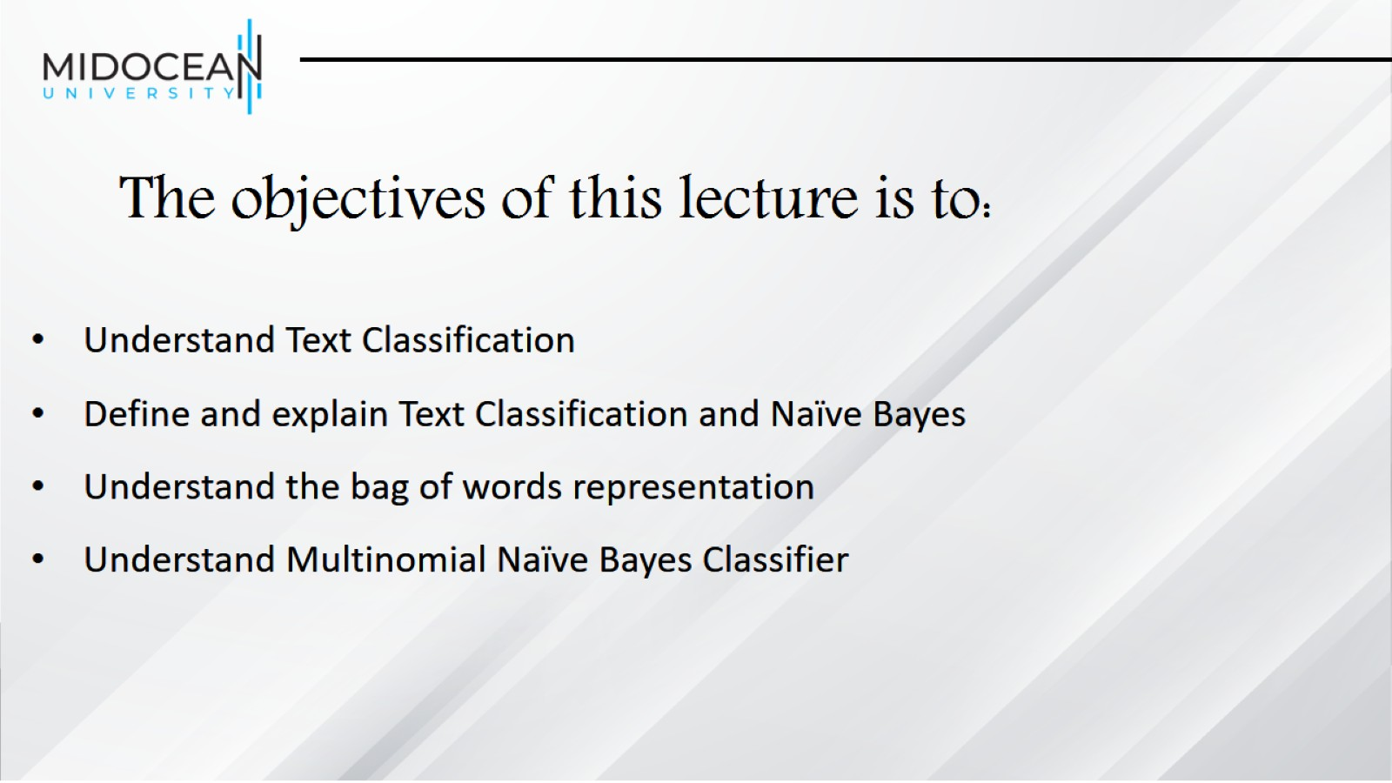
The objectives of this lecture is to:

Slide 4
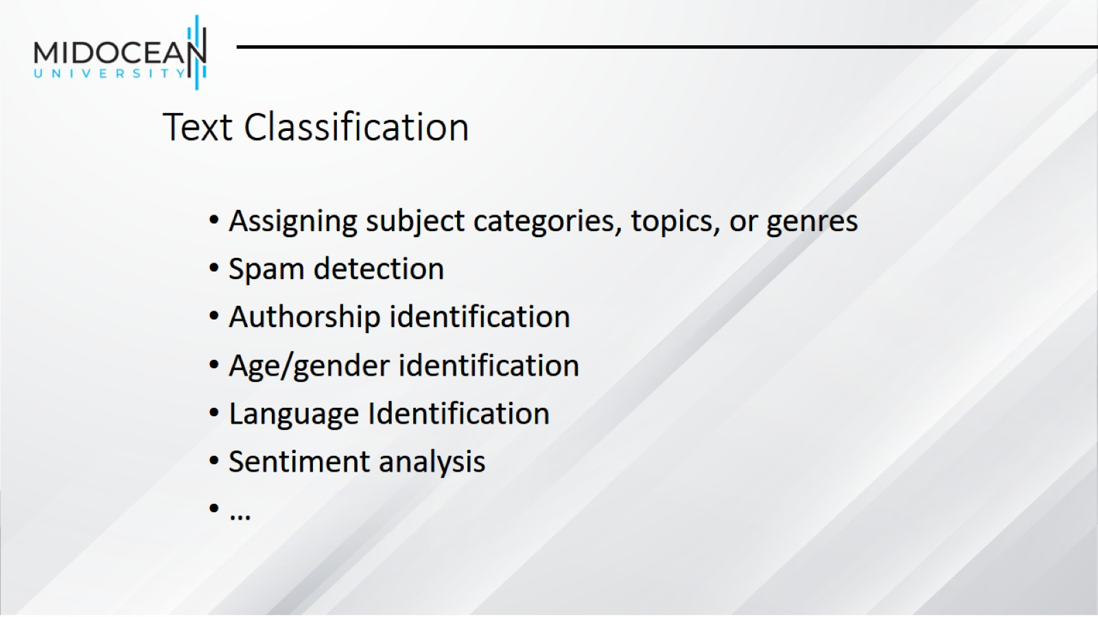
Text Classification

Slide 5
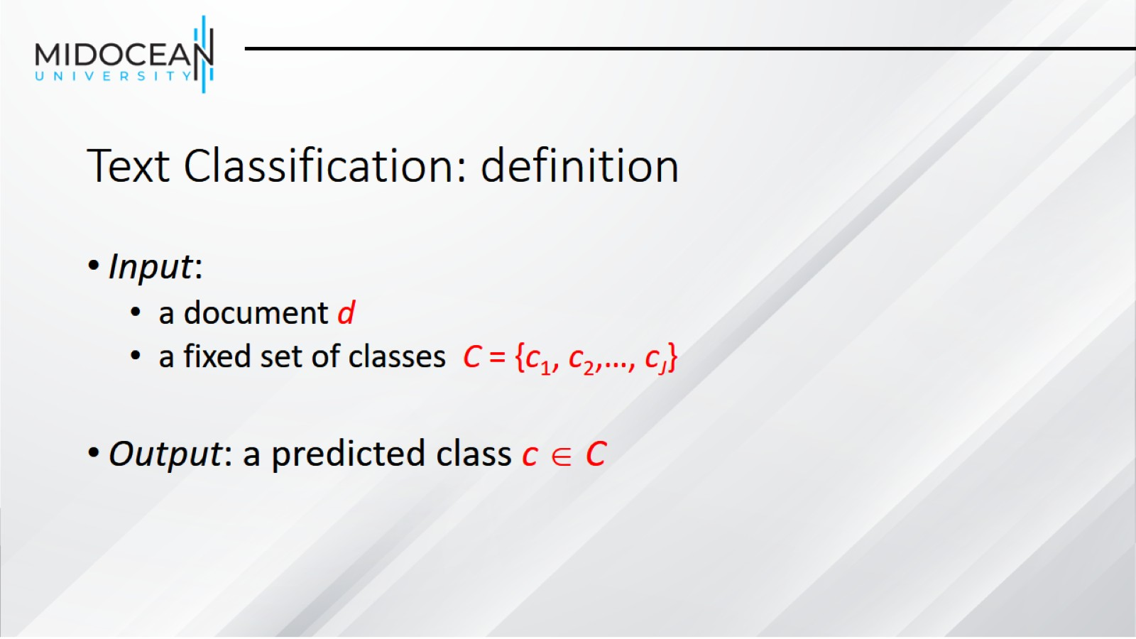
Text Classification: definition

Slide 6
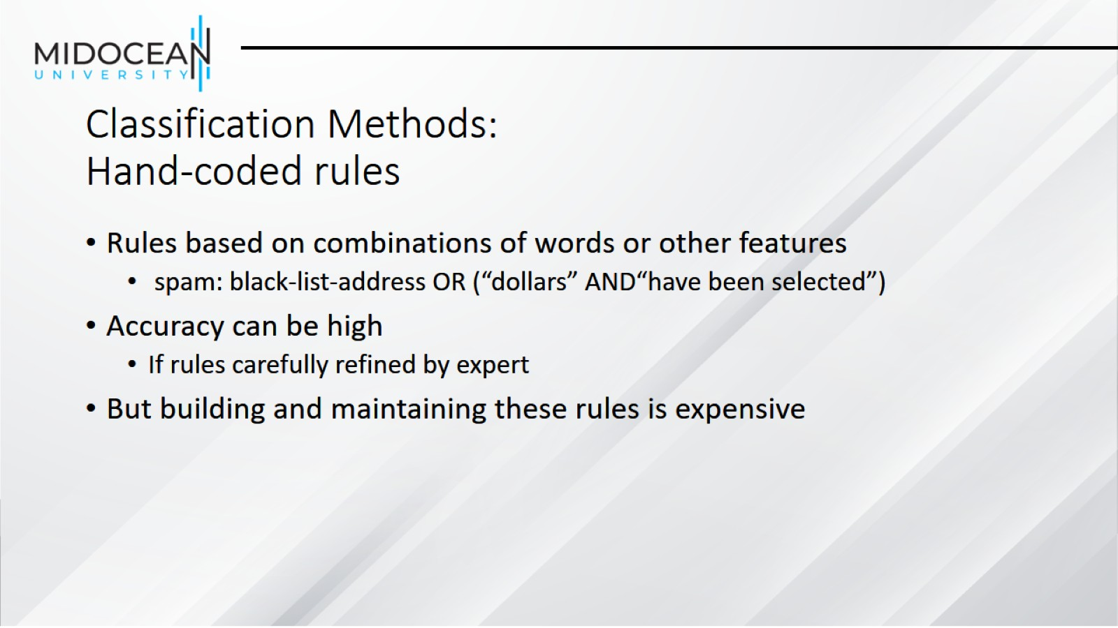
Classification Methods:
Hand-coded rules

Slide 7
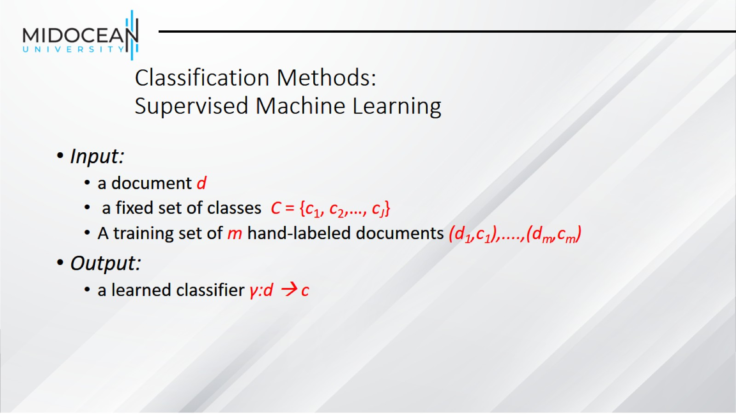
Classification Methods:
Supervised Machine Learning

Slide 8
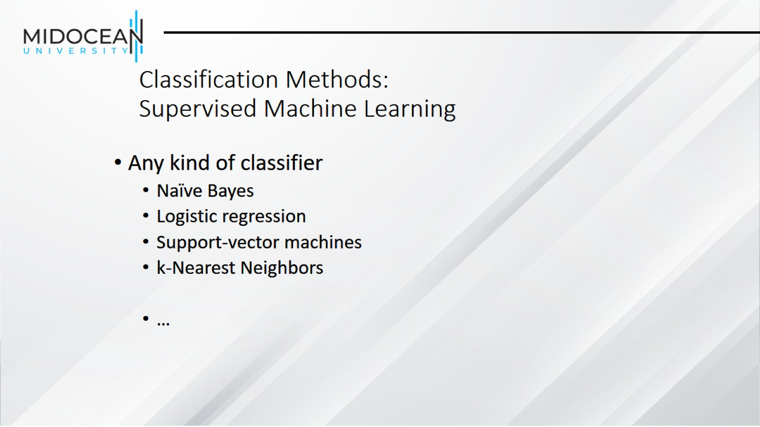
Classification Methods:
Supervised Machine Learning

Slide 9
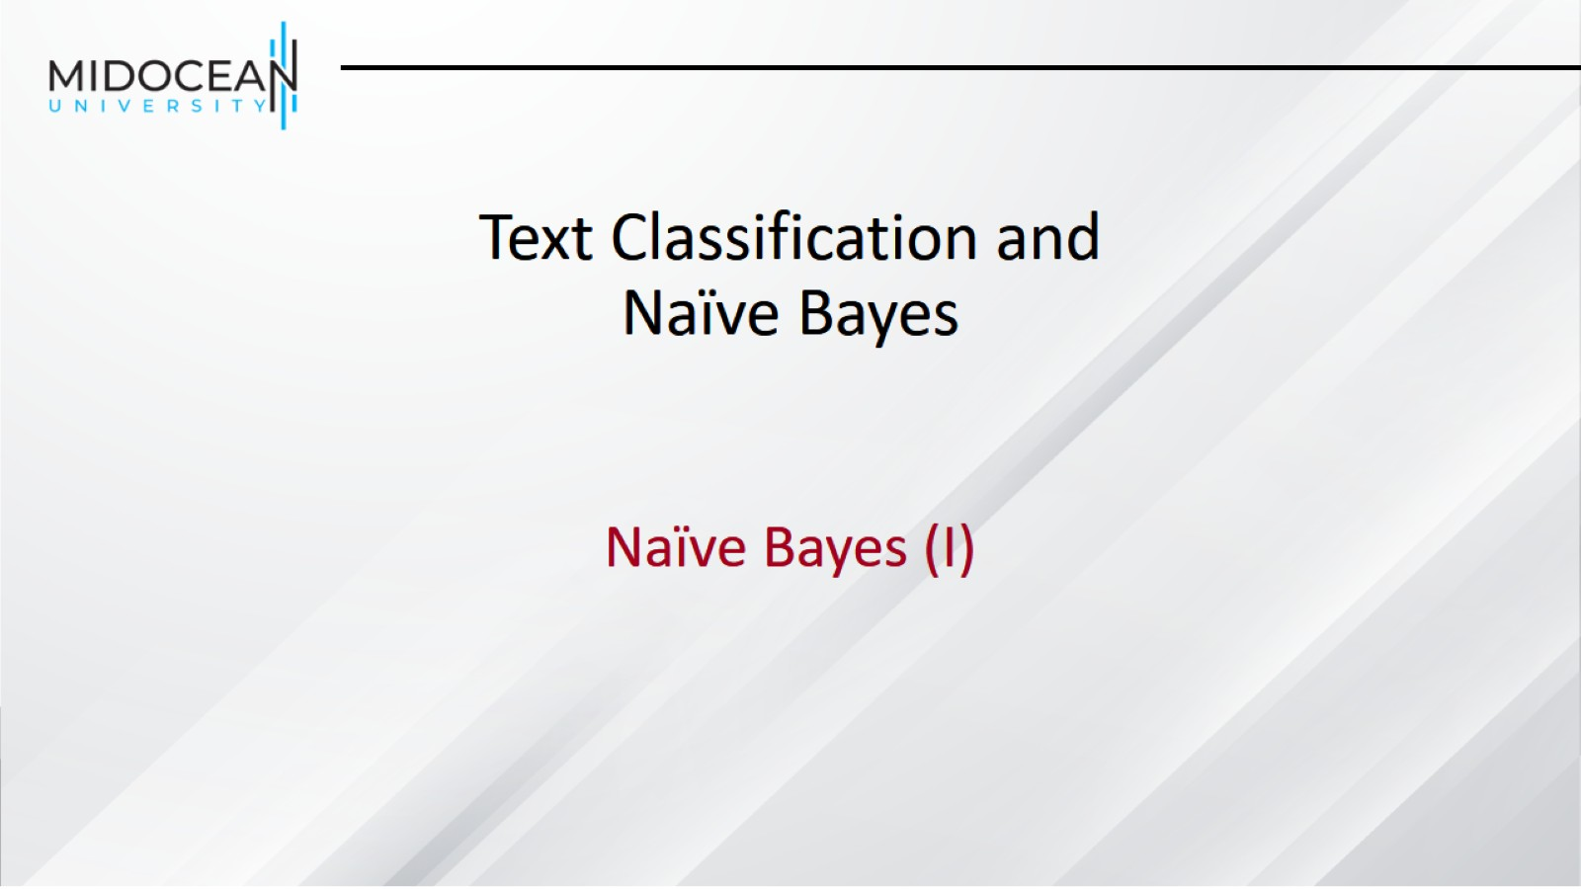
Text Classification and Naïve Bayes

Slide 10
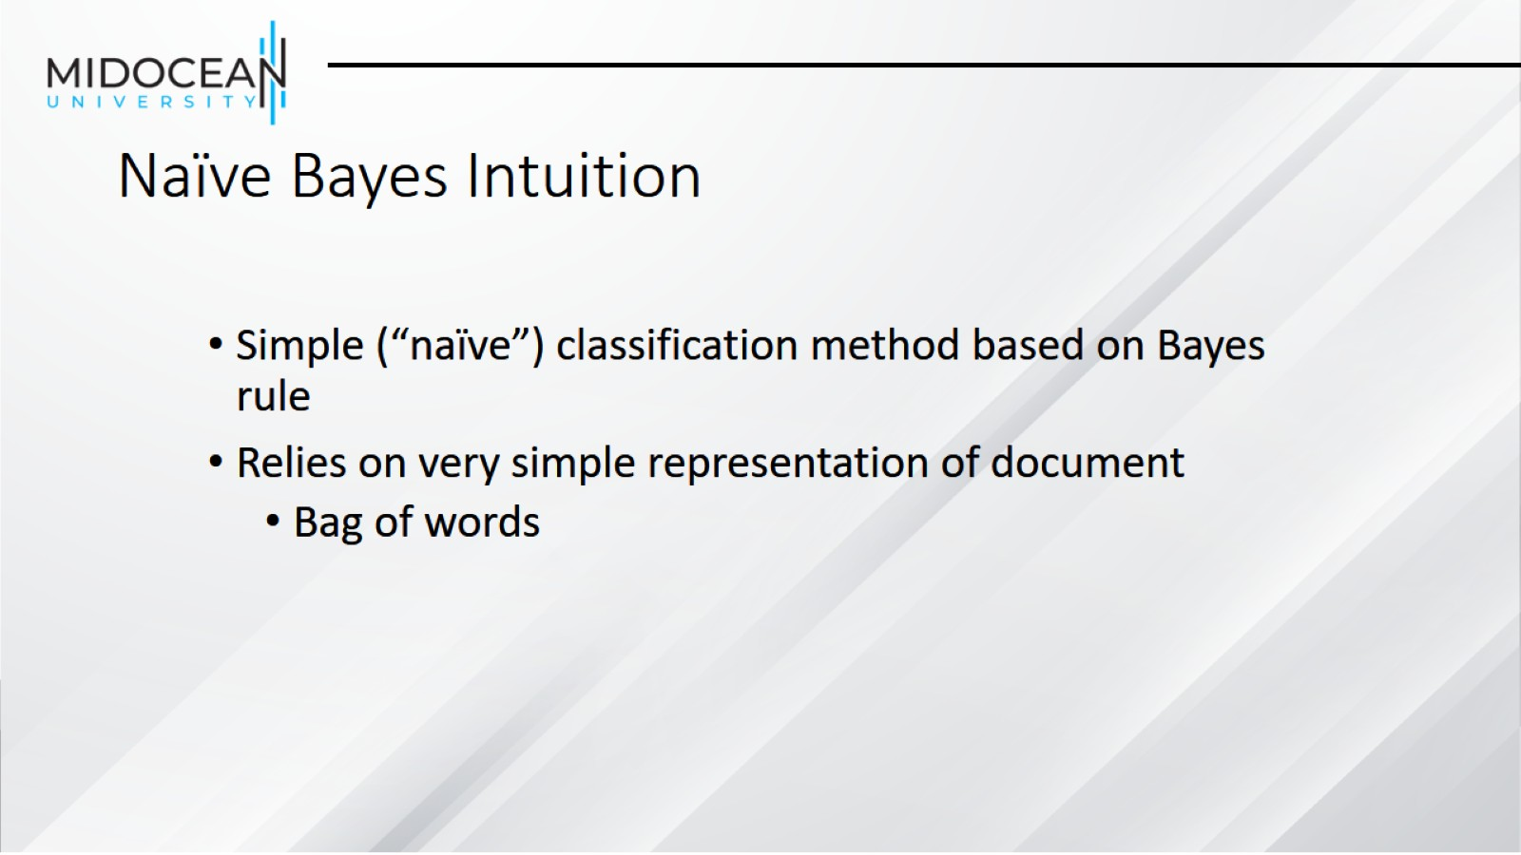
Naïve Bayes Intuition

Slide 11
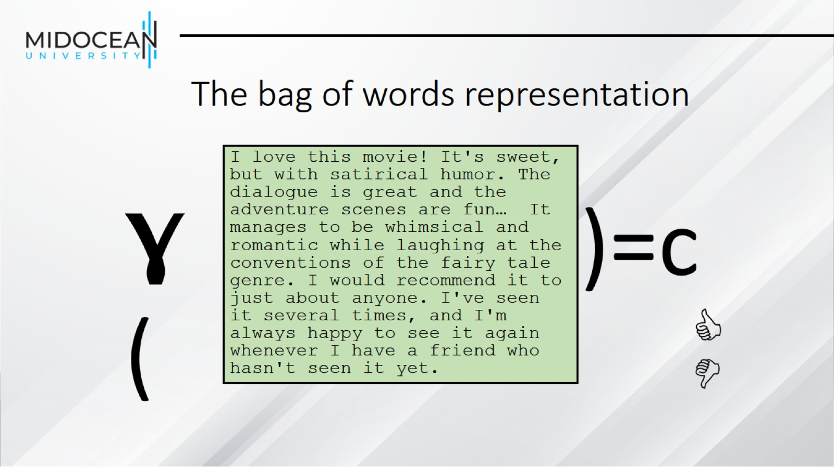
The bag of words representation

Slide 12
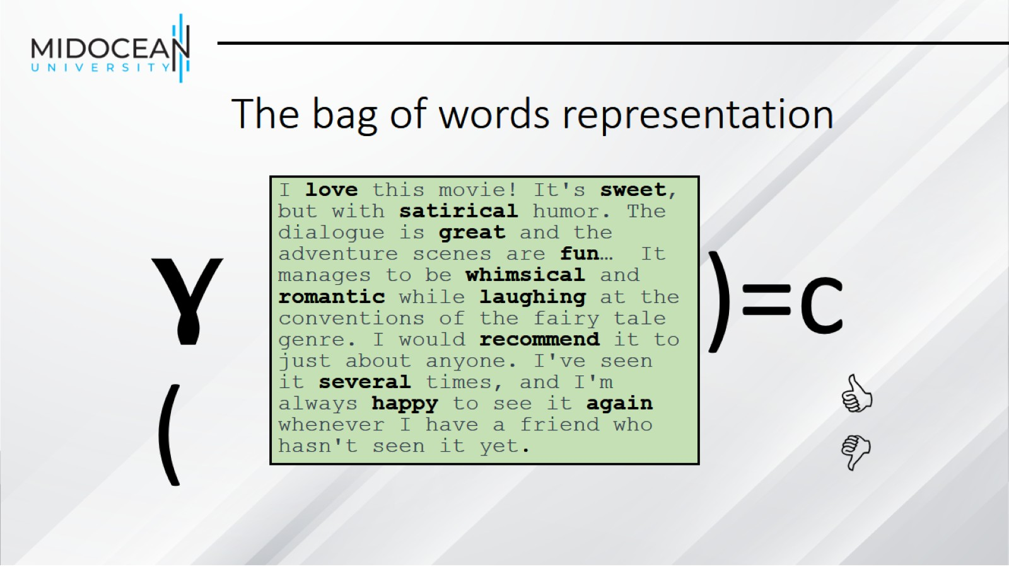
The bag of words representation

Slide 13
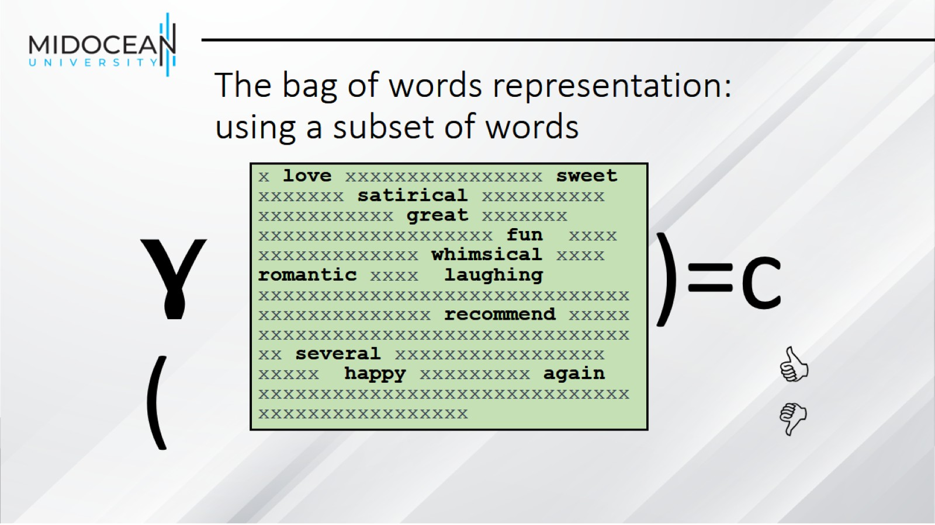
The bag of words representation: using a subset of words

Slide 14
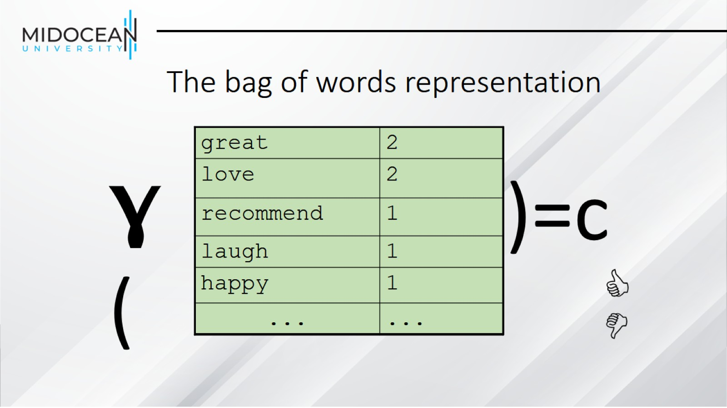
The bag of words representation

Slide 15
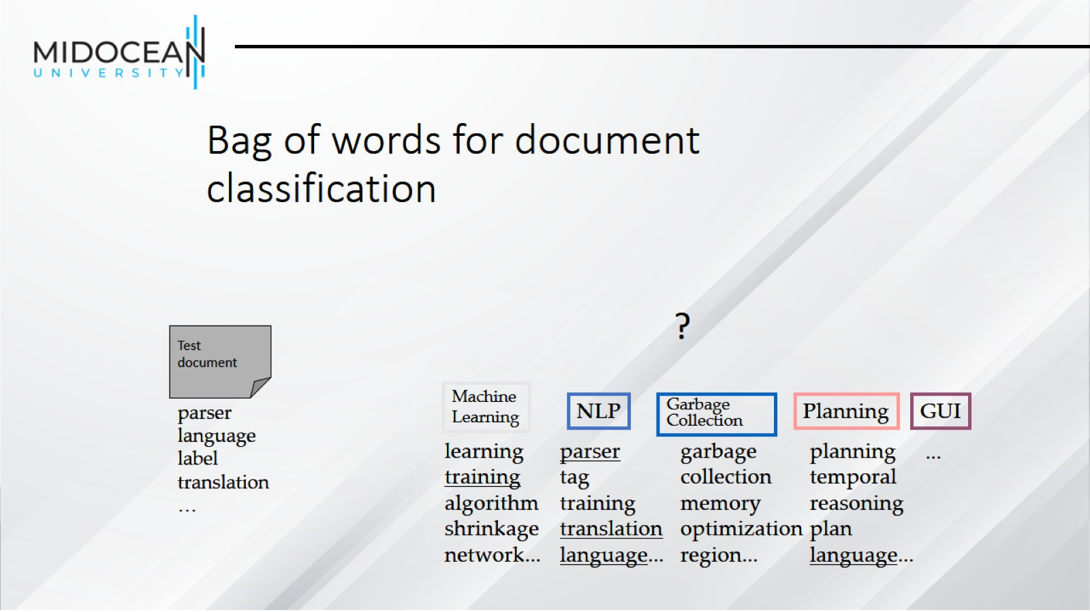
Bag of words for document classification

Slide 16
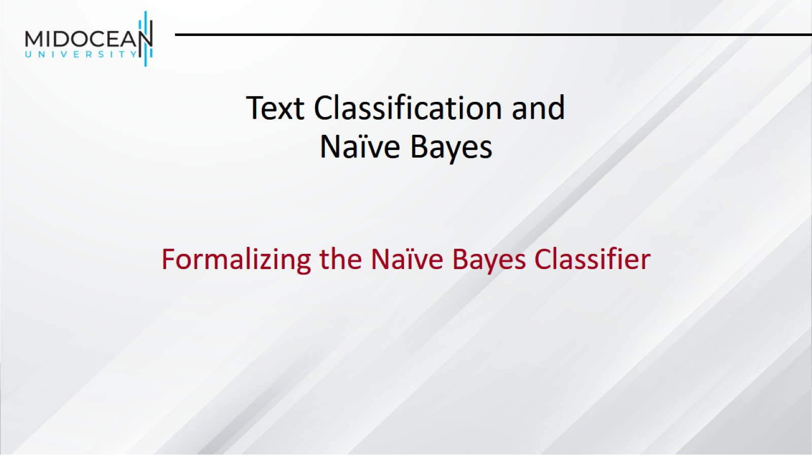
Text Classification and Naïve Bayes

Slide 17
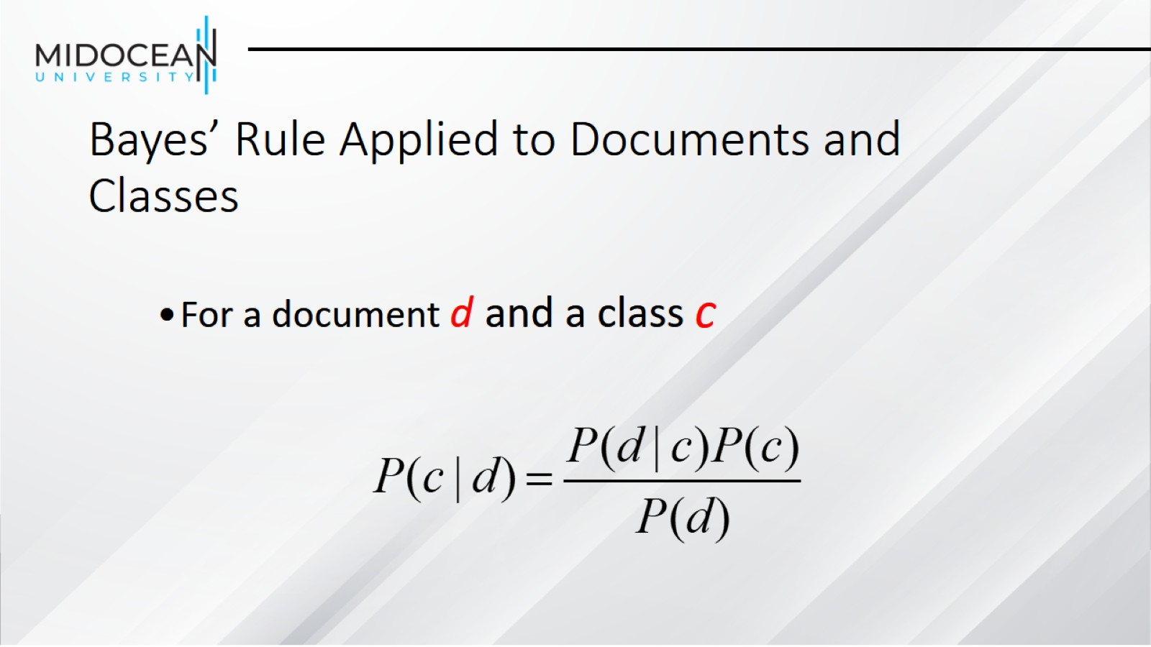
Bayes’ Rule Applied to Documents and Classes

Slide 18
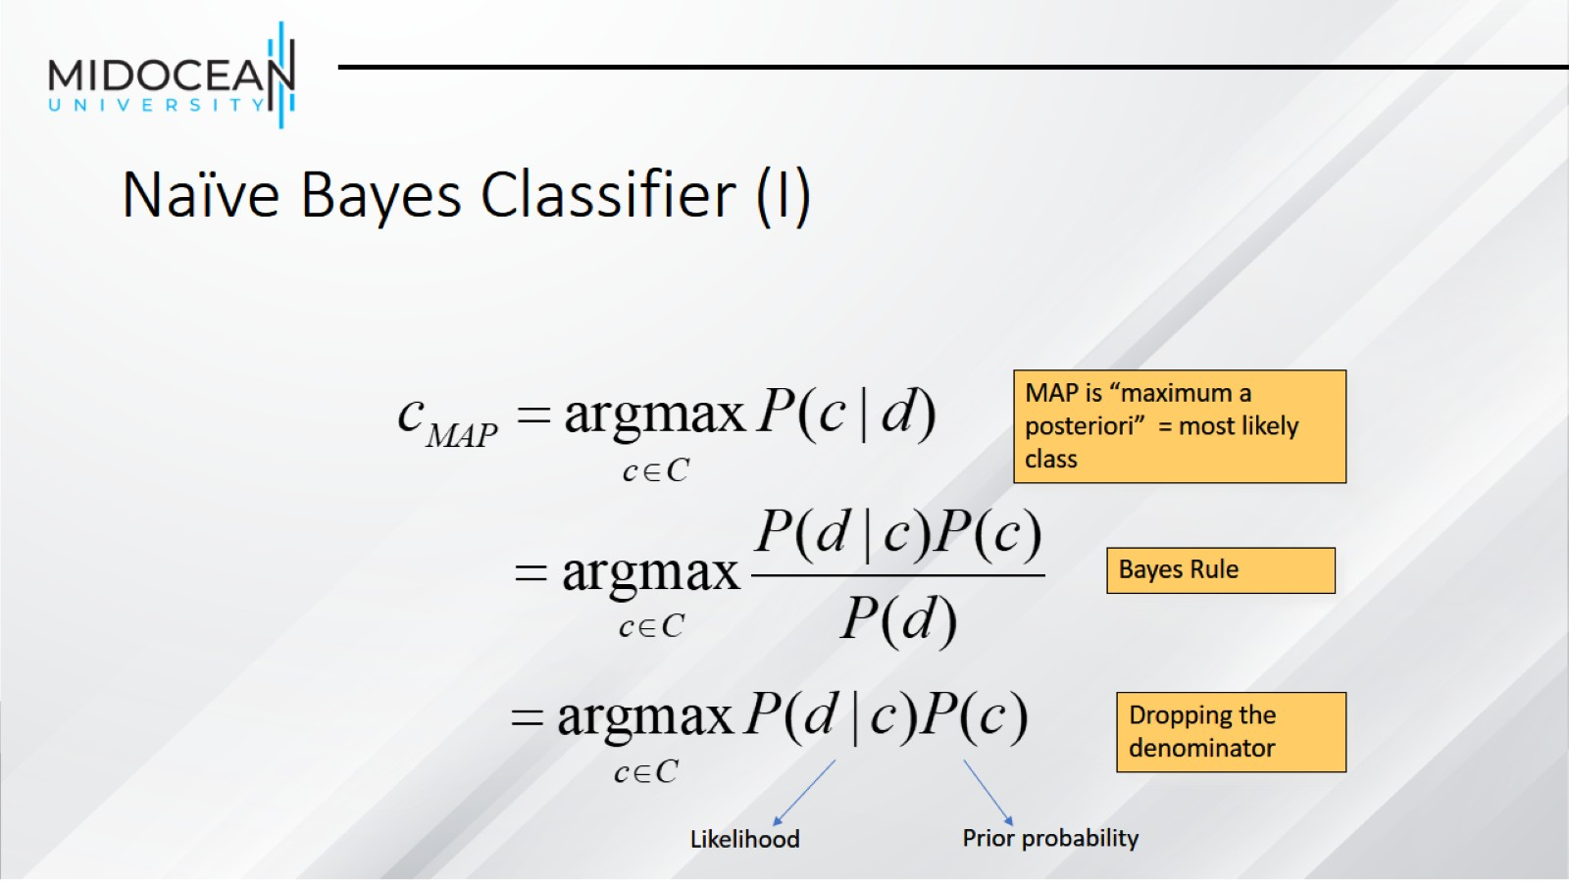
Naïve Bayes Classifier (I)

Slide 19
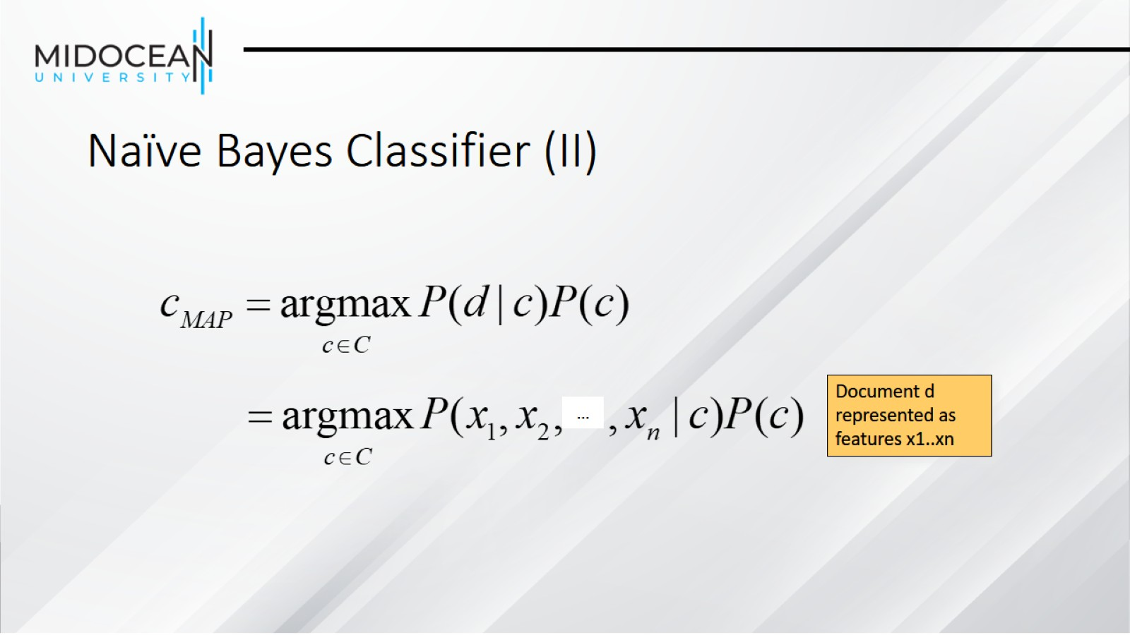
Naïve Bayes Classifier (II)

Slide 20
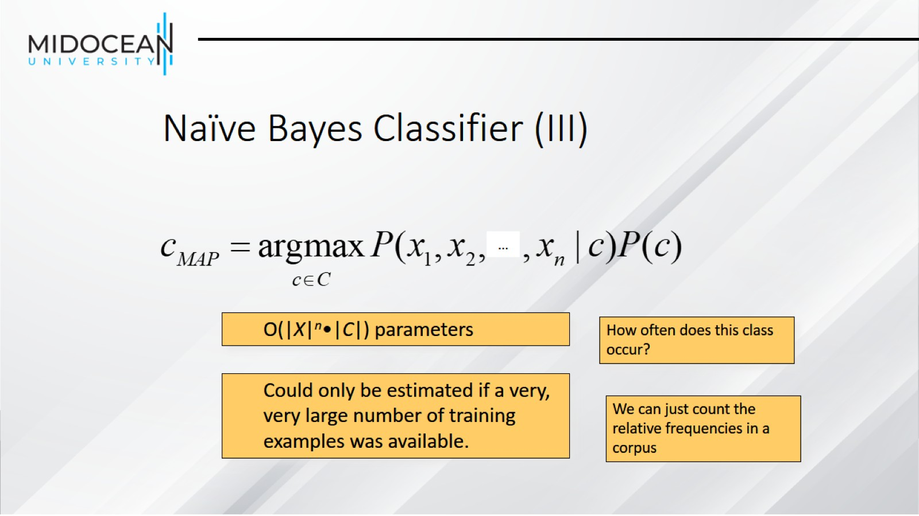
Naïve Bayes Classifier (III)

Slide 21
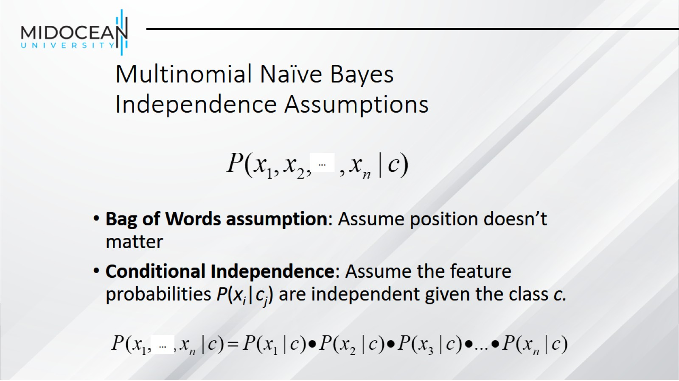
Multinomial Naïve Bayes Independence Assumptions

Slide 22
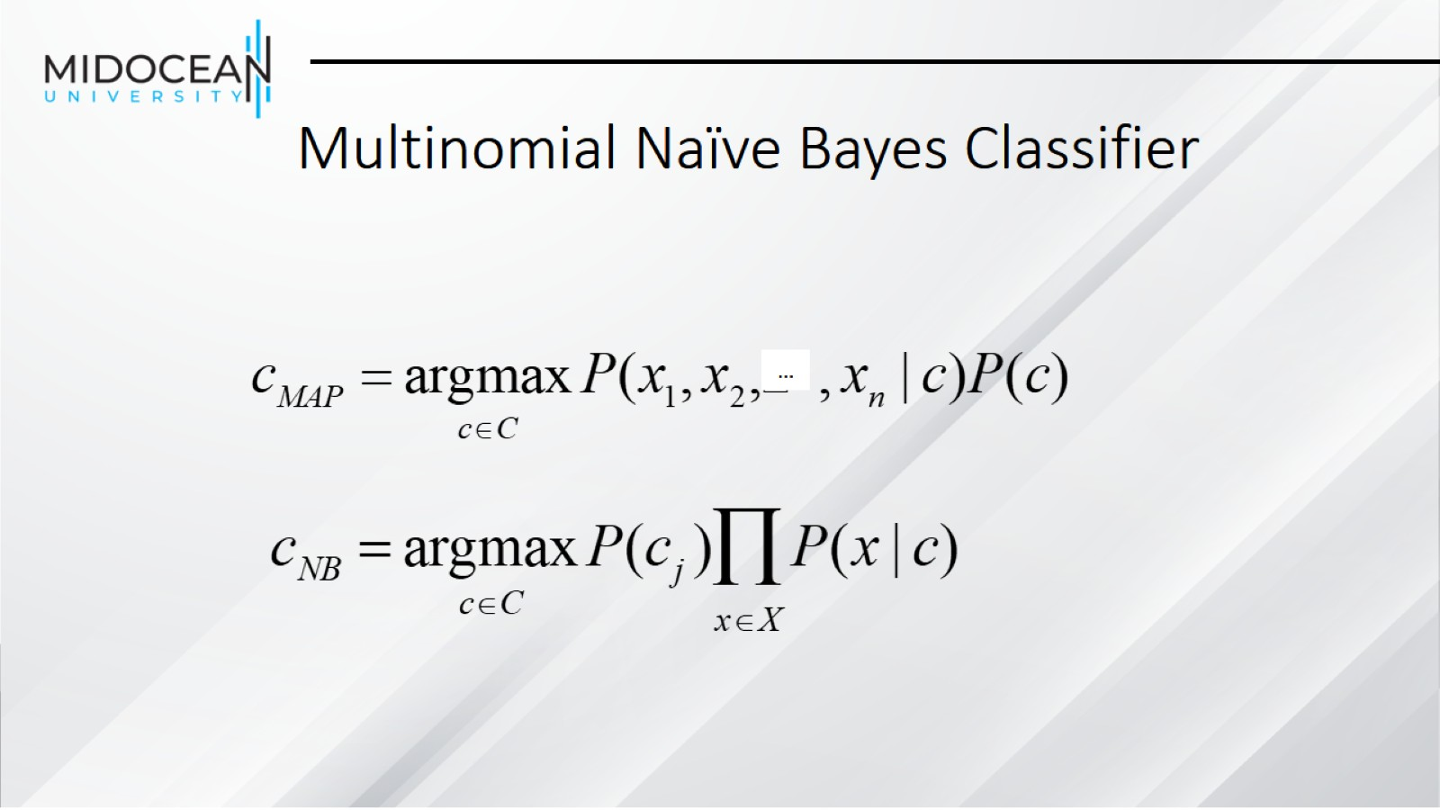
Multinomial Naïve Bayes Classifier

Slide 23
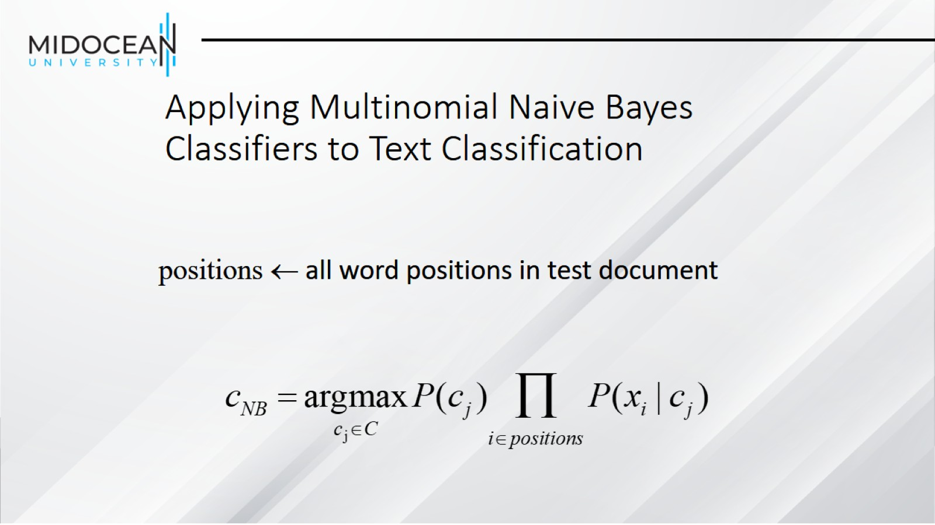
Applying Multinomial Naive Bayes Classifiers to Text Classification

Slide 24
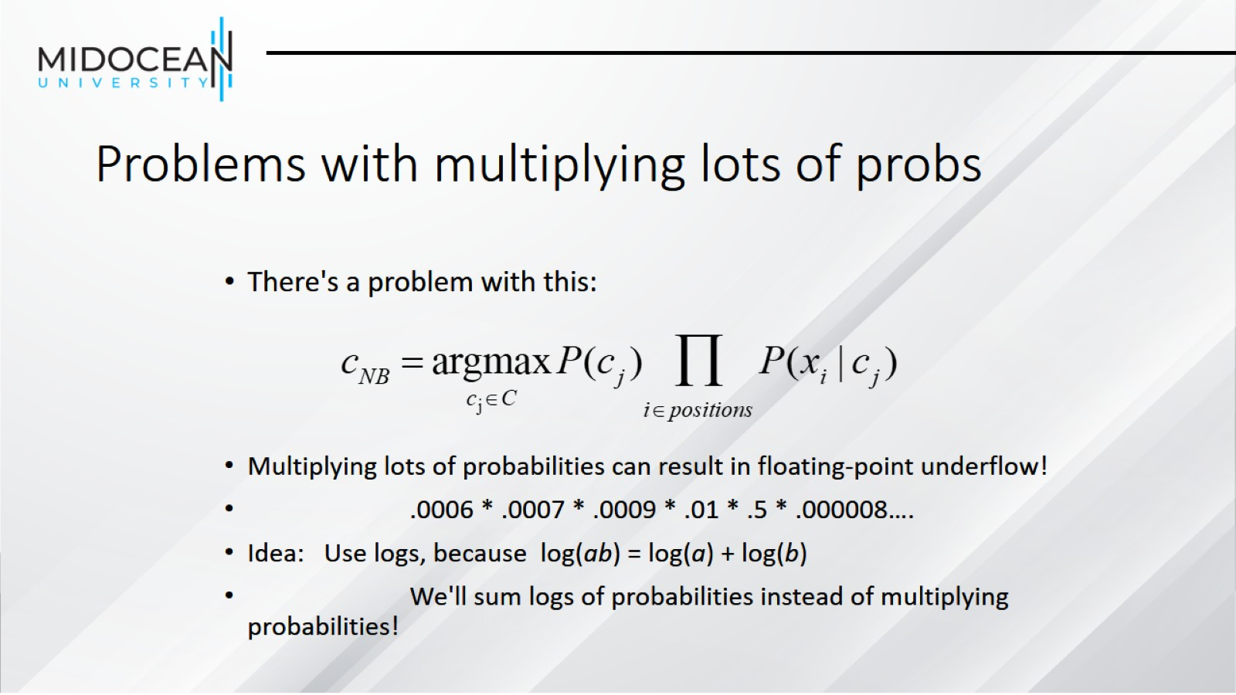
Problems with multiplying lots of probs

Slide 25
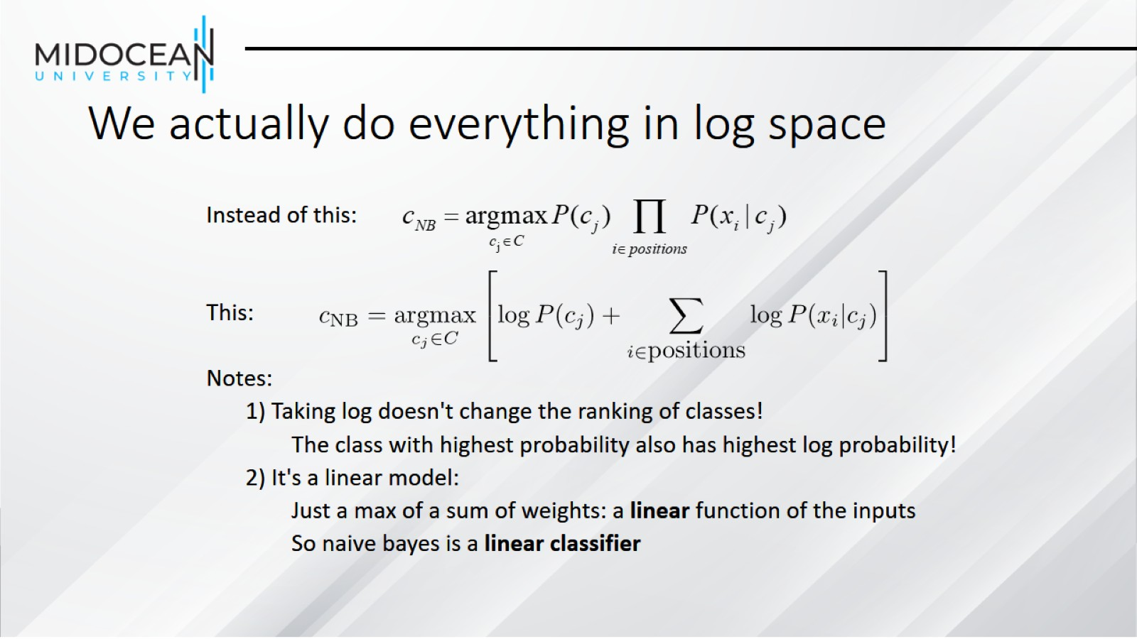
We actually do everything in log space

Slide 26
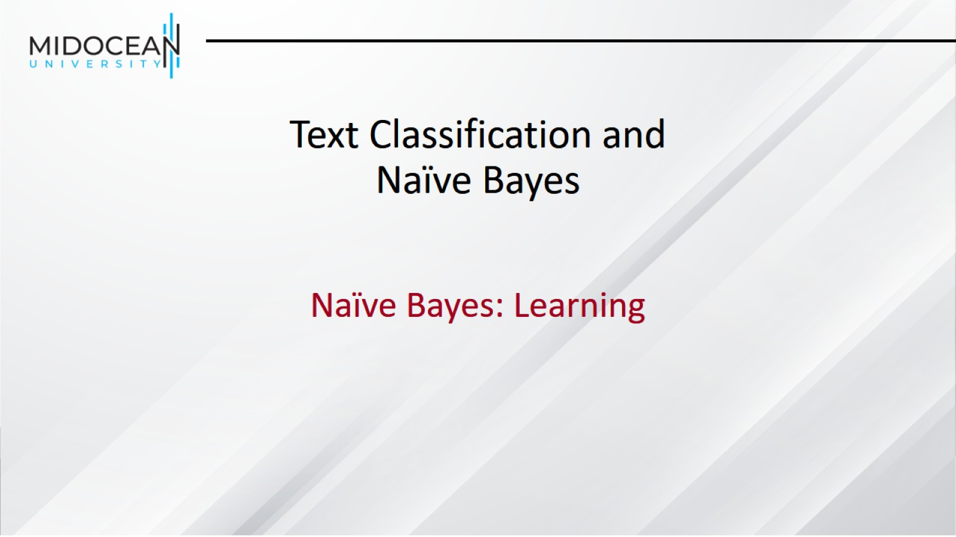
Text Classification and Naïve Bayes

Slide 27
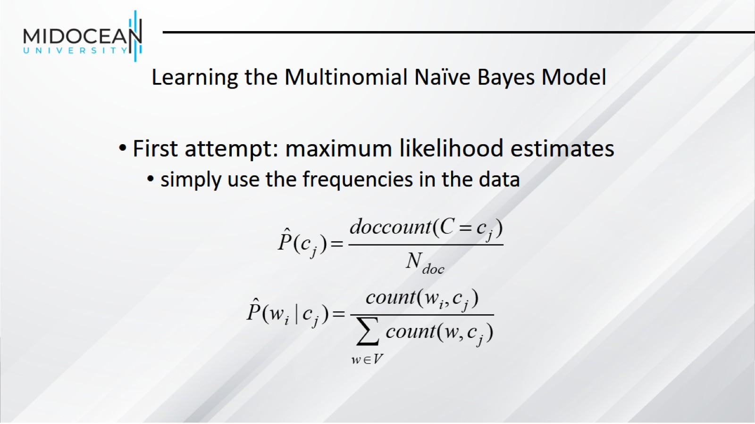
Learning the Multinomial Naïve Bayes Model

Slide 28
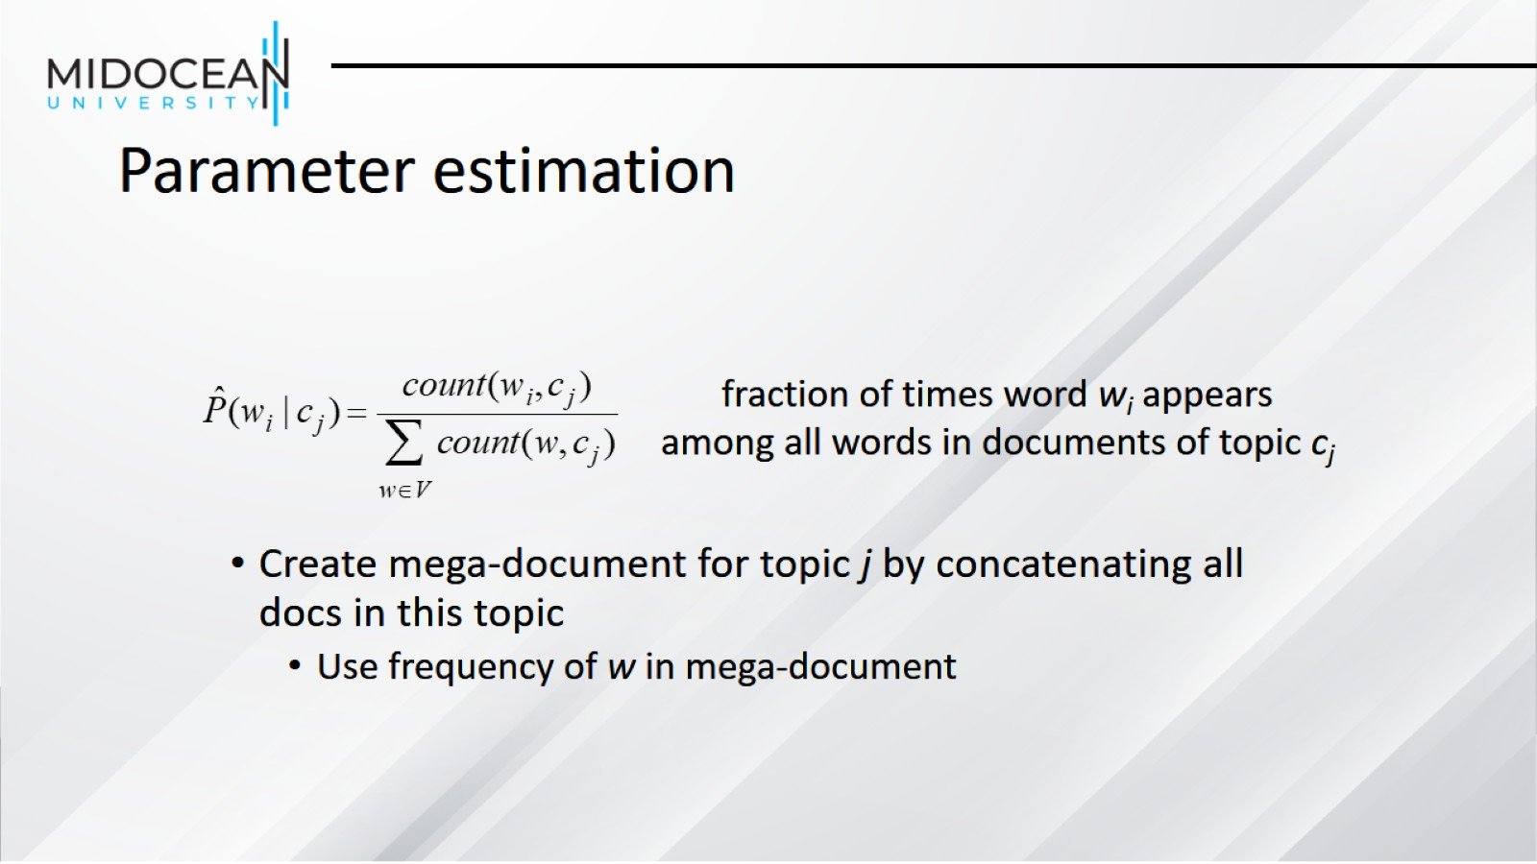
Parameter estimation

Slide 29
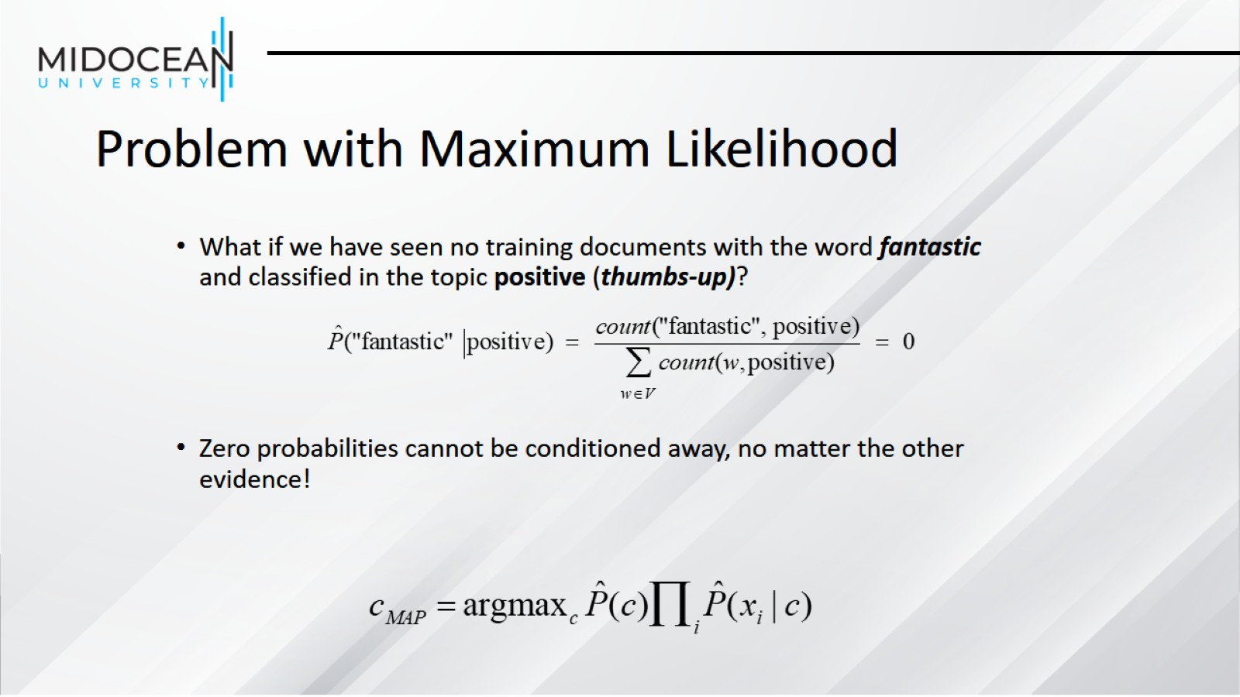
Problem with Maximum Likelihood

Slide 30
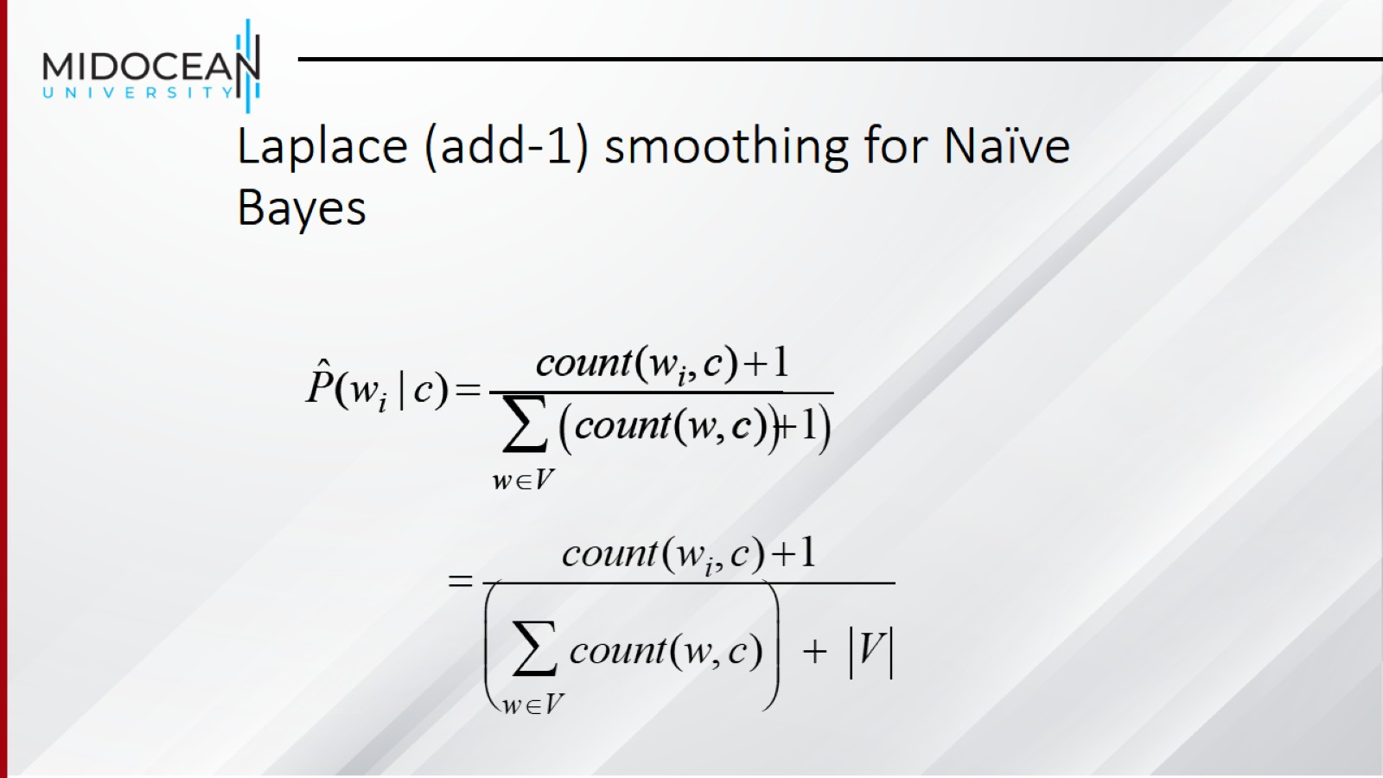
Laplace (add-1) smoothing for Naïve Bayes

Slide 31
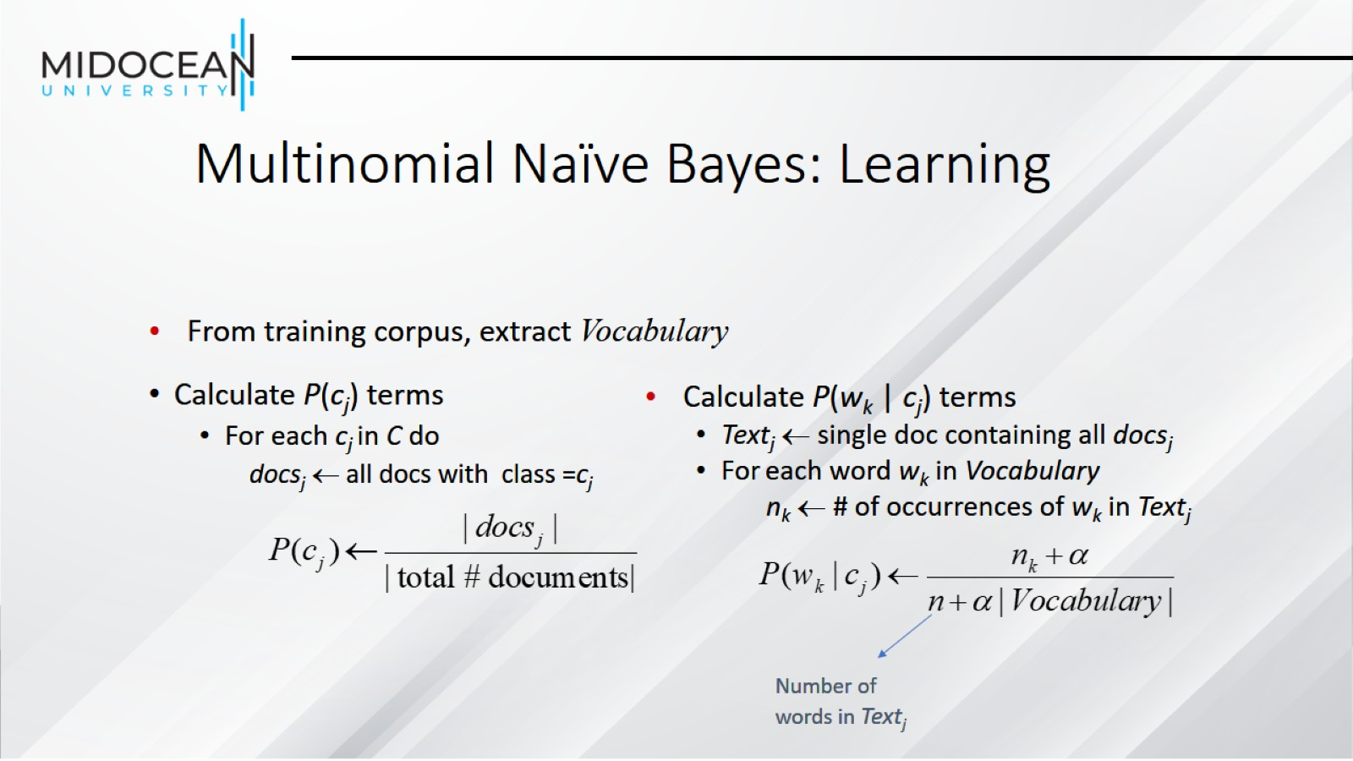
Multinomial Naïve Bayes: Learning

Slide 32
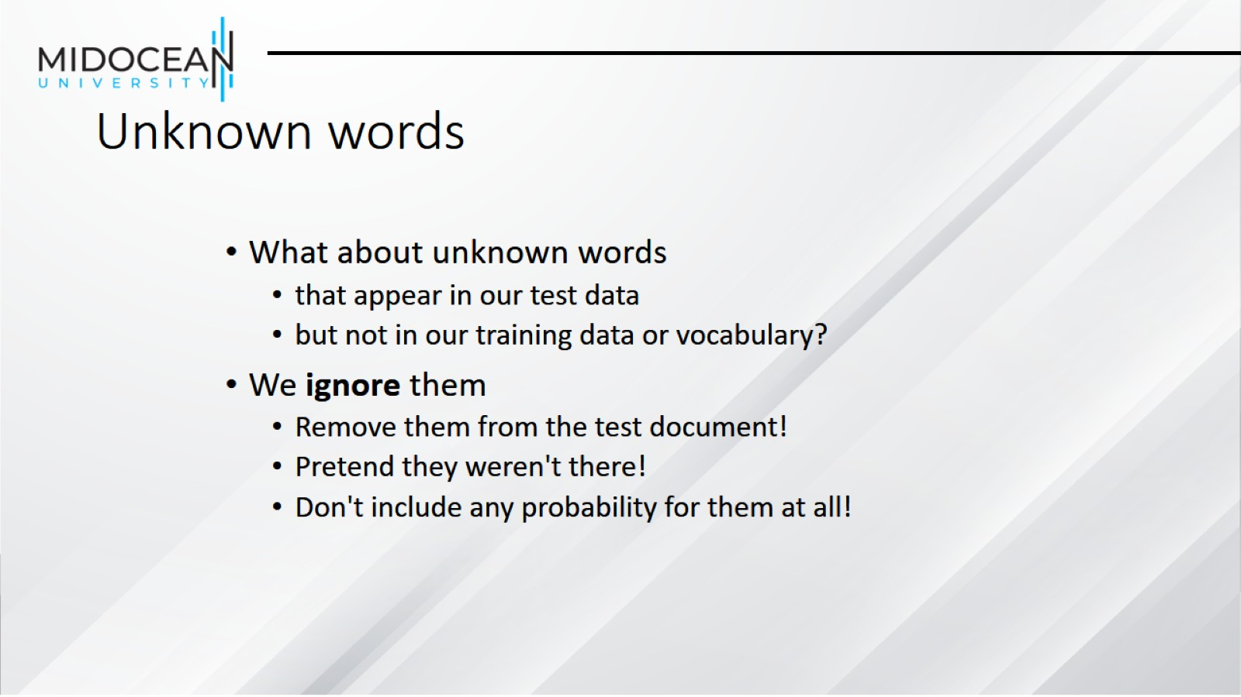
Unknown words

Slide 33
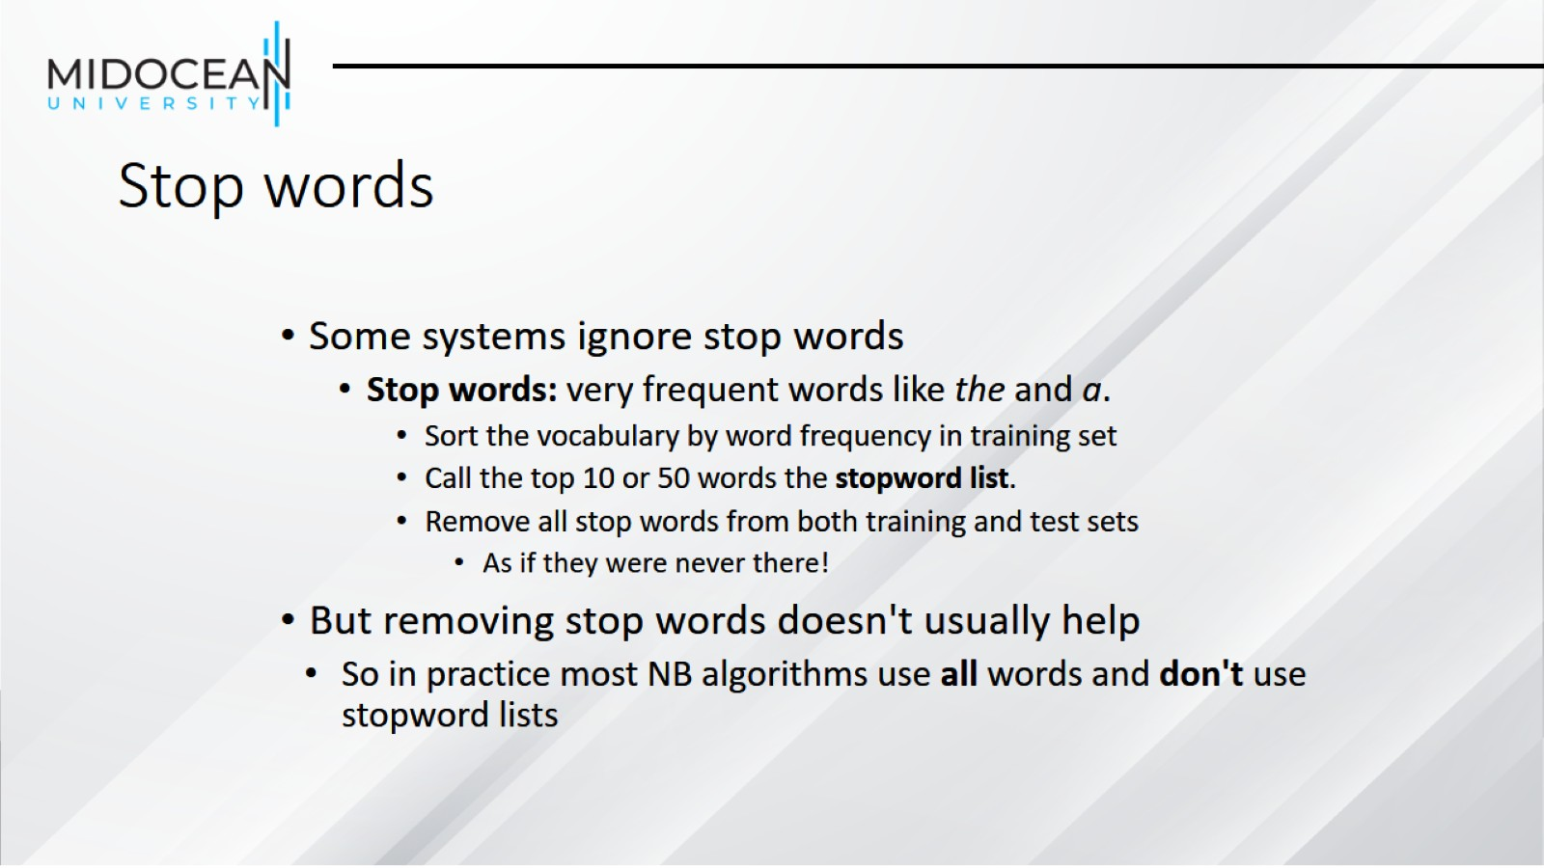
Stop words

Slide 34
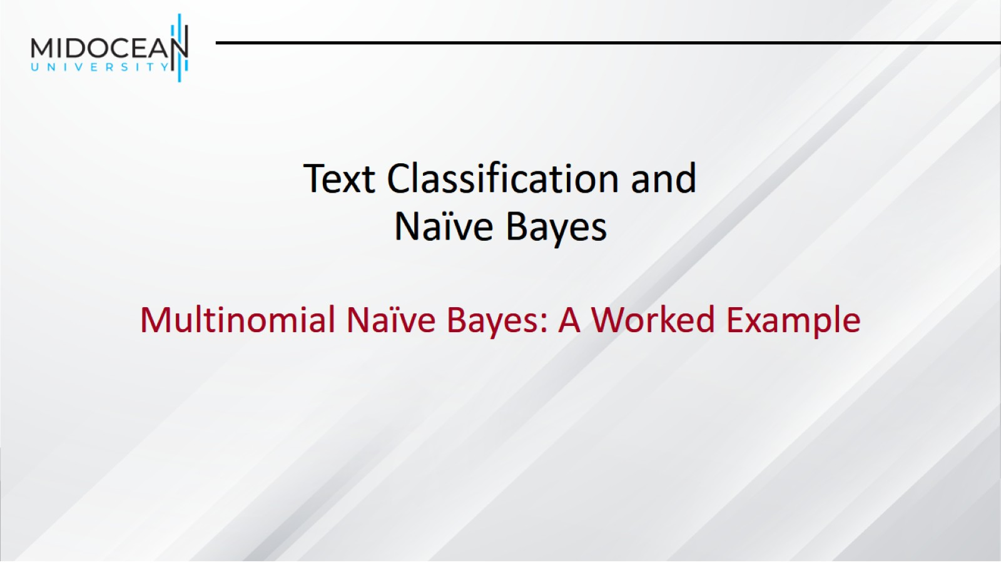
Text Classification and Naïve Bayes

Slide 35
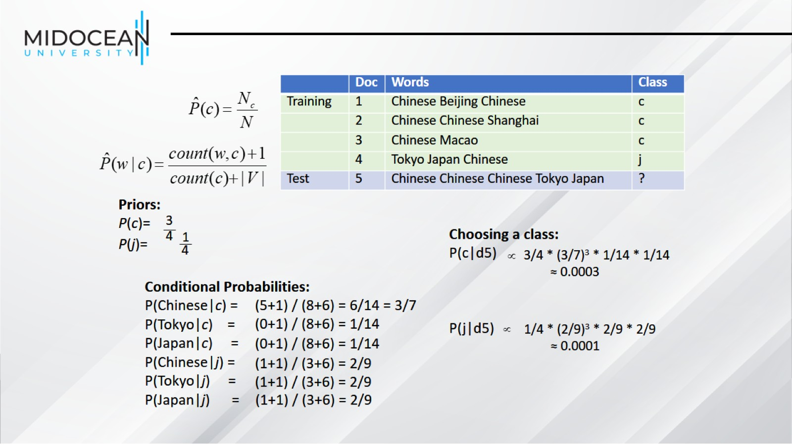

Slide 36
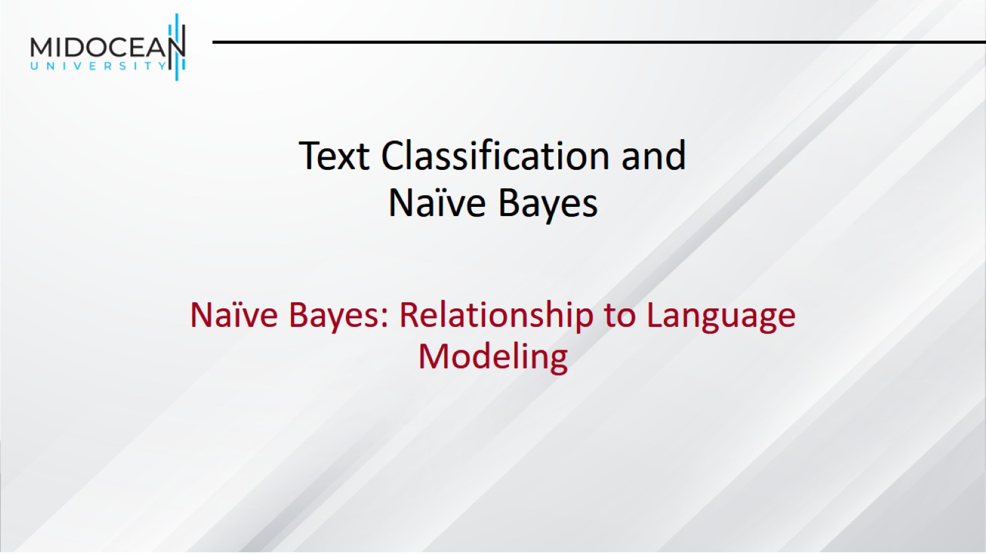
Text Classification and Naïve Bayes

Slide 37
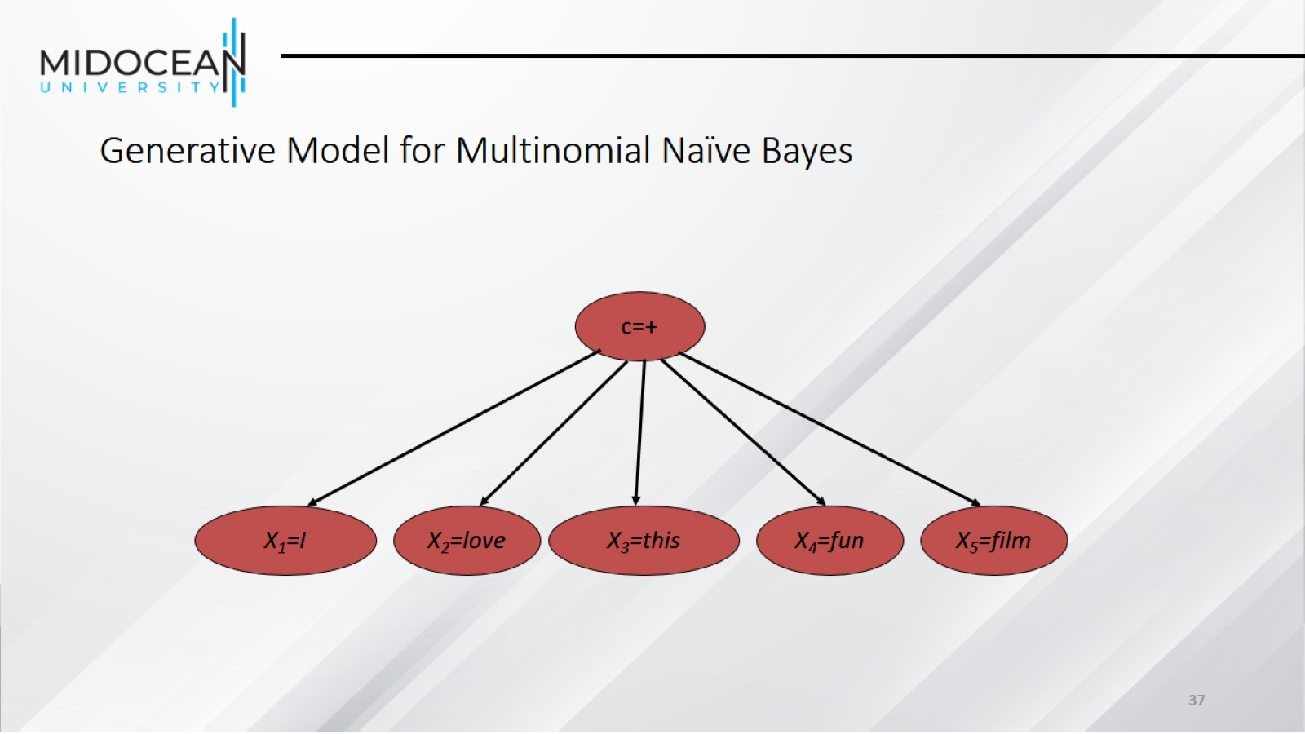
Generative Model for Multinomial Naïve Bayes

Slide 38
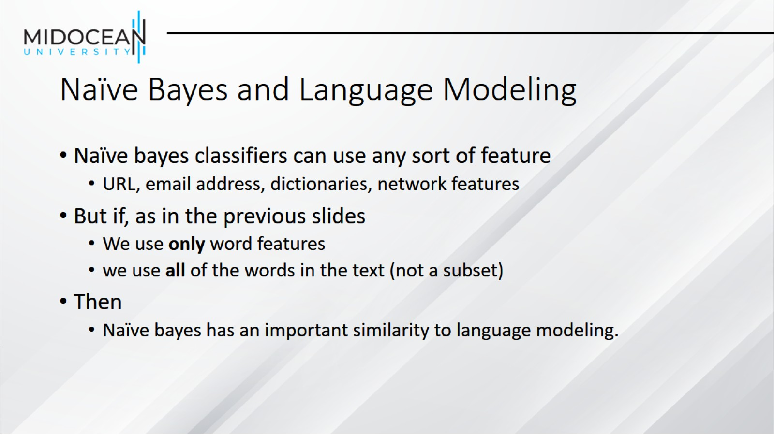
Naïve Bayes and Language Modeling

Slide 39
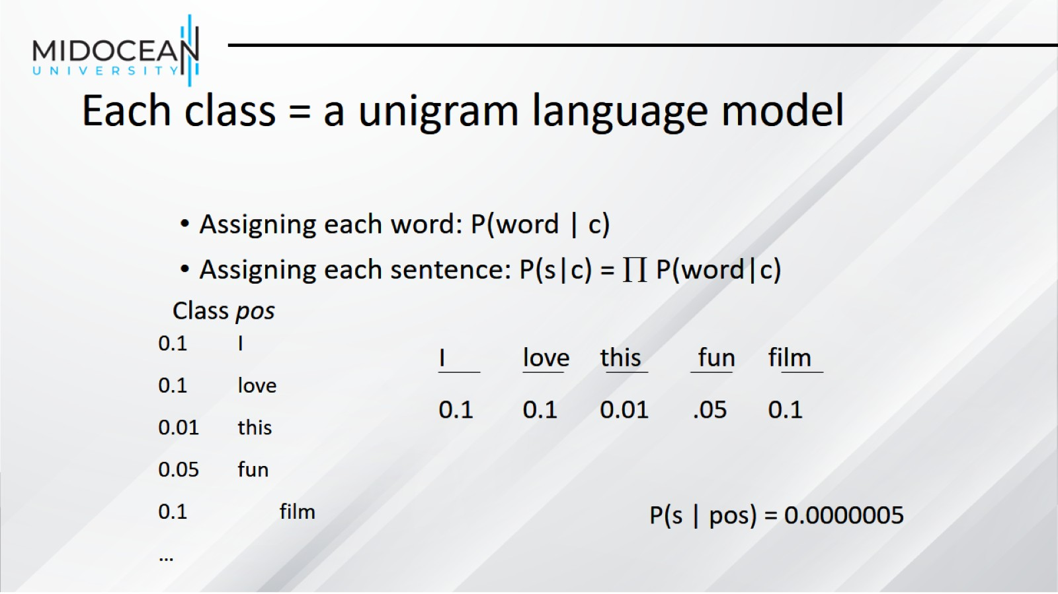
Each class = a unigram language model

Slide 40
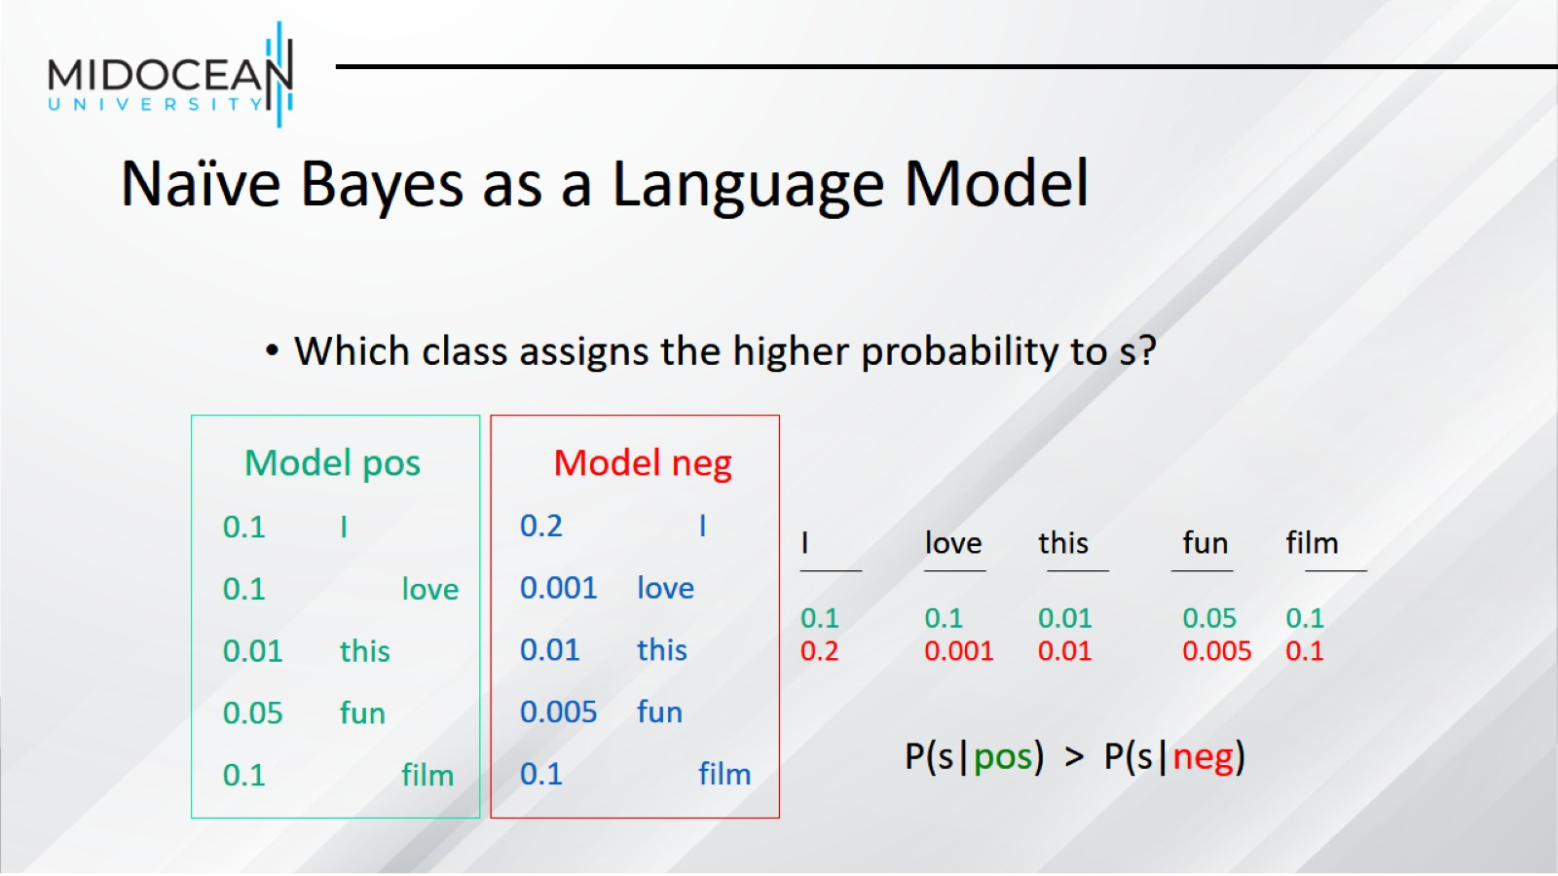
Naïve Bayes as a Language Model

Slide 41
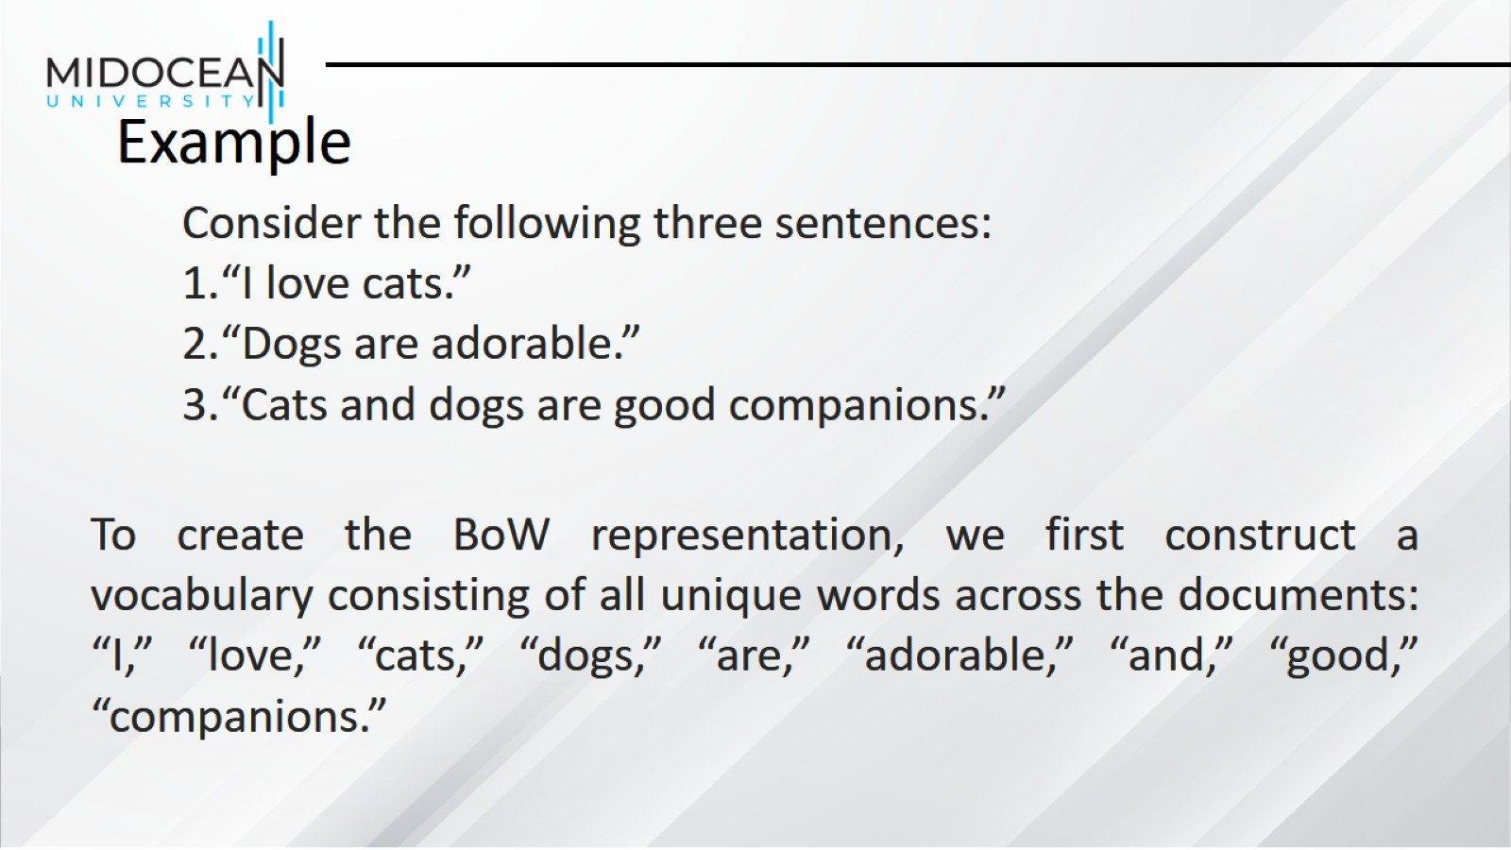
Example

Slide 42
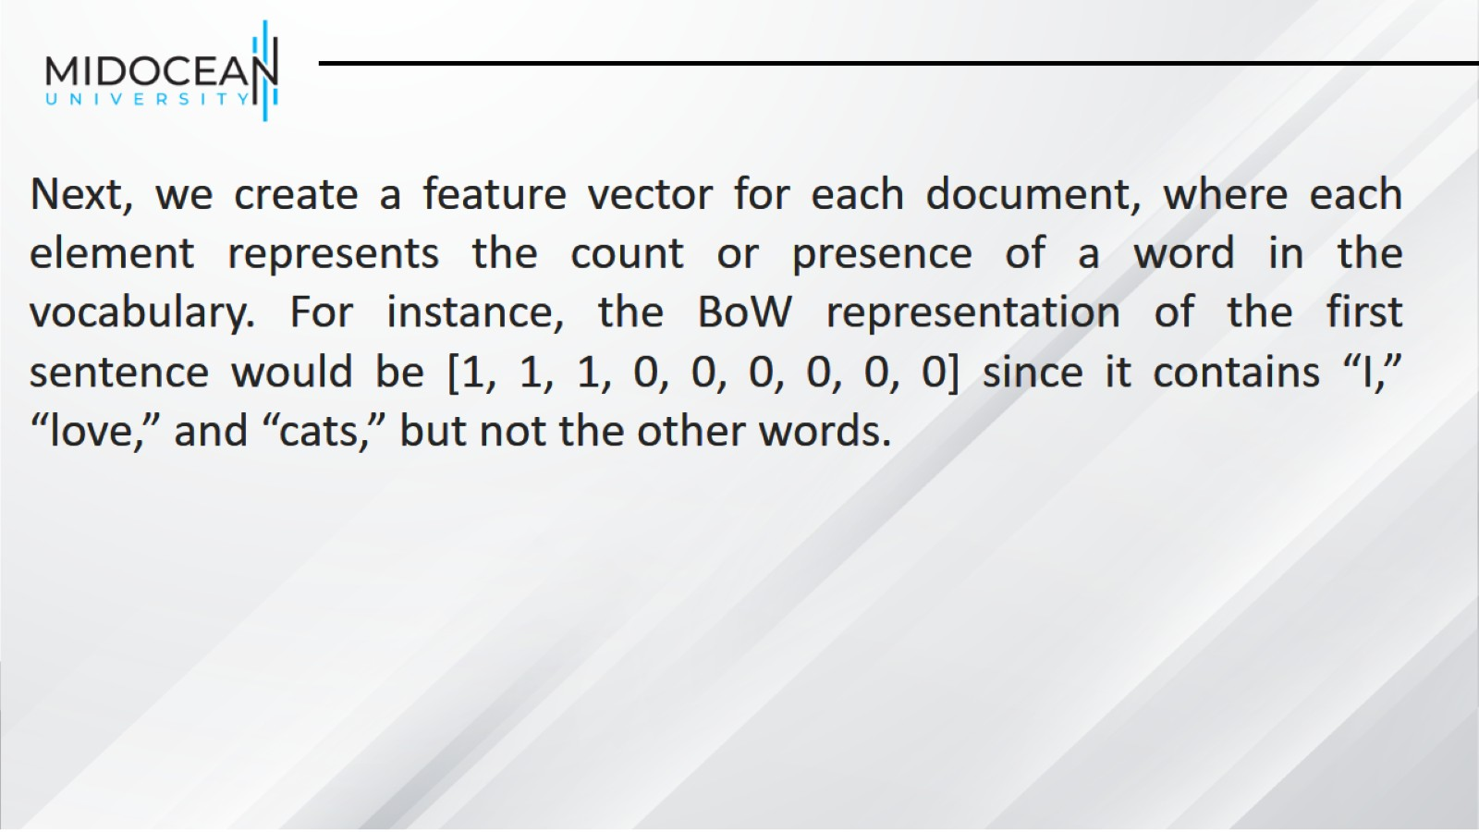

Slide 43
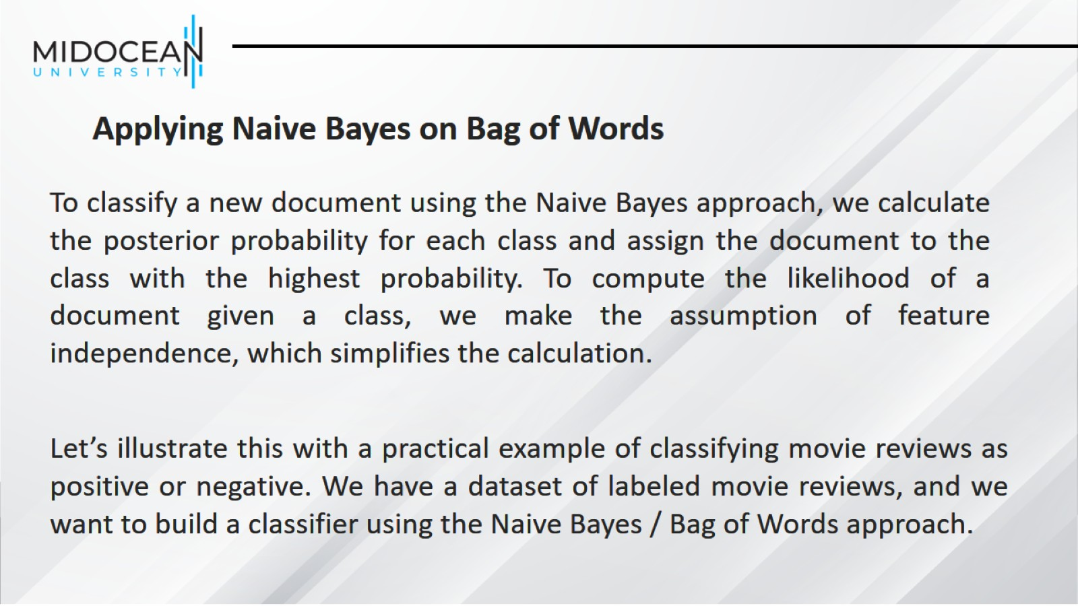

Slide 44
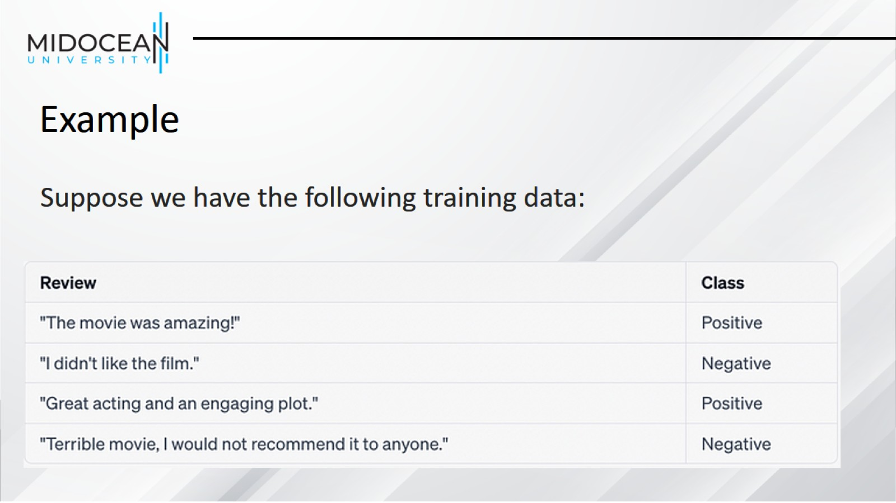
Example

Slide 45
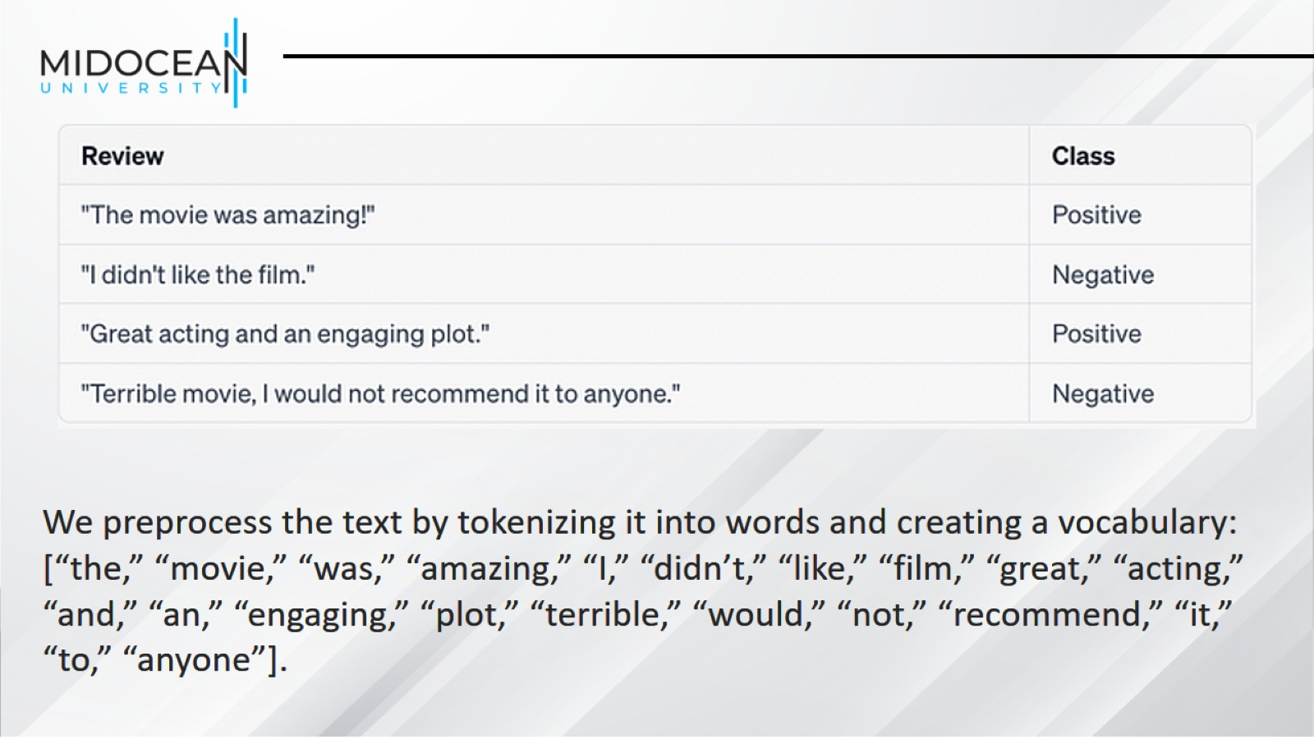

Slide 46
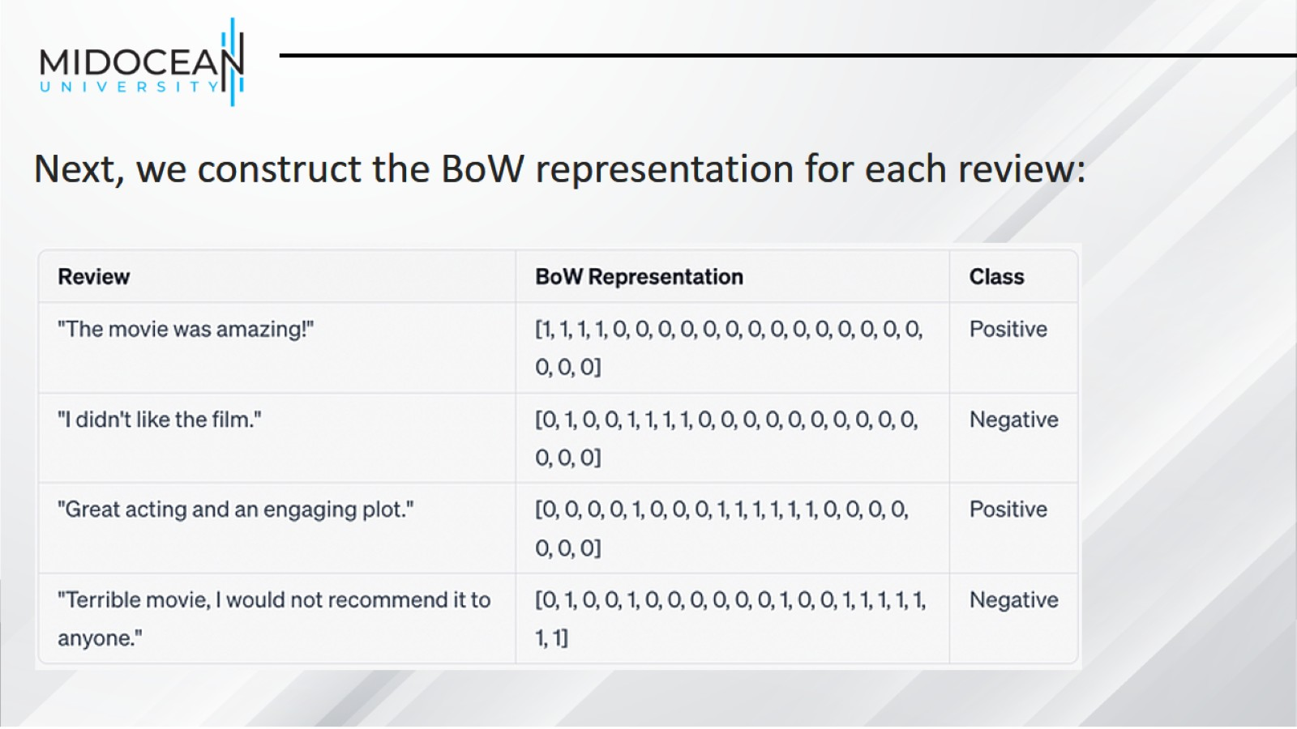

Slide 47
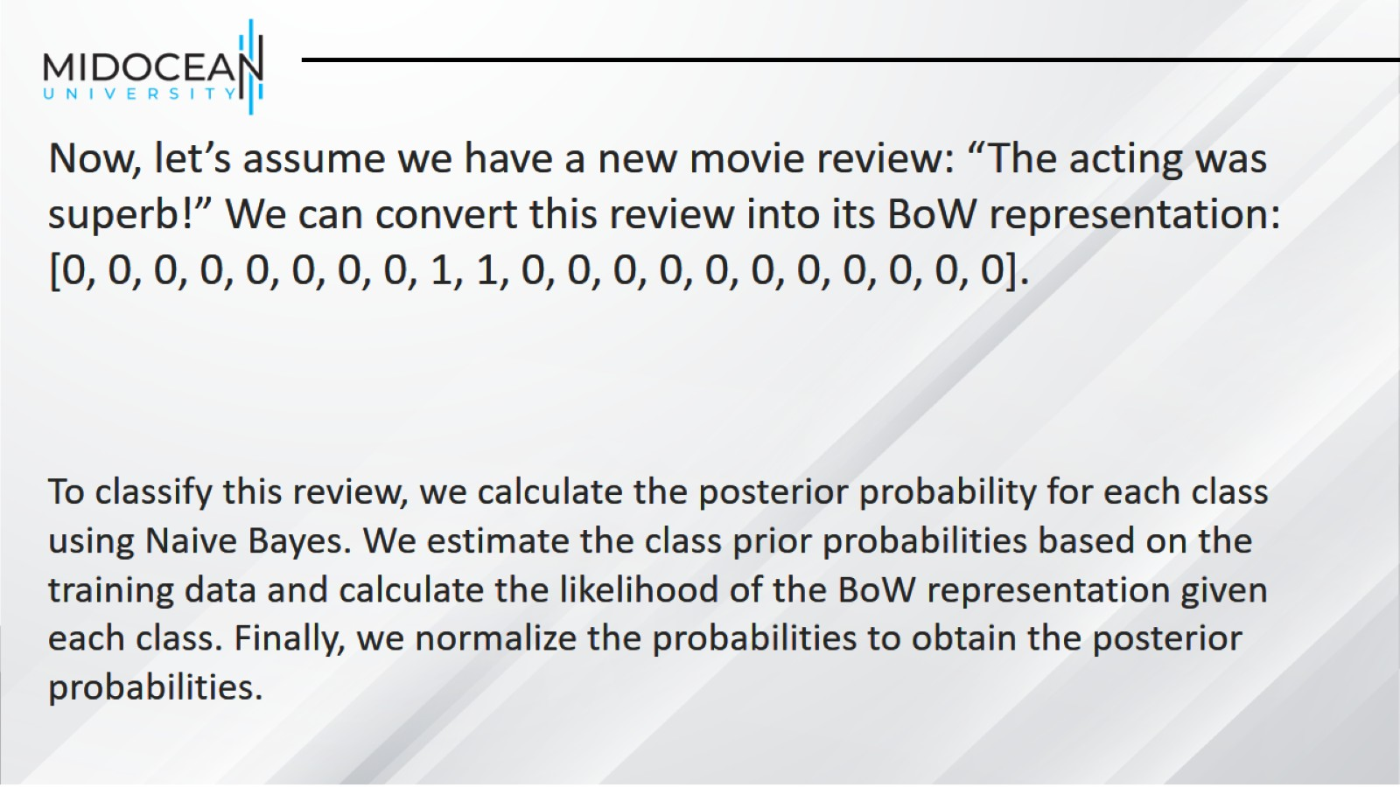

Slide 48
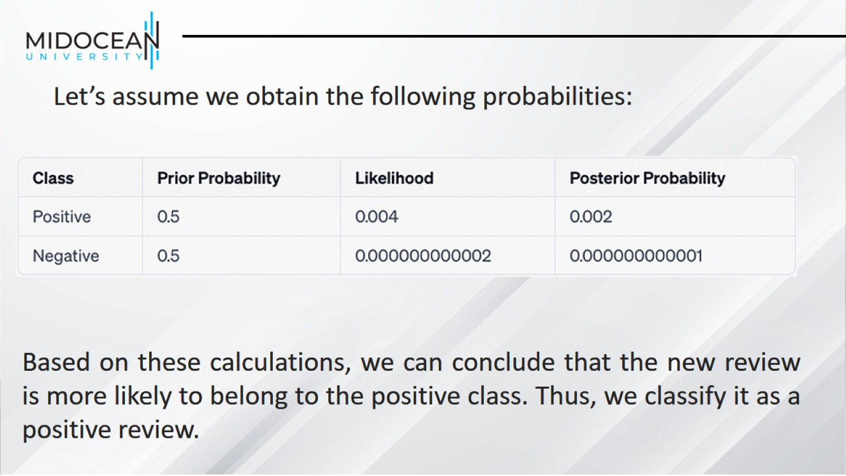

Slide 49
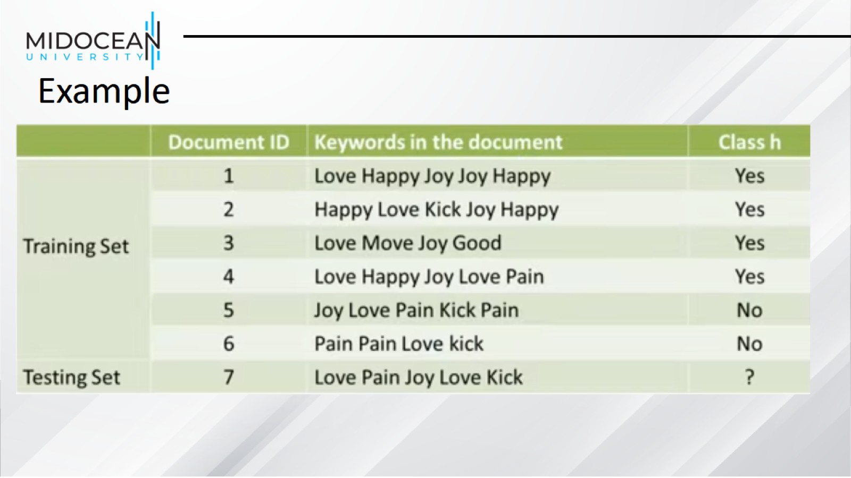
Example

Slide 50
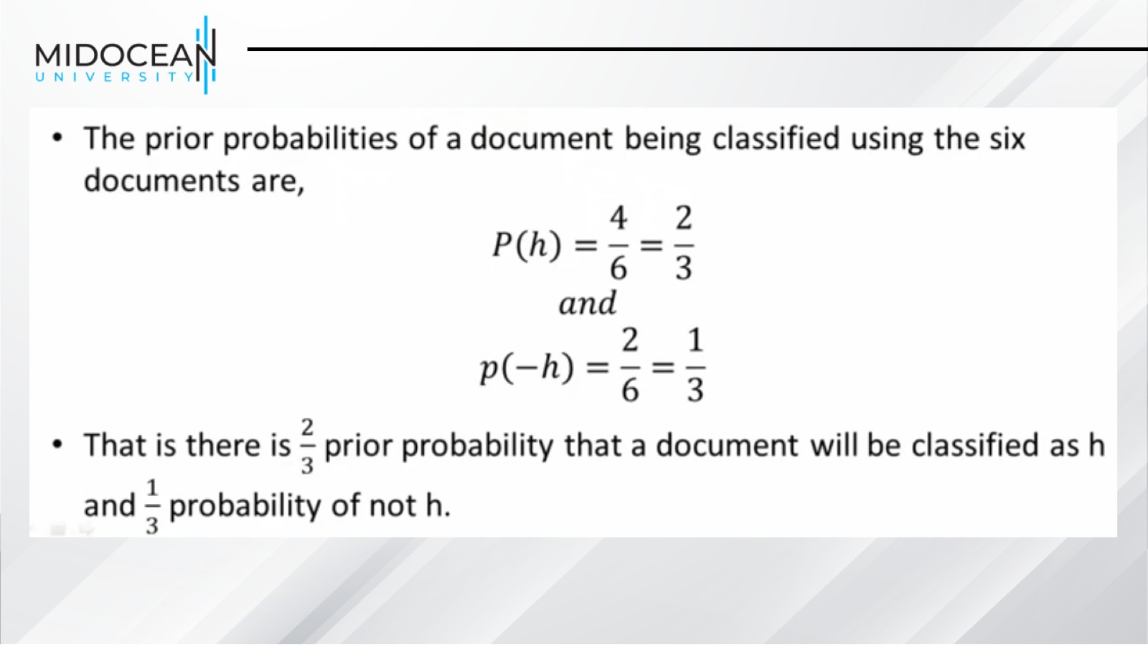

Slide 51
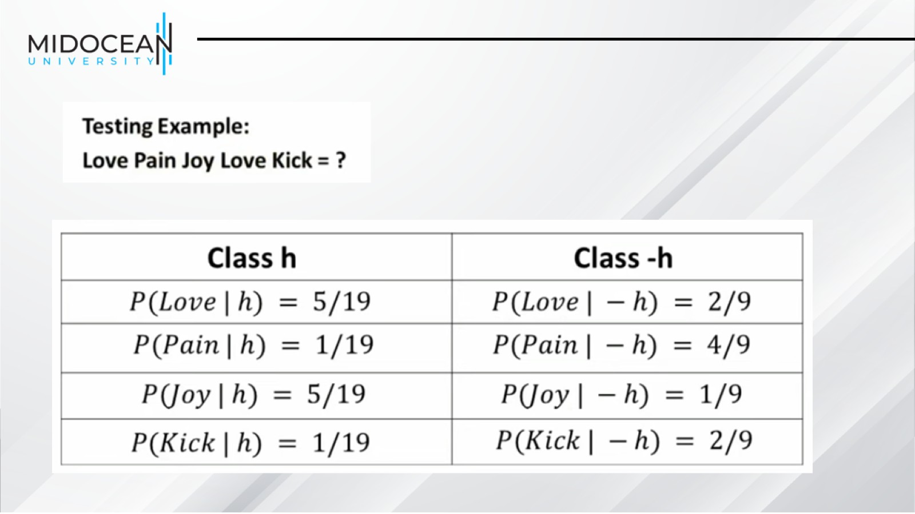

Slide 52
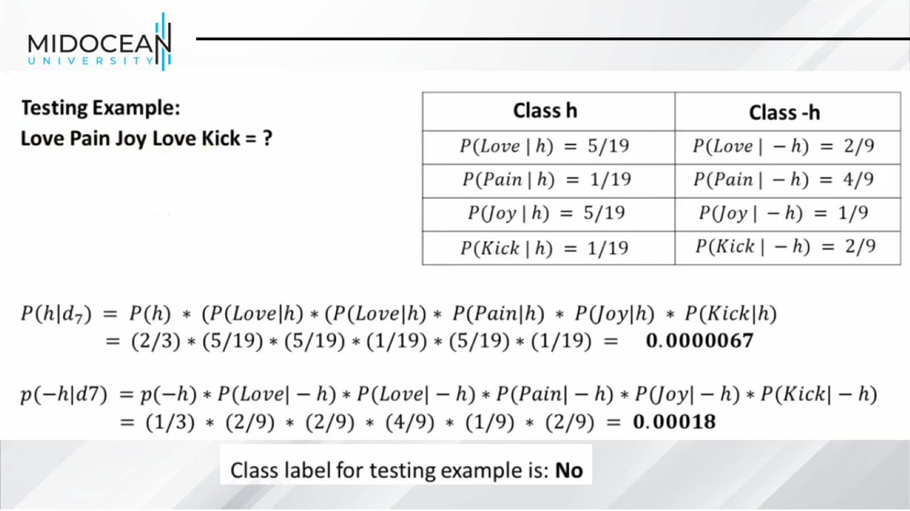

Slide 53

Summary: Naive Bayes is Not So Naive

Slide 54


