Slide 2
Chapter 4: Threads
Overview
Multithreading Models
Threading Issues

Slide 3
Threads
Thread comprises a thread ID, a program counter, a register set, and a stack. It shares with other threads belonging to the same process its code section, data section, and other operating system resources, such as open files and signals.
If the process has multiple threads of control, it can do more than one task at a time.

Slide 4
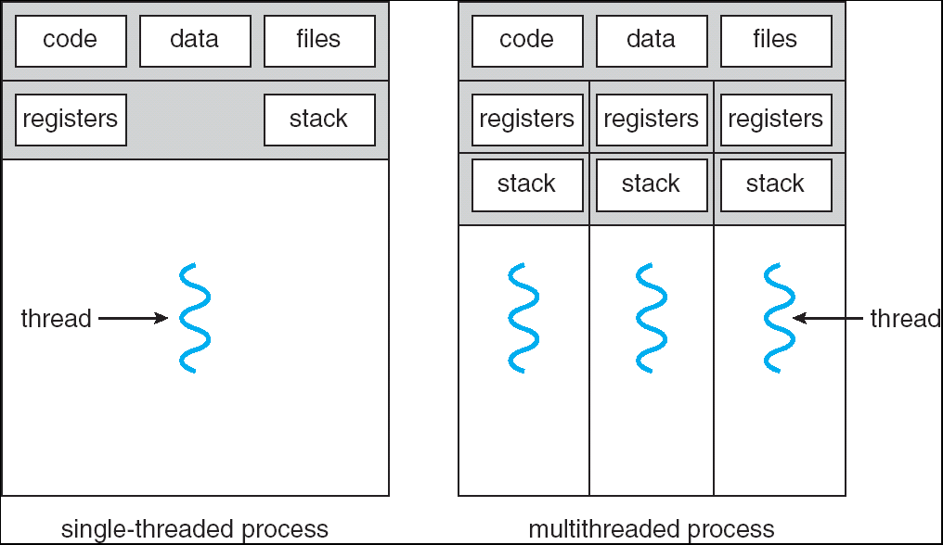
Single and Multithreaded Processes
Heavy weight process
Thread called a Light weight process LWP

Slide 5
Motivation
A application typically is implemented as a separate process with several threads of control.
Examples:
A web browser might have one thread display images or text while another thread retrieves data from the network.
A word processor may have a thread for displaying graphics, another thread for reading keystrokes from the user, and a third thread for performing spelling and grammar checking in the background.
A web server accepts client requests for web pages, images, sound, and so forth. The server would create a separate thread that would listen for client requests; when a request was made, rather than creating another process, it would create another thread to service the request.

Slide 6
Benefits
Responsiveness: multithreading an interactive application may allow a program to continue running even if part of it is blocked or is performing a lengthy operation, thereby increasing responsiveness to the user. For instance, a multithreaded web browser could still allow user interaction in one thread while an image is being loaded in another thread.
Resource Sharing: by default, threads share the memory and the resources of the process to which they belongs. The benefit of code sharing is that it allows an application to have several different threads of activity all within the same address space.

Slide 7
Benefits
Economy: allocating memory and resource for process creation is costly. In Solaris 2, creating a process is about 30 times slower than is creating a thread, and context switching is about five times slower.
Utilization of Multiprocessor Architectures: the benefits of multithreading can be greatly increased in a multiprocessor architecture, where each thread may be running in parallel on a different processor. In a singleprocessor architecture, only one thread is running at a time.

Slide 8
User Threads
Thread management done by user-level threads library. The library provides support for thread creation, scheduling and management with no support from the kernel.
Three primary thread libraries:
  POSIX Pthreads
  Win32 threads
  Java threads

Slide 9
Kernel Threads
Supported by the Kernel
Examples
  Windows XP/2000
  Solaris
  Linux
  Tru64 UNIX
  Mac OS X

Slide 10
Multithreading Models
Many-to-One
One-to-One
Many-to-Many

Slide 11
Many-to-One
Many user-level threads mapped to single kernel thread. Thread management is done in user space, so it is efficient, but the entire process will block if a thread makes a blocking system call. Also, because only one thread can access the kernel at a time, multiple threads are unable to run in parallel on multiprocessors.
Examples:
  Solaris Green Threads
  GNU Portable Threads

Slide 12
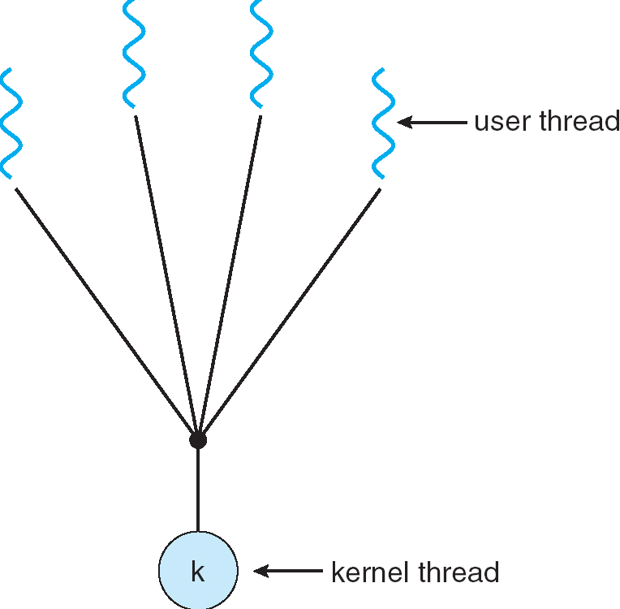
Many-to-One Model

Slide 13
One-to-One
Each user-level thread maps to kernel thread.
Examples
  Windows NT/XP/2000
  Linux
  Solaris 9 and later

Slide 14
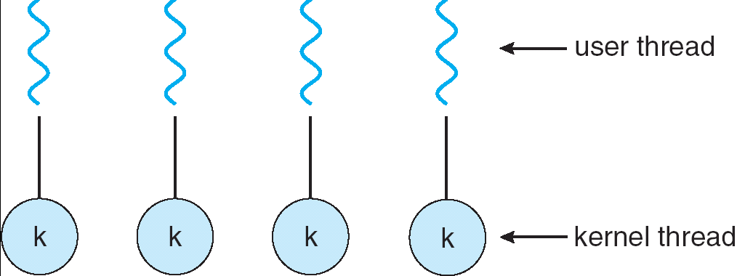
One-to-one Model

Slide 15
Many-to-Many Model
Allows many user level threads to be mapped to many kernel threads
Allows the operating system to create a sufficient number of kernel threads
Solaris prior to version 9
Windows NT/2000 with the ThreadFiber package

Slide 16
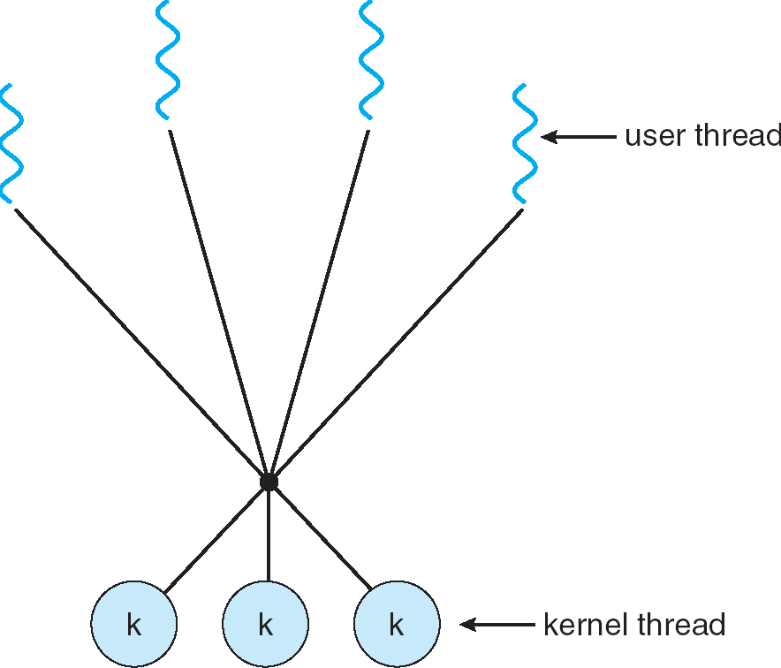
Many-to-Many Model

Slide 17
Two-level Model
Similar to M:M, except that it allows a user thread to be bound to kernel thread
Examples
  IRIX
  HP-UX
  Tru64 UNIX
  Solaris 8 and earlier

Slide 18
Objectives Chapter 5 CPU scheduling
To introduce CPU scheduling, which is the basis for multi programmed operating systems
To describe various CPU-scheduling algorithms ( There is no one best solution. No one is perfect!)
To discuss evaluation criteria for selecting a CPU-scheduling algorithm for a particular system

Slide 19
Basic Concepts
Single Process ➔ one process at a time
Maximum CPU utilization obtained with multiprogramming
CPU idle :waiting time is wasted

Slide 20
Basic Concepts
Cycle – Process execution consists of a cycle of CPU execution and I/O wait
CPU burst: a time interval when a process uses CPU only.
I/O burst: a time interval when a process uses I/O devices only.

Slide 21
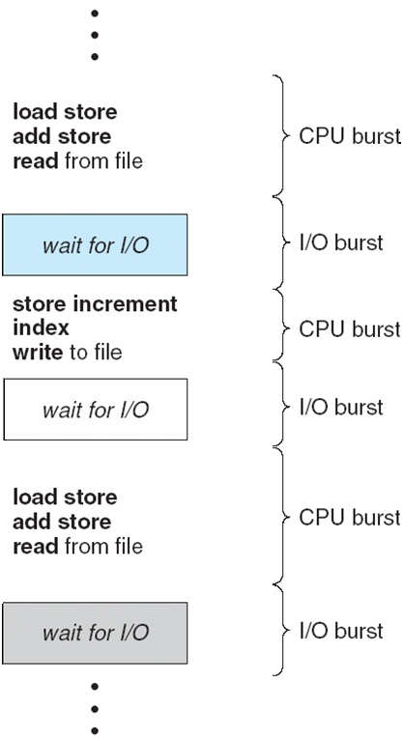
Alternating Sequence of CPU And I/O Bursts

Slide 22
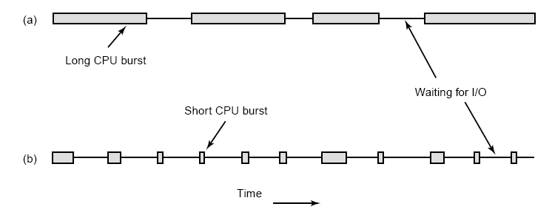

Slide 23
CPU Scheduler
CPU idle , operating system selects one process from ready Queue to be executed
Many mechanisms: FIFO, priority …
The Record in the queue are generally process control block PCBs of the processes

Slide 24
CPU Scheduler
Long term scheduling
Short term scheduling: CPU scheduler
Medium term scheduling

Slide 25
CPU Scheduler
CPU scheduling decisions may take place when a process:
  1. Switches from running to waiting state
  2. Switches from running to ready state
  3. Switches from waiting to ready
  4. Terminates
Scheduling under 1 and 4 in scheduling scheme is nonpreemptive or cooperative;
All other scheduling is preemptive

Slide 26
Dispatcher
Scheduler (Algorithm + Data Structure) decides which process to run next. Remember that decision always take time and resources.
Dispatcher module gives control of the CPU to the process selected by the short-term scheduler; this involves:
  switching context
  switching to user mode
  jumping to the proper location in the user program to restart that program
Dispatch latency – time it takes for the dispatcher to stop one process and start another running
At each clock interrupt, the OS gets to run and decide whether the currently running process should be allowed to continue or whether it has to choose another process and give it the CPU.

Slide 27
Scheduling Criteria
CPU utilization – keep the CPU as busy as possible
Throughput – # of processes that complete their execution per time unit
Turnaround time – amount of time to execute a particular process
Waiting time – amount of time a process has been waiting in the ready queue
Response time – amount of time it takes from when a request was submitted until the first response is produced, not output (for time-sharing environment)
Fairness- Give CPU to all processes in a fair manner

Slide 28
Scheduling Algorithm Optimization Criteria
Max CPU utilization
Max throughput
Min turnaround time
Min waiting time
Min response time

Slide 29
Scheduling Goals/Criteria Conflicts
CPU utilization and response time: CPU utilization is increased if the overheads associated with context switching is minimized. The context switching overheads could be lowered by performing context switches infrequently. This could however result in increasing the response time for processes.
Average turnaround time and maximum waiting time: Average turnaround time is minimized by executing the shortest tasks first. Such a scheduling policy could however starve long-running tasks and thereby increase their waiting time.
I/O device utilization and CPU utilization: CPU utilization is maximized by running long-running CPU-bound tasks without performing context switches. I/O device utilization is maximized by scheduling I/O-bound jobs as soon as they become ready to run, thereby incurring the overheads of context switches.

Slide 30
Scheduling Algorithms
First-Come, First-Served Scheduling
Shortest-Job-First Scheduling
Priority Scheduling
Round-Robin Scheduling
Multilevel Queue Scheduling
Multilevel Feedback Queue Scheduling

Slide 31
First-Come, First-Served (FCFS) Scheduling
By far the simplest CPU-scheduling algorithm is the first-come, first-served (FCFS) scheduling algorithm.
With this scheme, the process that requests the CPU first is allocated the CPU first.
The implementation of the FCFS policy is easily managed with a FIFO queue

Slide 32
First-Come, First-Served (FCFS) Scheduling
FIRST-COME, FIRST SERVED:
  ( FCFS) same as FIFO
  Simple, fair, but poor performance. Average queueing time may be long.
  What are the average queueing and residence times for this scenario?
  How do average queueing and residence times depend on ordering of these processes in the queue?

Slide 33
First-Come, First-Served (FCFS) Scheduling
One of the simplest scheduling policies
  non-preemptive. Once process is scheduled to run (get CPU), it keeps it until terminated or request I/O
      Process Burst Time
P₁ 24
P₂ 3
P₃ 3
Suppose that processes arrive in the order: P₁ , P₂ , P_{3 ,} all at time 0.
A Gantt Chart shows which process executed by the CPU at each time. The Gantt Chart (contains no Overhead time) for the schedule is:
Turnaround time for P_{1 ,} P₂ , and P₃ are 24, 27, 30 respectively
Waiting time = turnaround time - burst time
  Waiting time for P₁ = 0; P₂ = 24; P₃ = 27
  Average waiting time: (0 + 24 + 27)/3 = 17
P₁
P₂
P₃
0
24
27
30

Slide 34
FCFS Scheduling (Cont)
Suppose that the processes arrive in the order
P₂ , P₃ , P₁
The Gantt chart for the schedule is:
Turnaround time for P_{1 ,} P₂ , and P₃ are 30, 3, 6 respectively
Waiting time for P₁ = 6; P₂ = 0; P₃ = 3
  Average waiting time: (6 + 0 + 3)/3 = 3
Much better than previous case
Convoy effect short process behind long process. Lower CPU and device utilization than might be possible if the shorter processes were allowed to get CPU first.
FCFS is not suitable for time-sharing systems, where processes get a share of CPU at regular intervals-> suitable for batch systems
P₂
P₃
P₁
0
3
6
30

Slide 35
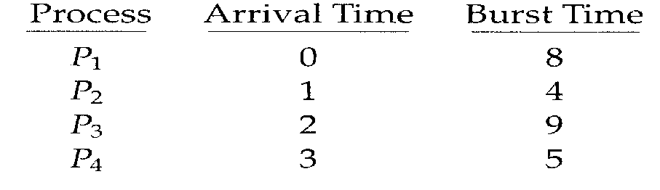
FCFS Scheduling (Cont)
Example without ignoring arrival time.
  _{Gantt Chart}
  0 8 12 21 26
  Average waiting time= [(0)+(8-1)+(12-2)+(21-3)]/4= 8.75 ms
  Average Turn Around time=[(8-0]+(12-1)+(21-2)+(26-3)]/4=15.25 ms
  Throughput = 4 jobs/26 ms = 0.15385 jobs/ms
P1 | P2 | P3 | P4

Slide 36
Shortest-Job-First (SJF) Scheduling
Associate with each process the length of its next CPU burst. Use these lengths to schedule the process with the shortest time. If several processes have the same CPU next burst time, use FCFS to select one
Process Arrival Time Burst Time
P₁ 0.0 6
P₂ 0.0 8
P₃ 0.0 7
P₄ 0.0 3
Non-Preemptive SJF scheduling Gannt chart (ignore arrival time)
Turnaround time for P_{4 ,} P₁ , P₃ and P₂ are 3, 9, 16, 24 respectively
Average waiting time = (0 + 3+ 9 + 16) / 4 = 7 (ignore arrival time)
  Same problem with FCFS = 10.25 msec
Non-preemptive
Version
P₄
P₁
P₃
P₂
0
3
9
16
24

Slide 37
Non-preemptive
Version SJF
Process Arrival Time Burst Time
P₁ 0.0 6
P₂ 2.0 8
P₃ 4.0 7
P₄ 5.0 3
Non-Preemptive SJF scheduling Gannt chart
P1
P₄
P₃
P₂
0
6
9
16
24
Turnaround time for P_{1 ,} P₂ , P₃ and P₄ are 6, 24, 16, 6 respectively
Average waiting time = (0 + (16-2)+ (9-4) + (6-5)) / 4 = 5

Slide 38
Non-Preemptive Shortest-Job-First (SJF) Scheduling without Ignoring Arrival time
Process Arrival Time Burst Time
P₁ 0.0 7
P₂ 2.0 4
P₃ 4.0 1
P₄ 5.0 4
Non-Preemptive SJF scheduling Gannt chart
Turnaround time for P_{1 ,} P₃ , P₂ and P₄ are
(7-0), (8-4), (12-2) , (16-5) respectively
7 , 4 , 10 , 11
Average waiting time = (0 + (7-4) + (8-2) + (12-5) / 4 = 4
Non-preemptive
Version
P₁
P₃
P₂
P₄
0
7
8
12
16

Slide 39
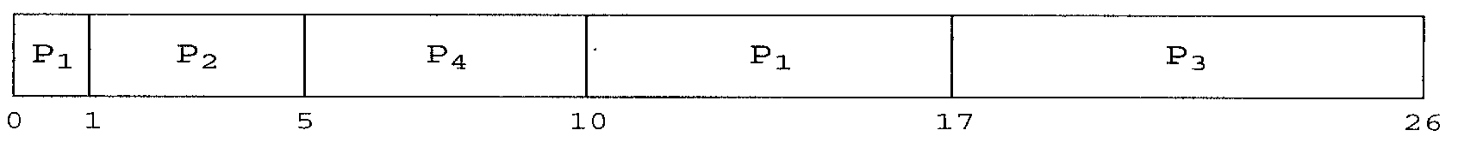
Preemptive SJF Scheduler
Preemptive SJF is optimal – gives minimum average waiting time for a given set of processes because it moves short process before a long one. It can’t be used for short-term scheduling
  The difficulty is knowing the length of the next CPU request. It is used frequently in long-term scheduling in batch systems because user can estimate running time needed
  Average waiting time= [(10-1)+(1-1)+(17-2)+(5-3)]/4= 6.5 ms
  Average Turn Around time=[(17-0]+(5-1)+(26-2)+(10-3)]/4=11.5 ms
  Throughput = 4 jobs/26 ms = 0.15385 jobs/ms
  Non-Preemptive scheduling waiting time = 7.75 ms
Preemptive
Version

Slide 40
Shortest-Job-First (SJF) Scheduling without Ignoring Arrival time
Process Arrival Time Burst Time
P₁ 0.0 7
P₂ 2.0 4
P₃ 4.0 1
P₄ 5.0 4
Turnaround time for P_{1 ,} P₂ , P₃ and P₄ are
(16-0), (7-2), (5-4) , (11-5) respectively
16 , 5 , 1 , 6
Average waiting time = ((11-2) + (5-4)+ (4-4)+ (7-5)/ 4
₌ 9 + 1 + 0 + 2 )/4 = 3
preemptive
Version
P₁
P₂
P₃
P₂
P₄
P₁
0
2
4
5
7
11
16

Slide 41
Exercise 1
Assume you have the following jobs to execute with one processor, with the jobs arriving in the order listed here
i T(pi)
0 80
1 20
2 10
3 20
4 50
Suppose a system uses FCFS and SJF scheduling .
Create a Gantt chart illustrating the execution of these processes?
What is the average wait time for the processes?
What is the turnaround time for process p3?

Slide 42
Exercise 2
Assume you have the following jobs to execute with one processor, with the jobs arriving in the order listed here
i arrival Time T(pi)
0 0 80
1 3 20
2 5 10
3 7 20
4 10 50
Suppose a system uses FCFS and SJF (preemptive and nonpreemptive) scheduling.
Create a Gantt chart illustrating the execution of these processes?
What is the average wait time for the processes?
What is the turnaround time for process p3?

Slide 43
End lecture 3
Thank You

