Slide 1



Digital Analytics
MKT631
Lecture 4
Prepared by
Dr. Karim Ahmed
www.midocean.ae

Slide 2
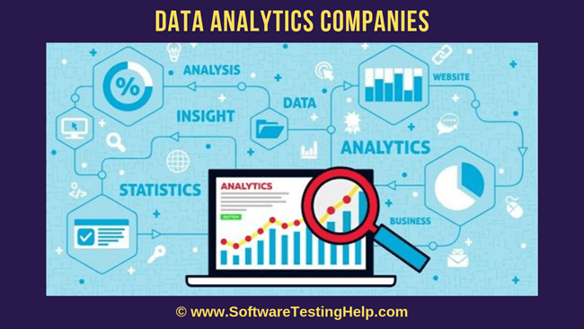
Digital Analytics
Industry Players

Slide 3

Lecture Content
Three Types of Data
Stories about Converging First-, Second and Third-Party Data
Digital Data Collection: Cookies, Tags and Sign-Ins
Third-Party Data and Analytics
Third-Party Data Aggregators—What They Do
Analytics Platforms vs. Data Integration Software
Demographics Data
Web Data Collection Issues
www.midocean.ae

Slide 4
Three Types of Data
First-Party Data
First-party data focuses on the concepts of ownership, control, and privacy. It is an
extension of the types of operational and customer information organizations already collect. It is extremely valuable data for mining consumer insights because it is the relevant information that a marketer has collected from his or her audience. First-party data is collected on past actions taken by consumers, so it is limited to current or past consumers.
www.midocean.ae

Slide 5
Three Types of Data
First-Party Data
Examples of first-party data include email lists, customer relationship management, purchasing data stored within in-house databases, data on social media channels, such as Facebook pages, Twitter accounts, LinkedIn company pages, Instagram, Pinterest, and Snapchat.
Marketers use first-party data to retarget visitors who came to their websites or are connected on Facebook with display ad campaigns. As more information is extracted from consumers, the content became more personalized and website conversion rates increase.
www.midocean.ae

Slide 6
Three Types of Data
Second-Party Data
Second-party data is data collected through other organizations, companies, or individuals and shared with other marketers. The marketer may have little or no control of the relevance or depth of the information collected with the second-party data which is being shared with them from their business partners and affiliates. An example of second-party data is seen in banking and credit card agreements. In the small print of most banking and credit card agreements, statements detail the permitted uses of customer data. Among the clauses, there is usually a statement about the information gathered from customer activities and shared with affiliates and business partners. Sometimes, customers can opt out of these second party arrangements, but often they cannot.
www.midocean.ae

Slide 7
Three Types of Data
Third-Party Data
Third-party data covers the data available to marketers that is aggregated, and sold by market research companies.
Many third-party data companies use predictive modeling via sampling and other
statistical methods to prepare their data sets.
Third-Party data provides intelligence that could be used for behavioral and contextual targeting. Ideally, marketers use first-party data in their strategies, but third-party data can supplement the strategy or provide groundwork when first-party data is insufficient.
www.midocean.ae

Slide 8
Stories about Converging First-, Second and Third-Party Data
Macy’s
Suppose a shopper is looking for a new dress shirt. The shopper enters his or her
requirements for the shirt into a Google search. The shopper lands on a website, such as Macys.com, and looks for available dress shirts.
Through Macy’s point of view, they would not have enough information to identify the shopper, but they can recognize their past behavior if the consumer visited the website previously, or suggest styles based on in-house, first-party data previously collected about the customer.
www.midocean.ae

Slide 9
Stories about Converging First-, Second and Third-Party Data
Macy’s
However, if Macy’s combined third-party data collected by the vendors—i.e., data brokers, and data management platforms—with Macy’s first-party data collected by Web Analytics, information may converge and provide insights, such as hovering activity on different shirts and shirt colors and point-of-sale (POS) data. Macy gains knowledge of who to prospect to (i.e., demographics and psychographic information) and the other merchandise the individual may be interested in purchasing. It may also use its intelligence to predict time-sensitive purchases and price adjustments for the
shopper.
www.midocean.ae

Slide 10
Stories about Converging First-, Second and Third-Party Data
Macy’s
Thus, Macy’s can create an engagement strategy that meets the needs of a specific customer, while using the same technologies to handle thousands of customers with similar needs every moment. To include second-party data, this information may be purchased from AMEX and Citibank on credit card activities of Macy’s online shoppers. Then, it can be combined with local store POS data to predict what shirts
to show a shopper from a specific region, such as Jersey City, New Jersey. Ultimately, Macy’s needs partners in the Digital Analytics ecosystem to help it align its internal data with third-party data.
www.midocean.ae

Slide 11
Digital Data Collection: Cookies, Tags and Sign-Ins
How do brands (or systems working on behalf of brands) collect consumers’
digital information? Historically, the three important tools are:
Digital Cookies
Tags
Sign-Ins
www.midocean.ae

Slide 12
Digital Data Collection: Cookies, Tags and Sign-Ins
Digital cookies
Digital cookies are text files that sit in an internet browser’s cache on your device, typically a desktop computer or laptop, and allow websites and servers to identify you through a unique cookie ID: a string of characters that is associated with the browser storing the cookie. Think of a digital cookie as a name tag. Lou Montulli, a 24-year-old programmer, invented cookies in 1994 and digital cookies have played a central role in the collection of digital data since then. They are particularly relevant in the collection of third-party data.
www.midocean.ae

Slide 13
Digital Data Collection: Cookies, Tags and Sign-Ins
Digital cookies
Purpose: Cookies are small pieces of data stored on a user's device (typically in their web browser) to track and store information about their online activity.
Functionality: They are commonly used for various purposes, including session management, personalization, tracking user behavior, and remembering user preferences.
Privacy Implications: Cookies can raise privacy concerns as they can be used to collect and share user data. However, regulations like GDPR and CCPA have imposed restrictions on how cookies can be used.
www.midocean.ae

Slide 14
Digital Data Collection: Cookies, Tags and Sign-Ins
Tags
Tags are strings of code that initialize when someone performs an action in a browser, such as loading a webpage or clicking an object displayed on that page. When activated, tags allow analytics tools or marketing partners to collect data related to consumer behaviors on the tagged website. Analytics platforms, such as Google Analytics and Adobe Analytics; testing tools, such as Adobe Target and Optimizely; market research companies, such as comScore, IRI, and Nielsen; and marketing partners, such as Google and Facebook, use tags. Tags are critical for the collection of second-party data.
www.midocean.ae

Slide 15
Digital Data Collection: Cookies, Tags and Sign-Ins
Tags
Purpose: Tags, often referred to as tracking tags or web tags, are snippets of code added to a website's HTML to collect data on user interactions and send it to analytics or marketing platforms.
Functionality: Tags are used for tracking website or app performance, user behavior, and conversions. They help in monitoring and optimizing digital marketing campaigns and the user experience.
Privacy Implications: Tags, when used in compliance with privacy regulations, are generally less intrusive than cookies as they focus on tracking website behavior rather than individual user data.
www.midocean.ae

Slide 16
Digital Data Collection: Cookies, Tags and Sign-Ins
Sign-Ins
Giving consumers the opportunity to create accounts and sign in is a common practice among online content providers. From The New York Times to Travelocity to Facebook, digital accounts are everywhere. Sometimes, those sign-ins are required and used to control access to subscriber-only information kept behind a sign-in paywall (think NYTimes.com’s premium content), sensitive financial information, such as credit card numbers (think Travelocity), or private personal data (think Facebook). Other content providers, including Google, give consumers the option to create accounts and sign in or access content without those steps.
www.midocean.ae

Slide 17
Digital Data Collection: Cookies, Tags and Sign-Ins
Sign-Ins
By tying activities to accounts, content providers can connect consumers to behaviors on their platforms without cookies and tags. Sign-ins are an important tool in the collection of first-party data.
www.midocean.ae

Slide 18
Digital Data Collection: Cookies, Tags and Sign-Ins
Sign-Ins
Purpose: Sign-ins or logins are mechanisms that allow users to access secure areas of a website or application by providing their credentials, such as a username and password.
Functionality: They are used for user authentication, granting access to personalized content, and securing user accounts.
Privacy Implications: Sign-ins involve users willingly sharing their data with the website or application, and it's crucial to maintain data security and privacy for user accounts.
www.midocean.ae

Slide 19
Third-Party Data and Analytics
Web Analytics, an example of first-party data, provides data on what is happening in the organization or business website by placing cookies into a visitor’s browser.
Web Analytics often lacks competitive or industry data outside of the tracked website. Most organizations would like to know how well they are competing in the major areas connected to their business goals and revenue with a few exceptions.
www.midocean.ae

Slide 20
Third-Party Data and Analytics
Taking competitive analysis information into consideration, Google Analytics provides anonymous benchmark data collected that can be useful to provide some idea of how well a website is performing against others in similar industries and locations. It also provides second- and third-party data from the DoubleClick Ad Network. Other platforms, such as IBM Coremetrics and Adobe Analytics, include industry-wide metrics gathered from customers running the analytics platform. Third-Party audience data from ComScore and Nielsen has been combined with Adobe Analytics in some customer implementations.
www.midocean.ae

Slide 21
Third-Party Data Aggregators—What They Do
1. Aggregate behavioral data of audience members from online publishers, such as
the New York Times, and Web portals, such as Yahoo, that repackage and resell them to other organizations.
2. Provide data collection scripts for publishers to run on their sites, allowing third-party data aggregators to collect data from publishers and portals as part of an ad network (e.g., Audience Science) or revenue share agreement (e.g., BlueKai).
3. Provide third-party cookie lists for sale to advertisers and agencies that are used
for ad targeting. The cookie list is available for bidding within minutes (particularly
for in-market audiences) and has a shelf-life of up to two months.
www.midocean.ae

Slide 22
Third-Party Data Aggregators—What They Do
Every third-party data aggregator has their way of combining data—that is why it is better to assemble the data side by side but not intermix it, which will degrade data quality. Third-party data collection is similar to an “uncontrolled laboratory” where platform vendors are mixing up their formulations of data, interpretations, and context with no regulation authority to monitor them.
www.midocean.ae

Slide 23
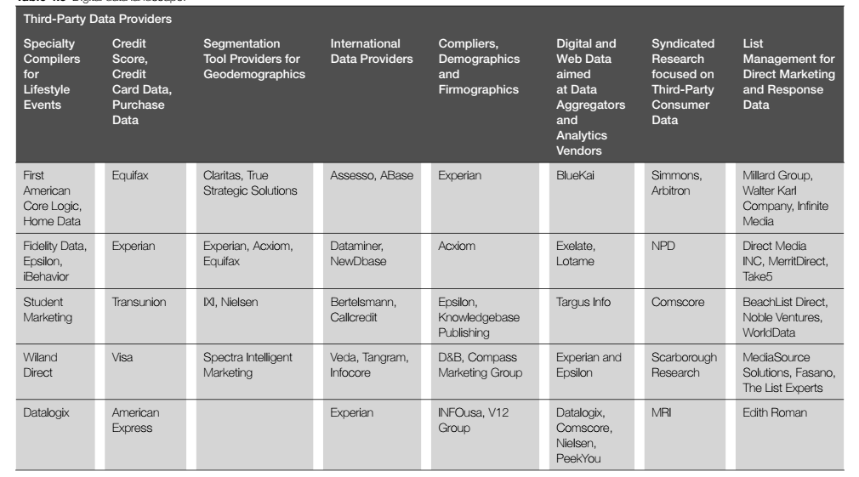
Analytics Platforms vs. Data Integration Software
www.midocean.ae

Slide 24
Analytics Platforms vs. Data Integration Software
Combining Digital Analytics with media measurement and attribution has become on of the hottest trends in digital marketing and analytics. According to Gartner,
traditional Web Analytics is a mature discipline dominated by a few players such as Adobe, Google, and IBM. The need for much more accurate measurement led to a vast influx of analytical talent moving into marketing departments and led to an
evolutionary change in these tools, so they provided what stakeholders needed.
Prime examples are Adobe Analytics and Google Analytics. Both are working hard to combine Digital Analytics with media measurement and attribution.
www.midocean.ae

Slide 25
Analytics Platforms vs. Data Integration Software
Google Analytics: This is one of the most widely used web analytics services globally. It's a free tool offered by Google. Google Analytics provides insights into website traffic, user behavior, and various metrics, including the number of visitors, pages viewed, session duration, and conversion rates. It's commonly used for tracking and optimizing website performance, understanding user interactions, and measuring the effectiveness of online marketing campaigns.
www.midocean.ae

Slide 26
Analytics Platforms vs. Data Integration Software
Adobe Analytics: Adobe Analytics, previously known as Omniture, is a comprehensive web analytics solution offered by Adobe. It's a paid service known for its robust capabilities. Adobe Analytics provides in-depth data on user behavior, segmentation, and marketing performance. It's often used by large enterprises and organizations to gain precise insights into customer journeys and engagement across digital channels.
www.midocean.ae

Slide 27
Analytics Platforms vs. Data Integration Software
WebTrends: WebTrends is another web analytics tool that helps businesses and organizations track website traffic and user behavior. It provides data on website visits, conversions, and other metrics. WebTrends is suitable for businesses looking for detailed analytics to make informed decisions about their online presence.
www.midocean.ae

Slide 28
Analytics Platforms vs. Data Integration Software
Cost:
Google Analytics: Offers a free version (Google Analytics Standard) with basic features. Also, has a premium version (Google Analytics 360) with advanced capabilities that comes at a cost.
Adobe Analytics: Typically comes with a substantial cost, especially for larger enterprises.
WebTrends: Costs can vary, and it offers different pricing plans depending on the specific needs of the organization.
www.midocean.ae

Slide 29
Analytics Platforms vs. Data Integration Software
Ease of Use:
Google Analytics: Known for its user-friendly interface and is relatively easy to set up and use.
Adobe Analytics: Offers powerful capabilities but may have a steeper learning curve and require more technical expertise to set up and utilize effectively.
WebTrends: Generally user-friendly and straightforward, making it a good choice for businesses looking for a balance between features and ease of use.
www.midocean.ae

Slide 30
Analytics Platforms vs. Data Integration Software
Customization and Scalability:
Google Analytics: Offers a high degree of customization and is scalable, but more advanced features are available in the paid version.
Adobe Analytics: Highly customizable and scalable, making it suitable for large enterprises with complex data needs.
WebTrends: Provides some level of customization but may not be as flexible as Adobe Analytics.
www.midocean.ae

Slide 31
Analytics Platforms vs. Data Integration Software
Data Accuracy:
Google Analytics: Provides accurate data for most websites and is considered reliable.
Adobe Analytics: Known for its accuracy and is used by many large enterprises for precise data analysis.
WebTrends: Offers reliable data accuracy for tracking website performance.
www.midocean.ae

Slide 32
Analytics Platforms vs. Data Integration Software
Integration:
Google Analytics: Easily integrates with various Google services and third-party tools, offering a wide range of possibilities.
Adobe Analytics: Integrates well with Adobe's marketing suite and other Adobe products, creating a seamless marketing ecosystem.
WebTrends: Offers integration options, but may not have as extensive a network of third-party integrations as Google Analytics.
www.midocean.ae

Slide 33
Analytics Platforms vs. Data Integration Software
Advanced Features:
Google Analytics: Google Analytics 360 offers advanced features, but the free version is somewhat limited in this regard.
Adobe Analytics: Known for its advanced features, extensive segmentation, and sophisticated analysis capabilities.
WebTrends: Provides a range of features, but it may not have the same level of advanced analytics capabilities as Adobe Analytics.
www.midocean.ae

Slide 34
Analytics Platforms vs. Data Integration Software
Ultimately, the choice between these tools will depend on your organization's specific needs, budget, and the level of data analysis and customization required. Smaller businesses may find Google Analytics to be a cost-effective and user-friendly choice, while larger enterprises may prefer the advanced capabilities of Adobe Analytics. WebTrends provides a balanced option for those looking for a middle ground.
www.midocean.ae

Slide 35
Demographics Data
comScore MyMetrix provides a wealth of data on many of the top websites in a region. comScore gains its data through a panel comprising millions of users who agree to run metering software on their Internet-connected devices. Once the data is collected and de-duplicated, it can be applied against official census numbers in a location/geography. comScore publishes an estimation of the actual traffic, behavior, geographic, psychographic, income/gender, and cross-visiting behavior. This third-party information can be valuable to businesses, particularly for advertisers and publishers, who are otherwise unable to gather the data.
www.midocean.ae

Slide 36
Demographics Data
Other providers of information are similar, but have a different cut or view of the data (and different methods to collect and tabulate it) including Quantcast and SimilarWeb, to name a few. Some of this third-party data is surfacing in newer analytics platforms such as IBM Watson Analytics along with the different marketing clouds from Salesforce, Adobe, Oracle, and IBM.
www.midocean.ae

Slide 37
Web Data Collection Issues
Users in Web Analytics platforms are not identical to people. Users are cookie value (first-party data), and an accurate count of Web users is not the same as actual users—as the same user might be accessing the website through multiple devices (each having its own IP address and cookies). The remedy for this problem is to have users log in to the site, so it is counted accurately, but that is not always possible.
Web Analytics can no longer capture the variety of traffic produced by the customer’s journey. In fact, no single piece of software does it all in one place.
www.midocean.ae

Slide 38
Web Data Collection Issues
Meaningful information is hard to isolate due to excessive amounts of generated data. It is also tempting to use the wrong key performance indicators, such as likes, shares, and followers, because they are easier to gather than others—which might be better suited but are harder to collect.
To reinforce the confusion about which metrics to use, there is no consensus on the right metrics for consumer activities on the Web.
www.midocean.ae

Slide 39
In this lecture, we discussed:
Three Types of Data
Stories about Converging First-, Second and Third-Party Data
Digital Data Collection: Cookies, Tags and Sign-Ins
Third-Party Data and Analytics
Third-Party Data Aggregators—What They Do
Analytics Platforms vs. Data Integration Software
Demographics Data
Web Data Collection Issues
www.midocean.ae

Slide 40



Thank You

