Slide 1


Corporate Entrepreneurship and Innovation
Prepared by Dr. Ibrahim Siam
ENT628
Entrepreneurship
Lecture 9

Slide 2


Chapter
Venture Teams And Intrapreneurs
13
CONTENTS
  Corporate venturing
  Intrapreneurs
  Facilitating intrapreneurship
  Handling internal politics
  Selecting a venture team
  Innovation departments or functions
  Innovation units or divisions
  Strategic 'fit'
  Deciding what to do with new ventures
ENT628
Entrepreneurship

Slide 3
Venture Teams And Entrepreneurs
Chapter
13
LEARNING OUTCOMES
Understand and explain the role of the intrapreneur and venture teams in larger firms and how they might be encouraged and facilitated
Understand and explain the character trials of intrapreneurs and how they might be developed
Understand and explain the basis on which to select a venture team Critically assess your own preferred team role;
Understand and explain how teams develop;
Critically analyze the role of innovation departments, innovation units, and corporate accelerators and incubators;
ENT628
Entrepreneurship

Slide 4
Chapter
Product/ Market Development
14
CONTENTS
  Product/market expansion
  Diffusion of innovation
  Developing existing products and markets
  Finding new markets
  Diversification
  External corporate venturing
  Acquisitions and industry life-cycles
  Reasons for corporate acquisitions
  Risk and corporate venturing
ENT628
Entrepreneurship

Slide 5
Venture Teams And Entrepreneurs
Chapter
13
LEARNING OUTCOMES
Understand and explain how internal and external corporate venturing impacts on product/ market development and how risk might be mitigated through continuous, incremental diversification
Critically analyze the role of corporate acquisitions in the context of innovation and product/ market development
Understand and explain why some corporate acquisitions succeed and others fail
Understand and explain how diversification is central to the process of corporate evolution can how it can add shareholder value
Use Porter's Five Forces analysis to assess the competitiveness of an industry
ENT628
Entrepreneurship

Slide 6
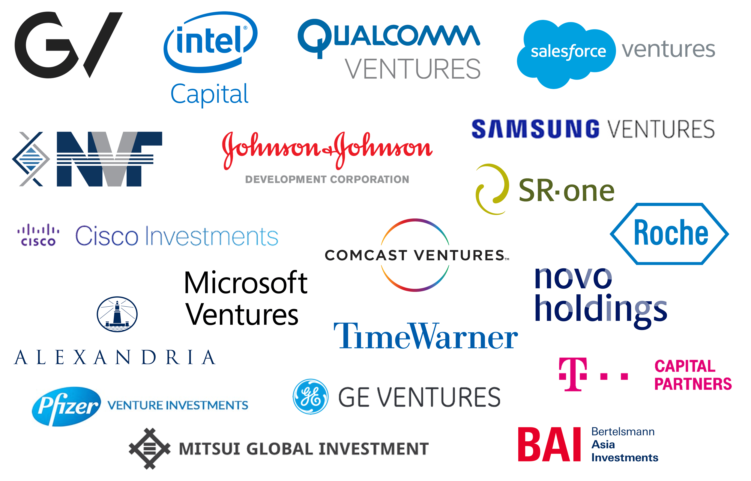
Chapter
Corporate ventures
11
Corporate ventures can be viewed simply as a series of tools or techniques that can help bring about entrepreneurial outcomes.
They help generate and maintain strategic renewal. Some of these tools and techniques relate to how the organization structures and manages itself internally (called internal corporate venturing) whilst others relate to how it struc­tures itself externally (called external corporate venturing).
An entrepreneurial architec­ture encourages and facilitates the development and use of these tools and techniques.
ENT628
Entrepreneurship

Slide 7
Chapter
13
Corporate ventures
  Internal corporate venturing
  concerned with how the organization encourages and manages innovative, entrepreneurial projects - how it encourages new businesses to develop internally whilst aligning them to the company's existing activities.
  Internal corporate venturing might be undertaken by an individual -who is known as an intrapreneur.
  More often it is now undertaken by a team, often called a venture team. One reason for this, particularly in tech firms, is the importance of cognitive diversity to facilitate the recombination of skills and ideas from different areas.
  Team formed for a specific project from staff with different skills from different departments.
ENT628
Entrepreneurship

Slide 8
Chapter
Corporate ventures
13
  External corporate venturing
concerned with how the organization structures itself externally to encourage innovation and develop new business areas.
This may be through partnerships, strategic alliances and joint ventures, It may also be through investments and acquisitions in strategically important smaller firms and the corporate venturing units needed to undertake this role.
ENT628
Entrepreneurship

Slide 9
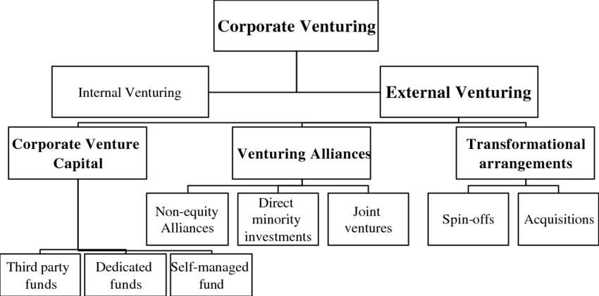
Chapter
Corporate ventures
13
ENT628
Entrepreneurship

Slide 10
Chapter
INTRAPRENEURS
13
The term intrapreneur is generally used to describe the individual charged with pushing through innovations within a larger organization, in an entrepreneurial fashion -a salaried 'entrepreneur' in a big company that they do not own.
Successful intrapreneurs share many of the character traits of entrepreneurs a need for achievement, a need for autonomy, drive, and determi­nation, a high internal locus of control, creativity, and innovativeness, and an ability to live with risk and uncertainty.
Although they have a desire for autonomy and a willing­ ness to live with risk and uncertainty, this does not translate into a desire to be completely independent and set up their own business - they are probably too risk-averse.
ENT628
Entrepreneurship

Slide 11
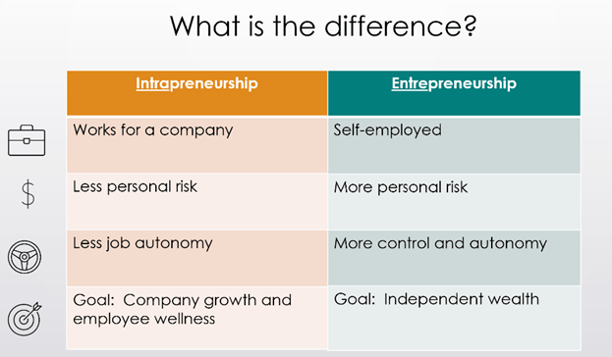
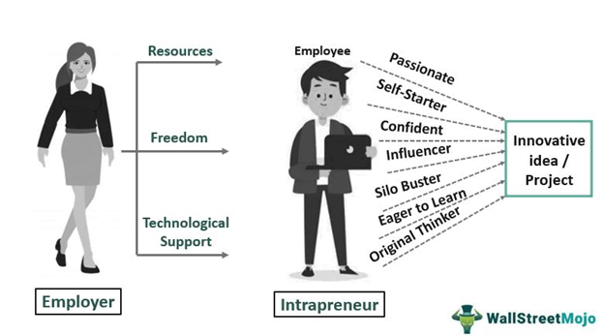
Chapter
INTRAPRENEURS
13
ENT628
Entrepreneurship

Slide 12
Chapter
Identifying Core Competencies
13
Competencies are the glue that binds existing businesses. They are also the engine for new business development: They suggested that there were three tests that can be applied to identify core competencies:
They should provide potential access to a wide variety of markets rather than generating competitive advantage only in one.
They should make 'a significant contribution to the perceived customer benefits of the end-product' -they add value.3
They should be difficult for competitors to copy. Products are easier to copy than pro­cesses and, as this book outlines, an entrepreneurial architecture should be particularly difficult to copy.
ENT628
Entrepreneurship

Slide 13
Chapter
Identifying Core Competencies
13
The best intrapreneurs are ambitious, rational, competitive and questioning. They dislike bureaucracy and are challenged by inno­vation, but they have an understanding of their organization and a belief in their colleagues. Unlike many entrepreneurs, they need to be adept at politics and good at resolving conflict as they navigate their way through the blocks and blockers in other operational units in their organization .
Intrapreneurs and venture teams need to be aligned around one important goal - a specific, measurable achievement within a specific time frame
ENT628
Entrepreneurship

Slide 14
Chapter
Facilitating Intrapreneurship
13
Intrapreneurs and venture teams should thrive within an organization with an entrepre­neurial architecture - an architecture created and nurtured by the leader of the organiza­tion. However, for an intrapreneurial project to succeed it needs a number of other facilitating elements:
• An intrapreneurial team - The team needs to have the necessary skills, knowledge, and competencies to undertake the project. It also needs to have appropriate team skills -the team needs to have an intrapreneurial culture, that develops visions, goals, and action plans; takes action and rewards action; encourages suggesting, trying and experimenting; encourages creating and developing regardless of the area; and encourages the taking of responsibility and ownership.
•
ENT628
Entrepreneurship

Slide 15
Chapter
Facilitating Intrapreneurship
13
• High-level sponsor - the intrapreneur and their team may need to be shielded in some way and made to feel that they are different and protected. Every project needs a high-level sponsor with sufficient authority both to protect them when times are difficult or vested interests are upset and to help them unblock the blockages to change as they occur. The sponsor should help secure resources, provide advice and contacts, and help give them the organizational freedom they need.
ENT628
Entrepreneurship

Slide 16
Chapter
Facilitating Intrapreneurship
13
Leading -This scale gauges the degree of respect and deference shown to authority figures (power distance}. (China, Russia)
Deciding -This scale measures how group decision-making is consensually compared to relying on one person (the boss). (Japanese)
Trusting -This scale balances task-based trust (from the head} with relationship ­based trust (from the heart). In task-based cultures (e.g., the USA, the UK, Germany) trust is built through work. In relationship -based societies (e.g., Brazil, China, India} trust is built by personal networks
• Resources - Resources of all kinds are needed for any project - particularly in terms of time and freedom or slack from day-to-day responsibilities. Other resources may include money, materials and access to information, knowledge and skills that other managers may be guarding jealously. The high-level sponsor may need to facilitate cross-departmental transfers of staff to provide the team with the necessary skills to undertake the project as well as press departments to provide information to the project team.
• Tolerance of uncertainty and risk-taking -The team need to believe that they can take risks in pushing through the project without any fear of penalties. These risks may relate not only to the success or failure of the project but also to potential damage to interpersonal relationships if the team is perceived as circumventing the authority of certain managers.
ENT628
Entrepreneurship

Slide 17
Chapter
Handling Internal Politics
13
Intrapreneurs face many blocks and blockers -some internal, others external. They need to navigate the internal politics of the organization from the very start and that can sometimes be the most difficult part of getting a new product or service to market.
success depends critically upon viewing the political challenge as part of the project from the very start and engaging with it: '[Intrapreneurs] apply a wide variety of political influence actions to help move the orga­nization.
They actively engage people across their organization. They position the product and the project in the context of the organization in a way that others could see the value and benefits. The ability to influence individuals in these groups depends upon the character and track record of the intrapreneur and their team.
ENT628
Entrepreneurship

Slide 18
Chapter
Selecting A Venture Team
13
Leading -This scale gauges the degree of respect and deference shown to authority figures (power distance}. (China, Russia)
Deciding -This scale measures how group decision-making is consensually compared to relying on one person (the boss). (Japanese)
Trusting -This scale balances task-based trust (from the head} with relationship ­based trust (from the heart). In task-based cultures (e.g., the USA, the UK, Germany) trust is built through work. In relationship -based societies (e.g., Brazil, China, India} trust is built by personal networks
Team working is commonplace now across most businesses and is particularly valuable in pushing through innovations. A single intrapreneur on their own rarely has all the skills required to see a project through to completion.
In order to be suc­cessful, the team needs to have:
The skills, knowledge and competencies to undertake the project, probably from a wide range of different disciplines such as computer programming, engineering, marketing, or finance.
A balance between creativity and project execution is necessary and has direct implications on the project's outcome.
Complementary personal characteristics so that their 'team roles' complement each other's. The team needs to build trust and this can be helped if the team has prior experience working together.
ENT628
Entrepreneurship

Slide 19
Chapter
Innovation Departments Or Functions
13
Leading -This scale gauges the degree of respect and deference shown to authority figures (power distance}. (China, Russia)
Deciding -This scale measures how group decision-making is consensually compared to relying on one person (the boss). (Japanese)
Trusting -This scale balances task-based trust (from the head} with relationship ­based trust (from the heart). In task-based cultures (e.g., the USA, the UK, Germany) trust is built through work. In relationship -based societies (e.g., Brazil, China, India} trust is built by personal networks
An innovation department is a permanent organizational structure set up for the purpose of originating and/or developing innovations.
These innovative ideas might originate from within the department or from other sources, including intrapreneurs.
The department then needs the resources to develop the idea. Innovation may also simply be a function within a department - for example, an innovation function might be located within the marketing department of a company.
ENT628
Entrepreneurship

Slide 20

Chapter
Innovation Departments Or Functions
13
There are a number of issues with innovation departments or functions:
They may find it difficult to think 'outside the box' in searching for innovative ideas because they share the same 'dominant logic' with the rest of the organization but are likely to have narrower horizons. Indeed, rather than allowing skills and competencies across the organi­zation to be leveraged, they may cause them to be compartmentalized. If the innovation function is part of the production department, the innovations are likely to relate to production. If it is part of the marketing department they are likely to relate to marketing.
ENT628
Entrepreneurship

Slide 21
Chapter
Innovation Departments Or Functions
13
They may not have the skills and capabilities to take a promising idea forward, despite it being in some way strategically important to the future of the organization. New ideas may need resources and investment beyond the normal budget of a department or function within a department. In these circumstances, the intervention of top management may be required to provide the resources and degree of organizational separation and/or support needed by the department.
They may be unduly susceptible to political in-fighting because of the seniority (or otherwise) of its managers and, even if it has an entrepreneurial architecture itself, it may face a hostile architecture elsewhere in the organization.
they have limited skills, knowledge and competencies compared to an ad hoc team drawn from across an organization.
ENT628
Entrepreneurship

Slide 22
Chapter
Innovation Units Or Divisions
11
What is really needed for large organizations that are seeking to encourage both incre­mental and radical innovation, particularly through the intrapreneurial teams is an organizational capability that is more flexible, has more resources, and greater perceived and real authority within the organization.
Many of the most innovative companies have therefore set up separate innovation units or divisions, often in a separate location, reporting directly to the CEO.
radical innovations are best placed in separate locations, led by a high-level manager with greater autonomy and free from the bureaucracy of the main organization
ENT628
Entrepreneurship

Slide 23
Chapter
Strategic 'Fit'
13
We should never underestimate the ability of large corporations with dominant market posi­tions to ignore internal developments. They might have the funds to invest in R&D on the one hand, but on the other, their existing products/markets might dominate their attention. if an innovation should potentially threaten that market position.
Once the flow of innovative ideas has started, the question will arise as to what to do with them, The two factors that influence how an incremental or a radical product /service innovation is handled by an organization are operational relatedness and strategic importance.
ENT628
Entrepreneurship

Slide 24
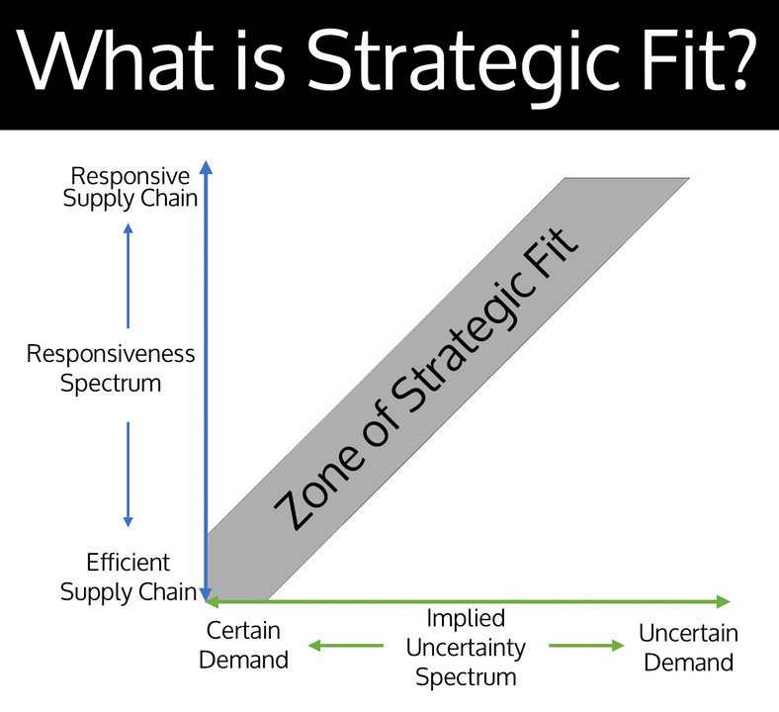
Chapter
Strategic 'Fit'
13
Operational relatedness refers to how close the innovation is to the existing product /service portfolio and its market footprint, reflecting the core skills, competencies and capabilities of the organization. This is not necessarily related simply to a company's own industry.
Strategic importance refers to how important innovation is to the future development of the organization. There could be many reasons for this, but one factor is the current strategic orientation of the organization and the business model it adopts in meeting the needs of customers. This might also provide some insights into its capabilities and competencies that underpin its business models (e.g. product quality, process efficiency or cost and customer focus
ENT628
Entrepreneurship

Slide 25
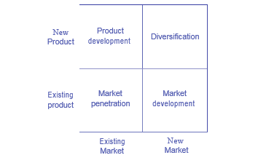
Chapter
Product/ Market Expansion
14
Innovation involves moving into new products and /or new markets and the risks involved increase the further the firm moves from its core competencies.
Companies will follow combinations of these routes as they grow, through both internal and external developments
ENT628
Entrepreneurship

Slide 26
Chapter
Product/ Market Expansion
14
• Market development is most successful for companies whose core competencies lie in the efficiency of their existing production methods, for example in the capital goods industries, and are seeking economies of scale, or for firms adept at sales, marketing, and developing close customer relationships. One way of lowering the risks associated with finding new markets is through strategic alliances/partnerships and joint ventures.
• Product and process development is most successful for those companies whose competencies lie in building good customer relationships, often associated with effective branding. However, of equal importance could be the ability to innovate. Again, one way of lowering the risks associated with product innovation is through the formation of strategic alliances/partnerships and joint ventures.
ENT628
Entrepreneurship

Slide 27
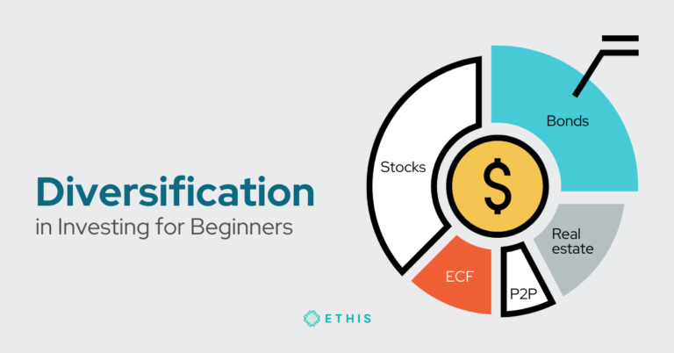
Chapter
Product/ Market Expansion
14
• Diversification - introducing new products into new markets - is a high-risk strategy for most companies. This is why, in the previous chapter, it was said that this sort of devel­opment should either be spun off and sold or set up as SBUs until a final decision about strategic importance is made. This can be likened to radical or disruptive innovation that might create a new-to-the-world industry. Whilst some firms might see these innova­tions coming from within, frequently they pursue this growth option through a strategy of acquisition.
ENT628
Entrepreneurship

Slide 28
Chapter
The New Venture Creation Framework
14
Market penetration can take time. Some customers may even be adopting an innovation for the first time at the end of its commercial life. The diffusion of innovation takes time as different types of customers adopt it at different stages of its life cycle.
Rogers (2003) argued that the adoption of innovations by consumers follows channels of communication within society and is not steady.
He classified custom­ers into five groups:
ENT628
Entrepreneurship

Slide 29
Chapter
The New Venture Creation Framework
14
Innovators (estimated at 2.5 percent) -These are risk-takers, typically with high social and financial status, who are interested and understand the innovation and are willing to experiment.
Early adopters (estimated at 13.5 percent) - These are opinion leaders, typically again with high social and financial status, who are sufficiently well connected and educated to learn about and understand the benefits of the innovation. It is important for any innovation to impact favorably on this group.
Early majority (estimated at 34 percent) -These form the majority of customers with aver­ age social and financial status. They have contact with early adopters and are likely to be influenced by them.
ENT628
Entrepreneurship

Slide 30
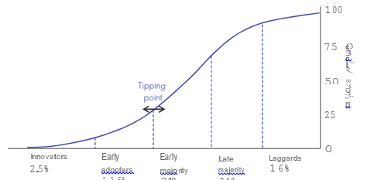
Chapter
The New Venture Creation Framework
14
Late majority (estimated at 34 percent) - These adopt the innovation after the average person, approaching any innovation with scepticism. Typically, they have below-average social and financial status.
Laggards (estimated at 16 percent) - These are the last to adopt an innovation. They are traditionalists who dislike change. Typically, they are older, with limited contacts outside their close network and also have below-average social and financial status.
ENT628
Entrepreneurship

Slide 31

Chapter
Developing Existing Products And Markets
14
Innovation is not just about finding entirely new products/market offerings. Existing products and markets can be adjusted innovatively so that their life is extended or their market expanded.
These innovations can start at the growth phase of the life cycle by expanding the product offering and meeting the needs of selected market segments so as to counter the threat of competition.
Expanding the offering means developing product variations.
( EX: A soft drink manufacturer
might start to offer sugar-free variants or new flavors. )
ENT628
Entrepreneurship

Slide 32
Chapter
Developing Existing Products And Markets
14
At the same time, the company might want to try to find new distribution channels so that more customers gain exposure to the product. Sometimes they move from a selective distribution network to a more intensive network. Associated with this is a more aggressive promotion and pricing strategy that encourages further market penetration ahead of the rapidly emerging competition. Building the brand is important and this will be a vital part of the advertising message.
ENT628
Entrepreneurship

Slide 33
Chapter
Developing Existing Products And Markets
11
Another technique is called product extension whereby a successful brands extended to similar but different products that might be purchased by the same customers. In this way a number of chocolate bar manufacturers have successfully extended their brand into ice cream. The key to success here is having a strong brand, one that actually means something to customers, and with values that can be extended onto the other products.
ENT628
Entrepreneurship

Slide 34
Chapter
Finding New Markets
14
Increasing numbers of businesses now sell their products internationally from day one. Selling to a very small target or niche market in one country can raise issues of viability. Selling to the same niche market globally can dramatically change the equation and offer the opportunity of high profits, because of economies of scale (also important if the pro­ duct is perceived as a commodity and cost leadership is dependent upon achieving them).
The internet has made it easier to sell internationally, particularly for virtual products that can be transmitted on the internet (e.g., music or apps). Physical products can use global internet retail platforms like Amazon or eBay to sell their product, take payment by credit card and use distribution networks like FedEx.
ENT628
Entrepreneurship

Slide 35
Chapter
DIVERSIFICATION
14
Diversification involves moving from core areas of activity into completely new and. untreated product and market areas
Unrelated diversification happens when the firm develops beyond its present 'industry' or 'sector' into new products/services and markets that, on the face of it, bear little relationship to the one it is in. Whether arising from internal development or acqui­sition, there is little or no operational relatedness with the innovation.
Related diversification - Related diversification is when development (or acquisition) is beyond the present product and market, but within the confines of the industry or sector in which the firm operates. In these circumstances, there is likely to be some operational relatedness that offers the opportunity for economies of scale, scope (synergy) or the expan­sion or extension of the firm's existing product range - in other words , there is some added benefit from the move.
ENT628
Entrepreneurship

Slide 36
Chapter
Acquisitions And Industry Life-cycles
14
The risks are said to be high because the firm understands neither the product /service nor the market the innovation is to be sold into and therefore might overvalue it and not understand how to deploy it. The further the company strays from its core competencies, the higher the risks because of problems with implementation, particularly when this is coupled with an imple­mentation strategy involving the acquisition.
Companies that pur­sue a strategy of diversification over time end up with a number of units or subsidiaries operating in different product /market sectors. Called conglomerates,
ENT628
Entrepreneurship

Slide 37
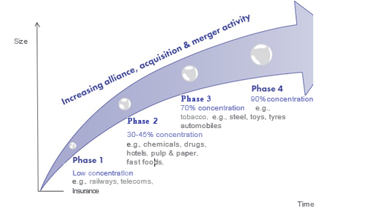
Chapter
Acquisitions And Industry Life-cycles
14
there is increasing acquisition and merger activity as industries mature and this leads to increased industry concentration.
indus­try typically has four distinct phases and the main factor determining corporate survival and success is the speed with which the company actively moves toward the final phase - the endgame curve - through a series of mergers and acquisitions
ENT628
Entrepreneurship

Slide 38
Chapter
Acquisitions And Industry Life-cycles
14
Phase 1 In this phase, there is heavy competition from start-ups, spin-offs, firms in dereg­ulated industries and smaller companies. As a result , there is low market concen­tration - less than 20 per cent, measured by the combined market share of the three biggest companies. This phase typically lasts at least five years.
Phase 2 The authors called this the 'scale phase' because size begins to matter. Corporate acquisitions increase and leading companies start to merge. Concentration increases to 30-45 per cent.
Phase 3 In this phase, companies extend their core business , eliminating secondary oper­ations or exchanging them with other firms for assets closer to their core business. Concentration increases to almost 70 per cent.
Phase 4 This final phase sees concentration reaching 90 per cent and large companies forming alliances in order to boost growth
ENT628
Entrepreneurship

Slide 39
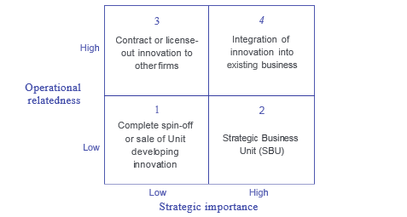
Chapter
Reasons For Corporate Acquisitions
14
The strategic acquisition of small firms by larger ones is probably the most visible form of external corporate venturing. It can also be a powerful accelerator of growth.
ENT628
Entrepreneurship

Slide 40
Chapter
Corporate-level Strategic Review
14
Box 1 Existing product(s) and market(s) –
Market dominance provides organizations with the opportunity to charge oligopoly prices and the acquisition of competi­tors may have a role to play in this, albeit at the price of acquiring the competitor. The company purchases a customer base and eliminates a competitor at the same time. We see this sort of acquisition activity in newly emerging markets where no clear dominant brands have yet been established.
ENT628
Entrepreneurship

Slide 41
Chapter
Corporate-level Strategic Review
14
Box 2 Introducing existing product(s) into new market(s) –
The purchase of another firm may be a way of buying market share - buying into a new market, possibly in another country. Once more, the aim is to achieve global market dominance quickly by buying from competitors in foreign markets. The purchase might also help gain economies of scale where this is important - for example, with technology and internet-based businesses that face high fixed costs in development and low variable costs in selling their product or service. There might also be economies of scope or synergy
Box 2 Introducing existing product(s) into new market(s) - The purchase of another firm may be a way of buying market share - buying into a new market, possibly in another country. Once more, the aim is to achieve global market dominance quickly by buying from competitors in foreign markets. The purchase might also help gain economies of scale where this is important - for example, with technology and internet-based businesses that face high fixed costs in development and low variable costs in selling their product or service. There might also be economies of scope or synergy.
ENT628
Entrepreneurship

Slide 42
Chapter
Corporate-level Strategic Review
14
Box 2 Introducing existing product(s) into new market(s) - The purchase of another firm may be a way of buying market share - buying into a new market, possibly in another country. Once more, the aim is to achieve global market dominance quickly by buying from competitors in foreign markets. The purchase might also help gain economies of scale where this is important - for example, with technology and internet-based businesses that face high fixed costs in development and low variable costs in selling their product or service. There might also be economies of scope or synergy.
Box 3 Introducing new product(s) into existing market(s) –
Any acquisition of another business with new products or technologies will involve finding markets for the innovations. One important motive in the purchase will be that the product is attractive to existing customers. It could be that these products replace existing ones, but it could also be the case that they offer the opportunity for product expansion (product variations that meet the needs of different market segments) and/or product extension (where a successful brand is extended to similar but different products).
ENT628
Entrepreneurship

Slide 43


Thank You

