Slide 1



Introduction to Digital Media
The Digital Media & Politics
DGM 711
Lecture 9
Prepared by
Dr. Shereen Kedwany

Slide 2

Reminder
Lecture 8
The public sphere, is a fundamental component of modern democracies, where individuals are free to discuss politics without being subject to an external authority, and can thus form a public opinion.
Media publics can successfully become politically active thanks to the emergence of an information‐rich digital environment and its related communication tools.
Digital technologies also favored the emergence of new kinds of players in the contemporary public sphere , such as WikiLeaks and Panama papers .
The networked public sphere is not inherently democratic in nature.
The algorithms that underpin digital platforms shape political and social interactions.
These are new forms of “algorithmic gatekeeping,”

Slide 3

Outline
Lecture 9
I. The Digital Divide:.
II. The Political Activity & Digital Media .
III. The Digital Surveillance .
IV. Conclusion.

Slide 4

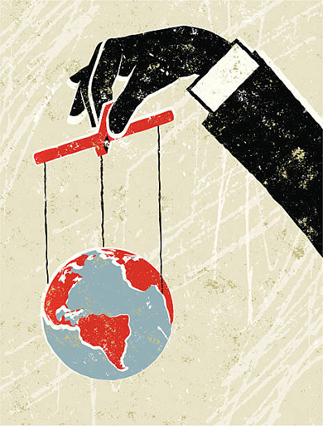
Lecture 9
I. The Digital Divide :
Power relations are now systematically organized around digital media, the ability to determine who can access them, as well as the planning and management of information flows.
This phenomenon has been transformed and strengthened by the emergence of the networked public sphere, but was present before the mass diffusion of digital media.

Slide 5


Lecture 9
I. The Digital Divide :
Since the 1990s there has been an increase in the number of citizens who access information and participate in political debates through digital media, while the number of individuals using only other media such as newspapers, radio, or television has decreased.
This change is gradual and develops unevenly in different areas of the world and social groups.
Indeed, although the internet can broaden citizen participation in the public sphere, access to digital technologies is uneven.

Slide 6
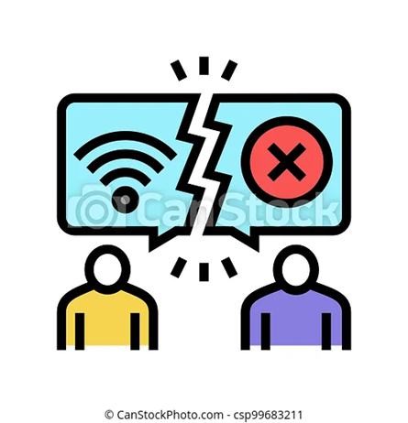
Lecture 9
I. The Digital Divide :
With the definition digital divide, media theorists highlighted the difference in access to network technologies that occurs between rich countries and poor countries, or between different classes or generations within the same country .
Indeed, in most advanced economies access to digital technologies and services is significantly higher than in developing countries .

Slide 7

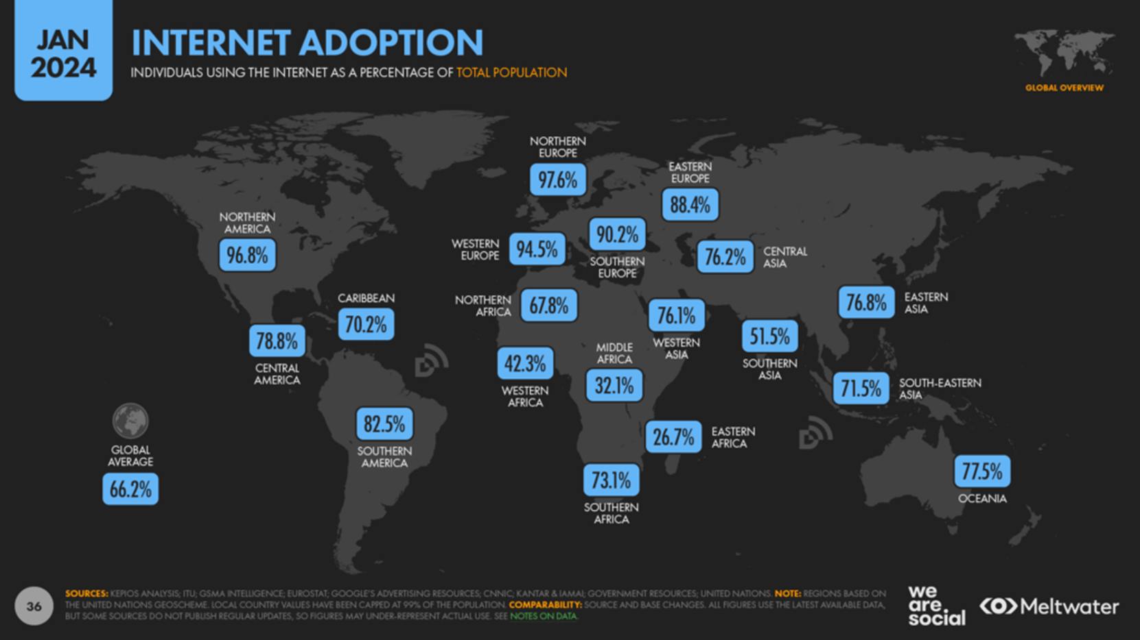
Lecture 9
I. The Digital Divide :
Source: https://wearesocial.com/uk/blog/2024/01/digital-2024/

Slide 8
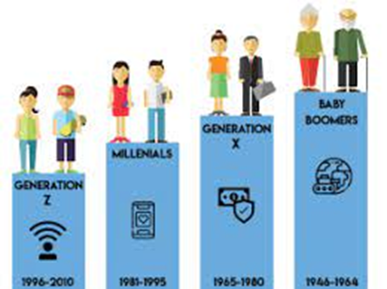
Lecture 9
I. The Digital Divide :
Furthermore, within a certain area the elderly, women, and low‐income communities may experience a digital divide in relation to other social groups.
Yet these divides tend to be the result of a multiplicity of factors.
For example, research on Seniors has confirmed the existence of both a “generational gap” and intergenerational differences in the use of mobile technologies such as tablets and mobile phones.

Slide 9

Lecture 9
I. The Digital Divide :
Such divides depend on several technological and socio‐economic factors and cannot be reduced to age alone .
The effects of these changes also depend on the type of society in which they occur.
Policies related to access to and transparency of information contribute to shaping how power is distributed.
Governments pursue initiatives to control access to information, and often are reluctant to foster greater transparency.

Slide 10
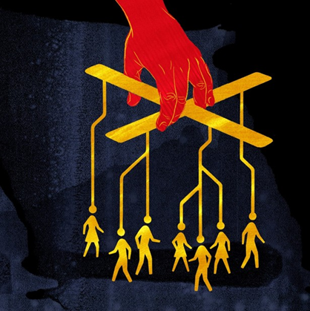
Lecture 9
I. The Digital Divide :
In authoritarian countries the distributed architecture of digital networks can make the control of information flows, and therefore of the public sphere, more difficult.
This difficulty can create room for free speech, as actors such as social movements may be able to use digital media to communicate freely in contexts in which the public sphere is strictly controlled by a regime.

Slide 11

Lecture 9
I. The Digital Divide :
On the other hand, these very changes can also give authoritarian regimes new tools to control the population, since activities on digital media are easily traceable and subject to surveillance.
Fears of a less controllable public sphere have led some governments, for example in North Korea, to restrict access to some digital services within the country.
This can have repercussions not only on freedom of speech, but also on economic development.

Slide 12
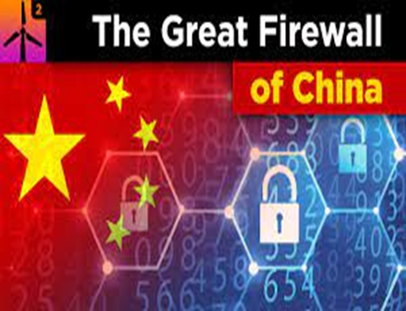
Lecture 9
I. The Digital Divide :
Non‐democratic governments, such as China’s, tend to exercise a very tight control on information flows.
The Chinese government filters unwanted content through its “Great Firewall of China,” a set of algorithms and other technologies that select sources and prevent the passage of certain types of information.
Users of that country’s internet are denied access to a number of websites and online resources, for example newspapers that publish information against the government.

Slide 13

Lecture 9
I. The Digital Divide :
some of these problems exist in many democratic countries, which may resort to censorship, filters, or other measures that restrict freedom of expression through digital media.
In sum, freedom of expression and the right to access information cannot be taken for granted, but rather need continuous revisions and negotiations, and are at the center of frequent legal and political battles .
As a response, some countries have discussed and implemented initiatives to protect freedom of expression and transparency.

Slide 14
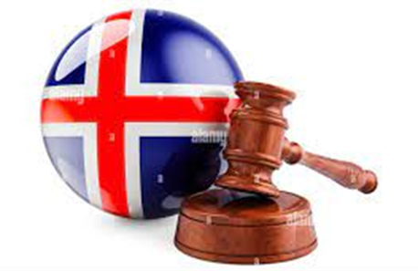
Lecture 9
I. The Digital Divide :
Through a series of laws developed in the 2010s, Iceland has set the goal of becoming a safe haven that protects journalists, internet users, and publishers around the world, while at the same time imposing increased transparency to the government.
These laws also aim to attract publishers, databases, and internet providers to the Icelandic market.

Slide 15

Lecture 9
II. The Political Activity & Digital Media :
Political activity is profoundly influenced by the media, as well as by information management systems.
If the most optimistic trends saw the networked public sphere as a means of creating forms of direct democracy intended to supplant the institutions of representative democracy, other more pessimistic accounts tend to see it as a reinforcement of existing hierarchies.
It is probably more correct to say that digital networks make new and different strategies of mobilization and participation possible, while at the same time providing an even greater power to some political actors.

Slide 16

Lecture 9
II. The Political Activity & Digital Media :
In Western societies, many political practices significantly depend on the ability to analyze the electorate with techniques in order to produce political marketing strategies targeted at different media.
Political parties develop platforms to collect data on their voters and supporters, collect donations, and communicate political content.

Slide 17
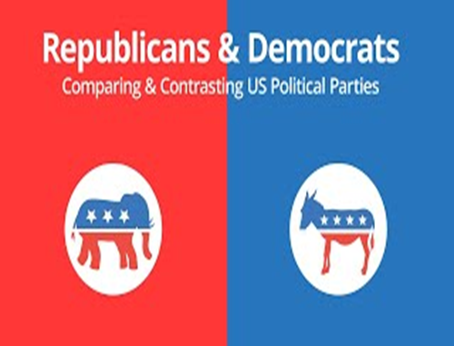
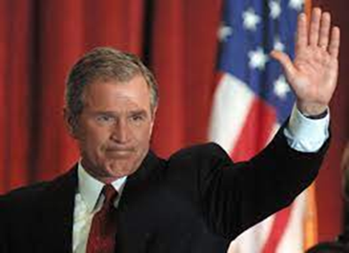
Lecture 9
II. The Political Activity & Digital Media :
In the United States, both the Democratic and the Republican Party run massive databases containing information about tens of millions of potential voters, such as data on demographic characteristics, voting behavior, and even purchasing behavior .
These data allow analysts to assign an individual profile to potential voters and arrange direct information flows through techniques borrowed from commercial marketing.
In the early 2000s for example the Republican database, Voter Vault, was much broader and more detailed than that of the Democratic Party.
This was one of the ingredients of George W. Bush’s success in the presidential elections of 2000 and 2004.

Slide 18
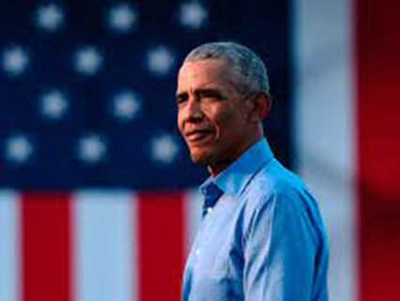

Lecture 9
II. The Political Activity & Digital Media :
Barack Obama’s race for the primaries of the Democratic Party and subsequent victory in the US presidential elections in 2008 is an example of the use of forms of digital‐ based collaboration for political purposes, as principles of grassroots political organizing were applied to the digital environment.
Thanks to a campaign based mainly on online platforms and created with the fundamental contribution of important figures in the world of digital media, like Chris Hughes, co‐founder of Facebook, who was responsible for his online campaign, Obama was able to defeat opponents in terms of number of people directly involved in his campaign, funds raised and, finally, votes.

Slide 19
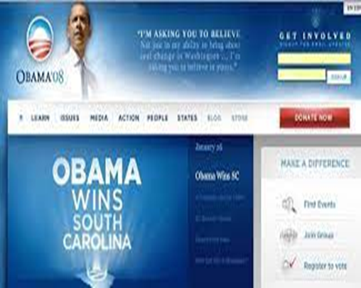
Lecture 9
II. The Political Activity & Digital Media :
Although the practices put in place by Obama cannot be considered the sole reason for his victory, his strategy leaving his supporters free to act and coordinate autonomously, but maintaining centralized control, has been studied as an early example of the political potential of digital environments.
The my.barackobama.com site played a crucial role, with 15 million Members who used it to organize at the local level for campaigning and fundraising (Castells 2009).

Slide 20
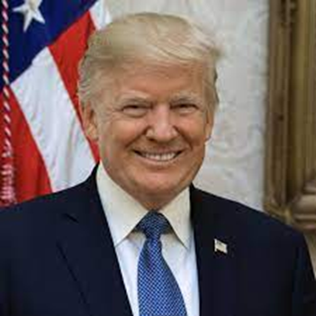
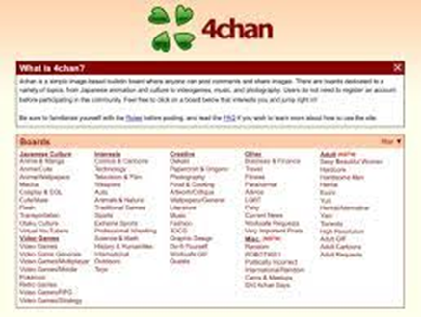
Lecture 9
II. The Political Activity & Digital Media :
In the same electoral cycle, Donald Trump was backed by an array of right‐wing groups that used websites such as 4chan (an underground imageboard forum) to produce and distribute memes and other viral content that increased the popularity of Trump or attacked Clinton, his opponent (Goerzen 2017).
In both cases, these initiatives mobilized hundreds of thousands of people, more than those involved in the official campaigns.

Slide 21
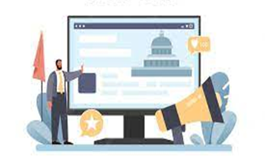
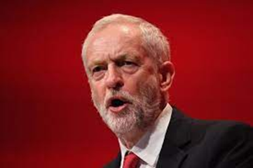

Lecture 9
II. The Political Activity & Digital Media :
In Europe, new political parties have adopted not only communication but also organizing strategies based on digital networks.
In 2017 in the United Kingdom, supporters of the Labour Party leader Jeremy Corbyn developed a smartphone app to coordinate delegates during the party’s conference .
In Italy, the Five Star Movement uses its digital platforms to create a space in which people with different political backgrounds converge to openly discuss issues of interest and vote on candidates and proposals.

Slide 22



Lecture 9
II. The Political Activity & Digital Media :
Other examples are Podemos in the Spanish state or the Pirate Party in Iceland, a political movement led by an interest in transparency and freedom of expression, the protection of individual digital rights and privacy, and intellectual property law reform.
These parties have grown to become major political actors, elected representatives in national legislations and at the European Parliament.
They promote digital‐media‐based forms of political participation.

Slide 23


Lecture 9
II. The Political Activity & Digital Media :
These “digital parties” may signal the emergence of organizational structures that in the future could ensure a vibrant and dynamic democratic debate attuned to the networked public sphere, while representing an alternative to the traditional mass parties of the twentieth century .
Some authors argue that these forms of digital democracy arise from the success of institutions like Wikipedia, which are based on a culture of participation based on direct access to information and online cooperation (Tkacz 2015).

Slide 24
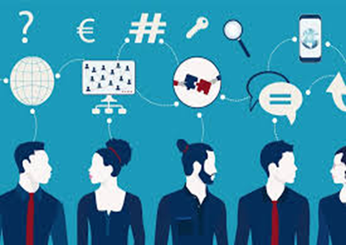
Lecture 9
II. The Political Activity & Digital Media :
On the other hand, digital media provide new tools for social control and repression.
Indeed, digital networks are characterized by a state of “passive participation” in which most information is not in the hands of the individuals who generated it but rather used by other actors and for purposes outside of user control.
Individuals are passively subject to this power, regardless of their political intentions and expectations .

Slide 25

Lecture 9
II. The Political Activity & Digital Media :
Any activity on digital media, whether it is access to a website, search engine use, interaction on social media, or exchange of messages via smartphone, leaves traces that are collected and monitored.
User data are in fact recorded, analyzed, and used for purposes of social control or profit.
This form of passive participation is created by two distinct but interlinked processes:

Slide 26



Lecture 9
II. The Political Activity & Digital Media :
1- Data capture is a set of processes that use information extracted from the analysis of user behavior and interaction to increase the efficiency of web companies (Agre 1994).
For example, Google uses user data – from your communications via Gmail and Google searches, to your movements tracked through Android phones – to create consumer profiles and then uses them to present personalized advertising to individual users.

Slide 27

Lecture 9
II. The Political Activity & Digital Media :
2- Surveillance is a process of data collection and analysis undertaken by public or private actors in order to control the behavior of individuals.
In many cases, governments use agreements with web corporations to access data on their citizens.
While corporate data capture allows the modification and improvement of the user experience, surveillance is covert and not perceptible by the user.

Slide 28
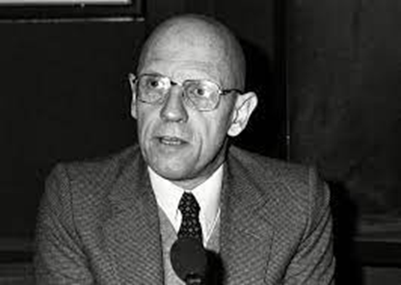
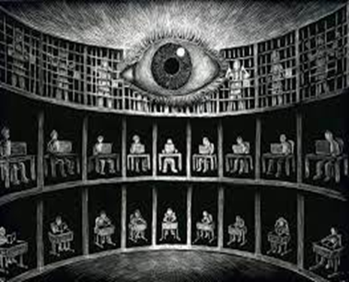
Lecture 9
III. The Digital Surveillance :
In the 1970s, French historian and philosopher Michel Foucault described the birth of a “disciplinary society” characterized by the pervasiveness of institutions dedicated to observing and normalizing citizens’ behavior (1977).
To describe disciplinary power, Foucault used the example of the Panopticon, a prison designed in the eighteenth century by the English philosopher and jurist Jeremy Bentham.
The architecture of this building allows one person to control all the prisoners, who are always visible but are not able to tell whether they are being observed.

Slide 29
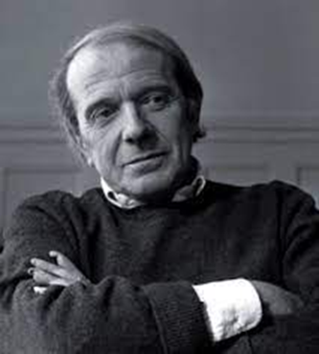
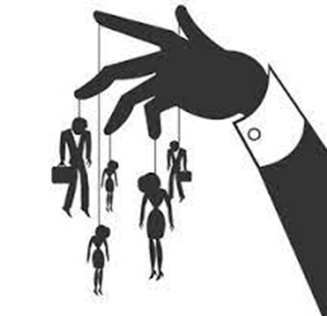
Lecture 9
III. The Digital Surveillance :
Similarly, the modern disciplinary society analyzed by Foucault was based on institutional control over individuals.
Another French philosopher, Gilles Deleuze, has proposed that the contemporary era is characterized by the transition to a “society of control” in which power is exercised through continuous and instantaneous control of the population, and even spread in the “brains and bodies” of the citizens (1992).

Slide 30
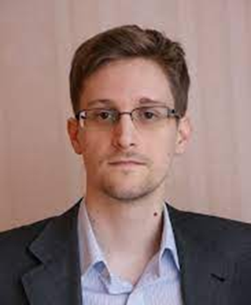

Lecture 9
III. The Digital Surveillance :
Several authors have referred to Foucault and Deleuze in order to interpret surveillance processes carried out through digital technologies, in particular since the 2010s and, later on, in reaction to revelations about the depth and reach of today’s surveillance systems.
In 2013, the American computer programmer Edward Snowden revealed to the world the existence of secret spying programs put in place by the National Security Agency (NSA), a US government agency.

Slide 31
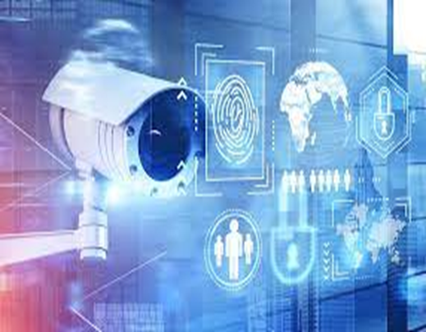
Lecture 9
III. The Digital Surveillance :
Thanks to Snowden’s revelations, as well as further information that emerged later, we know that several Western governments, particularly the US, operate surveillance systems that allow them to record all phone and online interactions.
These systems are often used without the mandate of a court (Greenwald 2014).

Slide 32

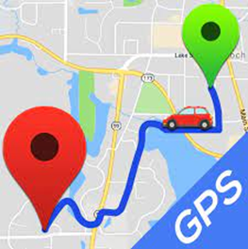
Lecture 9
III. The Digital Surveillance :
Surveillance processes depend on the cooperation of large web corporations, which have access to the data generated by users and capture it to improve their services or provide personalized advertising.
Thanks to this collaboration, state agencies can, for example, turn on the camera and microphone of any laptop or smartphone and use them to spy on a person without their knowledge.
These agencies have created databases that contain information on all digital communications, and in some cases have access to data about the movements of users of mobile phones with GPS.

Slide 33
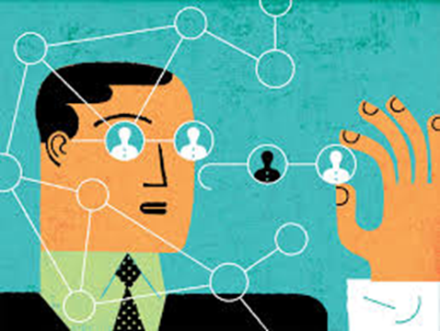
Lecture 9
III. The Digital Surveillance :
Thanks to algorithms that analyze the collected data, both web companies and surveillance agencies can construct the “profile” of a user, that is, a statistical extrapolation used to recognize and interpret patterns of behavior.
This is the result of corporations’ reliance on data capture and analytics as a core part of their business model.

Slide 34

Lecture 9
III. The Digital Surveillance :
In 2018, further revelations about the intertwining of political surveillance and social media commercial interests surfaced.
The Guardian released the so‐called Cambridge Analytica Files, a set of information revealing that Facebook had sold data from millions of unknowing users to a company that used them to influence the 2016 US elections (Cadwalladr 2018).

Slide 35
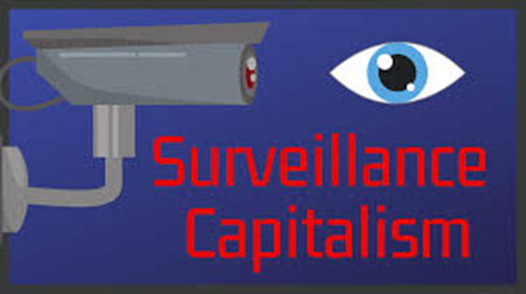
Lecture 9
III. The Digital Surveillance :
The ability of corporations such as Google or Facebook to extract relevant data from any human behavior has prompted social theorists to use definitions such as “surveillance capitalism” to describe the economic systems that sustain surveillance (Zuboff 2016).

Slide 36

Lecture 9
III. The Digital Surveillance :
On the other hand, surveillance is presented by governments as a useful practice aimed at protecting society from criminal or terrorist activities.
However, digital technologies have expanded surveillance to the entire population, in a sense making concrete the society of control imagined by Deleuze.
The collection of masses of data from surveillance cameras, emails, social media, web browsing, and phone calls is no longer targeted at individual suspects, but rather extended to all citizens.

Slide 37

Lecture 9
III. The Digital Surveillance :
Conversely, resistance to surveillance is based on technologies and actions that allow users to not produce data, or to make them untraceable or not analyzable .
The growing awareness of the pervasiveness of surveillance in digital environments has fostered forms of resistance.
While stricter regulation remains the most important way to defend digital media users from privacy breaches, individuals can choose specific strategies to resist surveillance.
Some are technical.

Slide 38


Lecture 9
III. The Digital Surveillance :
Encryption is based on a set of coding techniques that allow a user to read a text only if they possess its key.
One of the most used technologies for the exchange of encrypted emails is PGP (Pretty Good Privacy), an encryption system in which two users exchange deciphering keys that are generated for each message and thus are relatively secure.

Slide 39

Lecture 9
III. The Digital Surveillance :
Other strategies are political and have to do with individual and collective choices.
Refusal, that is choosing not to participate in the activities underpinned by commercial web services, may also be a form of resistance to surveillance and other forms of uneven power.
In some cases, the decision to abandon a dominant social media platform such as Facebook may be a way to assert one’s individuality as a consumer rather than a politically oriented decision (Portwood‐Stacer 2012).

Slide 40
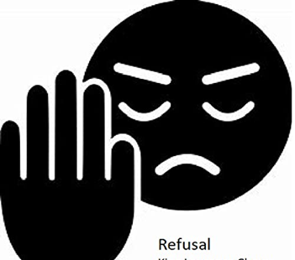
Lecture 9
III. The Digital Surveillance :
Indeed, the refusal to participate is a known commercial problem for social media business models; sites such as Facebook need to protect themselves by, for example, designing more engaging user relations .
Finally, in societies in which the public sphere is highly dependent on digital platforms, and social media use is considered a prerequisite to a meaningful political life, forms of media refusal that are not followed by the construction of alternatives, such as so‐called “Facebook suicides,” may result in marginalization .

Slide 41


Conclusion
Lecture 9
Power relations are now systematically organized around digital media and the networked public sphere
There has been an increase in the number of citizens who access information and participate in political debates through digital media.
Digital divide is the difference in access to network technologies that occurs between rich countries and poor countries, which depends on the type of society Policies related to access to and transparency of information .
Several Western governments operate surveillance systems that allow them to record all phone and online interactions.
Web corporations capture users' data to improve their services or provide personalized advertising.
Individuals can choose specific strategies to resist surveillance, such as encryption or refusal of participation in the commercial web services

Slide 42



Thank You

