Slide 1


Human Resources
Analytics
Prepared by Dr. Samah Abdelfatah
HRM 623
Lecture 6

Slide 2



PAYING FOR PERFORMANCE
Chapter
04
Lecture 06
HRM 623
Prepared by
Dr. Samah Abdelfatah
www.midocean.ae

Slide 3

Chapter
MAIN TOPICS
04
Paying for Performance—Performance Management Every Person Counts—A Real Performance Review— Make It Count: Strategic Applications— Disengagement And Turnover
www.midocean.ae

Slide 4
Chapter
PERFORMANCE MANAGEMENT
04
Performance management is one of a manager’s most confusing tasks. The reason that managers and supervisors have a difficult time conducting performance appraisals is twofold: psychological and systemic.
The First case, many cultures, particularly for America’s individual-based all-are created-equal value system, there is an underlying belief that criticizing another person’s performance is unacceptable. When organizations force this task on supervisors, those employees’ anxiety levels elevate.
The Second case, the system and the tools used by supervisors to do the job are problematic.
www.midocean.ae

Slide 5
Chapter
PAYING FOR PERFORMANCE
04
Connect individual and group performance with the organization’s key performance initiatives.
Most organizations claim that they align the top goals with employee performance, but close scrutiny reveals gaps and mis directions as the goal imperatives cascade down from the top to the middle and bottom.
Research has consistently shown that companies that set and maintain an alignment from top to bottom, and that pay for performance based on employees’ meeting objectively stated goals, outperform the market.
www.midocean.ae

Slide 6
Chapter
HOW TO REALLY PAY FOR PERFORMANCE
04
As organizations grow larger, the link between individual performance and organizational performance becomes more hidden by size, systems, and processes.
In a company of one, a person working for him- or herself, it is clear that company performance is largely determined by the performance of that person.
In a company with thousands of workers, the contribution of each individual is not always so clear, yet motivating and maximizing the performance of individuals is critical to company performance
www.midocean.ae

Slide 7
Chapter
EVERY PERSON COUNTS
04
The focus on individual performance is lost because people are aggregated into numbers.
These numbers are important for perspective—in fact, people costs make up as much as 70 percent of operating costs.
There is no doubt that people are supremely important to both output and cost; however, managing people in aggregate as an expense is a recipe for poor company performance.
www.midocean.ae

Slide 8
Chapter
EVERY PERSON COUNTS
04
Research found that Companies with performance management, goal management, and succession management outperform those that do not—it is that simple.
Performance management provides individual benchmarks relevant to the worker.
Goal management provides a context within which to act and get everyone on the team on the same page.
Succession management provides a framework for moving individuals to where they might have the greatest impact in the organization.
Of course, the data are the real power behind these talent-management applications.
www.midocean.ae

Slide 9

PERFORMANCE MANAGEMENT SYSTEMS
Performance Management Systems.
From a people perspective,
isn’t it fair to say that an individual should get clear expectations on what he or she should accomplish?
These individuals need to know how they are doing and how to improve. This is why success in different positions is measured differently
A strong performance management system measures individuals with relevant metrics, and these metrics are transparent and effectively communicated to the individuals in order to set clear expectations.
Chapter
04
www.midocean.ae

Slide 10

GOAL MANAGEMENT SYSTEMS
Chapter
04
(Individuals acting together toward a common goal), not by individuals.
Where performance management provides individual benchmarks for success, goal management links individual performance with the goals of the team or organization.
Players on the field need a context for making decisions. Goal management puts action into perspective for individuals, and also ensures that everyone is contributing to the team goals, or the objectives of the organization.
www.midocean.ae

Slide 11
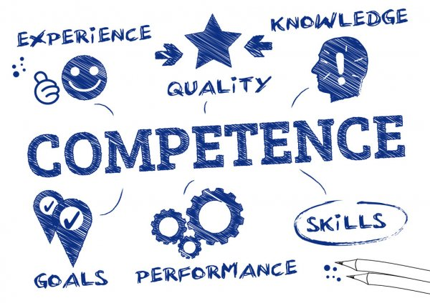
COMPETENCY MANAGEMENT SYSTEMS
How do you build a successful team?
Smart companies plan and identify the competencies required to succeed in various roles, and place and develop talent in those roles accordingly.
Competencies are one of the few reliable leading indicators of performance.
People with the right competencies for a role are more likely to succeed in that role.
Chapter
04
www.midocean.ae

Slide 12
A REAL PERFORMANCE REVIEW
Chapter
04
A real performance review is much more than a form, or even process.
Many companies look at a performance review as an appraisal, but it is really much more than that, as shown in Figure 4.12.
It is the single most powerful tool for driving the performance of an individual in an organization, and it will likely have substantial consequences on pay, future promotion, and (therefore) the engagement of the individual.
www.midocean.ae

Slide 13
PERFORMANCE MANAGEMENT PROCESS
The Dialog—
The line of communication between a manager and his or her direct reports is the start of all performance reviews.
The Data—Review the progress the individual has or has not made on the goal plan, assess his or her competencies, and measure the individual contributions. Only with comprehensive data can meaningful decisions be made.
The Direction—
If a performance review does not provide direction for both the manager and the employee, then the process itself has little value. The employee should be left with a clear impression of where he or she has excelled and where improvement is needed.
The automation of a form is the start of a performance management process, not the end.
A well-rounded and complete performance review has these three components
www.midocean.ae

Slide 14
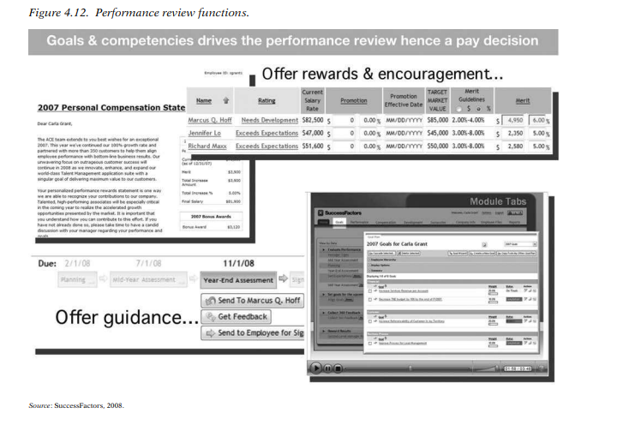
www.midocean.ae

Slide 15
WHY IS THERE SO MUCH FOCUS ON TRANSPARENCY AND DIRECTION?
Chapter
04
if they know what is expected and where they are going—it is also smart
from a performance perspective. Both clear links between individual
goals and company performance and having a clear career path are
strong drivers of employee engagement. Then, organizations are pushing
performance directly through the review process, as well as through
potential increased employee engagement.
In addition to being smart tactically—employees will find it harder to complain if they know what is expected and where they are going—it is also smart from a performance perspective.
Both clear links between individual goals and company performance and having a clear career path are strong drivers of employee engagement.
Then, organizations are pushing performance directly through the review process, as well as through potential increased employee engagement.
www.midocean.ae

Slide 16
Chapter
STRATEGIC APPLICATIONS
04
Use performance management data (which should include goals, competencies, and workforce planning data) to drive real value creation in your organization.
There are several rules you can use to ensure that you get the most from your performance management data.
www.midocean.ae

Slide 17
NEVER, EVER DO COMPENSATION PLANNING
IN A VACUUM
Chapter
04
Compensation is the clearest and most direct reward that companies control, and it is one of the most effective levers for motivating individual performance.
Real performance review data allow managers to set pay accordingly, to truly pay what the employees are worth.
The value of an integrated system extends even further; with analytics and comparative functions, managers can see how the pay is spread, how it compares to that of others in the organization, and what a global view of compensation in the company looks like.
Having a global stack ranking of performers can help in determining appropriate compensation levels, and it has the added benefit of highlighting high performers throughout the company.
The value of this data review is illustrated in Figure 4.13.
www.midocean.ae

Slide 18
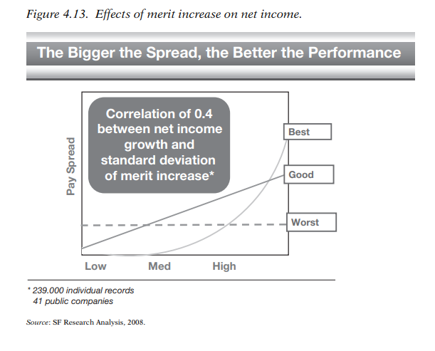
www.midocean.ae

Slide 19

2. NEVER DO LAYOFFS WITHOUT
PERFORMANCE DATA
Chapter
04
Layoffs happen because the company is spending too much money or because revenues have dropped, usually owing to changes in the external environment.
Financial pressure drives managers to make cost-cutting decisions quickly. Where people are managed as costs, bad decisions result.
People create the value in modern organizations; they make the products and intellectual property, sell to and support customers, and ultimately build the top line.
www.midocean.ae

Slide 20
Chapter
EXAMPLE, A TYPICAL LAYOFF SCENARIO
04
All departments are ordered to lay off 10 percent of their staff.
But what if one department was extremely high performing? Why lay off any of the high performers?
Global performance review data can help companies avoid these scenarios by allowing them to do real performance-based layoffs.
Don’t lay off aggregate groups; lay off the low and middle performers who aren’t contributing.
In uncertain times you want to keep your strongest people to keep your company performing and ready to emerge in a position of strength when the economy recovers.
www.midocean.ae

Slide 21
3. FILL HERE, FILL NOW
Chapter
04
Use your performance review data to drive the internal fill rates in your company.
Hiring from outside of the company is costly.
External hires are unknown quantities, typically have longer ramp-up to productivity times, and are generally much more expensive than filling an open position with an internal promotion or lateral move.
Of course, companies need and should want some external hires for fresh ideas and to expand the workforce, but finding the right balance between internal and external fills builds impressive cost savings and has the potential added benefit of increasing engagement.
www.midocean.ae

Slide 22
3. FILL HERE, FILL NOW
Chapter
04
Objectivity and transparency are the building blocks of a high-performance organization.
Progressive organizations don’t ‘‘manage turnover’’; they ‘‘optimize their workforce’’—a much deeper and more impactful action that sets the company up for long-term success.
www.midocean.ae

Slide 23
QUANTITATIVELY DRIVEN
PERFORMANCE MANAGEMENT
Chapter
04
Quantitative, objectively driven performance management simply provides you with the most strategic data to manage the business.
Simplicity is the key to getting the most strategic benefit from the process and to beating your competition while making work a better place for individuals in the process
Pay is an extremely sensitive issue for employees, and it serves several purposes.
  It is a scorecard that reflects one’s contribution to the organization.
  It is a fair assessment of reward that matches the market.
  It is a measure of comparative equity across the workforce.
www.midocean.ae

Slide 24
RECOGNIZING EMPLOYEE
DISENGAGEMENT AND TURNOVER
Chapter
04
There are two ways to look at turnover, or attrition.
It is almost always better to view a problem from the positive rather than the negative side.
Negative perspective
tracking turnover rates.
Positive viewpoint of retention
If we focus on keeping people whom we need, we will have better results than if we view the problem from the turnover side.
www.midocean.ae

Slide 25
Chapter
ENGAGEMENT
04
Engagement can also be viewed from two angles an employee’s feeling engaged with the company in general and the results of that lead to exceptional performance.
The first view is passive
Akin to job satisfaction.
The second is active
Drives value.
www.midocean.ae

Slide 26
DISORDER AND DISENGAGEMENT
Chapter
04
The phrase ‘‘attention-deficit disorder’’ can be used to describe a much broader range of phenomena than its usual psychological meaning. In today’s business climate, it certainly applies to a reduced focus on employee retention.
According to research employee disengagement already between 40 and 75 percent in most companies
Also, more than 80 percent of employees leave their jobs for reasons unrelated to pay, a large majority of managers still believe that pay is the main reason employees leave.
www.midocean.ae

Slide 27
THE UNFOLDING MODEL OF EMPLOYEE DISENGAGEMENT AND TURNOVER
Chapter
04
Knowing the causes of employee disengagement doesn’t guarantee that managers will recognize the signs of it. Nor does recognizing the signs guarantee that managers will care enough to do anything about it.
But what is helpful is to better understand the dynamics of how employees disengage and leave their jobs.
www.midocean.ae

Slide 28
THE UNFOLDING MODEL OF EMPLOYEE DISENGAGEMENT AND TURNOVER
Chapter
04
The down staircase in Figure 4.14 shows the intervening steps, from initial engagement through final departure. An employee typically starts a new job with great optimism and enthusiasm.
Some are able to sustain their enthusiasm. Others become disillusioned by the job or other workplace realities, which they may tolerate for long periods, during which time they typically withhold effort and show less enthusiasm.
Eventually, the employee may, or may not, begin an active search for another job, receive an offer, and leave. And as we know some employees quit and leave while others quit and stay (‘‘warm chair attrition’’).
www.midocean.ae

Slide 29
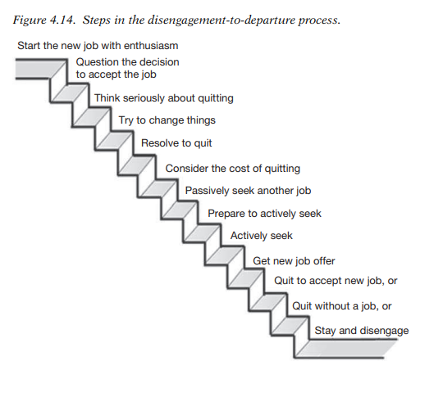
www.midocean.ae

Slide 30
THE TWO DISTINCT PHASES
OF EMPLOYEE DEPARTURE
‘‘Deliberation phase.’’
Phase 1 is the time that passes between an employee’s first thoughts of quitting and the actual decision to quit
‘‘Action phase.’’
Phase 2 is the time between the employee’s decision to leave and the actual leaving
www.midocean.ae

Slide 31
Chapter
‘‘TRIGGERING EVENT,’’ OR TURNING POINT
TO LEAVE
04
Dr. Lee’s studies have shown that 63 percent of all employee decisions to leave are precipitated by a ‘‘triggering event,’’ or turning point of some kind, such as:
Realizing they are underpaid compared to others doing the same job | A disagreement with the boss
Realizing they are not in line for promotion | A conflict with a co-worker
Being pressured to make unreasonable family or personal sacrifices | An unexpectedly low performance rating
Being asked to perform a menial duty (e.g., clean bathroom, go shopping for the boss) | A low pay increase or no pay increase
Being denied request for family leave | Being passed over for promotion
A close colleague quitting or being terminated | Being asked to do something unethical
www.midocean.ae

Slide 32
TO REVERSE DISENGAGEMENT AND TURNOVER, WATCH FOR THE SIGNS
Chapter
04
It is important for managers to be alert to the signs that an employee is just starting to disengage—when there is still time to do something about it.
So, what can managers do about it? they can observe the signs that employees are in the downward spiral of disengagement and possible departure.
There are three kinds of signs to watch for: behavior-based, event-based, and data-based.
www.midocean.ae

Slide 33
Chapter
1. BEHAVIOR-BASED SIGNS OF DEPARTURE
04
Here are some common signs that an employee may have experienced a triggering event and is thinking of leaving, or at least starting to disengage;
    Avoids eye contact
    Stops smiling or greeting
    Gives less energy and effort
    Arrives later
    Leaves earlier
    Has bursts of anger or frustration
    Participates less in meetings
Is absent more often Misses deadlines Applies for other jobs internally Increases community involvement and networking
www.midocean.ae

Slide 34
Chapter
2. EVENT-BASED SIGNS OF DEPARTURE
04
Some event-based signs may not indicate that the employee is disengaged, but they may nevertheless precipitate thoughts of leaving. The following types of triggering events are not preventable and exert more of a pull on the employee:
    Marriage
    Pregnancy
    Inheritance
    Personal or family health crisis
    Spouse or partner having job opportunity in another city
    Reaching eligibility for retirement benefits
Last child leaving home Paying off the mortgage Acquiring a company
www.midocean.ae

Slide 35
Chapter
2. EVENT-BASED SIGNS OF DEPARTURE
04
If an employee is already somewhat disengaged or dissatisfied with some aspect of the job or environment (push factor), a pull factor such as one of those listed above may be just the nudge he or she needs to move on.
These kinds of events may be the most difficult for managers to see or acknowledge, as the managers may, in fact, be the root of the problem.
www.midocean.ae

Slide 36
Chapter
3. DATA-BASED SIGNS OF DEPARTURE
04
The third kind of sign that may help in anticipating employee disengagement and turnover is available to us by reviewing data typically kept in human resources records. Like all signs and indicators, any one or two of the following data points may be meaningless, but when combined with others from the first two categories, they may add up to a flashing red light:
Absenteeism record
Tardiness record
Vacation days not taken
High turnover in the employee’s demographic group, type of position, or location
Declining performance ratings
Survey data showing low levels of engagement in employee’s unit
Employee being paid less than others at same level
Employee having record of frequent internal job postings Employee not having received performance review Employee having record of filing employee relations grievances
www.midocean.ae

Slide 37
Chapter
CAN WE REALLY PREDICT TURNOVER?
04
Yogi Berra supposedly remarked, ‘‘Predicting is hard . . . Especially about the future.’’ We need all the help we can get in predicting whom to hire, much less who will stay. But this is still not a science.
Theoretically, a manager could assign points to all the warning signs for a given employee, then add them up to see which ones fall into yellow, orange, and red alert groups.
Figure 4.15 may be a helpful tool for diagnosing which employees may be most at risk of leaving.
www.midocean.ae

Slide 38
Chapter
CAN WE REALLY PREDICT TURNOVER?
04
Based on the example in Figure 4.11, using the index scores of the nonmanagement group, let’s take a look at how things multiply o
It should be noted that B performers are valued, steady, and not dispensable—and are well worth your efforts to keep and engage them.
So are many C performers, who have simply been placed in the wrong jobs, mismanaged, or under coached.
To use the chart, simply list the names of your direct reports in the appropriate boxes, based on your evaluation of their performance and how at risk of disengaging or leaving they may be, based on your awareness of the signs presented here.
www.midocean.ae

Slide 39
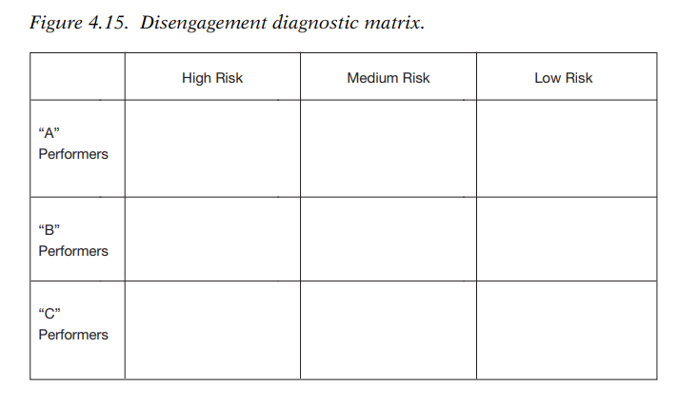
www.midocean.ae

Slide 40
DISENGAGEMENT DIAGNOSTIC MATRIX
Chapter
04
As an example, suppose you have noticed that Joe, one of your A performers, has stopped sending you e-mails in the last two weeks and has stopped speaking up in meetings.
You began seeing these changes the day one of Joe’s closest peers left the company. Joe has been working sixty to seventy hours a week to meet a critical project deadline and has not taken a vacation in two years.
So, is Joe a high or a medium risk? It doesn’t matter. What matters is that you care enough to notice and have a talk with Joe.
www.midocean.ae

Slide 41
REENGAGEMENT
Chapter
04
‘‘I value you as an employee and want to keep you. How are you feeling about things in general?’’
That simple question may well open a discussion that can lead to a resolution of the precipitating issue.
The good news is that most valued employees can be reengaged and retained with the right kind of attention, concern, and willingness to take action. But first you have to see the signs.
www.midocean.ae

Slide 42



Thank You

