Slide 1



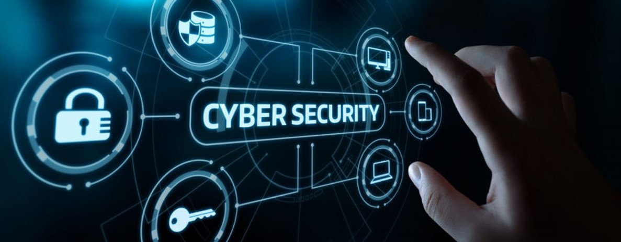
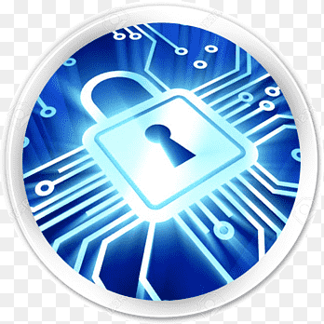
Lecture: #06
Securing Your Computers
Dr. Redhwan M. A. Saad
Head of Cybersecurity Department
Faculty of Informatics
Midocean University
CyberSecurity Fundamentals (CYB670)
www.midocean.ae

Slide 2

Chapter
Outline
06
    Securing Your Computers
Introduction
Firewall Settings
Antivirus Software
Anti-spyware Software
Anti-spam Software
Security Updates
Secure Browser Settings
Scan Devices Before Data Transfer
Social Engineering Attack Precautions
Miscellaneous Tips
2
www.midocean.ae
Cybersecurity Fundamentals, Dr. Redhwan M. A. Saad

Slide 3
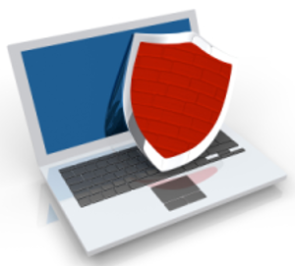
Chapter
Introduction
06
Computers have become the most integral parts of our day to day life.
We use computers so extensively that our personal and public matters and activities are fully under the influence of computers.
We communicate through computers, we buy through computers, we sale through computers, we travel with the help of computer-based systems, we work through computers, we are paid through computers, and even we order our food through computers.
3
www.midocean.ae
Cybersecurity Fundamentals, Dr. Redhwan M. A. Saad

Slide 4
Chapter
Introduction
06
The computers have drastically changed the way we lived our lives a few decades back.
In the 1970s when the first microprocessor was developed, nobody thought of that chip to influence the way it has done in today’s modern life.
After the development of internet and worldwide web, the influence of computers has become eminent on all fields and activities of life.
As the dependency of the people on computers increased, the issues with security of the computer expanded exponentially.
No one was aware of the dark side of the impact of computer till the first malicious program hit the internet resulting huge losses to the public lives and businesses.
4
www.midocean.ae
Cybersecurity Fundamentals, Dr. Redhwan M. A. Saad

Slide 5
Chapter
Introduction
06
The demand for the security of computers started increasing exponentially in the modern field of information technology.
There are many kinds of threats to the computers, communication networks, and all physical infrastructures that use the power of computer for their operations.
The threats to the computers can be divided into two major parts:
Traditional physical security threats
Cyber security threats
5
www.midocean.ae
Cybersecurity Fundamentals, Dr. Redhwan M. A. Saad

Slide 6
Chapter
Introduction
06
The physical threat can be further classified into:
Overt physical threats
Covert physical threat
Similarly, the cyber security threat can be classified into:
Computer security
Network security
Data Security
6
www.midocean.ae
Cybersecurity Fundamentals, Dr. Redhwan M. A. Saad

Slide 7
Chapter
Introduction
06
In this chapter, we are going to talk about the how to secure your computer from the cyber threats?
From the beginning of cyber security threats, the number of hackers is increasing very fast. Hundreds of thousand hacker attacks take place annually on the internet.
The list of the FBI’s most wanted cyber criminals is increasing continuously.
The total number of cyber criminals included the most wanted list of the FBI expanded to 63 in the first month of 2019.
7
www.midocean.ae
Cybersecurity Fundamentals, Dr. Redhwan M. A. Saad

Slide 8
Chapter
Introduction
06
The gravity of the cyber-attacks can be imagined by the latest statistics released by MacAfee Inc.
According to the MacAfee research, the total loss due to cybercrimes worldwide was estimated at about $600 billion in 2017.
With the advancement in the technology, the hackers are also becoming so sophisticated and advanced in attacking the computers.
Newer ideas, tools, techniques are being applied by the hackers to damage the cyber environment.
8
www.midocean.ae
Cybersecurity Fundamentals, Dr. Redhwan M. A. Saad

Slide 9
Chapter
Introduction
06
Let’s have a look at the major components used for securing our computers.
  Firewall Settings
  Antivirus Software
  Anti-Spyware Software
  Anti-Spam Software
  Security Updates
  Secure Browsing Settings
  Scan Devices before Data Transfer
  Social Engineering Attack Precautions
  Miscellaneous Tips
9
www.midocean.ae
Cybersecurity Fundamentals, Dr. Redhwan M. A. Saad

Slide 10

Chapter
Firewall Settings
06
Firewall is the first line of defense for the computer, when it is connected through the internet or other networks.
A firewall is a type of security software that is able to check and monitor traffic coming from certain sources and leaving for a certain ports or destinations.
Firewall software is used as the first line of defense for any kind of security threat originating from the external sources in a connected environment.
It is also the last security check-post for any traffic originating from your computer.
10
www.midocean.ae
Cybersecurity Fundamentals, Dr. Redhwan M. A. Saad

Slide 11
Chapter
Firewall Settings
06
Many firewall software monitors both incoming and outgoing traffics, but some firewall software only focuses on the incoming traffic because the main threat normally originates from the external sources sitting on the other side of the firewall.
The software applications that we use on our computers use the communication port numbers at transport layer of the OSI model.
The firewall checks the port numbers of the traffic to make sure that the traffic originated from the authorized sources and terminating at the genuine port.
11
www.midocean.ae
Cybersecurity Fundamentals, Dr. Redhwan M. A. Saad

Slide 12
Chapter
Firewall Settings
06
If there is any kind of irregularity in the traffic, the firewall is able to detect the suspicious activities and to generate an alert for the same.
It is also able to close the port for incoming traffic, if it is configured for the auto-blocking malicious activities.
In most of the cyberattacks, the hackers use the un-trusted connections to access the vulnerable applications on the computer to launch some malicious software code to install on your computers using those unauthorized connections.
Firewall is able to detect any un-trusted connection and stop it from intruding into the security of the system.
12
www.midocean.ae
Cybersecurity Fundamentals, Dr. Redhwan M. A. Saad

Slide 13
Chapter
Firewall Settings
06
Thus, the hacker is caught at the first defense of the computer before performing any malicious activity on the computers.
There is numerous firewall security software available in the market.
You can get so many firewalls for free too, but it is always not recommended to get the free security software for your computer with critical information.
Always purchase the firewall security software by paying their price.
The paid software is more robust and highly featured to capture numerous kinds of threats originating from the malicious users.
13
www.midocean.ae
Cybersecurity Fundamentals, Dr. Redhwan M. A. Saad

Slide 14
Chapter
Firewall Settings
06
A few very important firewall software that are known for having many great features and capabilities are mentioned below:
Zone Alarm Pro Firewall
Comodo Firewall
Norton Security Standard Firewall
Kaspersky Internet Security with Firewall
Bit Defender Security Firewall
TinyWall Firewall Software
It is always a great idea to activate the high-level security settings on firewall, but it may irritate you with many warnings and alerts. So, always try to configure firewall settings to allow all programs and their connections to monitor.
14
www.midocean.ae
Cybersecurity Fundamentals, Dr. Redhwan M. A. Saad

Slide 15
Chapter
Firewall Settings
06
If you have many applications that you don’t use, you should remove those applications from your computer to make your computer less prone to the external threats.
Windows operating system comes with integrated firewall software. It is activated by default, and you need to configure your security firewall for stronger security settings.
The Windows based firewall does not monitor the outgoing traffic from your computer, but it focuses mainly on the incoming traffic to monitor for any kinds of threats originating from the adversary sources.
15
www.midocean.ae
Cybersecurity Fundamentals, Dr. Redhwan M. A. Saad

Slide 16
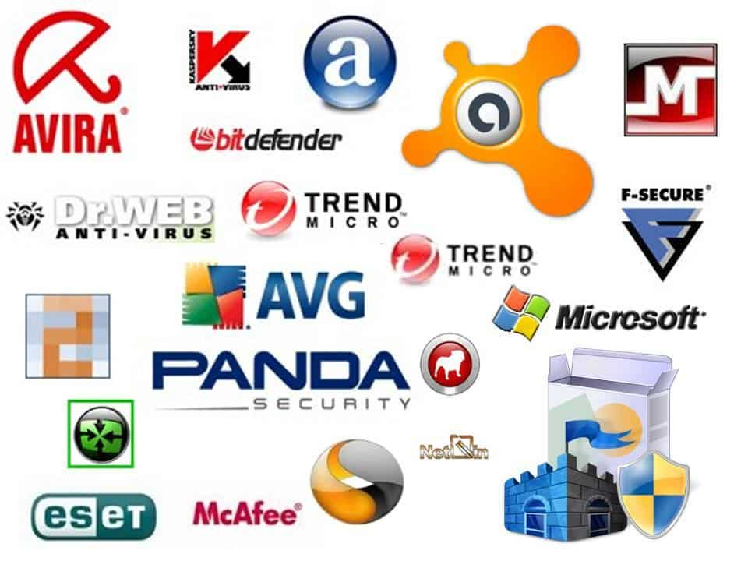
Chapter
Antivirus Software
06
Antivirus is one of the fundamental security tools that are recommended for every computer whether that is connected to the external world through internet or even it operates standalone position or in the silos.
Antivirus software is a security software utility that is able to detect different types of viruses and malwares on computers. It is also able to remove, delete, and quarantine a virus that has already affected the computer.
There are many types of viruses that commonly spread on the internet at a very high rate; among such viruses, Trojan horses, worms, viruses, rootkits, and other forms are a few very common to name. These viruses are very dangerous for damaging your valuable data on your computer.
16
www.midocean.ae
Cybersecurity Fundamentals, Dr. Redhwan M. A. Saad

Slide 17
Chapter
Antivirus Software
06
They use different types of application and system vulnerabilities to get them installed on the computer. Slowly and gradually, they start damaging, coping, or deleting your valuable data.
At some point, your will lose your data completely without any remedy to the data recovery.
Hackers and malicious attackers use different types of viruses for different purposes to launch some of the lethal cyberattacks on the networks and computers on the internet.
So, you should always be very well aware of the damage those viruses can inflict on your computers.
17
www.midocean.ae
Cybersecurity Fundamentals, Dr. Redhwan M. A. Saad

Slide 18
Chapter
Antivirus Software
06
The viruses also start duplicating on the computer, and thus reducing the performance of your computer by filling up the free space on your disk, using the excessive memory, choking data bandwidth and other resources of the computer and networks.
Many viruses create backdoors on the computers and start sending your valuable information and control to the handlers of the viruses through backdoor.
Once the control of your computer is transferred to the hackers, your computer starts acting as a source of cybercrimes by attacking the other computers on the network. Your computer becomes a ‘Zombie’ for hacker attacks.
18
www.midocean.ae
Cybersecurity Fundamentals, Dr. Redhwan M. A. Saad

Slide 19
Chapter
Antivirus Software
06
Numerous Good antivirus software programs, which are available in FREE as well as in paid versions.
You can choose any of those versions from the reputed antivirus software providers.
For computers with critical information and personal data, it is NOT recommended to use free antivirus software because those software programs offer limited capabilities and features.
And those limited capabilities are not sufficient for stopping certain viruses that are more powerful and more dangerous to your computers.
19
www.midocean.ae
Cybersecurity Fundamentals, Dr. Redhwan M. A. Saad

Slide 20
Chapter
Antivirus Software
06
Almost all available anti-virus software programs have multiple features like virus cleaner, spyware cleaner, Trojan horse detection, performance improvements and other standard features required for keeping your computer clean.
But, the paid versions of those antivirus software are more robust and have additional deeper features to cope with many dangerous of the cybercrimes.
20
www.midocean.ae
Cybersecurity Fundamentals, Dr. Redhwan M. A. Saad

Slide 21
Chapter
Antivirus Software
06
A few names of the top-notch antivirus software programs are mentioned below:
  Kaspersky Internet Security
  Panda Premium Antivirus
  AVG Internet Security
  Microsoft Security Essentials
  McAfee Total Protection
  Comodo Antivirus Software
  Avira Antivirus Pro
  Avast Security Ultimate
  Norton Security
Most of the antivirus are set to update their versions automatically by default, but in some cases if the antivirus software update is not turned on, activate it.
21
www.midocean.ae
Cybersecurity Fundamentals, Dr. Redhwan M. A. Saad

Slide 22
Chapter
Antivirus Software
06
You should also take of the following important points for keeping your computer free from viruses.
    Make sure your antivirus software automatically starts with the starting of your computer
    Antivirus is always on while the computer is on
    Always download and install the latest updates from the venders to update the virus definition database
    Regularly run quick scans on your computer
    Run full scans occasionally after a few weeks
    Always scan the data transfer mediums before copying any data
    Take notice of all warnings and alerts generated by the antivirus software
22
www.midocean.ae
Cybersecurity Fundamentals, Dr. Redhwan M. A. Saad

Slide 23

Chapter
Antispyware Software
06
Spyware is one of the most critical tools for launching cyberattacks on the targeted networks, services, or the computer servers.
Spywares are the malicious code design to spy on the activities of the user for getting information about the behavior of the internet user or steal the crucial information from the computers and online user accounts.
The advertisement campaigns can be started with proper focus on the targeted market segments suitable for their online marketing campaigns.
23
www.midocean.ae
Cybersecurity Fundamentals, Dr. Redhwan M. A. Saad

Slide 24
Chapter
Antispyware Software
06
One form of the dangerous spyware code is known as the keylogger, which is used to track and record the keys pressed. And sends it to the command-and-control center.
The hackers steal the information such as usernames, passwords, and other codes or pin numbers used for your financial activities and other valuable transactions through the internet.
24
www.midocean.ae
Cybersecurity Fundamentals, Dr. Redhwan M. A. Saad

Slide 25
Chapter
Antispyware Software
06
If you have already installed a full version of any antivirus software on your computer, you might have purchased the antispyware already. Many modern antivirus packages are also included with the spyware tools.
If there is no such security software on your computer, download one from the reputed companies to secure your computer from malicious spying on your computer, data, and your internet using behavior while browsing the internet.
Spyware codes normally spread through free downloads, free websites, and other such free sources available on the internet.
So, it is highly recommended to use the paid version of the software from the trusted security companies. Those software are not piggybacked with the spyware or other malicious codes.
25
www.midocean.ae
Cybersecurity Fundamentals, Dr. Redhwan M. A. Saad

Slide 26
Chapter
Antispyware Software
06
A few very well trusted antispyware software companies are listed below, you can choose any one of them to download the antispyware security software.
  SuperAntispyware software
  Spybot – Search and Destroy
  Adaware Software
  SpywareBlaster
  AVAST Antivirus (embedded)
  AVG Antivirus (embedded)
  MalwareBytes Spyware
  Emsisoft Emergency Kit
26
www.midocean.ae
Cybersecurity Fundamentals, Dr. Redhwan M. A. Saad

Slide 27
Chapter
Antispyware Software
06
Take the following measures to make your spyware protection more robust and effective:
  Use reliable and dedicated antispyware software.
  Always keep your antispyware software up to date
  Scan your computer regularly for any kind of spyware on your computer
  Always be vigilant while visiting the unknown websites
  Major source of spyware spreading is infected websites
  Deal strictly with the pop ups and alluring offers by clicking “x” on it
  Set your browser settings to block popup ads
  Don’t open emails from the unknown senders
27
www.midocean.ae
Cybersecurity Fundamentals, Dr. Redhwan M. A. Saad

Slide 28
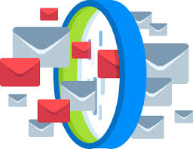
Chapter
Anti-Spam Software
06
Spamming is one of the major sources of spreading malwares on the internet.
Many spammers send malicious code like spyware, malwares, and viruses through different kinds of unsolicited emails from different sources.
A huge time was consumed on reading those unsolicited emails, which caused a huge loss to the company productivity.
28
www.midocean.ae
Cybersecurity Fundamentals, Dr. Redhwan M. A. Saad

Slide 29
Chapter
Anti-Spam Software
06
At that time two IT engineers started working on this problem by sorting out the IP addresses, servers, locations, company names and other information from where the spamming emails were originating.
That list was later used on the routers to filter the spamming emails through the boarder gateway protocol (BGP) on the internet.
They named it as the Mail Abuse Prevention System (MAPS). The name was a bit difficult so they reversed the order of the words to make it SPAM.
This list was later converted as real time black-hole list precisely referred to as RBL.
29
www.midocean.ae
Cybersecurity Fundamentals, Dr. Redhwan M. A. Saad

Slide 30
Chapter
Anti-Spam Software
06
A large majority of the public email servers like Google, Yahoo, Hotmail and others have successfully tracked and identified more than 99% of the spam emails and send them directly to their spam or junk folders.
Thus, a huge time and energy of the email users is saved.
But this problem is still a matter of concerned for many small and big organizations across the world.
They use different anti-spam services and software tools to stop this menace. This cost them money and manpower substantially.
30
www.midocean.ae
Cybersecurity Fundamentals, Dr. Redhwan M. A. Saad

Slide 31
Chapter
Anti-Spam Software
06
According to the latest research released by digital trends website suggest that the strike rate of spam emails has increased from 13.4% in 2017 to 14.2% in 2018. If this trend persists for a few years, the nuisance of spamming emails will soar again.
The spammers are becoming more sophisticated and start sending personalized emails and other phishing techniques to make the spamming more dangerous in years to come.
A large ratio of over 31% of the spam emails contain the malicious links, if the strike rate of clicking continues to increase the threat of cyberattacks will also increase substantially. The increase in the cyberattacks will inflict damages to the global economy exponentially.
31
www.midocean.ae
Cybersecurity Fundamentals, Dr. Redhwan M. A. Saad

Slide 32
Chapter
Anti-Spam Software
06
The major anti-spamming software and services include the following:
  Hornet Security Spamfilter Service
  SpamTitan anti-spam software
  MailCleaner anti-spam software
  SpamPhobia anti-spam
  Spambrella anti-spam service provider
  FireTrust MailWasher Service
You can also use customized services and software tools for safeguarding your company employees from the nuisance of spam emails.
32
www.midocean.ae
Cybersecurity Fundamentals, Dr. Redhwan M. A. Saad

Slide 33
Chapter
Anti-Spam Software
06
As mentioned earlier, the success rate of the anti-spam software tools or anti-spam email cleaning services is about 99% or so. Still there is a chance of the spam emails to pass through to the inbox of the users. Therefore, you need to take care of your emails too.
Other than using the anti-spamming emails solutions, you should also take care of the following points while using emails.
  Never open emails from unknown users
  Never click on the links or attachments of spam emails
Always keep the volume of spam emails in mind; if there is any spike in the emails consult with your cyber security person or service provider
33
www.midocean.ae
Cybersecurity Fundamentals, Dr. Redhwan M. A. Saad

Slide 34

Chapter
Security Updates
06
Computers perform different types of functions and activities based on the software code that runs not only the hardware of the computer, but also the software utilities that we use.
No software code is 100% perfect. There may be some flaws, bugs and other vulnerabilities in all types of software programs.
These bugs or vulnerabilities in the software programs may be present in the operating system, drivers, application software, utilities software, and network software.
The vulnerabilities in the websites and web-based applications can also be a major issue that can pose security threat.
34
www.midocean.ae
Cybersecurity Fundamentals, Dr. Redhwan M. A. Saad

Slide 35
Chapter
Security Updates
06
Hackers and cyber criminals use those vulnerabilities, flaws, bugs, and obsolete features to attack the computers and the networks. The security professionals always keep a close eye on the code, features of the code, bugs, possible vulnerabilities and other security related aspects to make improvements in the system and application software.
The modification and improvement in the software tools with new software patches or new version releases are known as the updates.
The updates are very critical not only for the security of your computer, data, and network, but also for the other people connected with you and your computer network.
35
www.midocean.ae
Cybersecurity Fundamentals, Dr. Redhwan M. A. Saad

Slide 36
Chapter
Security Updates
06
If you don’t update your software regularly, you would definitely remain at the risk, but your computer once infected, will also pose the threats for the other users on the internet because your computer may turn a zombie and spread security threats to other computers of the people known to you and the people connected on your network.
For keeping your computer updated with the security patches, you should need to install patches and install newer versions of the following applications:
Use the latest version of the operating system of your choice
Always install operating system software updates regularly without any delay
36
www.midocean.ae
Cybersecurity Fundamentals, Dr. Redhwan M. A. Saad

Slide 37
Chapter
Security Updates
06
Always use genuine security software programs
Avoid to use free programs, which may bring some malware accompanied with them
Always put your security applications on auto updating option
Update every software application that you use on your computer
Remove all applications that you don’t use
Always use the latest versions of the software utilities and applications on your computer
Don’t use the cracked version of software applications, it may be very dangerous for your data and computer security
Never delay in installing downloaded updates
37
www.midocean.ae
Cybersecurity Fundamentals, Dr. Redhwan M. A. Saad

Slide 38
Chapter
Security Updates
06
By taking all of the above-mentioned measures carefully, you can save your data, computer, and applications from big dangers.
Meanwhile, you also help in making the internet more secure for the people you know and the other people connected on your network.
38
www.midocean.ae
Cybersecurity Fundamentals, Dr. Redhwan M. A. Saad

Slide 39

Chapter
Secure Browser Settings
06
The vulnerabilities in the browsers are extensively exploited by the hackers and malicious attackers to intrude into the computer systems for carrying out cybercrime activities like data theft, identity theft, data corruption, ransom attacks, spamming, and other activities.
Many browsers are used by the internet users; among such commonly used browsers Google Chrome, Windows Explorer, Mozilla Firefox, and Netscape are a few very important ones to name.
Every browser has its own capabilities and security features.
Presently, Google Chrome is one of the most popular browsers used in the internet surfing and accessing the other online web services.
39
www.midocean.ae
Cybersecurity Fundamentals, Dr. Redhwan M. A. Saad

Slide 40
Chapter
Secure Browser Settings
06
Google and Mozilla Firefox are releasing their security patches and software features more frequently as compared to the other browsers.
That is the reason that many people prefer using these two very important browsers for majority of the operating systems including Linux, Windows, Mac, and others.
Every browser has numerous settings that relate performance, security, privacy, and other plugins and functions.
While using the browsers, you should take special care of all those features and capabilities, especially the security settings.
You should configure your browsers with high level of security and privacy settings to make sure that hackers would not be able to exploit the possible vulnerabilities in low secure settings of a browser.
40
www.midocean.ae
Cybersecurity Fundamentals, Dr. Redhwan M. A. Saad

Slide 41
Chapter
Secure Browser Settings
06
You should set the browser to safe browsing mode. Meanwhile, the settings should also not allow the tracking of the traffic request and turn on the SSL and HTTPs certificate settings.
All these security related settings would help you stay away from the malicious attacks of the hackers.
Your browser should be configured for automatic installation of plugins.
You should install plugins only when you are 100% sure about that plugin and you trust that vendor.
41
www.midocean.ae
Cybersecurity Fundamentals, Dr. Redhwan M. A. Saad

Slide 42
Chapter
Secure Browser Settings
06
The privacy settings of the browser should also be restricted to high-level of privacy.
Your location, personal information, login and passwords and other information should also be not configured to show or save for every user on the computer. You should also set separate user group for accessing the computer resources.
It is always recommended not use the administrator account for normal activities like emailing, internet surfing, normal home or office work or other such routine activities.
If you are not logged in as administrator, then any malicious attempt to install some code on your computer would be difficult for the hackers.
The malicious program will be prompted with logging in as administrator to install any new program.
42
www.midocean.ae
Cybersecurity Fundamentals, Dr. Redhwan M. A. Saad

Slide 43
Chapter
Secure Browser Settings
06
Thus, your computer will remain safe from hidden attempts to install some malicious programs on your computer, and you will also be alerted for any attempt to alter the settings of your computer or any attempt to install some malicious programs on your computer.
Let’s summarize the main settings of your browser to keep your computer safe from any malicious attempt to alter your computer resources and settings.
Setup privacy settings to high level
Use separate strong password-based user groups
Don’t safe passwords on browsers
43
www.midocean.ae
Cybersecurity Fundamentals, Dr. Redhwan M. A. Saad

Slide 44
Chapter
Secure Browser Settings
06
Don’t login as an administrator until you really need it
Activate the safe browsing settings on the browser
Your browsing traffic should be attached with ‘Do Not Track’ request
Activate SSL and HTTPS settings
All popup, plugin, and other activities should be denied or should be asked to get permission from the computer admin
Computer resources and content access settings should be very strong
Always check for harmful software installed on your browser or computer
44
www.midocean.ae
Cybersecurity Fundamentals, Dr. Redhwan M. A. Saad

Slide 45
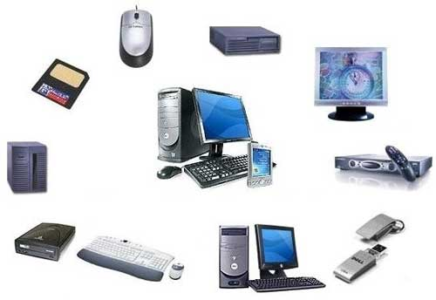
Chapter
Scan Devices before Data Transfer
06
Data travelers or other devices to run or transfer data from one point to another one have been the major transporter of viruses, worms, Trojans, and other malicious codes.
Among such devices flash drive, CDs, DVDs, external hard drive, and any other data transferring devices.
All those devices should be properly scanned with the updated antivirus and anti-malware software to detect and kill any malicious programs attached to the data.
After scanning the devices fully, you can copy or transfer data between the devices; this will reduce the threat of viruses to infect your computer.
45
www.midocean.ae
Cybersecurity Fundamentals, Dr. Redhwan M. A. Saad

Slide 46

Chapter
Social Engineering Attack Precautions
06
Social engineering is very important source for unleashing a cybercrime on your data, personal information, and bank account information.
In this form of cyber-attacks different mediums like text messages, chatting, group discussion, telephone call, and emails are used to communicate with you to exploit your innocence or ignorance. This is also a part of cyber frauds.
You might have noticed that you get an email from a legitimate looking source that you got a prize through a lucky draw or you got a big job opportunity in a big organization. That email looks like it has been sent from a legitimate company and you will be lured by the presentation of the content.
46
www.midocean.ae
Cybersecurity Fundamentals, Dr. Redhwan M. A. Saad

Slide 47
Chapter
Social Engineering Attack Precautions
06
The hacker on the other end of the communication tries to use the social behavior to influence your thoughts and asks you to provide your personal information including the bank account and other information.
When they receive this information, they request you for some processing fee and may ask for credit card information.
If you provide this information, they use it maliciously to damage you to steal money from your banks or from your credit card.
If you send the money they ask for, they will go away and will not appear again.
47
www.midocean.ae
Cybersecurity Fundamentals, Dr. Redhwan M. A. Saad

Slide 48
Chapter
Social Engineering Attack Precautions
06
The main objective of such social engineering attacks is to achieve the financial benefits from the innocent people.
They also use the text messages, phone calls and other mediums for the same purpose.
In those cases, the in-person communication is used so efficiently that you will not doubt on their sincerity at any point of time.
They use very professional manners to talk with you so politely and effectively that you start believing in their conversation and provide the information they like to get from you.
48
www.midocean.ae
Cybersecurity Fundamentals, Dr. Redhwan M. A. Saad

Slide 49
Chapter
Social Engineering Attack Precautions
06
Hackers use the social engineering tactics to spread malware in your mobile and computer device through emails, attached documents, and messages.
Once you click the emails and its attachments, the viruses embedded in those emails download and install on your computer or mobile device. Thus, those viruses start carrying out the activities that they are designed for by the hackers sitting at the remote site.
So, never open emails, text messages or other messages from unknown people.
If you see any kind of such alluring message from the unknown, just delete it without any second thoughts!
49
www.midocean.ae
Cybersecurity Fundamentals, Dr. Redhwan M. A. Saad

Slide 50
Chapter
Miscellaneous Tips
06
All of the above-mentioned items are the major components of keeping your computer free from the viruses and other cyber-attacks.
There are many other factors that are also very important for keeping your computer free from the viruses.
All those factors should be considered carefully other than the above-mentioned items. Those miscellaneous tips play very crucial role in your personal behavior towards the computer security.
As we known, the security is a continuous process and it is not possible to achieve by acting once.
You will have to adopt different recommendations and industry guidelines in your behavior so that you can make your habit 100% in compliant with the computer security standards and procedures.
50
www.midocean.ae
Cybersecurity Fundamentals, Dr. Redhwan M. A. Saad

Slide 51
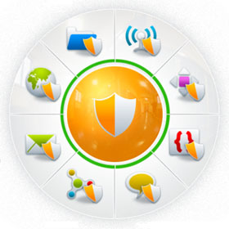
Chapter
Miscellaneous Tips
06
The main tips for keeping your computer free from viruses are listed below:
Never use the cracked software
Never use free software because free software tools are normally embedded with some additional codes and advertisements, which can spy on the users and take the information and send to the company servers.
Never save your passwords on your computer or browsers because if your computer is compromised, then your passwords and other information will at direct risk
Don’t provide critical information on telephone, email, or SMS
Don’t open files sent by unknown people
51
www.midocean.ae
Cybersecurity Fundamentals, Dr. Redhwan M. A. Saad

Slide 52
Chapter
Miscellaneous Tips
06
Don’t visit faulty websites
Set your browser settings at high security and privacy
Always create separate users for a computer
Create a guest account with minimum privileges, if required
Uninstall all Apps that are not in use
Don’t install unknown applications
Always install the plugins that you deem necessary for your use
Avoid to use free applications
Always update your applications
Use latest versions of OS
Use latest versions of applications
52
www.midocean.ae
Cybersecurity Fundamentals, Dr. Redhwan M. A. Saad

Slide 53
Chapter
Miscellaneous Tips
06
Never miss a security patch or update at all
Daily check for the security updates
Turn off your computer if you are not using it
Turn off the internet router, if not used for a certain period of time
Take security as a serious matter in your life
Regularity check for the security guidelines
Always make a copy of your valuable data
Create check-points on your computer
Run schedule virus scans regularly
Always download something from the reliable websites
Never try to use the public data sharing websites for exchanging data
53
www.midocean.ae
Cybersecurity Fundamentals, Dr. Redhwan M. A. Saad

Slide 54
Chapter
Miscellaneous Tips
06
Use highly secure and reliable data sharing and collaboration platforms for data transfers
Use strong passwords. The strong passwords should contain different combinations of the lower and the upper-case letters, symbols and numeric
Encrypt your important data files through regular encryption options available with the operating systems or through any other tools available in the market
By taking all of the above-mentioned standard guidelines and tips for keeping your computer safe from viruses and other malware threats, you can avert big data losses and enjoy smooth internet browsing without incurring any damage to your computer.
54
www.midocean.ae
Cybersecurity Fundamentals, Dr. Redhwan M. A. Saad

Slide 55
Chapter
Quiz, ex.
06
1. In the …………………………………………………………..,the hacker tries to use the social behavior to influence your thoughts and asks you to provide your personal information including the bank account and other information.
A. social engineering attack.
B. MITM.
C. DoS.
D. DDoS.
2. The first microprocessor was developed In the……………………..
1970s.
1990s.
1980s.
1950s.
55
www.midocean.ae
Cybersecurity Fundamentals, Dr. Redhwan M. A. Saad

Slide 56



Thank You

