Slide 1


Slide 2
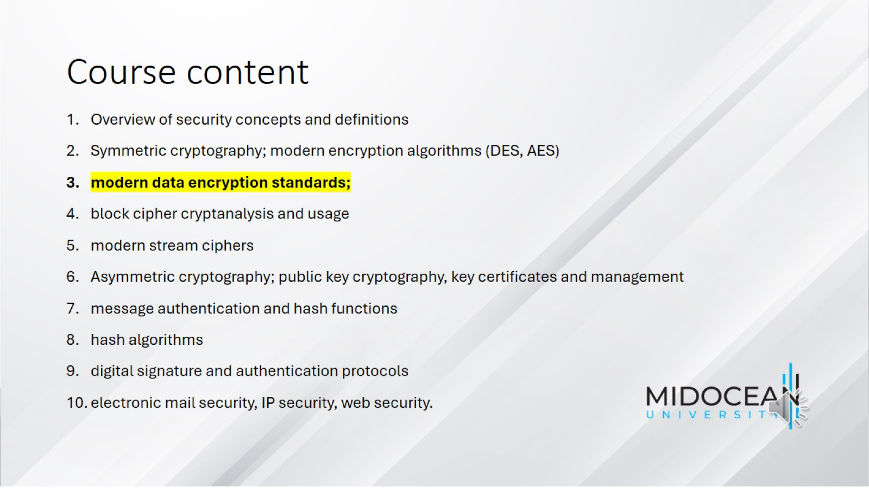
Course content

Slide 3
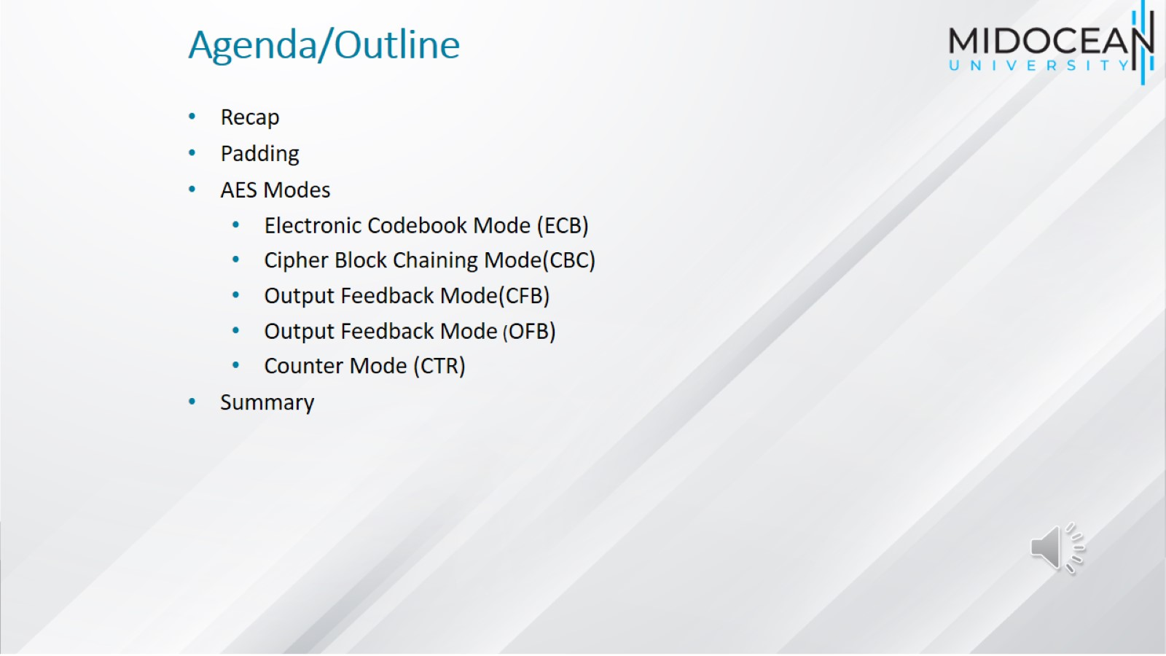
Agenda/Outline

Slide 4
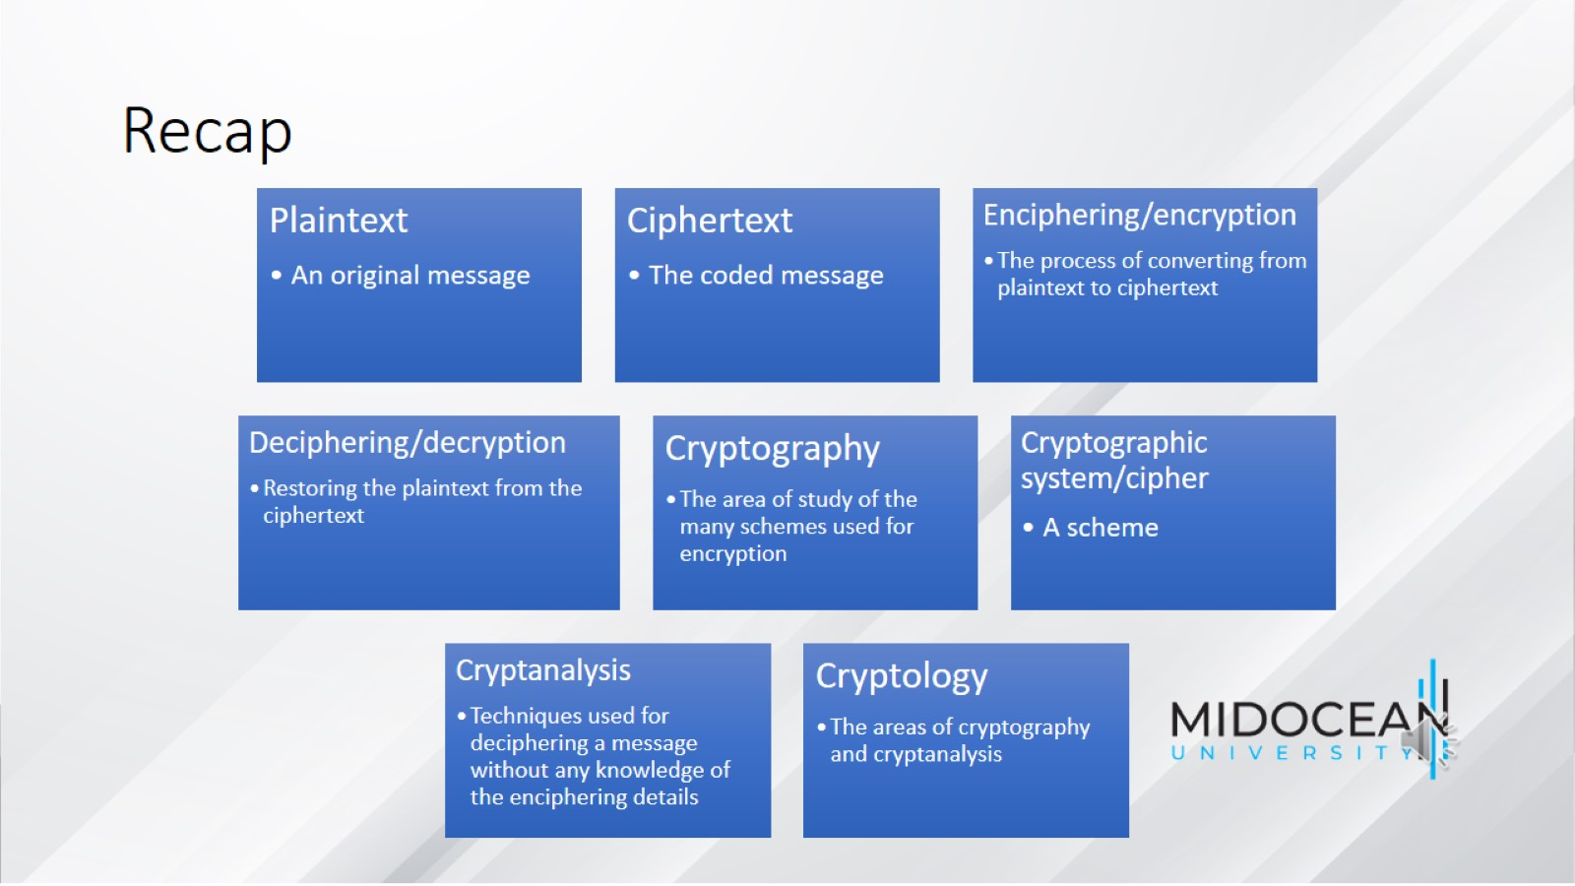
Recap

Slide 5
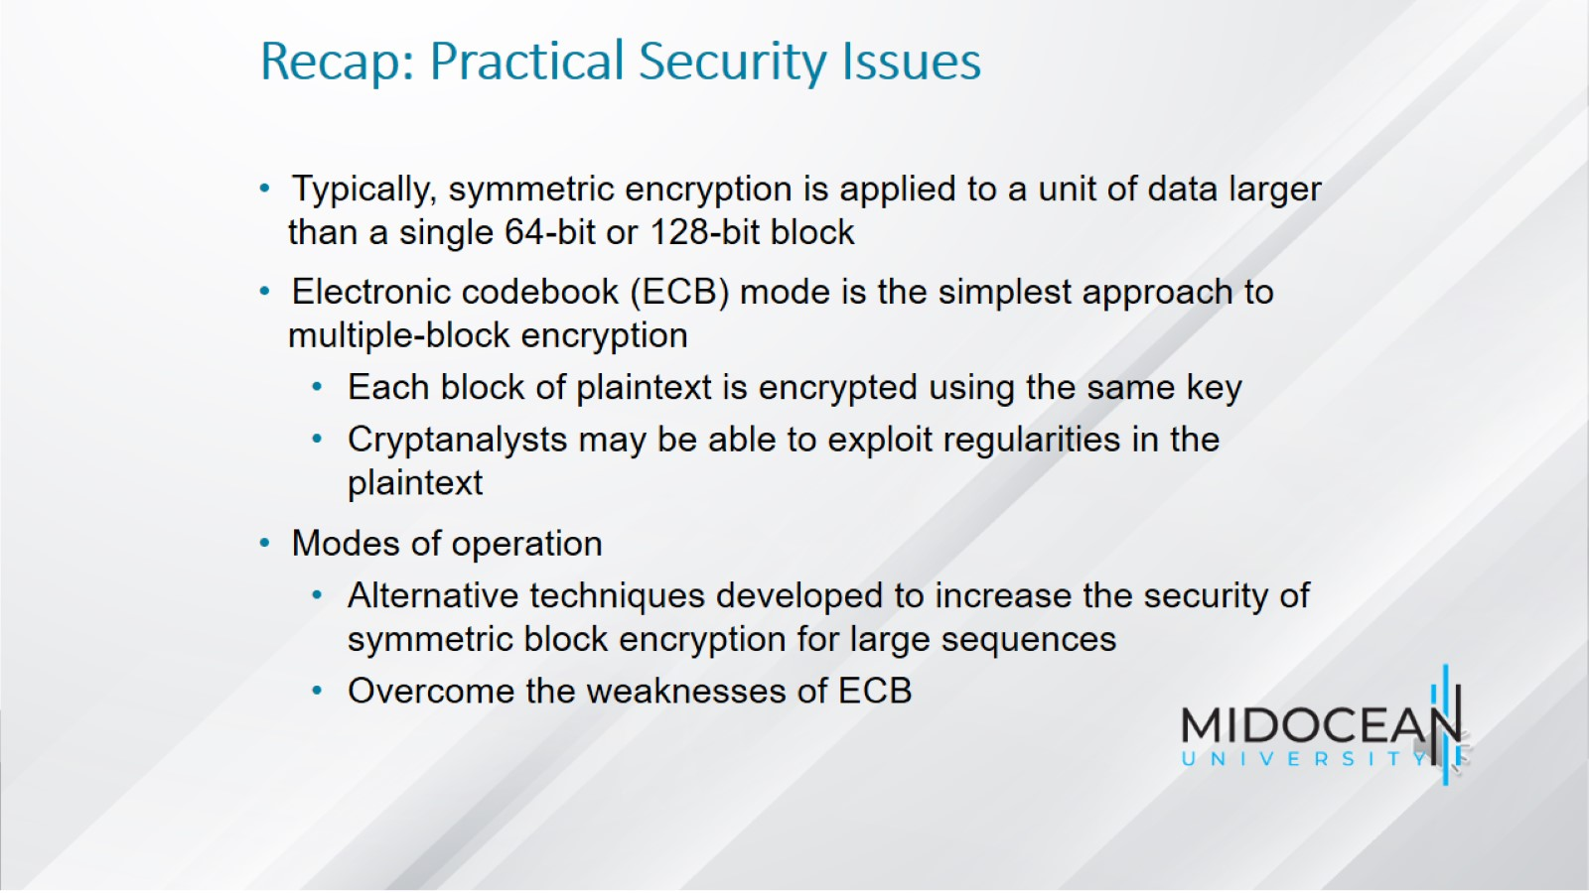
Recap: Practical Security Issues

Slide 6
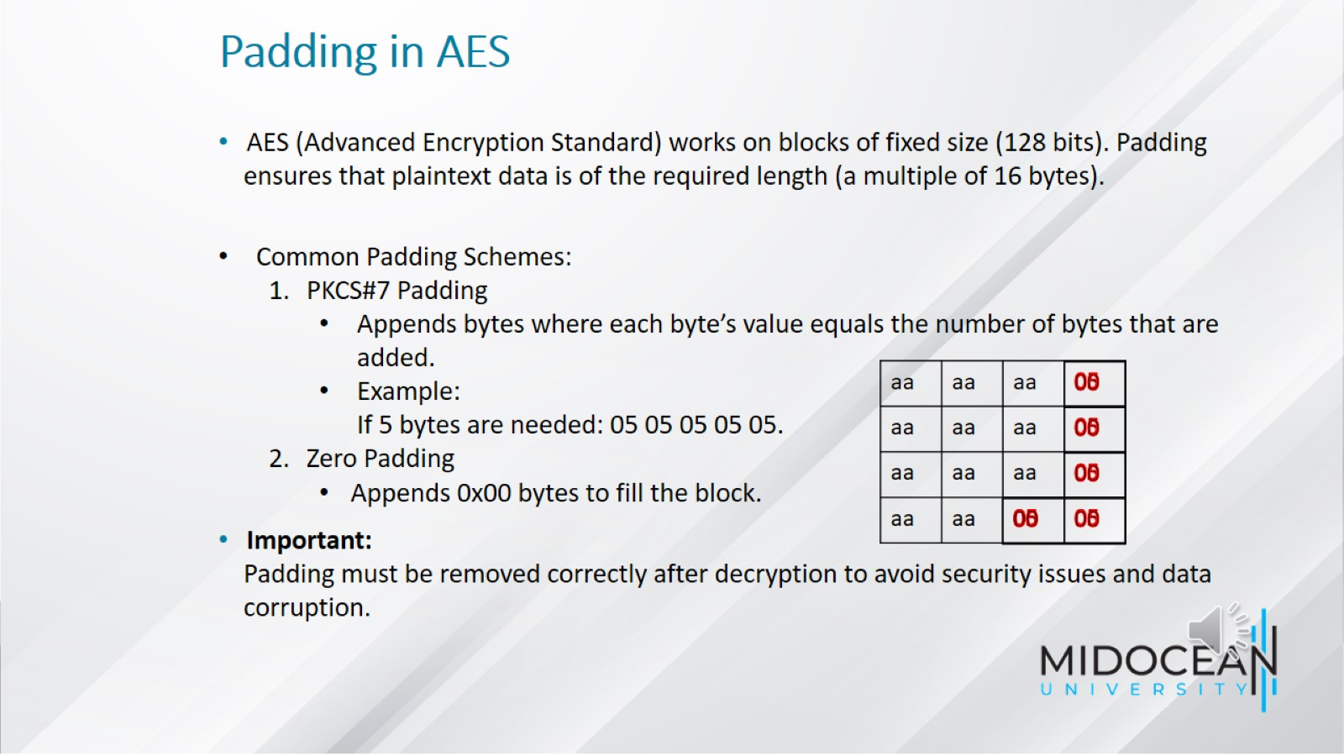
Padding in AES

Slide 7
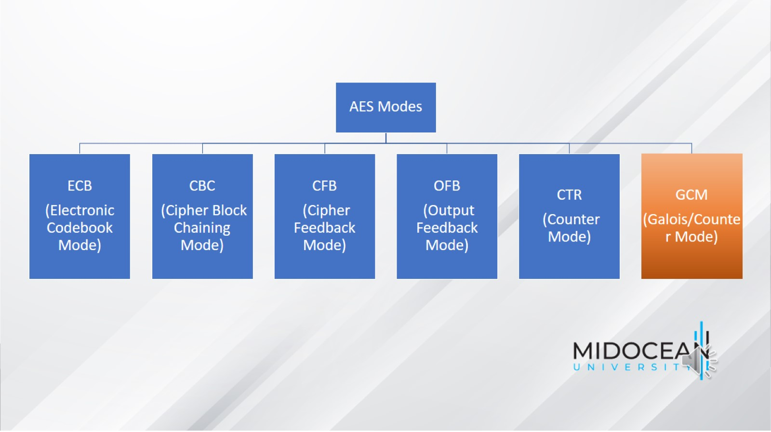

Slide 8
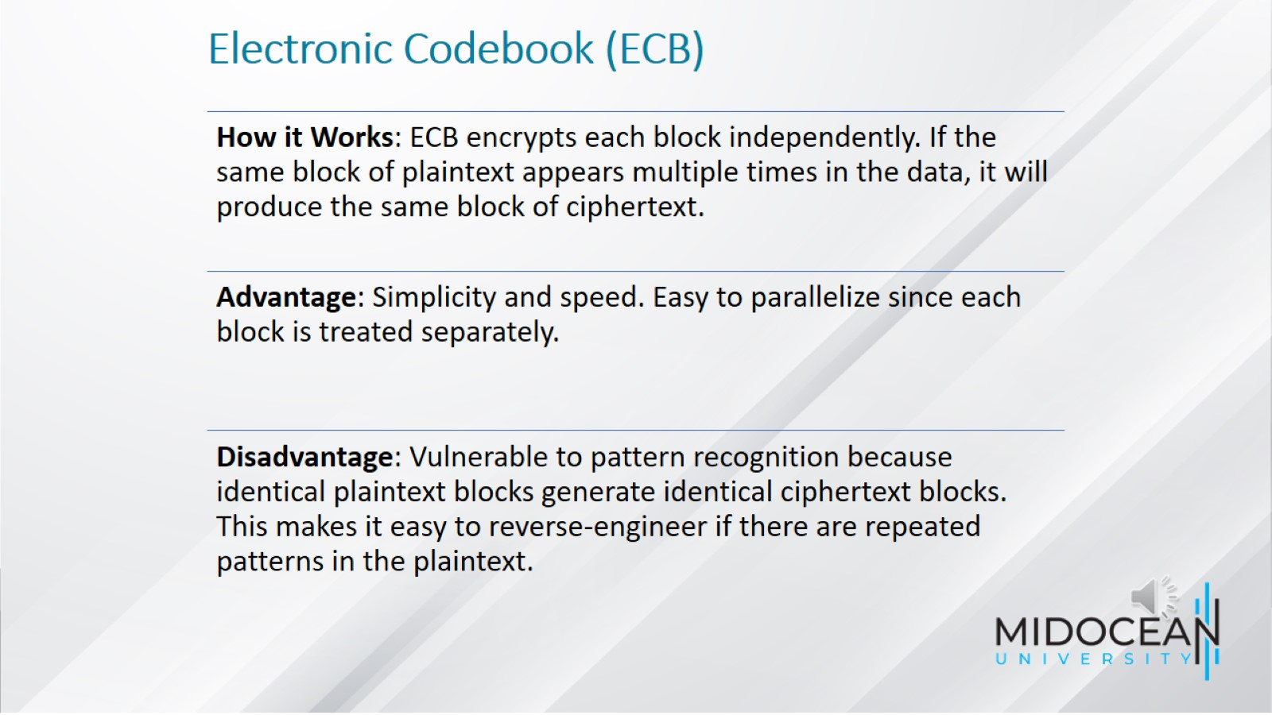
Electronic Codebook (ECB)

Slide 9
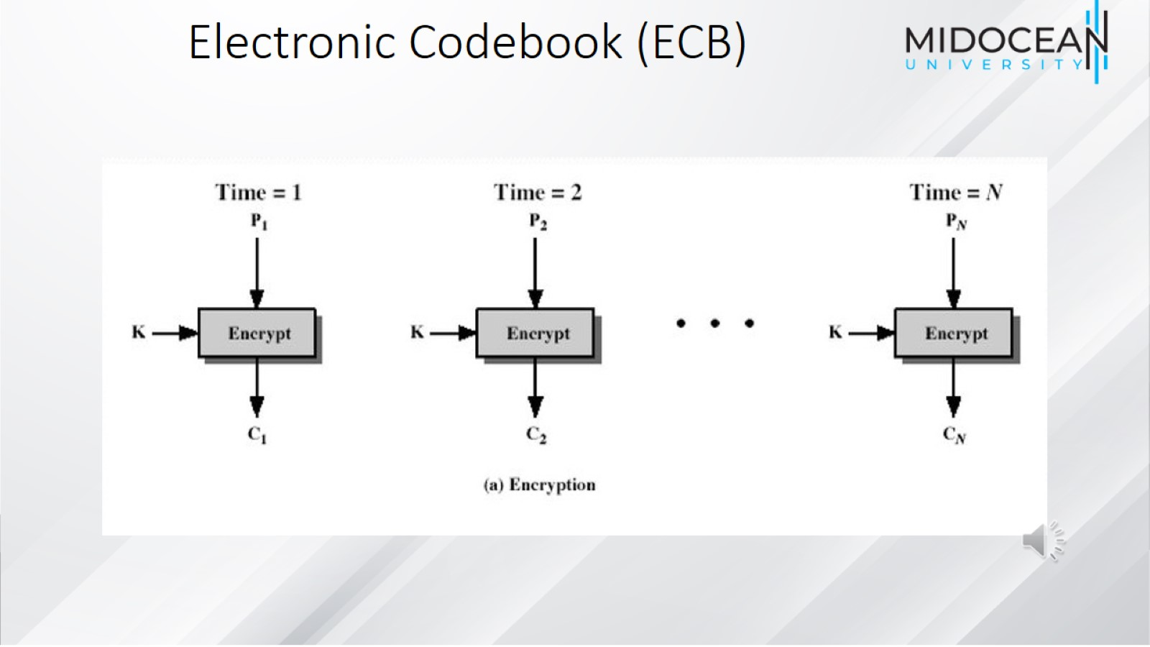

Slide 10
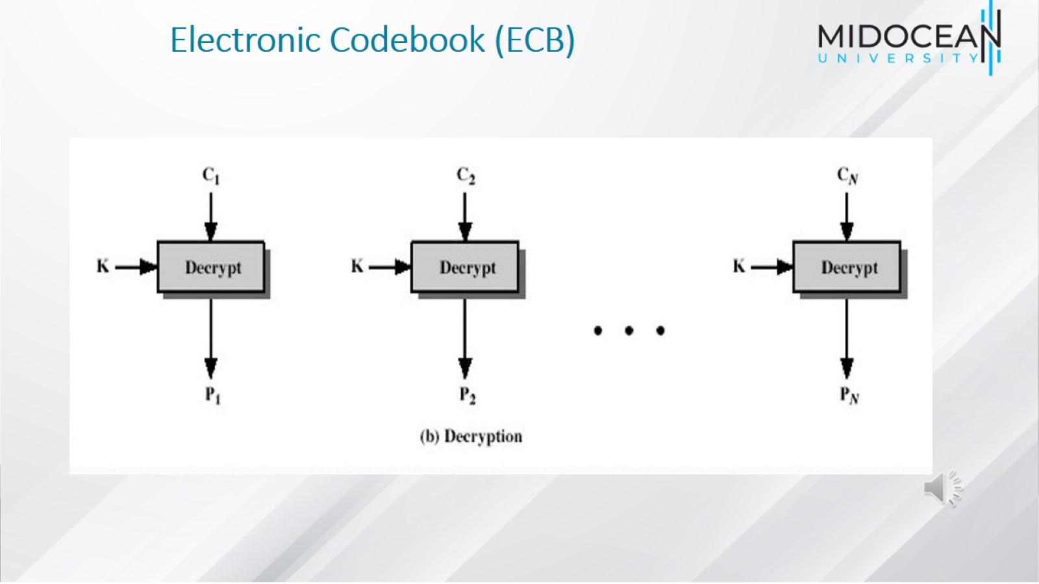
Electronic Codebook (ECB)

Slide 11
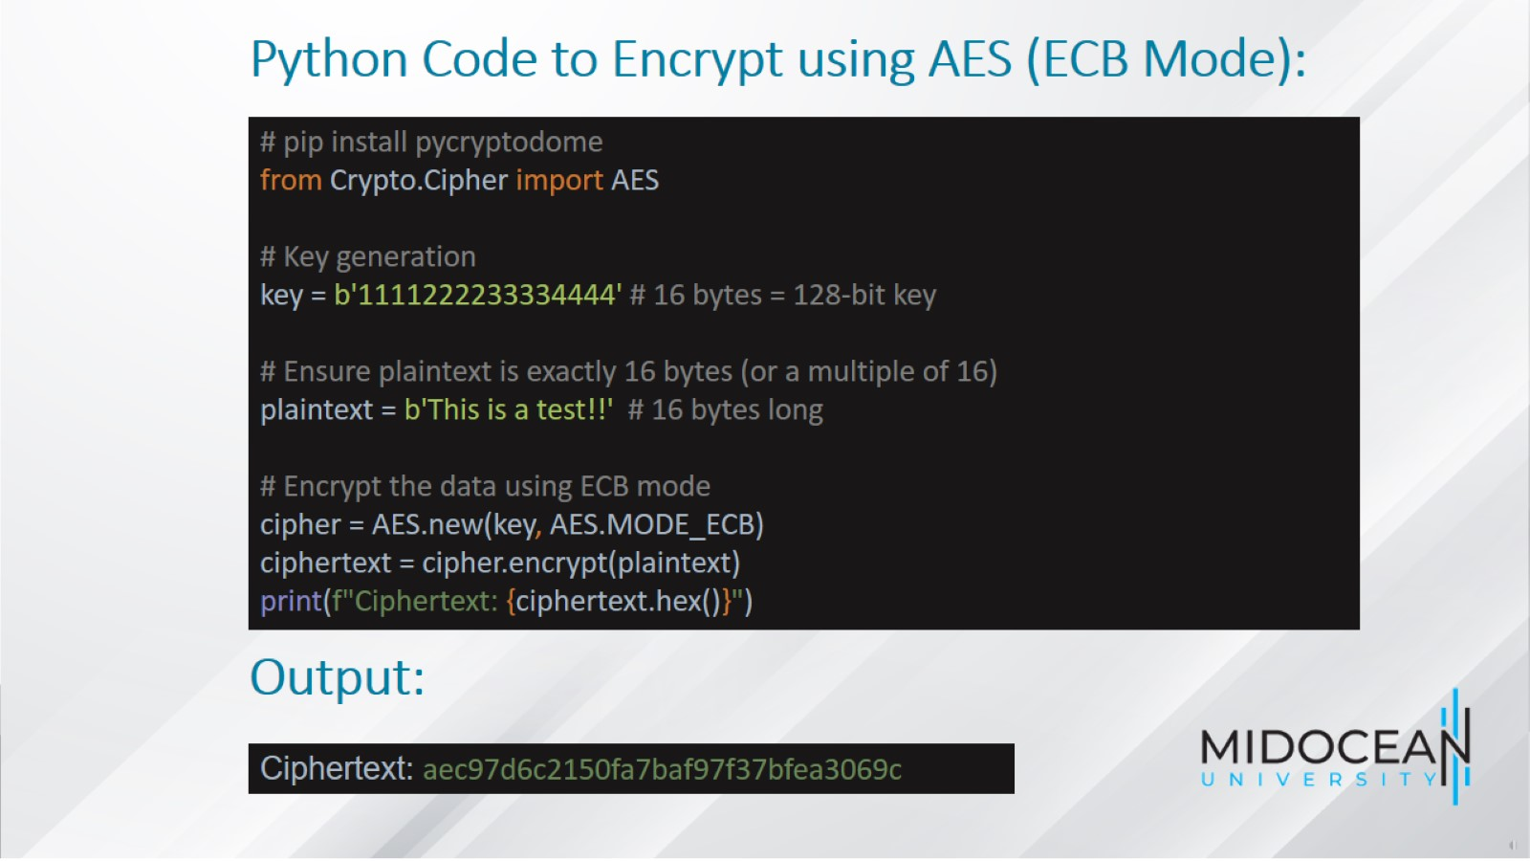
Python Code to Encrypt using AES (ECB Mode):

Slide 12
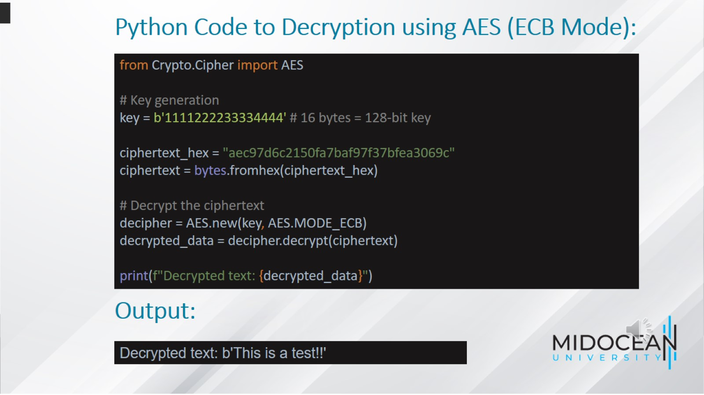
Python Code to Decryption using AES (ECB Mode):

Slide 13
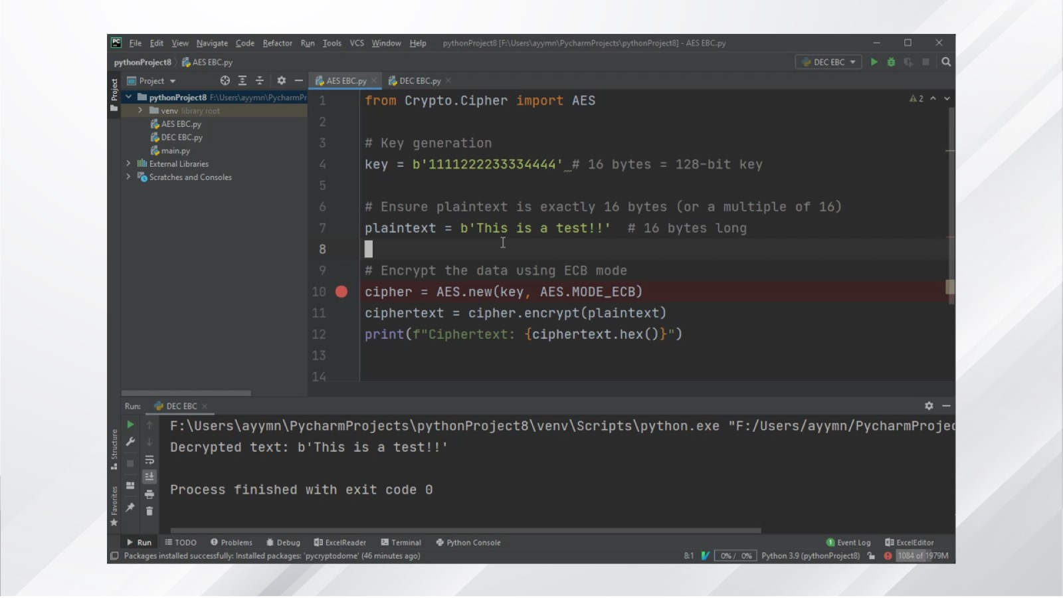

Slide 14
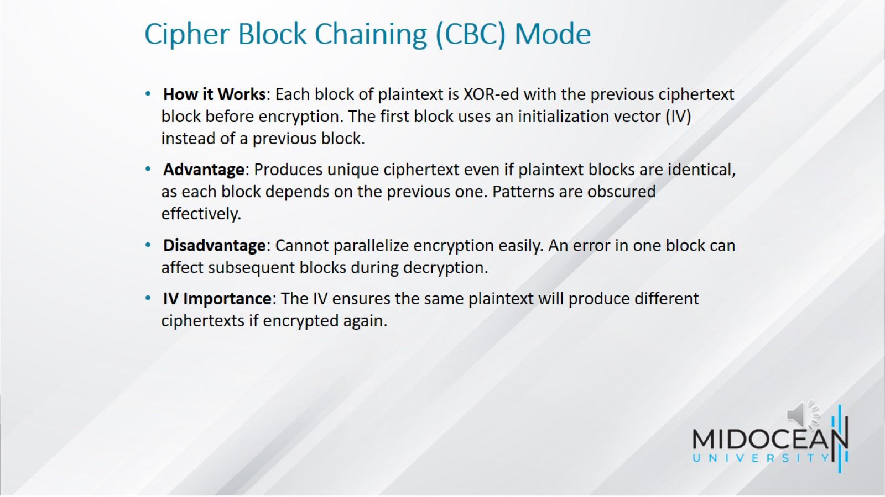
Cipher Block Chaining (CBC) Mode

Slide 15
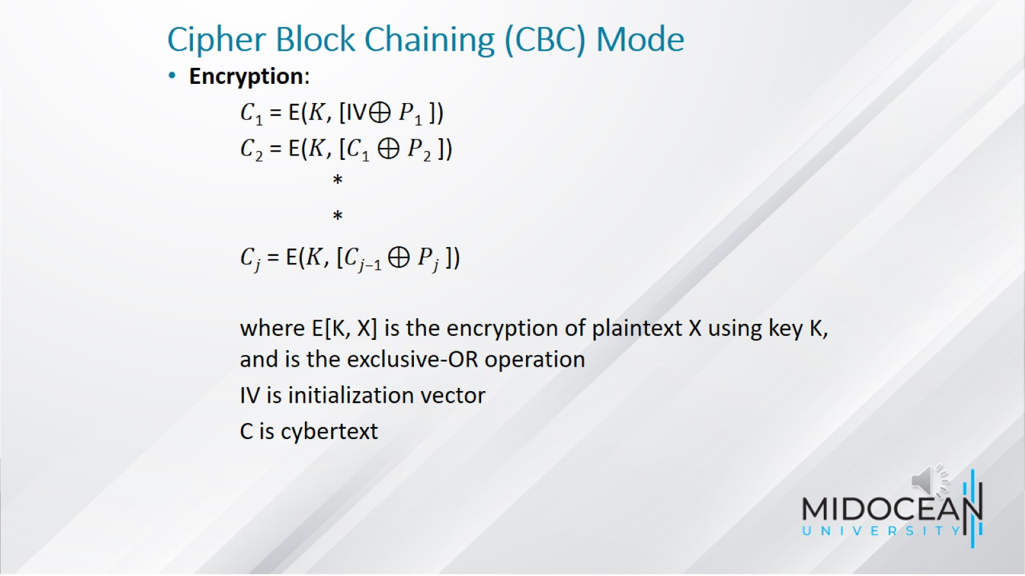
Cipher Block Chaining (CBC) Mode

Slide 16
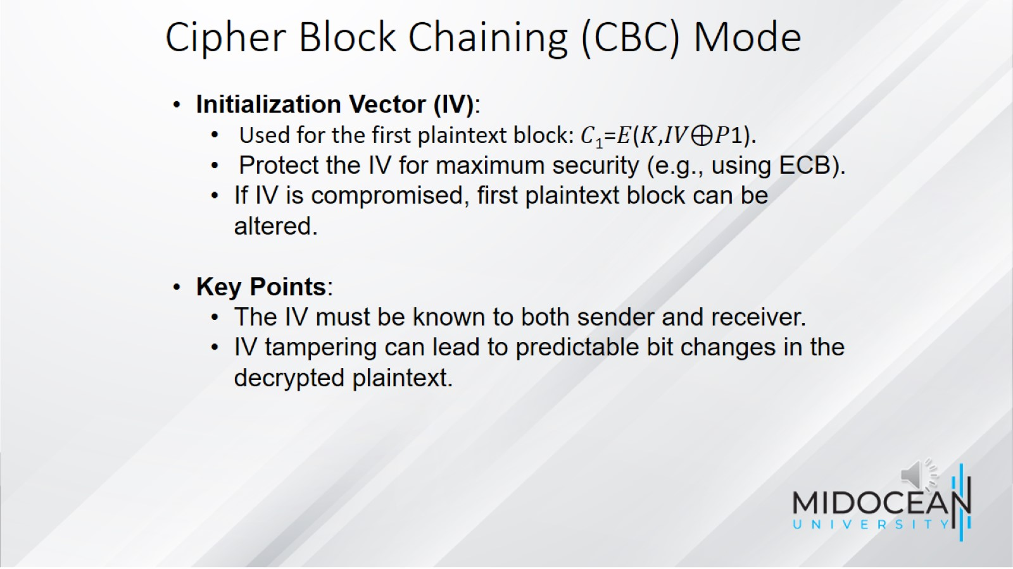

Slide 17
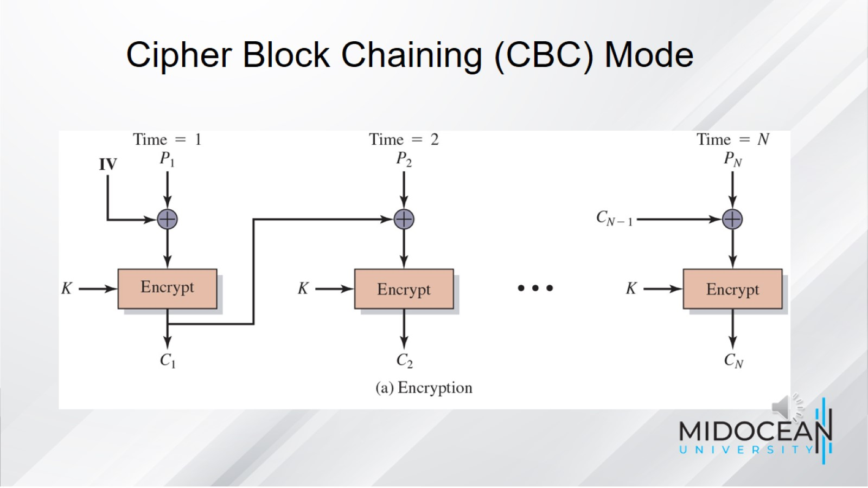

Slide 18
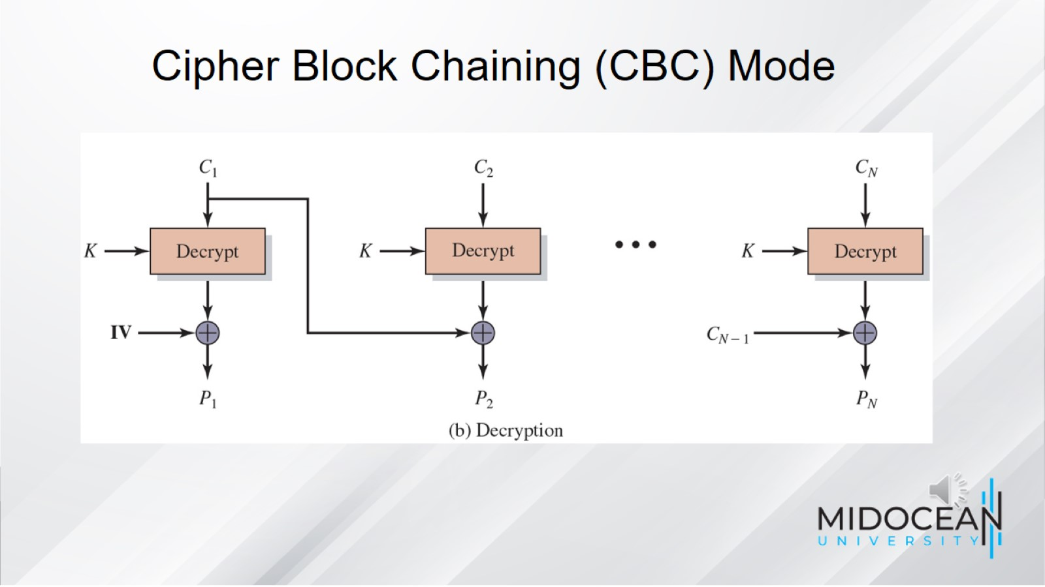

Slide 19
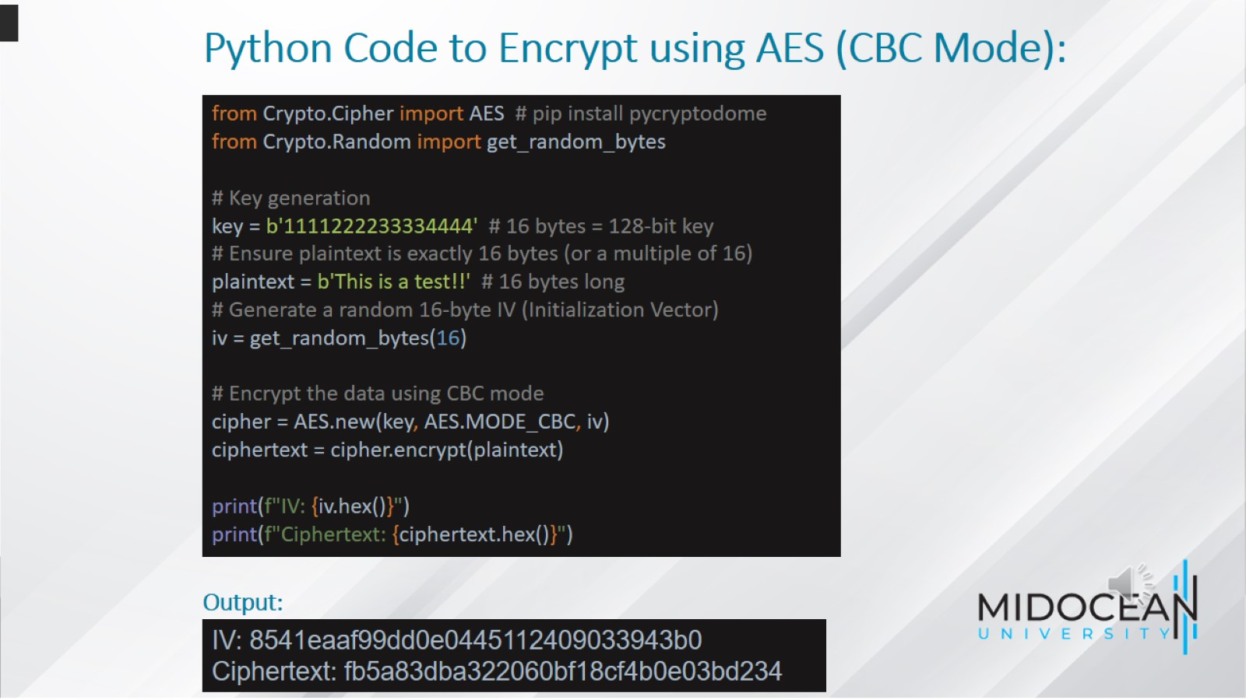
Python Code to Encrypt using AES (CBC Mode):

Slide 20
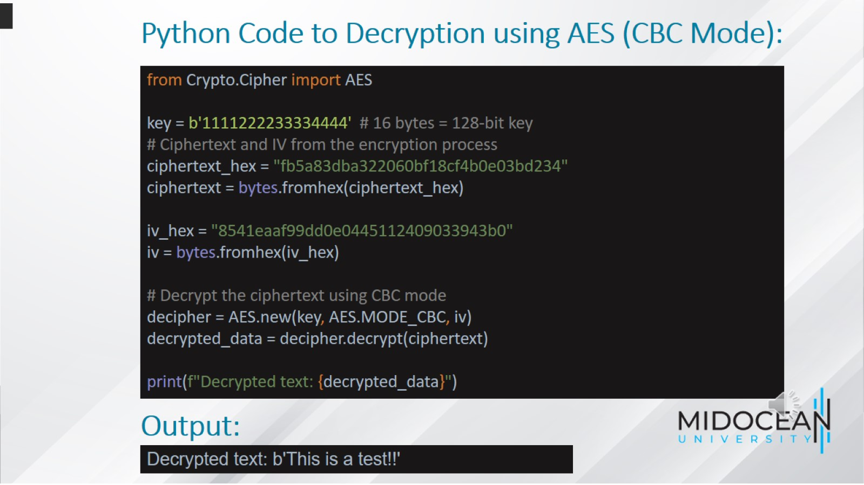
Python Code to Decryption using AES (CBC Mode):

Slide 21
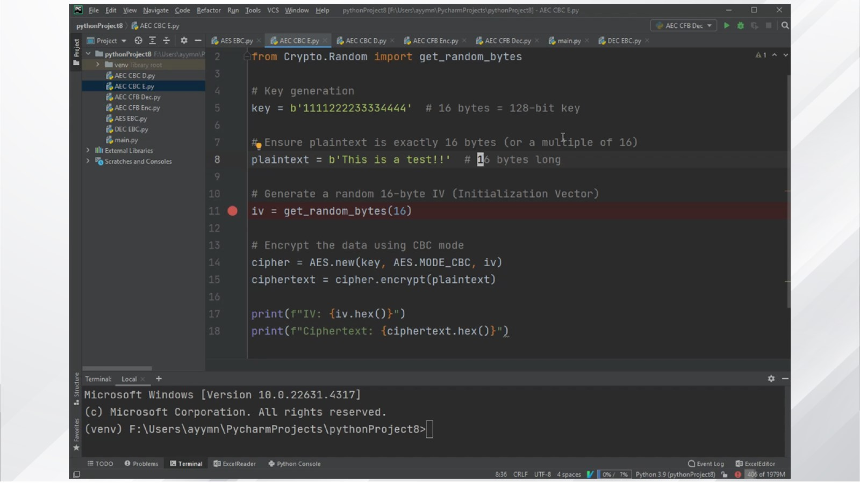

Slide 22
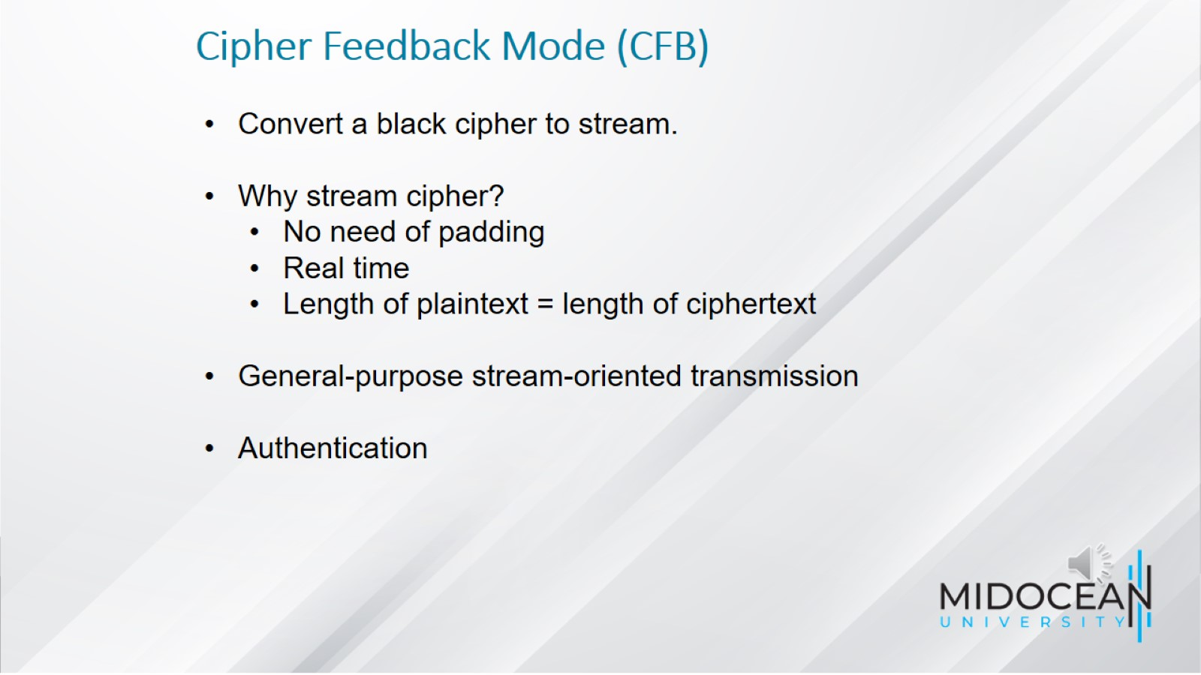
Cipher Feedback Mode (CFB)

Slide 23
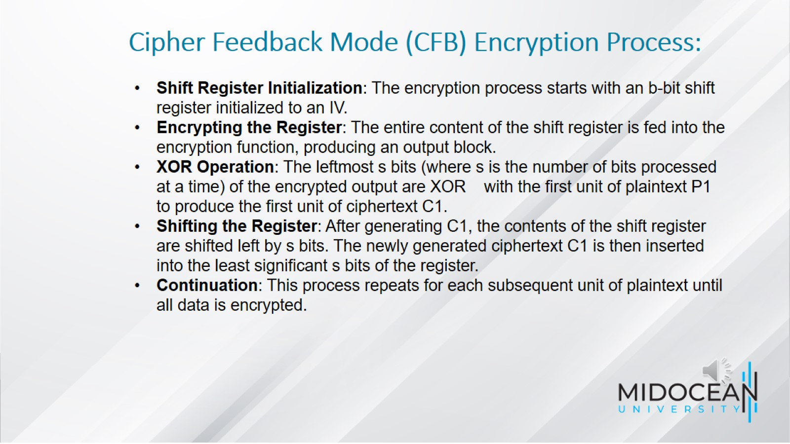
Cipher Feedback Mode (CFB) Encryption Process:

Slide 24
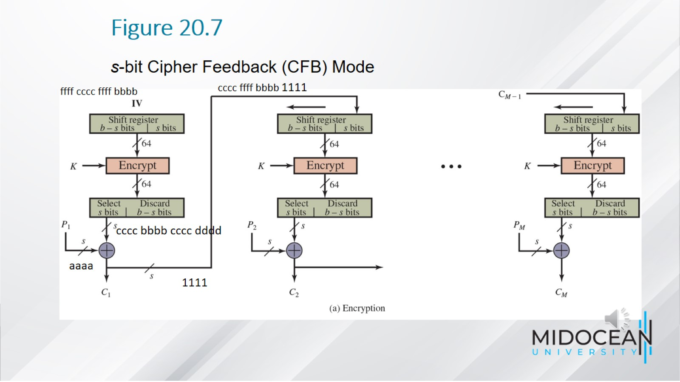
Figure 20.7

Slide 25
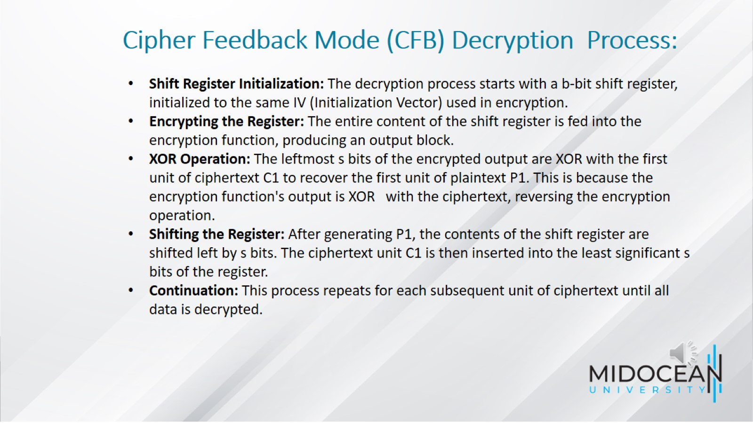
Cipher Feedback Mode (CFB) Decryption Process:

Slide 26
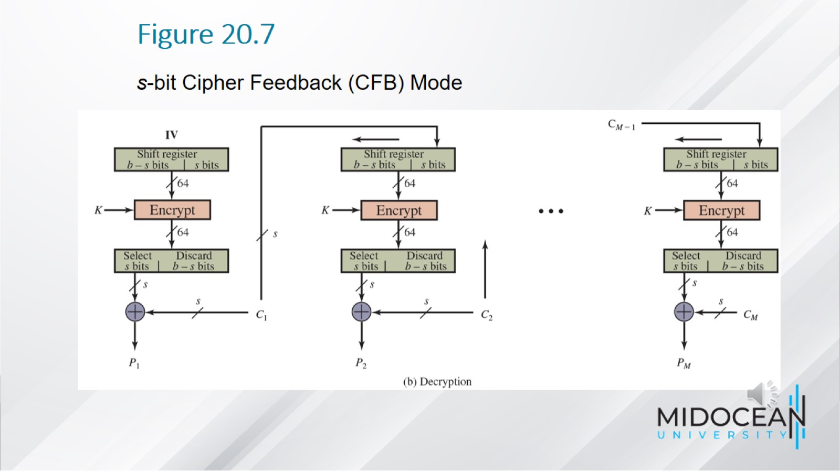
Figure 20.7

Slide 27
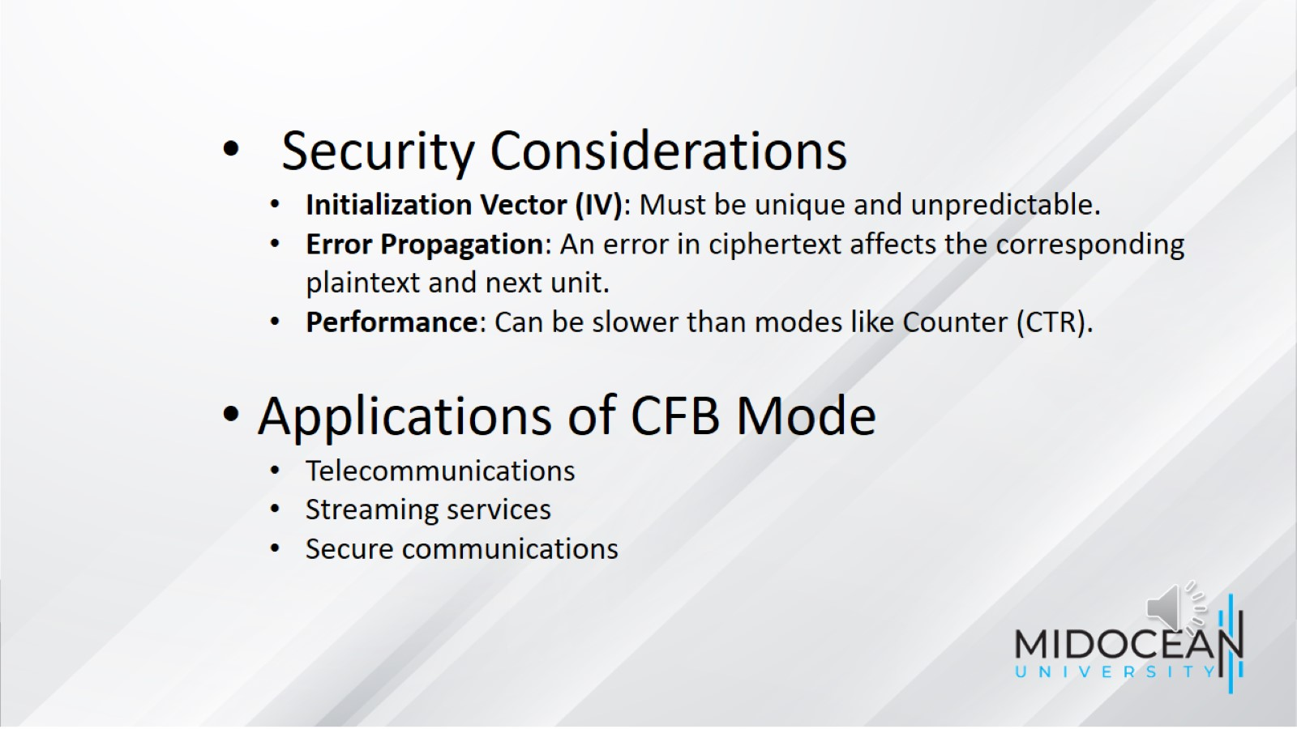

Slide 28
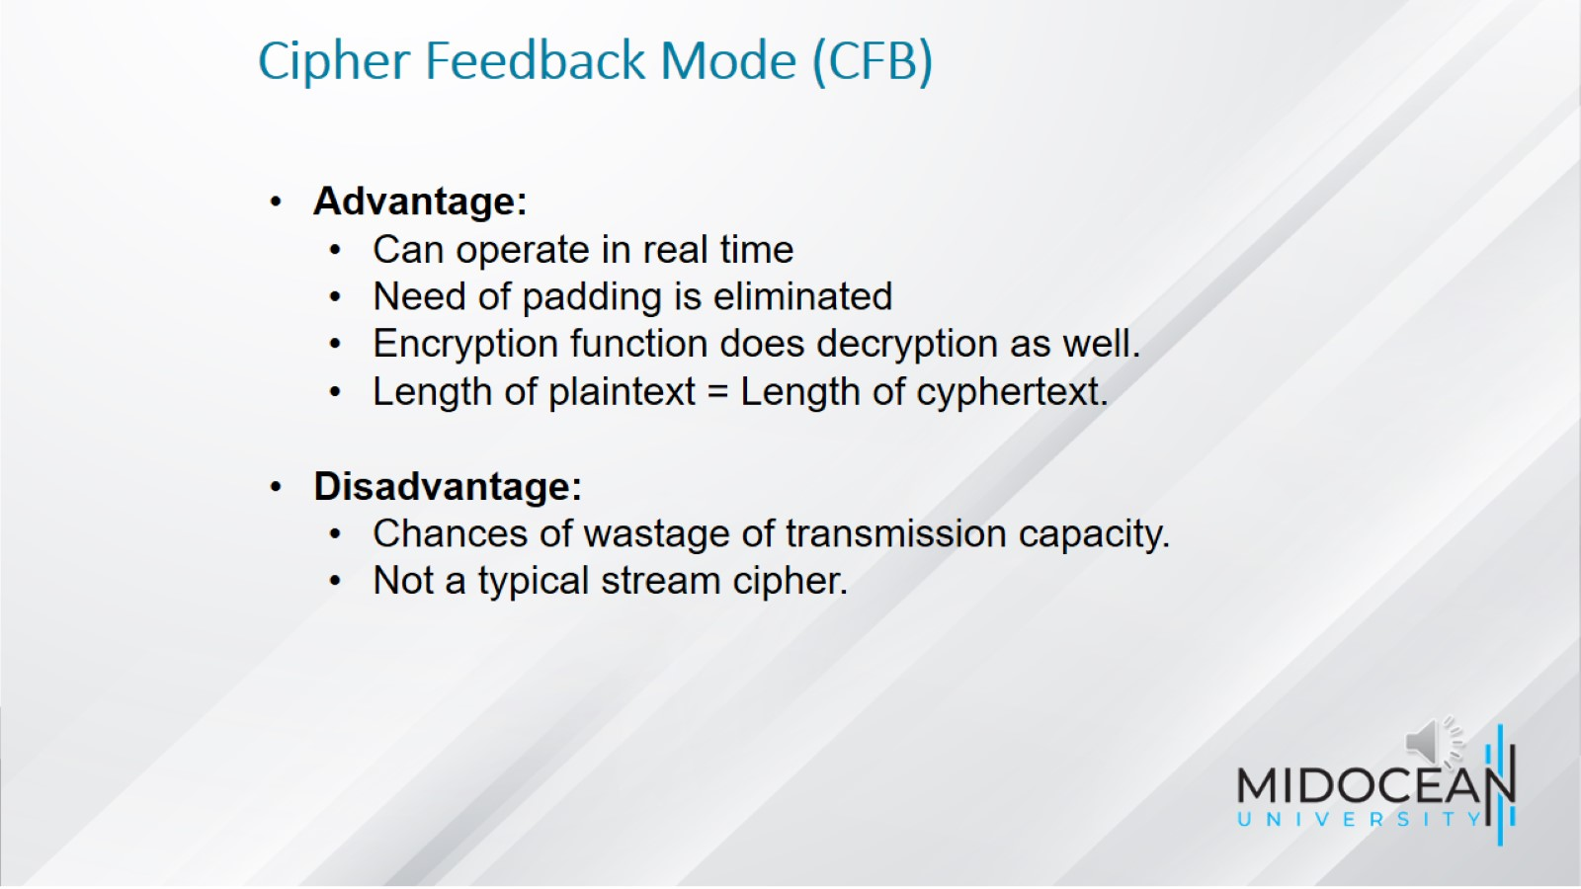
Cipher Feedback Mode (CFB)

Slide 29
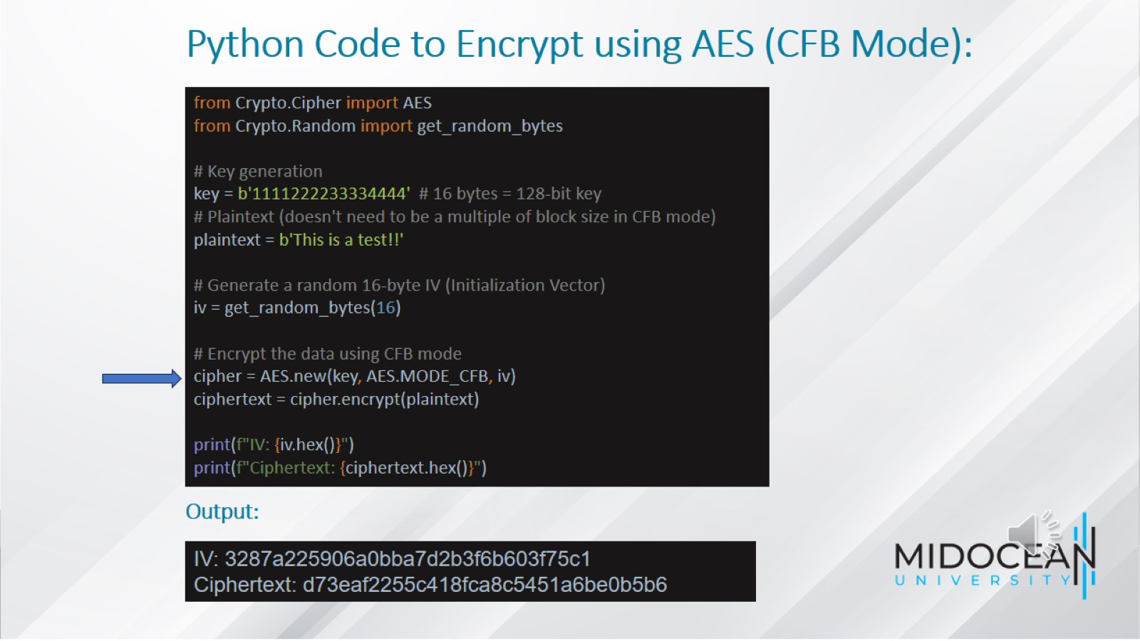
Python Code to Encrypt using AES (CFB Mode):

Slide 30
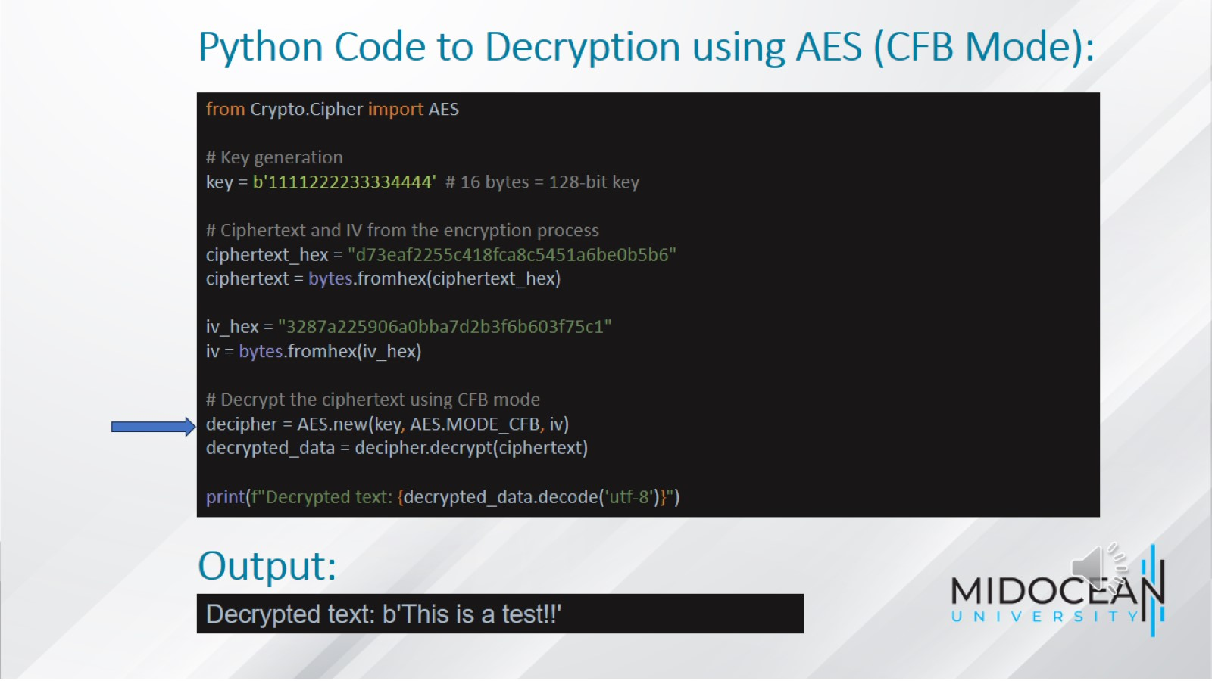
Python Code to Decryption using AES (CFB Mode):

Slide 31
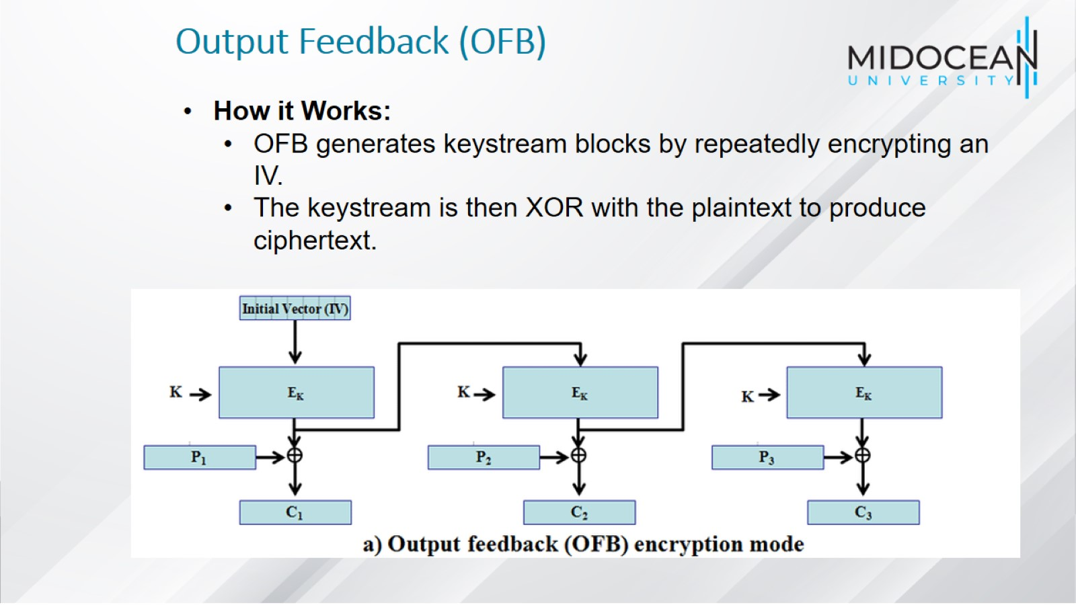
Output Feedback (OFB)

Slide 32
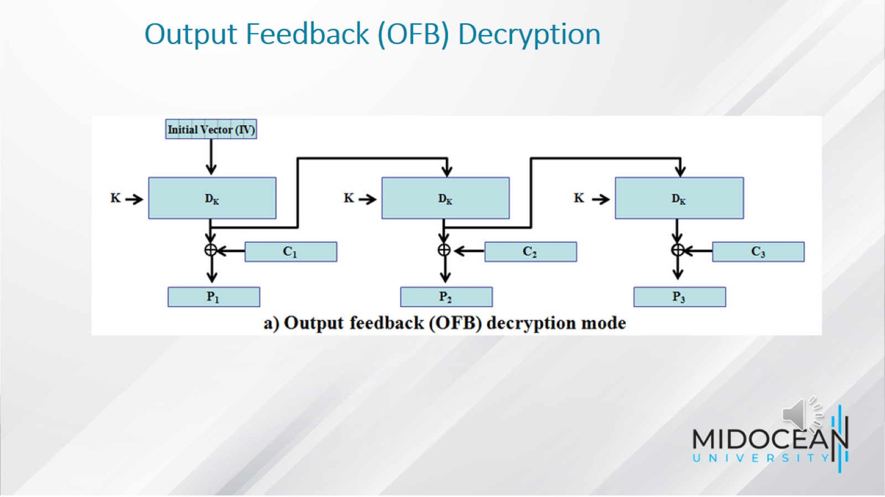
Output Feedback (OFB) Decryption

Slide 33
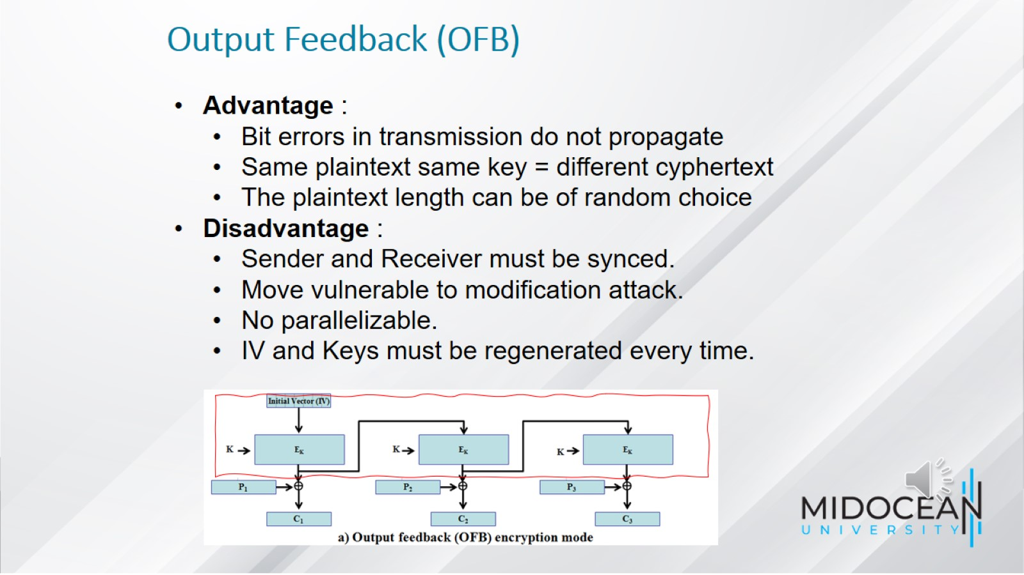
Output Feedback (OFB)

Slide 34
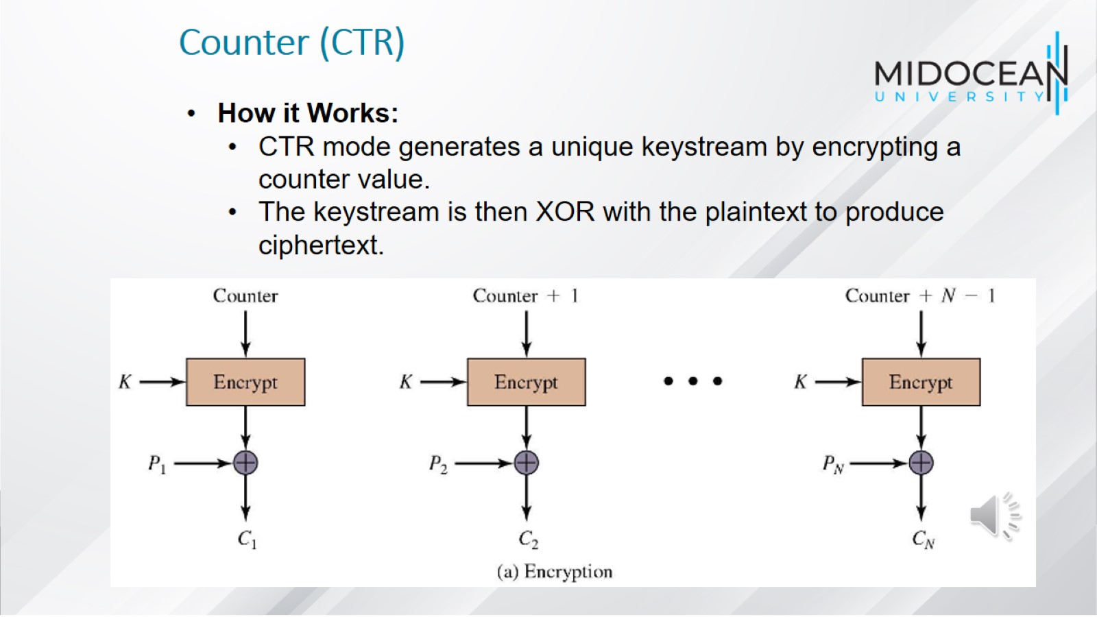
Counter (CTR)

Slide 35
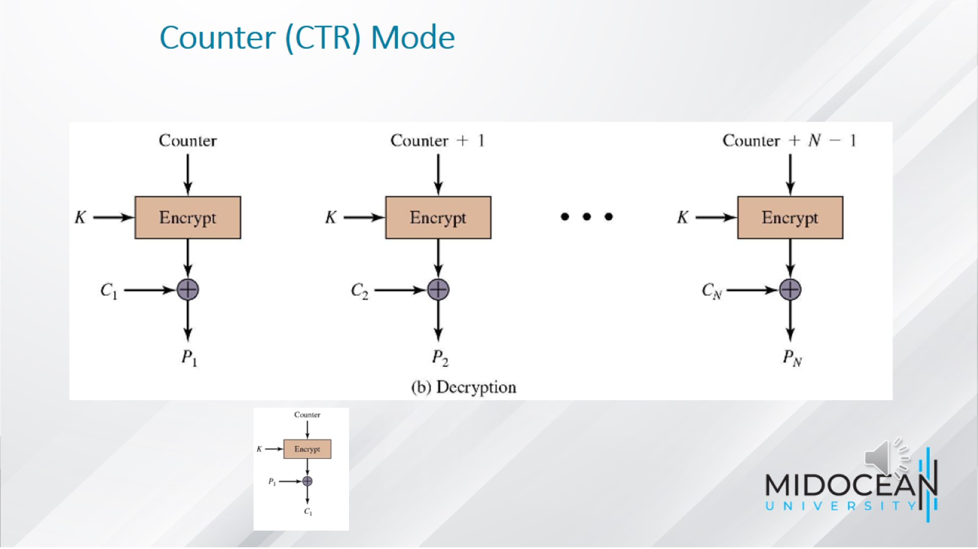
Counter (CTR) Mode

Slide 36
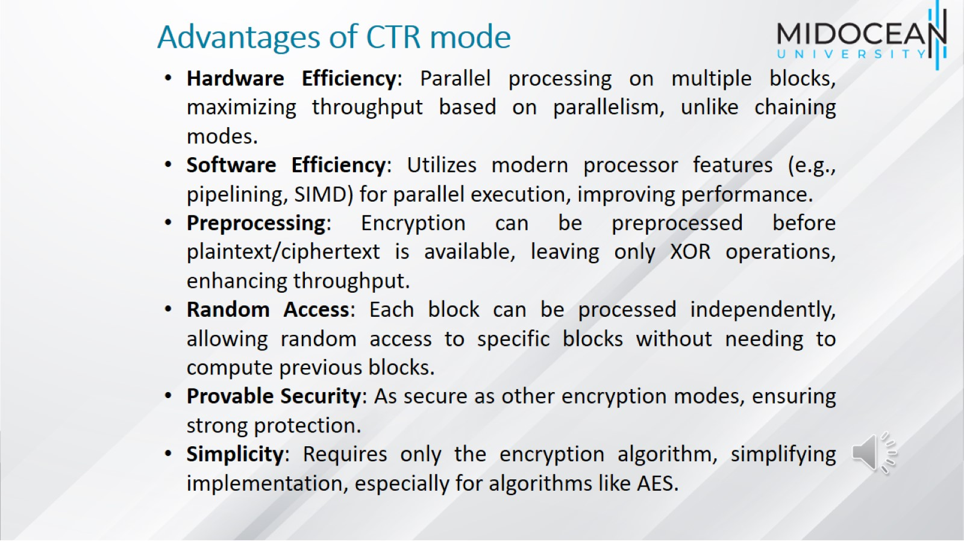
Advantages of CTR mode

Slide 37
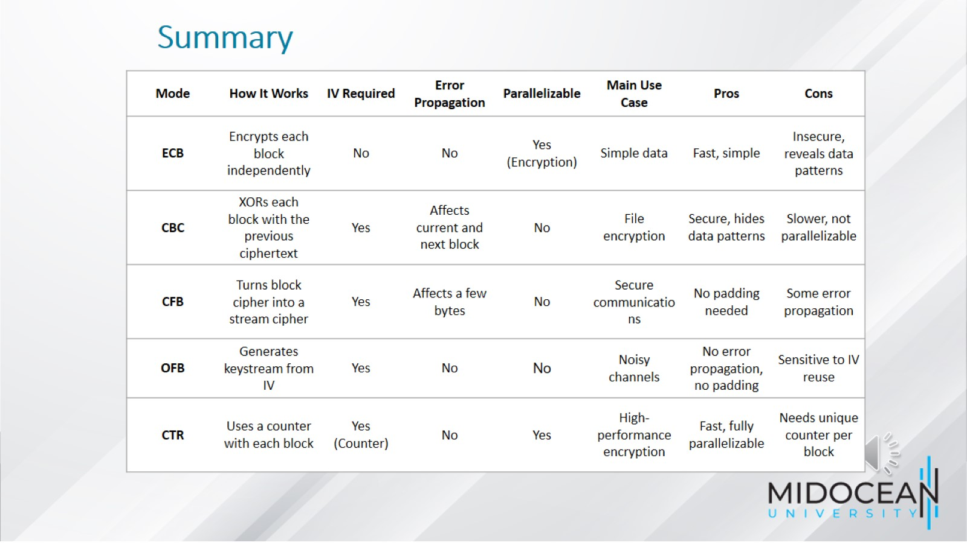
Summary

Slide 38


