Slide 1


Agile Project
Management
Prepared by Eng. Ahmed Hussein, MBA, PfMP©, PMP©, CMP APMG
PMG 622
Master of Project Management
Lecture 09

Slide 2


Role of the Project Manager in Agile Projects
Lecture 9
PMG 622
Agile Project Management
Prepared by
Eng. Ahmed Hussein, MBA, PfMP©, PMP©, CMP APMG
www.midocean.ae

Slide 3

Chapter
Learning Objectives
09
The role and responsibilities of the project manager in Agile Projects
How applying Servant Leadership principles improves agile projects
How the Agile team operates
www.midocean.ae

Slide 4
Chapter
Key Points from Previous Lecture
08
Monitoring and controlling is done throughout agile projects using existing events and artifacts
KPIs allows us to forecast, analyze, take decisions and corrective actions
There are many KPIs around efficiency, customer value, and quality
Applying Agile principles reduces project risks. We develop Risk Adjusted Backlog that prioritizes high value and high risk features.
Risk management is inherent in Agile processes and the team is responsible for identifying, prioritizing and mitigating risks.
www.midocean.ae

Slide 5

Chapter
The Project Manager in an Agile Environment
09
www.midocean.ae

Slide 6
Role of the Project Manager in an Agile Environment
Role and responsibilities of the project manager in an agile project is different from traditional projects.
Many Agile approaches do not address the role of the project manager.
Some agile practitioners think the role of the project manager is not needed due to self-organizing teams taking on the responsibilities.
Project managers can add significant value in agile projects.
The value of projects managers is not in their position or authority, but in their ability to make everyone else better.

Slide 7
There are many names for project manager in Agile projects
Project Manager
Scrum Master
Team Coach
Project Team Lead
Team Facilitator
Delivery Manager

Slide 8
The Traditional Project Manager
A project Manager: the person assigned by the performing organization to lead the team that is responsible for achieving the project objectives.
Responsible for Planning the Project
At the center of coordination for the project
Manages day-to-day activities
Tracking and representing the status to the rest of the organization

Slide 9
Role of the Project Manager in an Agile Environment
Project Managers are Servant Leaders, changing their emphasis to:
Coaching people who need help,
Foster greater collaboration on the team,
Aligning stakeholders’ needs, and
Encourage the distribution of responsibility to the team.
Teams coordinate their own work and collaborate with the business representative (Product Owner).
Project managers shift form being the center to serving the team and management.

Slide 10
Chapter
Agile Values to Guide the Project Manager
09
“We are uncovering better ways of developing software by doing it and helping others do it. Through this work we have come to value:
Individuals and interactions over processes and tools
Working software over comprehensive documentation
Customer collaboration over contract negotiation
Responding to change over following a plan
That is, while there is value in the items on the right, we value the items on the left more.”
www.midocean.ae

Slide 11
Chapter
Agile Principles to Guide the Project Manager (1/2)
09
1
2
3
4
Business people and developers must work together daily throughout the project.
Build projects around motivated individuals. Give them the environment and the support they need, and trust them to get the job done.
The most efficient and effective method of conveying information to and within a development team is face-to-face conversation.
Continuous attention to technical excellence and good design enhances agility.
www.midocean.ae

Slide 12
Chapter
Agile Principles to Guide the Project Manager (2/2)
09
7
At regular intervals, the team reflects on how to become more effective, then tunes and adjusts its behavior accordingly.
5
Simplicity--the art of maximizing the amount of work not done–is essential.
6
The best architectures, requirements, and designs emerge from self-organizing teams.
www.midocean.ae

Slide 13
As a Project Manager, Start with an Agile Mindset
Ask the following questions together with the team to help develop an implementation strategy:
How can the project team act in an agile manner?
What can the team deliver quickly and obtain early feedback to benefit the next delivery cycle ?
How can the team act in a transparent manner?
What work can be avoided in order to focus on high-priority items?
How can a servant-leadership approach benefit the achievement of the team’s goals?

Slide 14
Charter the Project and the Team
The Project Charter helps the team knows why this project matters, where the team is headed, and what the project objective is.
The Team Charter (or “Social Contract”) provides team norms and an understanding on how to work together.
Team Charter helps create an Agile Environment and may include :
Team values, such as sustainable pace and core hours,
Working agreements, such as what ”ready” means so the team can take in work; what “done” means so the team judge completeness consistently; respecting the time box; or the use of work-in-progress limits;
Ground rules, such as one person talking in a meeting, how we make decisions, and how we resolve conflicts
Group norms, such as how the team treats meeting times.

Slide 15
Chapter
Servant Leadership
09
www.midocean.ae

Slide 16
Chapter
Servant Leadership
09
“Servant leadership is an approach to leadership that emphasizes the importance of serving others. Servant leaders put the needs of others first and help people develop and perform as highly as possible.”
Agile approaches promote using Servant Leadership to lead the team.
Servant Leadership can be applied in any situation that requires leadership or management and not only in Agile project management
www.midocean.ae

Slide 17
Servant Leader Characteristics
Empathy
Understand the feelings of others. They are able to put themselves in other people's shoes and see things from their perspective.
Humility
Servant leaders are not arrogant or self-serving. They are willing to admit their mistakes and learn from others.
Awareness
Being aware of own strengths and weaknesses. Being also aware of the needs of others and the needs of the organization.
Persuasion
Can influence others without using coercion. They are able to build consensus and get people to buy into their vision.
Conceptualization
Able to see the big picture, think strategically, and come up with innovative solutions to problems.

Slide 18
Benefits of Servant Leadership
Increased Engagement
Create a work environment where employees feel valued and respected. This can lead to increased employee engagement and productivity.
Improved Decision Making
Gather input from a variety of stakeholders. This can lead to more informed and effective decision-making.
Enhanced Innovation
Create a culture of creativity and innovation. This can lead to the development of new products, services, and processes.
Stronger Customer Relationship
Focused on serving others. This can lead to stronger customer relationships and increased customer satisfaction.

Slide 19
Servant Leader Responsibilities
Facilitate
Manage relationship to build communication and coordination within the team and across the organization. Facilitation helps everyone do their best thinking and work.
Remove Organizational Obstacles
Identify obstacles and work to eliminate them. For ex. streamline processes, eliminate lengthy documentation, and deal with difficult stakeholders.
Pave the way for Others’ Contribution
Create positive environments, fulfill the needs of the team, project, and organization to make everyone focus and do their best work.

Slide 20
Servant Leadership Characteristics that help being Agile and facilitate Team’s success:
Promoting self-awareness
Listening
Serving those on the team
Helping people grow
Coaching vs. controlling
Promoting safety, respect, and trust
Promoting the energy and intelligence of others

Slide 21
Servant Leader activities examples:
Educate
Educate stakeholders on why and how to be Agile
Support
Support the team through mentoring, encouragement and support
Advocate
Advocate for team members training and career development
Grow
Grow team members through and beyond their current role
Help
Help the team with technical project management activities
Build
Build relationships with external groups
Celebrate
Celebrate successes

Slide 22
The 3Ps for the Agile Project Manager
Purpose
Work with the team to define the "why" or purpose so they can engage around the goal for the project.
People
Encourage the team to create an environment where everyone can succeed.
Process
Do not plan on following the "perfect" agile process, but look for the results. When the team delivers finished value often and reflects on the product and process, the team is agile and the process doesn’t matter.

Slide 23
Chapter
The Agile Team
09
www.midocean.ae

Slide 24




Main Roles in an Agile Team
Product Owner
Agile Coach/ Scrum Master/ Project Manager
Team
Responsible for the Product Backlog, Prioritization, and for maximizing the value delivered to customers, usually comes from the business side
Responsible for helping the team follow the Agile (Scrum, Kanban, Lean, XP,…) framework, removes roadblocks, facilitates communication, and helps the team to continuously improve.
Responsible for developing the product. The Team is a cross-functional team that includes specialists

Slide 25
Attributes of Successful Agile Teams (1/2)
Attribute | Goal
Dedicated People | Increased focus and productivity Small team, usually 5-9 people
Cross-Functional team members | Develop and deliver often Deliver Finished value as an independent team Integrate all work activities to deliver finished work Provide feedback from inside the team and from others, such as the product owner
Colocation or ability to manage any location challenges | Better communication Improved team dynamics Knowledge sharing Reduced cost of learning Able to commit to working with each other

Slide 26
Attributes of Successful Agile Teams (2/2)
Attribute | Goal
Mixed team of generalists and specialists | Specialists provide dedicated expertise and generalists provide flexibility of who does what Team brings their specialist capabilities and often become generalizing specialists with a focus specialty plus breadth of experience across multiple skills
Stable work environment | Depend on each other to deliver Agreed-upon approach to the work Simplified team estimations and calculations

Slide 27
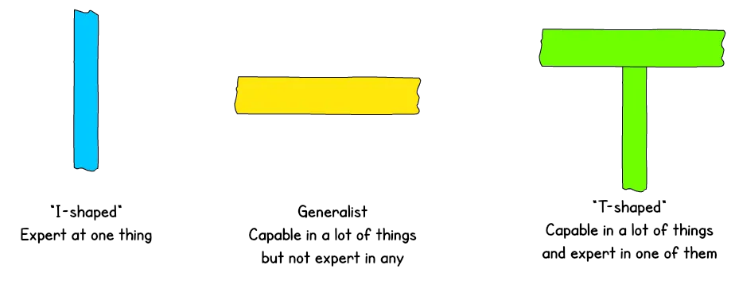
I-Shaped and T-Shaped Teams
Successful Agile Teams are made up of Generalizing Specialists (or T-Shaped people)

Slide 28
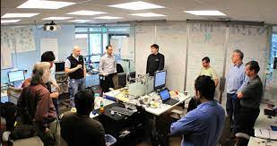

Colocation
“Team Room”
Ideally the whole team, including the product owner or domain expert, has the use of a dedicated space for the duration of the project, set apart from other groups’ activities.
This space is furnished with the various amenities that the team may need: workstations, whiteboards and flipcharts, wall space to display task boards, project plans or other charts, and so on.

Slide 29
Geographically distributed teams need Virtual Workspaces
Use collaboration tools (Trello, Slack,….)
Gather the team face-to-face at the beginning of the project to know each other and build relationships
Make video-conferencing for stand-up meetings
All ceremonies/events are made as video-conference

Slide 30

Geographically distributed teams need Virtual Workspaces
Fishbowl Window:
  Set up long-lived video conferencing links between various locations
  Start it at the beginning of the day and keep it open all day long.
  People can see and engage with each other
  Improves communication in remote teams

Slide 31

Geographically distributed teams need Virtual Workspaces
Remote Pairing:
  Derived from XP Methodology
  Divide the team into pairs of two
  Each pair shares screen, voice, and video all day long
  Improves collaboration in the team

Slide 32
Tips for Agile Team Management
Keep It Simple, don’t apply rigid process and focus on results
Aim for dedicated teams (fully assigned to the project)
Bring in complimentary and multi-functional skills
Let the team do the planning
Emphasize Collaboration
Don’t focus on roles, pick skills and capabilities instead

Slide 33
Chapter
Key Points
08
Role of Agile Project Manager is different from Traditional Project Manager and emphasizes facilitation, support, development, removing obstacles and creating the right environment.
Agile values and principles guide the Agile Project Manager.
Agile approaches emphasize using Servant Leadership to help and support the team, and create positive Agile environments to increase performance.
Your team should be composed of T-Shaped People (Generalized Specialists and should be dedicated to the project and collocated.
Servant Leadership focus on helping people to develop and perform at their best.
www.midocean.ae

Slide 34

www.midocean.ae
Preparation for discussion panel:
Read the article: “Servant Leadership: How Does Leadership Work in an Agile Context?”
Watch the VIDEO:
“What is Servant Leadership”
Question: Have you every applied Servant Leadership? What makes it standout from other Leadership Styles?
Chapter
09
For Discussion Panel

Slide 35
www.midocean.ae
Before next lecture:
Key Challenges and Trends in Agile Project Management
Read the Article
“Top Agile Trends 2024: Stay ahead with these latest Agile trends”
Chapter
09
For Next Lecture

Slide 36


Thank You

