Slide 1





Lecture: #07
Attacks on Passwords
Dr. Hesham Abou Elfetouh
Cybersecurity Department
Faculty of Informatics
Midocean University
Secure Operating Systems (CYB610)
www.midocean.ae

Slide 2
Chapter
Outline
07
    This chapter covers the following topics and concepts: User authentication
Password Selection Criteria
One-Time Passwords
Challenge-response Authentication
Attacks on Passwords
2
www.midocean.ae
Secure Operating Systems

Slide 3
Chapter
Introduction
07
In Previous Lecture you learned:
User authentication
Password authentication
Access control
Probable Passwords
Passwords Likely for a User
3
www.midocean.ae
Secure Operating Systems

Slide 4
Chapter
CHAPTER 7 GOALS
07
When you complete this chapter, you will be able to:
Describe the Password Selection Criteria
Explain the One-Time Passwords
Describe the Advantages of salt
Explain the Attacks on Passwords
4
www.midocean.ae
Secure Operating Systems

Slide 5
Chapter
Password Selection Criteria
07
Use characters other than just AZ.
  If passwords are chosen from the letters AZ, there are only 26 possibilities for each character.
  Adding digits expands the number of possibilities to 36.
  Using both uppercase and lowercase letters plus digits expands the number of possible characters to 62.
  It takes about 100 hours to test all 6-letter words chosen from letters of one case only, but it takes about 2 years to test all 6-symbol passwords from upper- and lowercase letters and digits.
5
www.midocean.ae
Secure Operating Systems

Slide 6
Chapter
Password Selection Criteria (count)
07
Choose long passwords
  Choosing longer passwords makes it less likely that a password will be uncovered.
  Remember that a brute force penetration can stop as soon as the password is found.
  Some penetrators will try the easy cases known words and short passwords and move on to another target if those attacks fail.
Avoid actual names or words
  There are 266 or about 300 million 6-letter "words", but there are only about 150,000 words in a good dictionary.
6
www.midocean.ae
Secure Operating Systems

Slide 7
Chapter
Password Selection Criteria (count)
07
Choose an unlikely password
  To remember the password easily, you want one that has special meaning to you
  you don't want someone else to be able to guess this special meaning.
  The first letters of words from a song, a few letters from different words of a private phrase, or a memorable football team are examples of reasonable passwords.
  Password-cracking tools also test replacements of 0 (zero) for o or O (letter "oh") and 1 (one) for l (letter "ell") or $ for S (letter "ess").
7
www.midocean.ae
Secure Operating Systems

Slide 8
Chapter
Password Selection Criteria (count)
07
Change the password regularly
  Even if there is no reason to suspect that the password has been compromised, change is advised.
  Don't write it down
Don't tell anyone else
  The easiest attack is social engineering, in which the attacker contacts the system's administrator or a user to elicit the password in some way.
  Under no circumstances should you ever give out your private password.
8
www.midocean.ae
Secure Operating Systems

Slide 9
Chapter
Password Selection Techniques
07
User education
users can be told the importance of using hard to guess passwords and can be provided with guidelines for selecting strong passwords
Computer generated passwords
users have trouble remembering them
Reactive password checking
system periodically runs its own password cracker to find guessable passwords
Proactive password checking
user is allowed to select their own password, however the system checks to see if the password is allowable, and if not, rejects it
goal is to eliminate guessable passwords while allowing the user to select a password that is memorable
9
www.midocean.ae
Secure Operating Systems

Slide 10
Chapter
One-Time Passwords
07
    A one-time password is one that changes every time it is used.
    Instead of assigning a static phrase to a user, the system assigns a static mathematical function.
    The system provides an argument to the function, and the user computes and returns the function value.
10
www.midocean.ae
Secure Operating Systems

Slide 11
Chapter
One-time password functions
07
f(x) = x + 1.
The system prompts with a value for x, and the user enters the value x + 1.
The kinds of mathematical functions used are limited only by the ability of the user to compute the response quickly and easily.
Other similar possibilities are:
f(x) = 3x² - 9x + 2.
f(x) = d * h, where d is the date and h is the hour of the current time.
11
www.midocean.ae
Secure Operating Systems

Slide 12
Chapter
One-time password functions
07
(x) = r(x)
The receiver uses the argument as the seed for a random number generator.
The user replies with the value of the first random number generated.
A variant of this scheme uses x as a number of random numbers to generate.
The receiver generates x random numbers and sends the Xth of these to the host.
12
www.midocean.ae
Secure Operating Systems

Slide 13
Chapter
One-time password functions
07
f(a₁a₂a₃a₄a₅a₆) = a₃a₁a₁a₄
  The system provides a character string, which the user must transform in some predetermined manner.
f(E(x)) = E(D(E(x)) + 1)
  In this function, the computer sends an encrypted value, E(x).
  The user must decrypt the value, perform some mathematical function, and encrypt the result to return it to the system.
13
www.midocean.ae
Secure Operating Systems

Slide 14



Chapter
Challenge-response Authentication
07
Goal: Bob wants Alice to “prove” her identity to him
Protocol ap1.0: Alice says “I am Alice”
“I am Alice”
Failure scenario??
14
www.midocean.ae
Secure Operating Systems

Slide 15
Chapter
Challenge-response Authentication
07
Goal: Bob wants Alice to “prove” her identity to him
Protocol ap1.0: Alice says “I am Alice”
in a network,
Bob can not “see” Alice, so Trudy simply declares
herself to be Alice
“I am Alice”
15
www.midocean.ae
Secure Operating Systems

Slide 16
Chapter
Authentication: another try
07
Protocol ap2.0: Alice says “I am Alice” in an IP packet
containing her source IP address
Alice’s
IP address
“I am Alice”
Failure scenario??
16
www.midocean.ae
Secure Operating Systems

Slide 17
Chapter
Authentication: another try
07
Protocol ap2.0: Alice says “I am Alice” in an IP packet
containing her source IP address
Trudy can create
a packet “spoofing”
Alice’s address
Alice’s
IP address
“I am Alice”
17
www.midocean.ae
Secure Operating Systems

Slide 18
Chapter
Authentication: another try
07
Protocol ap3.0: Alice says “I am Alice” and sends her
secret password to “prove” it.
Alice’s
IP addr
Alice’s
password
“I’m Alice”
Failure scenario??
Alice’s
IP addr
OK
18
www.midocean.ae
Secure Operating Systems

Slide 19
Chapter
Authentication: another try
07
Protocol ap3.0: Alice says “I am Alice” and sends her
secret password to “prove” it.
Alice’s
IP addr
Alice’s
password
“I’m Alice”
playback attack: Trudy records Alice’s packet
and later
plays it back to Bob
Alice’s
IP addr
OK
Alice’s
IP addr
Alice’s
password
“I’m Alice”
19
www.midocean.ae
Secure Operating Systems

Slide 20
Chapter
Authentication: yet another try
07
Protocol ap3.1: Alice says “I am Alice” and sends her
encrypted secret password to “prove” it.
Alice’s
IP addr
encrypted
password
“I’m Alice”
Failure scenario??
Alice’s
IP addr
OK
20
www.midocean.ae
Secure Operating Systems

Slide 21
Chapter
Authentication: another try
07
Protocol ap3.1: Alice says “I am Alice” and sends her
encrypted secret password to “prove” it.
Alice’s
IP addr
encrypted
password
“I’m Alice”
record
and
playback
still works!
Alice’s
IP addr
OK
21
www.midocean.ae
Secure Operating Systems

Slide 22
Chapter
Authentication: yet another try
07
Goal: avoid playback attack
Nonce: number (R) used only once –in-a-lifetime
ap4.0: to prove Alice “live”, Bob sends Alice nonce, R. Alice
must return R, encrypted with shared secret key
“I am Alice”
R
Alice is live, and only Alice knows key to encrypt nonce, so it must be Alice!
K (R)
A-B
22
www.midocean.ae
Secure Operating Systems

Slide 23
Chapter
Authentication: ap5.0
07
ap4.0 doesn’t protect against server database reading
can we authenticate using public key techniques?
ap5.0: use nonce, public key cryptography
“I am Alice”
Bob computes
R
+
-
-
K
(K (R)) = R
K (R)
A
A
A
and knows only Alice could have the private key, that encrypted R such that
+
-
K
(K (R)) = R
A
A
23
www.midocean.ae
Secure Operating Systems

Slide 24
Chapter
Password File Access Control
07
Can block offline guessing attacks by denying access to encrypted passwords
make available only to privileged users
vulnerabilities
weakness in the OS that allows access to the file
accident with permissions making it readable
users with same password on other systems
access from backup media
sniff passwords in network traffic
shadow password file
  a separate file from the user IDs where the hashed passwords are kept
24
www.midocean.ae
Secure Operating Systems

Slide 25
Chapter
Password File?
07
Bad idea to store passwords in a file
But need a way to verify passwords
Cryptographic solution: hash the pwd
  Store y = h(password)
  Can verify entered password by hashing
  If Trudy obtains “password file”, she does not obtain passwords
But Trudy can try a forward search
  Guess x and check whether y = h(x)
25
www.midocean.ae
Secure Operating Systems

Slide 26
Chapter
Salt
07
Hash password with salt
Choose random salt s and compute
y = h(password, s)
and store (s,y) in the password file
Note: The salt s is not secret
Easy to verify salted password
But Trudy must re-compute dictionary hashes for each user
  Lots more work for Trudy!
26
www.midocean.ae
Secure Operating Systems

Slide 27
Chapter
Advantages of salt
07
Without salt
  Same hash functions on all machines
    Compute hash of all common strings once
    Compare hash file with all known password files
With salt
  One password hashed 2¹² different ways
    Precompute hash file?
      Need much larger file to cover all common strings
    Dictionary attack on known password file
      For each salt found in file, try all common strings
27
www.midocean.ae
Secure Operating Systems

Slide 28

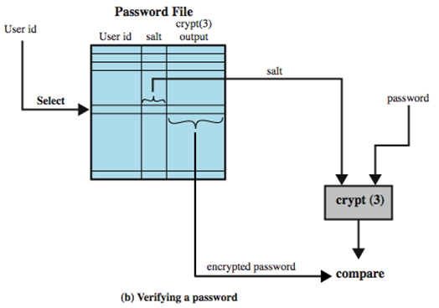
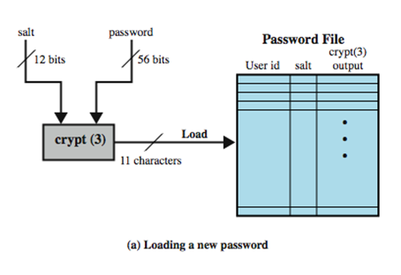
Chapter
Use of Hashed Passwords
07
prevents duplicate passwords from being visible in the password file.
greatly increases the difficulty of offline dictionary attacks. For a salt of length b bits, the number of possible passwords is increased by a factor of 2^{b}.
becomes nearly impossible to find out whether a person with passwords on two or more systems has used the same password on all of them.
28
www.midocean.ae
Secure Operating Systems

Slide 29
Chapter
Attacks on Passwords
07
Some ways you might be able to determine a user's password, in decreasing order of difficulty.
  Try all possible passwords.
  Try frequently used passwords.
  Try passwords likely for the user.
  Search for the system list of passwords.
  Ask the user.
29
www.midocean.ae
Secure Operating Systems
Notes:
Ordinary عادي

Slide 30
12 steps an attacker might try in order to determine a password
Chapter
07
No password
The same as the user ID
Is, or is derived from, the user's name
Common word list (for example, "password," "secret," "private") plus common names and patterns (for example, "asdfg," "aaaaaa")
Short college dictionary
Brute force, full character set
Common non-English language dictionaries
Short college dictionary with capitalizations (PaSsWorD) and substitutions (0 for O, and so forth)
Complete English with capitalizations and substitutions
Common non-English dictionaries with capitalization and substitutions
Brute force, lowercase alphabetic characters
Complete English word list
30
www.midocean.ae
Secure Operating Systems
Notes:
Ordinary عادي

Slide 31
Chapter
Exhaustive Attack (brute force attack)
07
The attacker tries all possible passwords, usually in some automated fashion.
If passwords are words consisting of the 26 characters AZ and can be of any length from 1 to 8 characters:
  There are 26¹ passwords of 1 character, 26² passwords of 2 characters, and 26⁸ passwords of 8 characters.
  The system as a whole has 26¹ + 26² + ... + 26⁸ = 26⁹ - 1 almost equals 5 * 10¹² or five million possible passwords.
31
www.midocean.ae
Secure Operating Systems
Notes:
Ordinary عادي

Slide 32
Chapter
Exhaustive Attack (brute force attack)
07
If we want to use a computer to create and try each password at a rate of checking one password per millisecond, it would take on the order of 150 years to test all.
But if we can speed up the search to one password per microsecond, the work factor drops to about two months.
32
www.midocean.ae
Secure Operating Systems
Notes:
Ordinary عادي

Slide 33
Chapter
Exhaustive Attack (brute force attack)
07
Searching for a single particular password does not necessarily require all passwords to be tried.
An intruder needs to try only until the correct password is identified.
People tend to pick simple passwords.
33
www.midocean.ae
Secure Operating Systems
Notes:
Ordinary عادي

Slide 34
Chapter
Attacking Systems via Passwords
07
A common attack path for Trudy would be:
outsider normal user administrator
One weak password on a system –or one week password on an entire network- could be enough for the first stage of the attack to succeed.
34
www.midocean.ae
Secure Operating Systems

Slide 35
Chapter
Attacks on Passwords
07
Attacker could…
  Target one particular account
  Target any account on system
  Target any account on any system
  Attempt denial of service (DoS) attack
Common attack path
  Outsider → normal user → administrator
  May only require one weak password!
35
www.midocean.ae
Secure Operating Systems

Slide 36
Chapter
Dictionary Attack – some numbers
07
Typical password dictionary
  1,000,000 entries of common passwords
    people's names, common pet names, and ordinary words.
  Suppose you generate and analyze 10 guesses per second
    This may be reasonable for a web site; offline is much faster
  Dictionary attack in at most 100,000 seconds = 28 hours, or 14 hours on average
If passwords were random
  Assume six-character password
    Upper- and lowercase letters, digits, 32 punctuation characters
    689,869,781,056 password combinations.
    Exhaustive search requires 1,093 years on average
36
www.midocean.ae
Secure Operating Systems

Slide 37
Chapter
Dictionary Attack
07
Trudy pre-computes h(x) for all x in a dictionary of common passwords
Suppose Trudy gets access to password file containing hashed passwords
  She only needs to compare hashes to her pre-computed dictionary
  After one-time work, attack is trivial
Can we prevent this attack? Or at least make attacker’s job more difficult?
37
www.midocean.ae
Secure Operating Systems

Slide 38
Chapter
Password Cracking
07
Dictionary attacks
  develop a large dictionary of possible passwords and try each against the password file
  each password must be hashed using each salt value and then compared to stored hash values
Rainbow table attacks
  pre-compute tables of hash values for all salts
  a mammoth table of hash values
  can be countered by using a sufficiently large salt value and a sufficiently large hash length
38
www.midocean.ae
Secure Operating Systems

Slide 39
Chapter
Password Cracking
07
Password crackers exploit the fact that people choose easily guessable passwords
  Shorter password lengths are also easier to crack
John the Ripper
  Open-source password cracker first developed in in 1996
  Uses a combination of brute-force and dictionary techniques
39
www.midocean.ae
Secure Operating Systems

Slide 40
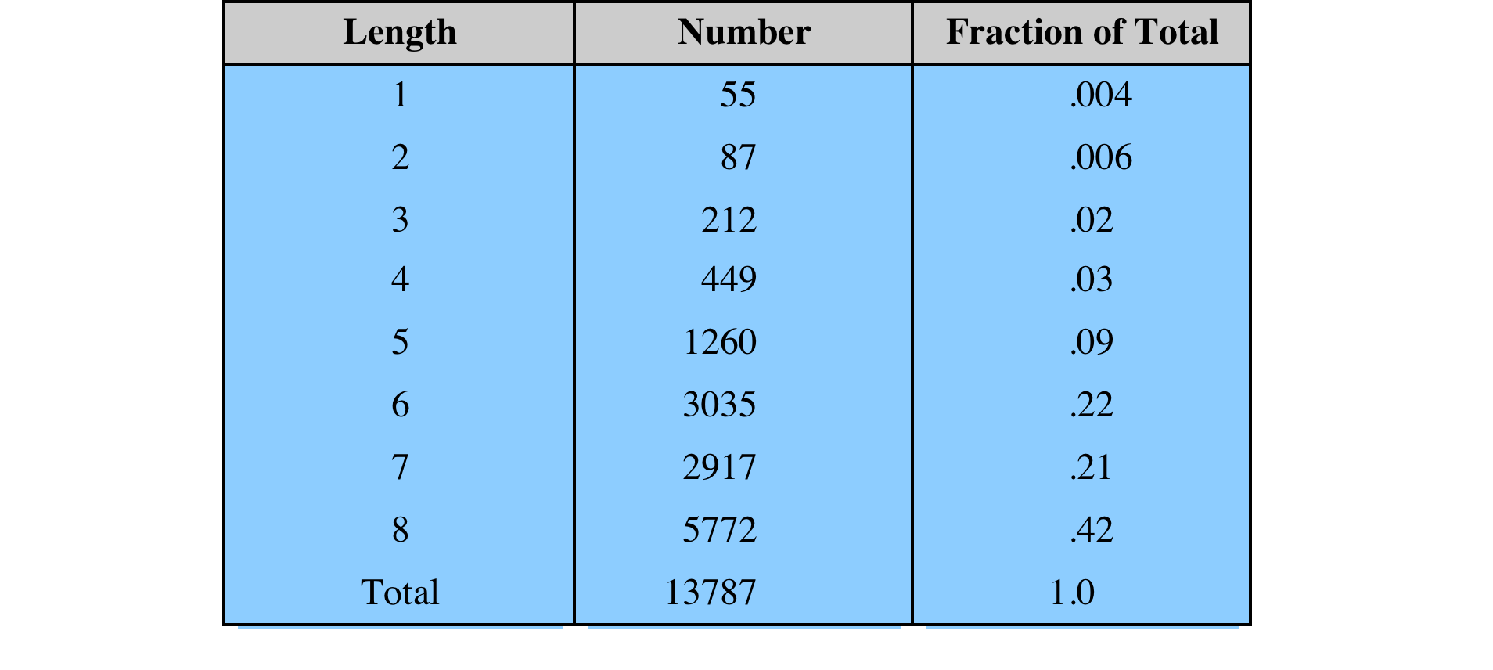
Chapter
Observed Password Lengths
07
Purdue University study on 54 systems and 7000 users
40
www.midocean.ae
Secure Operating Systems

Slide 41
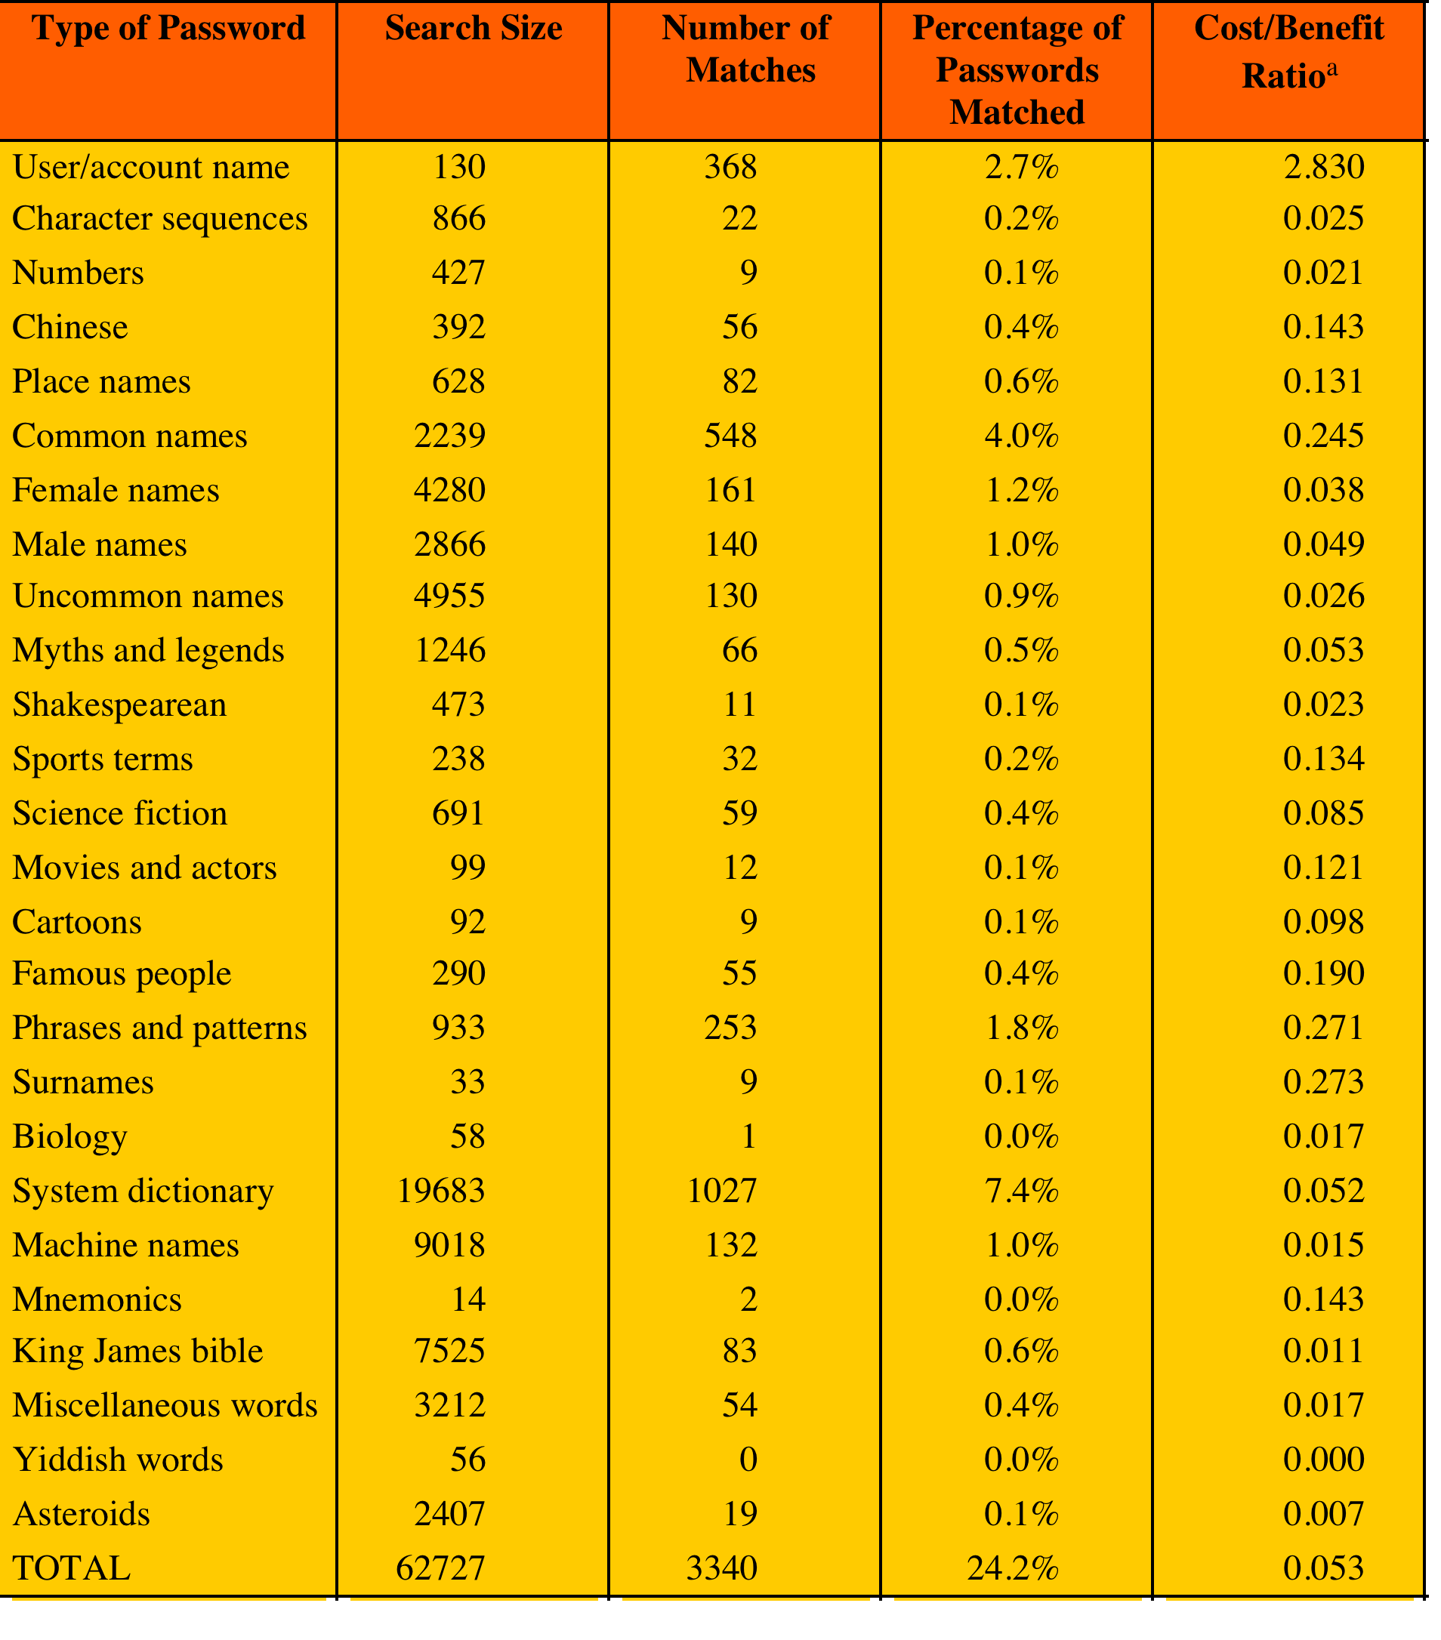
Chapter
Observed Password Lengths
07
Passwords Cracked from a Sample Set of 13,797 Accounts Compiled 3M dictionary words and their variations.
The more words that need to be tested for a match, the lower the cost/benefit ratio.
41
www.midocean.ae
Secure Operating Systems

Slide 42
Chapter
Observed Password Lengths
07
Study in 2013
25,000 students at university with complex password policy
42
www.midocean.ae
Secure Operating Systems

Slide 43
Chapter
Improved Implementations
07
Much stronger hash/salt schemes available for Unix
Recommended hash function is based on MD5
  salt of up to 48-bits
  password length is unlimited
  produces 128-bit hash
  uses an inner loop with 1000 iterations to achieve slowdown
OpenBSD (Open source UNIX O.S) uses Blowfish block cipher based hash algorithm called Bcrypt
  most secure version of Unix hash/salt scheme
  uses 128-bit salt to create 192-bit hash value
43
www.midocean.ae
Secure Operating Systems

Slide 44
Chapter
Modern Approaches
07
Complex password policy
  Forcing users to pick stronger passwords
However, password-cracking techniques have also improved
  The processing capacity available for password cracking has increased dramatically
  The use of sophisticated algorithms to generate potential passwords
  Studying examples and structures of actual passwords in use
44
www.midocean.ae
Secure Operating Systems

Slide 45
Chapter
Proactive Password Checking
07
Rule enforcement
  Specific rules that passwords must adhere to
Password cracker
  Compile a large dictionary of passwords not to use
Bloom filter
  Used to build a table based on dictionary using hashes
  Check desired password against this table
45
www.midocean.ae
Secure Operating Systems

Slide 46
Chapter
Summary
07
This chapter explained:
Password Selection Criteria
One-Time Passwords
Challenge-response Authentication
Attacks on Passwords
46
www.midocean.ae
Secure Operating Systems

Slide 47



Thank You

