Slide 1

Submitted in fulfillment of the requirements for the degree
Master of Science in Artificial Intelligence
Credit Card Fraud Detection Using Adaptive Machine Learning
Prepared by
Name: Ahmad Mostafa Abutalib
ID No.: 243002097
Supervisor Name: Dr. Amjad Qatish

Slide 2

Agenda Overview
Problem Statement & Research Objectives
Previous Works
Methodology and Proposed Approach
Project Steps and Timeline
Expected Results
Conclusion

Slide 3
Problem Statement & Research Objectives
Background
The rapid growth of digital transactions has increased the risk of credit card fraud.
Traditional rule-based systems struggle to keep pace with evolving fraud strategies.

Slide 4
Problem Statement & Research Objectives
Problem
Existing systems are static, slow to adapt, and generate a high number of false positives.
This leads to disrupted customer experiences and increased operational costs.

Slide 5
Problem Statement & Research Objectives
Contribution of This Study
Propose a real-time fraud detection framework using ML/DL.
Apply adaptive learning to maintain accuracy over time.

Slide 6
Problem Statement & Research Objectives
Research Problem
Traditional fraud detection systems are static, slow to adapt, and generate high false positives.

Slide 7
Research Questions & Research Objective
Research Questions | Research Objective
Q1: How can machine learning improve detection accuracy compared to rule-based systems? | Objective 1: Build a real-time fraud detection framework using ML/DL.
Q2: Which algorithm provides the best trade-off between accuracy and speed?
Q3: How can adaptive learning help maintain system accuracy over time? | Objective 2: Implement adaptive learning for continuous improvement.

Slide 8
Previous Work
Overview of Previous Studies
Recent studies (2020–2024) have applied various machine learning and deep learning techniques to credit card fraud detection. Results show promising accuracy levels ranging from 83% to 96%, depending on the methodology:
CNN (Convolutional Neural Network) variants (without pooling) struggled with feature loss, achieving lower accuracy.
Hybrid models like CNN (Convolutional Neural Network) – SVM (Support Vector Machine) and BiLSTM (Bidirectional Long Short-Term Memory) – GRU (Gated Recurrent Unit) improved performance but still suffered from data imbalance and limited adaptability.
LSTM (Long Short-Term Memory) -based approaches reached higher accuracy, yet they remain resource-intensive and lack real-time deployment validation.

Slide 9
Previous Work
Gap of Previous Studies
Despite advances, these studies did not provide a practical real-time framework. They fell short in:
Real-time adaptability – most experiments were conducted offline.
Handling imbalanced datasets – limited use of advanced resampling or cost-sensitive methods.
Sustainability of accuracy – lack of adaptive learning to respond to evolving fraud patterns.
Scalability – high computational cost limits deployment in real-world banking or e-commerce environments.

Slide 10
Previous Work
Comparison of Previous Studies
Study Title & Source | Year | Method | Dataset | Result | Limitation
Credit Card Fraud Detection Using CNN without Pooling | 2023 | CNN variant | Kaggle | 83.72% | Feature loss → low accuracy
Hybrid CNN–SVM for Fraud Detection | 2023 | CNN–SVM | Kaggle | 91.05% | Still imbalanced, offline only
BiLSTM–GRU–MaxPooling | 2020 | BiLSTM–GRU | Kaggle | 91.37% | Complex, hard real-time deployment
LSTM Approach for Fraud Detection | 2024 | LSTM | Kaggle | 96.3% | Resource-intensive, no real-time test

Slide 11
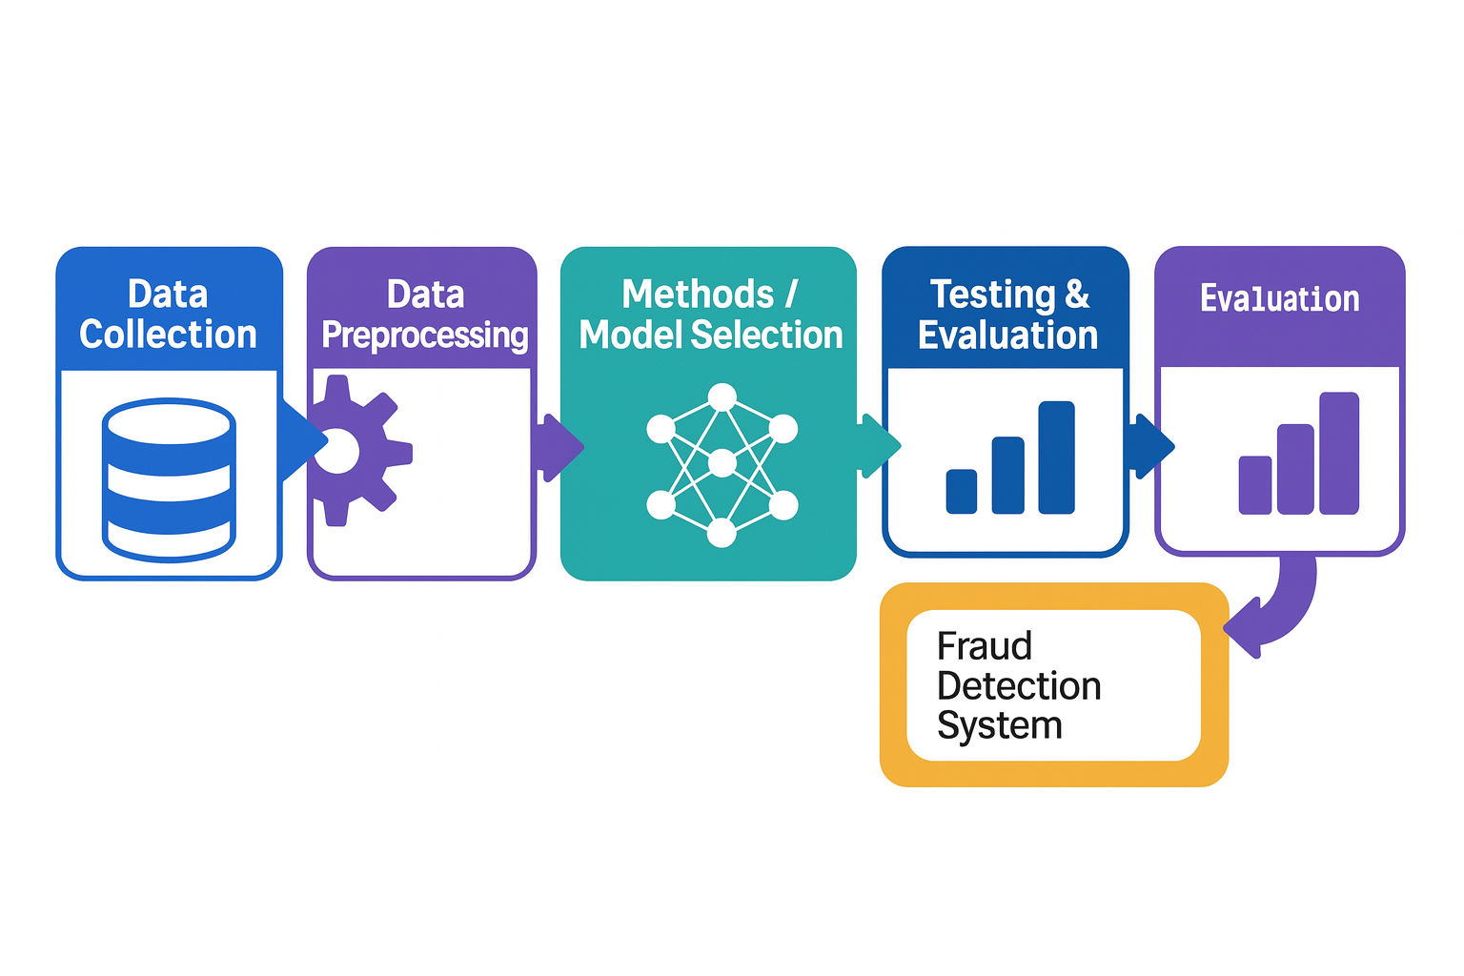
Methodology & Proposed Approach

Slide 12
Methodology & Proposed Approach
Data Collection
Kaggle dataset with anonymized transactions (only 0.172% fraud).

Slide 13
Methodology & Proposed Approach
Data Preprocessing
Remove missing/invalid values.
Normalize continuous variables.
Handle imbalance using SMOTE

Slide 14
Methodology & Proposed Approach
Model/Method Selection
Traditional ML Models (Baselines)
Logistic Regression – simple interpretable baseline.
Decision Trees – non-linear, easy to understand.
Random Forest – ensemble, handles non-linear relations.
SVM (Support Vector Machine) – effective in high-dimensional data.

Slide 15
Methodology & Proposed Approach
Model/Method Selection
Boosting Model
XGBoost (Extreme Gradient Boosting) – efficient boosting, high accuracy for tabular data.

Slide 16
Methodology & Proposed Approach
Model/Method Selection
Deep Learning Models
CNN (Convolutional Neural Network), RNN (Recurrent Neural Network) – feature extraction & sequential learning.
LSTM (Long Short-Term Memory), GRU (Gated Recurrent Unit), BiLSTM (Bidirectional Long Short-Term Memory), BiGRU (Bidirectional Gated Recurrent Unit) – capture sequential and temporal transaction patterns.
DNN (Deep Neural Network) – captures complex data interactions.

Slide 17
Methodology & Proposed Approach
Model/Method Selection
Optimization Techniques
Hyperparameter tuning (grid search, learning rate).
Regularization to reduce overfitting.

Slide 18
Methodology & Proposed Approach
Testing & Evaluation
Metrics: AUC (Area Under the Curve), Precision, Recall, F1-score (F1 Measure), Latency.

Slide 19
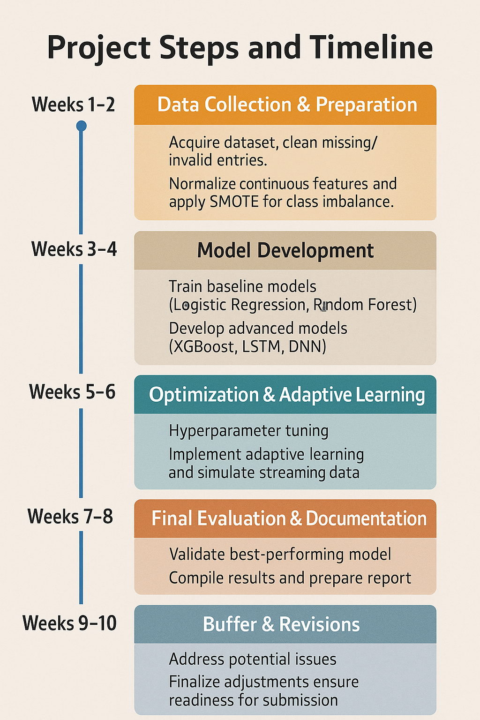
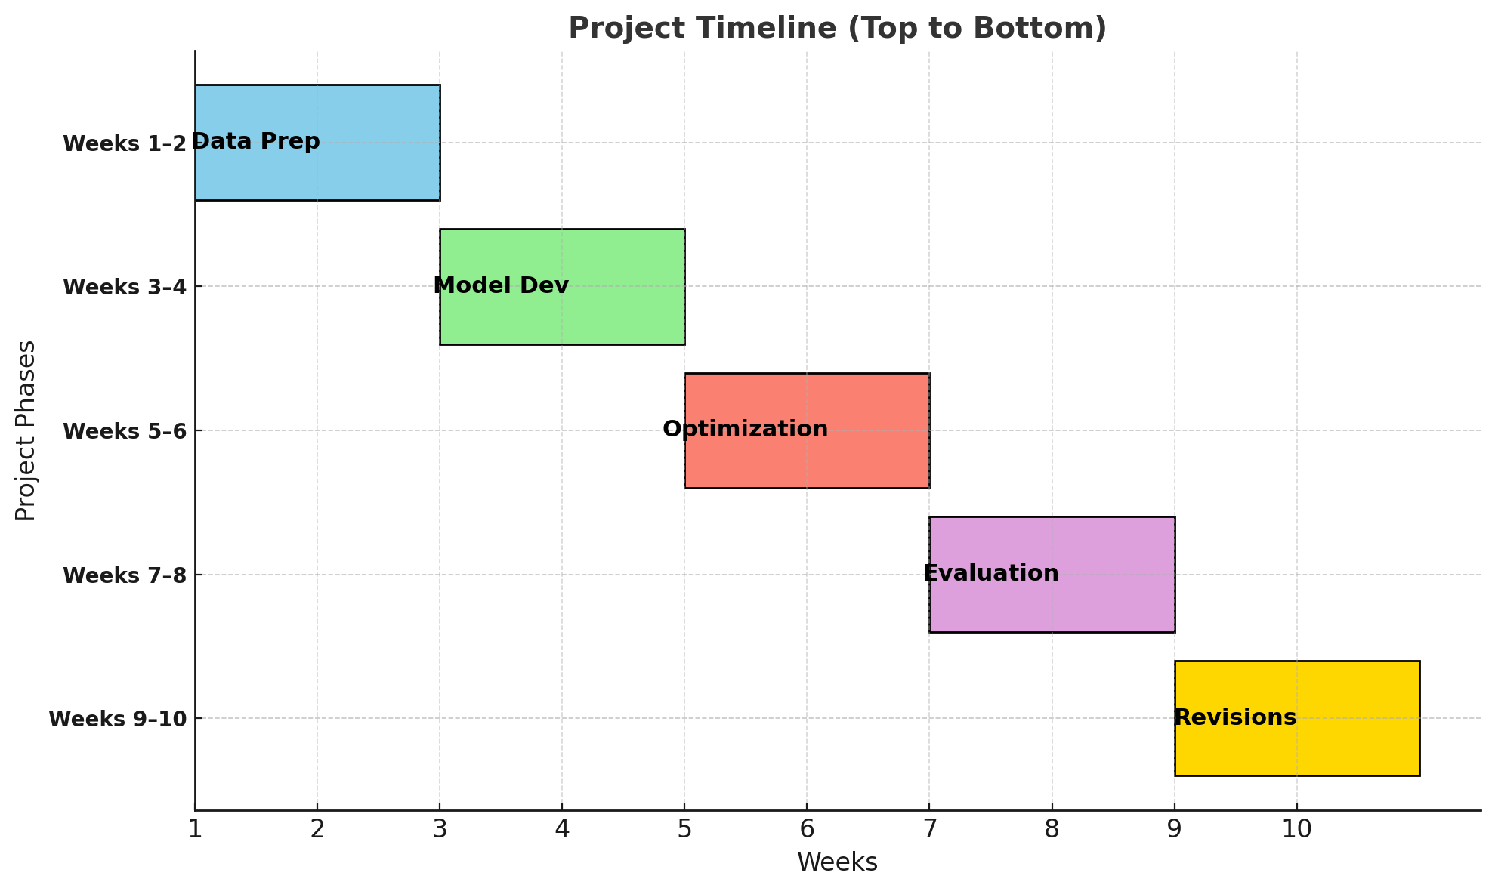
Project Steps and Timeline

Slide 20
Expected Results
Higher Accuracy – Fewer false positives.
Adaptive System – Learns and evolves with new fraud patterns.
Real-Time Performance – Fast detection for high-volume transactions.
Practical Use – Scalable for banks and e-commerce.

Slide 21
Conclusion
Scalable framework for banks, e-commerce, and payment platforms.
Credit card fraud remains a critical challenge in the digital era, with growing risks and financial losses.
Traditional detection systems are static, limited in adaptability, and generate many false positives.
This research proposes a real-time fraud detection framework using ML/DL, integrated with adaptive learning.
The expected outcome is an accurate, scalable, and practical system ready for deployment in banks, e-commerce, and payment platforms.
By combining transactional and behavioral data, the framework ensures long-term resilience against evolving fraud patterns.

Slide 22

Thank you for your attention

