Slide 1

Project Risk &Supply Chain Risk
Prepared by Dr. Dalia Hosni
Introduction
PMG 663
Project Risk &Supply Chain Risk

Slide 2
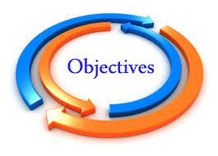

Introduction
Project Risk &Supply Chain Risk
To understand risk management definition
To understand Risk identification and assessment − techniques and tools & Development and justification of risk-driven management decisions.
To understand supply chain risk management, vulnerability and develop risk response strategies
Developing an understanding of basic principles of Risk management processes, procedures & Risk analysis techniques.
To understand how implementation of supply chain risk management strategies can be effective by industry based real world case studies and scenarios illustrating macro and micro-level risks, and approaches to their management.

Slide 3

Introduction
Project Risk &Supply Chain Risk
To understand the concept of risk, uncertainty & risk parameters in the context of commercial
management.
Analyze risk assessment and mitigation strategies in specific situations
To develop a capacity to critically review the principles and applications of risk and vulnerability management in the context of commercial environments
Describe supply chain risk management strategies to implement and monitor appropriate management techniques relevant to specific situations

Slide 4

Introduction
Project Risk &Supply Chain Risk
What Is a Project?
What Is a Risk?
Types of Project Risk
Supply chain management
Risk in Supply chain
Supply Chain Risk Management (SCRM)

Slide 5
Introduction
Project Risk &Supply Chain Risk
Section Topics:
Plan Risk Management
Identify Risks
Perform Qualitative Risk Analysis
Perform Quantitative Risk Analysis
Plan Risk Responses
Monitor and Control Risks

Slide 6
Introduction
Project Risk Management
التنفيذ
المراقبة والمتابعة
الإغلاق
تخطيط
Initiating
Executing
Monitoring
&
Controlling
Planning
Closing
إعداد
Plan Risk Management
Identify Risks
Perform Qualitative Risk Analysis
Perform Quantitative Risk Analysis
Plan Risk Responses
Monitor and
Control Risks

Slide 7




Introduction
Supply chain management
- A supply chain consists of
Supplier
Manufacturer
Distributor
Retailer
Customer
Upstream
Downstream
- aims to Match Supply and Demand, profitably for products and services
SUPPLY SIDE
DEMAND SIDE
- achieves
+
+
+
+
+
=
The right
Product
The right
Price
The right
Store
The right
Quantity
The right
Customer
The right
Time
Higher
Profits

Slide 8
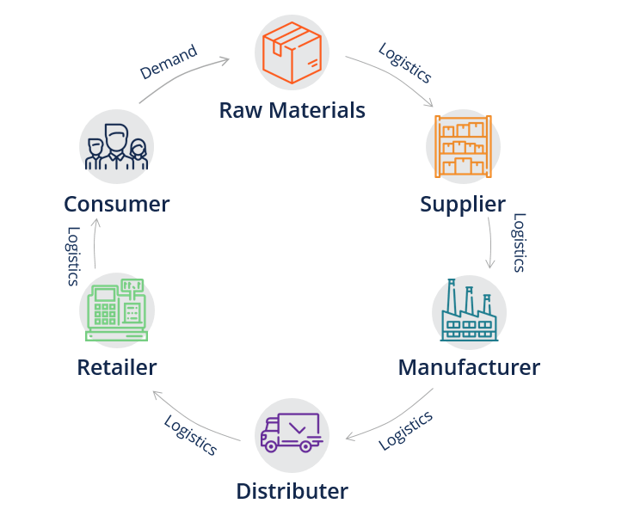
Introduction
Supply chain management
A supply chain consists of all activities associated with the flow and transformation of goods from raw materials to end users

Slide 9
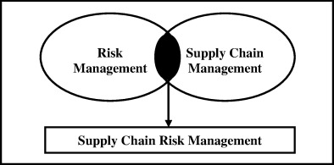
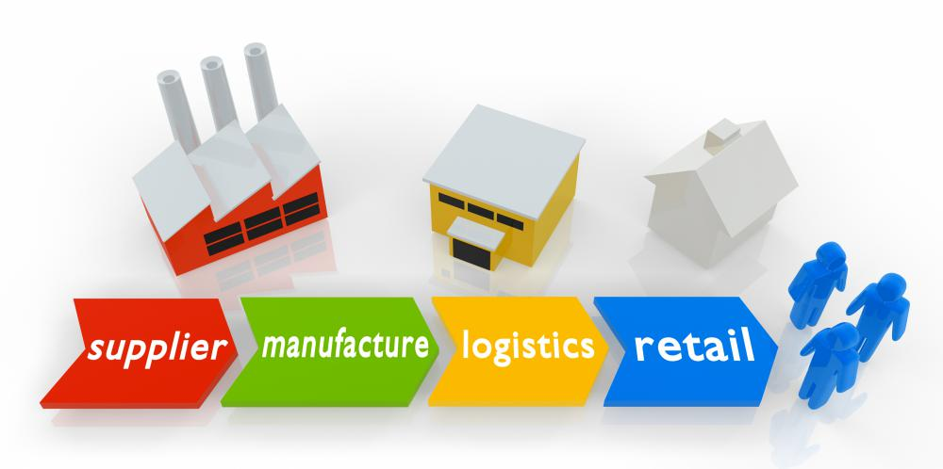
Introduction
Supply Chain Risk Management (SCRM)
_ the risk in the end-to-end supply chain

Slide 10
Introduction
Global Supply-Chain Issues
PRODUCT
LINE DIVERSITY
MARKET
CONCENTRATION
PRODUCTION
DISPERSION
Techno-
logy / dev-
elopment
Custo-
mer
Parts /
Components
Inbound
supply
Marketing
/retailing
Assembly
Physical
distribution
Shorter product
life cycles
Concentrated
demand
Price erosion
Product / model
proliferation
Global sourcing
Focused factories

Slide 11

Introduction
Short Exam

Slide 12

Introduction

