Slide 1

A Hybrid CNN-Transformer Framework for
Facial Expression Recognition
Ammar Wassas
Supervised by Dr. Mohamed Eassa
College of Informatics, Midocean University

Slide 2
OVERVIEW
Agenda
1
Introduction
2
Problem Statement
3
Objectives
4
Contribution
5
Related Work
6
Research Gap
7
Methodology
8
Results
9
Discussion
10
Conclusion and Future Work
2

Slide 3
Introduction
1

Slide 4



1
INTRODUCTION
Why Facial Expression Recognition Matters
A foundational capability for affective computing, with direct applications across high-value domains — building on six decades of research since Ekman & Friesen's (1971) cross-cultural emotion studies.
Healthcare
Education
Human-Computer Interaction
Monitoring patient wellbeing and mental health cues
Gauging student engagement and comprehension
Building emotionally responsive interfaces
3

Slide 5
1
INTRODUCTION
The FER2013 Dataset: A Persistent Challenge
35,887
16.4:1
15–20%
65.5%
Total labeled images
across 7 emotion classes
Class imbalance ratio
(Happy vs. Disgust)
Estimated automated
annotation noise
Human-level accuracy
ceiling (Li & Deng, 2020)
Both imbalance and noise are addressed head-on in this study's methodology — not treated as fixed constraints.
4

Slide 6
Problem Statement
2

Slide 7

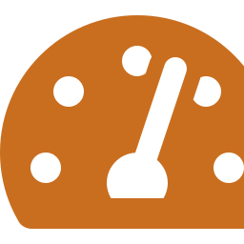


2
PROBLEM STATEMENT
Interrelated Problems in FER Research
Data Quality
Accuracy vs. Efficiency
16.4:1 class imbalance and 15–20% annotation noise restrict achievable model accuracy
Top-performing models rely on large ensembles or hierarchical attention with high parameter counts
Inconsistent Evaluation
Lack of Interpretability
Most studies report only overall accuracy, masking weaknesses on rare emotion classes
Transformer-based FER models rarely offer visual explanation of individual predictions
5

Slide 8
Research Objectives
3

Slide 9
3
OBJECTIVES
Research Objectives
1
2
3
Assess state-of-the-art FER and identify limitations
Design a hybrid CNN-Transformer weighted ensemble
Address noise & imbalance via FER+, MixUp/CutMix, weighted loss
4
5
6
Implement YOLOv8-based face detection preprocessing
Benchmark against six state-of-the-art approaches
Provide explainability via Grad-CAM
6

Slide 10
Contribution
4

Slide 11




4
CONTRIBUTION
Contributions to the FER Literature
Data-Preprocessing
Model / Ensemble
Evaluation
Interpretability
YOLOv8 face detection standardizing FER2013 into clean, face-centered 224×224 RGB crops
Hybrid CNN-Transformer combining EfficientNet-B3 and ViT-Small via weighted ensemble
Multi-dimensional methodology with per-class F1 alongside overall accuracy, benchmarked vs. six SOTA approaches
Grad-CAM on EfficientNet-B3 to visualize which facial regions drive each prediction
7

Slide 12
Related Work
5

Slide 13




5
RELATED WORK
The FER Research Landscape
Fifteen Scopus-indexed studies reviewed, all evaluated on the original, unrefined FER2013 labels.
CNN Architectures
Attention / Transformers
Imbalance / Noise Handling
Lightweight Deployment
Explainability
VGG, transfer-learning CNNs, kernel/filter tuning
Cross-attention, ViT variants, hierarchical fusion
Focal loss on ConvNeXt — the only study to target imbalance directly
AutoML search, mobile-efficient hybrids, HRI systems
Zero of fifteen studies apply visual interpretability
8

Slide 14
5
RELATED WORK
Summary of Related Work on FER2013
# | Authors | Method | Year | Accuracy
1 | Khaireddin and Chen | VGG-CNN | 2021 | 73.28%
2 | Minaee et al. | Deep-Emotion | 2021 | 70.02%
3 | Liu et al. | AMPA-Net | 2022 | 74.48%
4 | Sun et al. | Cross-Attention Transformer | 2023 | 74.84%
5 | Xue et al. | ViT-AP | 2022 | 73.50%
6 | Tao and Duan | Hierarchical Attention Network | 2024 | 76.20%
7 | Pecoraro et al. | LHC-Net | 2022 | 74.42%
8 | Akhand et al. | Transfer Learning CNN | 2021 | 72.40%
9 | Agrawal and Mittal | Optimized CNN | 2020 | 70.80%
10 | Li et al. | Hybrid ViT (Multi-Scale) | 2024 | 69.84%
11 | Goel et al. | AutoML-FER | 2025 | 76.40%
12 | Chen et al. | ConvNeXt + SENet | 2025 | 70.40%
13 | He et al. | MSAFNet | 2025 | 73.25%
14 | Telceken et al. | EfficientMobileNet | 2025 | 77.60%
15 | Raj and Demirkol | CNN for HRI | 2025 | 64.00%
All fifteen studies evaluated on the original, unrefined FER2013 labels — none apply FER+ relabeling.
9

Slide 15
5
RELATED WORK
Accuracy Progression Across Reviewed Studies
Best prior result: Telceken et al. (2025), 77.6%

Slide 16
Research Gap
6

Slide 17
6
RESEARCH GAP
No Reviewed Study Solves
Data quality (noise + imbalance) handled together
✗
Computational efficiency reported
✗
Per-class evaluation beyond overall accuracy
✗
Visual interpretability of predictions
✗
EfficientViT-FER is designed to close this exact gap.
10

Slide 18
Methodology
7

Slide 19





















7
METHODOLOGY
The EfficientViT-FER Pipeline
Stage 1: Data Collection
Stage 5: Training Framework
Stage 2: Preprocessing
Stage 4: Hybrid EfficientViT-FER Architecture
Stage 3: Data Augmentation
Stage 6: Evaluation

Slide 20
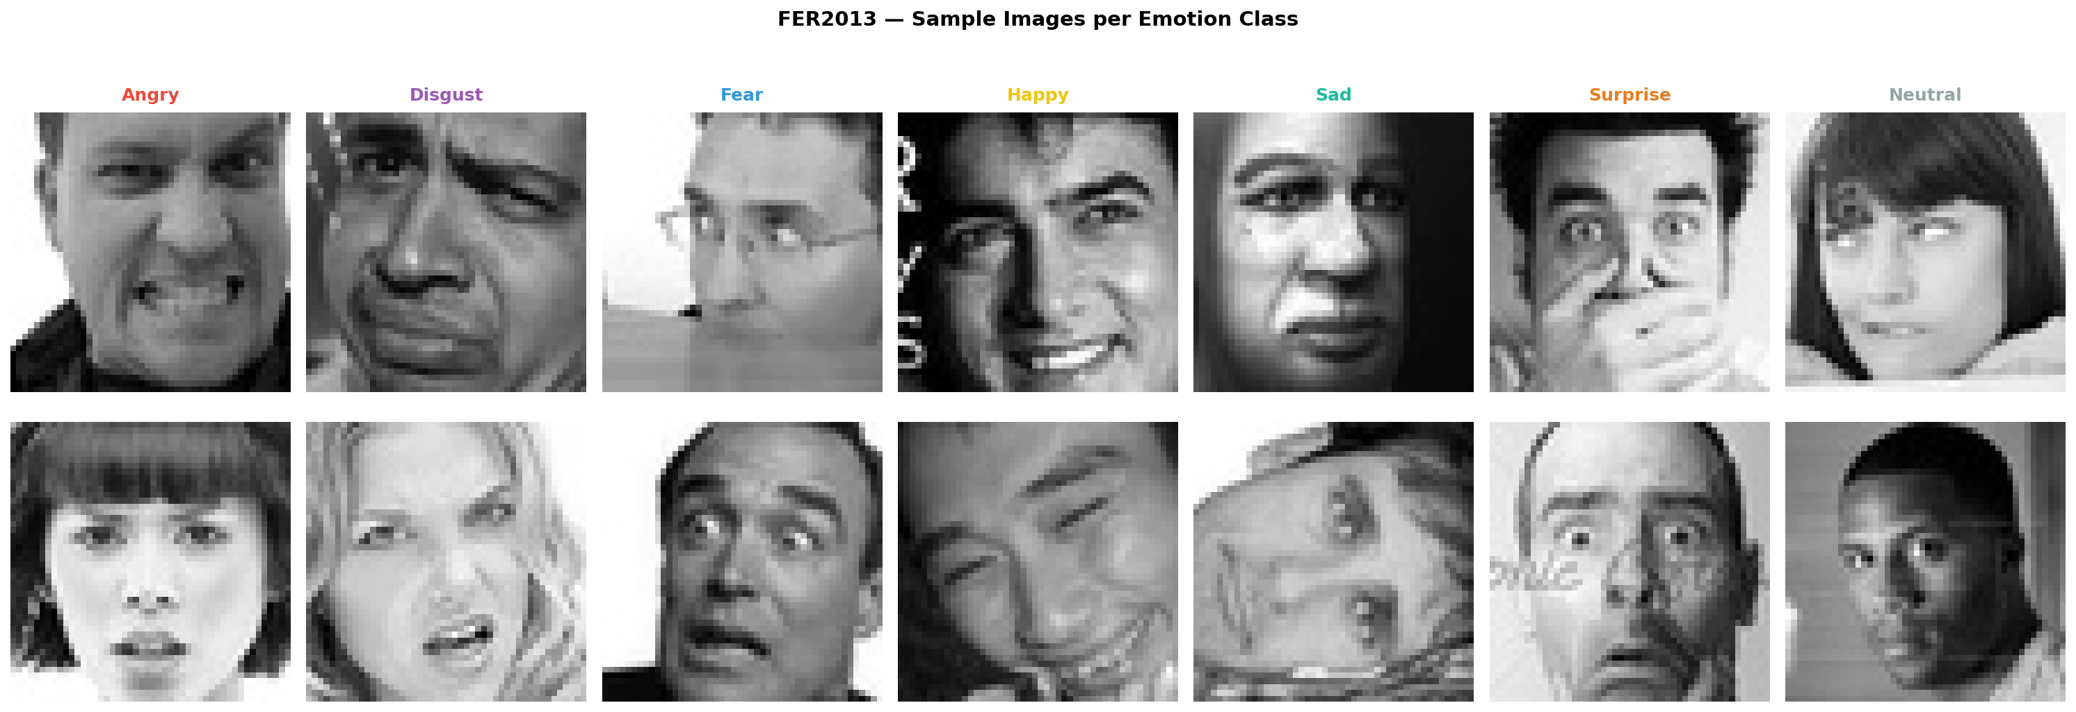
7
METHODOLOGY
Dataset (FER2013) : Imbalanced, and Addressed at Every Stage
16.4 : 1
imbalance ratio
(Happy vs. Disgust)
35,887 grayscale images, 48×48 pixels, 7 emotion classes
How imbalance is addressed, not just at one stage, but throughout the pipeline:
Minority-class-targeted augmentation (Disgust, Fear, Surprise) — stronger transforms for rare classes
Publicly available on Kaggle under the Database Contents License (DbCL) v1.0
Class-frequency-weighted loss — Disgust's raw weight (9.37) capped at 2.0 to prevent instability
FER+ crowd-sourced relabeling (Barsoum et al., 2016) used for noise reduction
Images acquired via automated web search — no controlled capture conditions
Per-class evaluation (F1-score) alongside overall accuracy — imbalance can't hide behind aggregate numbers
12

Slide 21
7
METHODOLOGY - PREPROCESSING
Stage 1: FER+ Label Refinement
Ten crowd-sourced annotators label every image; majority vote becomes the clean training label
262
ŷ = argmax( Σₖ₌₁¹⁰ 𝟏[aₖ = c] )
images (0.7%) excluded
"Unknown / Not-a-Face" votes
exceeded emotion votes
Majority vote across 10 annotators, c ∈ {1,…,7}
Result: 35,625 valid images retained before the 70/15/15 stratified split.
Impact: This single step contributes ~+23 percentage points of accuracy over raw, noisy labels — the largest single factor in this study's results.
13

Slide 22
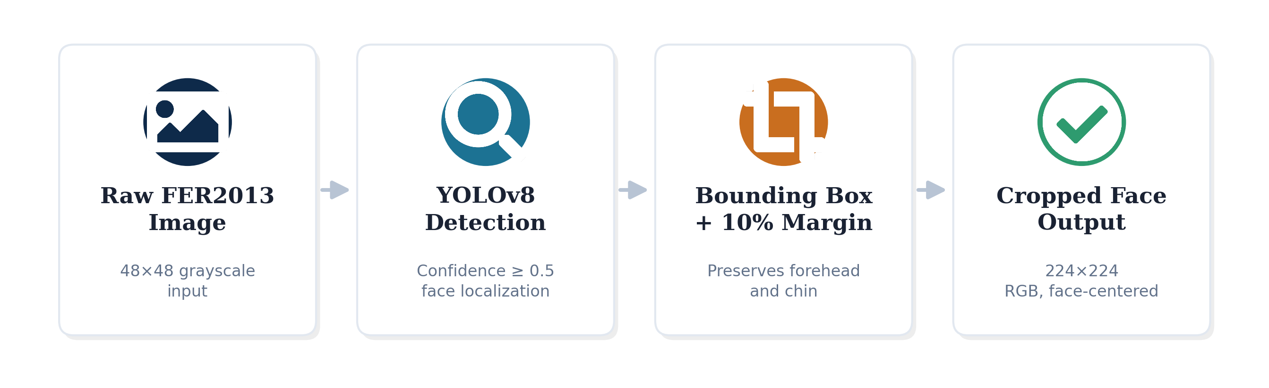
7
METHODOLOGY - PREPROCESSING
Stage 2: YOLOv8 Face Detection & Cropping
Confidence threshold: 0.5 — detections below are treated as fallback
Bounding boxes expanded 10% on all sides to preserve forehead/chin
Fallback images retained via direct resize — no data discarded
Overall detection success: 78.1%, with rates varying by emotion (55.0% Disgust → 78.9% Surprise)
14

Slide 23



7
METHODOLOGY - PREPROCESSING
Stage 3: Standardization
Bicubic Resize
Grayscale → RGB
Pixel Normalization
48×48 → 224×224 pixels using a 16-pixel weighted interpolation kernel
Single channel replicated 3× for compatibility with ImageNet-pretrained backbones
ImageNet mean/std statistics applied for stable fine-tuning convergence
Why upscale despite no new information gained? Both backbones are pretrained on ImageNet at fixed 224×224 resolution. With only ~25,000 training images, transfer learning is essential — training from scratch caused severe overfitting in preliminary experiments (below 30% accuracy).

Slide 24
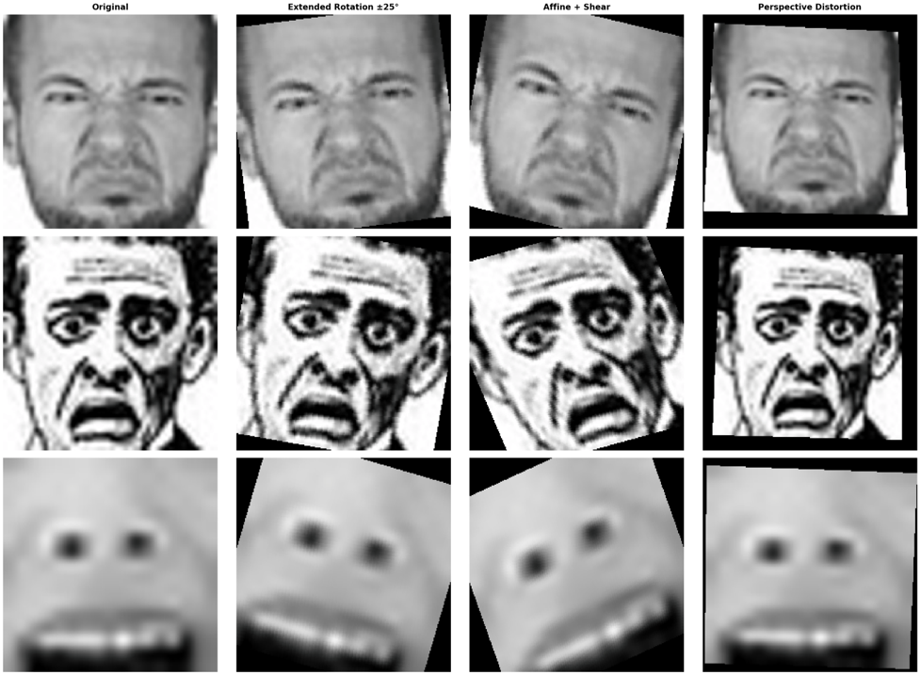
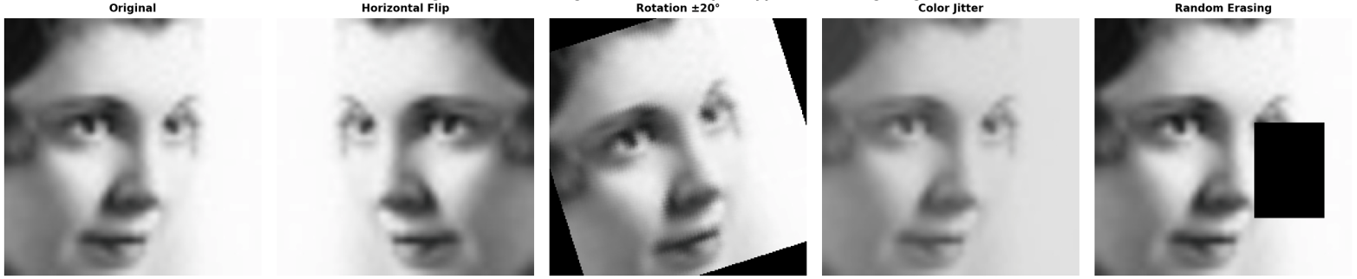
7
METHODOLOGY – DATA AUGMENTATION
Data Augmentation: Two-Tier Strategy for Imbalance
General (All Training Images)
Minority Classes Only — Disgust, Fear, Surprise
• Horizontal flip (p=0.5)
• Zoom ±10%
• Rotation ±20°
• Extended rotation ±25°
• Brightness/contrast jitter
• Horizontal shear (s=0.1)
• Random grayscale (p=0.05)
• Perspective distortion (ratio 0.2)
• Random erasing (p=0.1)
15

Slide 25
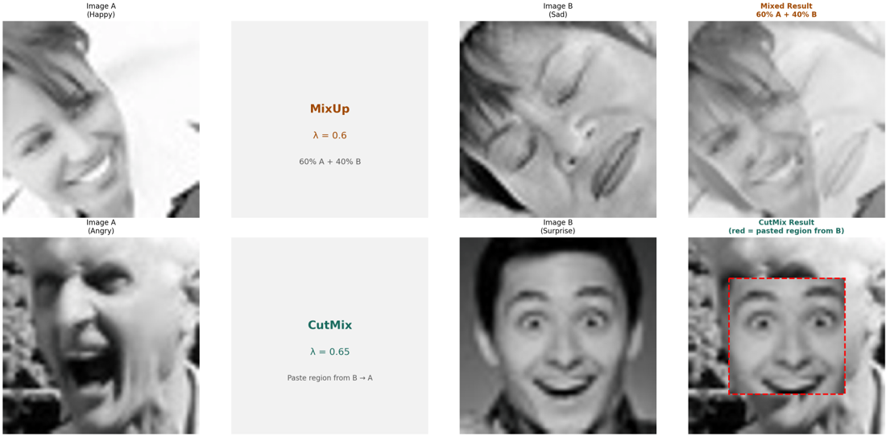
7
METHODOLOGY – DATA AUGMENTATION
Batch-Level Augmentation: MixUp & CutMix
MixUp (α=0.2, p=0.3): linearly blends two images and labels, smoothing decision boundaries between similar emotions
CutMix (α=1.0, p=0.3): pastes a region from one image onto another, teaching the model to focus on discriminative local regions
16

Slide 26


7
METHODOLOGY
Backbones: A Dual-Architecture Design
EfficientNet-B3
ViT-Small
11.49M parameters
21.67M parameters
Compound-scaled CNN with Squeeze-and-Excitation in MBConv blocks. Extracts local convolutional features — edges, textures, local facial patterns.
Splits input into 196 patches (16×16), processed via multi-head self-attention. Captures long-range dependencies — e.g., brow-to-mouth relationships.
P_eff = Softmax(W_head · F_B3 + b_head)
P_vit = Softmax(W_cls · Z_cls + b_cls)
Weight 0.80 in the final ensemble — the dominant branch
Weight 0.20 — complementary global-attention signal
17

Slide 27
7
METHODOLOGY
Ensemble Fusion & Test-Time Augmentation
P_final = w_eff · P_eff + w_vit · P_vit P_tta = (1/5) · Σᵢ₌₁⁵ P_final(augᵢ(x))
0.80 / 0.20
final weights (EffNet / ViT)
selected on validation only
Original • H-Flip • +10° • −10° • 110% Crop
Five-view TTA contributes +1.79pp; ensemble adds +0.87pp — both isolated via controlled ablation.
18

Slide 28
7
METHODOLOGY
Training: Class-Weighted Loss & Configuration
L = −Σᶜ wᶜ · ỹᶜ · log(pᶜ) wᶜ = N / (C · Nᶜ) — completing the imbalance-handling loop
Optimizer
Backbone/Head LR
AdamW
1e-5 / 5e-5
Batch size
Max epochs
64
30
Early stop patience
Hardware
8
A100 GPU
Disgust's raw weight (9.37) capped at 2.0 to prevent training instability.
19

Slide 29
Results
8

Slide 30
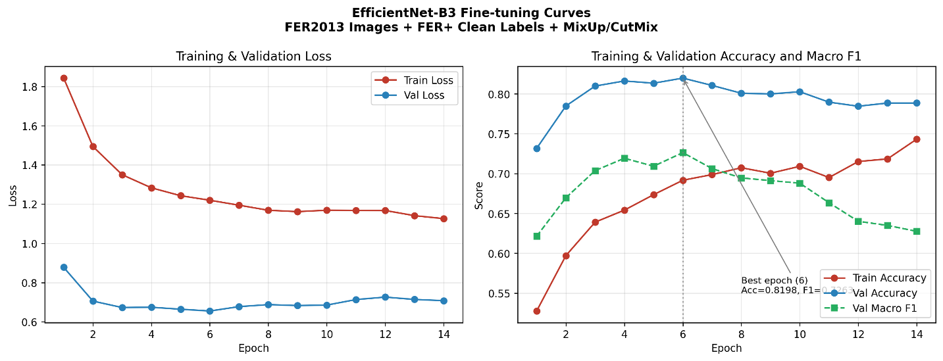
8
RESULTS
Training Convergence: Peak at Epoch 6
81.98%
peak validation accuracy
(epoch 6)
Macro F1: 0.7263
Both metrics peak simultaneously at epoch 6, genuine peak, not an arbitrary cutoff.
Trained 14 epochs total (8-epoch early-stopping patience) • ~49 sec/epoch on NVIDIA A100 • ~11 minutes total training time
From epoch 7 onward, both metrics declined for 8 consecutive epochs, a clean overfitting signature that validates the early-stopping design.

Slide 31
8
RESULTS
Building Up to 82.54%: Controlled Ablation
82.54%
81.67%
Macro F1: 0.7218
79.88%
Macro F1: 0.7074
→
→
Macro F1: 0.6312
EfficientNet-B3
Alone
+ Test-Time
Augmentation
+ ViT-Small
Ensemble
+1.79 pp
+0.87 pp
20

Slide 32
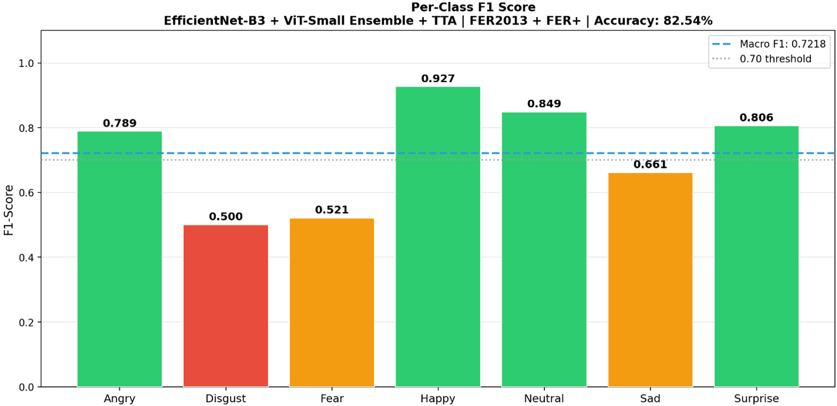
8
RESULTS
Per-Class Performance: The Imbalance Outcome
0.50 / 0.51
F1: Disgust / Fear
(smallest training sets)
Happy leads at 0.9260 F1 (7,654 samples). Despite our imbalance interventions, minority classes remain the hardest.
Aggregate accuracy (82.54%) mitigates — but does not fully resolve — class imbalance.
21

Slide 33
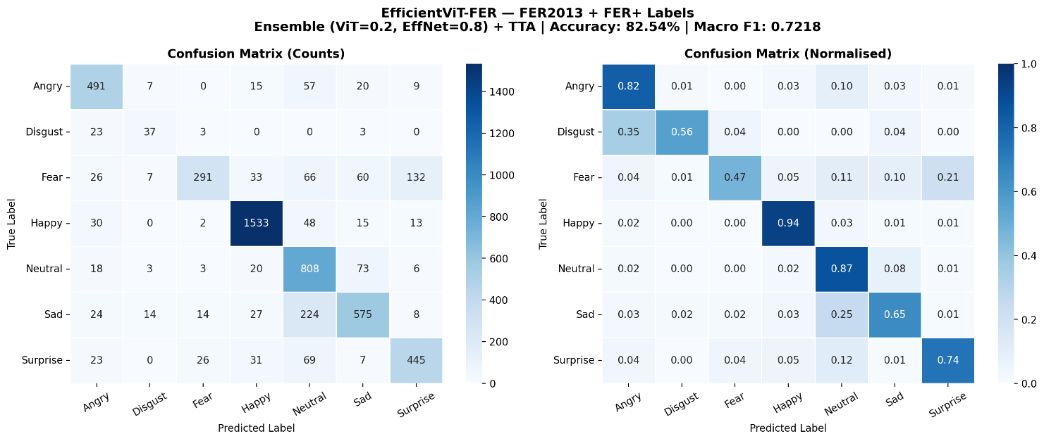
8
RESULTS
Confusion Matrix: Systematic, Not Random
Disgust → Angry (34.8%) — shared brow-lowering, nose-wrinkling
Sad → Neutral (25.3%) — shared low facial-muscle activation
Fear → Surprise (21.5%) — shared raised brows, widened eyes
22

Slide 34
8
RESULTS
Comparison: Proposed Method vs. Closest Baselines
Study | Model | Year | Accuracy | Δ
Khaireddin and Chen | VGG-CNN | 2021 | 73.28% | − 9.26
Pecoraro et al. | LHC-Net | 2022 | 74.42% | − 8.12
Xue et al. | ViT-AP | 2022 | 73.50% | − 9.04
Tao and Duan | Hierarchical Attention Network | 2024 | 76.20% | − 6.34
Goel et al. | AutoML-FER | 2025 | 76.40% | − 6.14
Telceken et al. | EfficientMobileNet | 2025 | 77.60% | − 4.94
Proposed Work | EfficientViT-FER | 2026 | 82.54% | —
+4.94 percentage points over EfficientMobileNet (Telceken et al., 2025), the strongest prior benchmark.
23

Slide 35
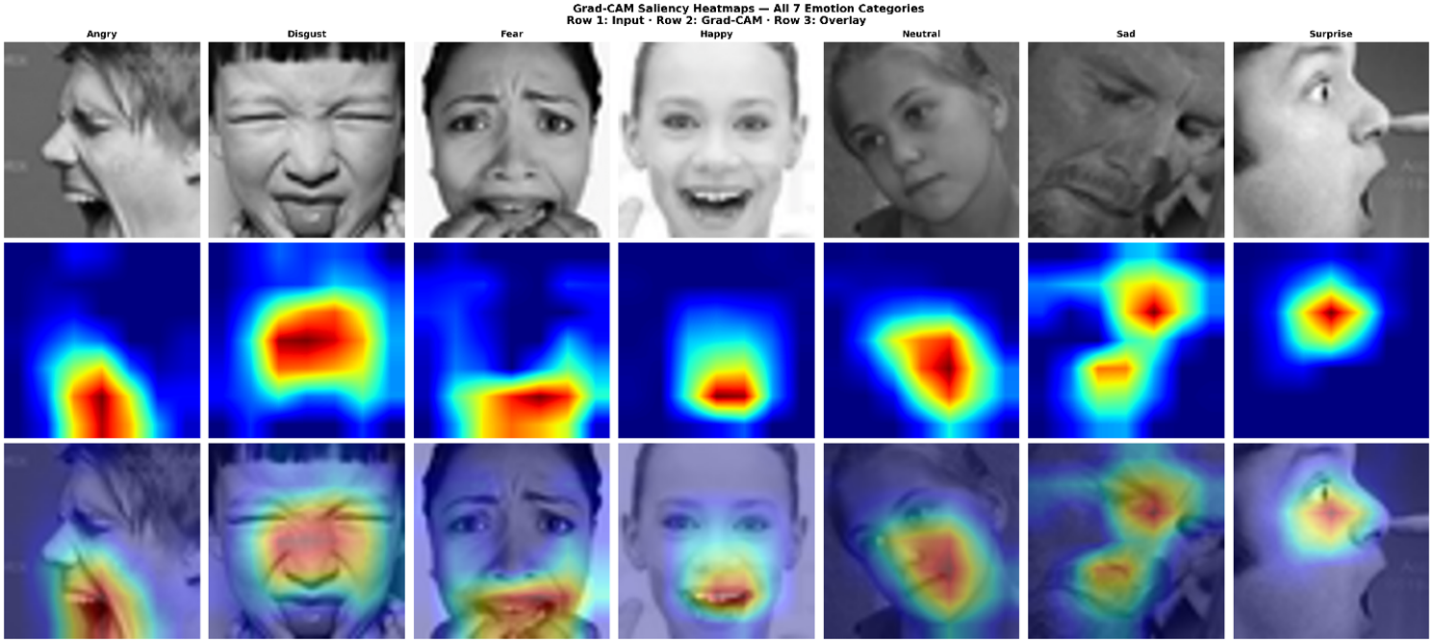
8
RESULTS
Grad-CAM: Attending to Meaningful Regions
Attention correlates with facial regions tied to relevant Action Units — mouth/cheek for Happy, brow region for Angry and Fear — even on misclassified examples, where attention still stays on the face rather than background.
Applied to EfficientNet-B3 only — an explanatory aid, not proof of internal reasoning.
24

Slide 36
Discussion
9

Slide 37




9
DISCUSSION
What We Did Differently, and What We Added
Combined, not isolated
Fixed the labels, not just the model
Prior work tackles noise OR imbalance OR efficiency OR interpretability. This study addresses all four together, in one pipeline.
FER+ refinement (+23pp) shows label quality matters more than architectural complexity — a finding largely absent from prior FER literature.
Per-class transparency
Built-in explainability
Reports F1 per emotion, not just aggregate accuracy — revealing where imbalance still bites, unlike most reviewed studies.
Zero of the fifteen reviewed studies apply visual interpretability. This work adds Grad-CAM validation as standard practice.
25

Slide 38



9
DISCUSSION
Acknowledged Limitations
Minority-class performance: Disgust (F1=0.50) and Fear (F1=0.51) still trail
Inference cost: two-model, five-view TTA pipeline is ~10× slower than a single pass
Grad-CAM is an explanatory aid, not proof of internal reasoning
No cross-dataset (RAF-DB/AffectNet/CK+) or demographic-bias validation; no edge-device latency testing
26

Slide 39
Conclusion & Future Work
10

Slide 40
10
CONCLUSION & FUTURE WORK
Data Quality Beats Architectural Complexity
82.54%
0.7218
+4.94pp
+23pp
test accuracy
macro F1-score
over best prior benchmark
from label refinement alone
EfficientViT-FER demonstrates that targeted data-quality interventions, label refinement, targeted augmentation, and ensemble fusion, deliver greater gains on noisy, imbalanced FER benchmarks than increasing model complexity alone, while remaining interpretable via Grad-CAM.
Outperforms all fifteen reviewed baseline methods on FER2013.

Slide 41
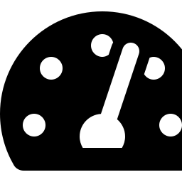



10
CONCLUSION & FUTURE WORK
Future Work
Lightweight Inference
Cross-Dataset Evaluation
Demographic Fairness
Real-Time Video Streams
Model distillation into a single compact network for single-pass, low-latency deployment
Validate generalization on RAF-DB, AffectNet, and CK+ benchmarks
Assess systematic bias across age, gender, and ethnicity using annotated data
Extend to temporal modeling with latency and frame-rate benchmarking

Slide 42
Thank You
Questions & Discussion
Ammar Wassas • Supervised by Dr. Mohamed Eassa
College of Informatics, Midocean University
253002052@st.midocean.edu.km
27

