Slide 1



Graded Protection of Information
Security & Other Standards
Lecture 2
HCIA-Security
Prepared by
Dr. Abdelrhman Ahmed

Slide 2
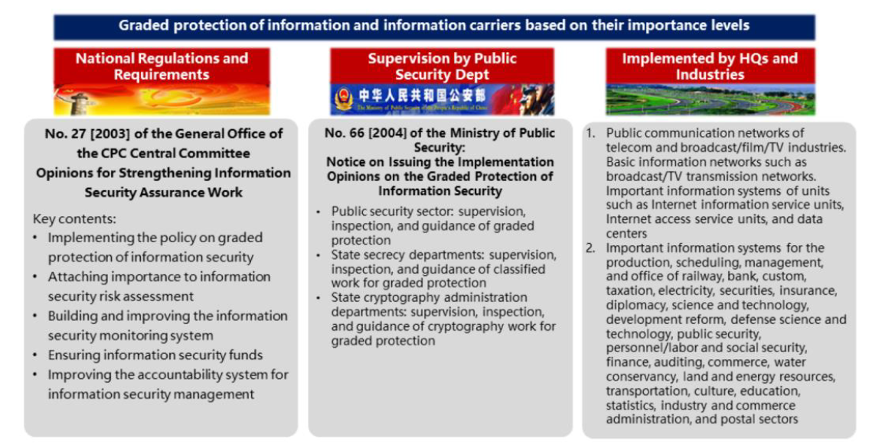
Chapter
02
Definition

Slide 3
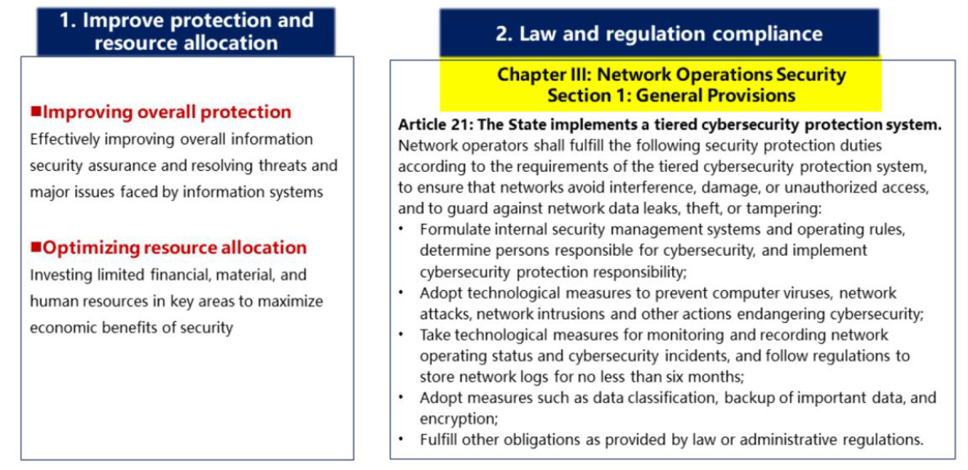
Chapter
Significance
02

Slide 4
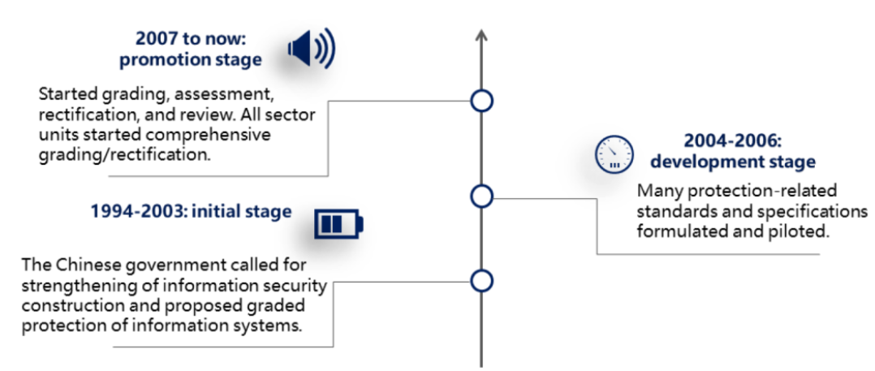
Chapter
Background & Development
02

Slide 5
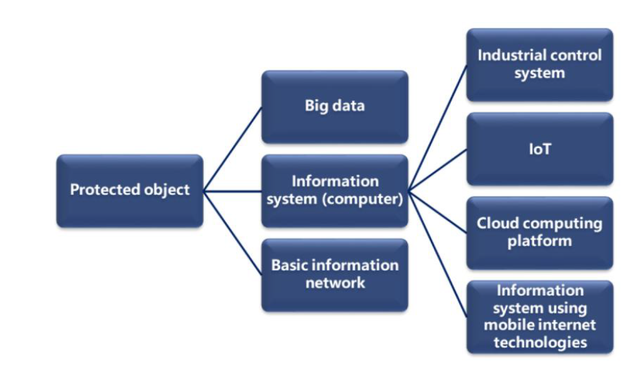
Chapter
Scope
02

Slide 6
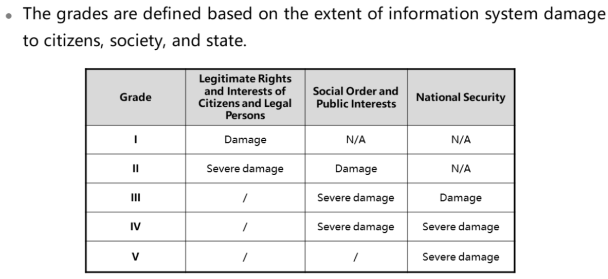
Chapter
Grades
02

Slide 7
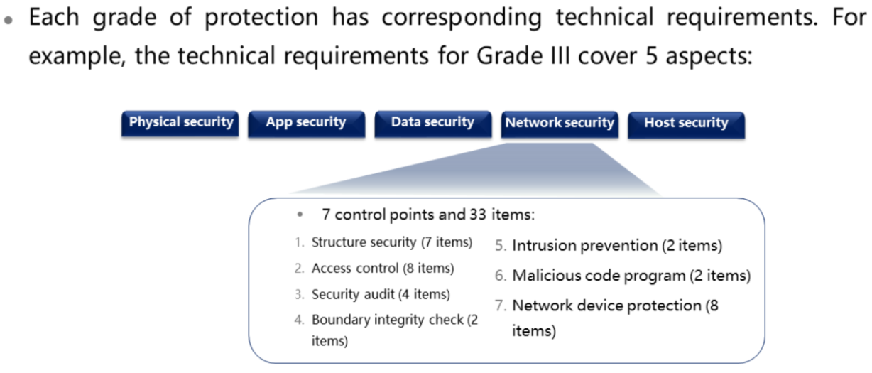
Chapter
02
Basic Technical Requirements

Slide 8
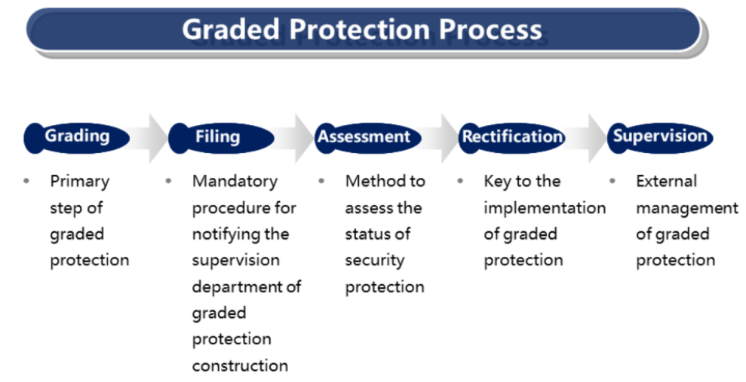
Chapter
02
Process

Slide 9
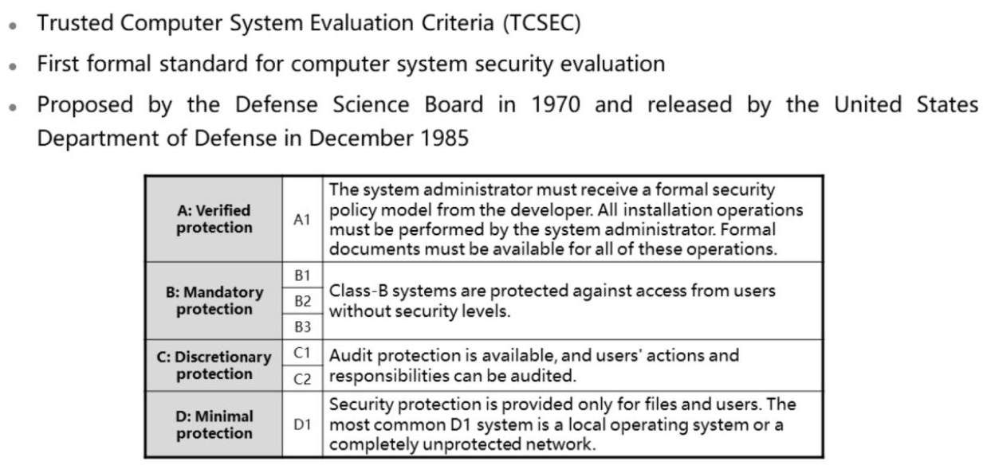
Chapter
Other Standards – US - TCSEC
02

Slide 10
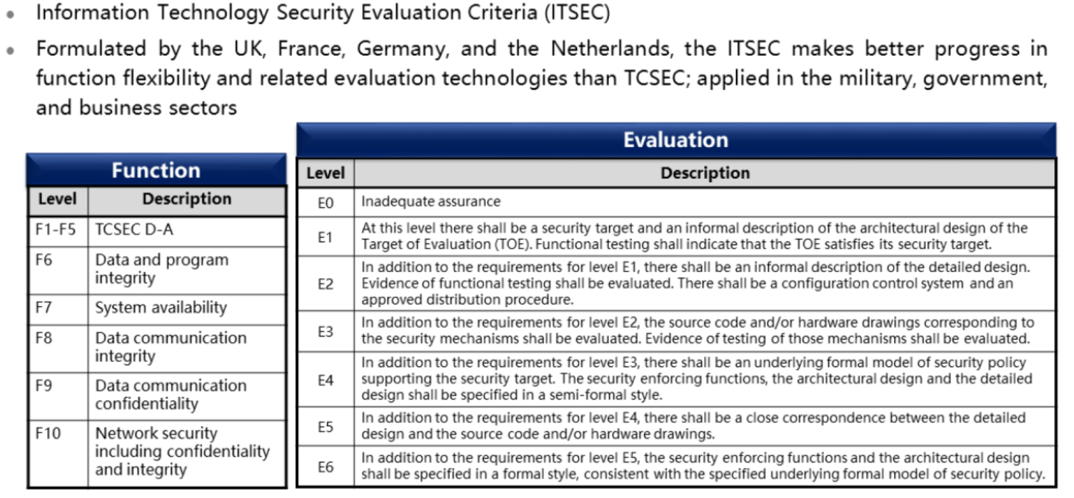
Chapter
Other Standards – Europe - ITSEC
02

Slide 11
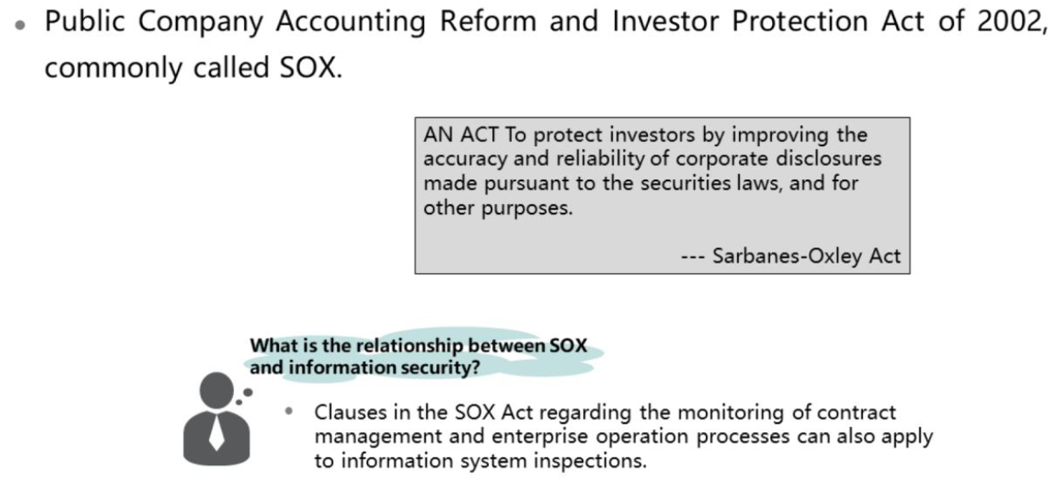
Chapter
Other Standards – Sarbanes – Oxley Act
02

Slide 12
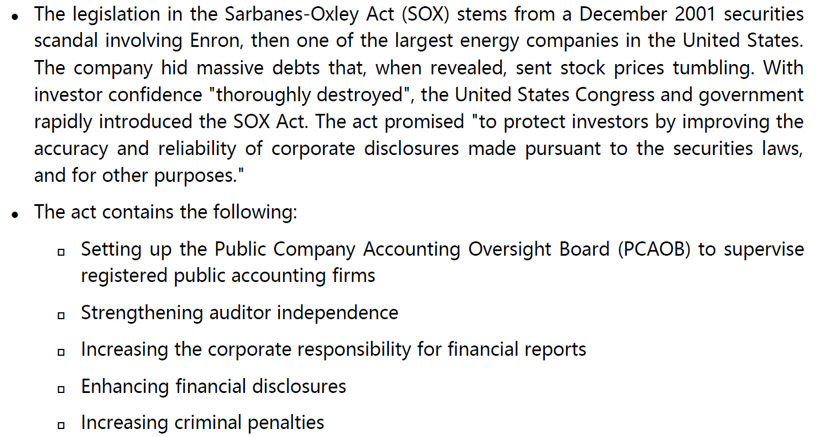
Chapter
02
Scope

Slide 13



Thank You

