Slide 1


Storage Technologies
IT403
Prepared by
Dr. Ahmed El-Douh
Lecture 8

Slide 2



Storage Technologies
Lecture 8
IT403
Business Continuity and Storage Backup technologies
Prepared by
Dr. Ahmed El-Douh

Slide 3
Objectives
Upon completion of this module, you will be able to:
  Understand the importance and challenges of Business Continuity.
  Understand the definition, standards, and the cost–risk relationship.
  Know the common Business Continuity solutions, including Backup vs Disaster Recovery.
  Understand Huawei Business Continuity and Storage Backup technologies in Datacenters.
www.midocean.ae

Slide 4
Chapter
Outlines
08
Challenges of Business Continuity.
Definition of Business Continuity.
Overview of Business Continuity Solutions.
Overview Of Backup Solutions.
Architecture Of Backup Solutions.
Common Backup Networks.
Common Backup Technologies.
www.midocean.ae

Slide 5


Chapter
08
Challenges of Business Continuity
www.midocean.ae

Slide 6
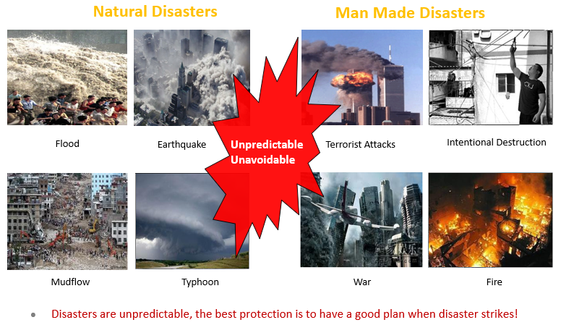
Unpredictable Natural Disasters and Man Made Disasters
www.midocean.ae

Slide 7
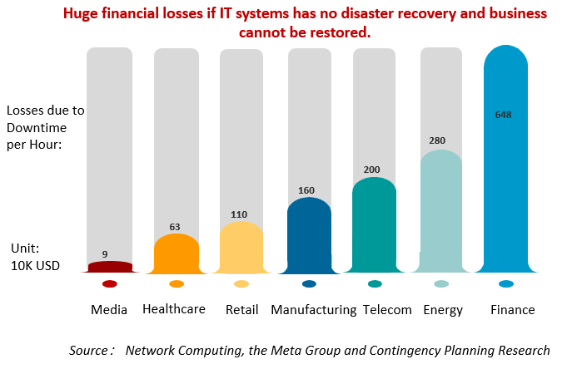
Why We Need Business Continuity and Disaster Recovery?
www.midocean.ae

Slide 8
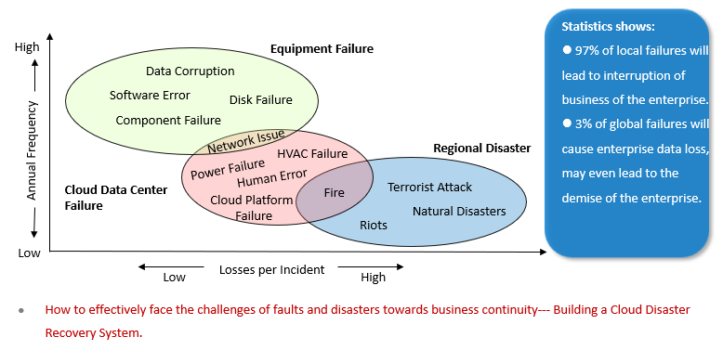
Types of Incidents That Affects Business Continuity of IT Systems
www.midocean.ae

Slide 9
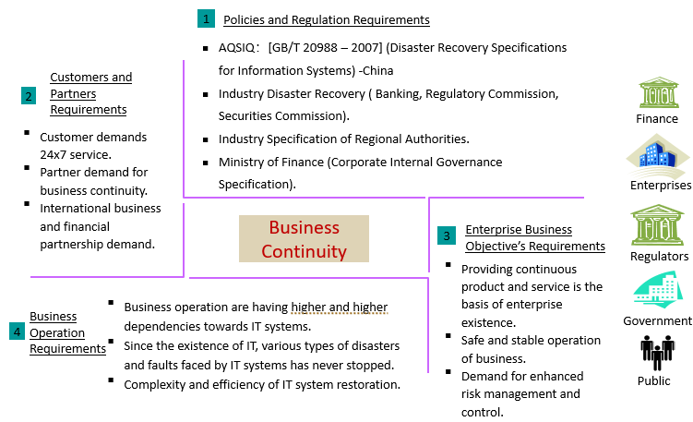
Requirements of Business Continuity
www.midocean.ae

Slide 10
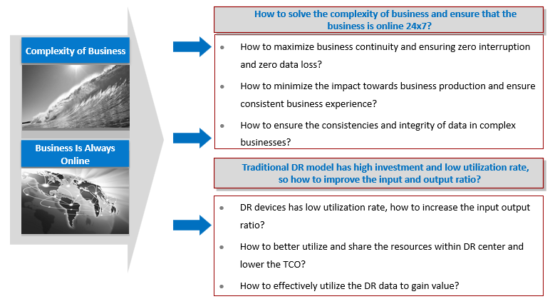
Challenges Faced By Business Continuity and Disaster Recovery (1)
www.midocean.ae

Slide 11
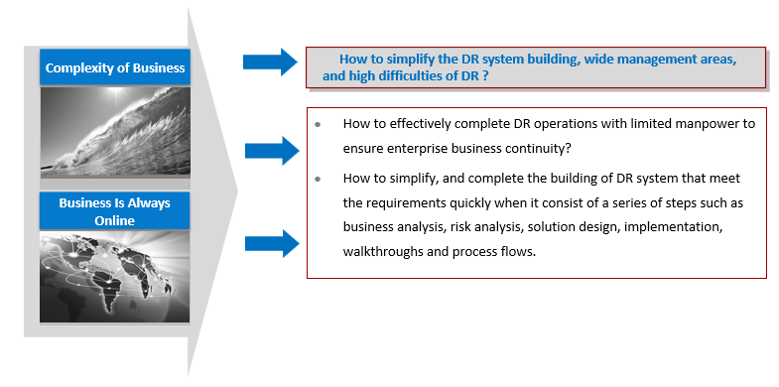
Challenges Faced By Business Continuity and Disaster Recovery (2)
www.midocean.ae

Slide 12
Chapter
08
Definition of Business Continuity
www.midocean.ae

Slide 13
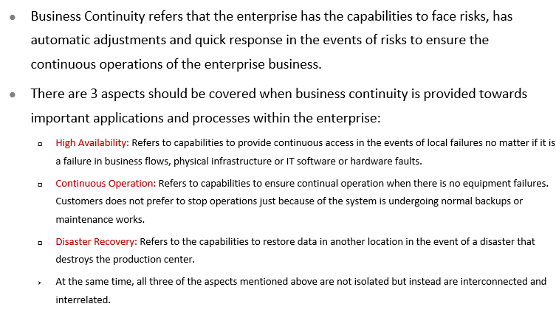
What is Business Continuity?
www.midocean.ae

Slide 14
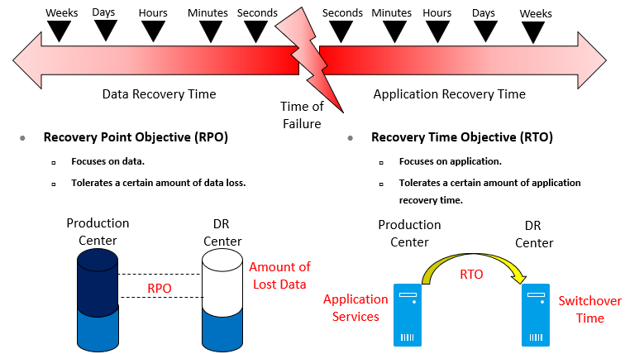
Key Indicators To Measure Disaster Recovery Systems: RTO and RPO
www.midocean.ae

Slide 15
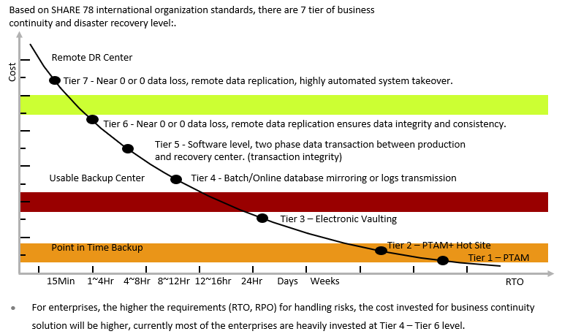
International Standards For Business Continuity System
www.midocean.ae

Slide 16
Chapter
Overview of Business
Continuity Solutions
08
www.midocean.ae

Slide 17
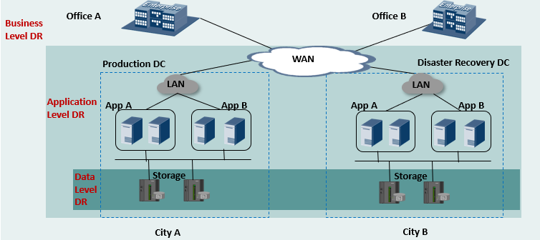
DR Classification Based on DR Effect
www.midocean.ae

Slide 18
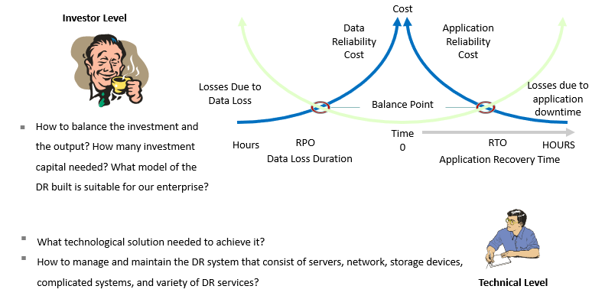
Main Challenges of Building A DR System
www.midocean.ae

Slide 19
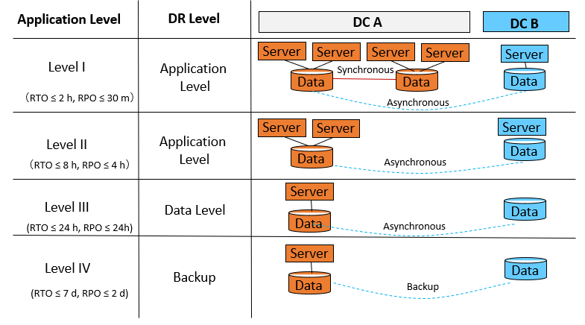
DR Solution Architecture
www.midocean.ae

Slide 20
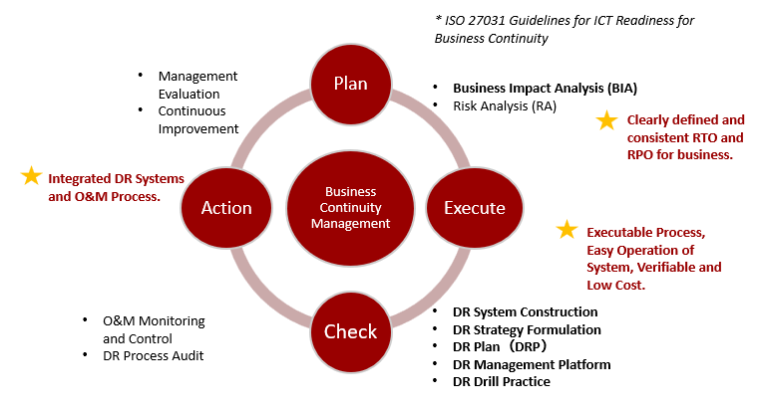
Continuous Improvement Method for DR Construction
www.midocean.ae

Slide 21
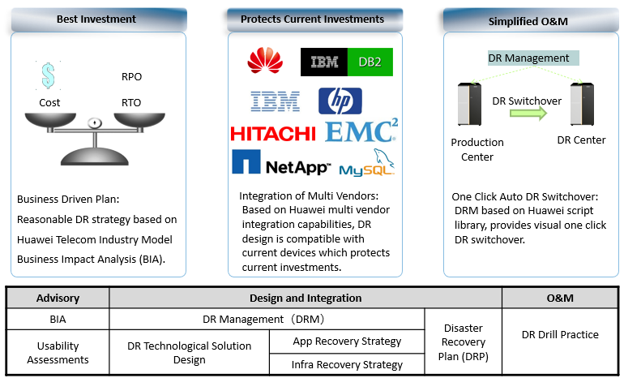
Huawei Integrated End-to-End DR Service
www.midocean.ae

Slide 22
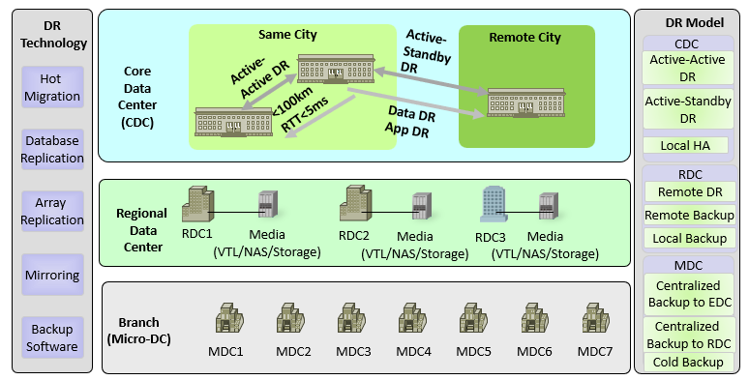
Panorama Of Huawei Integrated DR Solution
www.midocean.ae

Slide 23
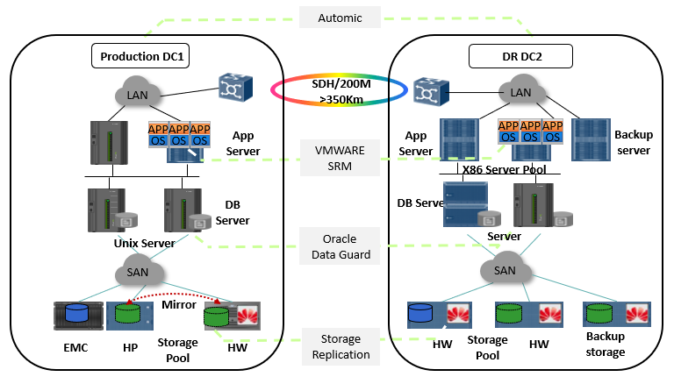
Application Case: Industry Best Practice Combined Multivendor Solution
www.midocean.ae

Slide 24
Chapter
08
Overview Of Backup Solutions
www.midocean.ae

Slide 25
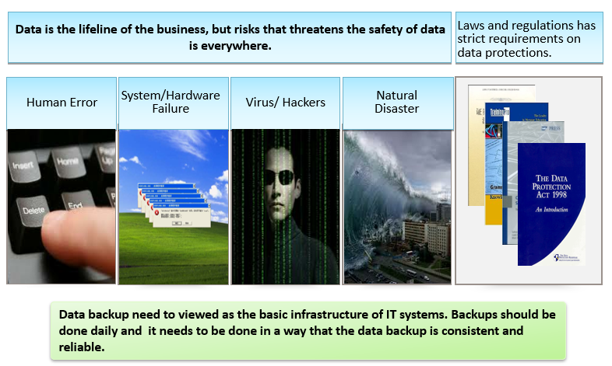
Why Do We Need Backup ?
www.midocean.ae

Slide 26
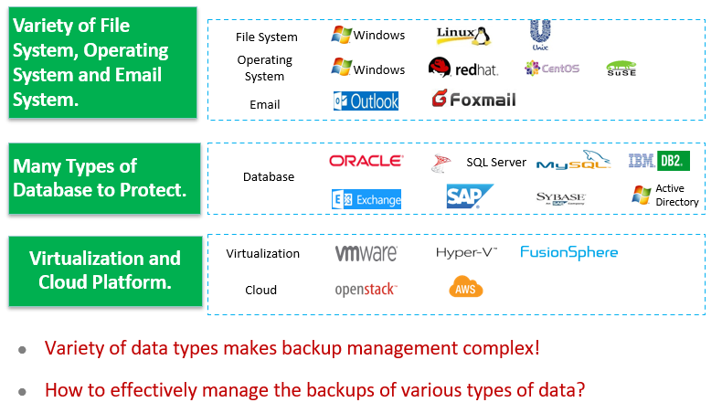
Challenges Faced By Backups: Variety of Data Types
www.midocean.ae

Slide 27
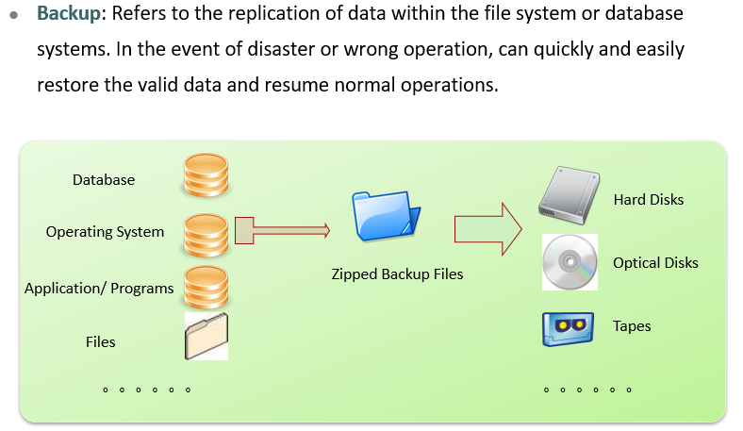
What is Backup ?
www.midocean.ae

Slide 28
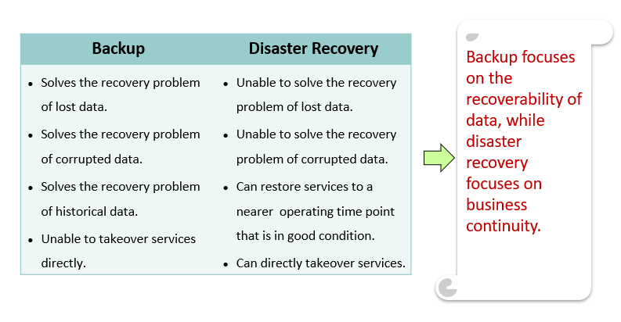
Backup VS Disaster Recovery
www.midocean.ae

Slide 29
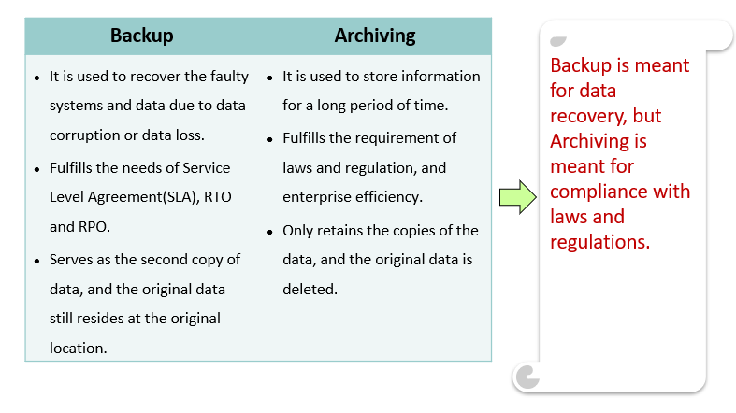
Backup VS Archiving
www.midocean.ae

Slide 30
Chapter
08
Architecture Of Backup Solutions
www.midocean.ae

Slide 31
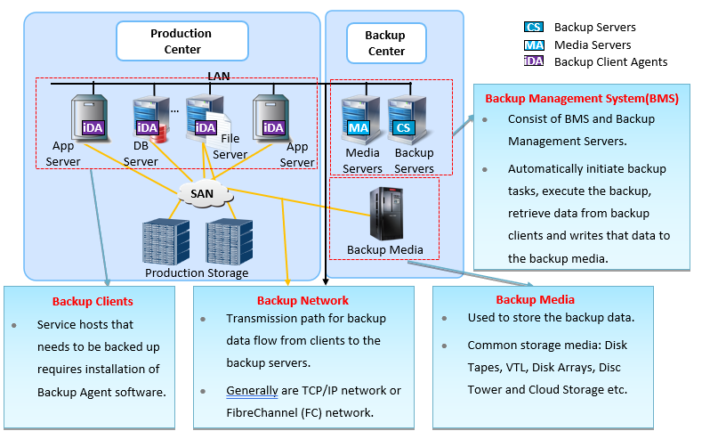
Components of Backup Systems
www.midocean.ae

Slide 32
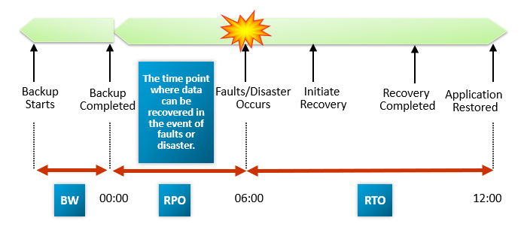
Main Elements Of Backup Systems
www.midocean.ae

Slide 33
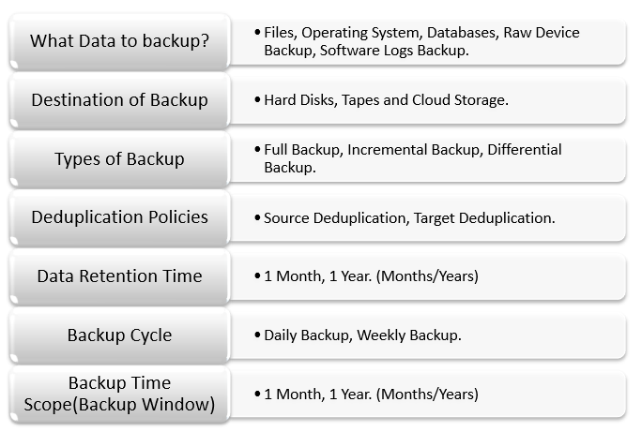
Backup Strategy & Policies
www.midocean.ae

Slide 34
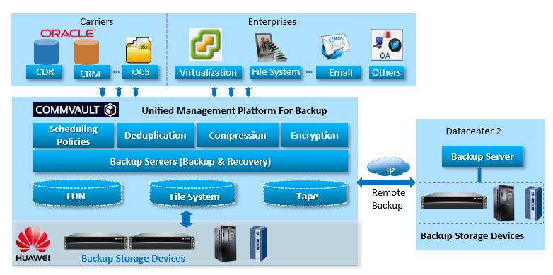
Architecture of Backup Solutions
www.midocean.ae

Slide 35
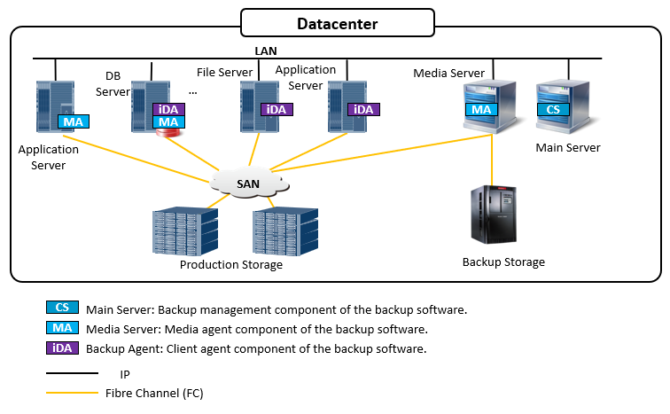
Local Centralized Backup
www.midocean.ae

Slide 36
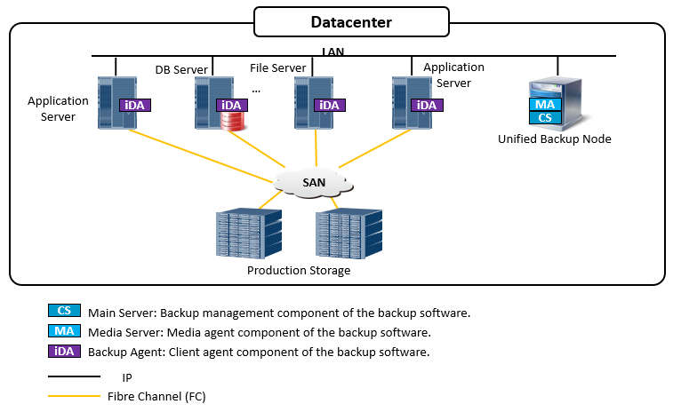
Unified Backup
www.midocean.ae

Slide 37
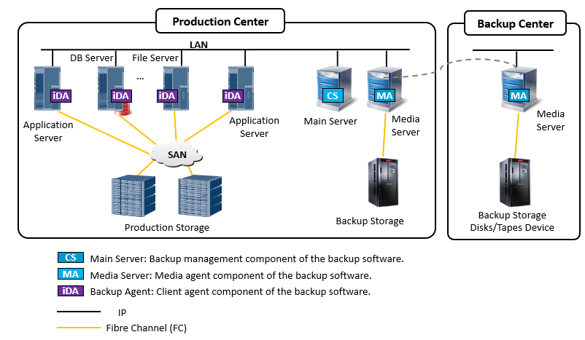
Local and Remote Centralized Backup
www.midocean.ae

Slide 38
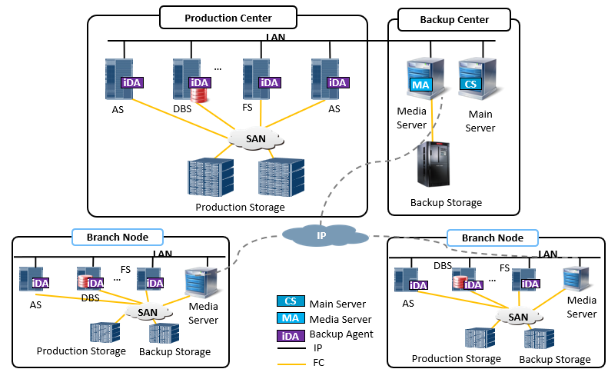
Multi Branch Centralized Backup
www.midocean.ae

Slide 39
Chapter
08
Common Backup Networks
www.midocean.ae

Slide 40
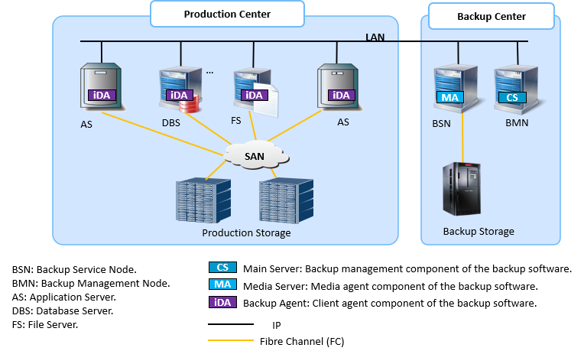
LAN - Base
www.midocean.ae

Slide 41
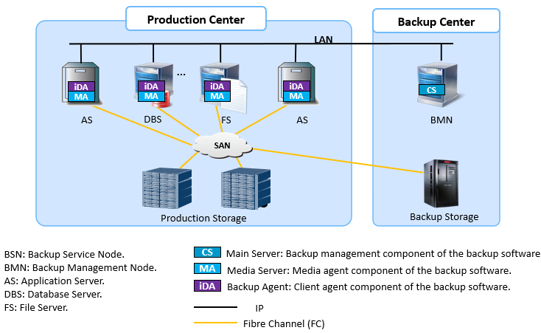
LAN - Free
www.midocean.ae

Slide 42
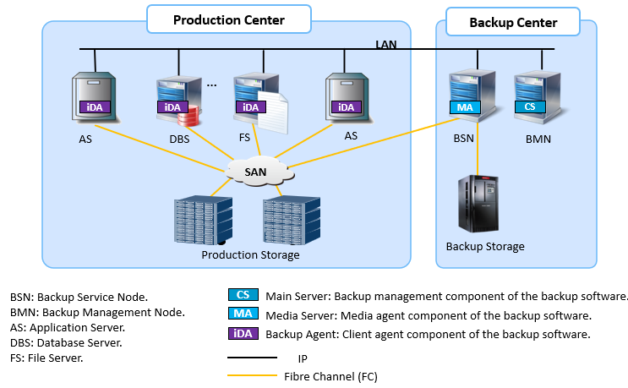
Server - Free
www.midocean.ae

Slide 43
Chapter
08
Common Backup Technologies
www.midocean.ae

Slide 44
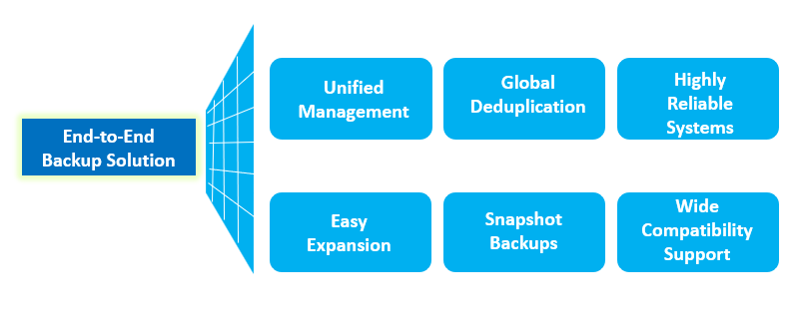
The Many Features Of Backup
www.midocean.ae

Slide 45
Chapter
08
Overview Of Backup Solutions
www.midocean.ae

Slide 46
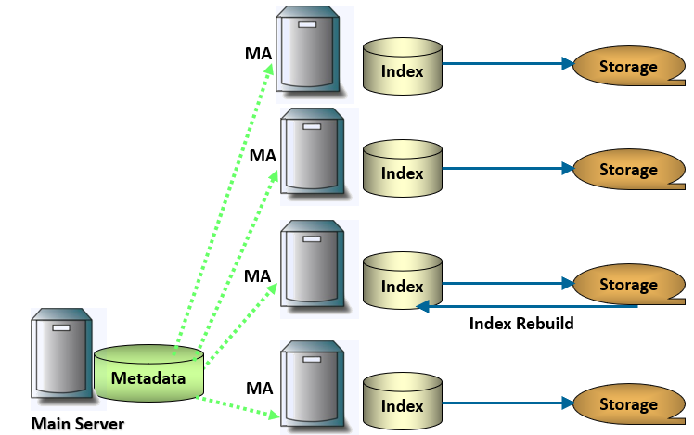
Easy Expansion: Easy Scale Out Expansion For Single Backup Domain
www.midocean.ae

Slide 47
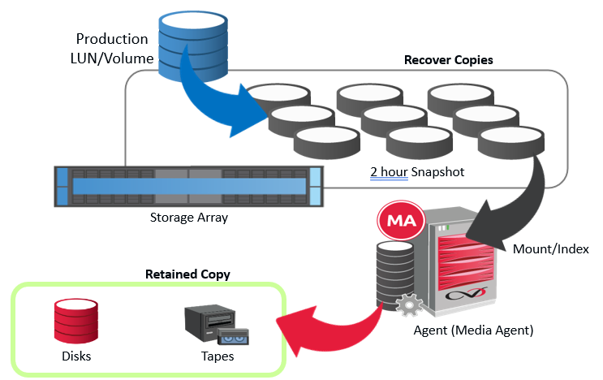
Snapshot Backup
www.midocean.ae

Slide 48
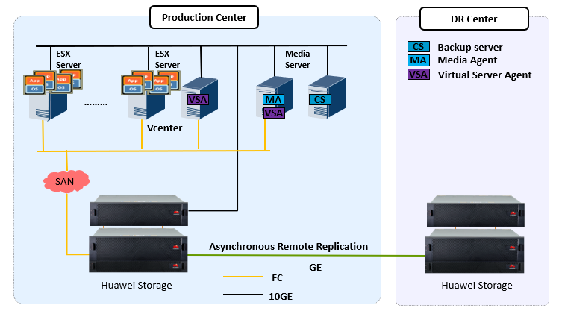
Case 1: Library Backup of XX University
www.midocean.ae

Slide 49
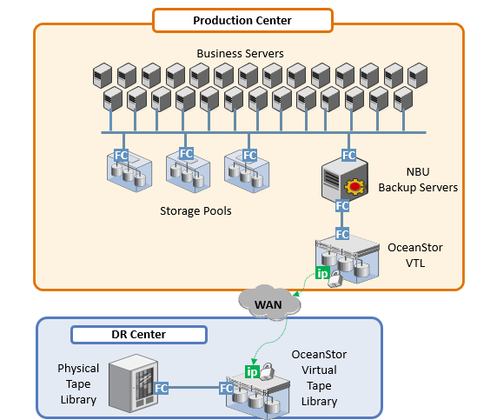
Case 2: XX Remote Backup Solution
www.midocean.ae

Slide 50



Thank You

