Slide 1



Digital Content Direction
Prepared by Dr. Sherihan Mohamed
DGM 733
Lecture 9

Slide 2




Lecture 9
Lecture 8 Conclusion:
Remember the last Lecture we talk about:
(Social Media in Content Production)
* From direct contact to distributed media.
* A more participatory media environment for many.
* Why Are You on Social Media?
* Sorting Out Fact from Fiction.
* Conclusion.
* References.

Slide 3

Online Community Management
and Content Moderation
Lecture 9

Slide 4

Lecture 9
Lecture Outlines:
(Online Community Management)
* What Are Online Communities?
* Online Community Managers.
* Who’s Who in the Online Community?
* Conclusion.
* References.

Slide 5

Lecture 9
Digital Content Direction
What Are Online Communities?

Slide 6

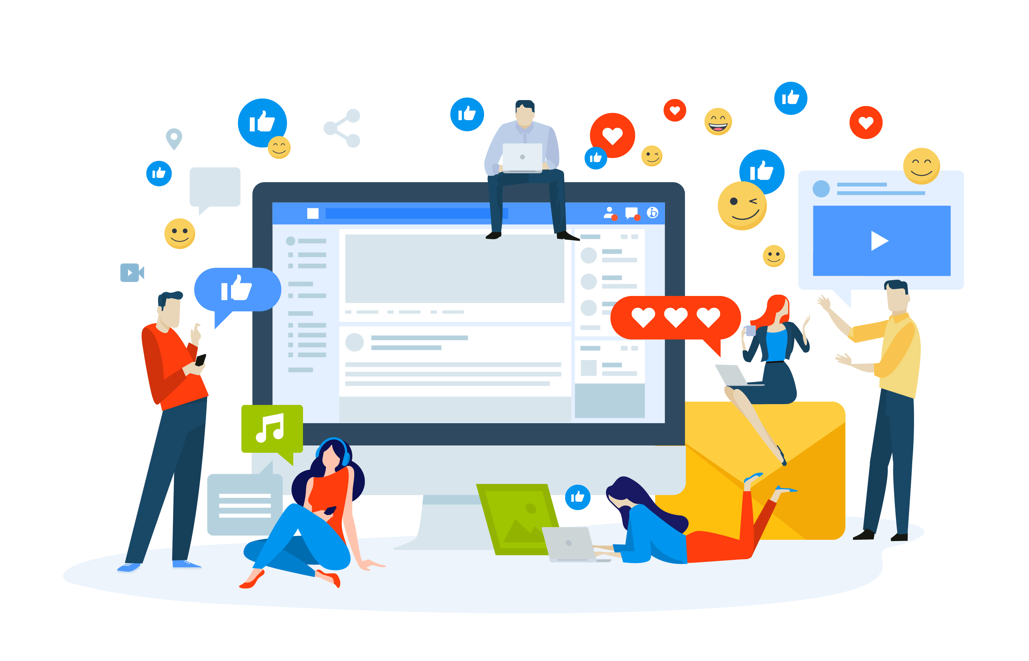
Online communities are ‘social aggregations that emerge from the Net when enough people carry on those public discussions long enough, with sufficient human feeling, to form webs of personal relationships in cyberspace’.

Slide 7
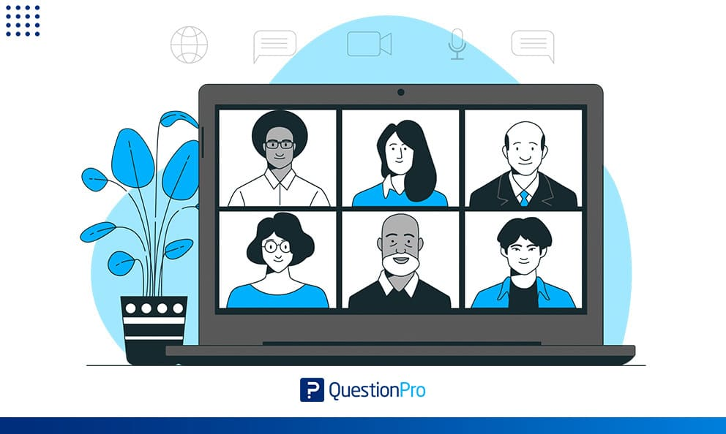
One scholarly definition of an online community is this: "a virtual and community is defined as an aggregation of individuals or business partners who interact around a shared interest, where the interaction is at least partially supported or mediated by technology (or both) and guided by some protocols or norms".

Slide 8
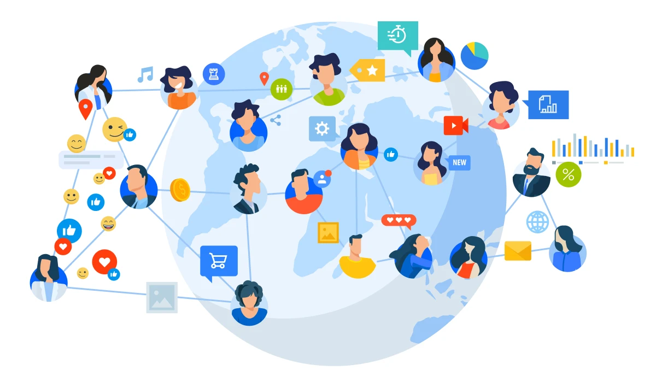
These communities can take numerous forms: ⁽¹⁾social media pages, ⁽²⁾websites, ⁽³⁾ discussion boards or ⁽⁴⁾(frequently) a combination of these.
Online communities can be premised around everything from shared interests to professional networking and professional development.

Slide 9

The rise in popularity of Web 2.0 websites has allowed for easier real-time communication and connection to others and facilitated the introduction of new ways for information to be exchanged.

Slide 10
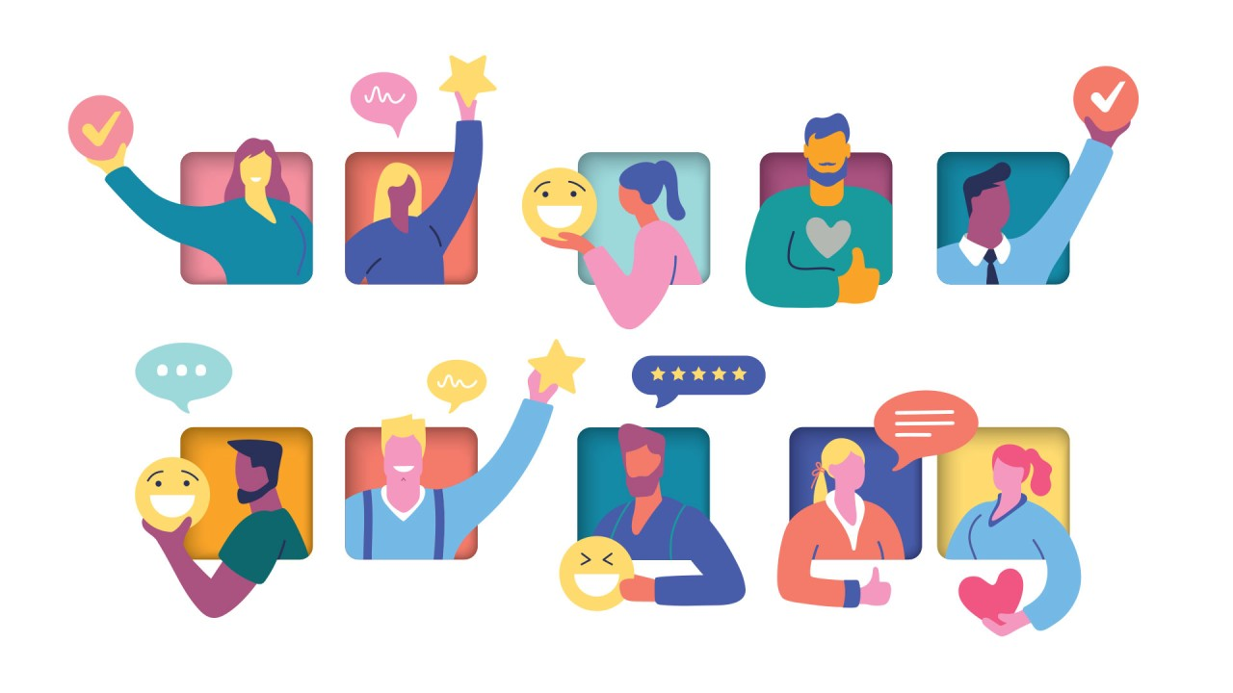
Online communities have many potential benefits. They can provide a sense of togetherness and unity. In that respect, these communities differ from social networks, as community designer Liz Jackson explains:

Slide 11
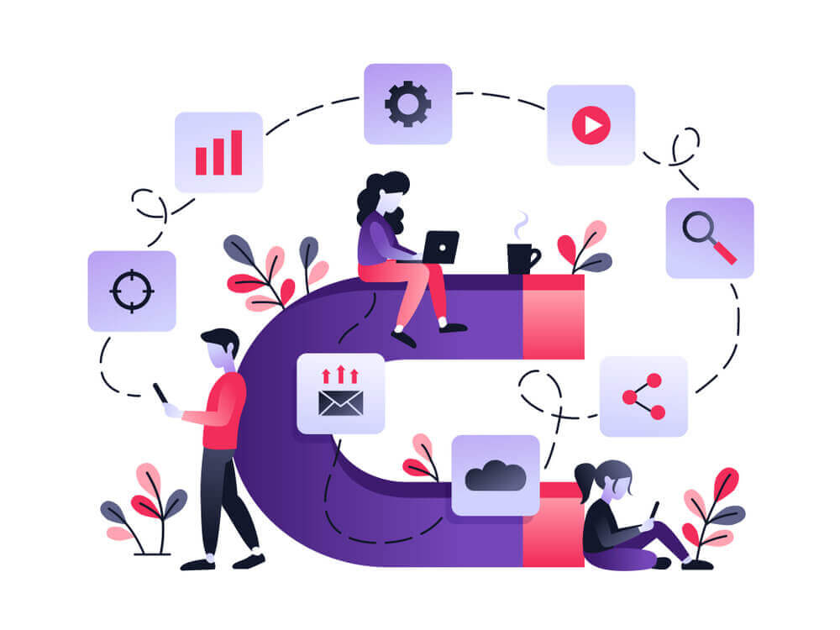
Online communities and social networks are very different, the first offers a sense of place, the other is not a place but a kind of group awareness grown from comments, images, addresses, photos, and appointments to do something or be somewhere (whether real or virtual).

Slide 12
Online communities can provide a sense of collective identity among members; these members are not atomised individuals, But part of a larger and more cohesive group. They can help establish friendships that can carry over to the ‘offline’ world.
Employment-related online communities can provide professional support, advice and networking opportunities; one example is the ACM online community.

Slide 13

Another key use of web communities is access to and the exchange of information.
With communities for even very small niches it is possible to find people also interested in a topic and to seek and share information on a subject where there are not such people available in the immediate area offline.

Slide 14

This has led to a range of popular sites based on areas such as health, employment, finances and education.
Online communities can be Vital for companies for marketing and outreach.

Slide 15

Unexpected and innovative uses of web communities have also emerged with social networks being used in conflicts to alert citizens of impending attacks.
The UN sees the web and specifically social networks as an important tool in conflicts and emergencies.

Slide 16

Yet, these interactions may also lead to a downfall of social interactions or deposit more negative and derogatory forms of speaking to others, in connection, surfaced forms of racism, bullying, etc. may also be investigated and linked to online communities.

Slide 17
Lecture 9
Digital Content Direction
Online Community Managers

Slide 18
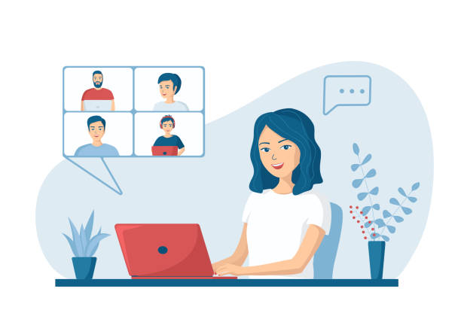
A community manager is a cultural intermediary ‘whose job is to generate shared value for participants and stakeholders’.
The tasks include ‘the development of standards and policies, and collaborative strategies and techniques for regulation and intervention to optimise for good and minimise for harm’.

Slide 19

The community manager’s job is to ‘cultivate a dedicated community through social media, live social events, and strategic communication’. Their job is Not simply to produce and upload content, or delete nasty remarks in comments sections (though they can also perform these roles).

Slide 20

In a nutshell, a community manager plays a pivotal role in making an online space a ‘community’, and more than that, a community that is safe and enjoyable to inhabit. In doing this, the community manager is required to enforce community guidelines.

Slide 21
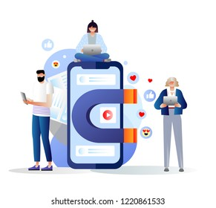
These guidelines are designed to maintain a respectful community. The guidelines can vary from community to community.
The following is a sample of the community guidelines for The Conversation, a popular site that was first established in 2011 and that publishes journalistic ‘knowledge transfer’ work written by university researchers:

Slide 22
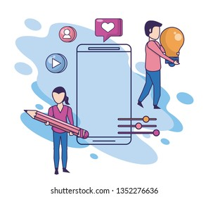
• Don’t attack people and don’t respond to attacks, report them and move on.
• Keep your posts on topic and constructive.
• Take responsibility for the quality of the conversations you take part in.
• Above all, respect others and their opinions.

Slide 23
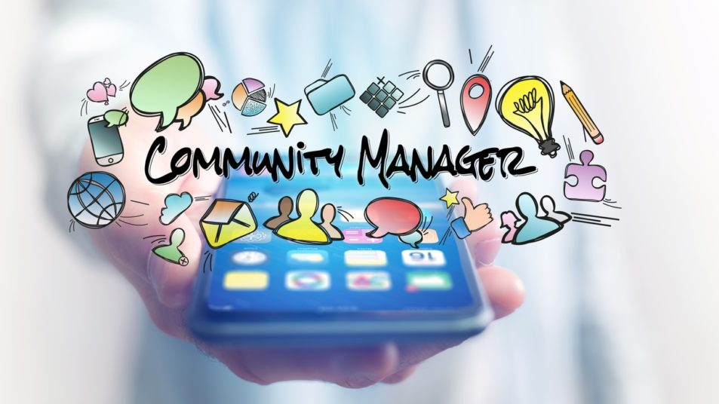
Community guidelines such as those are generally outlined in a tab featured somewhere on the landing page for a particular site or platform.
Visitors to that community can click on the tab to find out what is regarded as acceptable behaviour and what is not within that community.

Slide 24

There are a number of important skills that community managers require in order to do their jobs.
The following are a selection of these; they have been chosen because they appear frequently in existing online community management literature.

Slide 25
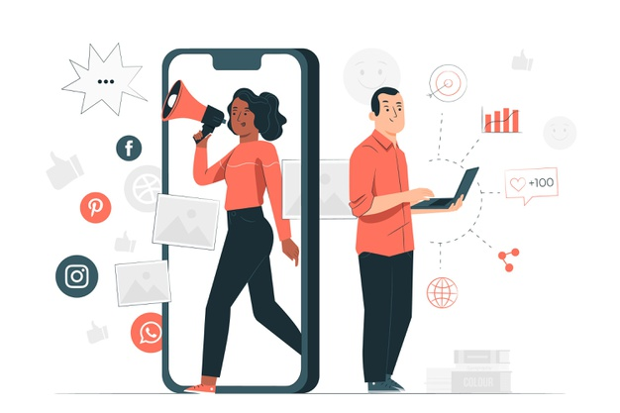
• Skills in digital content production. This should go without saying in a book devoted to that very topic!
• High-level media literacy skills. These can include the ability to decode ‘dog whistles’ and coded messages that promote conspiracies and/or bigotry.

Slide 26
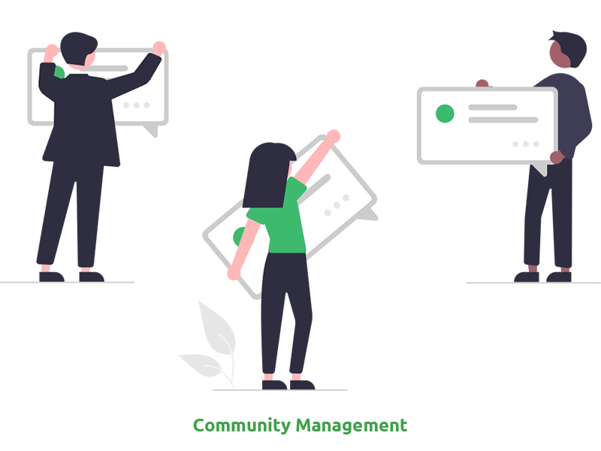
• A commitment to cultivating a lively and respectful online community, one that adheres to the community guidelines.
• The ability to cultivate personal resilience in the face of online hostility.
• The ability to be proactive and to intervene in conflicts and acts of hostility.

Slide 27

• The ability to empathise with community members. Might these community members be facing stresses or challenges in their lives that are impacting on their participation in communities? It should be noted that such challenges are not excuses for poor behaviour, and that the community manager’s role is not to play counsellor for members.

Slide 28

• A strong knowledge of the topic at the heart of that online community, as well as the members who comprise that community.
• A willingness to listen to members and take on board their feedback. What do community members want? What do they think the community could be doing better?

Slide 29
Lecture 9
Digital Content Direction
Who’s Who in the Online Community?

Slide 30
So, we have talked about the online community manager, but who else is in an online community? Answering this question is difficult, given the sheer diversity of individuals that these spaces can comprise.
Elliot Volkman (2011) lists a number of archetypes that are commonly found in online communities. They include the community manager, as well as the following cast of characters:

Slide 31

• The community architects: These are the individuals who wanted to establish the community in the first place. They can also be community managers, but not always.
• Contributor: These can be paid or unpaid. They can contribute anything from a blog post to a GIF, meme or a comment on a discussion board.

Slide 32

• Paid member: These are the members who are paid to interact with other members in the community, e.g., by commenting on posts. These paid members are frequently high-profile, for activities undertaken within and/or outside the community. There are definite similarities between the paid member and the Social Media Influencer.

Slide 33

• Power user: These are the individuals who help set the agenda for community discussions or suggest new directions and initiatives for a community. Volkman (2011) calls these individuals ‘a community manager’s best friend’, not least because of the (usually) unpaid labour that they perform.

Slide 34

• Free member: These members do not pay to belong to a community, nor are they paid to do so. They are the ones who tend to interact most with the content published within an online community, e.g., through likes and shares.

Slide 35
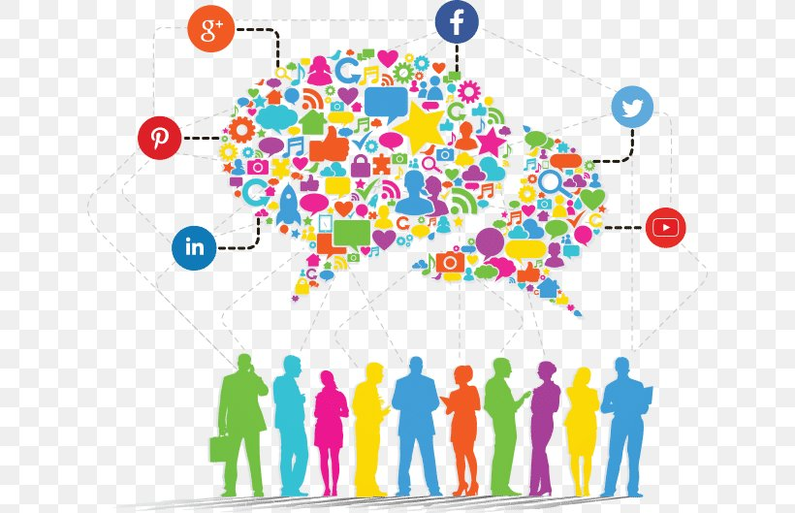
• Active lurker: These are the community members who engage with community content (e.g., by reposting in their own social networks), but who never contribute content. They are lurking in the background, waiting to share and like.

Slide 36

• Passive lurker: These are members who inhabit a particular community, but who do not engage in any way with the content posted within that community. It’s very likely that other community members, and indeed the community manager themselves, do not know of the passive lurker’s existence.

Slide 37

To Volkman’s list, we could add another archetype: ‘the exile’. Venessa Paech describes exiles as individuals who have been banned or suspended from a particular online community. These individuals are defined very much by the fact that they were once members, and that they are now consumed with ‘revenge or re-entry’ —with ‘re-entry’ meaning being allowed back into the community.

Slide 38

The exile might indeed wear their banishment as a badge of honour (‘hey, I got banned from xxx community how cool am I?’).
The exile’s desire for ‘revenge or re-entry’ can lead to disruptive and even harmful behaviour, ranging from posting content in a community with the specific aim of generating distress, to stalking other community members.

Slide 39
Lecture 9
Lecture Outlines:
(Online Community Management)
* What Are Online Communities?
* Online Community Managers.
* Who’s Who in the Online Community?

Slide 40


Lecture 9
Lecture References:
* Jenkins, H., Ford, S., & Green, J. (2013), Spreadable media: Creating value and meaning in a networked culture, New York University Press.
* Jay Daniel Thompson & John Weldon (2022), Content Production for Digital Media: An Introduction, Springer Nature Singapore.

Slide 41


Thank You

Slide 42

Digital Content
Direction
Lecture 9
DGM 733
Prepared by:
Dr. Sherihan Mohamed

