Slide 1



Project Feasibility Study
PMG201
Prepared by Mrs. Deena Ibrahim
Lecture 8
SCHEDULING THE PROJECT

Slide 2

PERT and CPM Networks.
Project Uncertainty and Risk Management.
Simulation.
The Gantt Chart.
Extensions to PERT/CPM.

Slide 3
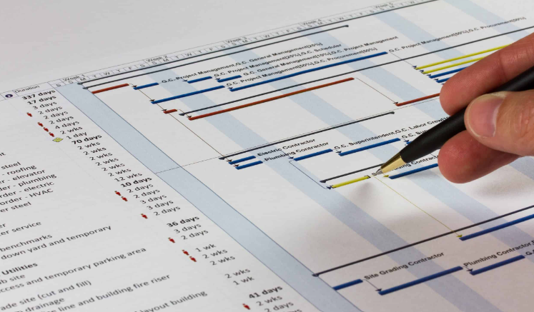
Introduction
The project schedule is simply the project plan in an altered format. It is a convenient form for monitoring and controlling project activities. Actually, the schedule itself can be prepared in several formats.
In this chapter, we describe the most common formats— Gantt charts and PERT/CPM networks — and demonstrate how to convert a project plan or WBS into these formats. We also note some of the strengths and weaknesses of the different displays.

Slide 4
Introduction
We can show how to estimate the likelihood that a project can be completed on or before a specific time.
It should be obvious that these three activities are not actually separable. Because a budget must include both the amounts and timing of resources received or expended, one cannot prepare a budget without knowing the specifics of each task and the time period(s) during which the task must be undertaken.

Slide 5
Introduction
It is useful to begin study of these interdependent, partial descriptions of a project with an examination of the planning process because this process is the foundation of all that follows.
The problem is that planning, budgeting, and scheduling are parts of the same basic process. They are considered separately only because we cannot write about all three at the same time.

Slide 6

Project Scheduling
Identifying precedence relationships.
Sequencing activities.
Determining activity times & costs.
Estimating material & worker requirements.
Determining critical activities.

Slide 7

Purposes of Project Scheduling
Shows the relationship of each activity to others and to the whole project.
Identifies the precedence relationships among activities.
Encourages the setting of realistic time and cost estimates for each activity.
Helps make better use of people, money, and material resources by identifying critical bottlenecks in the project.

Slide 8
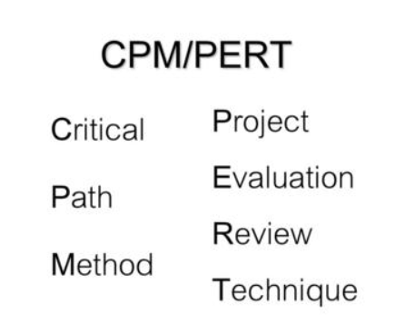
PERT and CPM Networks
Program Evaluation Review Technique (PERT)
is a project management planning tool used to calculate the amount of time it will take to realistically finish a project. PERT charts are used to plan tasks within a project — making it easier to schedule deliverables and coordinate with team members.
The critical path method (CPM) is a technique where you identify tasks that are necessary for project completion and determine scheduling flexibilities. A critical path in project management is the longest sequence of activities that must be finished on time in order for the entire project to be complete.

Slide 9
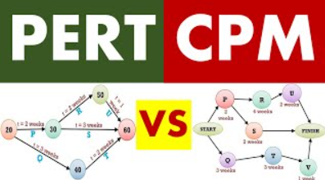
The Language of PERT/CPM
Activity — A task or set of tasks required by the project. Activities use resources and time.
Event — An identifiable state resulting from the completion of one or more activities. Events consume no resources or time. Before an event can be achieved or realized , all its predecessor activities must be completed.
Milestones — Identifiable and noteworthy events marking significant progress on the project.

Slide 10
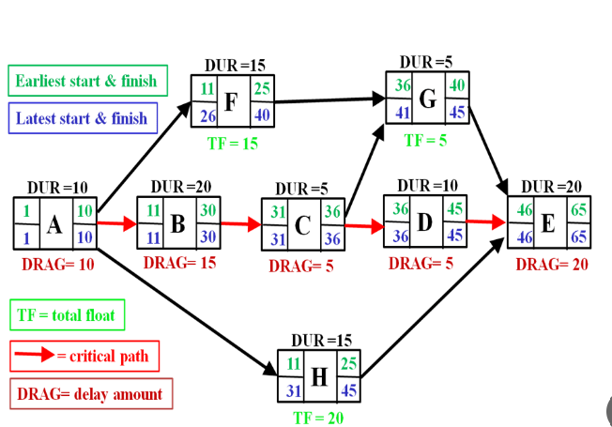
The Language of PERT/CPM
Network — A diagram of nodes (may represent activities or events) connected by directional arcs (may represent activities or simply show technological dependence) that defines the project and illustrates the technological relationships of all activities. Networks are usually drawn with a “ Start ” node on the left and a “ Finish ” node on the right. Arcs are always tipped with an arrowhead to show the direction of precedence, that is, from predecessors to successors.

Slide 11
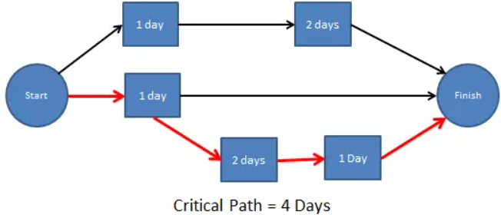
The Language of PERT/CPM
Path — A series of connected activities between any two events in a network.
Critical path — The set of activities on a path from the project ’ s start event to its finish event that, if delayed, will delay the completion date of the project.
Critical time — The time required to complete all activities on the critical path.

Slide 12
PERT VS. CPM
CPM | PERT
A method to control cost and time. | A technique of planning and control of time.
Deterministic Model | Probabilistic Model
One time estimate | Three time estimates
CPM is for non-research projects like construction projects. | PERT is best for research and development projects,
Crashing is a compression technique applied to CPM, to shorten the project duration, | The crashing concept is not applicable to PERT.

Slide 13
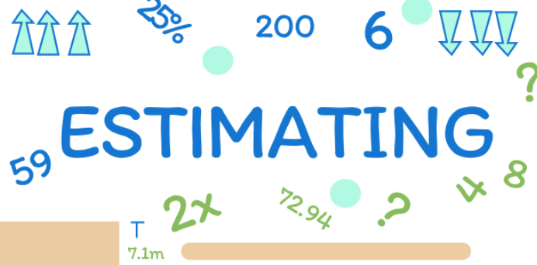
There are three different estimates of activity duration in PERT:
Optimistic (best case scenario).
Pessimistic (worst case scenario).
Most Likely .
1. Optimistic time, expressed as ‘t_{o}‘ represents estimate of minimum possible time by which an activity can be completed assuming that everything is in order according to the plan and there can be only minimum amount of difficulty.
2. Pessimistic time, expressed as ‘t_{p}’ represents estimate of maximum possible time by which an activity can be completed assuming that things may not be in accordance with the plan and there can be incidence of difficulties in carrying out the activity.
3. Most likely time, expressed as ‘t_{m}‘, represents estimate of time for completion of an activity, which is neither optimistic nor pessimistic, assuming that things should go in a normal way.

Slide 14

Building the Network
There are two ways of displaying a project network. In one we depict the activities as arrows and events as nodes. This gives an activity - on - arrow (AOA) network. Alternatively, we can create an activity - on - node (AON) network by showing each task as a node and linking the nodes with arrows that show their relationship.

Slide 15
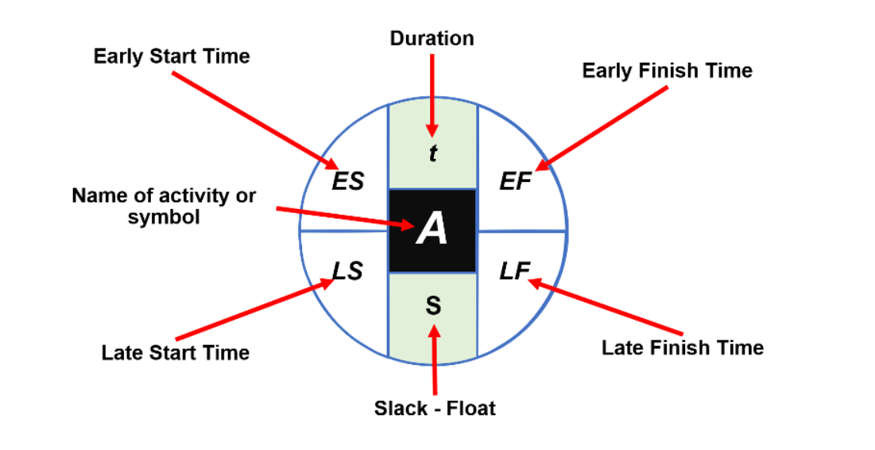
Float is the amount of time that an activity can be delayed without affecting the project end date.

Slide 16
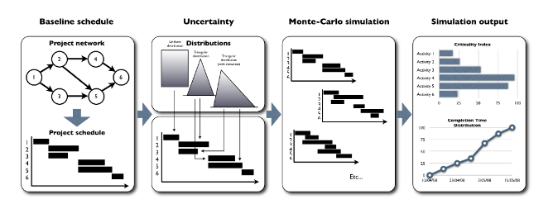
Project Uncertainty and Risk Management
Four steps of schedule risk:
Displays the four different steps of a schedule risk analysis.
1- Baseline schedule: Construct an activity timetable
2- Define uncertainty: Define activity time and cost probability distributions
3- Run Monte-Carlo simulations: Run multiple project progress simulations.
4- Interpret the simulation results: Interpret the sensitivity measures.

Slide 17

SIMULATION ANALYSIS
Estimation of the distribution of different possible outcomes.
Instead of arbitrarily specifying a relatively small number of scenarios,
a computer generates several thousand possible combinations of variables via probability distributions according to the historical data.
The entire probability distribution of outcomes can be constructed from the simulation results.

Slide 18

Traditional Statistics vs. Simulation
At many conferences and in the literature of project management, there are sessions devoted to risk management. The participants at one recent conference, all highly experienced PMs from several different industrial sectors, were not of a single mind about the best way to handle the problems we have discussed in this chapter.

Slide 19
Traditional Statistics vs. Simulation
Some prefer the traditional statistical approach, some favored simulation, and some favored adding sizable contingency allowances in both the budget and the schedule, and then ignoring uncertainty. A decade ago, the group that ignored uncertainty would have been in the majority. Dealing with risk is no longer restricted on interest of a few statisticians, but is now an everyday problem for the PM.

Slide 20
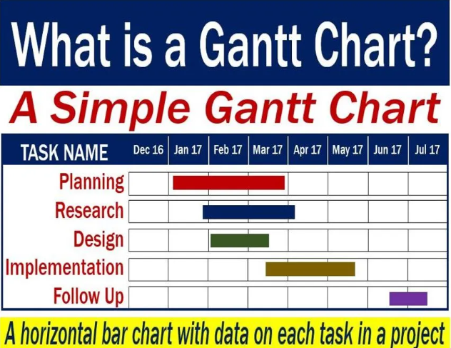
THE GANTT CHART
The Gantt chart is a useful complement to a project network. It is easily constructed and read. It can contain a considerable amount of information and is an excellent communication device about the state of a project.
Its major weakness is that it does not easily expose the project ’ s technology, that is, the technical relationships between a project ’ s many activities.
Even with predecessors marked on a Gantt chart, it is difficult to see the project technology and, thus, to use the Gantt chart alone to manage a complex project. PERT/CPM networks are often used as complements to Gantt charts.

Slide 21
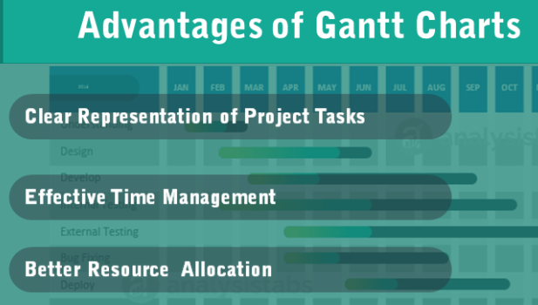
THE GANTT CHART
Establish a time-phased network
Can be used as a tracking tool
Benefits of Gantt charts
Easy to create and comprehend.
Identify the schedule baseline network.
Allow for updating and control.
Identify resource needs.
Visual scheduling tool.
Graphical representation of information.
Track progress towards completion.

Slide 22
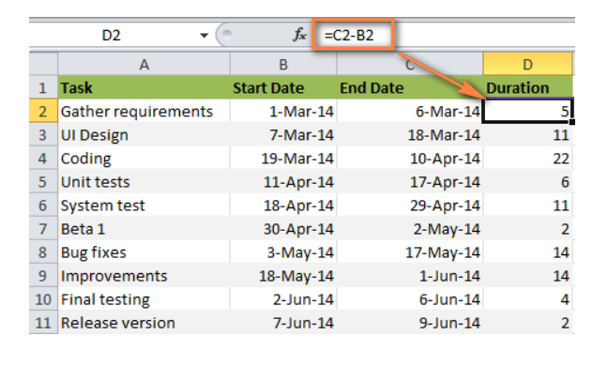
Building a Gantt Chart
Create a project table
List each task is a separate row and structure your project plan by including the Start date, End date and Duration, i.e. the number of days required to complete the tasks.
Duration = End Date - Start Date

Slide 23
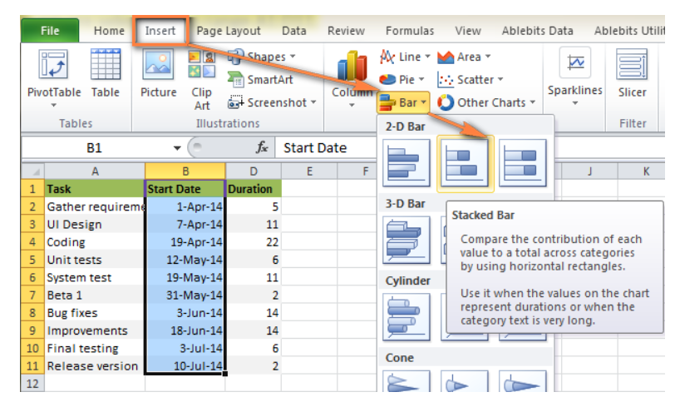
2. Make a standard Excel Bar chart based on Start date:
Switch to the Insert tab > Charts group and click Bar.
Under the 2-D Bar section, click Stacked Bar.

Slide 24
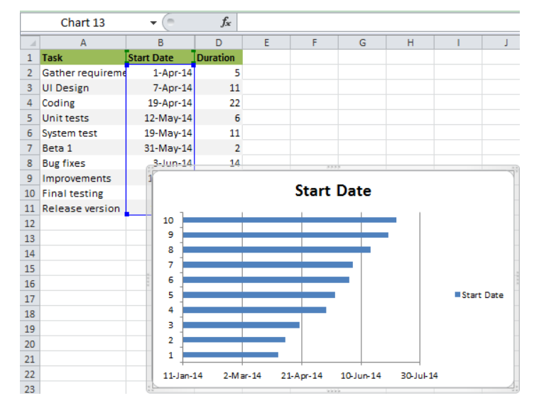
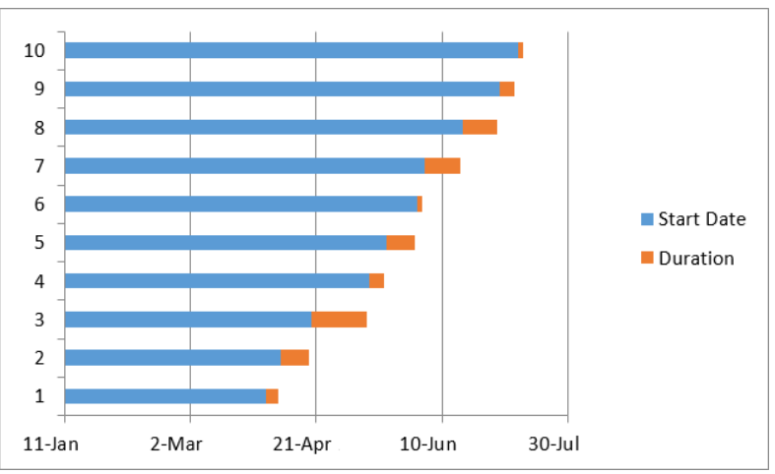
2- As a result, you will have the following Stacked bar added to your worksheet.
3. Add Duration data to the chart.

Slide 25
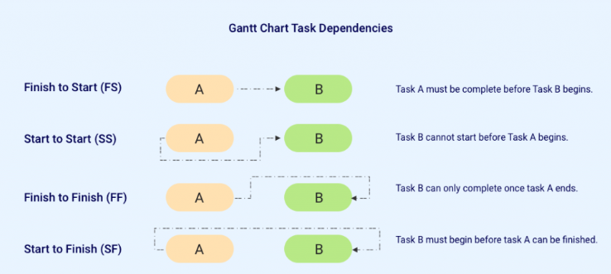
Dependencies: Show dependencies between activities with arrows

Slide 26
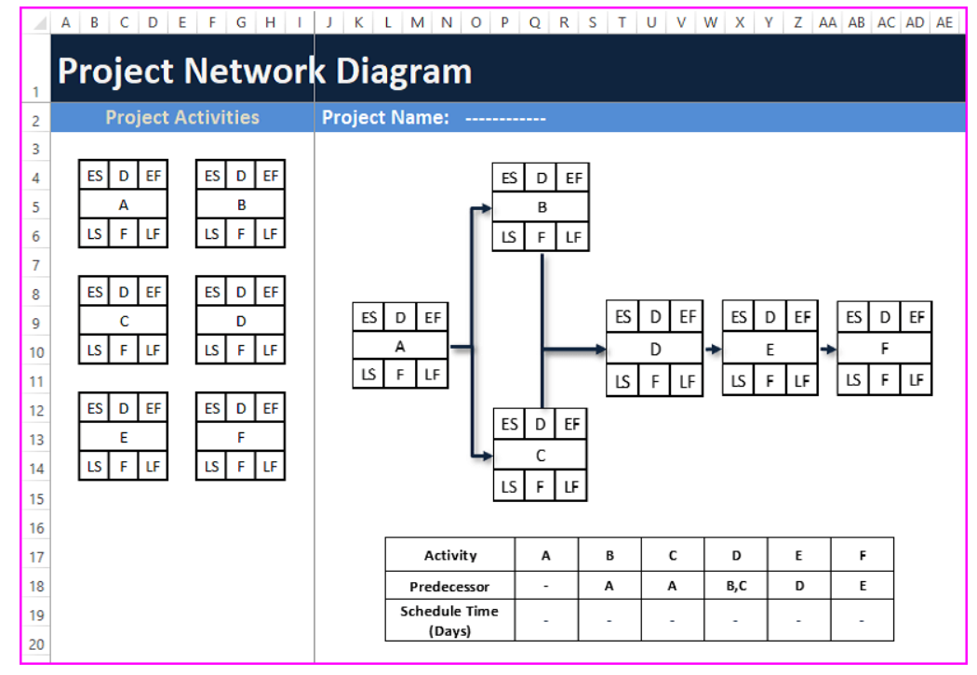
Extensions to PERT/CPM
Project Network Diagrams AOA/AON
• A project network illustrates the relationships between activities / tasks in the project.
• Showing the activities as nodes or on arrows between event nodes are two main ways to draw those relationships. Two types of Network Logic:-
• Activity on Arrow (AOA)
• Activity on Node (AON).
• With activities on arrow (AOA) diagrams, you are limited to showing only the finish to-start relationships.

Slide 27
• "Dummy" activities have to be added to show some of the more complex relationships and dependencies between activities. Activity on Node (AON) diagrams place the activity on the node, and the interconnection arrows illustrate the dependencies between the activities.
• There are more flexible and can show all of the major types of relationships.

Slide 28
Since the activity is on a node, the emphasis (and more data) usually can be placed on the activity.
The main difference between AOA & AON is AOA diagrams emphasize the milestones (events); AON networks emphasize the tasks.

Slide 29

Activity on Arrow Disadvantages | Activity on Arrow Advantages
• The AOA network can only show finish-to start relationships. • There are instances when “dummy” activities can occur in an AOA network. Dummy activities do not have durations associated with them; they simply show that a task has some kind of dependence on another task. AOA diagrams are not as widely used as AON. | • An arrow denotes passage of time . • Scheduling (manually) on an AOA diagram is easier than on an AON diagram. • In general, AOA needs fewer arrows than AON and therefore the network will be more compact and clear.

Slide 30

Activity on Node Disadvantages | Activity on Node Advantages
• Large networks require dedicated maintenance and analysis. | • AON does not have dummy activities since the arrows only resent dependencies. • AON can accommodate any kind of task relationship. • AON is the most widely used network - diagramming method today and all project management software supports it.

Slide 31


Slide 32


