Slide 1


Project Quality
Management
Prepared by Dr. Ehab Mahmoud

Slide 2



Project Quality
Management
Lecture 8
PMG354
Planning the project
Prepared by
Dr. Ehab Mahmoud
www.midocean.ae

Slide 3

Objectives
Lecture
08
At the end of this lecture, we expect to acquire a knowledge about the project planning phase and all related activities that have been carried out to be able to execute for the project.
www.midocean.ae

Slide 4

Lecture
Contents
08
Project planning
Develop a Project Management Plan
Subsidiary Management Plans
Baselines
Plan Scope Management
Collect Project Requirements
Requirements Traceability Matrix
Define Project Scope
Define Scope Tools and Techniques
Define Scope Outputs
Create a Work Breakdown Structure (WBS)
Work Packages / Activities
www.midocean.ae

Slide 5
Project planning
Develop scope Document
Create WBS
Create activity list
Create network diagram
Estimate resource requirements
Estimate time & cost
Determine critical path
Develop Schedule
Develop Budget
Determine roles & responsibilities
Develop communication plan
Risk planning
Determine purchase requirements
Develop final project plan
Get sign off
Kick off Meeting
www.midocean.ae

Slide 6
Planning a Project
Develop a Project Management Plan
Plan Scope Management
Collect Requirements
Define Scope
Create a WBS
www.midocean.ae

Slide 7
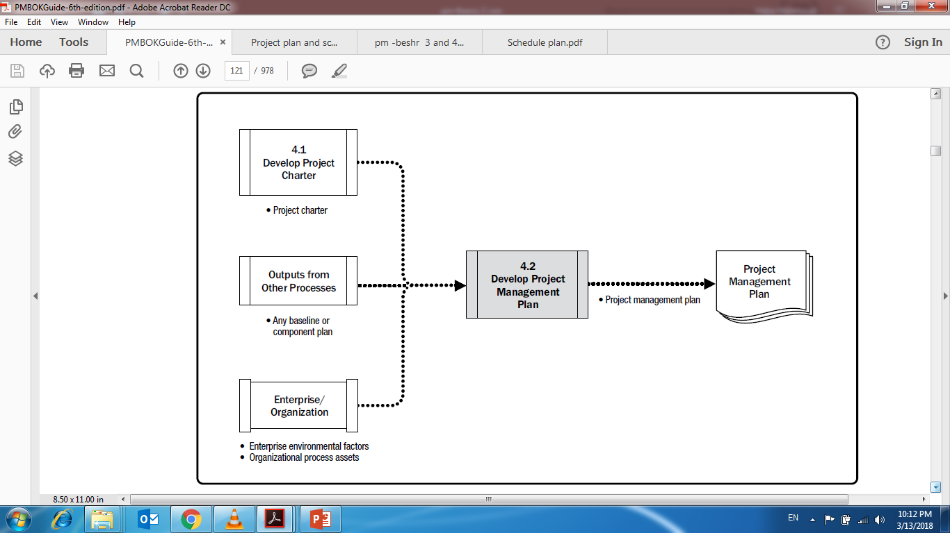
Develop a Project Management Plan
www.midocean.ae

Slide 8
The Project Management Plan
The project management plan defines how the project is executed, monitored and controlled, and closed.
The project management plan’s content varies depending on the project location and complexity of the project.
www.midocean.ae

Slide 9
The Project Management Plan
The project management plan should be baselined; that is, it is necessary to define at least the project references for scope, time, and cost, so that the project execution can be measured and compared to those references and performance can be managed. Before the baselines are defined, the project management plan may be updated as many times as necessary.
www.midocean.ae

Slide 10
The Project Management Plan
No formal process is required at that time. But, once it is baselined, it may only be changed through the Perform Integrated Change Control process. Consequently, change requests will be generated and decided upon whenever a change is requested. This results in a project management plan that is progressively elaborated by controlled and approved updates extending through project closure
www.midocean.ae

Slide 11
Project Management Plan
Till now; your project defined at a high level and formally authorized by the sponsor, you’re ready to begin planning your project.
Project planning is the second of five project management process groups.
Project Management Plan : is a formal document (approved by stakeholders) that defines how the project will be executed, monitored, and controlled to achieve its objectives.
www.midocean.ae

Slide 12
Project Management Plan Components
Subsidiary plans
Baselines
Additional components.
  Change management plan.
  Configuration management plan.
  Performance measurement baseline
  Project life cycle.
  Development approach.
  Management reviews.
www.midocean.ae

Slide 13
Subsidiary Management Plans
Subsidiary Plan | Description
Scope Management Plan | Provides guidance on the project scope.
Requirements Management Plan | Specifies the planning for requirements of the project.
Schedule Management Plan | Describes the plan to control the project schedule.
Cost Management Plan | Describes the plan to control project costs.
Quality Management Plan | Describes the implementation of the performing organization’s quality policy through out the project.
Resource Management Plan | Provides guidance on how project resources should be categorized, allocated, managed, and released.
Communications Management Plan | Documents the approach to communicate efficiently and effectively with the stakeholders.
Risk Management Plan | Describes how risk management is structured and performed on the project.
Procurement Management Plan | Describes how the procurement processes will be managed
Stakeholders Management Plan | Establishes how stakeholders will be engaged in project decisions and execution, according to their needs, interests, And impact
www.midocean.ae

Slide 14
Baselines
Scope baseline: The approved version of a scope statement, work breakdown structure (WBS), and its associated WBS dictionary, which is used as a basis for comparison.
Schedule baseline: The approved version of the schedule model that is used as a basis for comparison to the actual results.
Cost baseline: The approved version of the time-phased project budget that is used as a basis for comparison to the actual results.
www.midocean.ae

Slide 15
Performance Measurement Baselines
Scope baseline
Cost baseline
Schedule baseline
The project scope statement
The agreed-upon schedule, including the start and finish dates for each activity
The time-phased cost budget
work breakdown structure (WBS)
WBS dictionary
www.midocean.ae

Slide 16
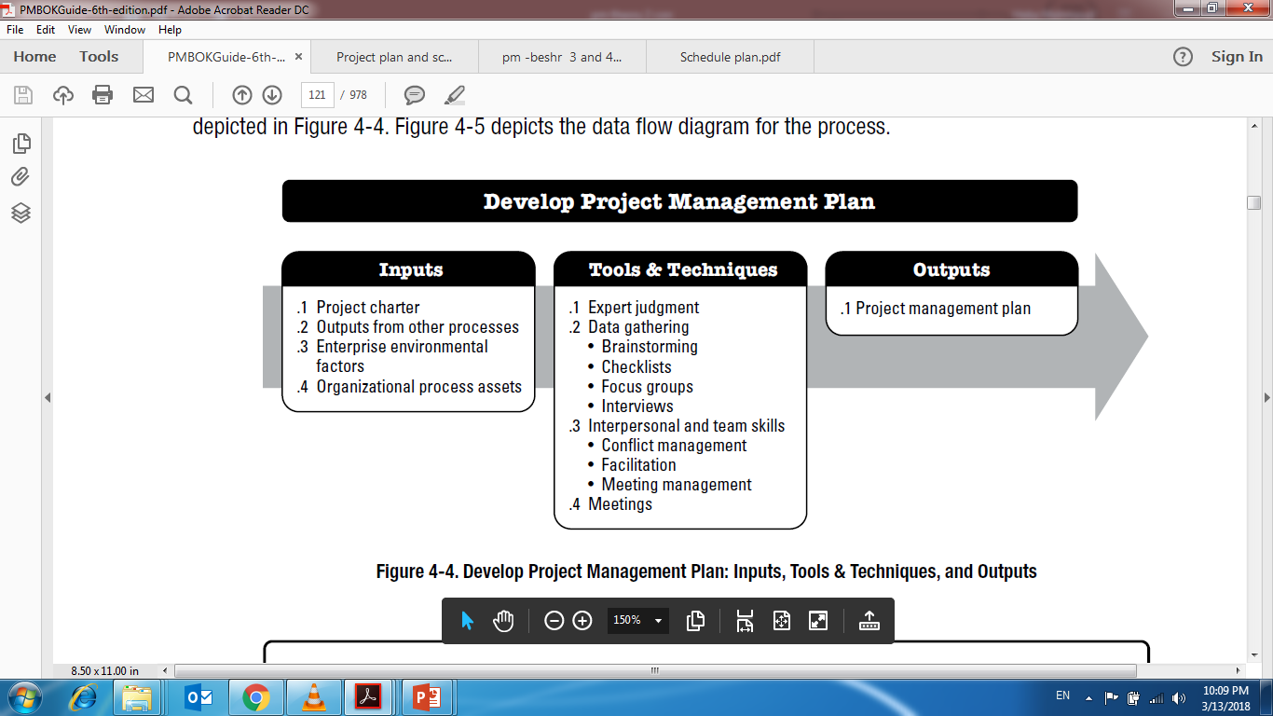
Develop a Project Management Plan
www.midocean.ae

Slide 17
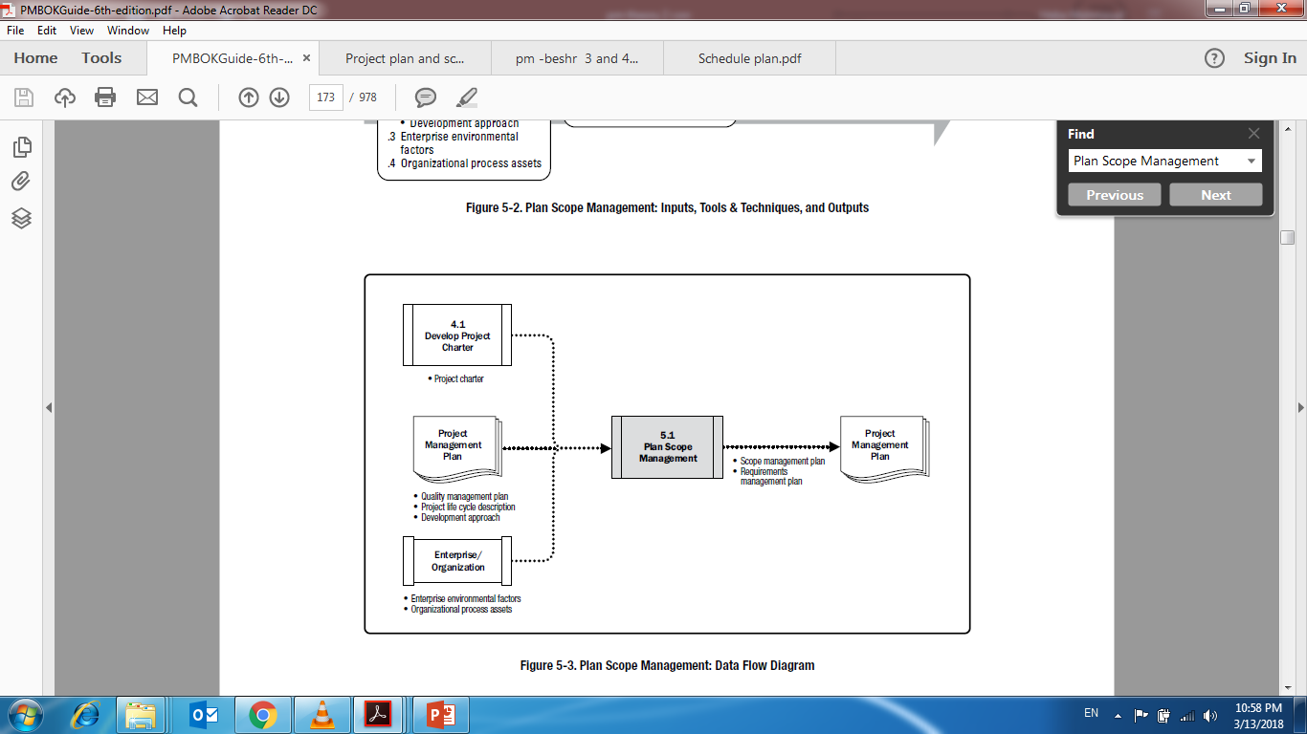
Plan Scope Management
www.midocean.ae

Slide 18
Plan Scope Management Outputs
Scope Management Plan:
1) The scope management plan is a component of the project management plan that describes how the scope will be defined, developed, monitored, controlled, and validated. The components of a scope management plan include:
  Process for preparing a project scope statement;
  Process that enables the creation of the WBS from the detailed project scope statement;
  Process that establishes how the scope baseline will be approved and maintained; and
  Process that specifies how formal acceptance of the completed project deliverables will be obtained.
The scope management plan can be formal or informal, broadly framed or highly detailed, based on the needs of the project.
www.midocean.ae

Slide 19
Guidelines to Develop a Scope Management Plan
Review the project management plan and subsidiary plans.
Review the enterprise environmental factors.
Review the organizational process assets.
Use tools and techniques such as expert judgment.
Hold meetings to develop the scope management plan.
Document the scope management plan and the requirements management plan.
www.midocean.ae

Slide 20
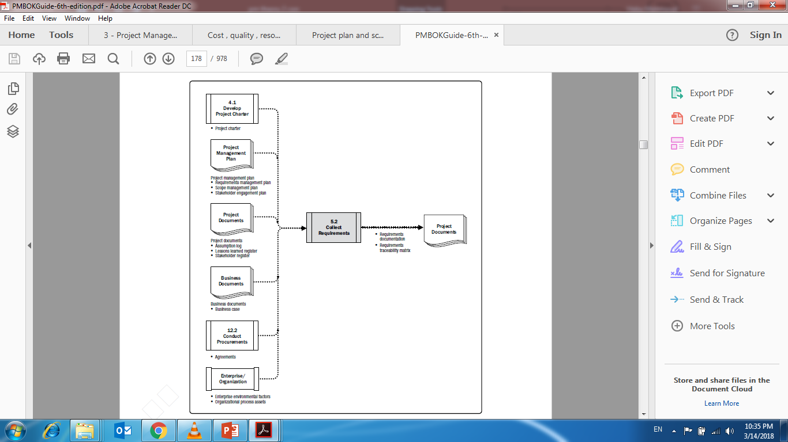
Collect Project Requirements
www.midocean.ae

Slide 21
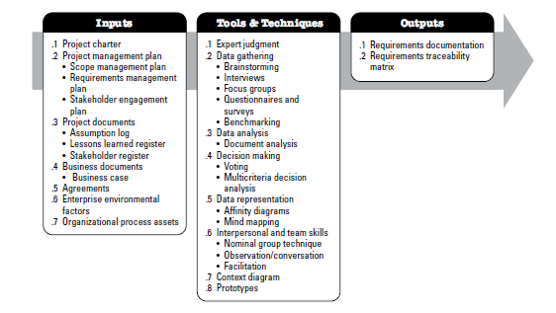
Collect Requirements
www.midocean.ae

Slide 22
Project Requirements
You need to be aware of the project stakeholder requirements and document them to avoid missing critical information.
Conditions or capabilities that must be accomplished by project outcomes
Outcomes and expectations of customer, sponsor, and stakeholders
Foundation for building the WBS
www.midocean.ae

Slide 23
Requirements Documentation
Business requirements
Stakeholder requirements
Solution requirements
Project requirements
Transition requirements
Requirements assumptions, dependencies, and constraints
www.midocean.ae

Slide 24
Requirements Traceability Matrix
The implementation of a requirements traceability matrix helps ensure that each requirement adds business value by linking it to the business and project objectives.
It provides a means to track requirements throughout the project life cycle, helping to ensure that requirements approved in the requirements documentation are delivered at the end of the project.
Finally, it provides a structure for managing changes to the product scope
www.midocean.ae

Slide 25
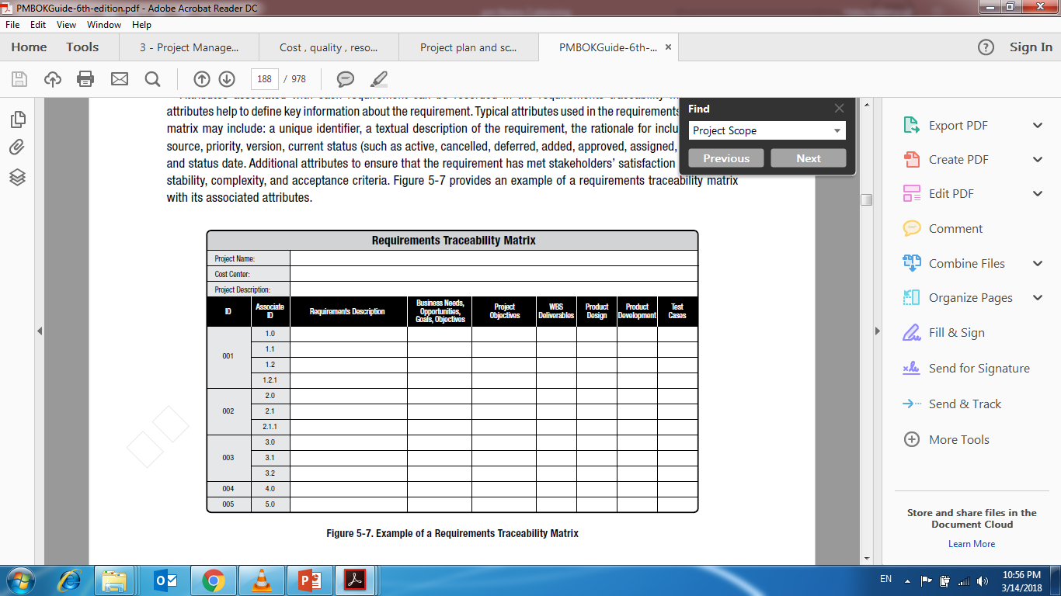
Requirements Traceability Matrix
www.midocean.ae

Slide 26
Guidelines to Collect Project Requirements
Review the scope management plan.
Review the requirements management plan.
Review the stakeholder management plan.
Review the project charter.
Review the stakeholder register.
Use tools and techniques such as interviews, focus groups, facilitated workshops, group creativity techniques, and so on.
Document the requirements and the requirements traceability matrix.
www.midocean.ae

Slide 27
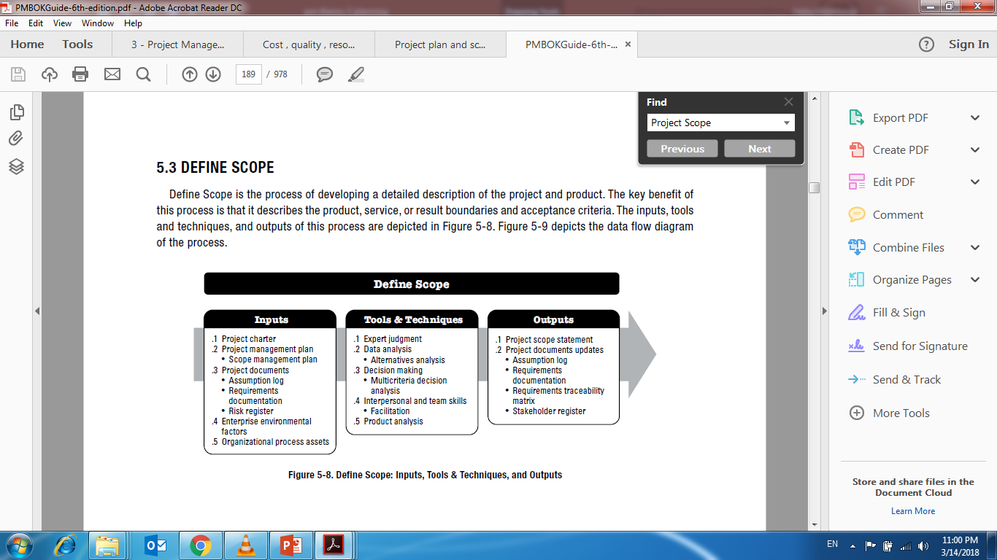
Define Scope
www.midocean.ae

Slide 28
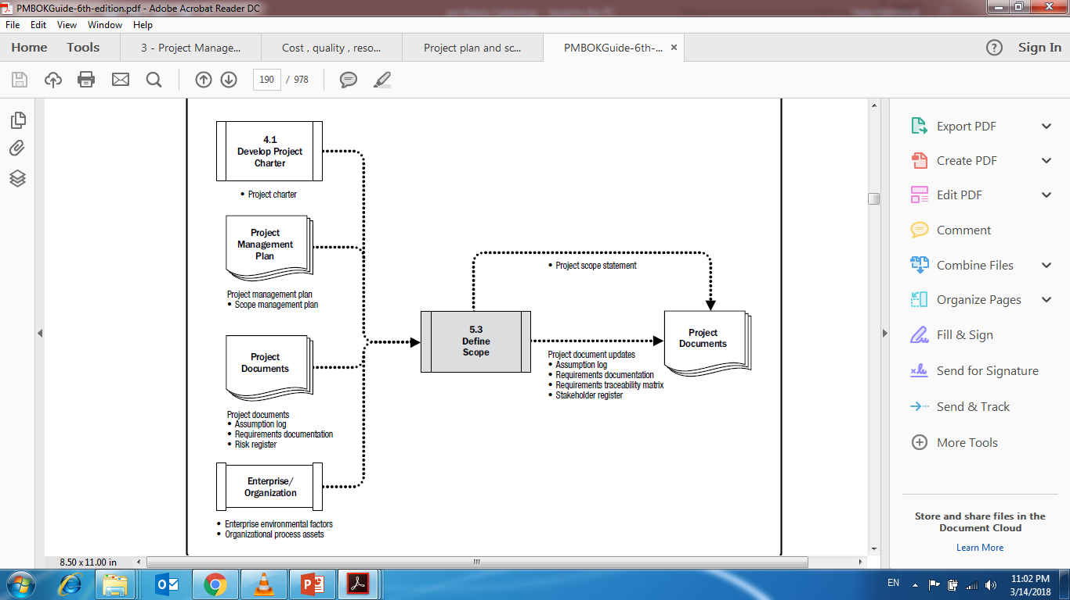
Define Project Scope
www.midocean.ae

Slide 29
Define Scope Tools and Techniques
Product Analysis: the process of translating project objectives into tangible solid deliverables and requirements.
Technique | Description
Functional Analysis | Analyzing all of the things that a product does, including primary and related functions to identify unnecessary functions that might drive up cost on a product.
Value Engineering And Value Analysis | Identifying and developing the cost versus benefits ratio for each function of a product.
Quality Function Deployment | Identifying what the customer's needs are, and translating those needs into technical requirements.
Systems Engineering | Analyzing products holistically, integrating factors such as users, usage environment, and related hardware or software with which the product must function.
www.midocean.ae

Slide 30
Define Scope Tools and Techniques
Alternatives Identification Techniques: are methods for generating as many alternative solutions and plans as possible during planning to achieve project goals
Technique | Description
Lateral Thinking | A creative approach to problem solving in which the team attempts to think about a problem in new ways and generate a fresh solution.
Brainstorming | A general creativity technique for generating possible alternatives. The goal is to generate as many ideas as possible from as many team members as possible (ex: mind map)
Delphi Technique | A group technique that extracts and summarizes anonymous group input to choose among various alternatives.
www.midocean.ae

Slide 31
Define Scope Outputs
Project Scope Statement
Content | Description
Project Objectives | The measurable success criteria for the project.
Product Description | The characteristics of the product, service, or result of the project undertaken.
Project Requirements | The conditions or capabilities the deliverables of the project must be met.
Project Deliverables | Any tangible, measurable result or outcome required to complete a project or portion of a project.
Project Boundaries | The parameters of what is and what is not included within a project.
Product Acceptance Criteria | The process and criteria for accepting finished products or services resulting from a project.
Project Constraints | Factors that limit the way that the project can be approached
Project Assumptions | Statements that must be taken to be true in order for the planning to begin.
www.midocean.ae

Slide 32
The Scope Statement
A Scope Statement: defines the project and what it does and does not need to be accomplished (what is included and what is not included) (what is in scope and what is out of scope).
The project scope statement is created at an early stage in the project to reflects the stakeholders’ common understanding of major activities to be performed in the project.
www.midocean.ae

Slide 33
The Scope Statement
The project scope statement typically includes :
  Project objectives, deliverables, and requirements
  Project constraints and assumptions
  Product acceptance criteria
It may also include initial project organization, defined risks, schedule milestones, initial work breakdown structure, and approval requirements.
www.midocean.ae

Slide 34
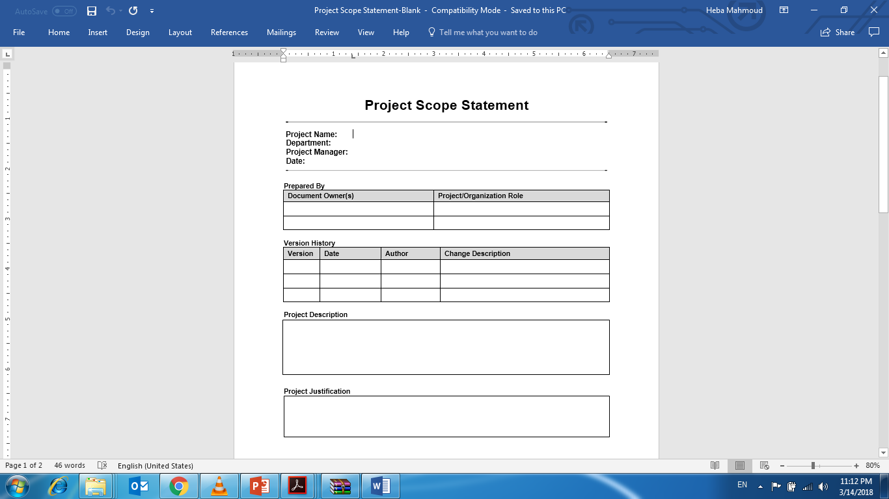
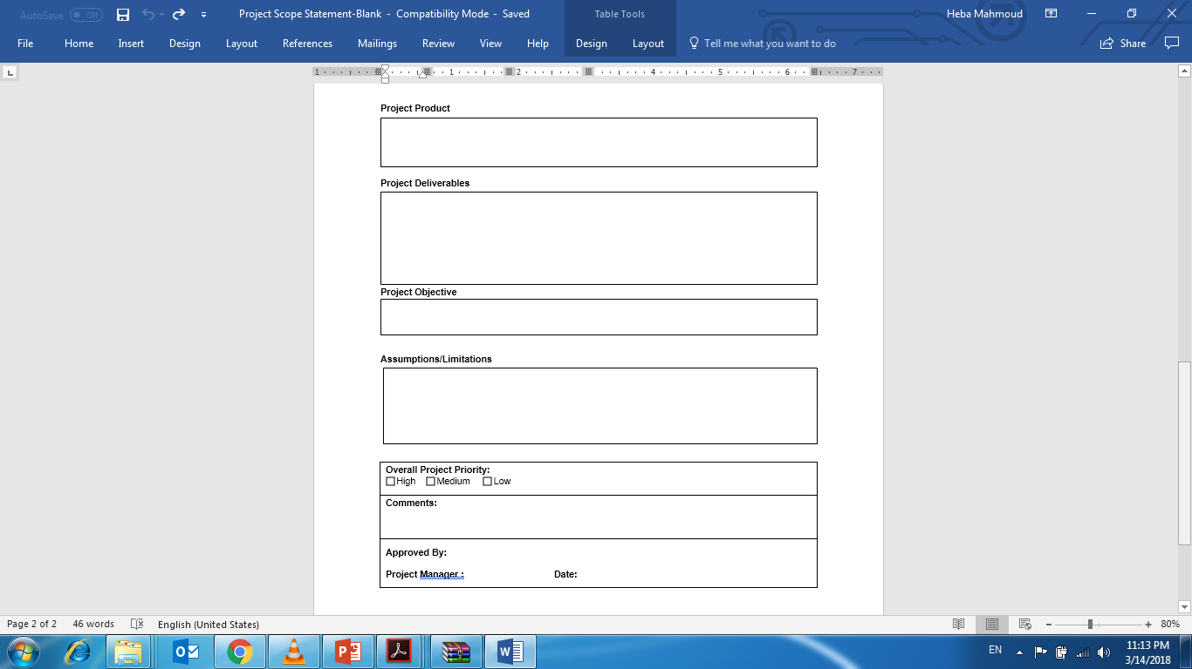
The Scope Statement
www.midocean.ae

Slide 35
Guidelines to Develop a Project Scope Statement
Review the scope management plan for the activities for developing, monitoring, and controlling the project scope.
Review the project charter for the high-level project description and product characteristic and project approval requirements.
Review the requirements documentation.
Review the organizational process assets.
Use tools and techniques such as expert judgment, product analysis, alternatives generation, and facilitated workshops to define the project scope.
Document the project scope statement and update any project documents, as needed.
www.midocean.ae

Slide 36
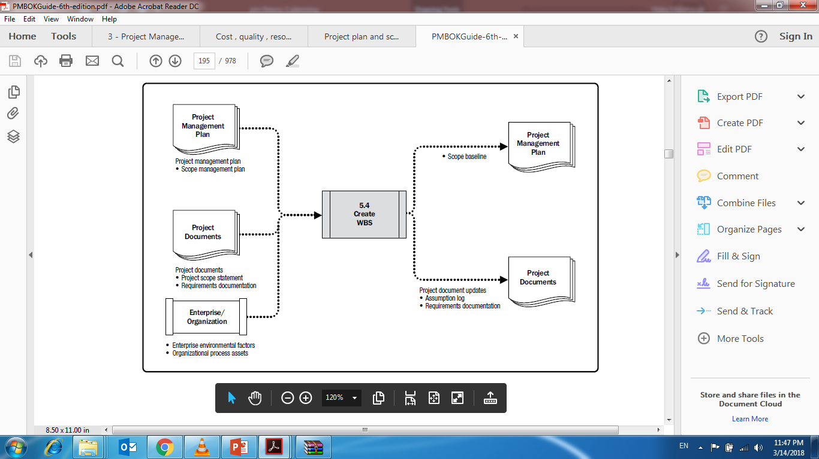
Create a Work Breakdown Structure (WBS)
www.midocean.ae

Slide 37
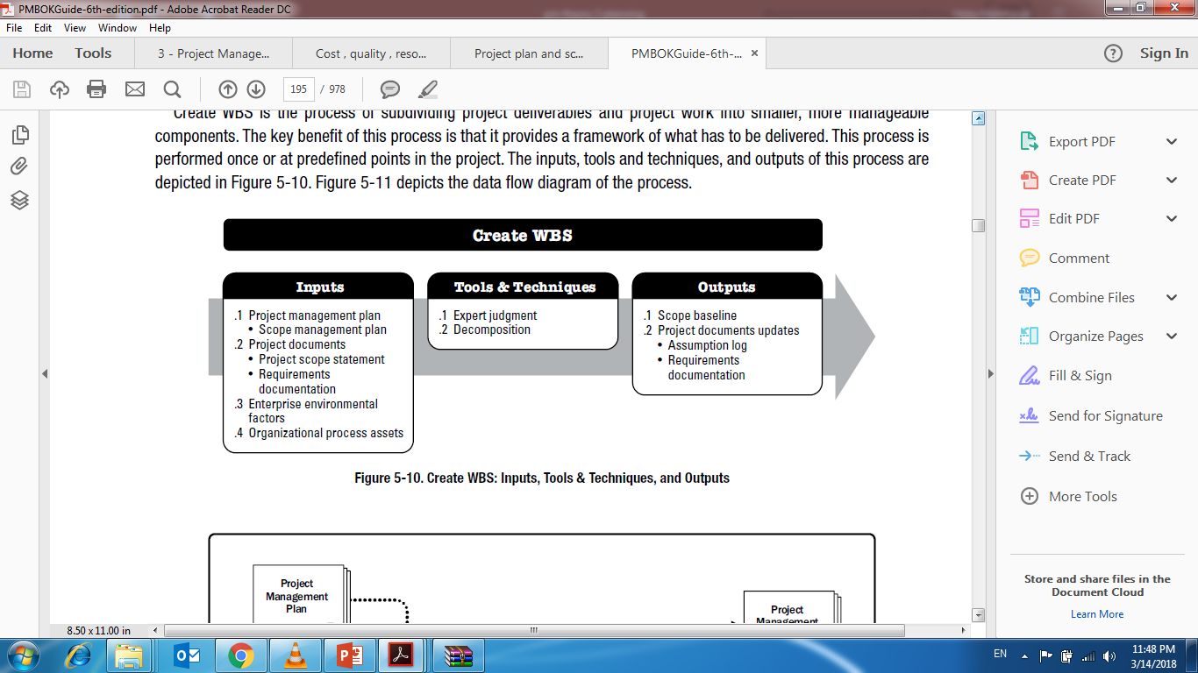
Create a Work Breakdown Structure (WBS)
www.midocean.ae

Slide 38
Work Breakdown Structure
You created a project scope statement and identified the skills required for the project team; the next logical step will be to identify the smaller tasks in the project that can be assigned to the individual team members.
The Work Breakdown Structure (WBS): is a hierarchical structure that subdivides project work into smaller, more manageable pieces of work named work packages which will braked down to activities.
www.midocean.ae

Slide 39
Work Breakdown Structure
A WBS defines the total scope of work required to complete the project; the deliverables and their component sub-deliverables are represented on the WBS in levels of descending order.
The smallest, most granular deliverable that cannot be further subdivided is called a work package.
www.midocean.ae

Slide 40
Work Packages / Activities
Work Package: refers to the planned work or the deliverables that are contained in the lowest-level component of the work breakdown structure (WBS).
Work packages can be broken down or subdivided into smaller, even more manageable components, called activities.
Activity: is a unit of project work that must be performed to complete a project deliverable; every activity has a duration, cost and consumes resources.
www.midocean.ae

Slide 41
Create WBS Tools and Techniques
Decomposition: “drill - down”: separating deliverables and their required work into manageable, measurable, assignable, and more specific work packages.
www.midocean.ae

Slide 42
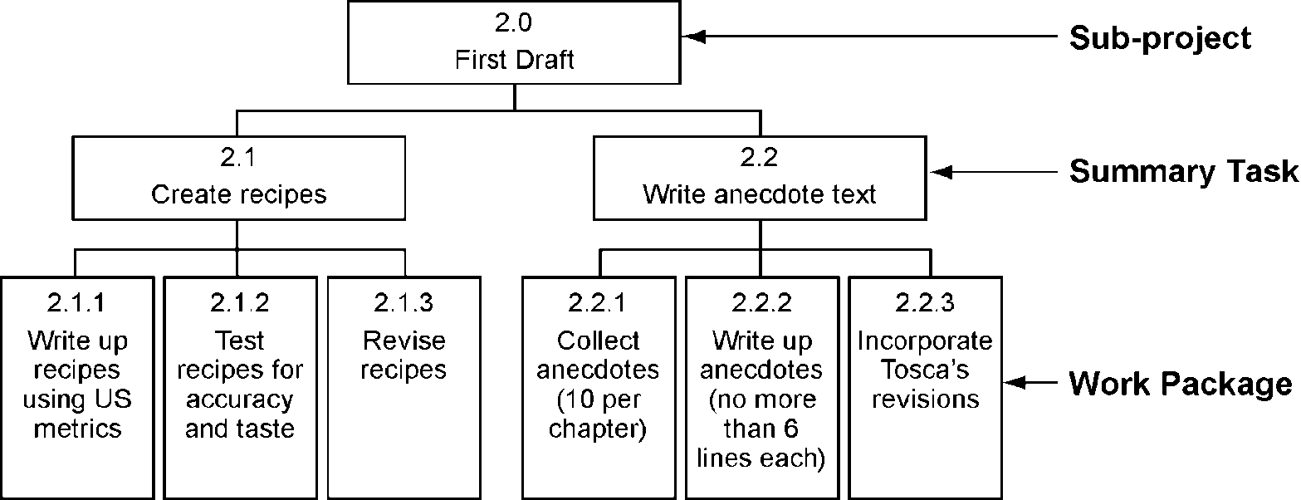
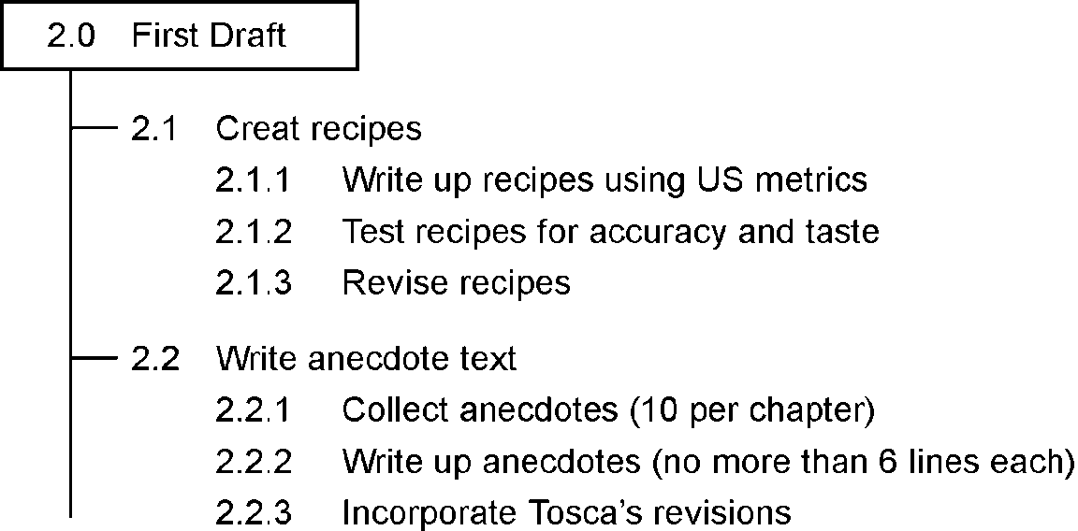
WBS (Hierarchy and Tree Format)
Hierarchy Format
Tree Format
www.midocean.ae

Slide 43

Work Package Example

Work Packages are used in estimating the scheduling, and staffing the project.
Work Package WBS#: 1.1.3.1 Title: Initial Web site Design
Work package assigned to: Amy Phillips
Description: Approved color online comps of home page and at least one other page of company Web site. Design should include interface elements and proposed functionality.
WBS#
Activity
Responsible
Party
Estimated Duration
(Hours)
1.1.3.1.1
Research requirements
1.1.3.1.2
Produce paper comps of 3 designs
1.1.3.1.3
Review comps & select design
Produce online comps of selected design
1.1.3.1.4
1.1.3.1.5
Review and approve online comps
www.midocean.ae

Slide 44
Guidelines to Create a WBS
Review the scope management plan
Review the project scope statement
Review the requirements documentation
Review the enterprise environmental factors
Review organizational process assets
Use tools and techniques
Use expert judgment
Document the scope baseline.
Validate your WBS using a bottom-up approach to ensure the lower-level components are necessary and sufficient for the completion of each decomposed item.
Using your organization’s or project’s code of accounts, assign a unique numeric cost code for each element indicating its branch and level on the WBS for cost tracking and reporting.
www.midocean.ae

Slide 45



Thank You

