Slide 1




Organizational Behavior and Projects
PMG421
Prepared by Mrs. Deena Ibrahim
Lecture 6
Tools for
Managing Project Quality

Slide 2


Collecting and Understanding Project Data
2. Tools for Collecting Data 2.1 Check Sheet
3- Tools for Understanding Data 3.1 Graphs 3.2 Histograms 3.3 Pareto Charts 3.4 Scatter Diagrams
4- Summary

Slide 3

Collecting and Understanding Project Data
The evolution of quality theory and practice has created a number of tools that may be applied to managing project quality. The tools described in the following lectures constitute a set that is generally relevant to project management. Other quality tools may be useful, depending on the project situation.

Slide 4
Tools described here fall into five categories, including tools for:
◆ Collecting data.
◆ Understanding data.
◆ Understanding processes.
◆ Analyzing processes.
◆ Solving problems.
Very Important, the number of defects or errors is not as important as the cost or the effect of the error.

Slide 5
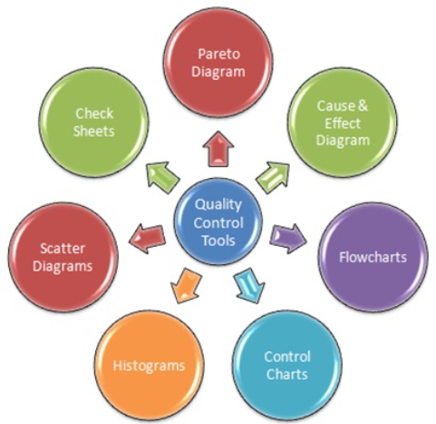
The set includes the seven basic tools of quality described by Ishikawa in his book Guide to Quality Control.
◆ Check sheet.
◆ Graph.
◆ Histogram.
◆ Pareto chart.
◆ Scatter diagram.
◆ Control chart.
◆ Cause and effect diagram.

Slide 6
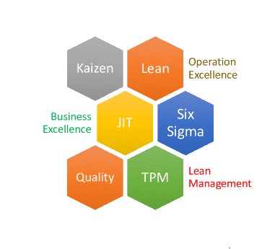
Seven additional tools are:
◆ Flow chart.
◆ Run chart.
◆ Brainstorming.
◆ Affinity diagram.
◆ Nominal group technique and multivoting.
◆ Force field analysis.
◆ Pillar diagram.
The set also includes two tools, compliance matrix and peer review, that are related to general management, but are so common in use and so relevant to project quality management that any discussion would be incomplete without them.

Slide 7
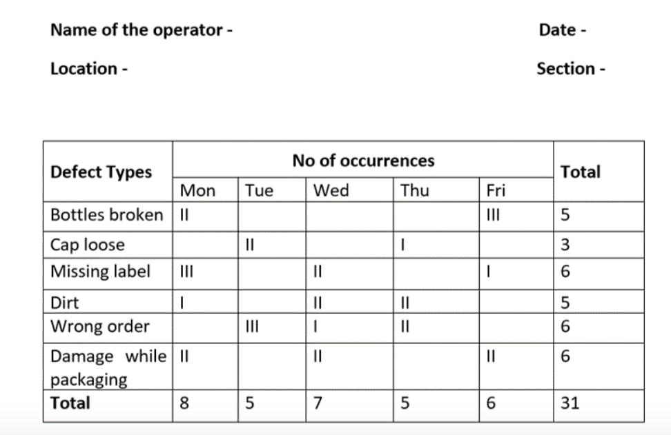
2- Tools for Collecting Data:
Improper or incomplete collection of data is a fundamental error with an effect that may be magnified many times by subsequent action. Data may be collected in an ad hoc fashion by a quick scan, word of mouth, or even assumption. All of these methods yield unsatisfactory results. A more deliberate method is necessary.
Check sheet

Slide 8
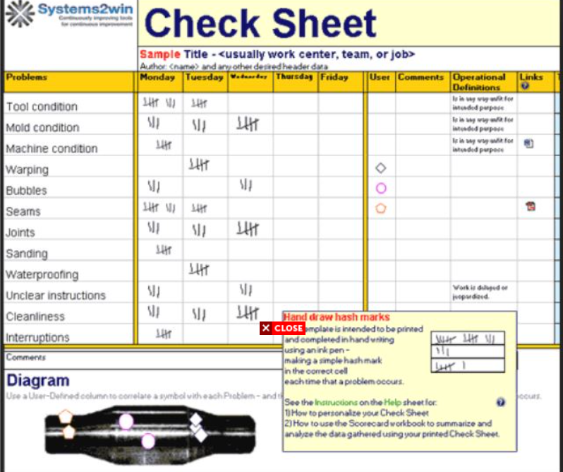
2.1 What is a Check sheet?
Basically, a check sheet is a form of the document for organizing and collecting data in a real-time process or in a location where the data is generated. The data we collected can either be qualitative or quantitative. When the data is quantitative, the check sheet is also called a tally sheet.
It is very important to understand which form is to use for the intended purpose and so we can make good use of it.

Slide 9
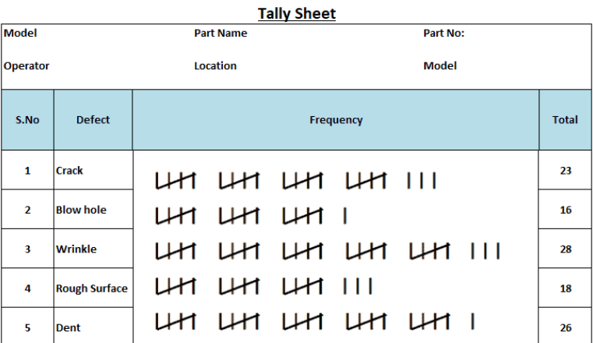
Usage of check sheets:
Probability distribution of a process : To get the visualize form of the distribution of a process. It is a frequency distribution tally sheets which are used to create a histogram and so we can check the outlook of a process.
Identification of defect type :Here we can categorize all the defects types and lists in the form of frequency distribution table. Then we can plot a bar chart to check the occurrence of defect types.
Identification of defect by location : We can detect the defects in which location it occurs.

Slide 10
Check sheet format (Design specification)
We can design in accordance with our requirement but we should keep in mind that it is well designed for the intended use.
Following are some of the common points which are included in the format are:-
Name of the operator
Types of data collected
Location of data collection took place
Data collection schedules
Reason for collecting data and so on.

Slide 11

Benefits of Check sheet
- It is a basic quality tool and easy to demonstrate.
- Very useful in process improvement.
- It helps to make a better decision.
- It is a versatile tool which can be used in many domains like manufacturing, pharmaceutical, service sector and so on.

Slide 12
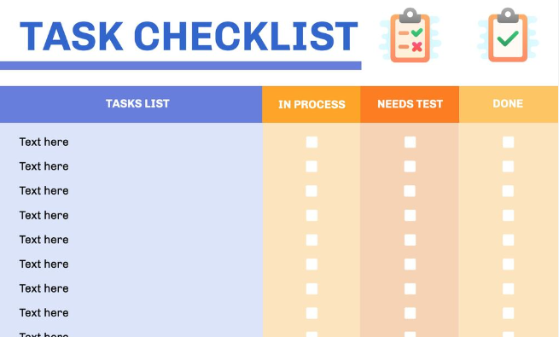
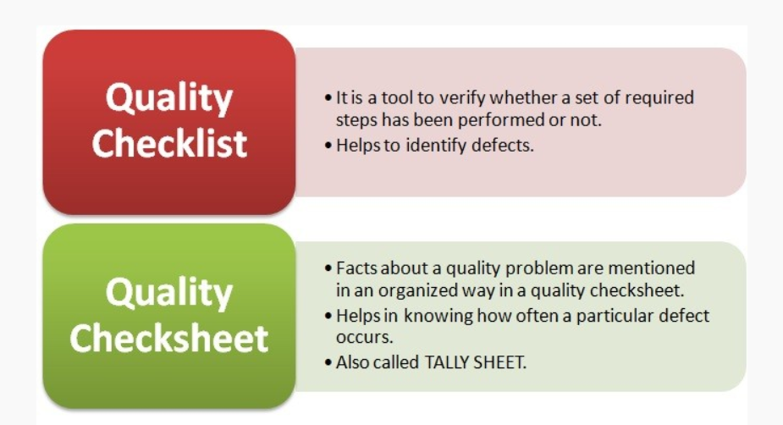
Checklist V. Check sheet

Slide 13

3- Tools for Understanding Data
Four tools may be helpful to project managers to understand data:
Graphs,
Histograms,
Pareto charts,
And scatter diagrams.
Graphs
Histograms
Pareto charts
Scatter diagrams

Slide 14
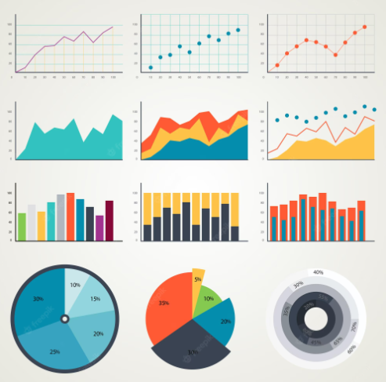
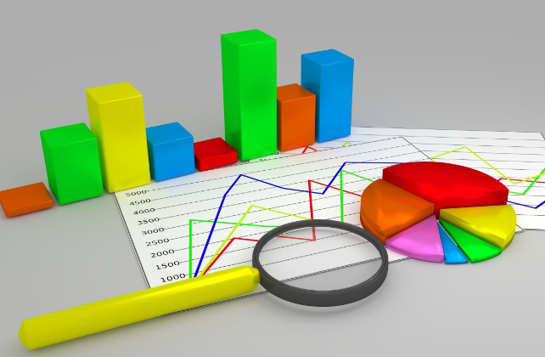
3.1 Graphs
Graphs are one of Ishikawa’s seven basic tools. The purpose of a graph is to organize, summarize, and display data, usually over time. Ishikawa described three different types of graphs, including line graphs, bar graphs, and circle graphs.

Slide 15

Four steps are involved in graphs format:
Define events and data. It is important to determine what information will be addressed in the graph.
Design the graph. Select the type of graph to be used, considering the data and the audience of the graph.
Collect data if this has not already been done. A check sheet may be useful for this step. Data may be collected incrementally and cumulatively over time.
Enter data. Prepare the graph by entering data.
Notes:
https://www.ccohs.ca/oshanswers/prevention/effectiv.html

Slide 16
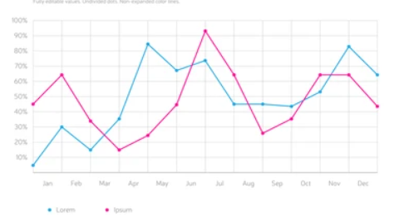
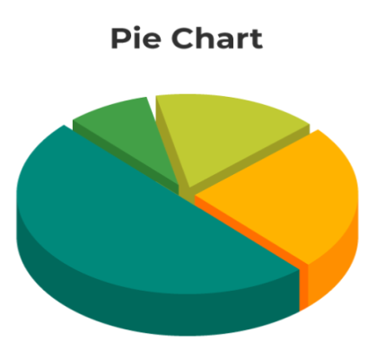
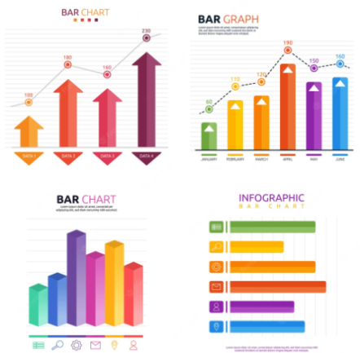
TYPES OF GRAPHS
The line graph is a form commonly used to report project financial information. The “burn” chart may be familiar to many with project management experience. It shows how available funds are being “burned up” (that is, expended) during project implementation
A circle graph (often called a “pie chart”) is useful for displaying data when the relationships between data elements and the whole are more important than showing data over time..
A bar graph displays data as vertical or horizontal bars. It can show data over time or data at a single point in time.

Slide 17

Benefits of Graphs:
They are attractive.
They give a bird’s eye- view of the data.
They can be easily understood.
They facilitate comparison of various characteristic.
Long lasting impression.

Slide 18
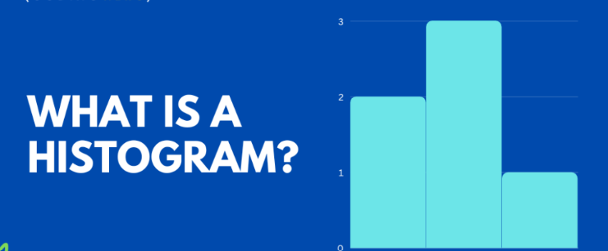
3.2 Histograms
A histogram is a type of bar graph that deals with data that exist in a continuous range from a low number to a high number. Histograms display frequency distribution, or how often (frequency) individual data points occur across the range of the data from low to high (distribution). Histograms summarize data in a form that is more easily understood than a table of collected numbers.

Slide 19
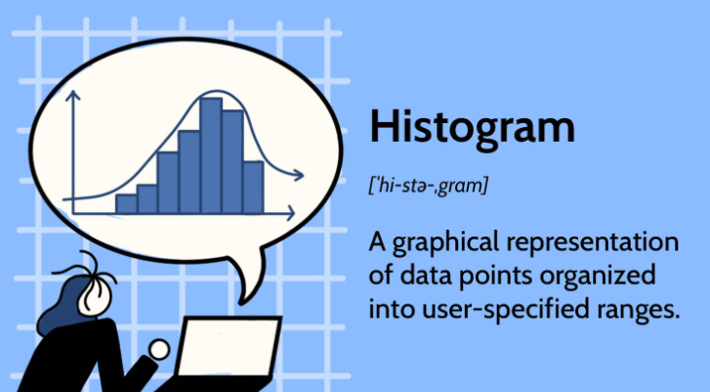
Creating and using a histogram requires six steps:
Select the measures to be examined. Typical measures are things like size, speed, time, weight, dimensions, and so on.
Collect the data. Again, a check sheet may be useful. Data may already exist in some sort of spreadsheet or tabular form.
Prepare a frequency table. This is the first step in organizing the data. It is a summary of data in a sequential format.

Slide 20
4. Design the histogram. Histograms are constructed in a disciplined way. Throwing the data together in a way that seems convenient at the moment may result in a display that is completely useless.
5. Draw the histogram. Enter the data and prepare the graphic display.
6. Interpret the data. View the bars of the histogram and analyze their relationship to each other.

Slide 21
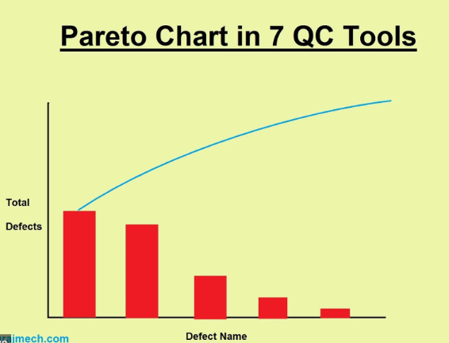

3.3 Pareto Charts
Pareto chart is a bar graph with data in descending order. This deliberate arrangement of data in descending order from left to right on the chart is its signature characteristic. So the first step in preparing a Pareto chart is to create a bar graph with the defect or error data arranged in descending order.
A Pareto chart is a helpful tool to identify the greatest opportunity for improvement among a number of possibilities and to identify the small number of most influential causes (the “vital few”) among the complete set of possible sources of error.

Slide 22
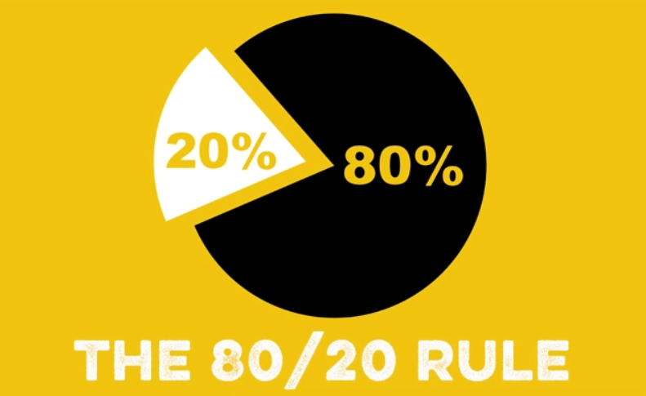
It is named for Vilfredo Pareto, an Italian economist, who determined through study that wealth seems to be distributed in populations according to an 80/20 rule:
80 percent of the wealth is controlled by 20 percent of the population. This rule also seems to be valid for defects in administrative and production processes:
80 percent of the defects are caused by 20 percent of the possible sources of error.

Slide 23

When to use Pareto Chart:
1- USE it EARLY IN YOUR QUALITY IMPROVEMENT PROCESS. Pareto charts can be used at the start of a new round of quality improvement to figure out what business problems are responsible for the most complaints or losses, and dedicate improvement resources to those
2- USE A PARETO CHART LATER IN YOUR QUALITY IMPROVEMENT PROCESS. Once a project has been identified, and a team assembled to improve the problem, a Pareto chart can help the team select the appropriate areas to focus on.

Slide 24
3- USE A PARETO CHART TO BUILD CONSENSUS: can be very helpful in resolving conflicts, particularly if a project involves many moving parts or crosses over many different units or work functions.
4- USE PARETO CHARTS OUTSIDE OF QUALITY IMPROVEMENT PROJECTS: By helping you visualize the relative importance of various categories, you can use them to prioritize customer needs, opportunities for training or investment.

Slide 25
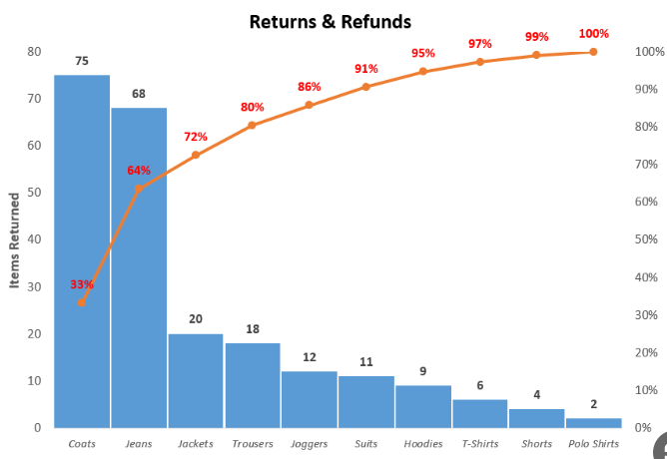
Important Note:
When cost of errors is more significant than number of errors, simply construct the Pareto chart in a way that expresses the cost of the errors, not the number.
HOW TO CREATE A PARETO CHART
Gather Raw Data about Your Problem. Tally Your Data..
Label your horizontal and vertical axes. Draw your category bars.
Add cumulative counts and lines.

Slide 26
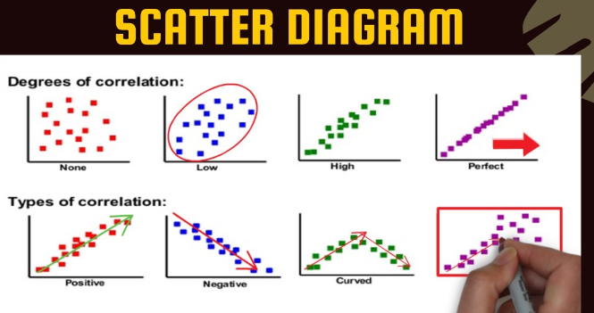
3.4 Scatter Diagrams
A scatter diagram identifies possible relationships between two variables. Understanding relationships among data elements is essential to understanding the data as a whole. also called a scatter plot. They are an incredibly powerful chart type, allowing viewers to immediately understand a relationship or trend, which would be impossible to see in almost any other form.

Slide 27
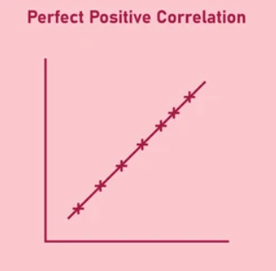
How to make scatter diagram,
1. Define the theoretical relationship. Relationships between variables are not always obvious. This first step identifies the two variables that will be formally examined.
2. Collect 50 to 100 paired samples of data. Analysis must be based on a sufficient amount of data. Too few data may result in wrong conclusions that arise from the limited data.

Slide 28
3. Plot the data on x-y axes. The x-axis, the horizontal axis, should be used for the independent variable; that is, the variable that is the base. The data of the other variable will change in some regular way as the base changes if there is a relationship between the two. The y-axis should be used for the dependent variable; that is, the variable that may change in some regular way as the base changes.
4. Interpret the data. Look for regular patterns among the plotted points.
Y-axis, Dependent
X-axis, Independent

Slide 29
When to Use Scatter Charts,
A side from scientific studies, there are a few times when businesses may decide to use a scatter chart:
- To identify anomalies.
- To see how one variable affects another.
To see a correlation, pattern, trend, or relationship.

Slide 30

Benefits of Scatter Charts,
Scatter charts have multiple benefits and advantages.
- Clearly Shows Relationships.
- Easy to Create and Understand.
- The Range of Data Can be Determined.

Slide 31

◆ Quality tools provide a mechanism for managing project quality.
◆ A check sheet may be used to compile and record data from observations or historical records. A check sheet includes a collection of data. A checklist describes things to do.
◆ Graphs may be used to organize, summarize, and display data over time. A line graph shows how data change over time. A bar graph shows how data change and how separate data elements are related to each other. A pie graph shows how data elements are related to each other, especially how separate elements constitute a whole.

Slide 32
A Pareto chart is a bar graph with bars arranged in descending order from left to right. The bars represent sources of error, and the values of the bars reflect the number of defects. A Pareto chart includes a cumulative percentage curve that helps identify the “vital few,” the small number of sources of error (about 20 percent) that account for most of the defects (about 80 percent).
When the cost of defects is more important than the number of defects, a Pareto chart should be constructed so that bars represent the cost of defects rather than the number.
◆ Scatter diagrams identify possible relationships between two variables.

Slide 33


Slide 34


