Slide 1



Introduction to Economics
Orientation Lecture
MGM112
The Economic Problem
Prepared by
Lec. Dina ElWakkad
www.midocean.ae

Slide 2


GENERAL INFORMATION
Course Name: MGM112- Introduction to Economics
Course Instructor: Dina Samir ElWakkad
Email: dina.elwakkad@esu.ac.ae
www.midocean.ae

Slide 3
GENERAL INFORMATION
v
ترفع المحاضرات الأسبوعية على المنصة التعليمية Moodleيوم السبت من كل أسبوع في تمام الساعة 12 ظهرًا بتوقيت الرياض
www.midocean.ae

Slide 4
GENERAL INFORMATION
v
حلقات النقاش وهي حلقات أسبوعية اختيارية للطالب وغرضها مناقشة ما تم طرحه خلال المحاضرة المسجلة لكل أسبوع ستكون بأذن الله علي رابط زوم والذي سوف يتم الإعلان عنه علي المنصة التعليمية Moodle
www.midocean.ae

Slide 5
Quizzes
v
يفتح الاختبار القصير الأسبوعي يوم السبت في تمام الساعة العاشرة مساءً وهو متاح لمدة أسبوع ثم يقفل يوم السبت الذي يليه في تمام الساعة التاسعة مساءً
الاختبار يشمل أسئلة كتابية وصوتية
تعد الإجابة علي الاختبار القصير بمثابة حضور للطلاب والطالبات
الاختبار القصير من 8 درجات (بمجموع 80 درجة)
فترة السماحية للاختبار القصير 24 دقيقة.
www.midocean.ae

Slide 6
Quizzes
v
Exams & Marks | 80% Short exams during the semester
 | 20% Final Exam
www.midocean.ae

Slide 7
Course Content
LEC 1 - The Economic problem
LEC 2 Demand Theory
LEC 3 Supply theory
LEC 4 Market Equilibrium, and its applications
LEC 5 Elasticity of Demand, and Elasticity of Supply
LEC 6 Government Intervention in Markets
LEC 7 output, and Cost
LEC 8 Monetary Policy, and Fiscal policies
LEC 9 MEASURING GDP AND ECONOMIC GROWTH
LEC 10 International Trade
www.midocean.ae

Slide 8
Learning Outcomes
v
At the end of this course, students should be able to:
Describe and evaluate the models and methods used in economic analysis.
Formulate real world examples in the language of economic modeling.
Apply and use the economic models to analyze these issues.
Assess the potential and limitations of the models and methods used in economic analysis.
program level competencies.
www.midocean.ae

Slide 9
Objectives of this Lecture
v
After studying this lecture, you will be able to:
  Define economics and distinguish between microeconomics and macroeconomics
  Explain the three big questions of microeconomics
  Explain the three big questions of macroeconomics
  Explain the ideas that define the economic way of thinking
www.midocean.ae

Slide 10
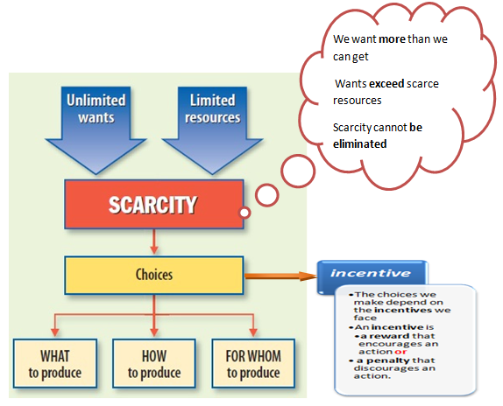
1. WHAT IS ECONOMICS?
v
www.midocean.ae

Slide 11
1. WHAT IS ECONOMICS?
v
Scarcity
  All economic questions arise because we are unable to satisfy all our wants—because we face scarcity.
  Economics is the social science that studies the choices that individuals, businesses, governments, and societies make as they cope with scarcity.
www.midocean.ae

Slide 12
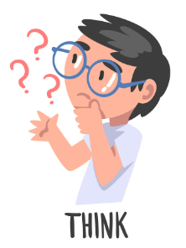
Think
v
Scarcity requires that people must
A) cooperate.
B) compete.
C) trade.
D) make choices.
As an economic concept, scarcity applies to
both money and time.
money but not time.
C) time but not money.
D) neither time nor money.
www.midocean.ae

Slide 13
2. Compare between Microeconomics and Macroeconomics.
v
  Economics divides into Two Main parts: Microeconomics, Macroeconomics
 | Microeconomics | Macroeconomics
Definition | Microeconomics is the study of choices that individuals and businesses make, the way those choices interact in markets, and the influence of governments. | Macroeconomics is the study of the performance of the national and global economies.
Examples | Why are people buying more e-books and fewer hard copy books? | Why is the unemployment rate so high?
Questions | What to produce ? How to produce? For whom to produce ? | 1)What Determines the Standard of Living? 2)What Determines the Cost of Living? 3)Why Does Our Economy Fluctuate?
www.midocean.ae

Slide 14
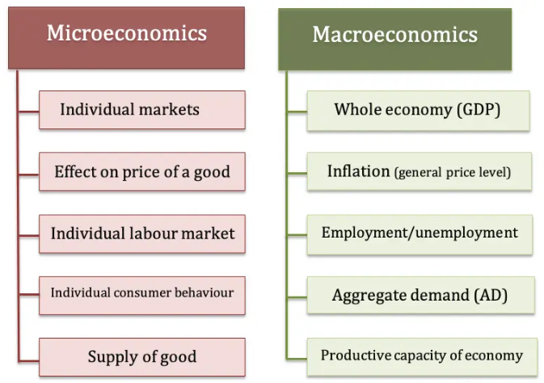
2. Compare between Microeconomics and Macroeconomics.
v
www.midocean.ae

Slide 15
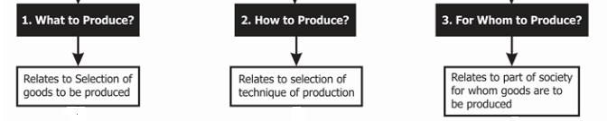
3.Explain the three big questions of Microeconomics?
v
  Microeconomics seeks to understand what determines:
www.midocean.ae

Slide 16
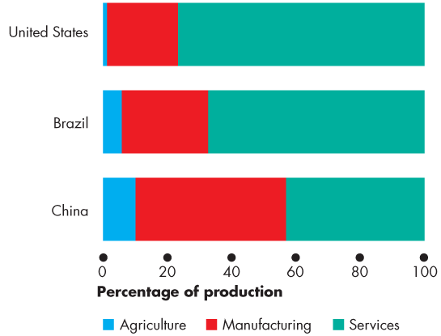
3.Explain the three big questions of Microeconomics?
v
  Microeconomics seeks to understand what determines:
What…. ?
Goods and services are the objects that people value and produce to satisfy human wants.
www.midocean.ae

Slide 17
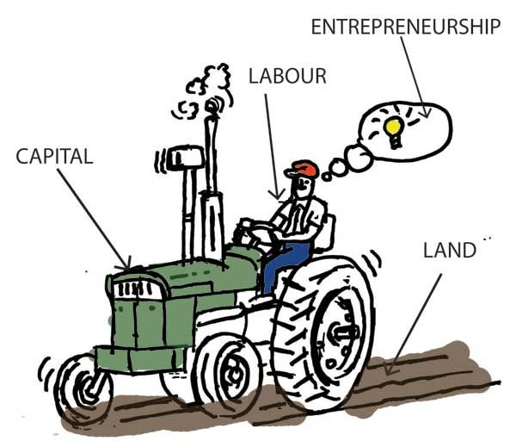
3.Explain the three big questions of Microeconomics?
v
  Microeconomics seeks to understand what determines:
How…. ?
Goods and services are produced by using factors of production: the inputs used to produce goods and services
www.midocean.ae

Slide 18
3.Explain the three big questions of Microeconomics?
v
How…. ?
Land:
  The “gifts of nature” that we use to produce goods and services .
Labor:
  The work time and work effort that people devote to producing goods and services
  The quality of labor depends on human capital, which is the knowledge and skill that people obtain from education, on-the-job training, and work experience.
Capital:
  The tools, instruments, machines, buildings, and other constructions that businesses use to produce goods and services
Entrepreneurship :
  The human resource that organizes land, labor, and capital.
www.midocean.ae

Slide 19
3.Explain the three big questions of Microeconomics?
v
For Whom / Who…. ?
Who gets the goods and services depends on the incomes that people earn.
  Land earns rent.
  Labor earns wages.
  Capital earns interest.
  Entrepreneurship earns profit
www.midocean.ae

Slide 20
Think
v
When firms in an economy start producing more computers and fewer televisions, they are answering the ____ question.
A) “when”
B) “for whom”
C) “what”
D) “where”
few machines and a great deal of labor, it is answering the ________ part of one of the two big economic questions.
A) "what"
B) "how"
C) "where"
D) "for whom"
www.midocean.ae

Slide 21
Think
v
The fact that people with higher incomes get to consume more goods and services addresses the ________ part of one of the two big economic questions.
A) "for whom"
B) "when"
C) "where"
D) "how"
www.midocean.ae

Slide 22
4.Explain the three big questions of Macroeconomics?
v
What Determines the Standard of Living?
The standard of living is the level of consumption that people enjoy on the average and is measured by average income per person.
What Determines the Cost of Living?
The cost of living is the amount of money it takes to buy the goods and services that a typical family consumes
In the time of inflation, decreasing value of $, increasing cost of living.
In the time of deflation, increasing value of $, decreasing cost of living.
www.midocean.ae

Slide 23
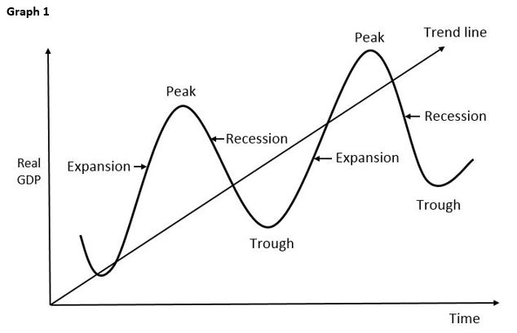
4.Explain the three big questions of Macroeconomics?
v
Why Does Our Economy Fluctuate?
The business cycle is the periodic but irregular up-and-down movement in production and jobs in an economy.
www.midocean.ae

Slide 24
5. Compare ,contrast between Positive statements and Normative statements
v
 | Positive statements | Normative statements
Definition | are about what is Statements may be right or wrong, Statements can be tested They are economics. | Are about what ought to be. (a value judgment.) Statements express an opinion, but they don’t assert a fact that can be checked. Statements depend upon values and cannot be tested. They are not economics.
Examples | “Our planet is warming because of the amount of coal that we are burning” “A rise in the minimum wage will bring more teenage unemployment.” | “We ought to cut back on our use of coal” “The minimum wage should not be increased”.
www.midocean.ae

Slide 25
Think
v
The statement “Prices rise more in countries with rapid growth in the money supply” is
A) a political statement.
B) a positive statement.
C) a normative statement.
D) an ethical statement
"Government should act to reduce poverty levels."
A) This statement is a normative statement.
B) This statement is a positive statement.
C) This statement is an example of the fallacy of composition.
D) This statement is an example of the post hoc fallacy.
www.midocean.ae

Slide 26
Summary outlines
v
Definition of Economics, and Scarcity
Microeconomics, and Macroeconomics
The 3 big Questions of Microeconomics
The 3 big Questions of Macroeconomics
Comparison between Positive statements and Normative statements
www.midocean.ae

Slide 27


Thank You

