Slide 1


Project Procurement and
Supply Chain
Prepared by Dr. Tarek Mohamed
PMG 433
Lecture 3

Slide 2


Plan, execute and control of supply-chain projects
Lecture 3
PMG 433
Prepared by
Dr. Tarek Mohamed
www.midocean.ae

Slide 3

Course Agenda
Chapter
1-Discuss the meaning of supply chain project management.
2-Understand the role of project management in the supply
chain optimization.
3-Explaining how to streamline the supply chain management
with project management.
4-Discussing the challenges and solutions in integrating the
project and supply chain management.
5- Identify the supply chain project management methodology
www.midocean.ae

Slide 4
Supply Chain Management (SCM)
It involves managing the flow of supplies through all stages of the production cycle including the sourcing, production, and distribution of products or services from raw materials to end customers.
A series of interconnected processes span across different functions within an organization and often extend to external partners.
The primary components of SCM include suppliers, manufacturing, production, distribution, inventory management, information systems, and customer service.
www.midocean.ae

Slide 5
Project Management (PM)
“Project management is the discipline of planning, organizing, and managing resources to bring about the successful completion of specific project goals and objectives.”
Project management is as good as managing a business or an organization.The project management involves planning, coordination, execution and evaluation.
These are the basic activities undertaken in any organization. It is very important to develop meaningful and achievable project deliverables. Attempting an unachievable result is waste of money, time and effort.
www.midocean.ae

Slide 6
Project Management (PM)
It entails the application of processes, methods, skills, knowledge, and experience to develop and reach specific project objectives within agreed parameters, according to project acceptance criteria.
The final deliverables of PM are constrained by a finite budget and timeframe.
Key elements of PM include scope, schedule, quality, cost, risk, and procurement.
www.midocean.ae

Slide 7
What is Supply Chain Project Management?
A supply chain project is a distinct attempt to deliver a set of identified and agreed deliverables with given resources and within agreed time frame and financial budget in order to elevate the current supply chain operations into next level of targeted excellence.
The projects could address Strategic Improvement; Technological Improvement; Structural Improvement; and Supply Chain Performance improvements.
www.midocean.ae

Slide 8
What is Supply Chain Project Management?
Supply chain project management refers to the process of planning, executing, and controlling projects within the context of a supply chain or logistics operation.
It involves the application of project management principles and practices to ensure that specific supply chain-related projects are completed successfully, on time, within budget, and with the desired outcomes.
www.midocean.ae

Slide 9
The Role of Project Management in Supply Chain Optimization
Identifying Project Management within Supply Chains
While Supply Chain Management focuses on the ongoing flow of goods and services, Project Management plays a critical role in planning and driving improvements within this complex system.
Effective project managers must have a deep understanding of the supply chain environment in which they operate. This means more than just grasping procurement processes and systems; it involves comprehending the holistic nature of SCM.
This integration extends beyond procurement to encompass vital functions like operations management, manufacturing, logistics, and beyond.
www.midocean.ae

Slide 10
The Role of Project Management in Supply Chain Optimization
For project-based organizations, this issue is even more critical, as the supply or back-end portion of the chain is typically long, and without the total involvement of each and every supplier, value enhancement and project supply chain performance will be less than optimal.
For example, in the case of highly technical projects, it is not a typical to have fifth or even sixth tier suppliers upstream in the project supply chain . Managing the dynamic interrelationships and interactions that exist among these suppliers is considerably more complex and requires the effective integration of these supplier and their project activities into the larger framework of supply chain management.
www.midocean.ae

Slide 11
The Role of Project Management in Supply Chain Optimization
Conversely, supply chain managers must also be well-versed in PM skills to successfully adapt to changes and implement supply planning improvements.
PM revolves around delivering value by developing or modifying products, systems, and processes.
In today's dynamic landscape, project managers have an array of tools at their disposal, including methodologies like Waterfall, Agile, and Lean Six Sigma.
www.midocean.ae

Slide 12
The Role of Project Management in Supply Chain Optimization
A fascinating trend on the horizon is the rising demand for supply chain project managers.
These professionals possess the unique blend of SCM expertise and PM skills required to lead initiatives aimed at enhancing supply chains.
With the ever-accelerating pace of change driven by factors like technology, geopolitics, and global events such as the pandemic, the future looks exceptionally promising for supply chain project managers. Their ability to navigate these complex dynamics positions them as invaluable assets in the evolving business landscape.
www.midocean.ae

Slide 13
The Role of Project Management in Supply Chain Optimization
The Importance of Project Management Methodologies
Effective PM relies on established methodologies and best practices. Two widely adopted methodologies in supply chain optimization are Six Sigma and Lean.
Six Sigma aims to reduce defects and variations in processes, while Lean focuses on eliminating waste and enhancing efficiency.
Both methodologies provide structured approaches to tackle specific projects aimed at improving supply chain performance.
www.midocean.ae

Slide 14
Streamlining Supply Chain Management with Project Management
Project Management in Procurement
Efficient procurement is a cornerstone of a well-functioning supply chain.
Project management, led by a project manager, can be applied to procurement processes to identify cost-saving opportunities, streamline supplier relationships, and ensure timely delivery of raw materials, or components.
This involves managing projects related to supplier selection, negotiation, and performance monitoring.
www.midocean.ae

Slide 15
Streamlining Supply Chain Management with Project Management
2. Enhancing Distribution and Logistics with Projects
Distribution and logistics involve the movement of goods from production facilities to distribution centers and ultimately to end customers.
PM tools and software are essential for optimizing these processes.
Supply chain managers can lead projects aimed at route optimization, warehouse layout improvements, and transportation management system enhancements, all of which reduce transportation costs, minimize delivery times, and enhance overall supply chain visibility.
www.midocean.ae

Slide 16
Streamlining Supply Chain Management with Project Management
3. Inventory Management Projects
Inventory management is a critical area where PM can have a significant impact.
Project managers can lead initiatives focused on implementing just-in-time (JIT) inventory systems, demand forecasting improvements, and ABC analysis.
These projects are designed to reduce carrying costs, minimize stockouts, and improve inventory turnover rates, ultimately contributing to efficient supply chain management.
www.midocean.ae

Slide 17
Challenges and Solutions in Integrating Project Management
and Supply Chain Management
Overcoming Resistance to Change
Implementing project management practices within established supply chain processes may face resistance from supply chain managers and professionals accustomed to traditional approaches.
Addressing this challenge requires effective change management strategies, including training, clear communication, and demonstrating the benefits of project management in managing projects.
www.midocean.ae

Slide 18
Challenges and solutions in integrating project management
and supply chain management
2. Selecting the Right Project Management Tools and Software
Selecting the appropriate project management tools and project management software is crucial for supply chain project managers.
These tools enable project managers to plan, execute, and monitor projects effectively.
Careful consideration should be given to tools that align with supply chain management needs, ensuring efficient project management and risk management.
www.midocean.ae

Slide 19
Value Drivers in Project Supply Chain Management
3. Ensuring Collaboration and Communication
Effective collaboration and communication are essential for successful integration.
Cross-functional teams, led by supply chain project managers, should work together to ensure that projects align with supply chain goals and priorities.
Regular status updates and reporting mechanisms are critical for transparency and accountability, reducing project risks and enhancing overall project management.
www.midocean.ae

Slide 20
Successful Integration of Project Management and
Supply Chain Management
Apple Inc.: Supply Chain Innovation through Project Management
Apple's supply chain is renowned for its efficiency and innovation,largely due to the effective integration of project management.
Supply chain project managers oversee projects that involve precise coordination among suppliers, manufacturers, and logistics partners, ensuring that products reach global markets seamlessly. This project-driven approach is instrumental in managing Apple's complex supply chain and mitigating project risks.
www.midocean.ae

Slide 21
Successful Integration of Project Management
and Supply Chain Management
Dell Inc.: Project-Driven Supply Chain Transformation
Dell’s supply chain transformation is a testament to the power of project management in managing projects and mitigating project risks.
Dell revolutionized the computer industry by implementing a direct-to-consumer model and a build-to-order approach, all managed by supply chain project managers.
PM played a pivotal role in executing this transformation, allowing Dell to reduce inventory levels, cut costs, and improve customer satisfaction.
www.midocean.ae

Slide 22
Supply Chain Project Management Methodology
Supply Chain Projects objectives could vary depending upon scope of the project.Some projects could be undertaken to implement IT systems, some projects could be undertaken to improve efficiency of identified tasks and some projects could be part of continuous improvement plan or tear down reengineering activity.
What ever is the plan, we need methodology to executive the plan.
The project life cycle would include three critical phases,
The first one is project initiation, the second phase would be execution and the third and final stage would be control and reengineering phase. The success of the project largely depends upon efficiencies demonstrated in project initiation phase which is pre implementation phase
www.midocean.ae

Slide 23
Project Initiation – Phase 1
The is a critical phase. If this phase is not handled efficiently, the success of the project is not assured.
During this phase, the project manager may have to understand the scope of the project, mission statement and project deliverables clearly and also ensure that the Executive Management endorses the project and key deliverables.
People come up with very fancy deliverables without understanding the strength of the resources available to execute the project.
It is very much essential to make sure that the deliverables and resources are aligned and balanced.
www.midocean.ae

Slide 24
Project Initiation – Phase 1
For example, the primary objective of the project is to provide end to end supply chain visibility in order to align supply with demand and at the same time management is not willing to invest in IT systems, then there is a huge gap between expectations and reality.
The project manager may have to prove at this point that he/she is not a mere post man delivering what is entrusted to him.
The project manager may have to critically audit the project scope and deliverables and ensure that the organization has the required resources to deliver the targeted benefits by executing the project.
If necessary, the project manager should not hesitate to highlight the threats and weaknesses of the project resources upfront and make a sincere attempt to balance the resources and deliverables and if necessary to stall the project until the anomaly is corrected.
www.midocean.ae

Slide 25
Project Initiation – Phase 1
It is also necessary to agree on the project cost and timeline at this stage.
In order to complete this activity, the project manager may have to understand the activities involved and estimate the cost and time to be invested in the project.
This would act as a base line to compare with the actual performance in order to understand the project management efficiency.
www.midocean.ae

Slide 26
Project Initiation – Phase 1
It is time now to create a project team. The project team consists of full-time and part-time resources assigned to work on the project in order to help the project leader to achieve the objectives.
The Project team could include internal, part time and full time, cross functional and external members. This team could be dynamic, depending upon the requirements of the project few may join and few may quit the team from time to time.
www.midocean.ae

Slide 27
Project Execution – Phase 2
The first step is to align individual key performance indicators of the project team with project objectives.
The second step would be to analyse the current challenges, including process mapping and recording the current performance.
This activity helps the project team to understand the current process and challenges clearly and at the same the current level of performance is captured to use as a baseline to be used in the review phase of the project.
www.midocean.ae

Slide 28
Project Execution – Phase 2
The third step deals with the change management strategy. All projects involve change management.
It is essential to have a change management strategy developed at the very beginning to address the resistance to the change. “Change management is a structured approach to transitioning individuals, teams, and organizations from a current state to a desired future state.” Initially the project manager would act as a Change Agent.
As the project progresses, the project manager should identify and develop few more change agents who can help the project manager in influencing the team members resisting the change.
www.midocean.ae

Slide 29
Project Execution – Phase 2
The fourth step in the Phase 2 involves developing contingency plan. “A contingency plan is a plan devised for a specific situation when things could go wrong.” Some call this as Plan B.
The objective of this activity is to identify the risks (scope, deliverables, cost implications and timeline) involved and quantify in order to develop the contingency plan accordingly.
Basically, this activity is all about thinking in advance using “What If” condition. This would be the last step involving preparatory work. It is the time to walk the talk.
www.midocean.ae

Slide 30
Project Execution – Phase 2
The fifth step would deal with developing a solution or managing a solution. As explained earlier, the supply chain project objectives could vary based on project scope.
Some projects objective is to implement set of identified solutions and some could be to improve overall supply chain efficiencies.
The role of the project manager is to manage the identified solutions in some projects and develop solutions with the help of project team to improve the efficiency of identified activity.
www.midocean.ae

Slide 31
Project Execution – Phase 2
Managing a solution implementation could be a straight forward activity. Where as developing a solution to improve performance efficiency is quite challenging.
At this stage, the project manager should have end to end supply chain knowledge and thought leadership.
www.midocean.ae

Slide 32
Project Execution – Phase 2
The sixth step which deals with the implementation of the solution is the second part of “walk the talk” activity and developing the solution would be the first part. “Coming together is a beginning. Keeping together is progress.
Working together is success. It is the time to work together with all involved to implement the solution successfully. Team work is the essence to the success of the project.A typical team could include internal team members, cross functional team members and external team members.
The project manager has to manage every one in the team with dignity to make sure that the project objectives are not compromised. Big or small, every team member is important and has a role to play and that is the very reason that person is part of the team. Hence, the project manager should make sure that he/S handles every one efficiently.
www.midocean.ae

Slide 33
Project Control and Reengineering – Phase 3
This phase is about measuring the efficiency of improvements implemented.
This is the evaluation process to assess the success of the project against the baseline data captured at the execution phase and deliverables. If everything goes well as per the plan, this could be the project closure step.
The purpose of this activity is to hand over the documentation; improved process flows; deliverables; and results in the dry runs to the key stakeholders and seek permission to close the project.
The success of the project is determined by collecting answers to some critical questions such as:
www.midocean.ae

Slide 34
Project Control and Reengineering – Phase 3
Did the project achieve the targeted deliverables?
Did the customer/key stake holder agree the proposed changes?
Did the project meet the guidelines such as time and cost?
Did the project outcome meet the overall quality standards?
The project is not considered as completed unless the answers to the above questions are achieved and they are satisfactory and at the same time the stakeholders agree to close the project.
www.midocean.ae

Slide 35
Project Control and Reengineering – Phase 3
However, business environment is so volatile, some times every thing may not go according to the plan or key stakeholders may not be happy with the outcome of the project.
There is a need to go into a reengineering process.
Reengineering is fundamental rethinking in order to achieve desired improvements in performance. Some call it as “going back to drawing board” and this means start all over again and continues from the fifth step of the phase two until desired results are achieved and stake holders are happy about the outcome.
www.midocean.ae

Slide 36
Project Control and Reengineering – Phase 3
The project scoping should be undertaken very carefully and the project size should be kept at manageable level.
If the scope happens to be big, it would be recommended to break the project into small projects and integrate the same at the end in order to avoid project intimidation. Ultimately, all’s well that ends well.
www.midocean.ae

Slide 37
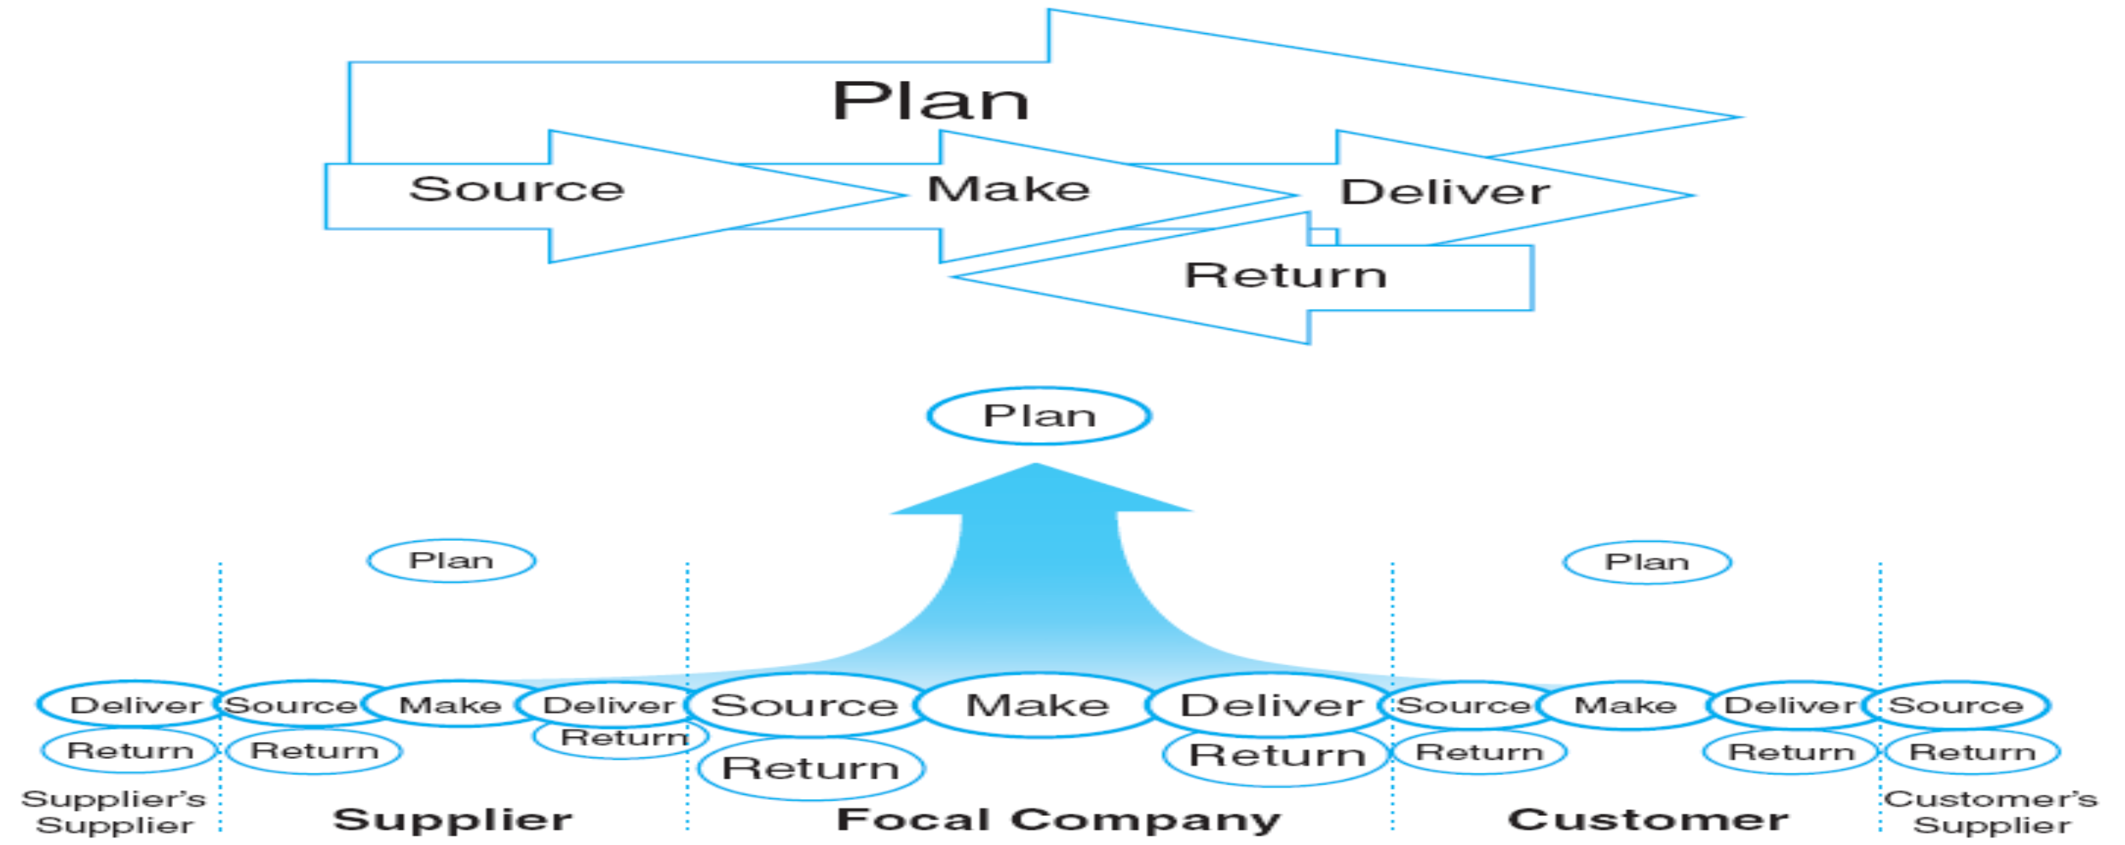
Project Supply Chain Metrics and the Supply
Chain Operations Reference (SCOR) Model
www.midocean.ae

Slide 38
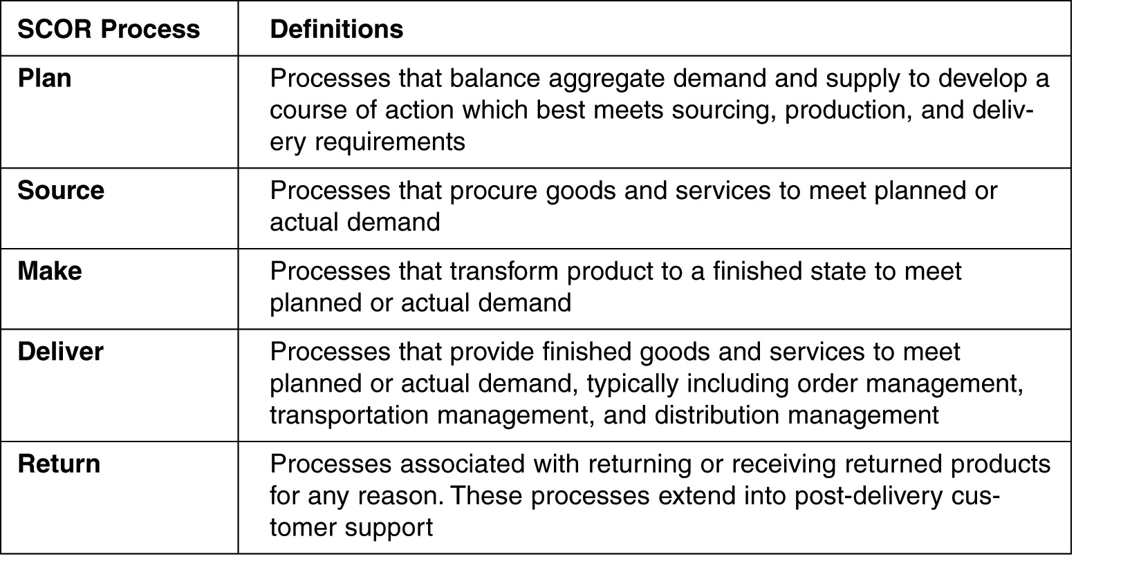
Project Supply Chain Metrics and the Supply
Chain Operations Reference (SCOR) Model
www.midocean.ae

Slide 39
Summary of Learning Objectives
Chapter
01
1-Discuss the meaning of supply chain project management.
2-Understand the role of project management in the supply
chain optimization.
3-Explaining how to streamline the supply chain
management with project management.
4-Discussing the challenges and solutions in integrating the
project and supply chain management.
5-Identify the supply chain project management methodology
www.midocean.ae

Slide 40
Essential Reference
Morris, P. W., & Pinto, J. K. (Eds.). (2007). The Wiley guide to project technology, supply chain, and procurement management (Vol. 4). John Wiley & Sons.
Schwalbe, K. (2015). Information technology project management. Cengage Learning.
Supply Chain Council
www.midocean.ae

Slide 41



Thank You

