Slide 1

Strategic And Operational Risk Management
PMG630
Prepared by
Dr. Ayman Hassan
  Lecture .3 “Tools and Techniques”

Slide 2


Chapter 3
Tools and Techniques
Prepared by
Dr. Ayman Hassan
www.midocean.ae

Slide 3



Important note, 1
r
REF, 1
REF,2
www.midocean.ae

Slide 4

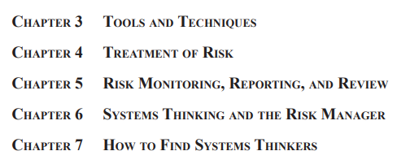
Important note, 1
r
Divided into two parts
2 Chapters
5 Chapters
REF, 1
Dr. Ayman Hassan
www.midocean.ae

Slide 5
Lecture No.3, The Content
Summary of the previous lecture .
Introduction
Summary descriptions of six common tools "Table 3.1a."
Preliminary Hazard analysis PHA
Where and when to use PHA?
PHA Format
Generalized steps for PHA
Hazard and operability analysis
HAZOP Format
Generalized steps for HAZOP
www.midocean.ae

Slide 6
Introduction
This chapter describes several common techniques and a principle used in managing operational risks.
The techniques are
1- Preliminary Hazard Analysis (PHA), 2- Hazard and Operability Analysis (HAZOP)
3- Job Safety Analysis (JSA) 4- Failure Mode and Effects Analysis (FMEA)
5- Fault Tree Analysis (FTA) 6- Cause and Consequences Analysis (CCA).
The principle is
" As Low As Reasonably Practicable (ALARP)" that gives guidance in applying the risk management process., Their basic descriptions are summarized in Tables 3.1a and 3.1b
www.midocean.ae

Slide 7
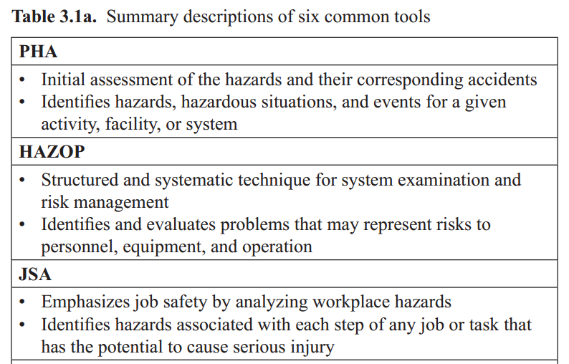
Summary descriptions of six common tools, 1
www.midocean.ae

Slide 8
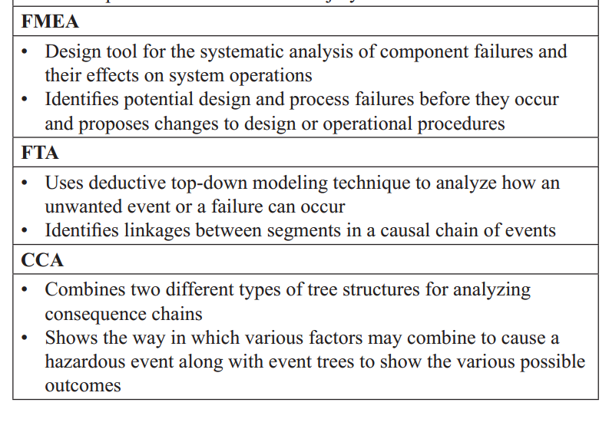
Summary descriptions of six common tools, 2
www.midocean.ae

Slide 9
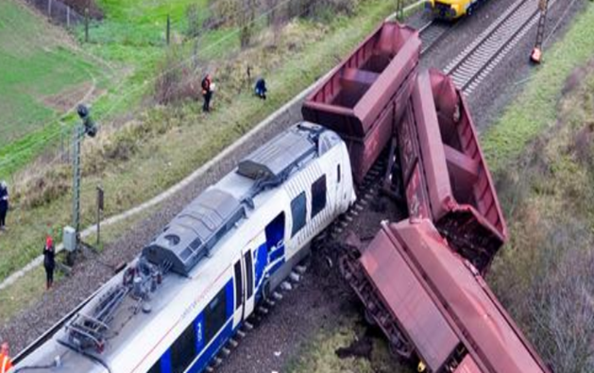
Preliminary Hazard analysis.1
The PHA is suitable as an initial risk study at an early stage of a project and its results are used to:
Compare main concepts,
Focus on the important risk issues,
Input for analysis of more detailed risks .
www.midocean.ae

Slide 10
Preliminary Hazard analysis.2
PHA used as an initial step in a detailed risk analysis of a system concept or an existing system.
The purpose of the PHA is then to identify those hazardous events that should be subject to further and more detailed risk analysis.
A PHA can be used to initiate the formation of a hazard log.
www.midocean.ae

Slide 11
SO, Where and when to use PHA?
A PHA is useful as a preliminary study to determine risk requirements in the early stages of the design process, especially safety-related requirements.
Hence, it is widely used to support the identification and development of system or product specifications.
It can also be used as an initial step of a detailed risk analysis of an existing project, product, or system, that is, a precursor to further detailed studies.
It can also serve as a complete risk analysis of a rather simple system or where conditions prevent a more extensive technique from being used
www.midocean.ae

Slide 12
Where and when to use PHA?... Cont,
A PHA can be used to initiate the formation of a hazard log.
A hazard log, also known as risk register or risk log, tracks information about a hazard from its initial identification to its proposed control measures through the implementation of interventions to address the hazard.
A hazard log facilitates the continuous monitoring of a hazard to make sure that it remains under control or is eliminated
www.midocean.ae

Slide 13
PHA Format.1
The tabular form or spreadsheet is the most widely used format for PHA.
An example of a PHA worksheet for a simple system, an elevator door, is shown in Figure 3.1. The columns of the PHA table generally follow the key questions of the risk management process:
What can go wrong?
What are the causes and consequences?
What are the likelihood or chances of occurrence?
what can be done to detect, control, and manage them?
www.midocean.ae

Slide 14
PHA Format.2
These questions provide a good guide to follow when completing a worksheet. The following are the descriptions of columns that correspond to the PHA worksheet shown in Figure 3.1.
• What can go wrong?
{ Column 1: Hazards that may lead to an accident
www.midocean.ae

Slide 15
PHA Format.3
• What are the causes and consequences? What are the likelihood or
chances of occurrence?
{ Column 2: Accidents that can occur from the hazards
{ Column 3: The potential causes that can bring about each accident
www.midocean.ae

Slide 16
PHA Format.4
{ Column 4: The likelihood that a particular cause triggers the
Accident.
{ Column 5: The severity of the consequences if the accident
occurs
www.midocean.ae

Slide 17
PHA Format.5
{ Column 6: The risk score based on the likelihood information
entered in Column 4 and the severity information entered in
Column 5
• What can be done to detect, control, and manage the hazards?
{ Column 7: Recommended preventive and control measures to
address the hazards, the causes, and their consequences
www.midocean.ae

Slide 18
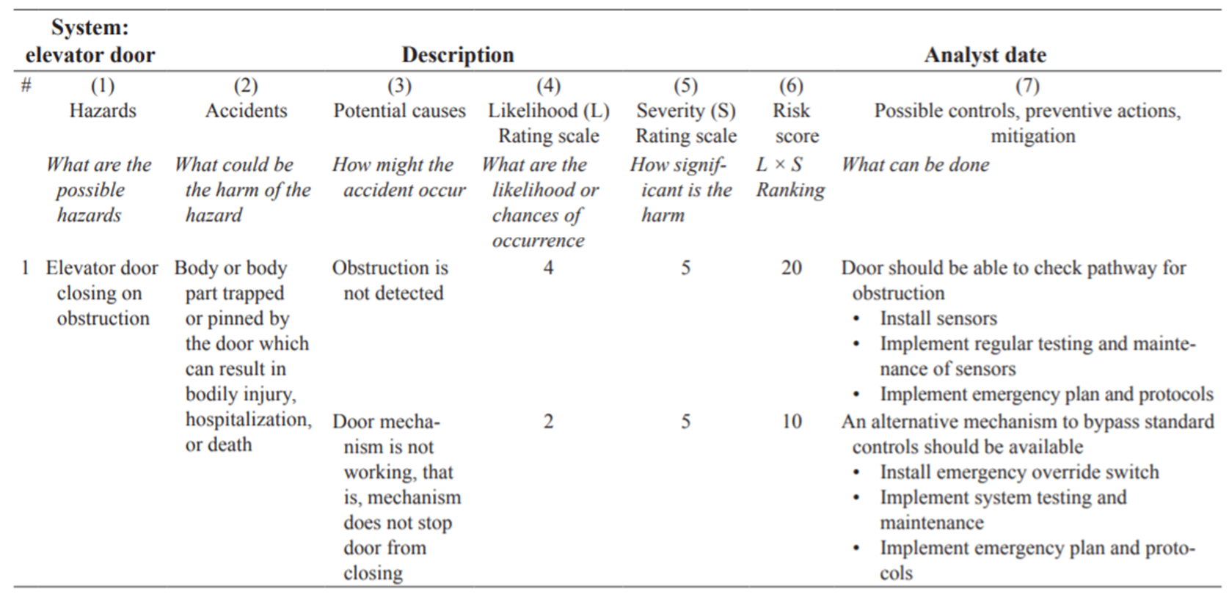
PHA Format.6
www.midocean.ae

Slide 19
Generalized steps for PHA
1. Define the system and scope of study.
2. Identify possible hazards.
3. Describe the accidents that can be caused by the hazards, as well as their consequences.
4. Identify potential causes of how might the accidents identified in step 3 can occur.
5. Evaluate each cause according to the likelihood that it can occur and the severity of consequences.
6. Rank hazards in terms of step 5.
7. Determine recommended preventive and control measures to address the hazards, the causes, and their consequences
www.midocean.ae

Slide 20
Generalized steps for PHA
Step 1
Defines the system and clearly distinguishes the scope of the PHA. As an example, consider an elevator door as a system of interest. For the succeeding steps, refer to the PHA worksheet in Figure 3.1.
Step 2
Identifies possible hazards. Recall from Chapter 1, a hazard is defined to refer to objects, actions, processes, or conditions that may contribute toward the occurrence of an accident. For an elevator door, a possible hazard is the door closing on an obstruction. This information is entered in Column 1 of the PHA worksheet.
www.midocean.ae

Slide 21
Generalized steps for PHA
Step 3
describes the potential accident caused by the hazard. What could be the harm of the door closing on an obstruction? If the obstruction was a body or body part, then getting pinned or trapped is a potential accident that may result in bodily injury, dismemberment, or even death. This information is entered in Column 2 of the PHA worksheet.
www.midocean.ae

Slide 22
Generalized steps for PHA
Step 4
Examines the possible causes of how the accident can occur. For the elevator door closing on an obstruction, two potential causes can be identified: (1) the obstruction is not detected and (2) the door mechanism is not working. This information is entered in Column 3 of the PHA worksheet.
www.midocean.ae

Slide 23
Generalized steps for PHA
Step 5
evaluates the likelihood and severity for each potential cause. A rating scale such as Tables 2.2 and 2.3 in Chapter 2 is typically adopted. For the elevator door PHA, suppose the number of accidents occurring from the obstruction not being detected is on average one per year, then the likelihood is rated at 4 (see Table 2.3). The absence of sensors on the elevator door accounts for this high likelihood of accidents. For the door mechanism not working, the number of accidents occurs only once per 100 years due to the high quality of the door mechanisms.
www.midocean.ae

Slide 24
Generalized steps for PHA
Step 6
facilitates the ranking of the hazards and potential causes by determining an overall risk score for each entry. For the elevator door PHA, this is done by multiplying likelihood and severity (L ×S). This information is entered in Column 6 of the PHA worksheet. The risk of an accident from the obstruction not being detected is more significant than the risk from the door mechanism not working, with a risk score of 20 and 10, respectively. Thus, addressing the detection of an obstruction should be prioritized.
www.midocean.ae

Slide 25
Generalized steps for PHA
Step 7
Develops recommended measures to prevent, control, or mitigate the hazards and its consequences as it relates to each potential cause. For the elevator door example, proposed measures such as the installment of sensors to detect obstructions is entered in Column 7 of the PHA worksheet.
www.midocean.ae

Slide 26
Hazard and Operability analysis
HAZOP
a Hazard and Operability Study,
is a systematic way to identify possible hazards in a work process.
In this approach, the process is broken down into steps, and every variation in work parameters is considered for each step.
www.midocean.ae

Slide 27
Hazard and Operability analysis
HAZOP is a top-down qualitative approach,
as opposed to semi quantitative approach such as PHA.
HAZOP is used to determine potential hazards in a process, operation, or system. In particular, it systematically identifies possible deviations from the design and operating intent and determines how these deviations may eventually become hazards.
www.midocean.ae

Slide 28
WHERE AND WHEN TO USE HAZOP ?
HAZOP was originally intended for analyzing accidents
that affect human health and safety.
It has since been adopted as a general-purpose risk management tool.
It is applicable to various types of systems, especially those with highly monitored performance and detailed design requirements found in the chemical, petroleum, food industries, and the like.
www.midocean.ae

Slide 29
Where and When to use HAZOP ?
Similar to PHA
- It is applicable during the design phase of a project, product, or system development to determine specifications.
- It is also often applied to existing systems to improve safety and minimize operational risk.
- It is, in fact, useful for periodic review throughout the life of a system to accommodate changes within the system and its environment.
- It can also be used as supporting documentation for hazard logs.
www.midocean.ae

Slide 30
Generalized Steps for HAZOP
1. Define the system and scope of study.
2. Divide the system into nodes and define each node’s design intent.
3. For each node, identify node elements such as material, input, process steps, or operations.
4. Define the element’s relation to the design intent, performance measure, and acceptable range of performance (parameters).
www.midocean.ae

Slide 31
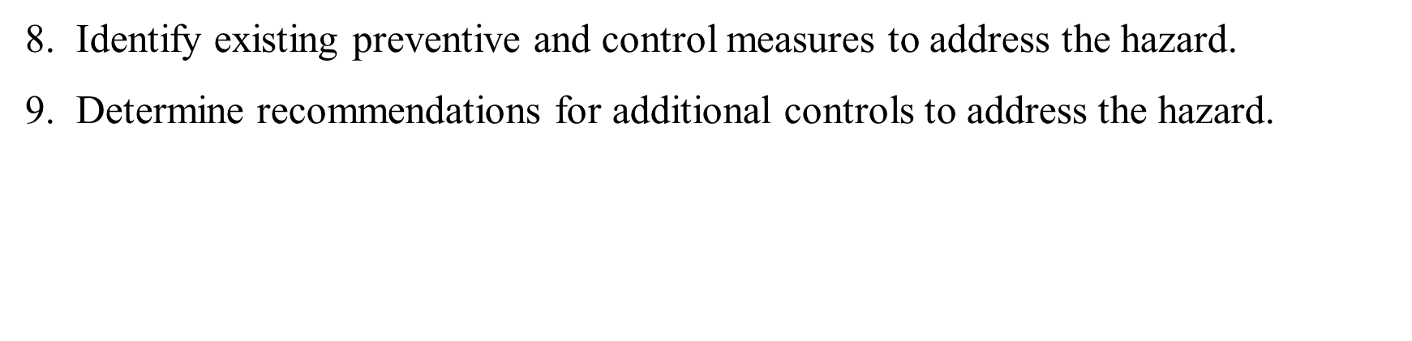
Generalized Steps for HAZOP
5. Define the deviation by selecting a process guideword and pair with parameter.
6. Establish the causality of the deviation with potential hazards.
7. Describe the consequences of each hazard.
www.midocean.ae

Slide 32
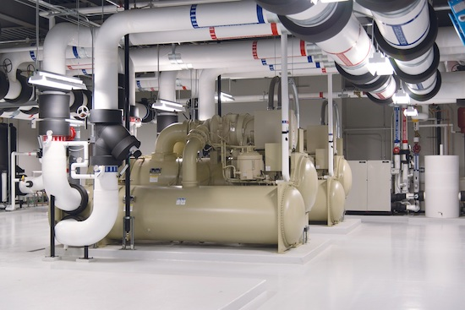
Generalized Steps for HAZOP
Step 1
Defines the scope of the analysis and system of study.
As an example for HAZOP, consider a cooling water facility for a production plant as a system of interest.
a system of interest
www.midocean.ae

Slide 33
Generalized Steps for HAZOP
Step 2
Divides the system into nodes.
Part of the cooling water facility is the water cooling circuit pipework as shown in Figure 3.2.
This represents a node in an overall HAZOP study of a cooling water facility.
To begin the analysis of each node, the design intent of the node and its corresponding parameters are defined.
For the water cooling pipework, its purpose is to continuously circulate cooling water.
www.midocean.ae

Slide 34
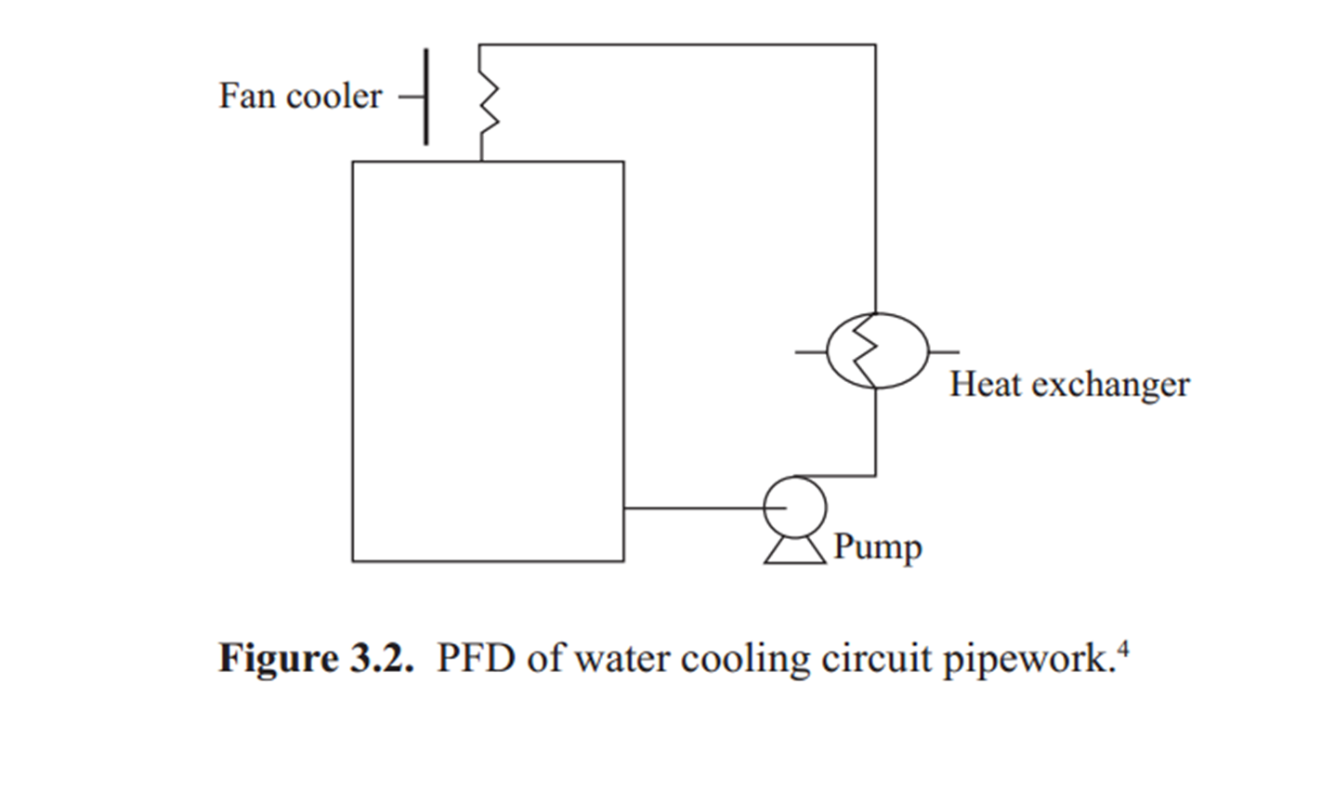
Generalized Steps for HAZOP
a system of interest
www.midocean.ae

Slide 35
Generalized Steps for HAZOP
Step 3
Identifies the node elements.
Elements are described in terms of its materials, inputs, components, and process steps and entered in Column 1 of the HAZOP worksheet.
For the water cooling pipework, the key processes are circulation and cooling.
www.midocean.ae

Slide 36
Generalized Steps for HAZOP
Step 4
Defines process parameters for each element as it relates to the design intent.
As defined in Step 2, the purpose of water cooling pipework is to continuously circulate cooling water and a key process identified in Step 3 is circulation.
How does circulation then achieve the system’s design intent?
To continuously circulate water, the system is designed to flow at a rate of 75.5 m/min.
www.midocean.ae

Slide 37
Generalized Steps for HAZOP
Step 5
Defines the deviation.
It follows then that for the water cooling pipework, a deviation or departure from the design intent would be a lack of adequate circulation.
In HAZOP, the term less flow rate or no flow describes this deviation.
This information is entered in Column 2 of the HAZOP worksheet.
www.midocean.ae

Slide 38
Generalized Steps for HAZOP
Step 6
Identifies the causes (i.e., the hazards) that can cause the deviation to occur.
For the deviation no flow, failure of the pump may be one of the potential causes. This information is entered in Column 3 of the HAZOP worksheet.
Note that the failure of the pump is described as a cause, not a deviation.
Also note that in HAZOP, the identified causes are analogous to what PHA identifies as hazards.
www.midocean.ae

Slide 39
Generalized Steps for HAZOP
Step 7
Defines the consequences for each hazard.
Pump failure means water is not flowing or circulating and, therefore, not cooled to the requirements of the production facility.
A consequence could be possible over-heating of equipment and interruption or delay in the production process if the work has to stop because of down equipment.
This information is entered in Column 4 of the HAZOP worksheet.
www.midocean.ae

Slide 40
Generalized Steps for HAZOP
Step 8
Describes existing measures on how the deviations and the hazards are addressed.
For the water cooling pipework, suppose a backup pump is in place, then its information is entered in Column 5 of the HAZOP worksheet.
www.midocean.ae

Slide 41
Generalized Steps for HAZOP
Step 9
Determines recommendations. An assessment has to be made as to whether existing measures are sufficient and effective.
Part of the analysis is to identify additional safeguards or controls when and if needed.
This information is entered in Column 6 of the HAZOP worksheet.
www.midocean.ae

Slide 42
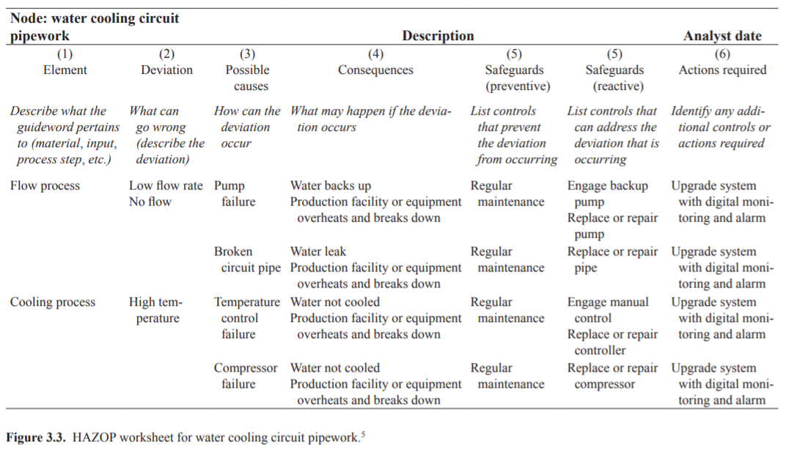
HAZOP Worksheet
www.midocean.ae

Slide 43
9. Conclusion
The generalized framework for operational risk management can be summarized in six steps, with one precursory step (hence, the label 1 + 6 guiding questions in Table 2.1). These questions extend the more commonly known risk analysis, assessment, and management.
The questions are as follows:
What should go right?
What can go wrong?
What are the causes and consequences?
What is the likelihood of occurrence?
What can be done to detect, control, and manage them?
What are the alternatives?
what are the effects beyond this particular time?
The notion of the causal chain of events was introduced to show interactions between elements of a system and how this can be used to assess the chances of occurrence and the consequences if the risk events occur.
The causal chain of events can also be used to generate ways of how initiating events can be detected before a risk event occurs, as well as what can be done to control their occurrence and consequences.
www.midocean.ae

Slide 44

10. References & Resources
Causal Chain - Tool/Concept/Definition (thwink.org)
www.midocean.ae

Slide 45

01
My Best Wishes …
* Dr. Ayman Hassan *
www.midocean.ae

