Slide 1


Slide 2


Slide 3

Exploration and Exploitation

Slide 4
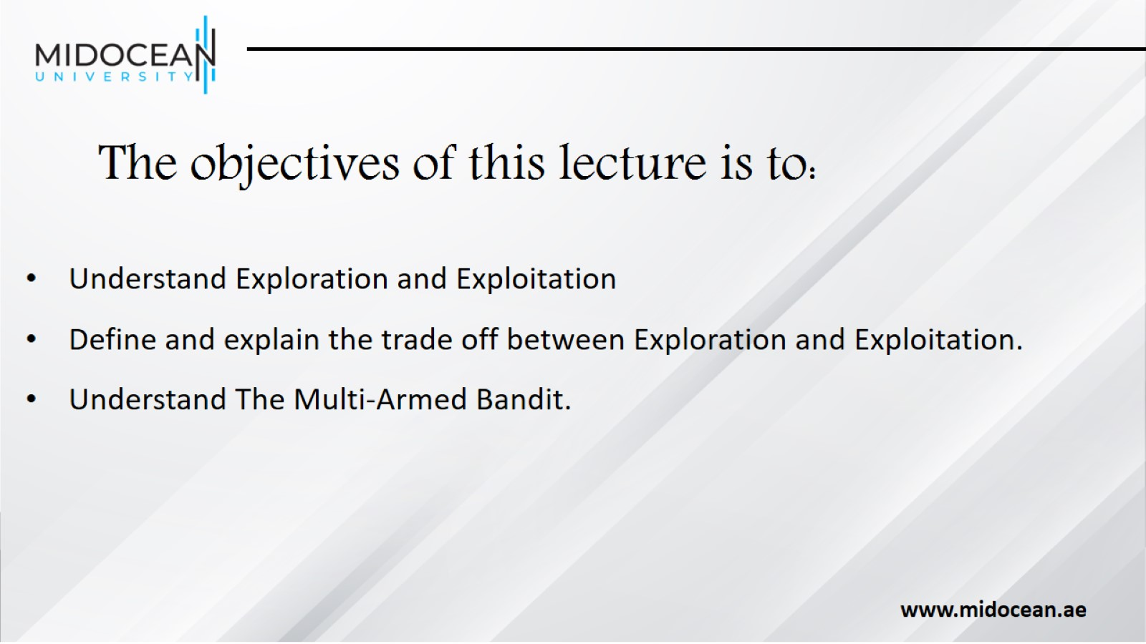
The objectives of this lecture is to:

Slide 5
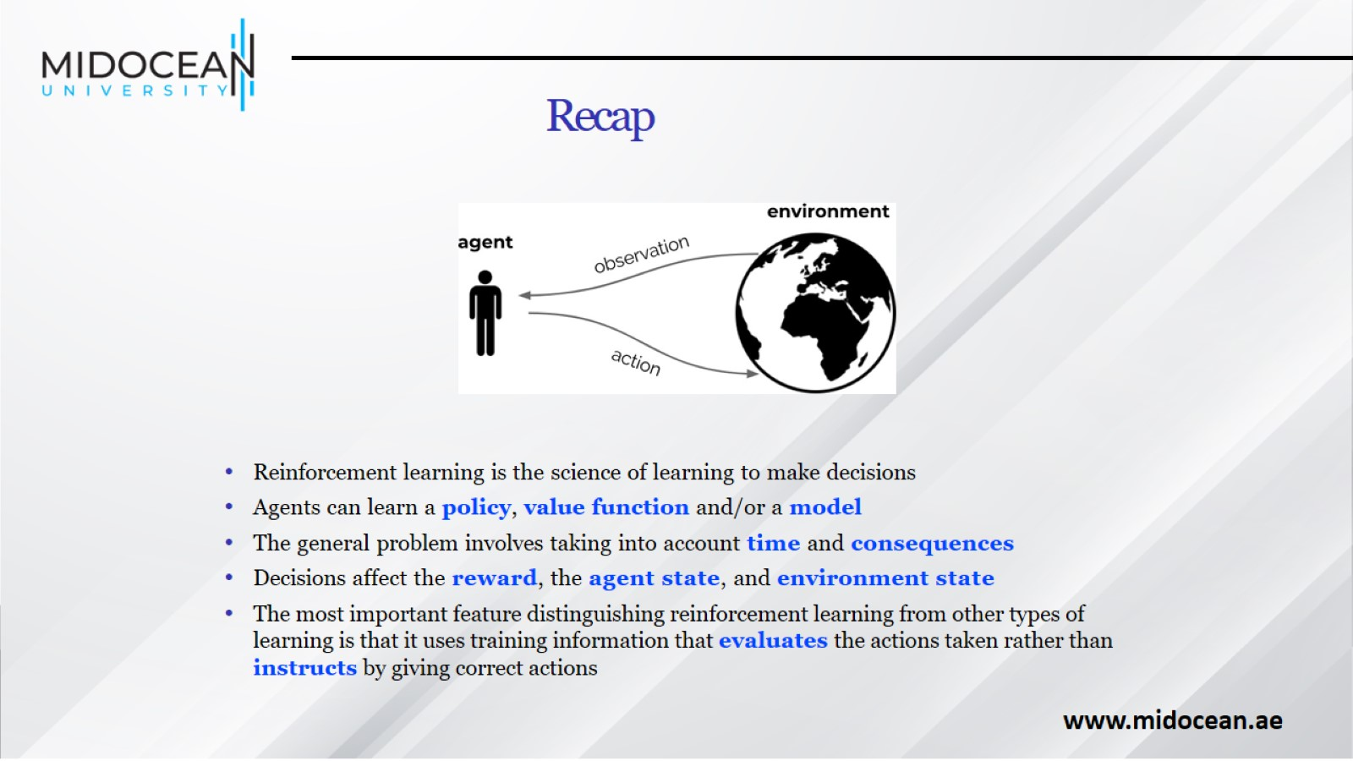
Recap

Slide 6
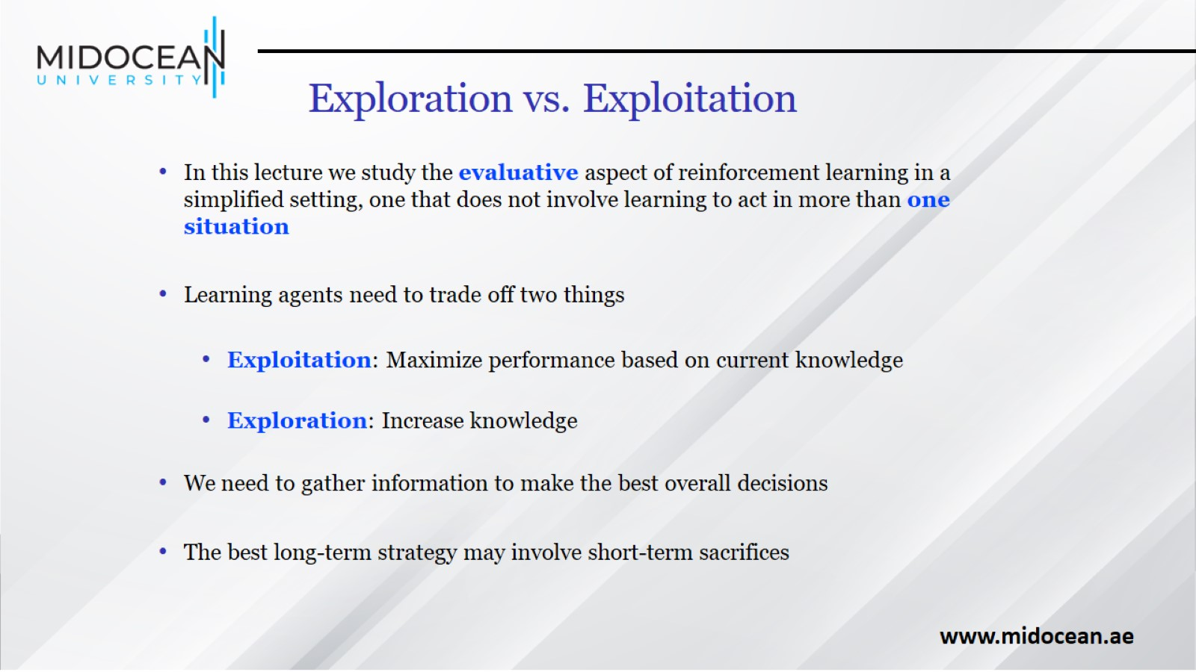
Exploration vs. Exploitation

Slide 7
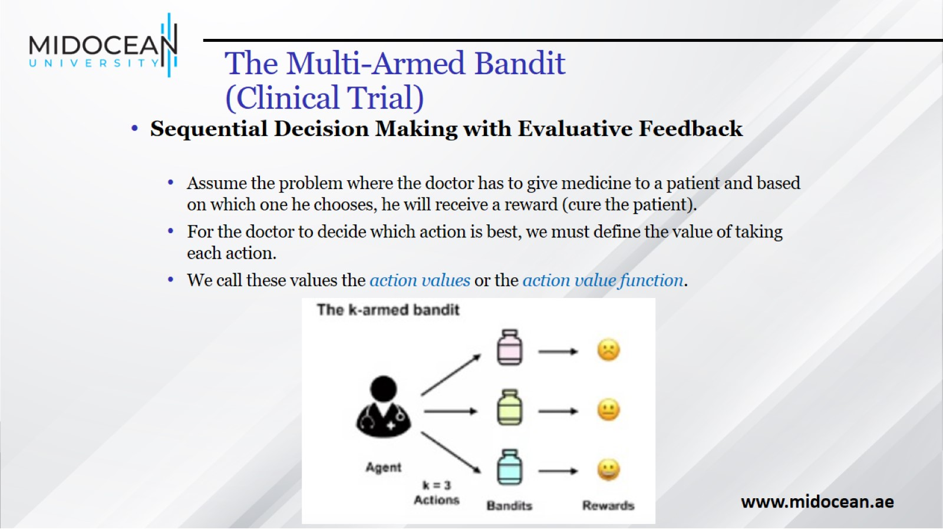
The Multi-Armed Bandit
(Clinical Trial)

Slide 8
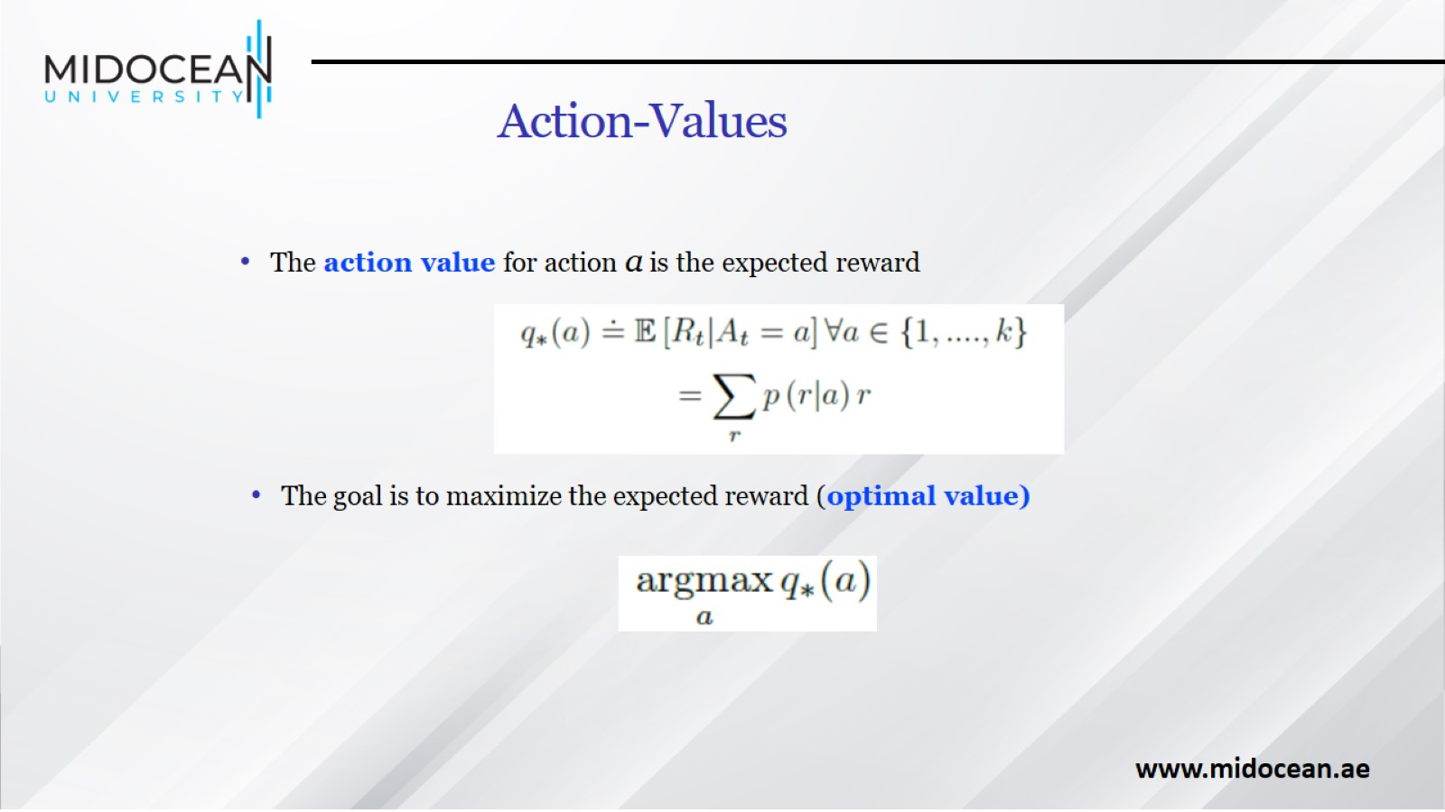
Action-Values

Slide 9
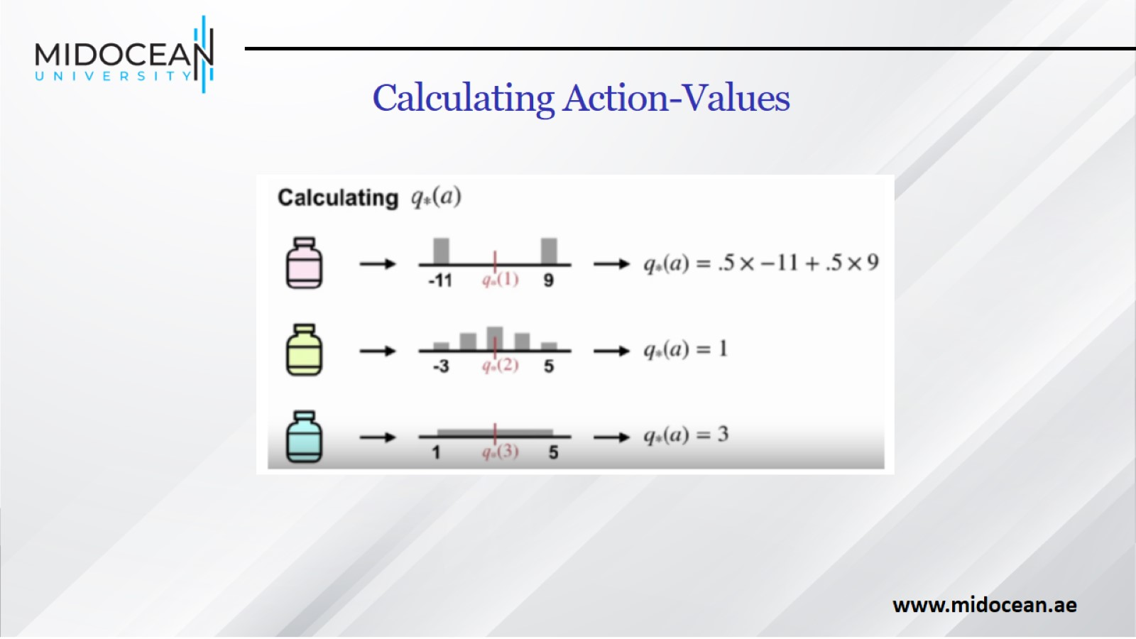
Calculating Action-Values

Slide 10
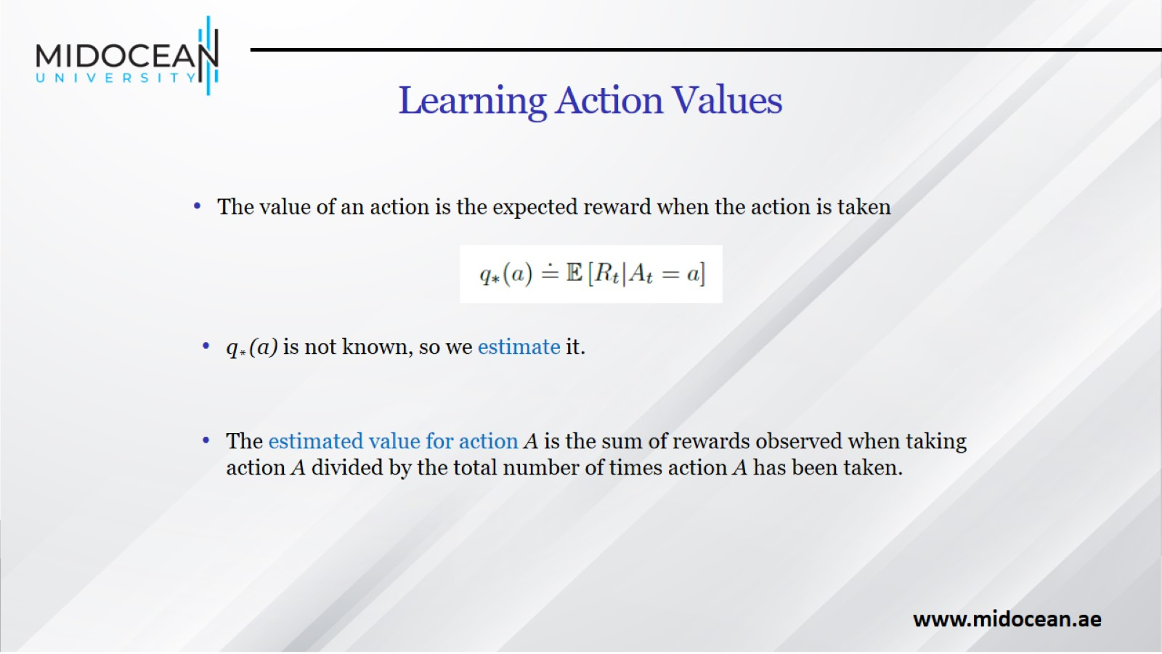
Learning Action Values

Slide 11
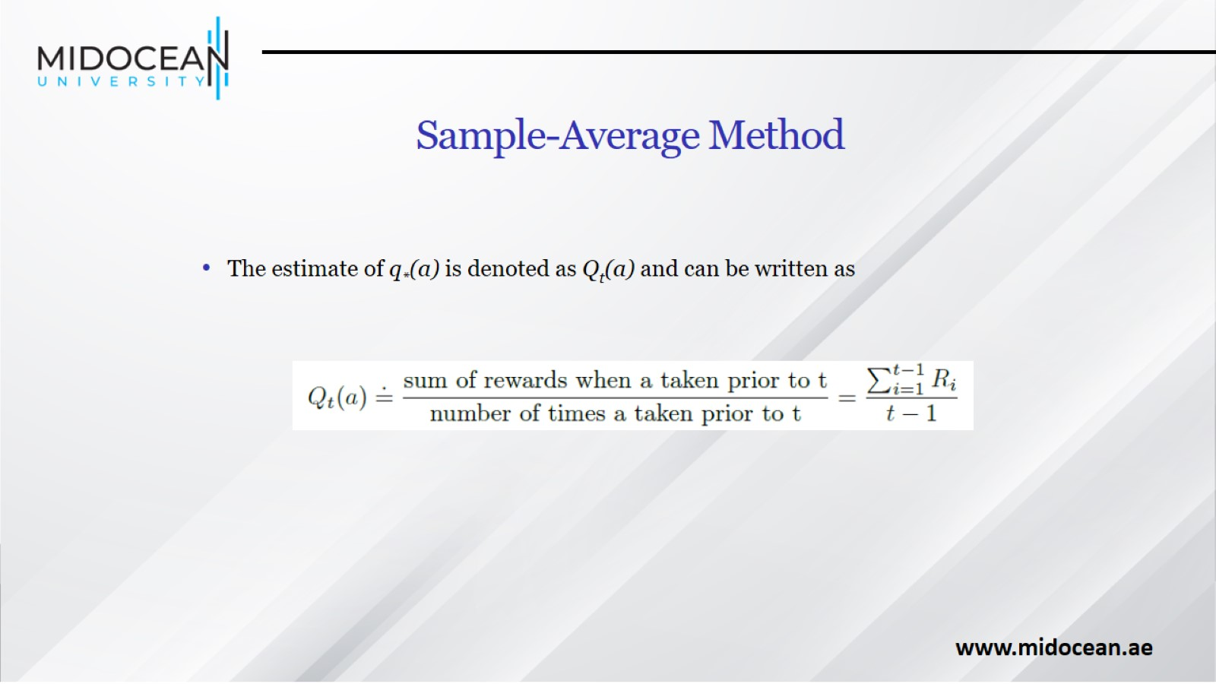
Sample-Average Method

Slide 12
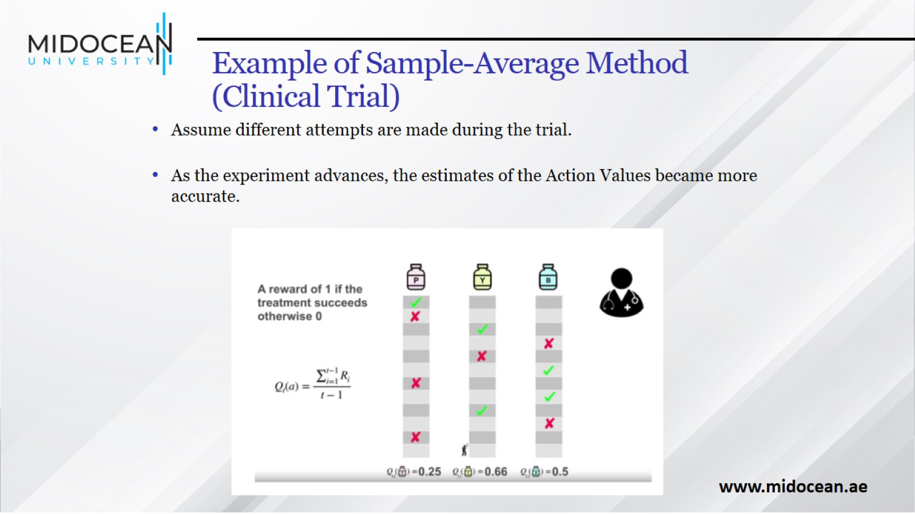
Example of Sample-Average Method
(Clinical Trial)

Slide 13
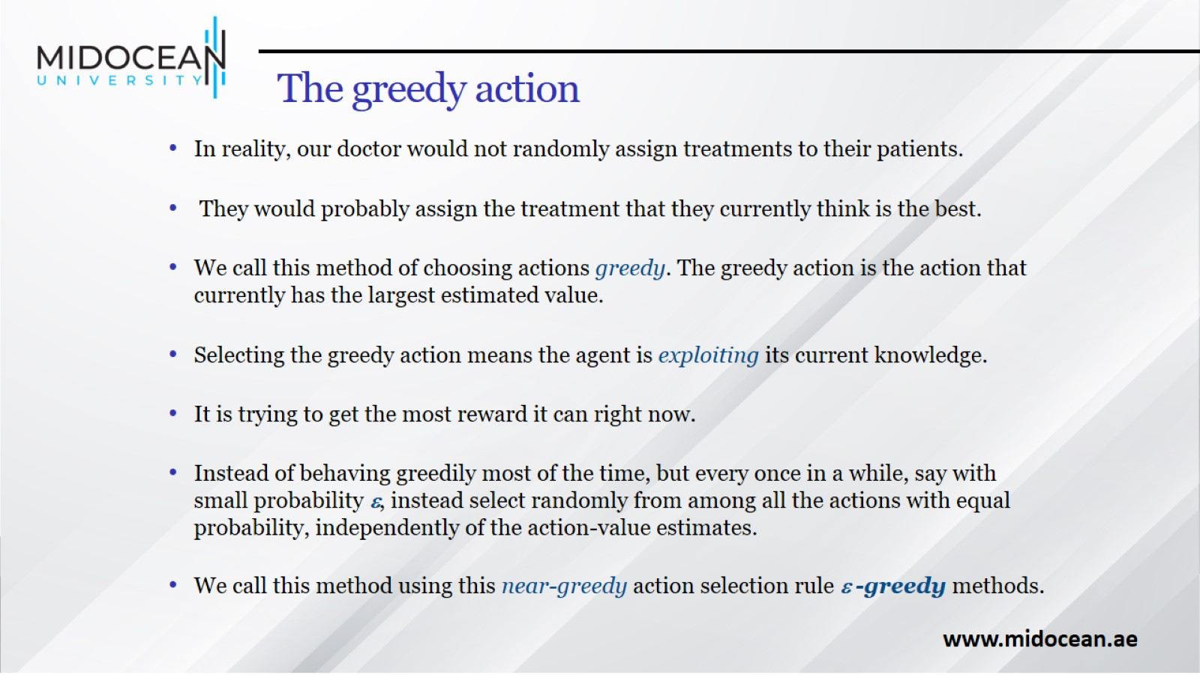
The greedy action

Slide 14
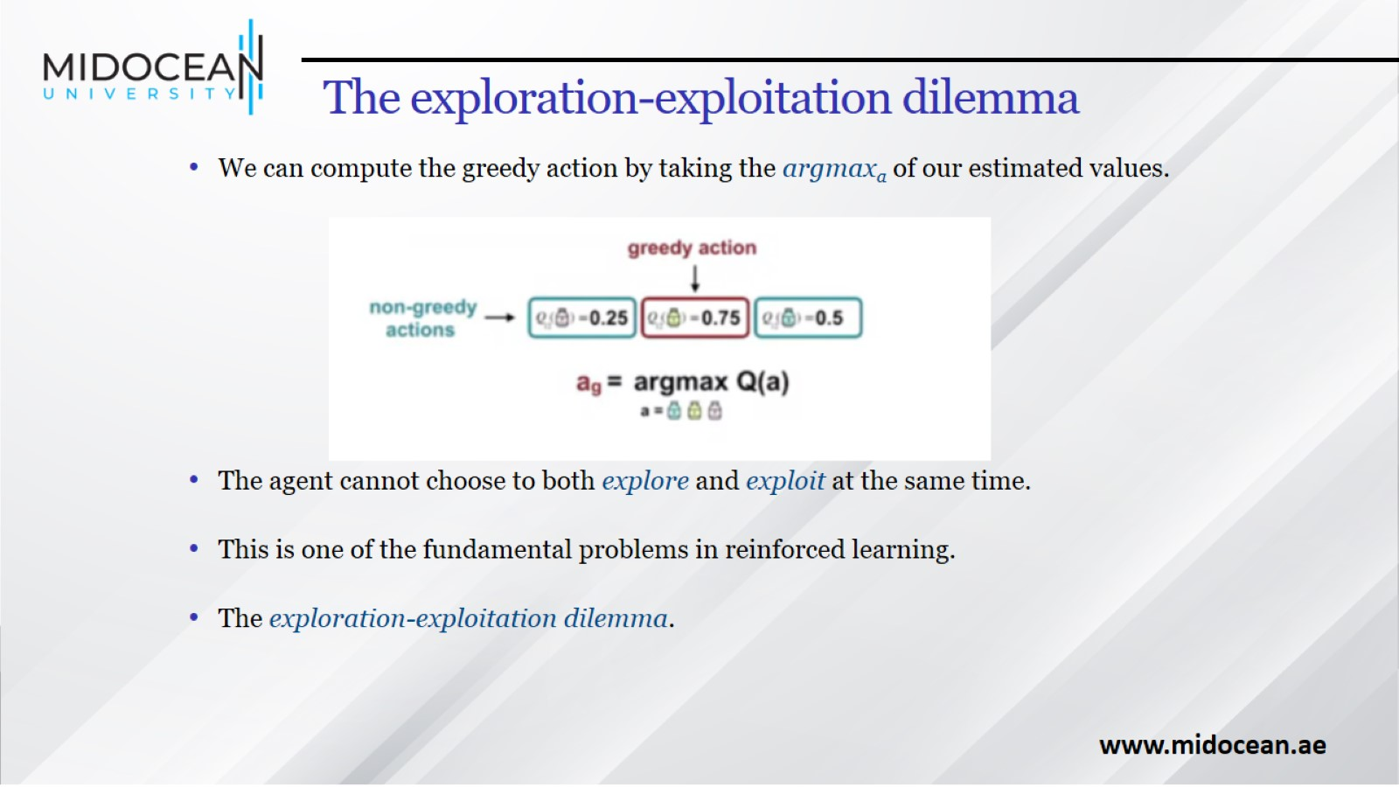
The exploration-exploitation dilemma

Slide 15
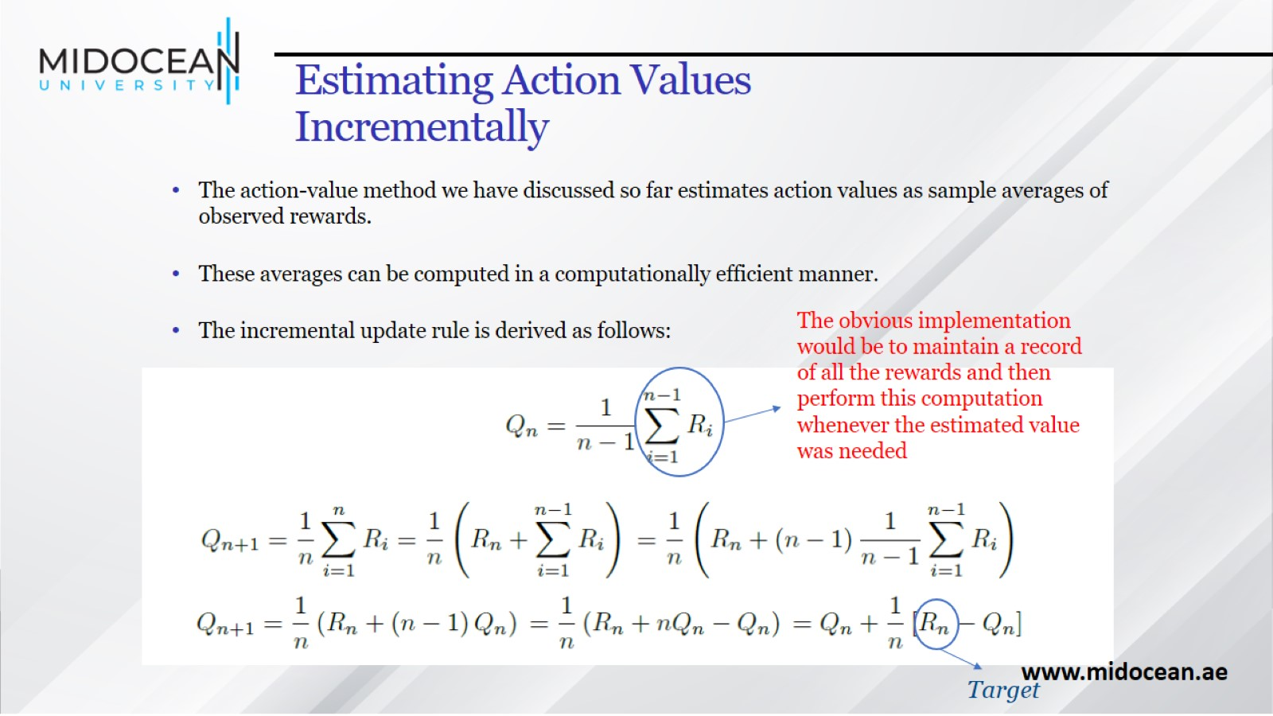
Estimating Action Values Incrementally

Slide 16
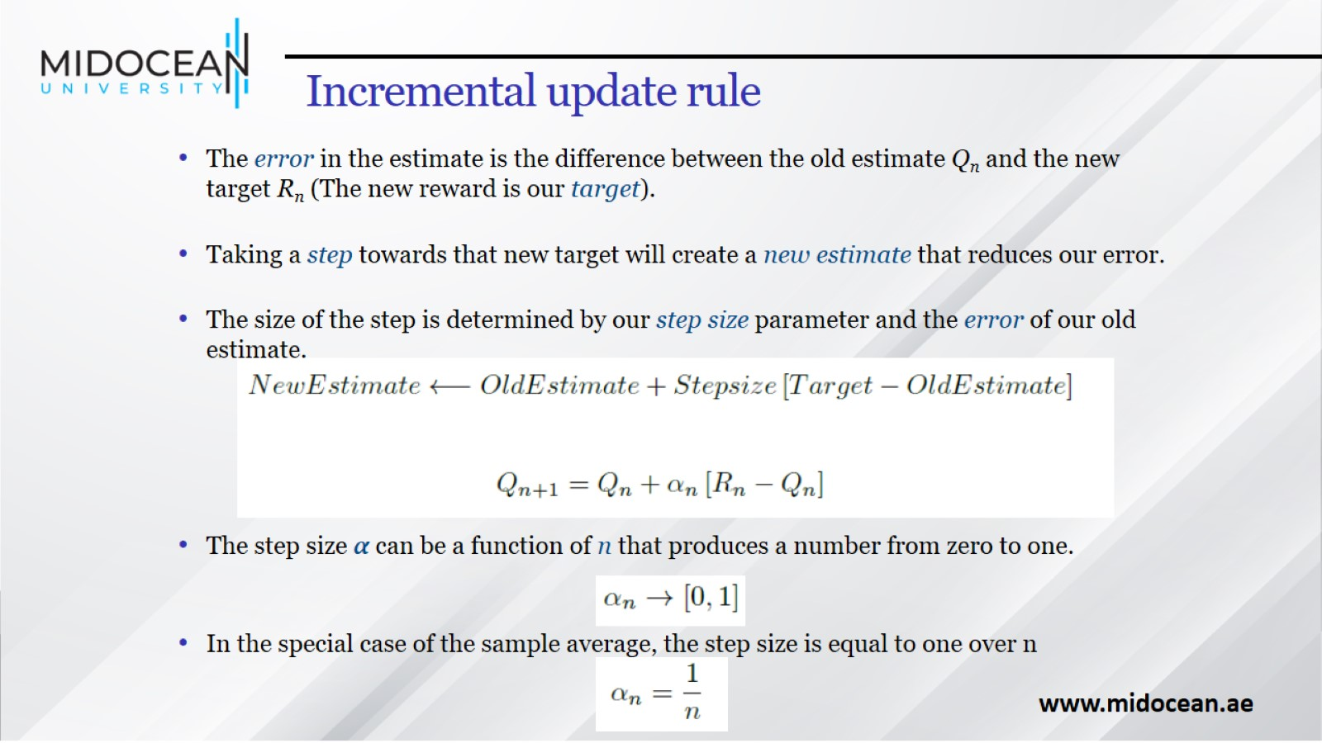
Incremental update rule

Slide 17
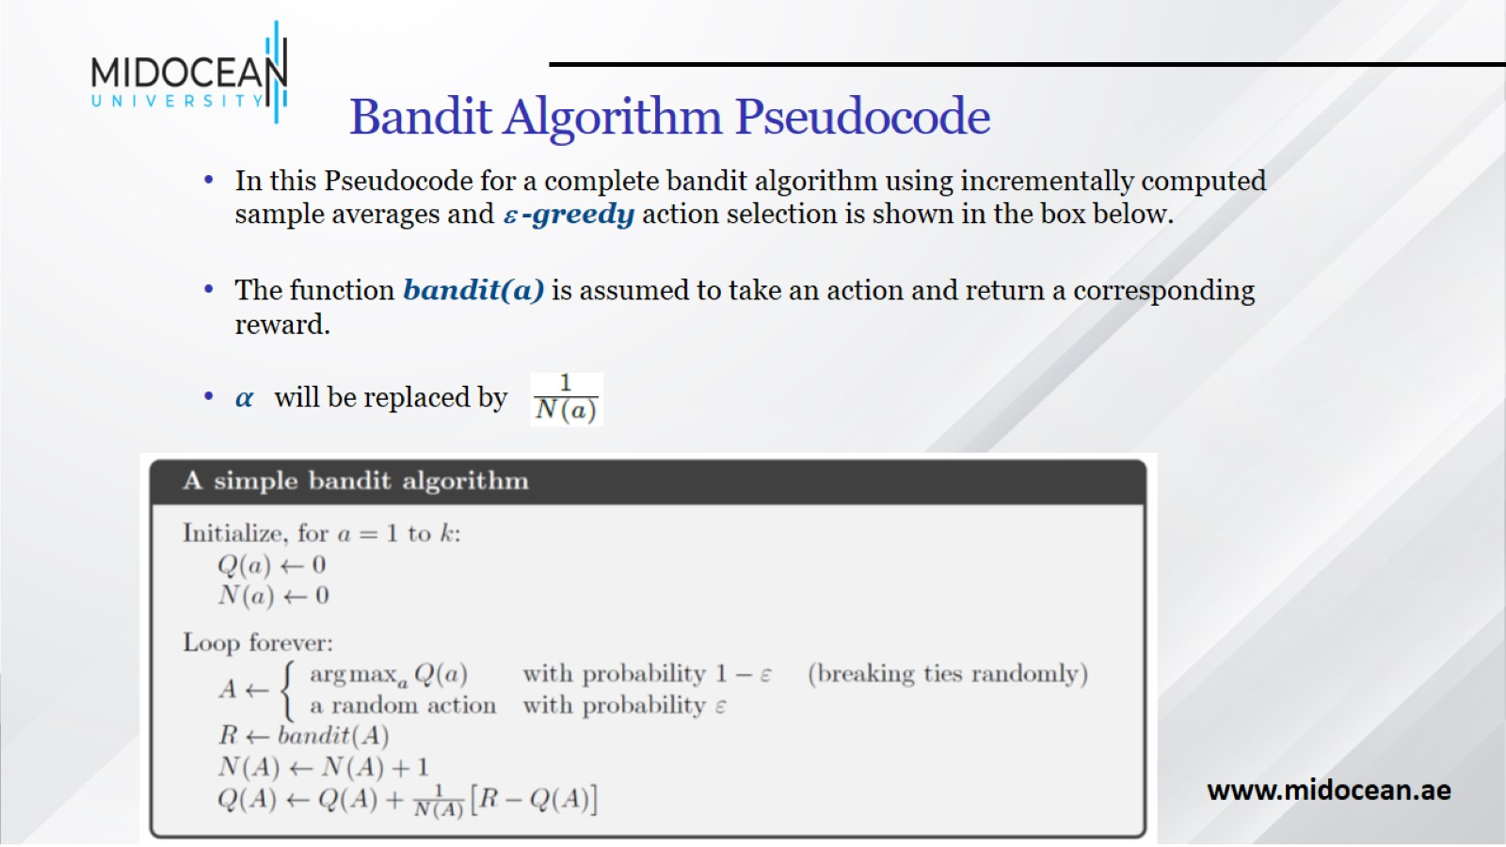
Bandit Algorithm Pseudocode

Slide 18
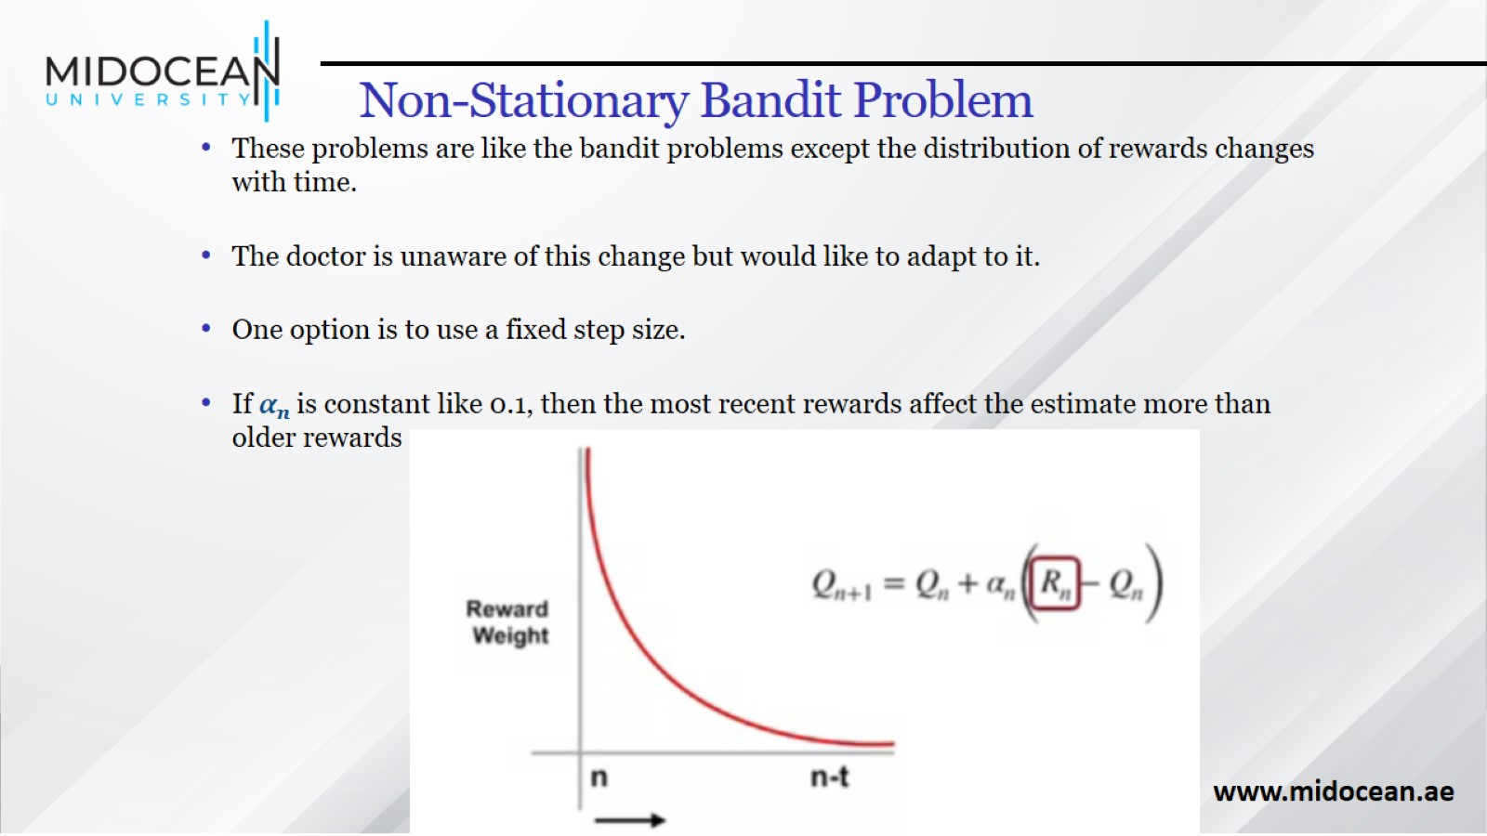
Non-Stationary Bandit Problem

Slide 19
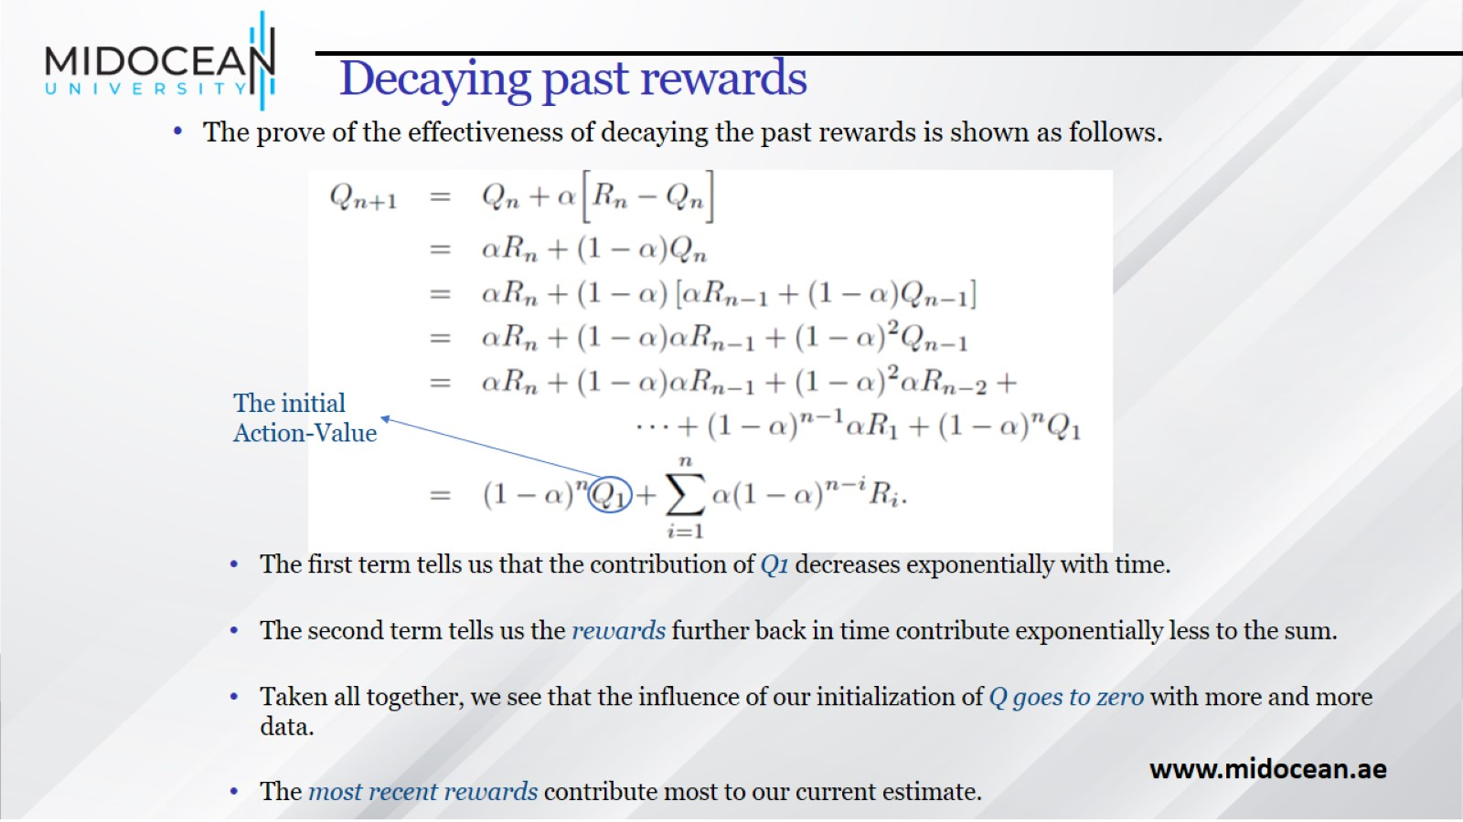
Decaying past rewards

Slide 20
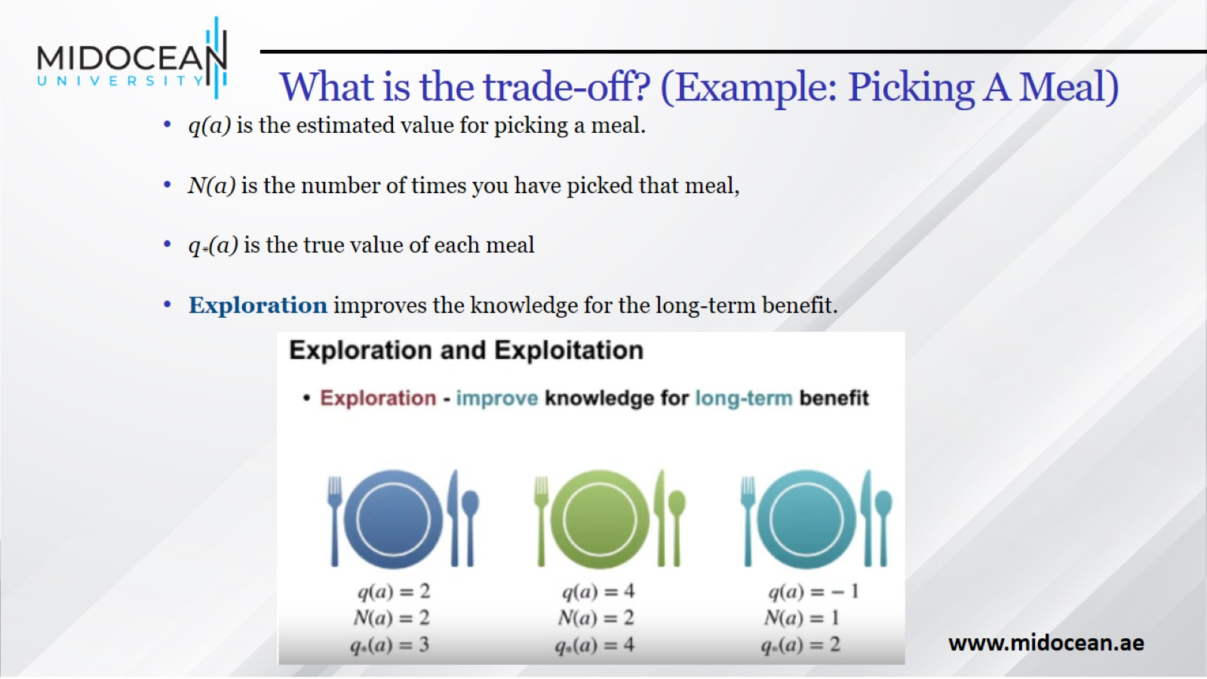
What is the trade-off? (Example: Picking A Meal)

Slide 21
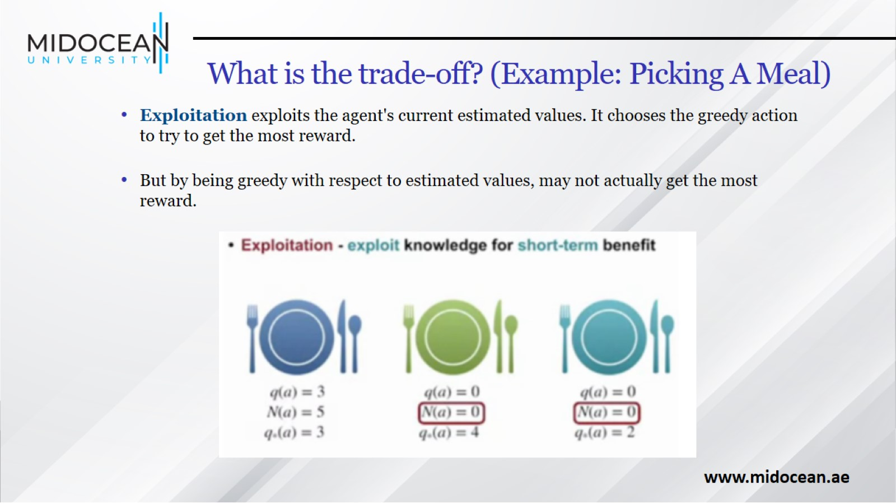
What is the trade-off? (Example: Picking A Meal)

Slide 22
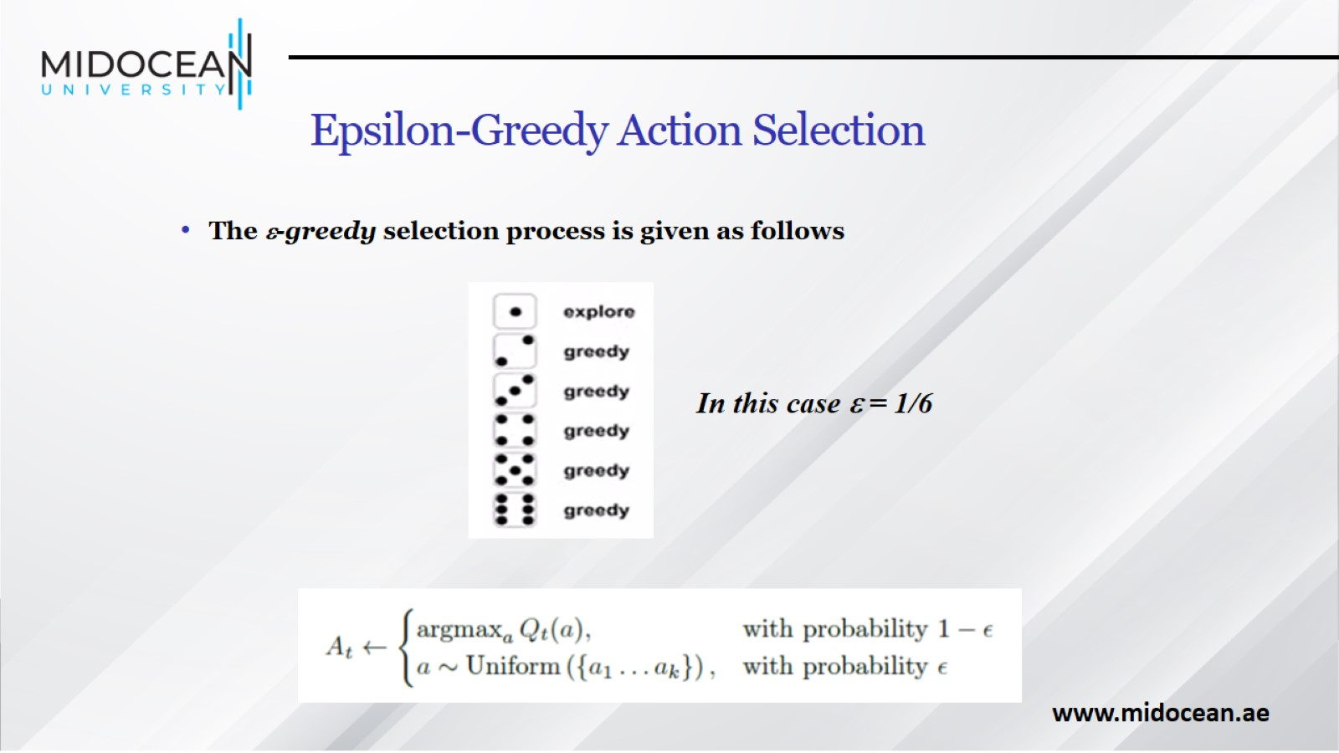
Epsilon-Greedy Action Selection

Slide 23
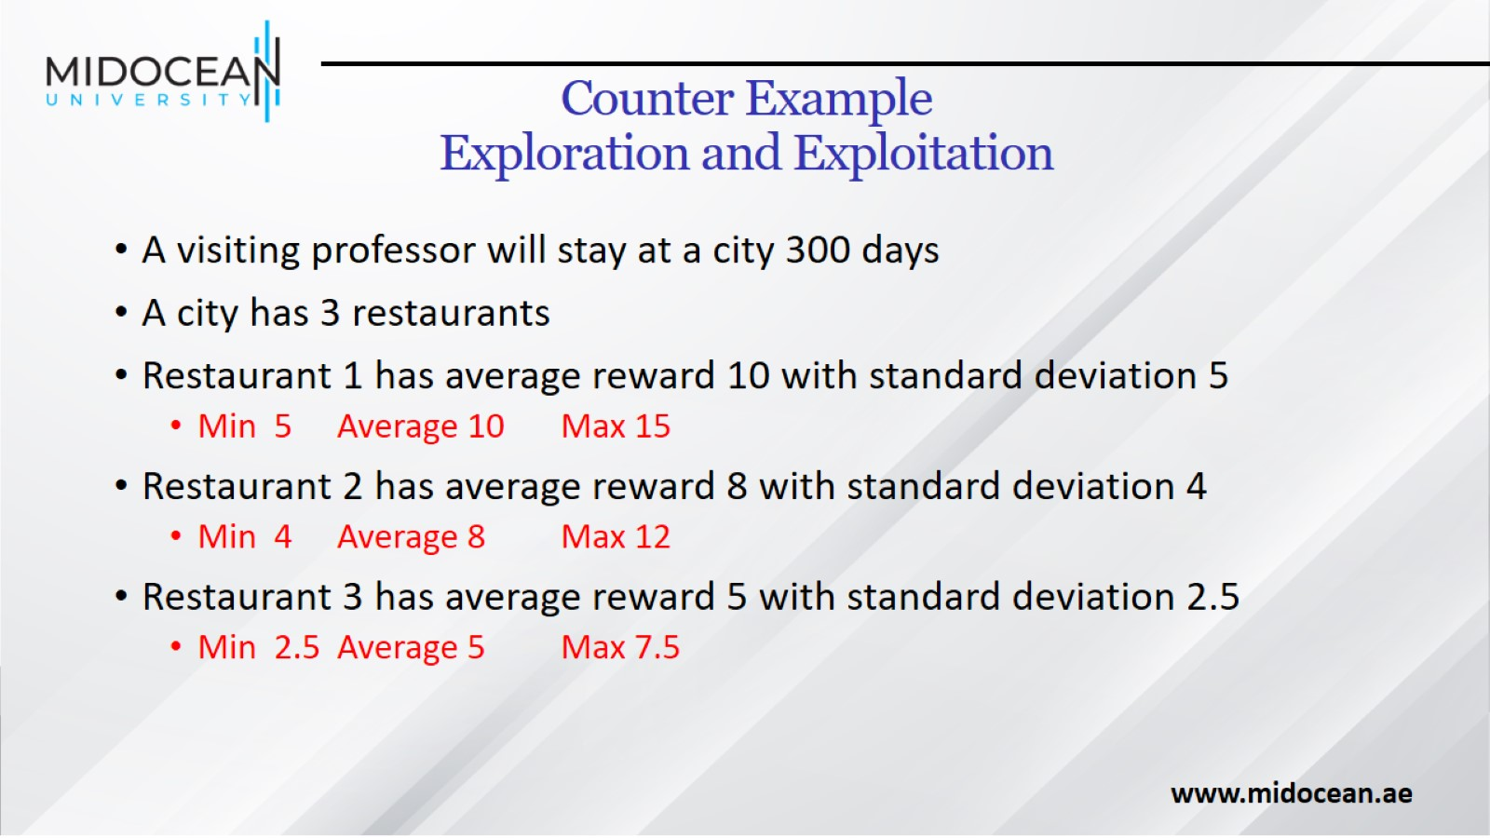
Counter Example
Exploration and Exploitation

Slide 24
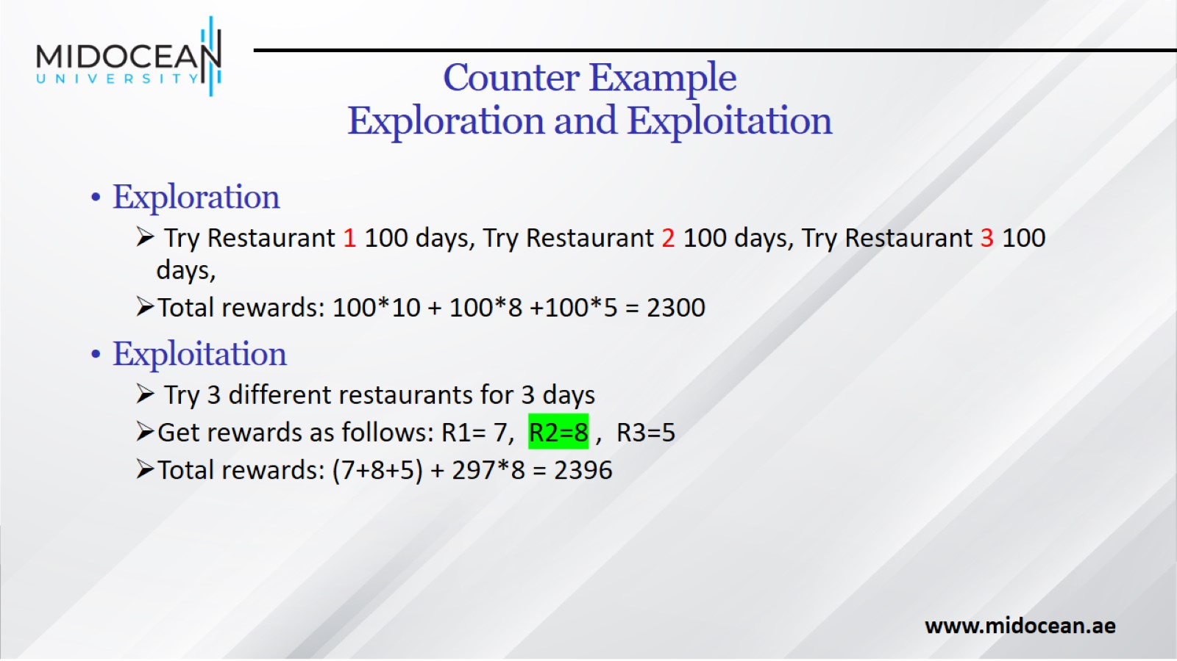
Counter Example
Exploration and Exploitation

Slide 25
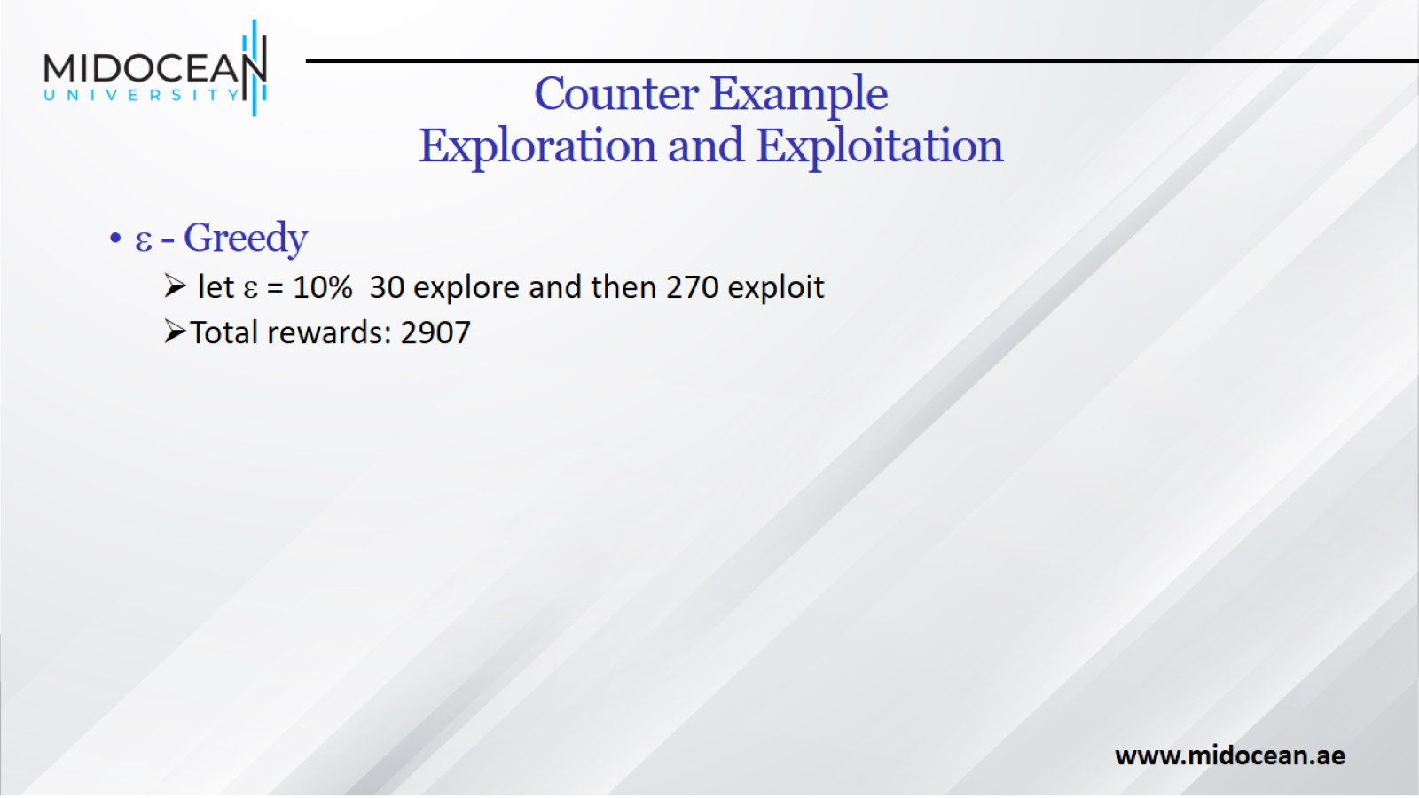
Counter Example
Exploration and Exploitation

Slide 26
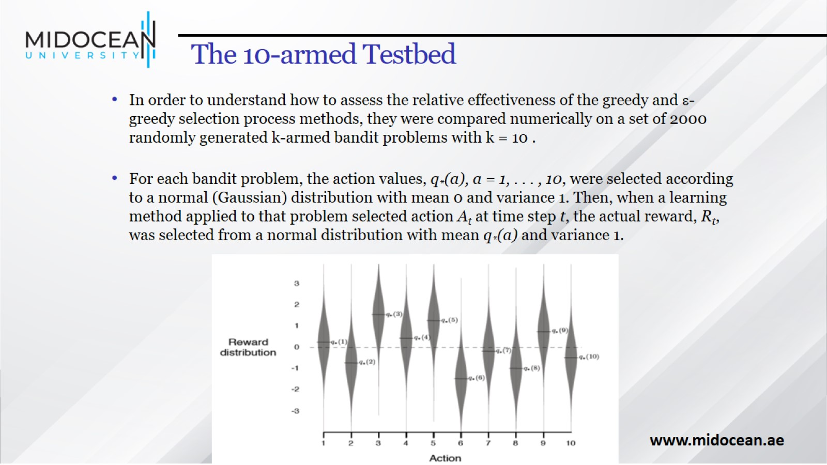
The 10-armed Testbed

Slide 27
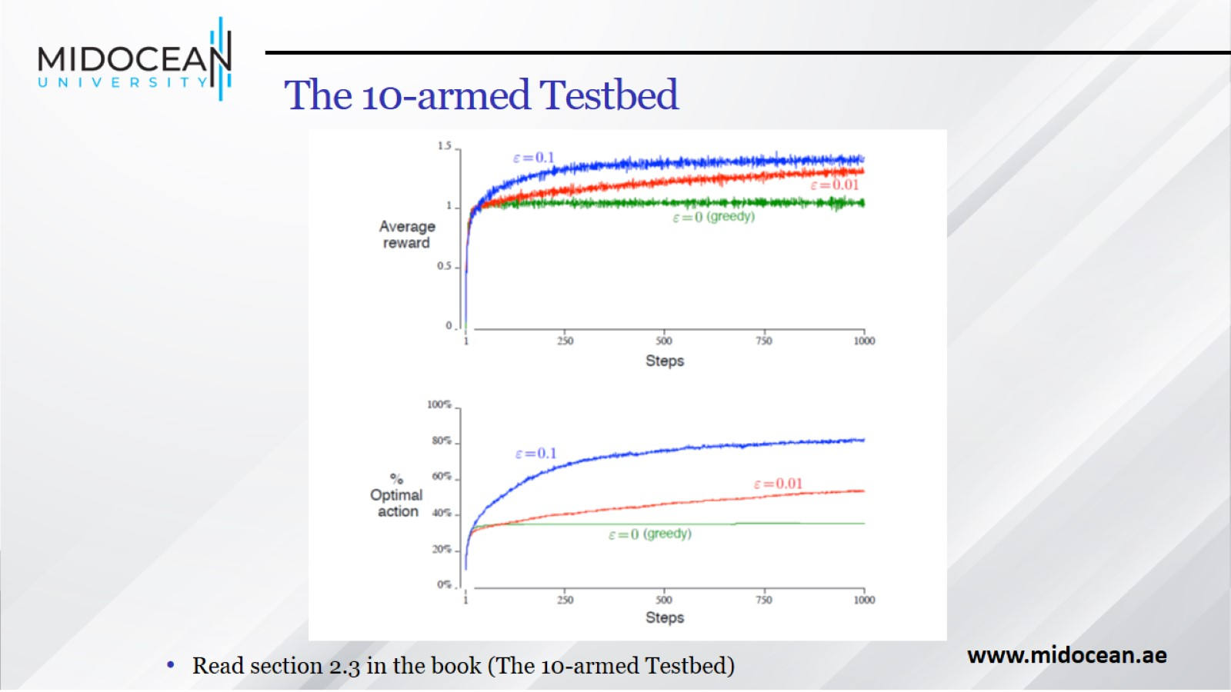
The 10-armed Testbed

Slide 28
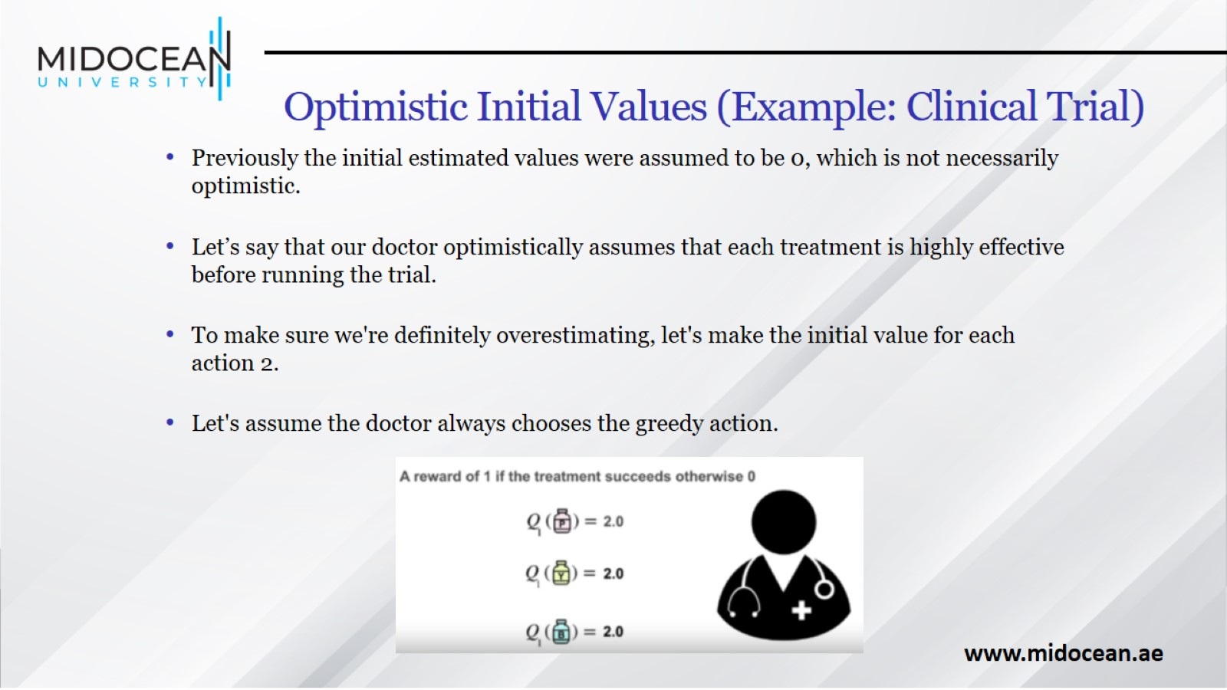
Optimistic Initial Values (Example: Clinical Trial)

Slide 29
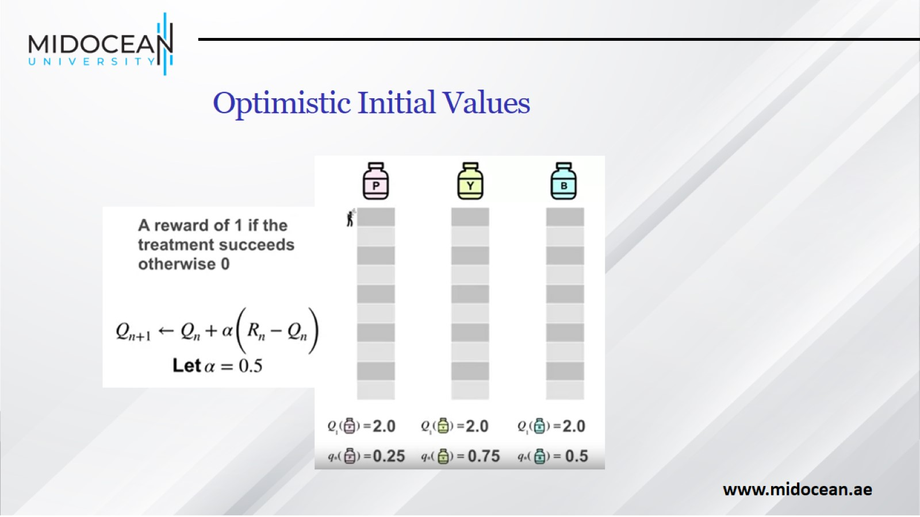
Optimistic Initial Values

Slide 30
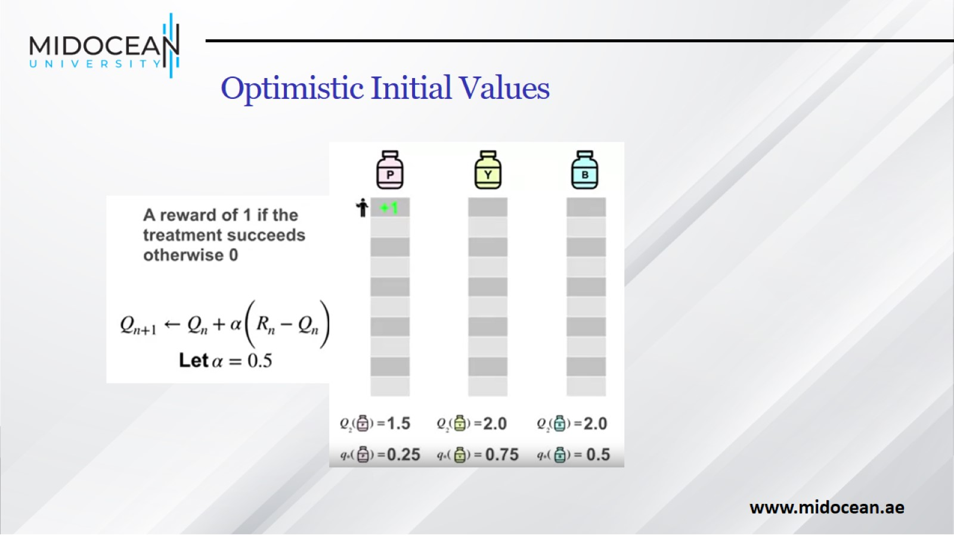
Optimistic Initial Values

Slide 31
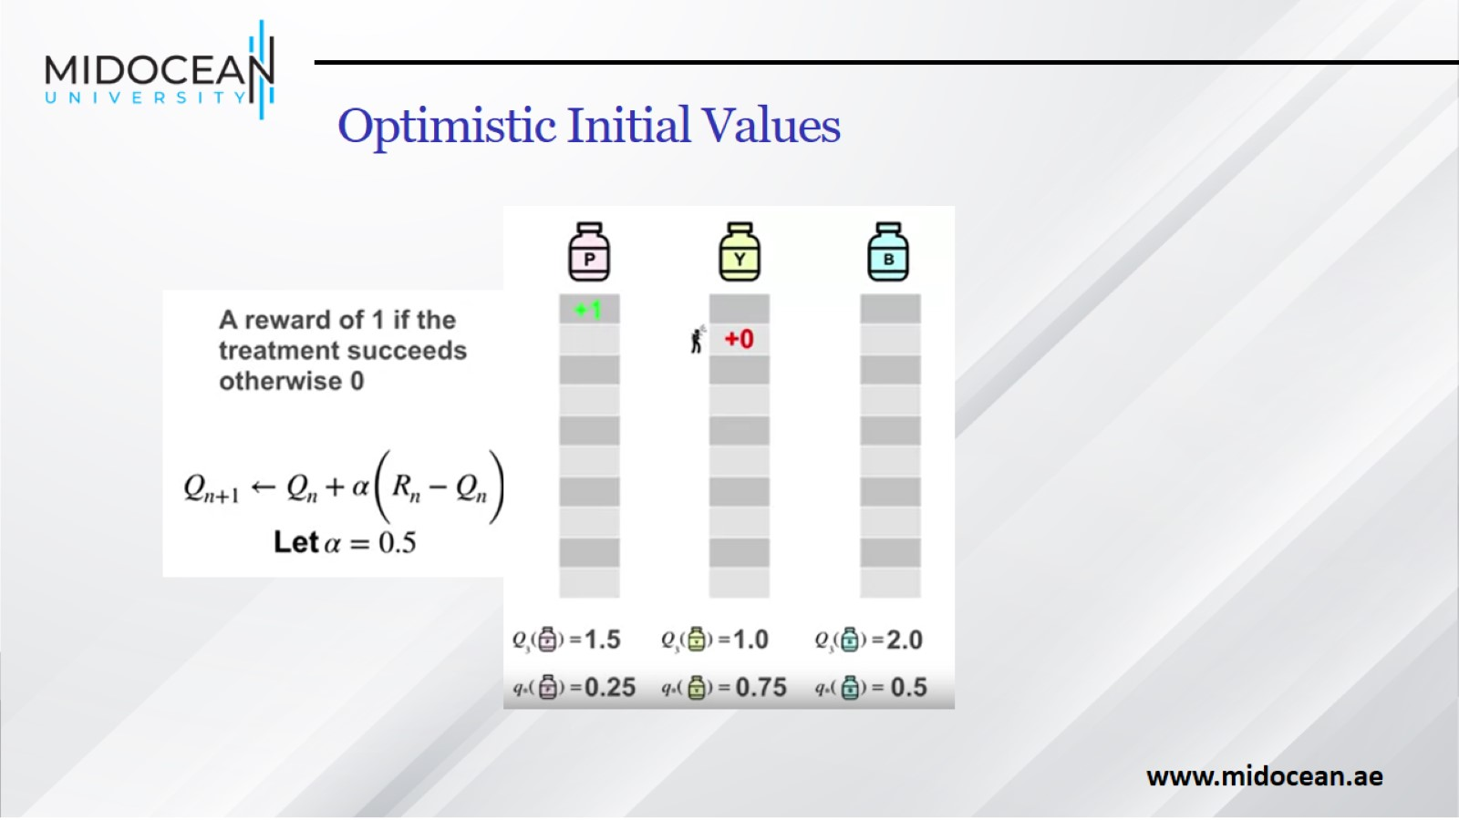
Optimistic Initial Values

Slide 32
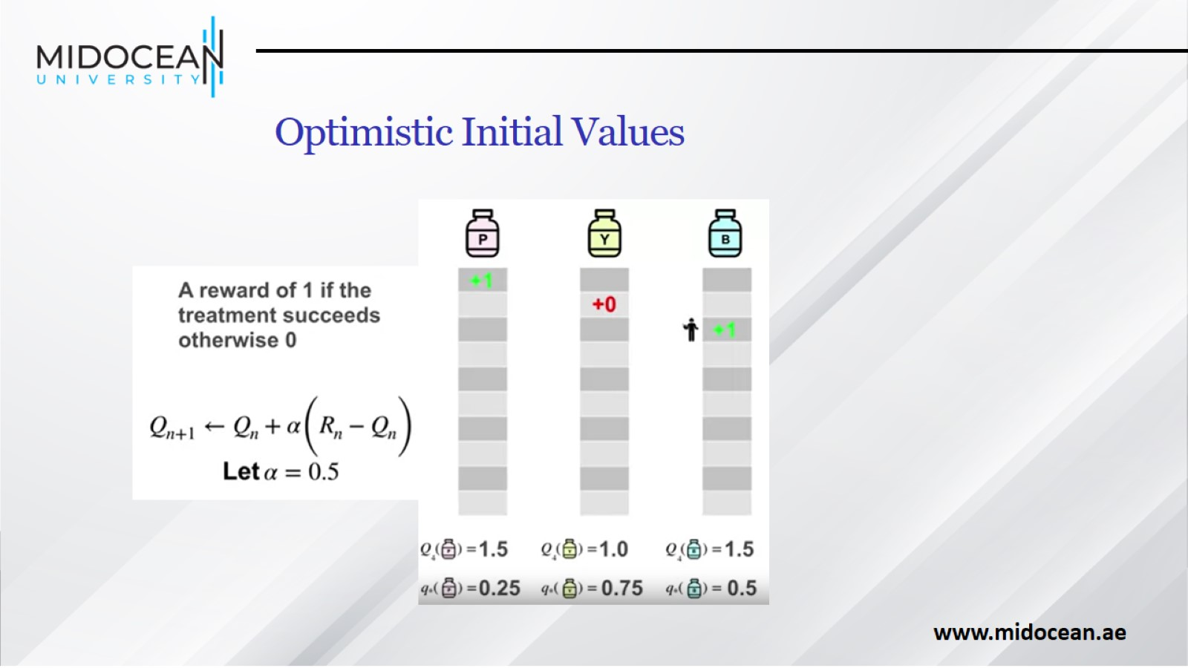
Optimistic Initial Values

Slide 33
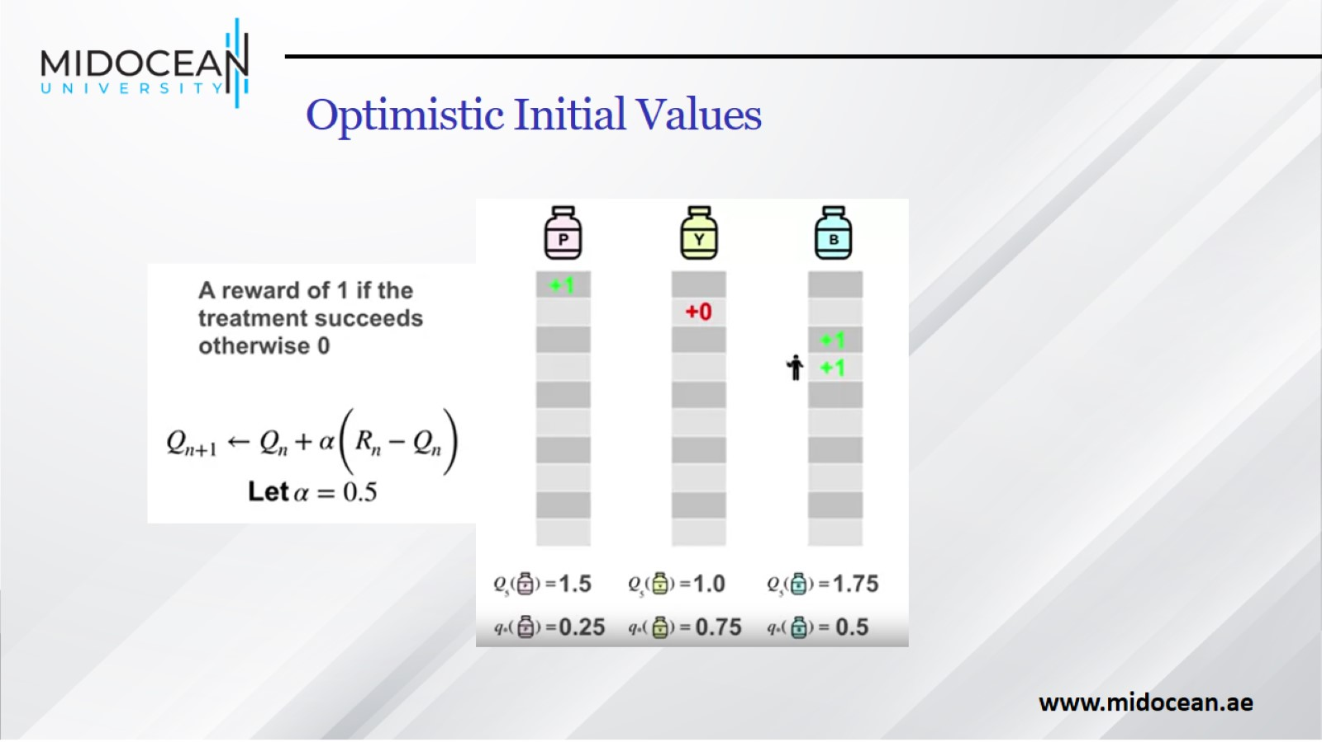
Optimistic Initial Values

Slide 34
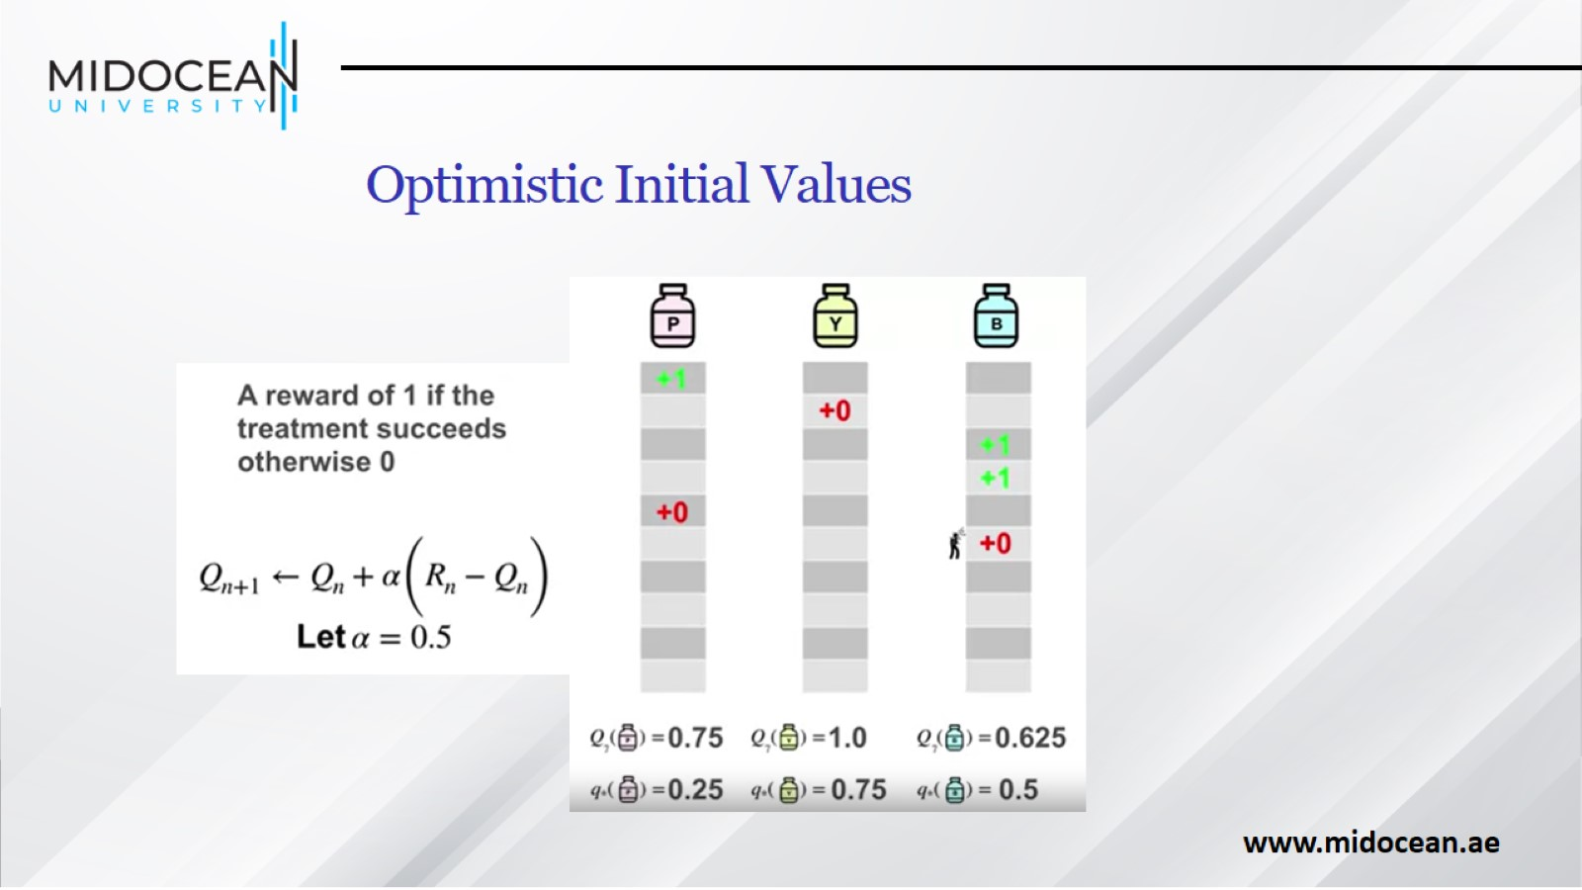
Optimistic Initial Values

Slide 35
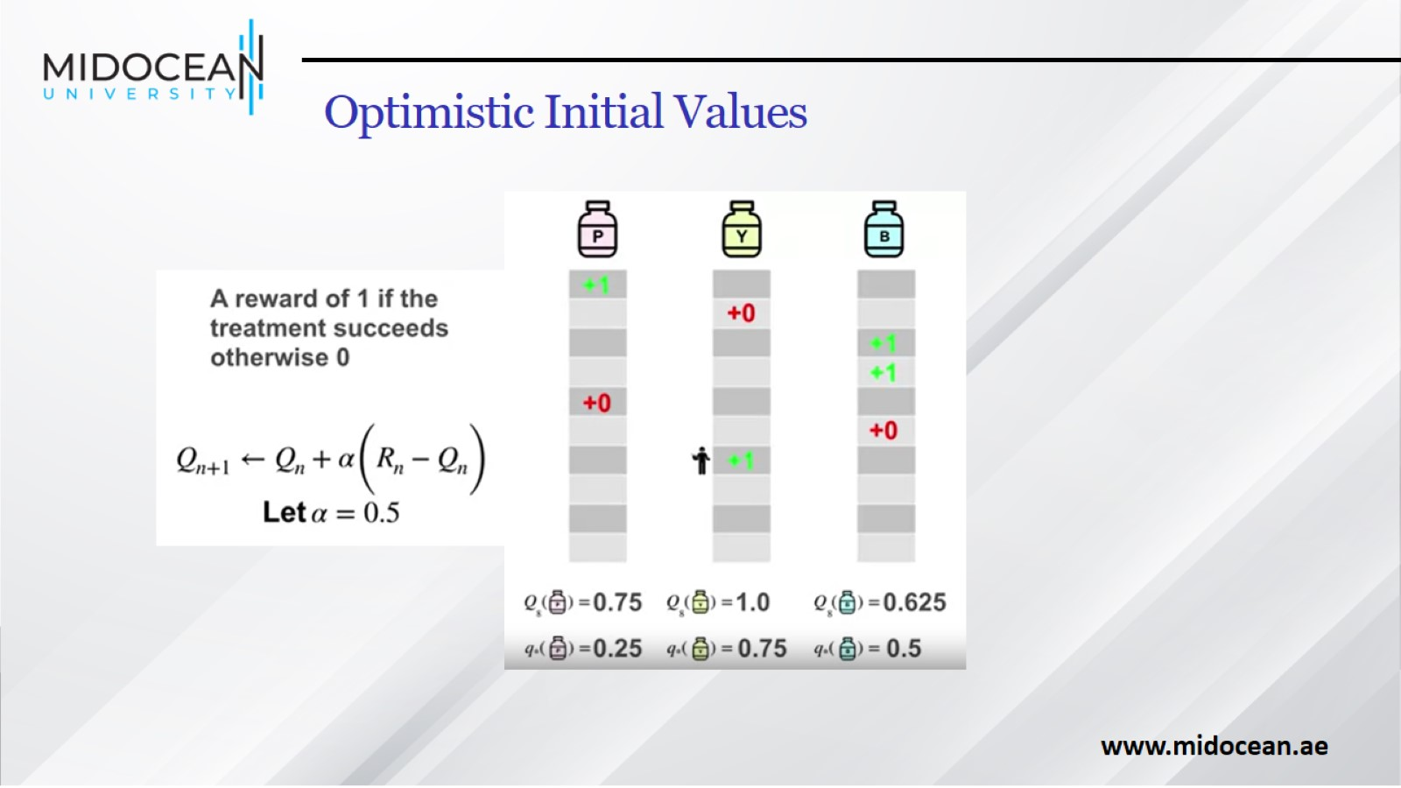
Optimistic Initial Values

Slide 36
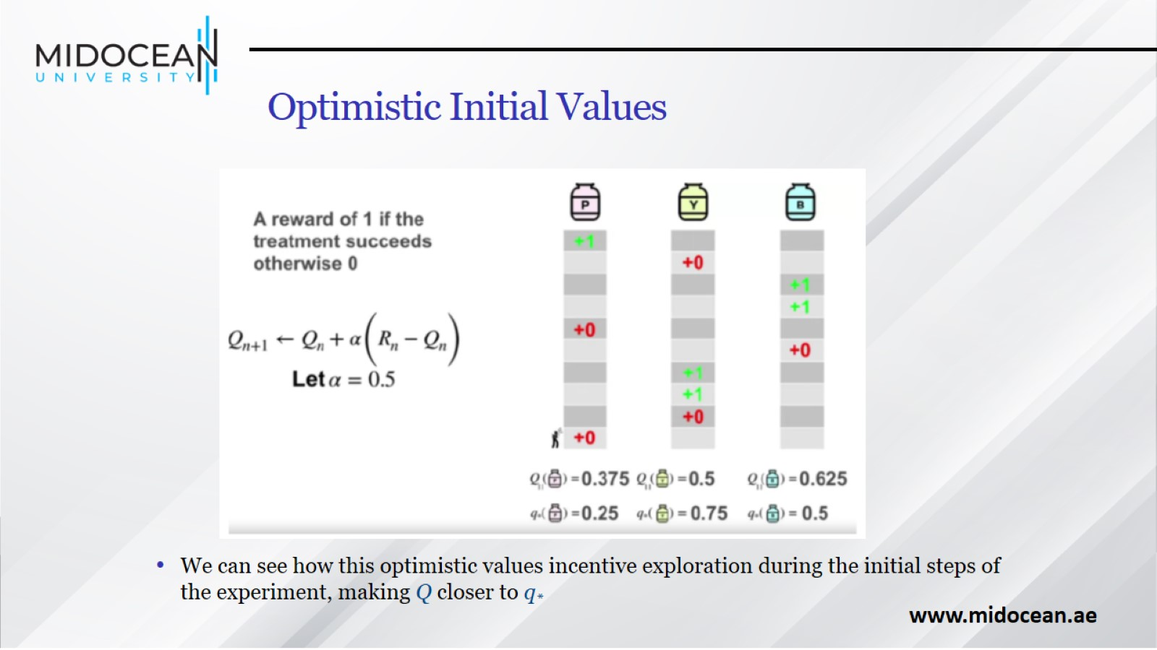
Optimistic Initial Values

Slide 37
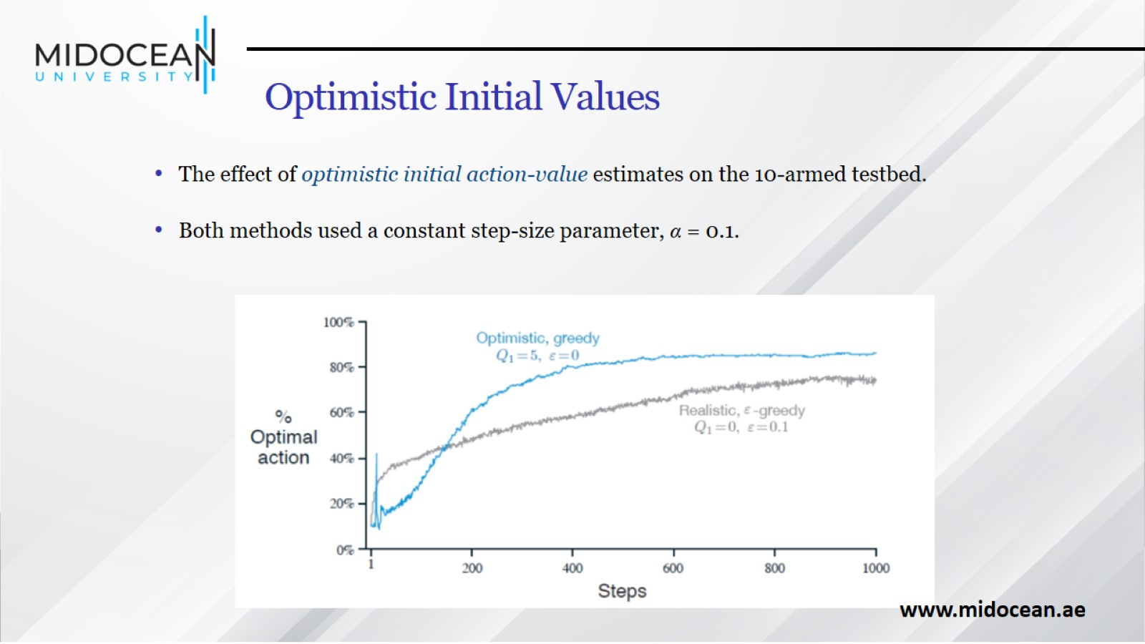
Optimistic Initial Values

Slide 38
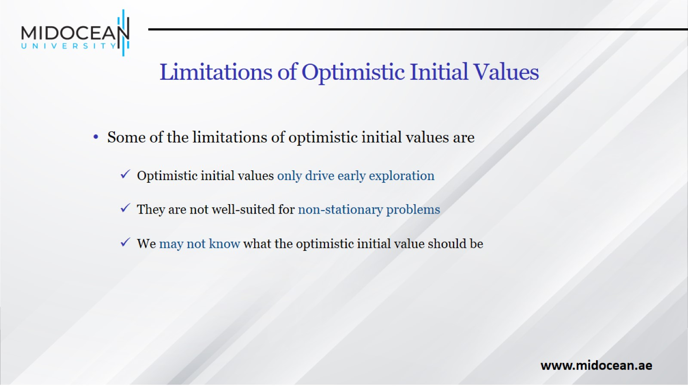
Limitations of Optimistic Initial Values

Slide 39
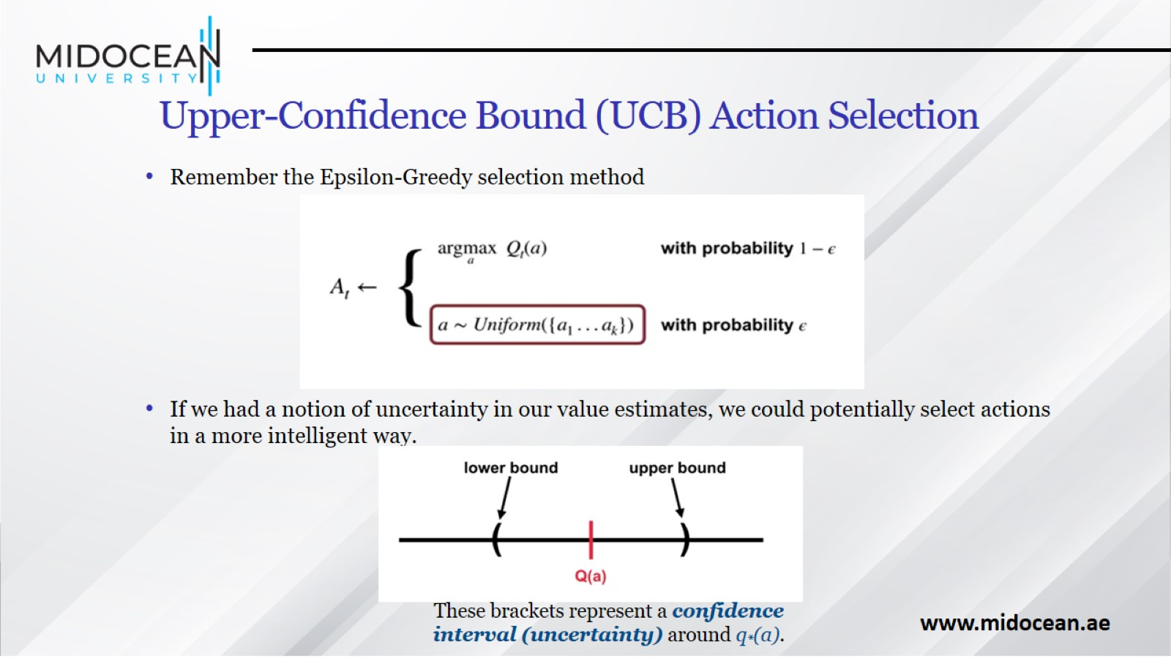
Upper-Confidence Bound (UCB) Action Selection

Slide 40
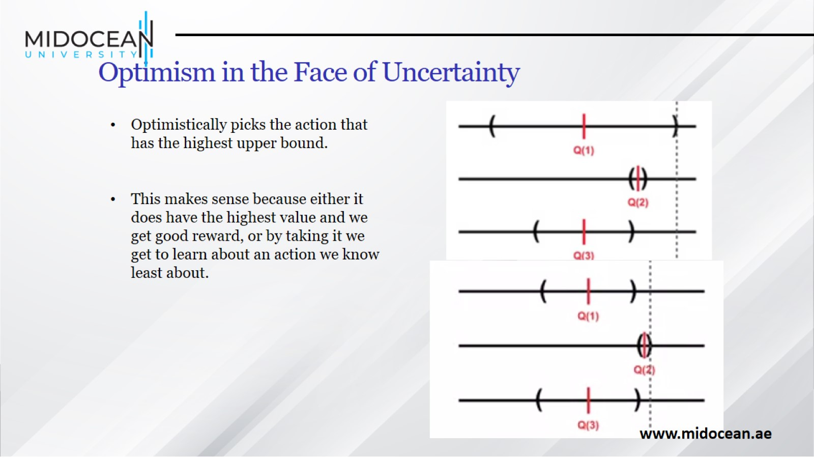
Optimism in the Face of Uncertainty

Slide 41
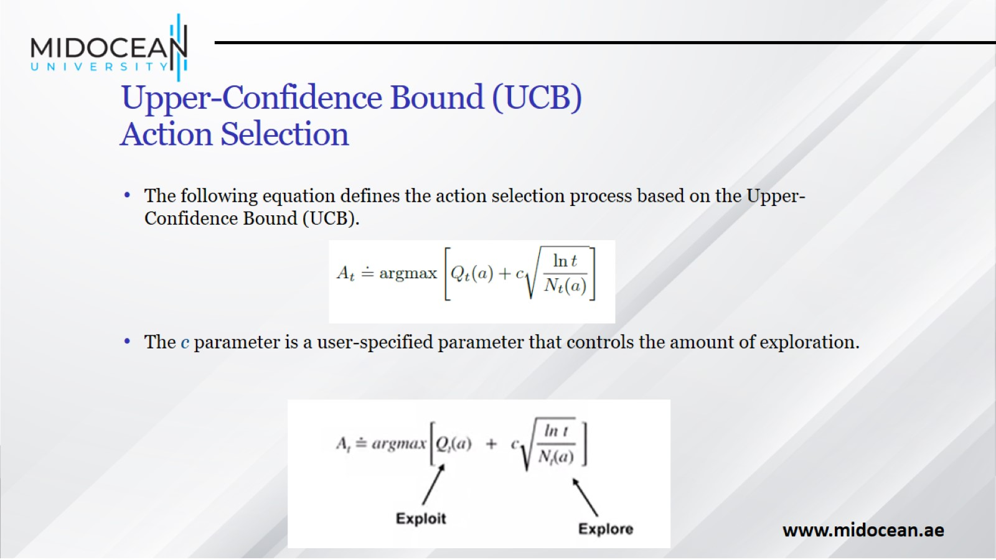
Upper-Confidence Bound (UCB)
Action Selection

Slide 42
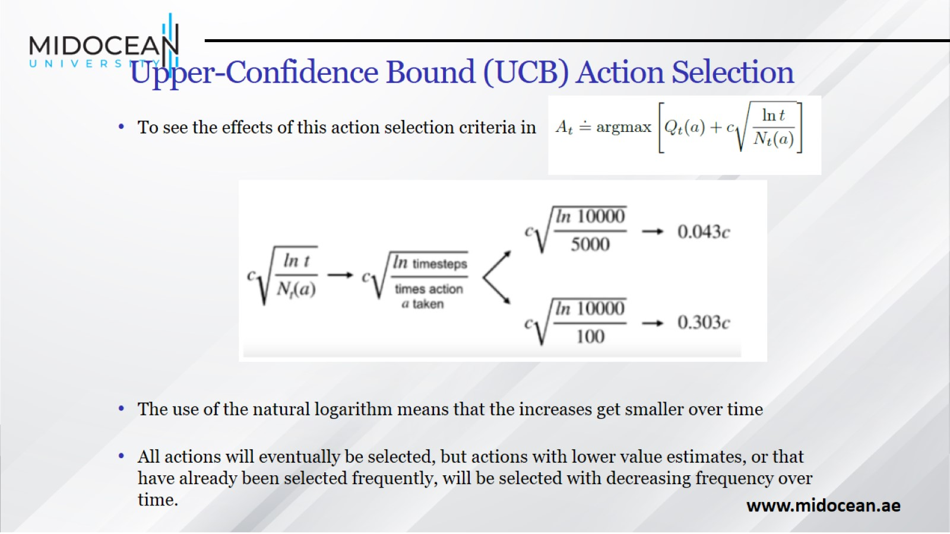
Upper-Confidence Bound (UCB) Action Selection

Slide 43
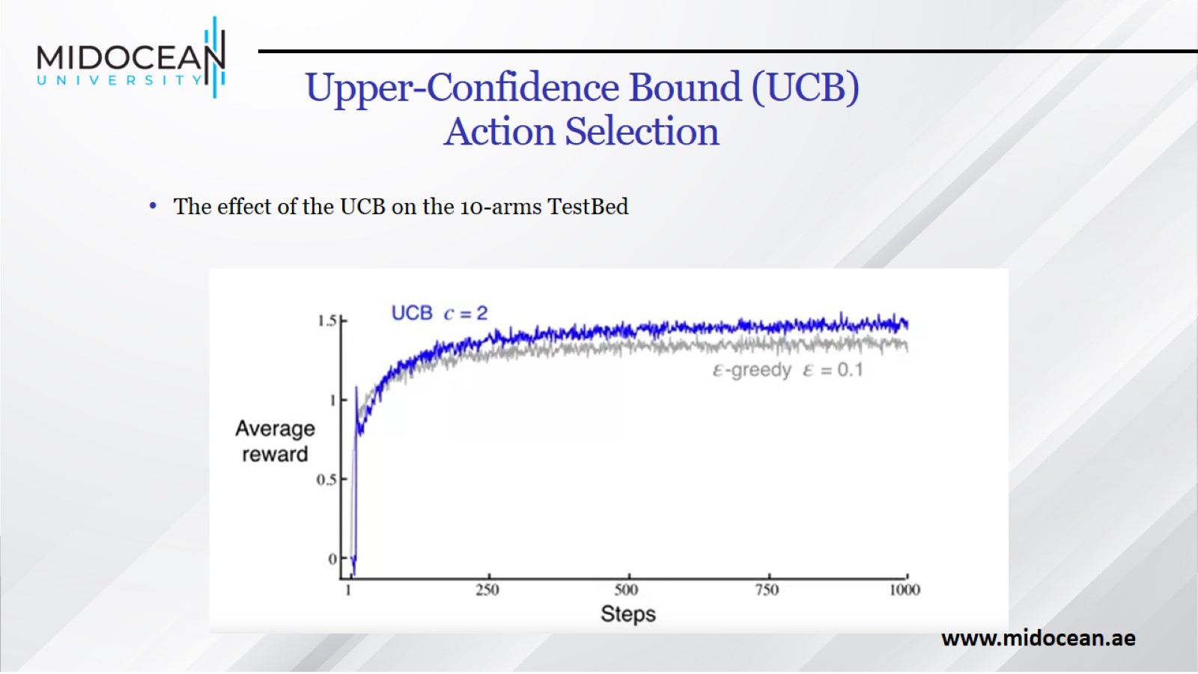
Upper-Confidence Bound (UCB)
Action Selection

Slide 44


