Slide 1



Data Monitoring & Analysis
Lecture 9
HCIA-Security
Prepared by
Dr. Abdelrhman Ahmed

Slide 2
Chapter
09
Forward
• The document describes how to obtain valid information by technical means and analyze the information to locate security risks and threats.
• Data can be collected from network devices or from terminal systems that provide services. Data monitoring and analysis can reveal network security risks and strengthen the network. If a security event occurs, data monitoring and analysis help rapidly locate the threat, and provide support for defense and event investigation.

Slide 3
Chapter
09
Objectives
• Upon completion of this course, you will be able to:
□ Describe the technical means of data monitoring and analysis.
□ Describe the data collection process.
□ Use techniques to locate threats.

Slide 4
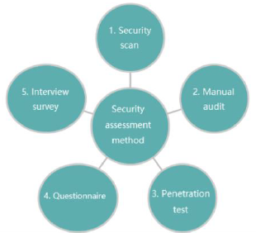
Chapter
09
Proactive Analysis
• Evaluate network security before attacks occur, rectify the identified issues and strengthen the network.
• The following figure shows the security assessment method.

Slide 5
Chapter
Security Scan
09
• Objectives: Use the scanning analysis and assessment tool to determine network security vulnerabilities of target systems.
• Contents:
□ Enabled ports
□ Weak passwords
□ SQL injection vulnerability
□ Cross-site scripting (XSS) vulnerability
• Output
□ Result generated by the scanner

Slide 6
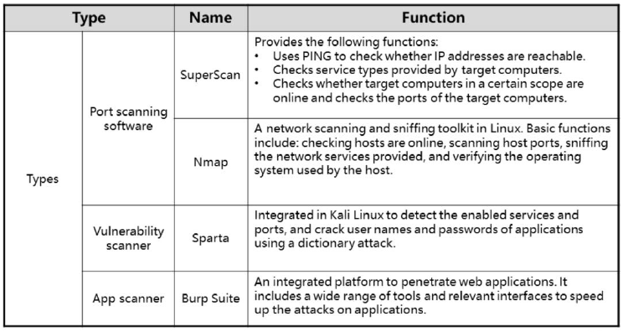
Chapter
09
Scanners

Slide 7
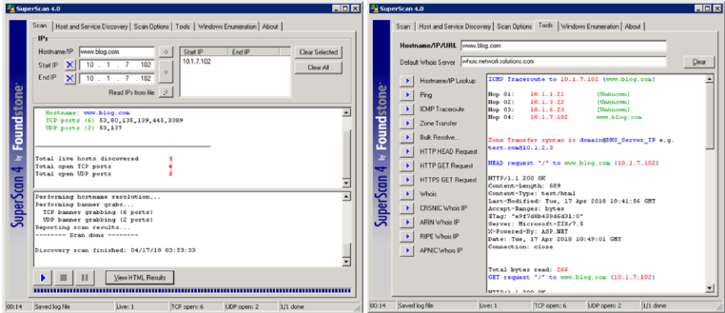
Chapter
SuperScan Usage
09
• SuperScan is used to scan the web server in a lab environment.

Slide 8
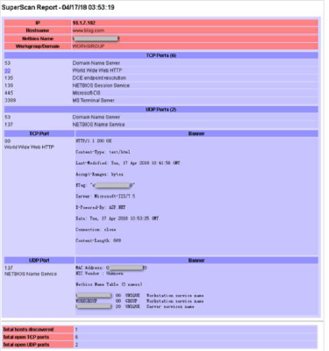
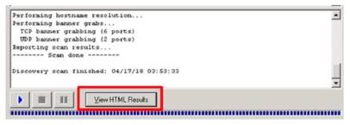
Chapter
09
Viewing the SuperScan Result
On the Scan tab, click View HTML Result. The SuperScan report is displayed

Slide 9
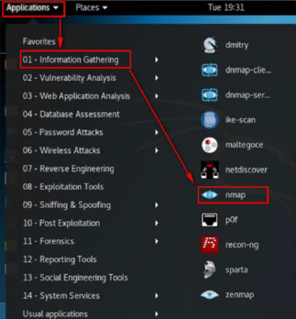
Chapter
NMAP Usage
09
• Click Applications > Information Gathering > nmap.

Slide 10
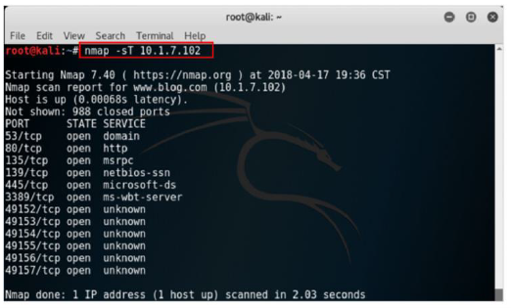
Chapter
09
Viewing the NMAP Scan Result
• Collect information about the target system based on the parameter rules of the Nmap tool.
• The following figure shows how to scan the TCP ports enabled on the host:

Slide 11
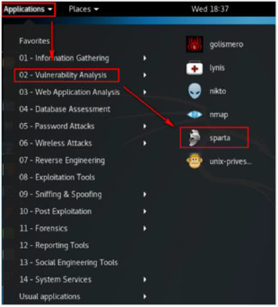
Chapter
09
Sparta Usage
• Click Applications > Vulnerability Analysis > sparta.

Slide 12
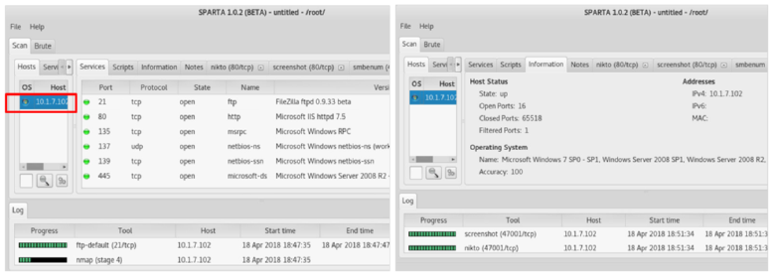
Chapter
09
Viewing the Sparta Scan Result
• On the Sparta page, add the address segment or host address to be scanned. The Sparta result shows the ports and apps enabled on the target host, as well as the operating system being used.

Slide 13
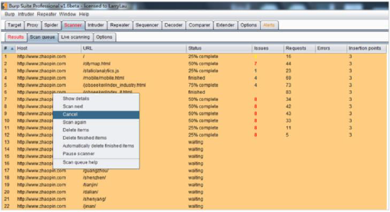
Chapter
09
Burp Suite Usage
• Burp Suite sends requests to apps and uses payloads to verify vulnerabilities. Burp Suite can effectively
scan the following vulnerabilities:
□ Client vulnerabilities: XSS, HTTP header injection, and operation redirection
□ Server vulnerabilities: SQL injection, command line injection, and file search

Slide 14
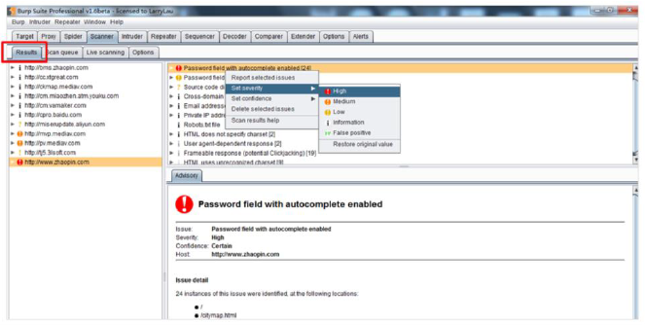
Chapter
09
Burp Suite Scan Result
• The Results tab page displays the scanned vulnerability details.

Slide 15
Chapter
09
Manual Audit
• Objectives:
□ Manual audit is a complement to security scan. It requires no software installation on the target system and does not affect the running status. It is useful for important hosts that do not allow software installation.
• Method:
□ Security specialists manually inspect target systems, including the host system, service system, database, network device, and security device.
□ The following check items may vary according to target systems:
■ Latest patch installed or not
■ Service minimization principle used or not, and unnecessary services and ports enabled or not
■ Firewall configuration policy correct or not

Slide 16
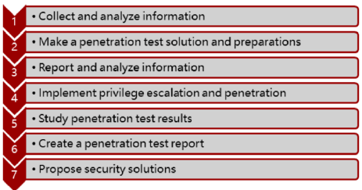
Chapter
09
Penetration Test
A penetration test is carried out as part of an external inspection. This test is an attempt to evaluate the security of operating systems and network services by safely exploiting vulnerabilities.
The penetration test process is as follows:

Slide 17
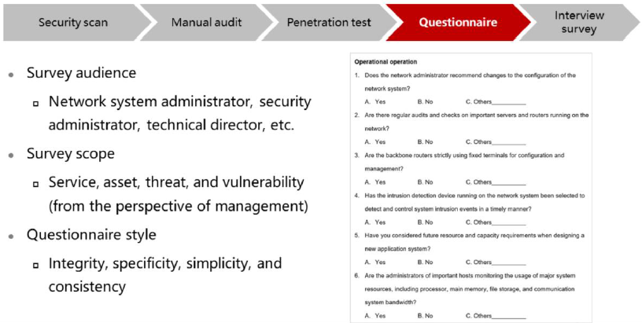
Chapter
09
Questionnaire

Slide 18
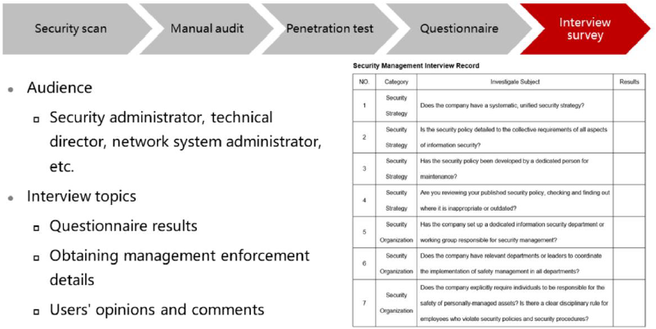
Chapter
09
Interview Survey

Slide 19
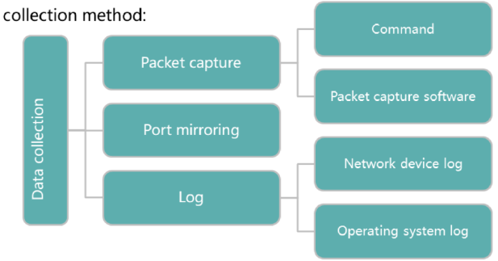
Chapter
Passive Collection
09
• When an attack occurs, users must collect data, analyze attack methods and vulnerabilities, and rectify the situation to minimize the impact.
• Data collection method:

Slide 20
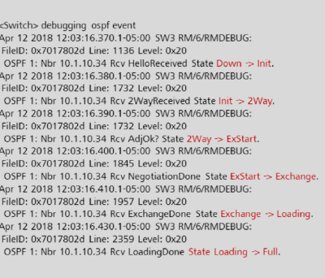
Chapter
09
Packet Capture – Commands (1)
• Command to check the OSPF neighbor states

Slide 21
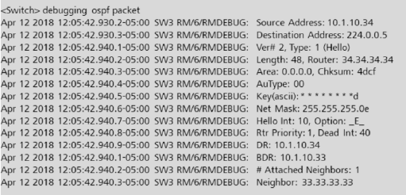
Chapter
Packet Capture – Commands (2)
09
• Command to view OSPF packet information

Slide 22
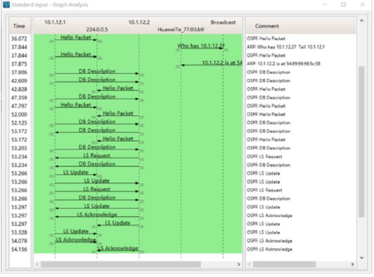
Chapter
Packet Capture – Tools (1)
09
• Use the Wireshark to capture packets, and check how OSPF adjacency is formed.

Slide 23
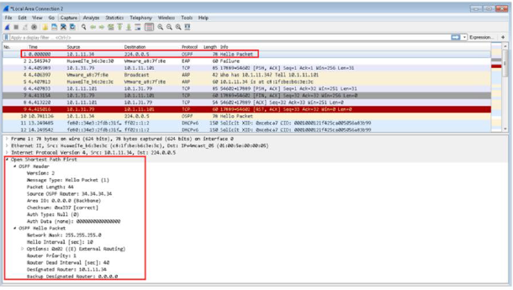
Chapter
09
Packet Capture – Tools (2)
• Use the Wireshark to capture packets, and check OSPF packet information.

Slide 24
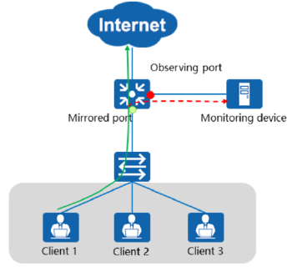
Chapter
09
Port Mirroring
• Port mirroring enables a device to copy the packets passing through a mirrored port and send them to a specified observing port for analysis and monitoring.

Slide 25
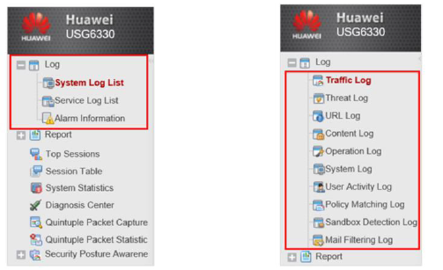
Chapter
09
Network Device Log
• The USG6330 firewall is used as an example. It supports logs and reports. When the hard disk is unavailable, you can only view and export system logs and service logs.
• Hard disk unavailable: • Hard disk available:

Slide 26
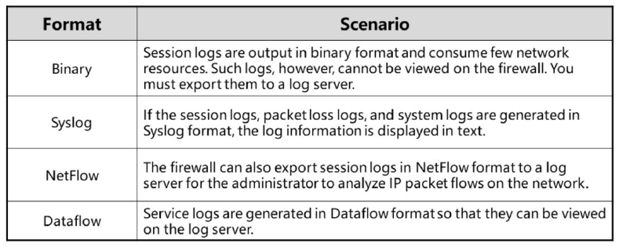
Chapter
09
Firewall Log Format
• Log formats supported by the firewall:

Slide 27
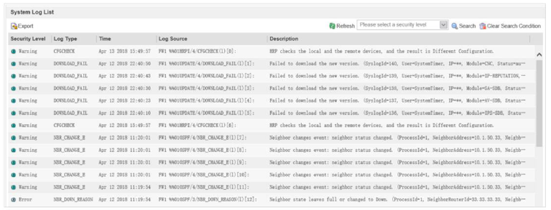
Chapter
09
System Logs
• This example uses the USG6000 firewall to describe how to view system logs.
□ Choose Monitor > Log > System Log.

Slide 28
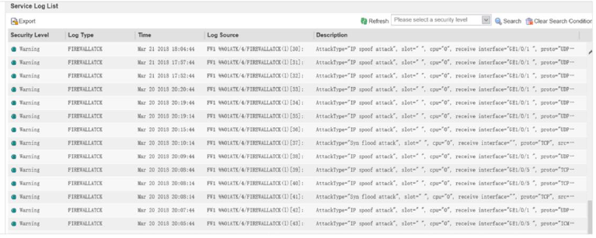
Chapter
09
Service Logs
• This example uses the USG6000 to describe how to view service logs.
□ Choose Monitor > Log > Service Log

Slide 29
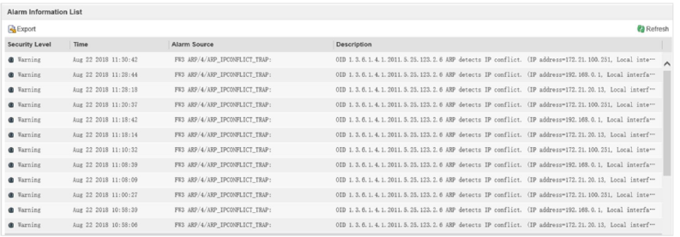
Chapter
09
Alarms
• This example uses the USG6000 to describe how to view alarms.
□ Choose Monitor > Log > Alarm Information.

Slide 30
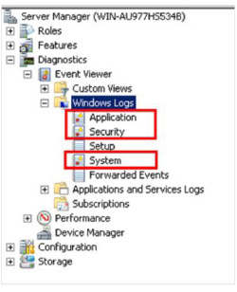
Chapter
09
Operating System Logs
• When using Windows:
Click Start.
Right-click Computer and choose Manage.
Select System Tools > Event Viewer > Windows Logs
Windows system logs are classified into:
□ System logs
□ Application logs
□ Security logs

Slide 31
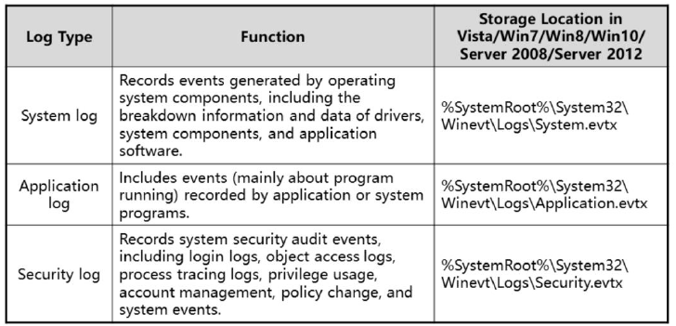
Chapter
09
Windows Log Types
• Windows log types:

Slide 32
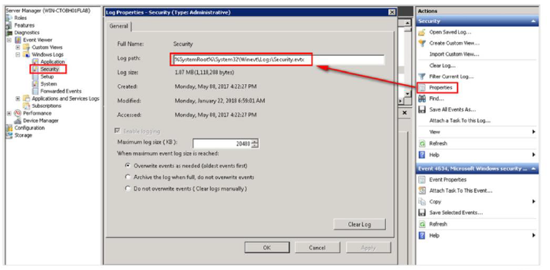
Chapter
09
Windows Log Storage
• To check the location of security logs, choose Properties.

Slide 33
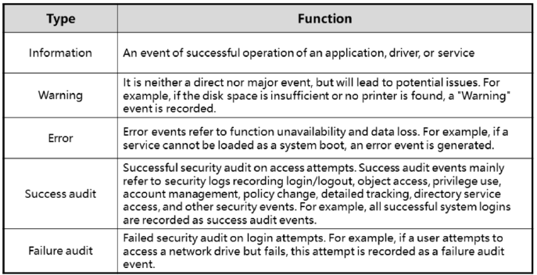
Chapter
09
Windows Log & Event Types
• Log and event types:

Slide 34
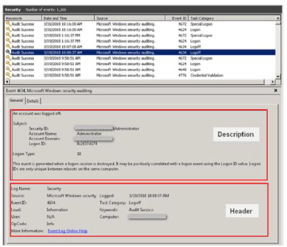
Chapter
09
Windows Log Formats
• A Windows log consists of two parts: header field and description field.

Slide 35



Thank You

