Slide 1


Slide 2
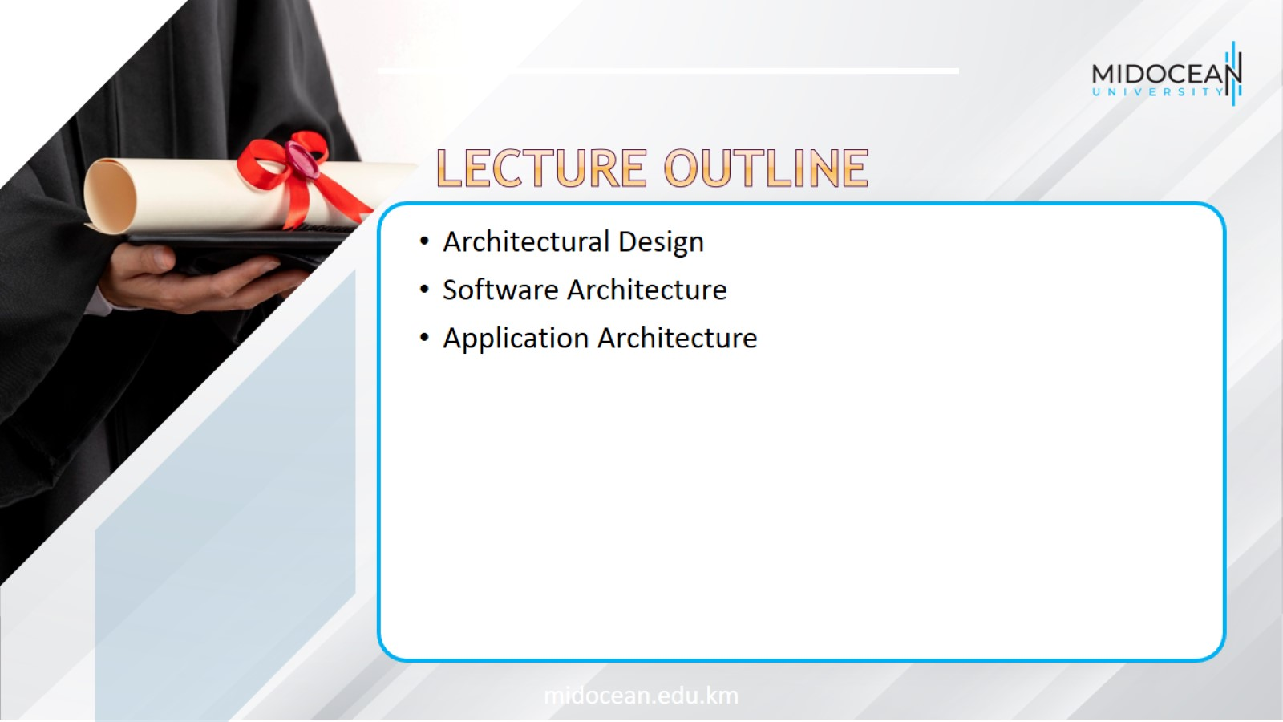

Slide 3
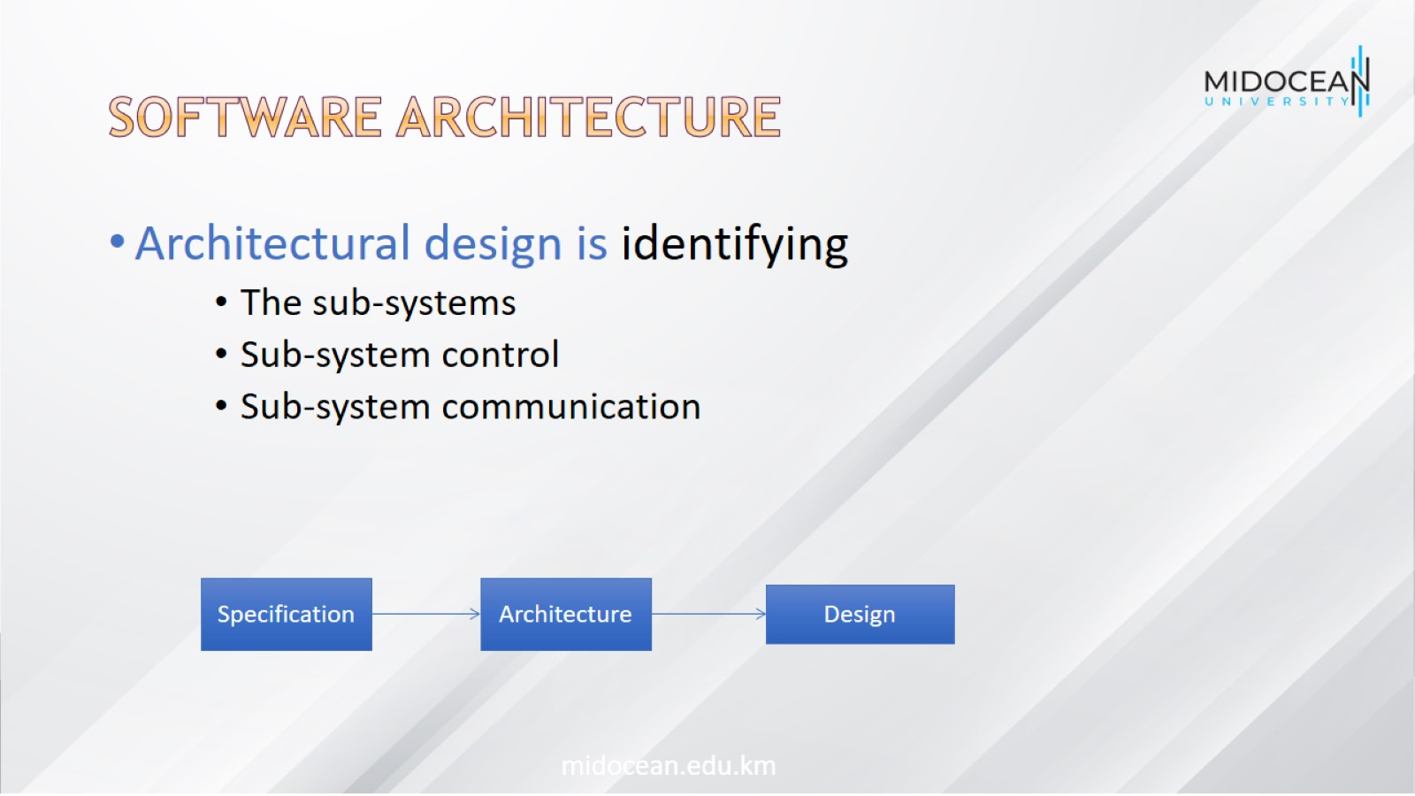
Software architecture

Slide 4
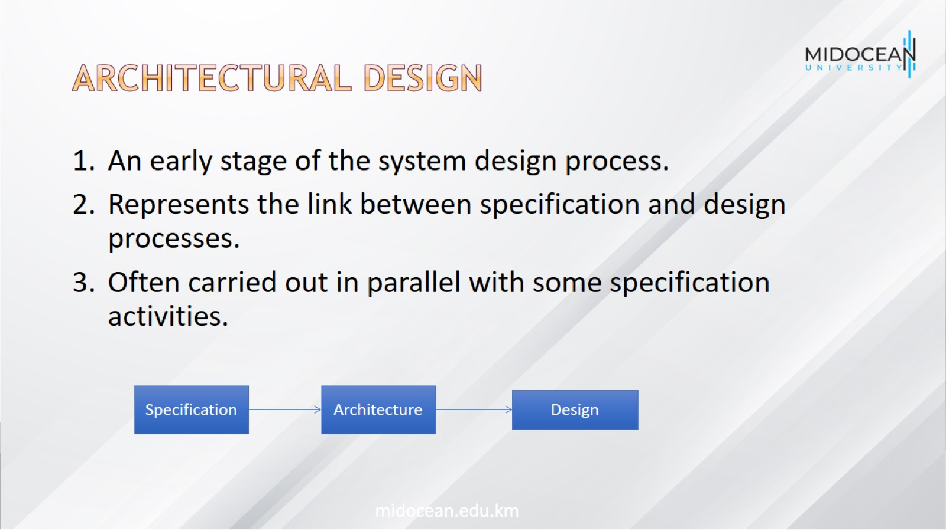
Architectural Design

Slide 5
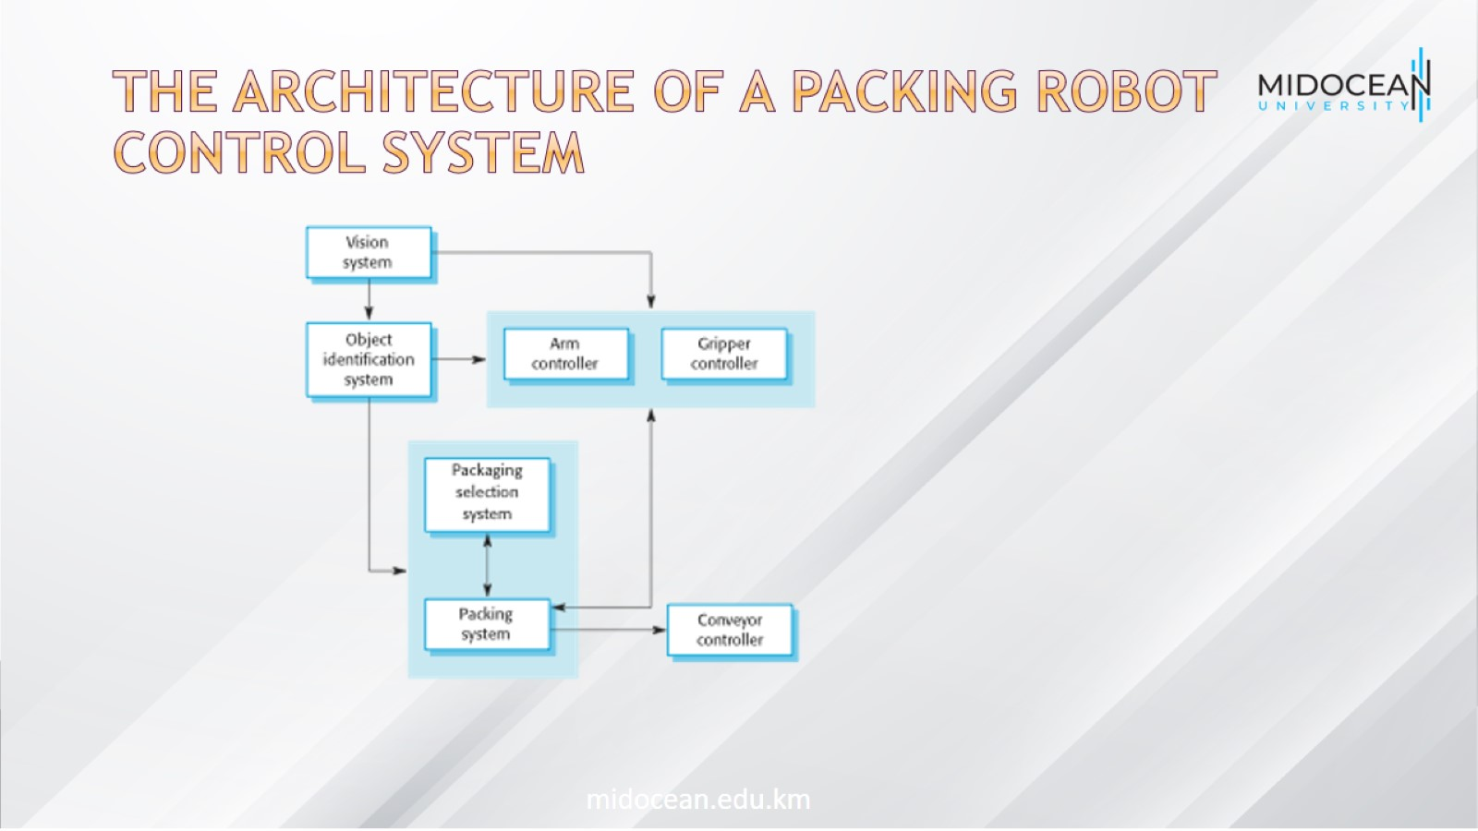
The architecture of a packing robot control system

Slide 6
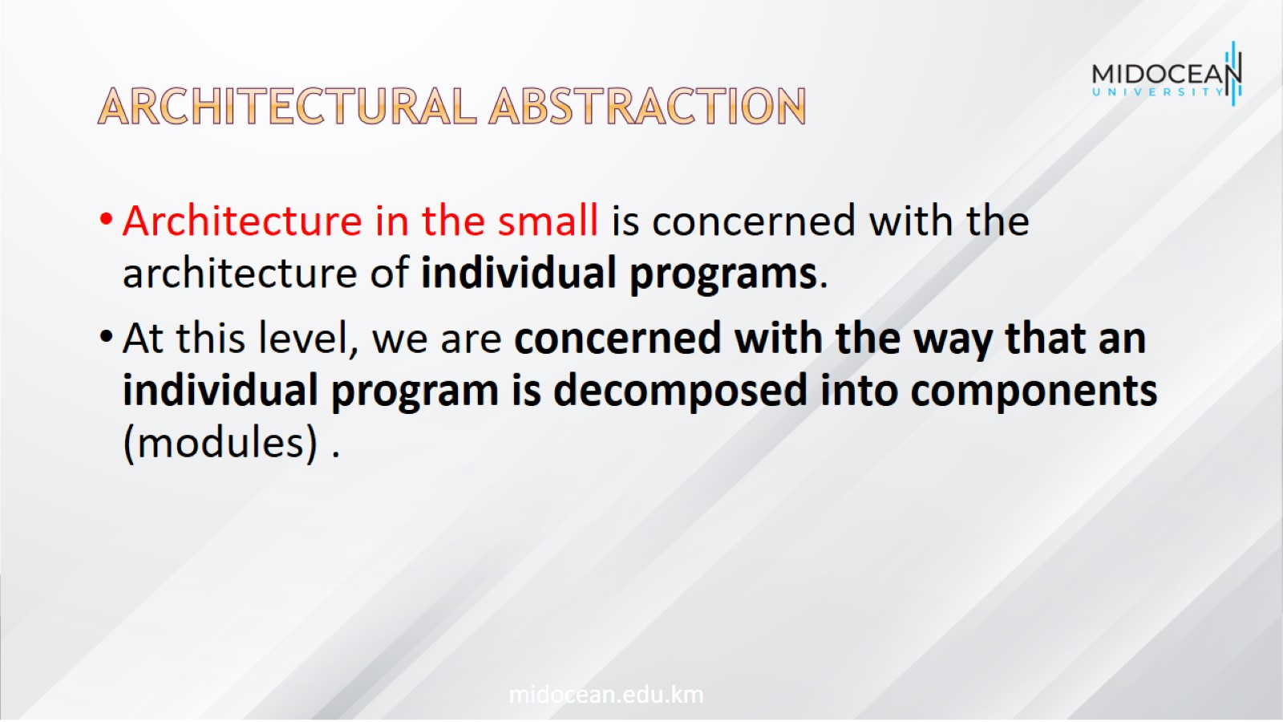
Architectural Abstraction

Slide 7
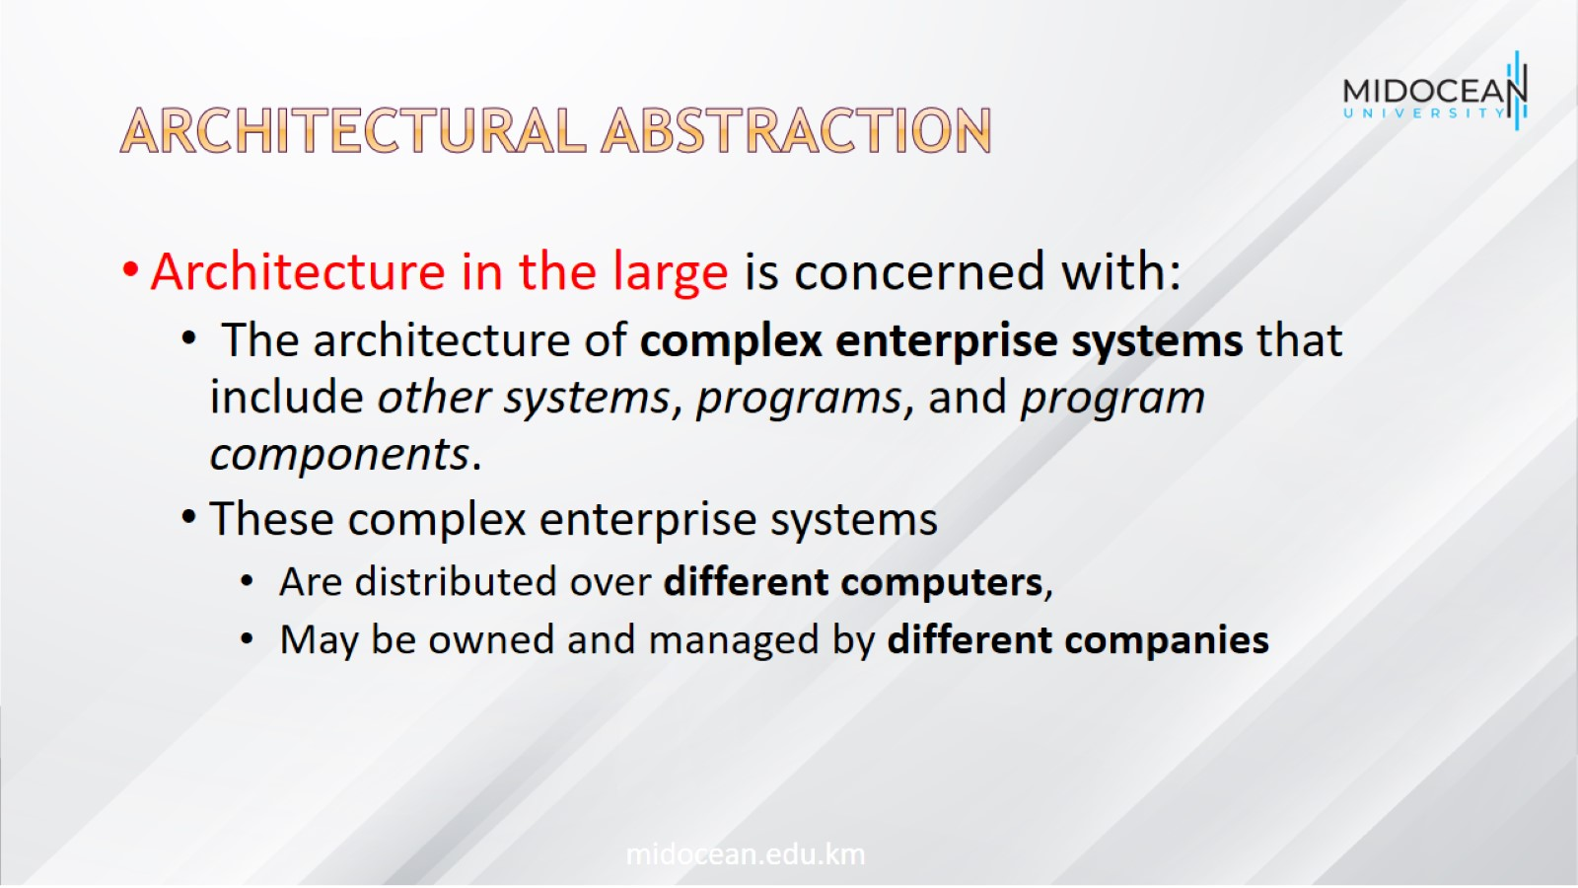
Architectural Abstraction

Slide 8
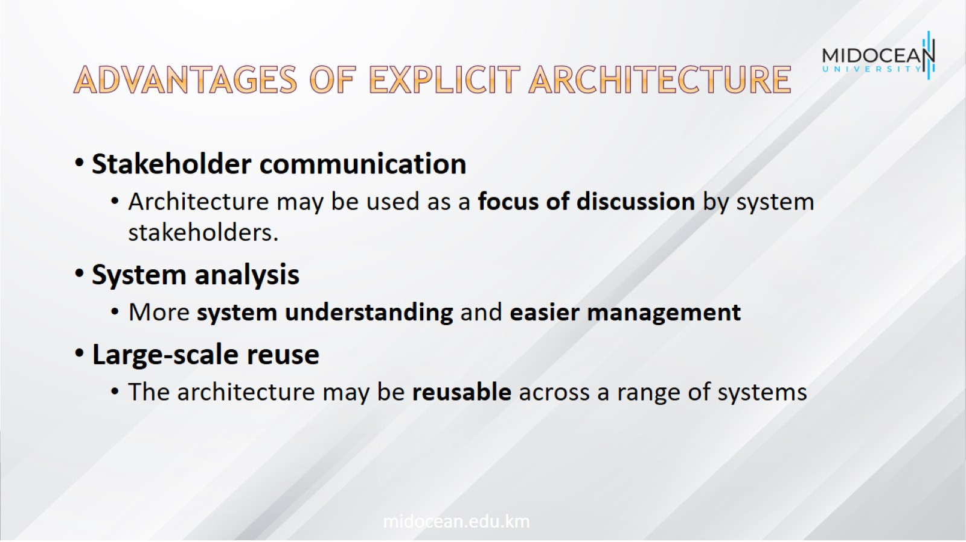
Advantages of explicit architecture

Slide 9
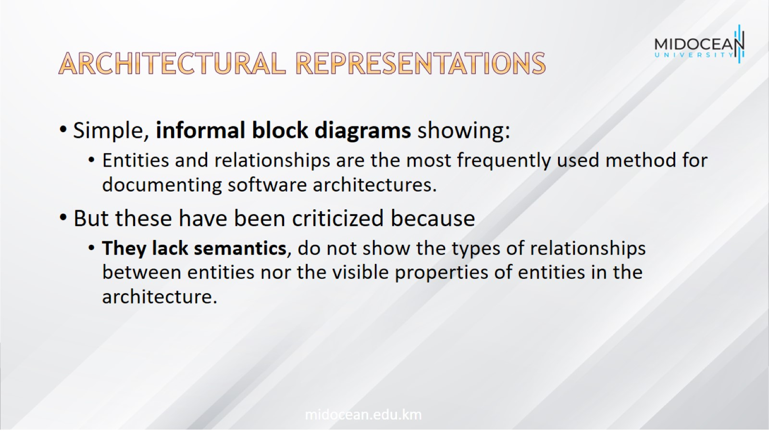
Architectural representations

Slide 10
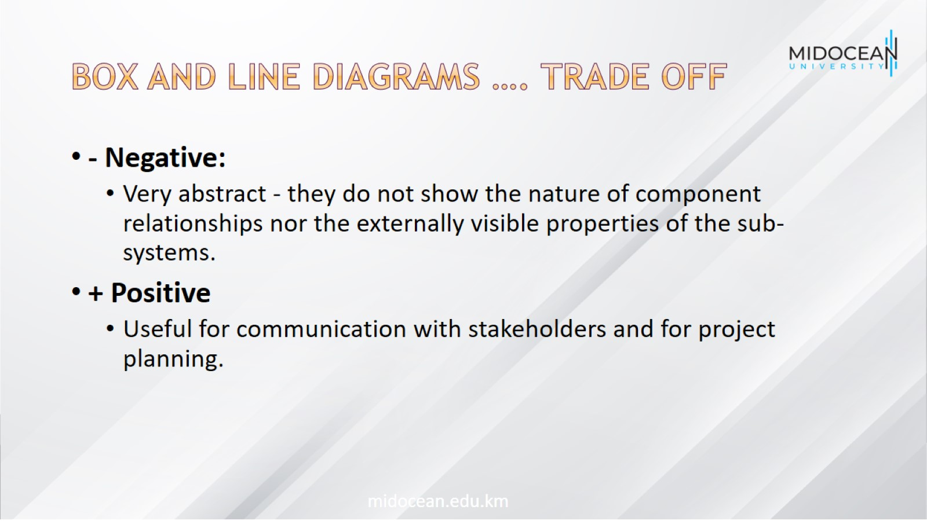
Box and line diagrams …. trade off

Slide 11
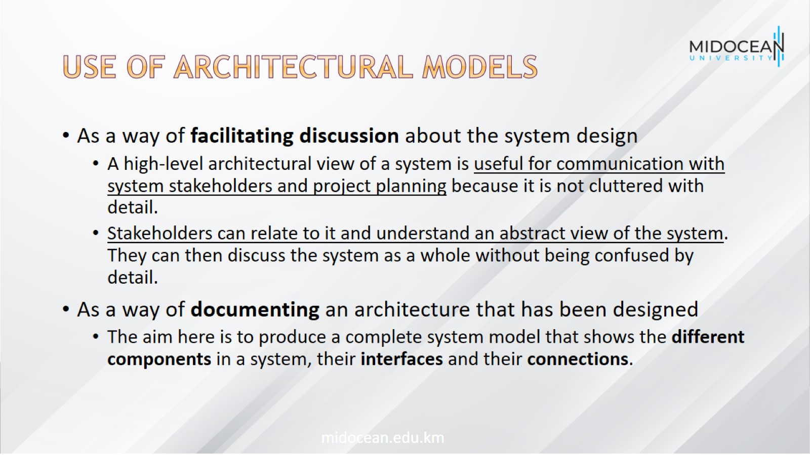
Use of architectural models

Slide 12
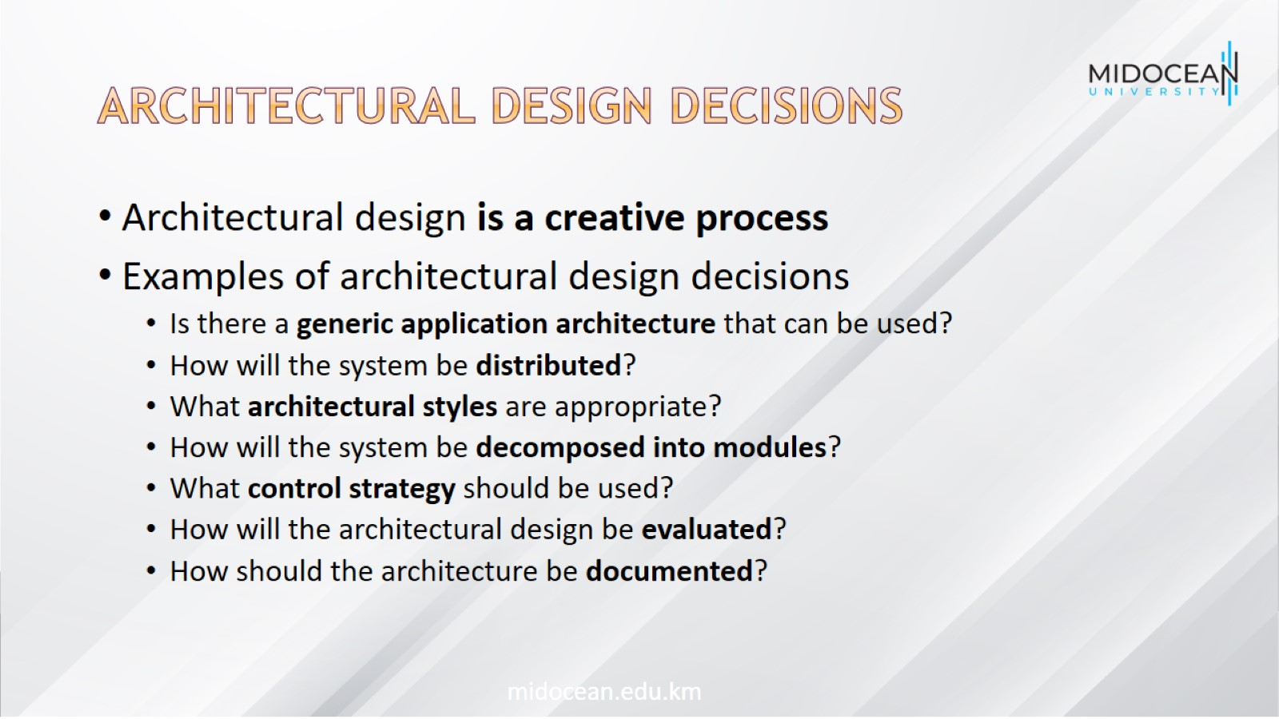
Architectural Design Decisions

Slide 13
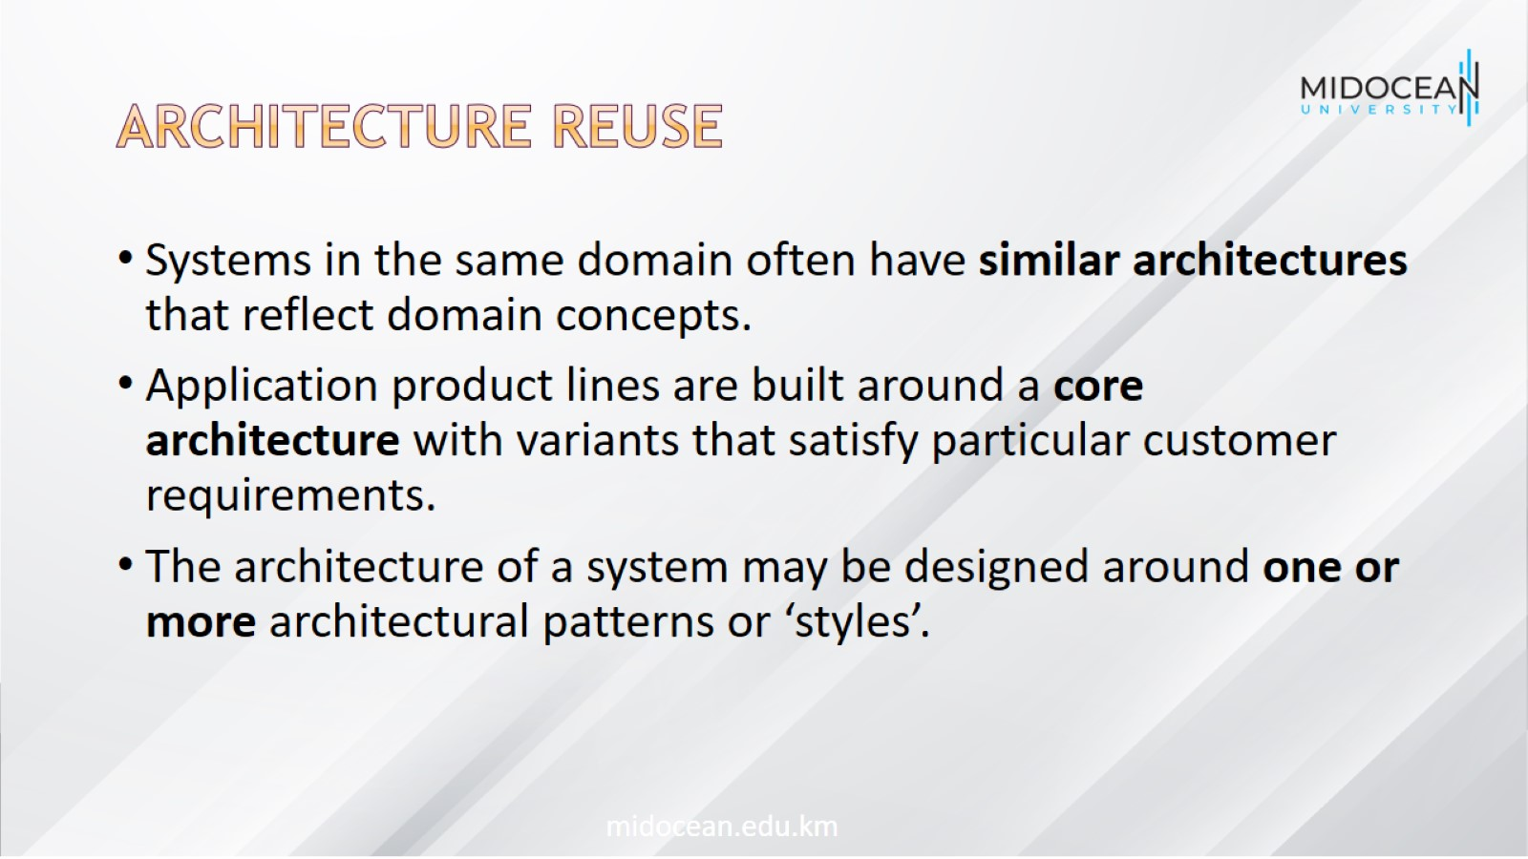
Architecture Reuse

Slide 14
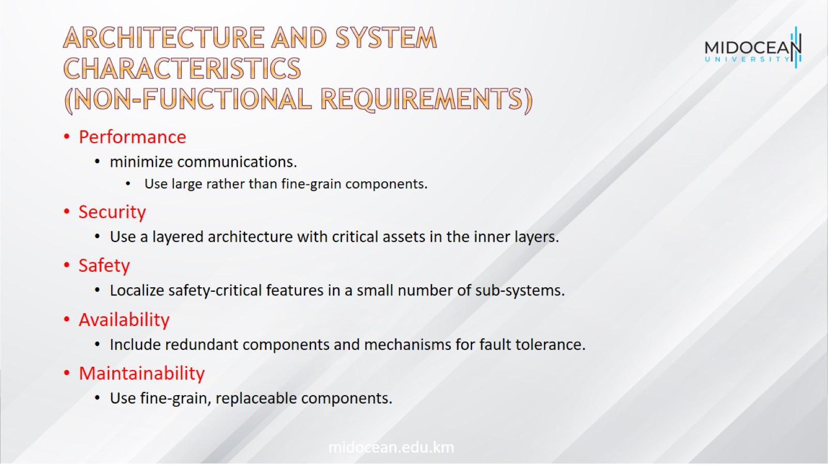
Architecture and system characteristics
(non-functional requirements)

Slide 15
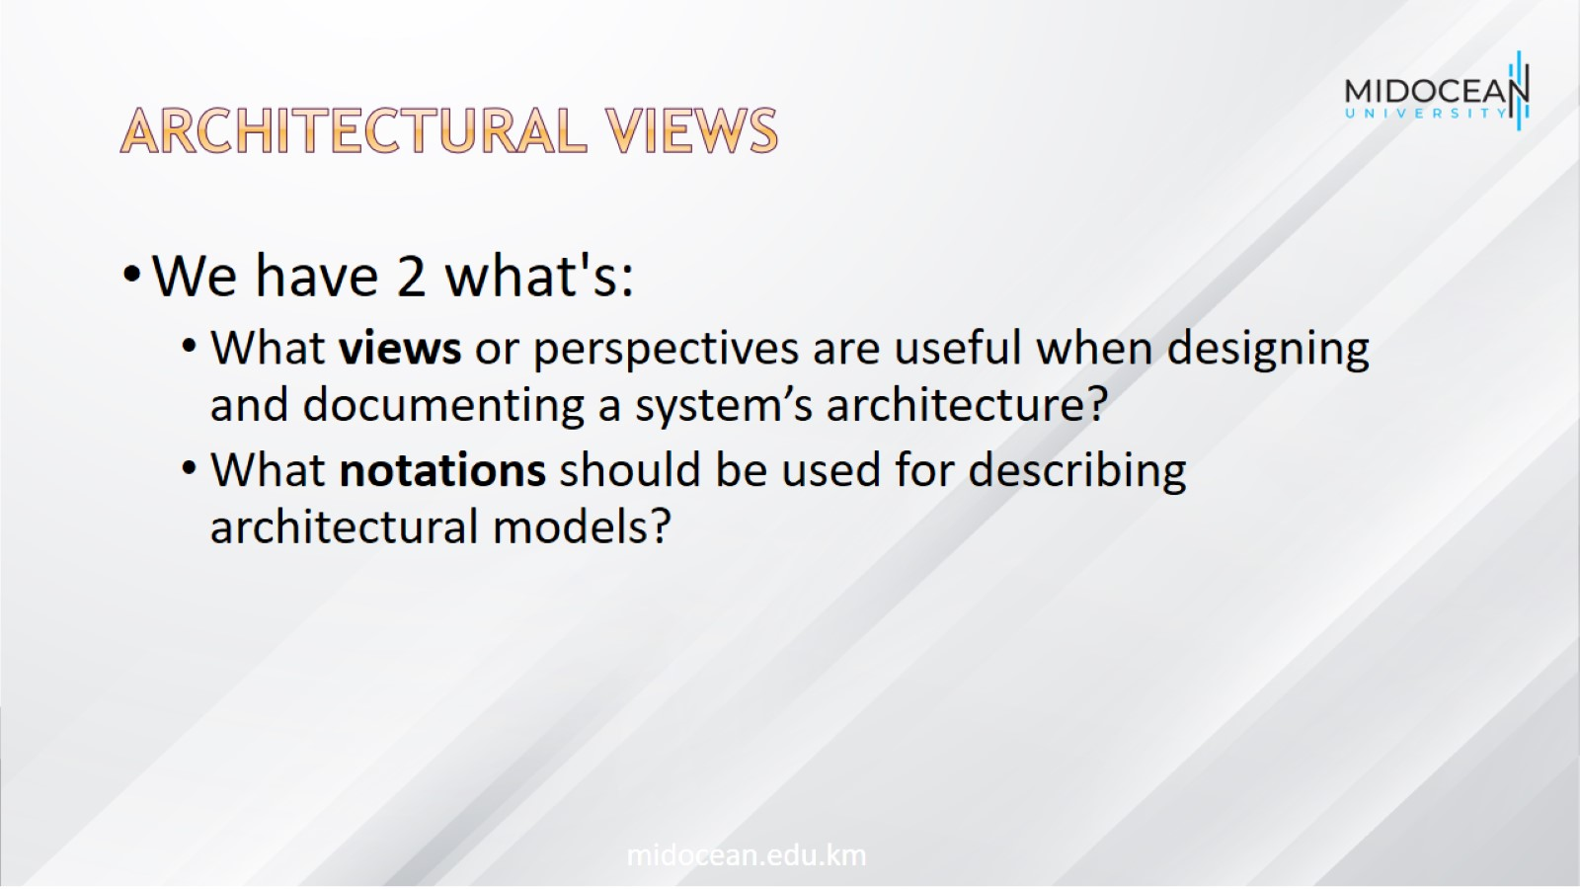
Architectural views

Slide 16
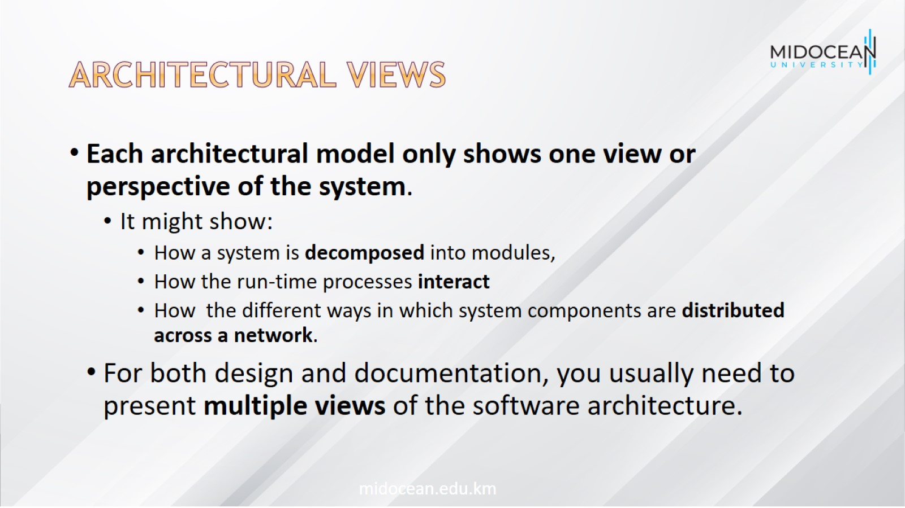
Architectural views

Slide 17
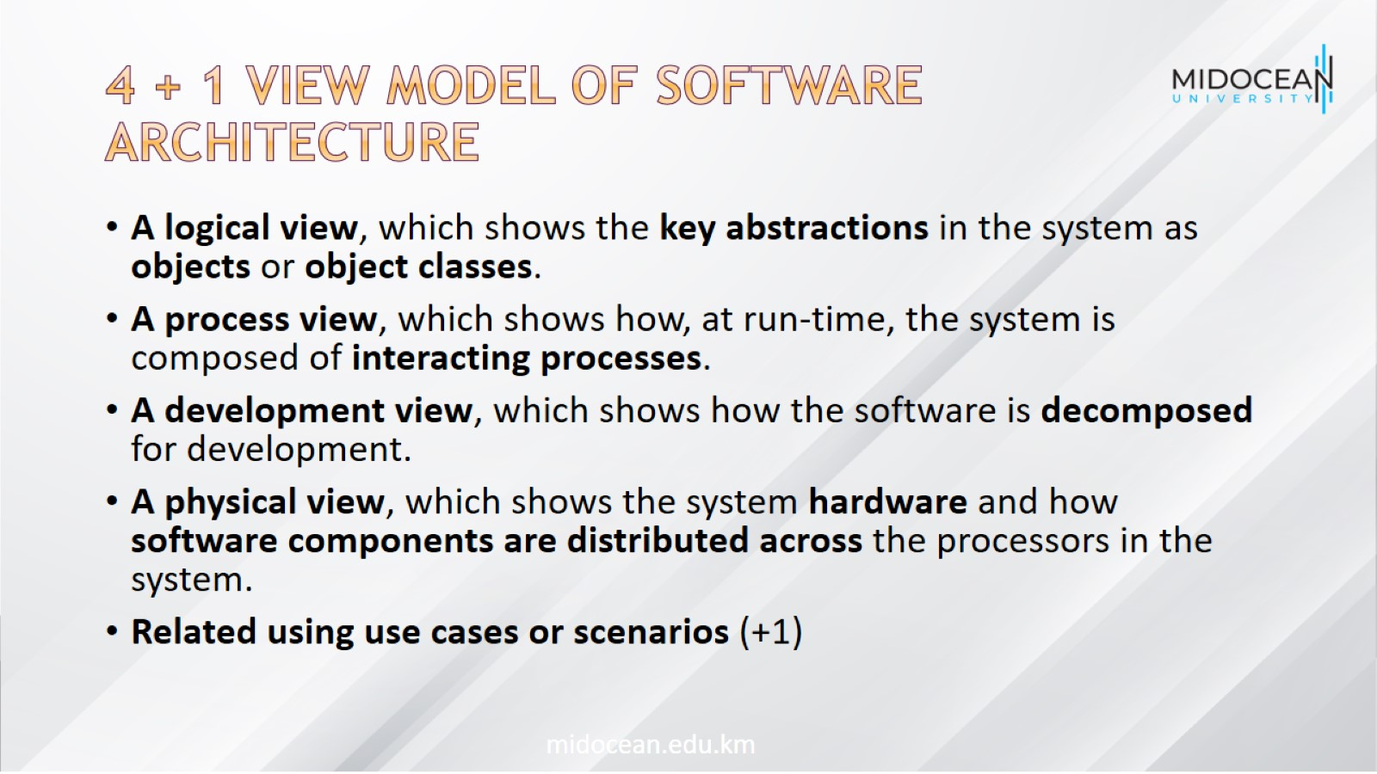
4 + 1 view model of software architecture

Slide 18
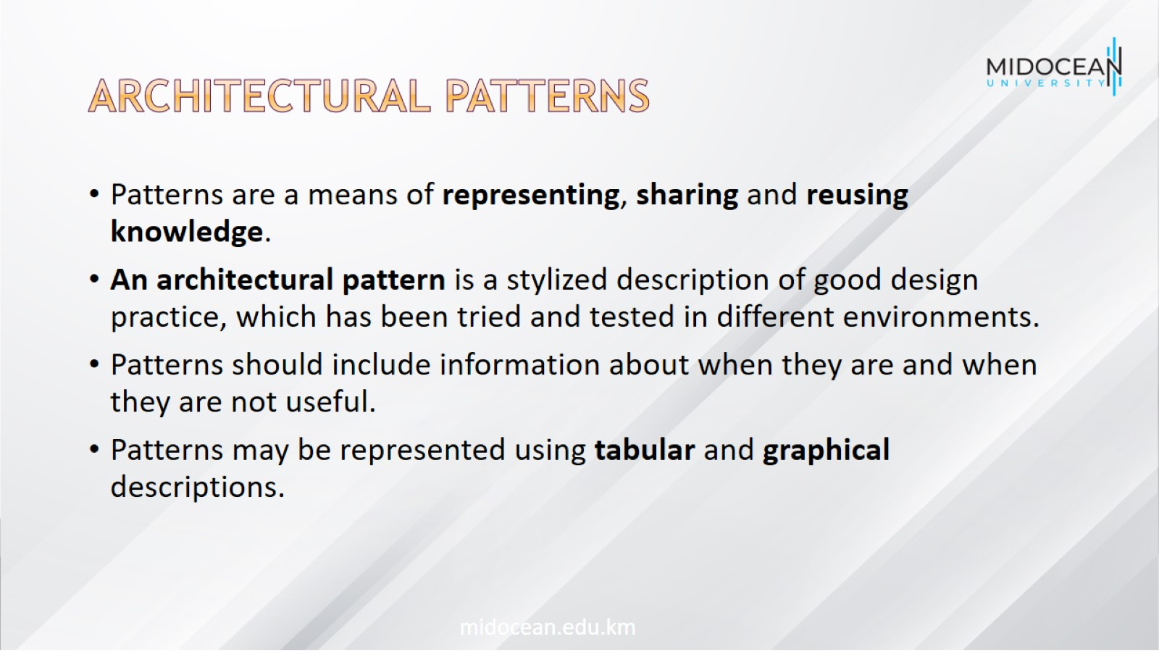
Architectural patterns

Slide 19
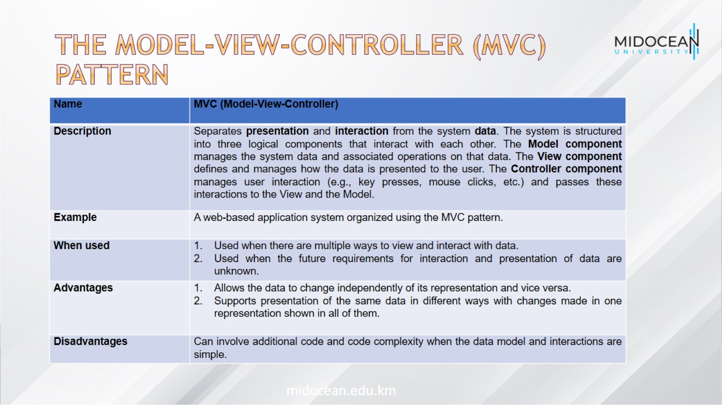
The Model-View-Controller (MVC) pattern

Slide 20
The Model-View-Controller (MVC) pattern

Slide 21
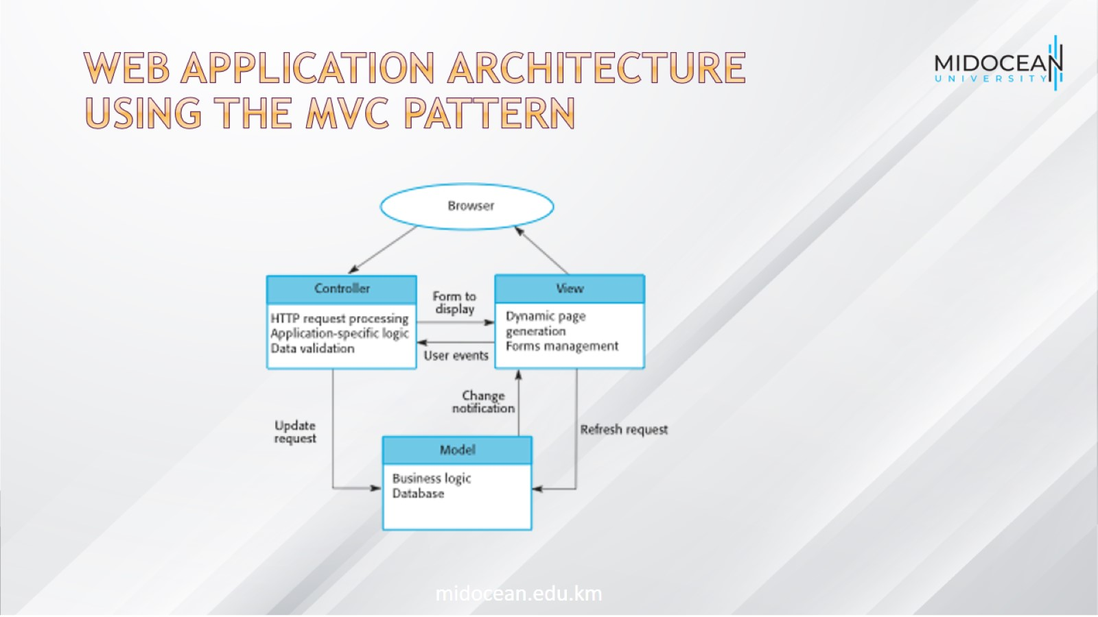
Web application architecture using the MVC pattern

Slide 22
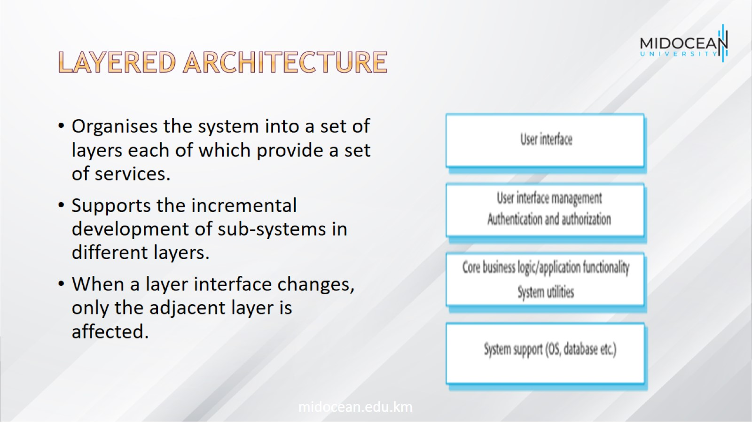
Layered Architecture

Slide 23
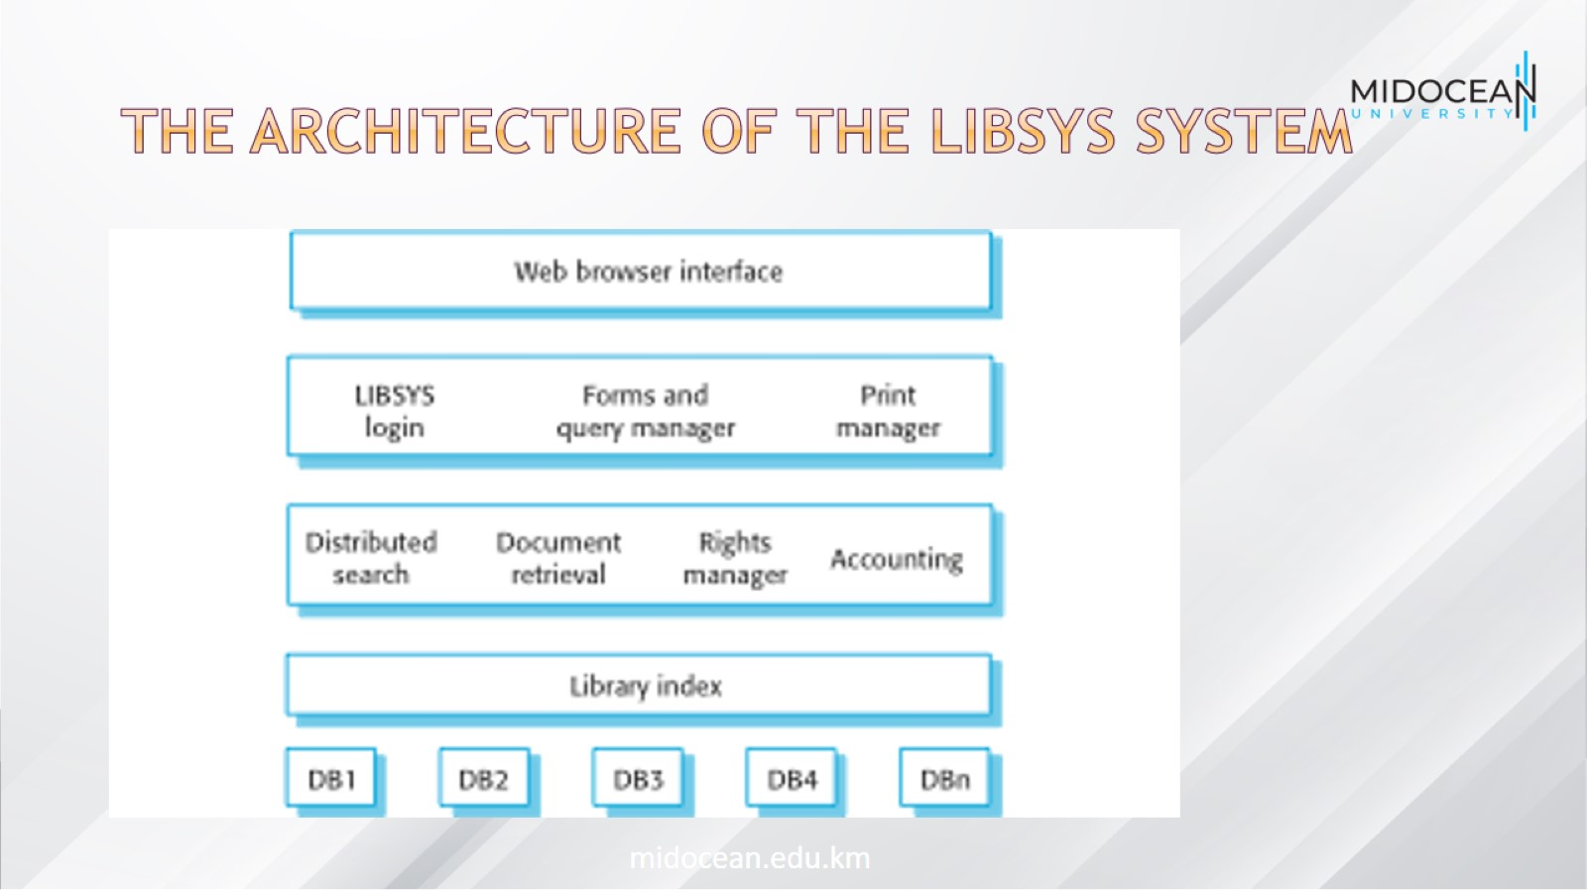
The architecture of the LIBSYS system

Slide 24
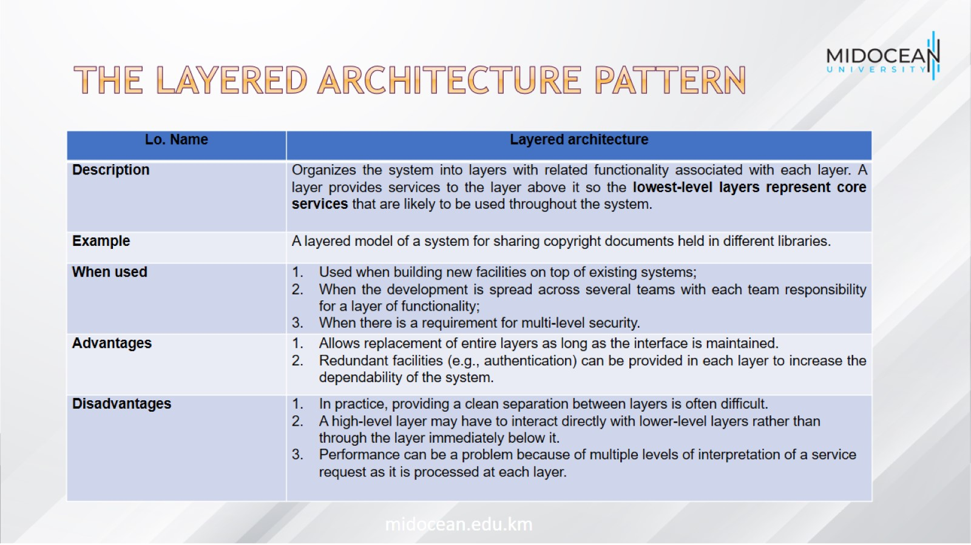
The Layered architecture pattern

Slide 25
The Layered architecture pattern

Slide 26
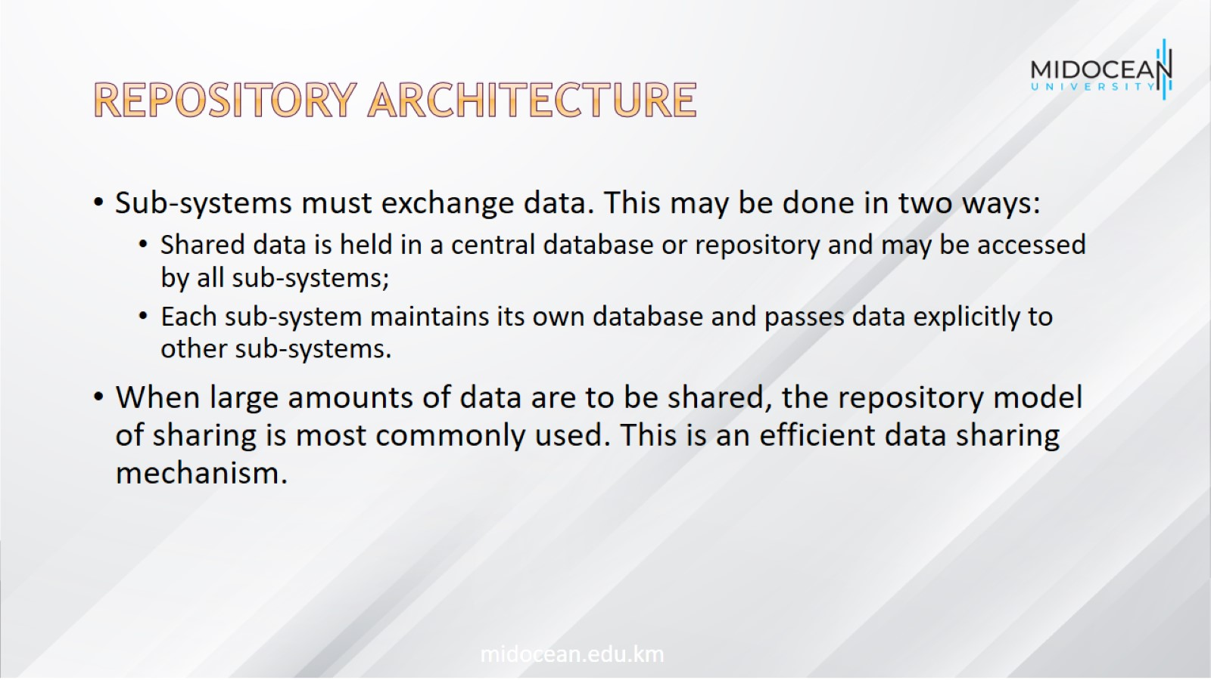
Repository Architecture

Slide 27
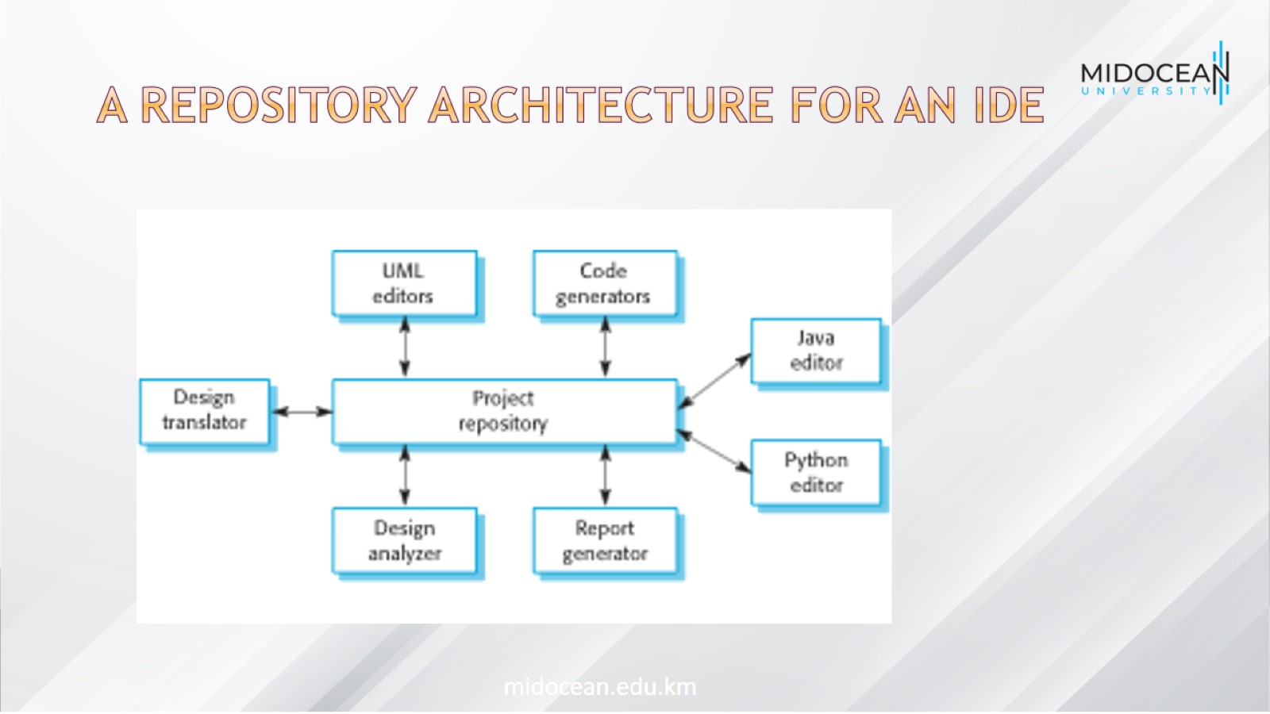
A repository architecture for an IDE

Slide 28
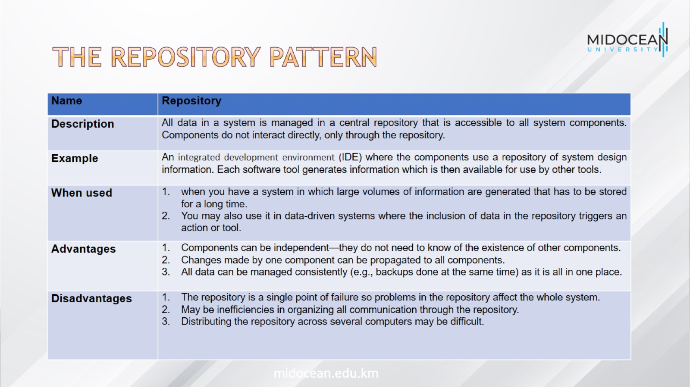
The Repository pattern

Slide 29
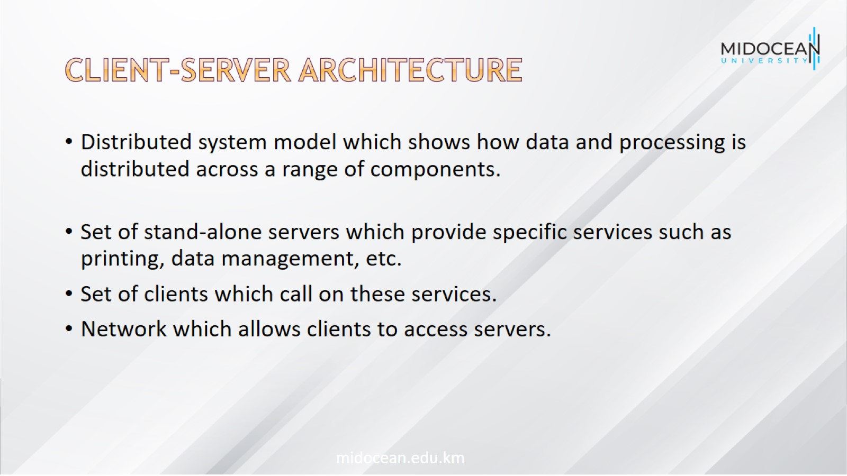
Client-Server Architecture

Slide 30
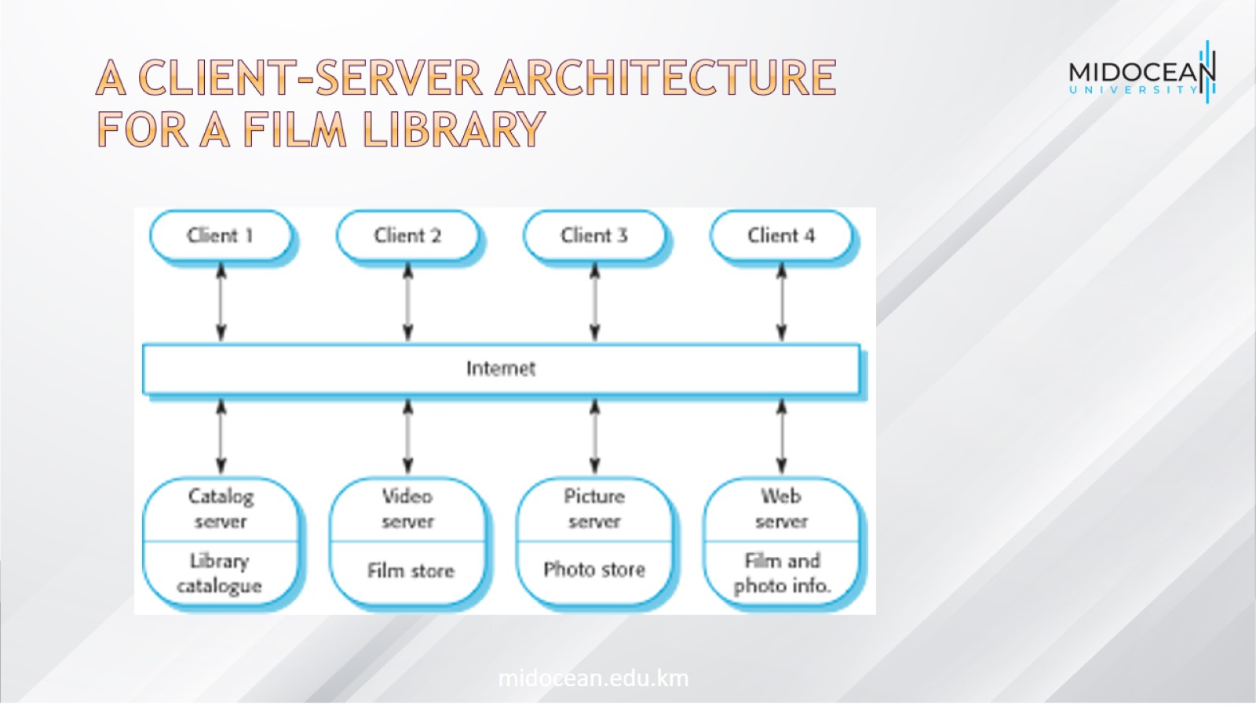
A client–server architecture for a film library

Slide 31
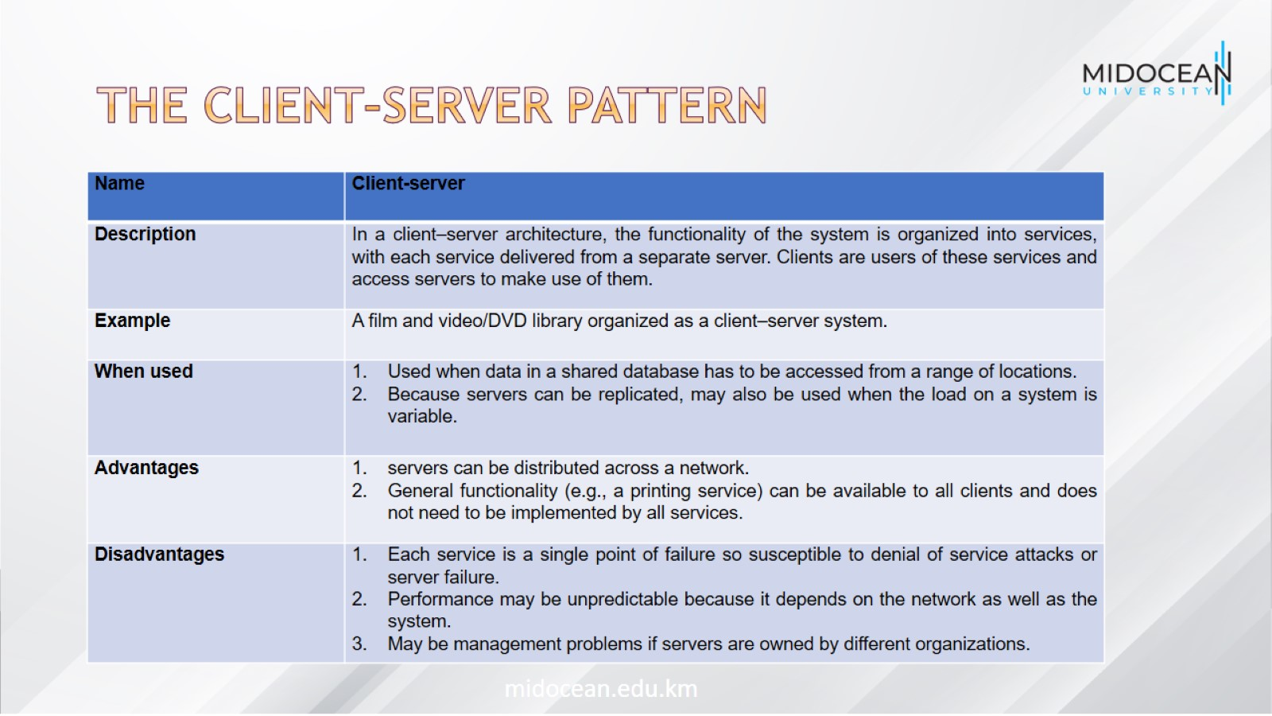
The Client–Server Pattern

Slide 32
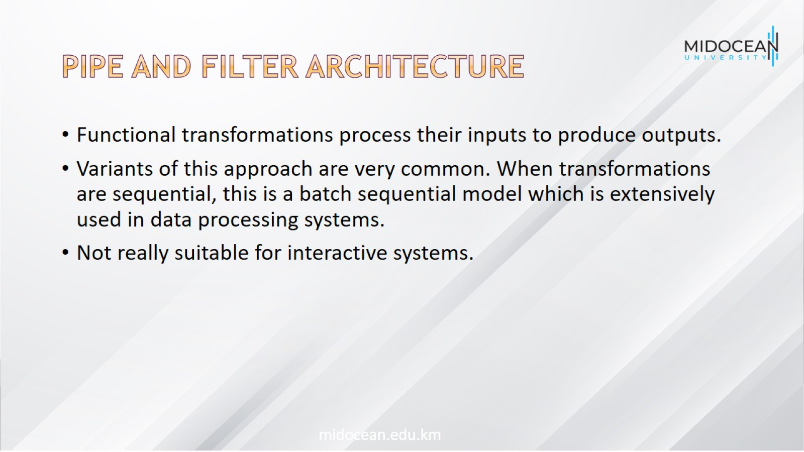
Pipe and Filter Architecture

Slide 33
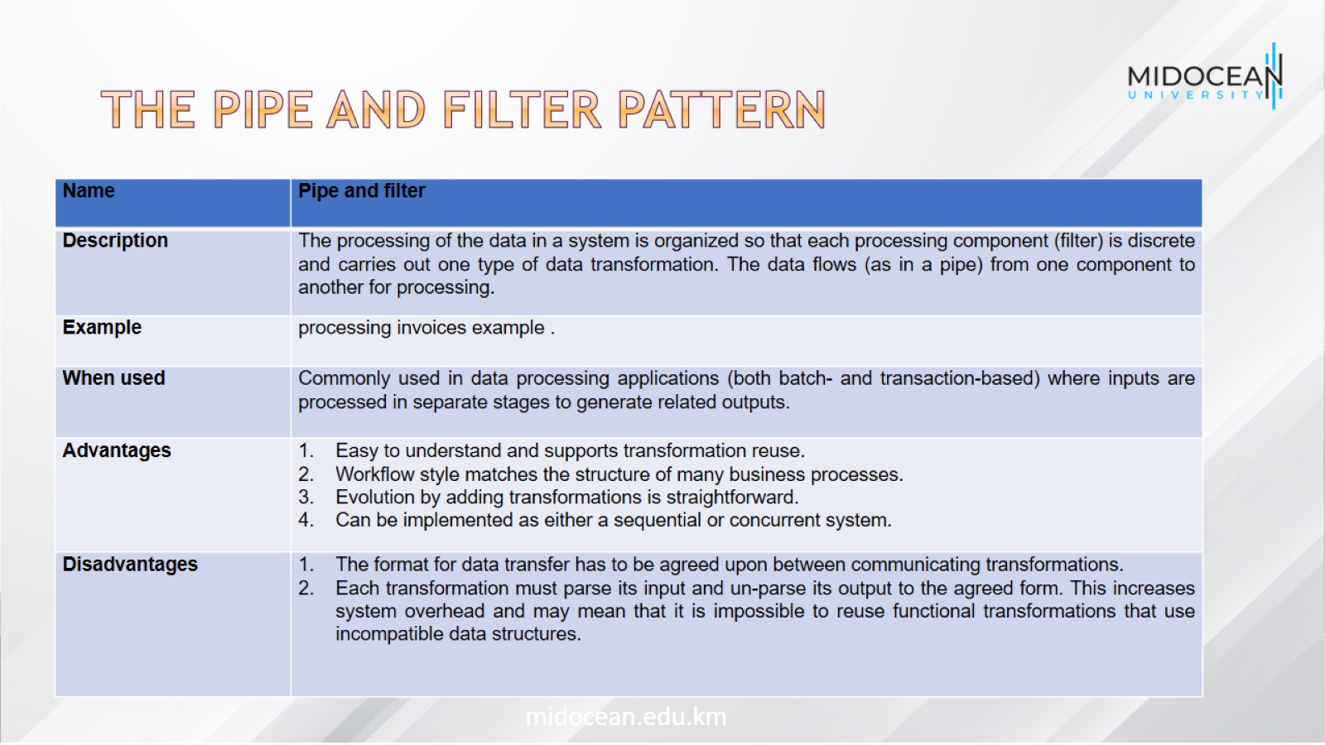
The pipe and filter pattern

Slide 34
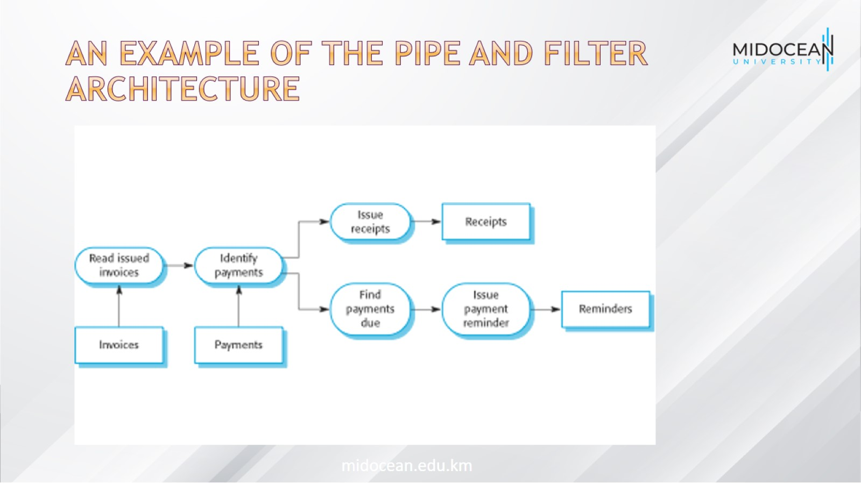
An example of the pipe and filter architecture

Slide 35

Application Architectures

Slide 36
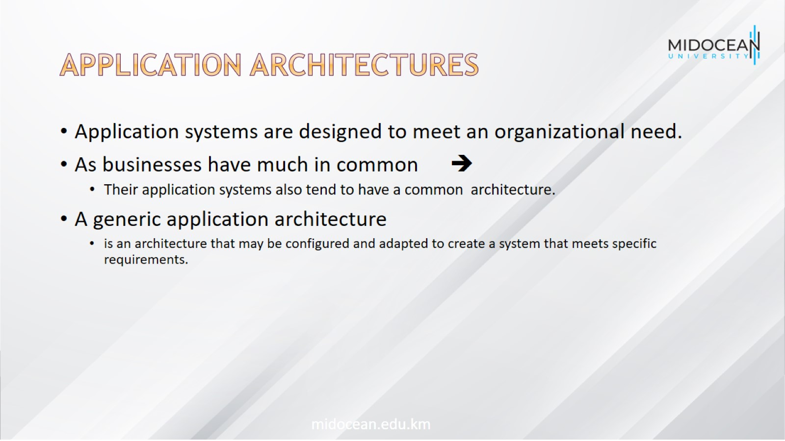
Application Architectures

Slide 37
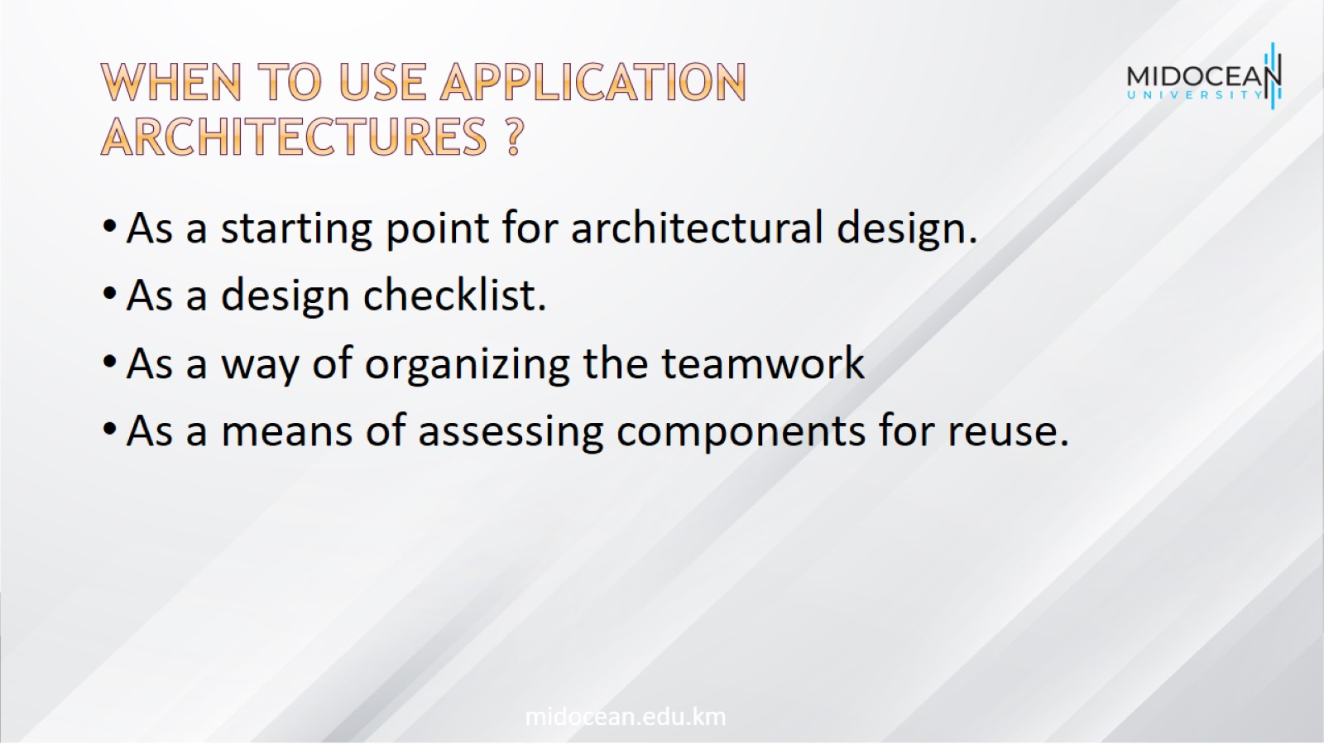
When to use Application
Architectures ?

Slide 38
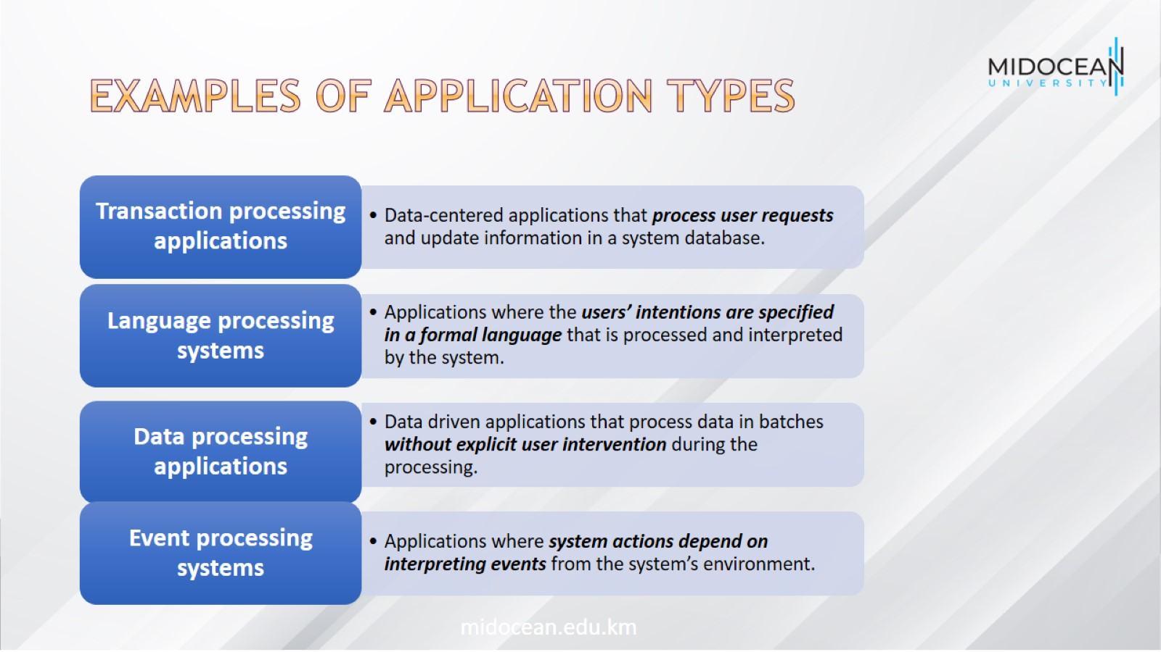
Examples of Application Types

Slide 39
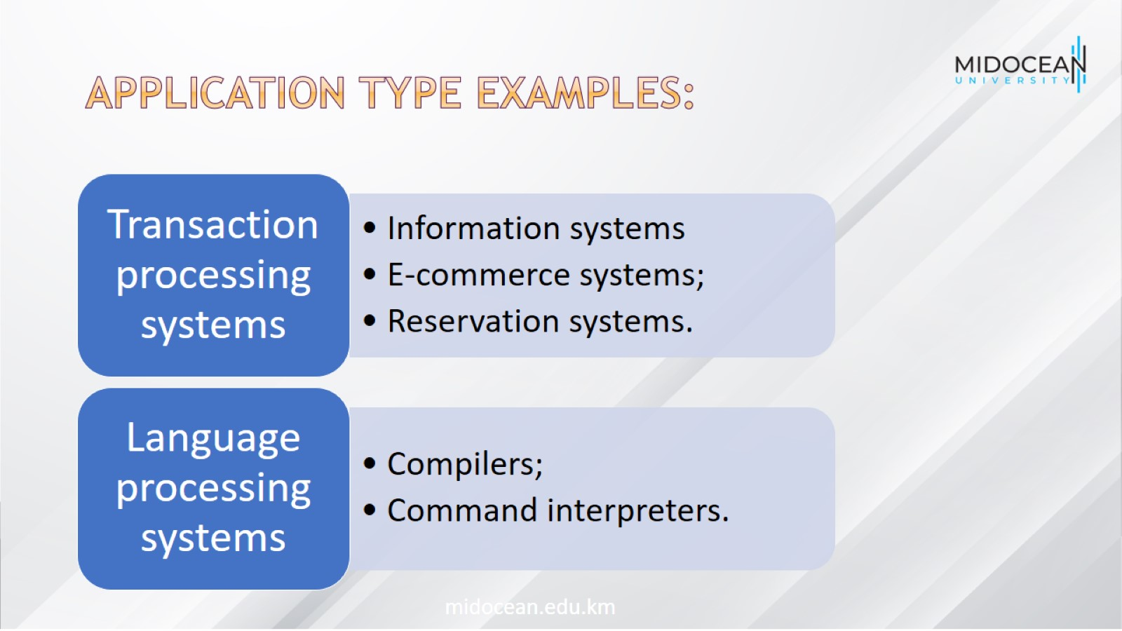
Application type examples:

Slide 40
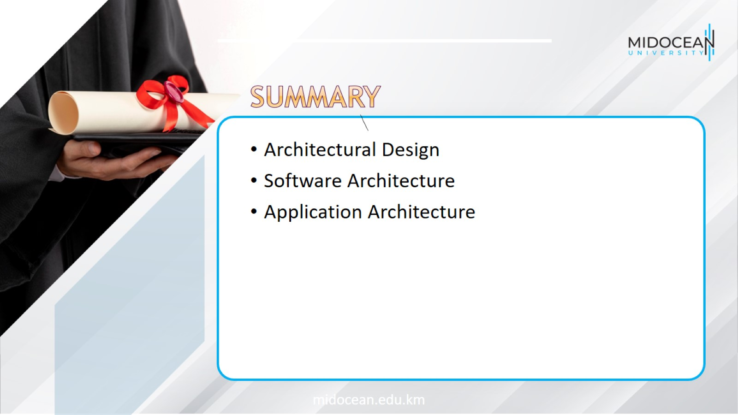

Slide 41


