Slide 1

The Information Society
Prepared by Dr. Shereen Kedwany
Lecture 3
DGM 711
Introduction to Digital Media

Slide 2


Chapter
03
Reminder
Digital media have common characteristics that distinguish them from Analog old media (Convergent, Hypertextual, Distributed, Pervasive, Algorithmic, Asymmetric, Ephemeral & Permanent) .
The architecture of the digital networks is not neutral, but rather has the power to shape the behaviors of their users.
The internet is an open system , based upon a global governance system.
Digital media and network technologies are composed of different “layers,” (physical, logical, content & Legal).
There are three generations of the web (Web 1.0 - Web 2.0 - Web 3.0 ).

Slide 3


Chapter
03
Outline
I. The Information Society Definition.
II. The Information Society Evolution.
III. The Networked Economy and Globalization.
VI. Conclusion.

Slide 4
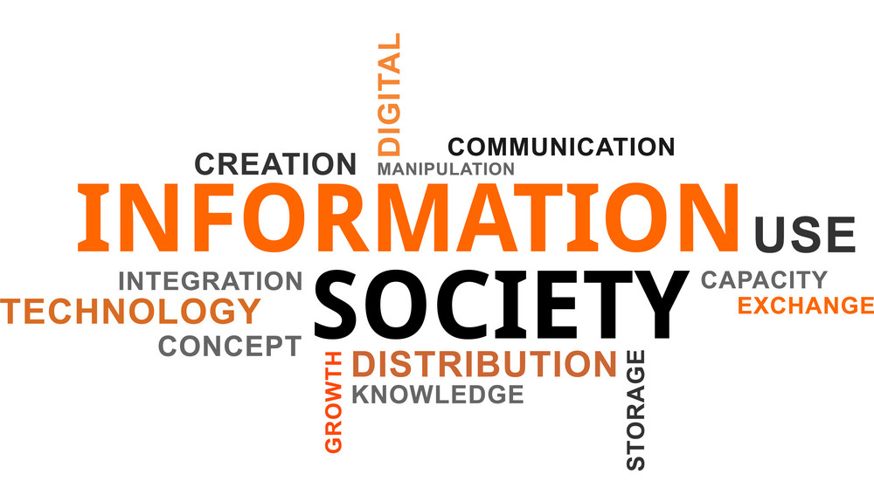
Chapter
03
I. The Information Society Definition
The production and management of information have assumed a key role in advanced societies, and have led to the emergence of terms such as “information society.”
The increasingly central position of information in social, political, and economic evolution has been made possible thanks to the evolution of computers and networks.
The information society is not a given, but rather a project that continues to grow in new directions.

Slide 5

Chapter
03
I. The Information Society Definition
The concept of information society refers to a form of society characterized by the importance of the production and management of information and knowledge (Webster 2014).

Slide 6
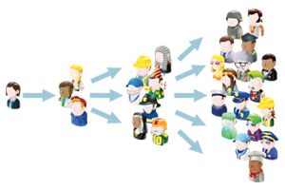
Chapter
03
I. The Information Society Definition
In information societies, technologies for the production, manipulation, and communication of information are pervasive and affect social and productive processes, as well as personal and political identities.

Slide 7

Chapter
03
I. The Information Society Definition
The ability to produce, manipulate, and distribute information becomes one of the main factors related to wealth and power, and therefore a battleground of economic, social, and political development for individuals, businesses, and governments.

Slide 8
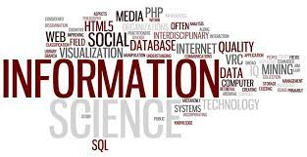
Chapter
03
II. The Information Society Evolution
The birth and affirmation of the information society are not only related to the spread of digital information and communication technologies, but also to the economic and political upheavals of the last few decades of the twentieth century, such as the end of the bipolar world, as well as the emergence of globalization processes and new production paradigms.

Slide 9

Chapter
03
II. The Information Society Evolution
These changes have been described with definitions that, while adopting different vantage points, tend to refer to the same set of phenomena.
For example, the second half of the twentieth century saw the emergence of concepts such as “post‐industrial society,” “post‐modern society,” “post‐Fordism,” “knowledge society,” “network society,” and “cognitive capitalism” .

Slide 10
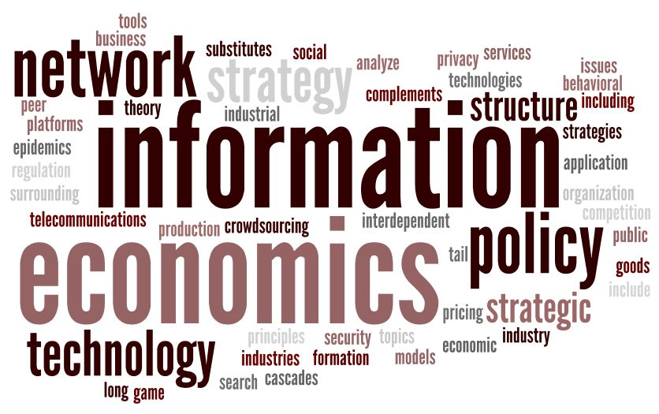
Chapter
03
II. The Information Society Evolution
Under this new paradigm, information and knowledge became key inputs in the economy and organization of contemporary societies.
The technologies which are used to produce, manage, and distribute information are widespread and characterized by decreasing costs, at least in rich countries where increasingly large sections of the population have access to a computer connected to digital networks and companies can organize their production processes and business through information technologies.

Slide 11

Chapter
03
II. The Information Society Evolution
In addition, information technologies make social and productive structures more flexible, as they allow actors to organize and carry out networked processes that would have been too costly and inefficient under traditional forms of organization.

Slide 12

Chapter
03
II. The Information Society Evolution
The concept of “information society” began to spread in the 1990s, both in the public debate and within academia.
The spread of the internet, which accelerated in the second half of the decade, created a feeling of radical change.
Visions of economic transformation were boosted by hopes about the democratic and transparent nature of new technologies, as well as their wide social effects.

Slide 13
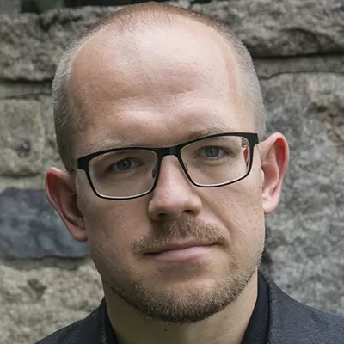
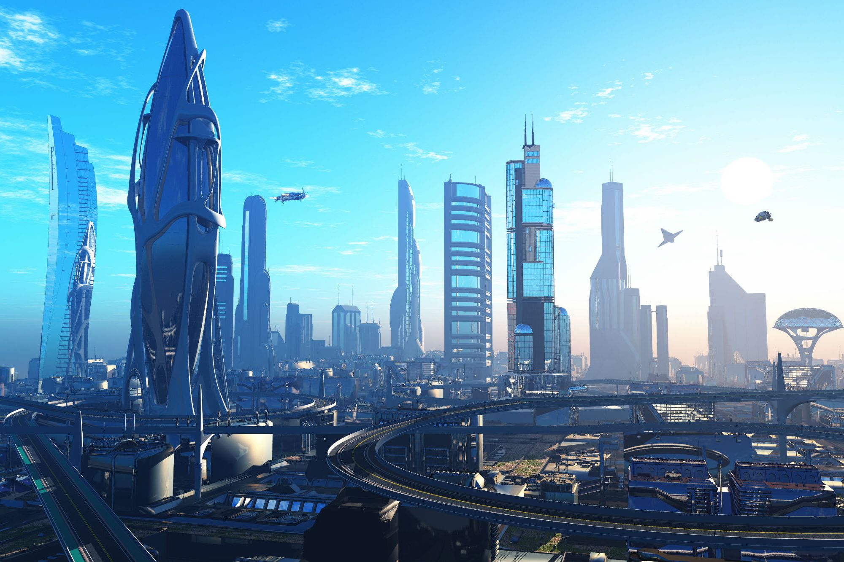
Chapter
03
II. The Information Society Evolution
According to “cyber‐utopian” view (Morozov 2011), digital networks would lead to widespread access to knowledge and a radical political democratization, as well as to a new economy based on communication and flexibility.

Slide 14
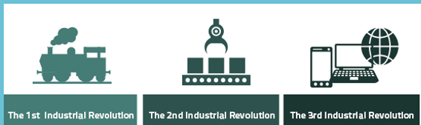
Chapter
03
II. The Information Society Evolution
In the economic realm, the birth of the information society was described as a third industrial revolution .
If the first was that of the steam engine and the second that of electricity and the internal combustion engine, the third would be based on technologies for the production, management, and transmission of information.

Slide 15

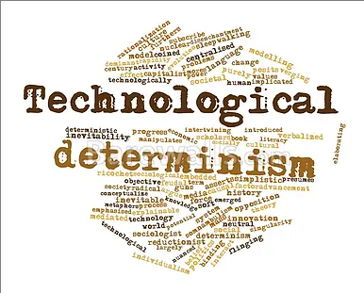
Chapter
03
III. The Networked Economy and Globalization
The debate on the rise of the information society has been dominated by the figure of the Catalan sociologist Manuel Castells, who in the 1990s articulated a detailed account of what he saw as a new era in the evolution of contemporary society, with effects in economy and politics.
Castells’s thesis contains a certain amount of technological determinism.

Slide 16

Chapter
03
III. The Networked Economy and Globalization
In fact, he formalized the economic, social, and political role of information in a changing society.
In industrial societies, economic and political power was linked to the production of material objects.
In information societies, informational or intangible assets such as brands, innovation, and knowledge determine economic success.
The era of informational capitalism begins.

Slide 17
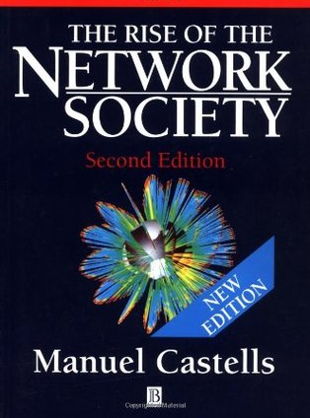
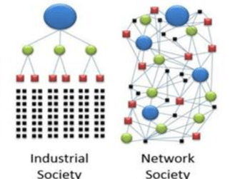
Chapter
03
III. The Networked Economy and Globalization
Castells described networks as the core organizational structures.
In fact, he tended to use the term “network society,” as in the title of the first volume of his book: The Rise of the Network Society (1996).

Slide 18

Chapter
03
III. The Networked Economy and Globalization
The economic system that has emerged from this transformation is characterized by being, in Castells’s definition, informational, global, and networked.
In the informational economy, productivity, competitiveness, and profitability depend on the ability to generate and manipulate information and knowledge.
Research and development, and thus innovation, become crucial for the enterprise.
Indeed, the money spent by the private sector in scientific and technological research exceeded public investment for the first time since World War II, a trend that continues today.

Slide 19
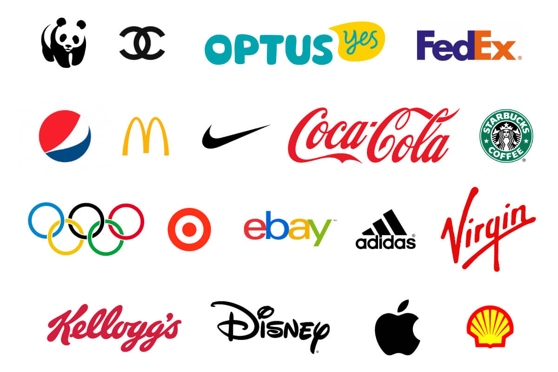
Chapter
03
III. The Networked Economy and Globalization
The main resources of the informational economy are not factories and machinery, but rather those related to information: brands, patents, the ability to manage networks of suppliers, subcontractors, and distributors, as well as design and marketing operations.
Companies like Nike or Apple do not own the factories that produce their shoes or smartphones: the production of material goods is subcontracted to external producers, often in Asia.

Slide 20


Chapter
03
III. The Networked Economy and Globalization
Western companies own the intellectual property (patents on product innovation and trademark rights), conduct research and development, organize networks of suppliers and sales operations, and manage marketing and communication.
Controlling these informational goods is more profitable, given that the capital invested in information provides a higher return than that invested in material production.

Slide 21

Chapter
03
III. The Networked Economy and Globalization
Information and knowledge are both the raw material and the output of the production processes these companies control.
Further, information is an intangible good that is crucially different from material goods and needs to be regulated by specific forms of property.
Thus, in an information society intellectual property rights acquire unprecedented importance .

Slide 22

Chapter
03
III. The Networked Economy and Globalization
For companies that produce goods with a high information content, such as in hi‐tech or the cultural industry, owning patents or copyrights becomes crucial.
In fact, since the early 1980s intellectual property rights have been expanded to the results of scientific research conducted in public universities, as well as to new types of informational goods.
Intellectual property rights have become longer and are more closely integrated at the national and global level .

Slide 23

Chapter
03
III. The Networked Economy and Globalization
Intellectual Property Rights
Intellectual property rights are an array of legal principles that enable creators and inventors to exercise ownership rights over the fruits of inventiveness and ingenuity.

Slide 24
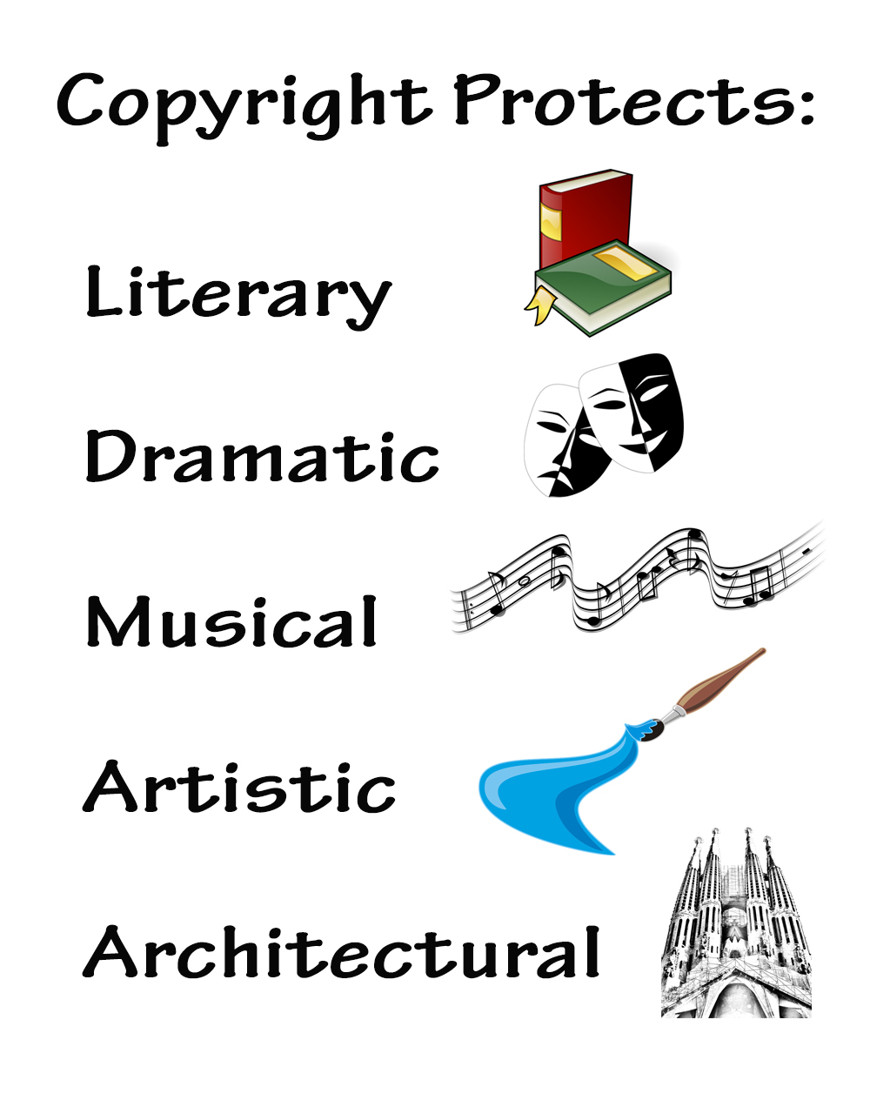
Chapter
03
III. The Networked Economy and Globalization
Intellectual property rights are divided in three main types:
1- Copyright protects artistic, literary, and scientific work.
for example, a song, a book, or a newspaper article.

Slide 25

Chapter
03
III. The Networked Economy and Globalization
2- Patents protect industrial inventions:
Innovations that in addition to being new and original are reproducible and applicable to industrial activities.
For example, a new microchip or touchscreen technology.

Slide 26
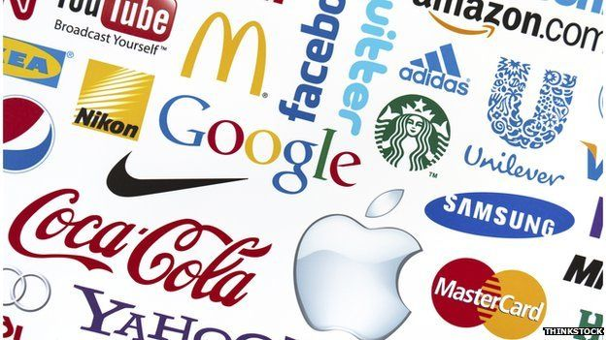
Chapter
03
III. The Networked Economy and Globalization
3- Trademarks distinguish a product or a company, making them recognizable by the consumer.

Slide 27

Chapter
03
III. The Networked Economy and Globalization
Intellectual property is a temporary concession that was originally meant to boost creative and inventive activities.
After a certain period of time, works or inventions enter the public domain, so that all of society can benefit from them.
This is based on the premise that information is different from material goods.

Slide 28


Chapter
03
III. The Networked Economy and Globalization
Although both can be traded on the market, from an economic point of view a car is quite different from a song.
First, a car is a material and tangible good that, if possessed by an individual, cannot be owned by another.
The cost of producing a material good never reaches zero.

Slide 29

Chapter
03
III. The Networked Economy and Globalization
Instead, an intangible good such as a song behaves differently.
Economists say that information is a non‐rival good, and has a marginal cost of zero.
Non‐rival means that the fact that a person sings a song does not prevent others from doing the same at the same time: unlike in the case of cars, which cannot be used by two people at the same time, there is no rivalry among the users of a song.

Slide 30

Chapter
03
III. The Networked Economy and Globalization
The marginal cost of reproducing information tends to be zero: recording a song has an initial cost, but the cost of producing copies is negligible.
Digital technologies have accentuated this feature: today, producing a new copy of a movie in a computer is simple, fast, and virtually without costs.
Intellectual property rights establish artificial marginal costs in the form of licensing fees to be paid to produce a copy of an intangible asset such as a copyrighted song or to build a patented machinery.

Slide 31
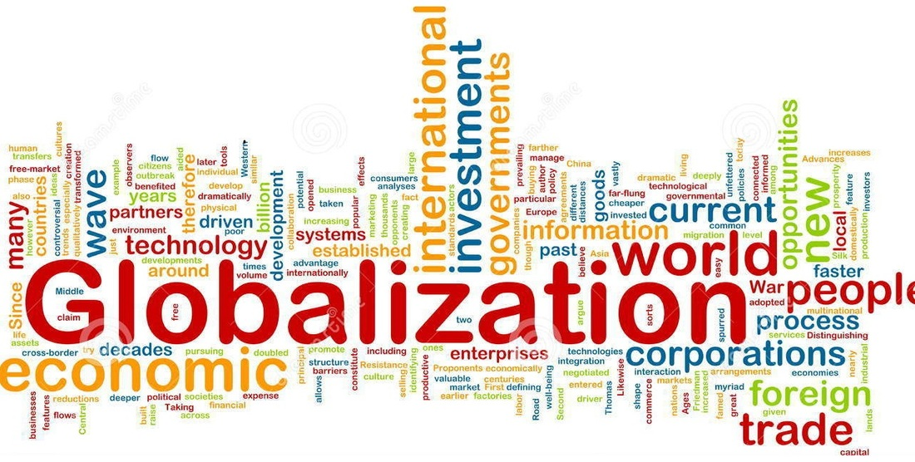
Chapter
03
III. The Networked Economy and Globalization
A globalized economy is characterized by economic institutions that have the organizational and technological capacity to operate on a global scale in real time.

Slide 32
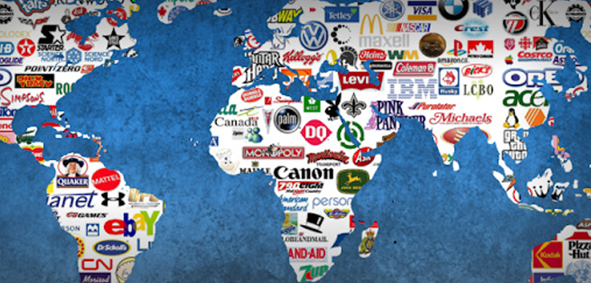
Chapter
03
III. The Networked Economy and Globalization
However, in today’s information society globalization has become a major economic phenomenon underpinned by the emergence of new actors.
Among the most important are organizations such as multinational companies, which use digital media and networks to control complex and transnational processes.

Slide 33

Chapter
03
III. The Networked Economy and Globalization
Production, consumption, and movement of goods are thus organized on a global scale.
This fosters the emergence of a global consumer culture in which goods, lifestyles, and forms of consumption spread around the world and are adapted in different local contexts.

Slide 34

Chapter
03
III. The Networked Economy and Globalization
Global financial markets, which are managed through digital media and network technologies, are another feature of the globalized economy .

Slide 35
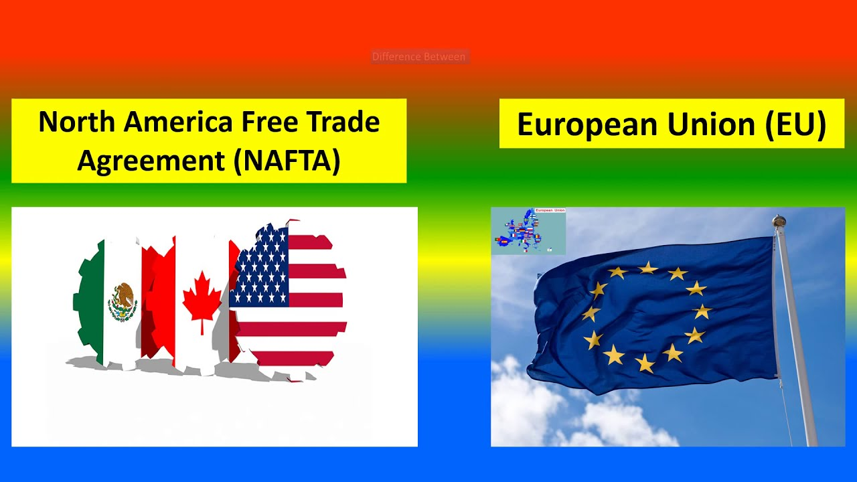
Chapter
03
III. The Networked Economy and Globalization
Finally, the importance of supranational entities and treaties that include sets of countries or entire regions of the globe increases.
This is the case of free trade agreements such as NAFTA (North American Free Trade Agreement), a treaty between Mexico, the United States, and Canada that has been in place since the 1990s, the European Union, the World Trade Organization, or the World Bank.

Slide 36

Chapter
03
III. The Networked Economy and Globalization
Finally, Castell’s networked economy is characterized by flexible forms of production.
The rigid hierarchies of factory work and the bureaucratic organizations of industrial society are transformed toward a new paradigm of the organization of production.
The processes that underpin production in such a paradigm have been described as based on network structures, and thus organized around decentralized and autonomous production units.

Slide 37
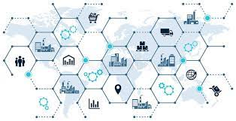
Chapter
03
III. The Networked Economy and Globalization
Networks of companies formed by suppliers, subcontractors, manufacturers, distribution companies, and commercial operations thrive in contemporary economies.
Networks were not born with these changes of new information and communications technologies, but rather are an old form of social organization: kinship networks are the fundamental form of tribal societies, and networks of business contacts by land and sea have been structuring globalization processes for centuries.

Slide 38

Chapter
03
VI. Conclusion
The concept of information society refers to a form of society characterized by the importance of the production and management of information and knowledge.
The ability to produce, manipulate, and distribute information becomes one of the main factors related to wealth and power.
The birth of the information society was described as a third industrial revolution .
The economic system of the information society is characterized by being informational, global, and networked.
In an information society, intellectual property rights are divided in three main types: (copyright, trademarks , patents).
A globalized economy is characterized by multinational companies, which own digital media, and foster the emergence of a global consumer culture .

Slide 39
Thank you for listening
DGM 711
Introduction to Digital Media

