Slide 1

Lists and Dictionaries Data Types
Prepared by Dr. Hamada I. AbdulWakel
Lecture 5
CYB550
Programming Foundations In Python

Slide 2

Lecture 5
MODULE OBJECTIVES
Investigate new python data types.
Explain how list and dictionary work.
Use methods in these new data types.
Decide whether a list or a dictionary is an appropriate data structure for a given application.

Slide 3
Lecture 5
New Python Data Types
A list allows the programmer to manipulate a sequence of data values of any types.
A dictionary organizes data values by association with other data values rather than by sequential position.

Slide 4
Lecture 5
List Data Structure
List : Sequence of data values (items or elements).
Some examples:
  Shopping list for the grocery store.
  To-do list.
  Guest list for a wedding.
  Text document, which is a list of lines.
Each item in a list has a unique index that specifies its position (from 0 to length – 1).

Slide 5
Lecture 5
List Basic Operations
Creating and printing list:
  Using range( ) method.
  Using [ ]
  Using list( ) method.
  Using print( ) method.

Slide 6
Lecture 5
List Basic Operations
Cont'd
Code:
  L1 = range(6)
  L2 = [1, 2, 3, 4]
  L3 = ["this is an item", 12]
  L4 = list()
  L5 = list( [10, 20, 30, 40] )
  L6 = list("python")
  print(L1)
  print(L6)

Slide 7
Lecture 5
List Basic Operations
Cont'd
Accessing, replacing, and slicing elements in list:
  List is mutable.
  Using the index operator [ ].
  The subscript operator is used to reference the target which is an element in the list.

Slide 8
Lecture 5
List Basic Operations
Cont'd
Code:
  Numbers = range(5)
  Numbers[5]
  Numbers[-1]
  Numbers[ : 3]
  Numbers[2 : ]
  Numbers[2] = 15

Slide 9
Lecture 5
List Basic Operations
Cont'd
Checking for list elements:
  Using in operator to determine an element's presence or absence.
  Use method index to locate an element's position in a list.
  >, <, ==

Slide 10
Lecture 5
List Basic Operations
Cont'd
Code:
  L1 = [10, 20, 30, 40]
  print(10 in L1)
  print(50 in L1)
  if 10 in L1:
  print(L1.index(10))
  print(20 not in L1)
  L2 = [1, 2, 3, 4]
  print(L1 == L2)

Slide 11
Lecture 5
List Methods
List methods:
Method | Description
len(L) | Get the length of list L
min(L) | Get the minimum element in list L
max(L) | Get the maximum element in list L
sum(L) | Get the summation of elements in list L

Slide 12
Lecture 5
List Methods
Cont'd
Code:
  L1 = [10, 20, 30, 40]
  print(len(L1))
  print(min(L1))
  print(max(L1))
  print(sum(L1))

Slide 13
Lecture 5
List Methods
Cont'd
List methods:
Method | Description
L.append(X) | Adds X element to the end of list L.
L1.extend(L2) | Adds the elements of list L2 to the end of list L1.
L.insert(index, X) | Inserts X element at index if index is less than the length of list L. Otherwise, inserts X at the end of L.
L.pop(index) | Removes and returns the element at index from list L. If index to specify, it removes and returns the element at the end of L.
L.count(X) | Counts the number of occurrence of element X in list L.

Slide 14
Lecture 5
List Methods
Cont'd
Code:
  L1 = [10, 20, 30, 40]
  L1.insert(1, 50)
  L1.append(10)
  L1.extend([1, 2, 3, 4])
  L1.pop()
  L1.pop(1)
  L1.count(20)

Slide 15
Lecture 5
List Methods
Cont'd
List methods:
Method | Description
L.index(X) | Returns the index of the first occurrence of element X in the list L.
L.remove(X) | Removes the first occurrence of the element X from the list L.
L.reverse() | Reverses the list L.
L.sort() | Sorts the elements in the list L in ascending order.

Slide 16
Lecture 5
List Basic Operations
Cont'd
Code:
  L1 = [5, 6, 2, 7, 1, 9]
  print(L1.index(2))
  L1.reverse()
  print(L1)
  L1.remove(2)
  print(L1)
  L1.sort()
  print(L1)

Slide 17
Lecture 5
Lists Equality
Mutable property of lists. If two aliases refer to the same list object, any modification make by any alias, the other can refer this object.
  L1 = [5, 6, 2, 7, 1, 9]
  L2 = L1
  L1[1] = 10
  print(L2)

Slide 18
Lecture 5
Lists Aliasing Side Effect
Cont'd
Prevent aliasing side effects:
  L1 = [5, 6, 2, 7, 1, 9]
  L2 = []
  for x in L1:
  L2.append(x)

Slide 19
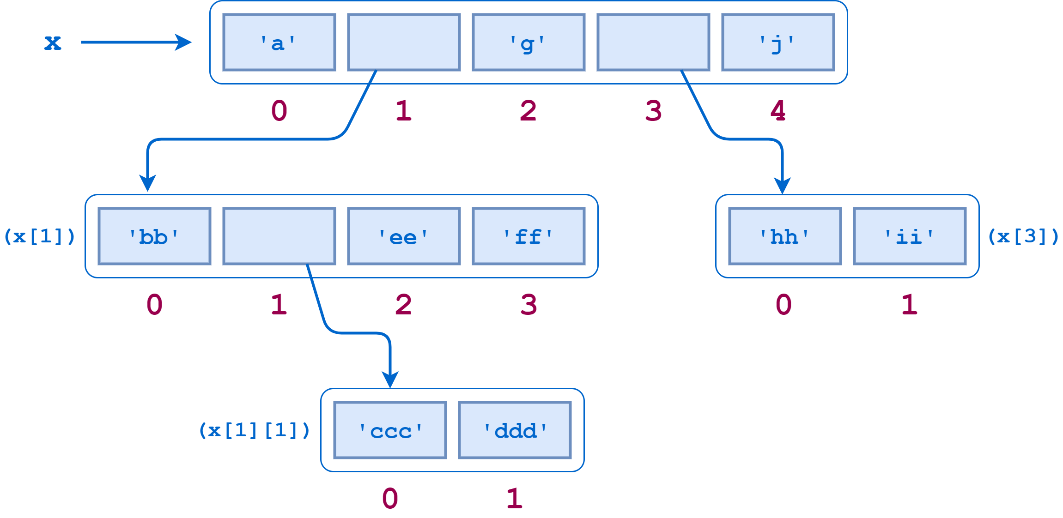
Lecture 5
Complex List
An element in a list can be any sort of object, therefore a list can contain sublists.

Slide 20
Lecture 5
Tuple Data Structure
Cont'd
A tuple resembles a list but is immutable.
Tuples are defined by enclosing the elements in parentheses ( ) instead of square brackets [ ].
Program execution is faster when manipulating a tuple than it is for the equivalent list.
Sometimes you don’t want data to be modified. If the values in the collection are meant to remain constant for the life of the program, using a tuple instead of a list guards against accidental modification.

Slide 21
Lecture 5
Tuple Data Structure
Cont'd
Tuple Immutable means, we can not add, delete, replace, reorder elements.
  T1 = ()
  T2 = (11, 22, 33)
  T3 = tuple([1, 2, 3, 4])
  T4 = tuple("abc")
  T2[0] = 44 #error 'tuple' object does not support item assignment

Slide 22
Lecture 5
Tuple Data Structure
Cont'd
Most of the operators and functions used with lists can be used in a similar fashion with tuples.
  T1 = (11, 22, 33)
  print(T1)
  print(T1[0])
  print(T1[0:2])
  print(min(T1))
  print(55 in T1)

Slide 23
Lecture 5
Tuple Basic Operations
Most of the operators and functions used with lists can be used in a similar fashion with tuples.
  T1 = (2)
  T2 = (2,)
  print(type(T1), type(T2))
  T3 = ('foo', 'bar', 'baz', 'qux')
  (s1, s2, s3, s4) = T3
  print(s1) #foo
  (s1, s2, s3) = T3 # error too many values to unpack

Slide 24
Lecture 5
Tuple Basic Operations
Cont'd
Code:
  T1 = 1, 2, 3
  print(T1)
  x1, x2, x3 = T1
  print(x1)
  x1, x2, x3 = 4, 5, 6
  print(x1)

Slide 25
Lecture 5
Dictionary Data Structure
A dictionary organizes information by association, not position.
  When you use a dictionary to look up the definition of “mammal,” you don’t start at page 1; instead, you turn directly to the words beginning with “M”.
Data structures organized by association are also called tables or association lists.
In Python, a dictionary associates a set of keys with data values.

Slide 26
Lecture 5
Dictionary Data Structure
Cont'd
A dictionary declaration.
  Code
  dict0 = {}
  dict1 = { <key>: <value>, <key>: <value>, . . . . , <key>:<value> }
  dict2 = dict([(<key>, <value>), (<key>, <value), . . ., (<key>, <value>)])
  dict3 = dict(keystring1='value', keystring2='value', . . . , keystringn='value')

Slide 27
Lecture 5
Dictionary Basic Operations
Accessing dictionary entries:
  friends = { 'Mohamed': 30, 'Ahmed': 25, 'Ali': 40 }
  print(friends)
  print(friends[1]) #error: elements are not accessed by numerical index.
  print(friends['Mohamed'])
  print(friends['Abdulrahman']) #error: keyerror 'Abdulrahman'

Slide 28
Lecture 5
Dictionary Basic Operations
Cont'd
Adding/removing entries to/from a dictionary:
  friends = { 'Mohamed': 30, 'Ahmed': 25, 'Ali': 40 }
  friends['Abdulrahman'] = 33
  print(friends)
  del friends['Mohamed']
  print(friends)
Updating the value for a specific key, not adding a new entry, keys are unique
  friends['Abdulrahman'] = 35

Slide 29
Lecture 5
Dictionary Basic Operations
Cont'd
Getting keys/values of a dictionary:
  friends = { 'Mohamed': 30, 'Ahmed': 25, 'Ali': 40 }
  print(len(friends))
  print(friends.keys())
  print(friends.values())

Slide 30
Lecture 5
Dictionary Basic Operations
Cont'd
Using in, not in, ==, =! operators with dictionary:
  friends1 = { 'Mohamed': 30, 'Ahmed': 25, 'Ali': 40 }
  friends2 = { 'Mohamed': 30, 'Ahmed': 25, 'Ali': 40 }
  print('Abdulrahman' in friends1)
  print('Ali' not in friends1)
  print(friends1 == friends2)
  friends2 = { 'Mohamed': 35, 'Ahmed': 25, 'Ali': 40 }
  print(friends1 == friends2)

Slide 31
Lecture 5
Dictionary Basic Operations
Cont'd
Method | Description
d.popitem() | Returns randomly select item from dictionary and also remove the selected item
d.clear() | Delete everything from dictionary
del d | Delete the dictionary d itself
d.get(key) | Returns value of key, if key is not found it returns None, instead on throwing KeyError exception
d.pop(key) | Removes the item from the dictionary, if key is not found KeyError will be thrown
d.has_key(key) | Returns True if the given key exists or False otherwise.
d.items() | Returns a list of tuples containing the keys and values for each entry.
dict(zip(lsit1, list2)) | Aggregate two lists to a dictionary

Slide 32
Lecture 5
Dictionary Basic Operations
Cont'd
Code:
  friends1 = { 'Mohamed': 30, 'Ahmed': 25, 'Ali': 40 }
  friends1.popitem()
  friends1.get("Ali")
  friends1.pop("Ali")
  friends1.has_key("Ali")
  friends1.items()
  friends1.clear()
  del friends1

Slide 33
Lecture 5
Dictionary Basic Operations
Cont'd
Traversing the dictionary entries:
  friends1 = { 'Mohamed': 30, 'Ahmed': 25, 'Ali': 40 }
  for key in friends1:
  print(key, ":", friends1[key])
  for val in friends1.values():
  print(val)

Slide 34
Lecture 5
Dictionary Basic Operations
Cont'd
Dictionary comprehension is an elegant and concise way to create a new dictionary from an iterable.
Dictionary comprehension consists of an expression pair (key: value) followed by a for statement inside curly braces {}.
  squares = { x : x * x for x in range(6) }
  print(squares)

Slide 35
THANK YOU

