Slide 1

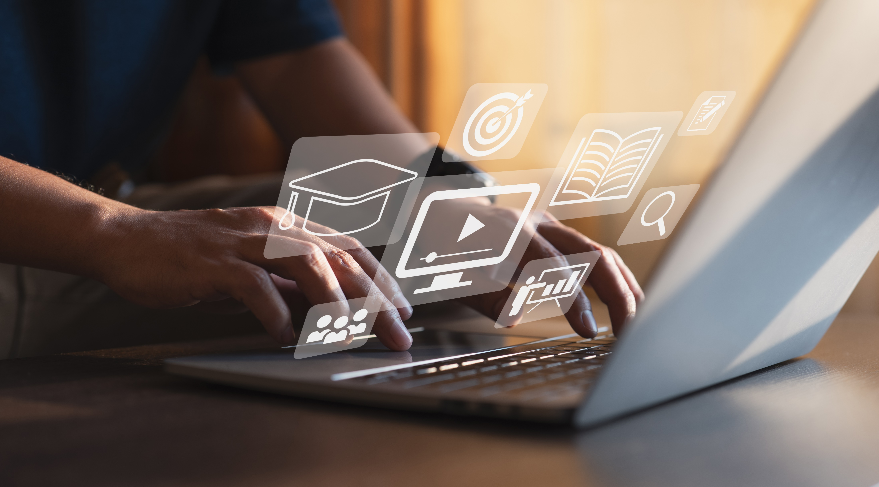
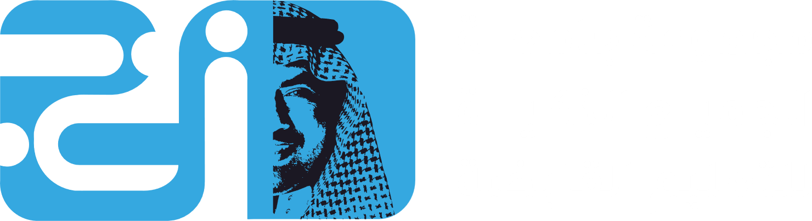
Digital Content Direction
Prepared by Dr. Sherihan Mohamed
DGM 733
Intro Lecture

Slide 2


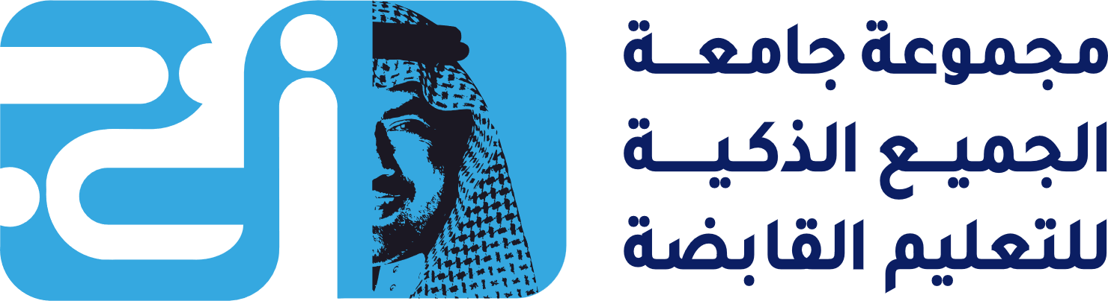

Intro Lecture
Lecture Outlines:
* Course description
* Learning outcomes
* Topics
* What is digital content?
* Why Media spreads?
* Conclusion

Slide 3
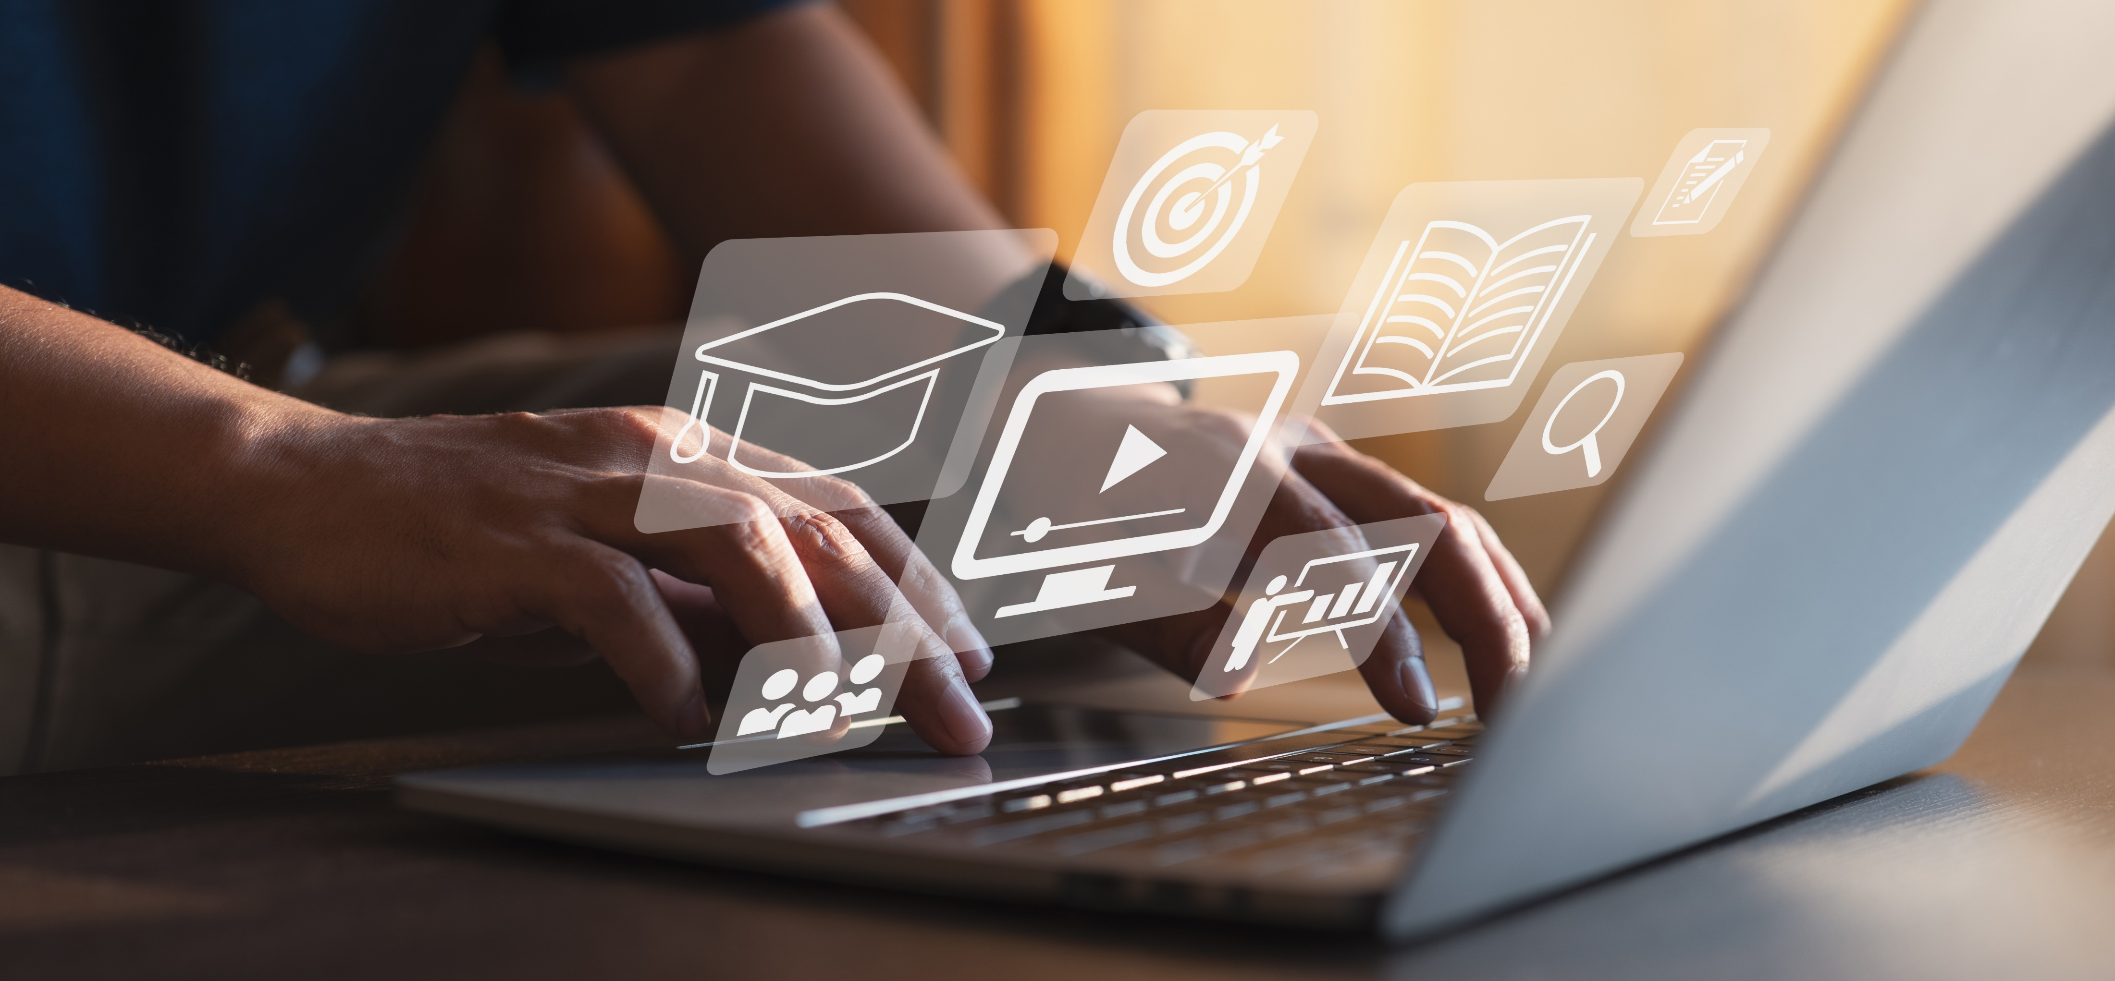
Intro Lecture
Digital Content Direction
Course description

Slide 4
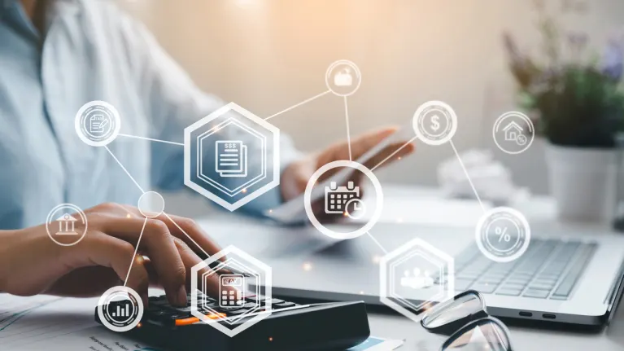
Course Description:
This course addresses digital content on different platforms, focusing on the manufacture of this content and the factors that are sought with the industry, most notably the references, ideas and trends of those involved in this industry, and their professionalism and skill.

Slide 5
And also covers principles and strategies for directing digital content across platforms—from websites to apps, e-newsletters to social videos—to achieve organizational objectives beyond creating awareness, informing, or entertaining. This includes developing creative guidelines and marketing practices to promote memorability, distinctiveness, and persuasiveness. In addition, this course emphasizes directing digital media to support diversity, inclusion, and accessibility.

Slide 6
Intro Lecture
Digital Content Direction
Learning outcomes

Slide 7
Learning outcomes:
Having successfully completed this course, you should be able to:
• Develop digital content analysis.
• Learn about the types of digital content makers.
• Be aware of the significance of the potential impacts of digital content.

Slide 8
• Evaluate digital content performance on strategic objectives.
• Craft creative directions based on market data, brand guidelines, and imagination.
• Analyze content progress using key performance indicators beyond vanity metrics.

Slide 9
• Integrate digital content into marketing campaigns that address all stages of the customer journey/marketing funnel from awareness to satisfaction.
• Devise guidelines for digital content to promote diversity and inclusion, addressing accessibility and cultural sensitivities.

Slide 10
Intro Lecture
Digital Content Direction
Topics

Slide 11

Topics
The main content of this course is:
Digital Content Purpose and Goals.
Who is a digital content creator?
Audiences and Other Stakeholders.
Owned versus Shared: Evaluating Platforms and Media Options.
Creative Direction.
Directing Development.
Marketing Integration of Digital Content.
Managing Digital Content.

Slide 12

Jenkins, H., Ford, S., & Green, J. (2013). Spreadable media: Creating value and meaning in a networked culture. New York University Press.
Recommended resources

Slide 13

Jay Daniel Thompson & John Weldon (2022), Content Production for Digital Media: An Introduction, Springer Nature Singapore.
Recommended resources

Slide 14
Intro Lecture
Digital Content Direction
What is digital content?

Slide 15
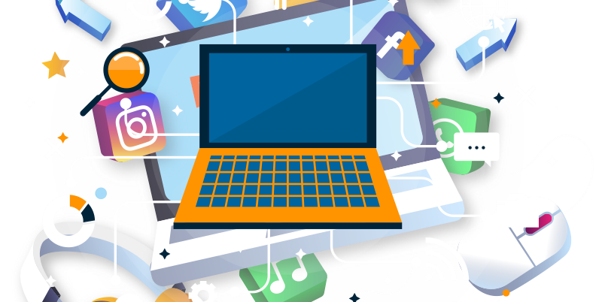
Digital content refers to any type of media that an organization uses to engage with visitors, customers, or users of their website or applications, distributed by online delivery systems.
What is digital content?

Slide 16
With more organizations now depending on their online presence to attract and retain users, digital content has become a vital resource in digital media producing. The term encompasses every type of publishable media from streaming video, downloadable guides, images, live broadcasts, or a piece of gated information.

Slide 17
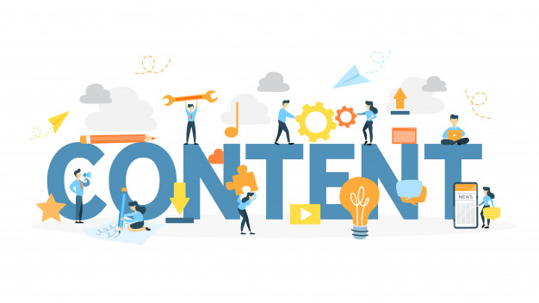
Viewed narrowly, digital content includes popular media types, while a broader approach considers any type of digital information (e. g. digitally updated weather forecasts, GPS maps, and so on) as digital content.

Slide 18
Types of digital content includes:
* Video: Types of video content include home videos, music videos, TV shows, and movies.
* Audio: Music is the most common form of audio.
* Images: Photo and image sharing is another example of digital content.

Slide 19
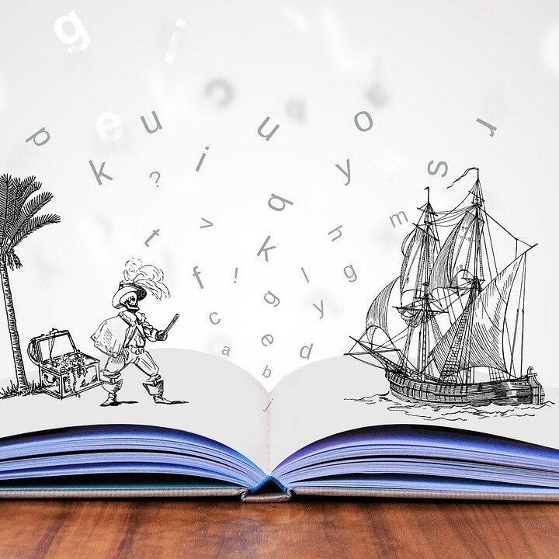
* Visual Stories: Stories are a new type of digital content.
* Text: Type of digital content which is available in text or written format. Blog websites which store data in form of textual format.

Slide 20
* Visual Stories:
What is Digital Storytelling?
https://youtu.be/JIix-yVzheM
Digital Storytelling
https://youtu.be/NmbHksCD1XQ

Slide 21
Intro Lecture
Digital Content Direction
Why Media spreads?

Slide 22
Digital Media Experiences Are Shaped by the Tools We Use.
Video
https://youtu.be/8AXiTZ6LQfs

Slide 23
The shift from distribution to circulation signals a movement toward a more participatory model of culture, one which sees the public not as simply consumers of preconstructed messages but as people who are shaping, sharing, reframing, and remixing media content in ways which might not have been previously imagined.

Slide 24
Cybersalon & Participatory Culture
Video
https://youtu.be/MZngUK2WuzA

Slide 25
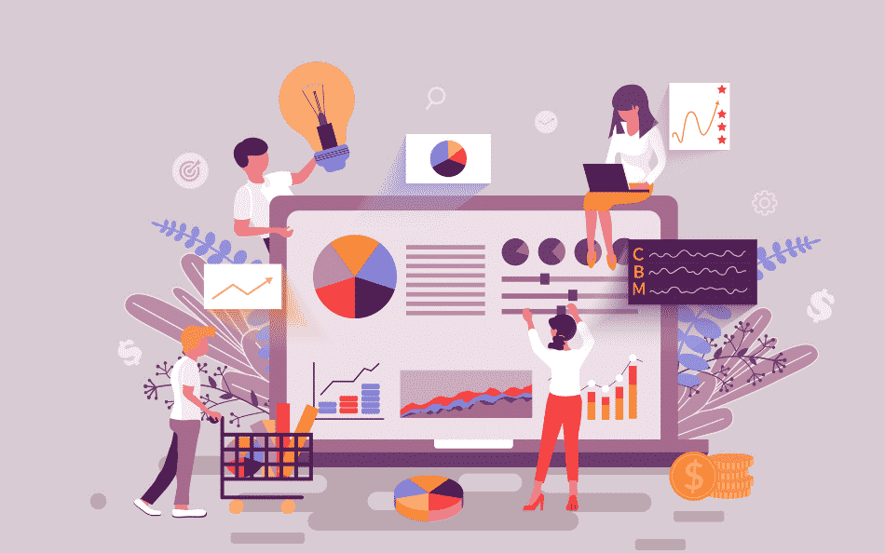
And they are doing so not as isolated individuals but within larger communities and networks, which allow them to spread content well beyond their immediate geographic proximity.

Slide 26
The term “participatory culture” describe the cultural production and social interactions of fan communities, initially seeking a way to differentiate the activities of fans from other forms of spectatorship. As the concept has evolved, it now refers to a range of different groups deploying media production and distribution to serve their collective interests, as various scholars have linked considerations of fandom into a broader discourse about participation in and through media.

Slide 27
Previous work on participatory culture stressed acts of reception and production by media audiences,
Audiences are making their presence felt by actively shaping media flows, and producers, brand managers, customer service professionals, and corporate communicators are waking up to the commercial need to actively listen and respond to them.

Slide 28
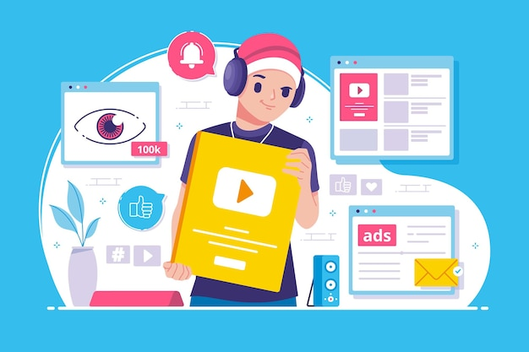
While many content creators are struggling with the growing prominence of such grassroots audience practices, an array of online communication tools have arisen to facilitate informal and instantaneous sharing.

Slide 29
These platforms offer new capacities for people to pass along media artifacts—and, in the process, to seek models to generate revenue through the activities of their users. However, while new tools have proliferated the means by which people can circulate material, word-of-mouth recommendations and the sharing of media content are impulses that have long driven how people interact with each other.

Slide 30
Spreadable Practices “Spreadability” refers to the technical resources that make it easier to circulate some kinds of content than others, the economic structures that support or restrict circulation, the attributes of a media text that might appeal to a community’s motivation for sharing material, and the social networks that link people through the exchange of meaingful bytes.

Slide 31
Spreadability assumes a world where mass content is continually repositioned as it enters different niche communities. When material is produced according to a one-size-fits-all model, it imperfectly fits the needs of any given audience. Instead, audience members have to retrofit it to better serve their interests.

Slide 32
As material spreads, it gets remade: either literally, through various forms of sampling and remixing, or figuratively, via its insertion into ongoing conversations and across various platforms. This continuous process of repurposing and recirculating is eroding the perceived divides between production and consumption.

Slide 33
The circulation of media content within participatory culture can serve a range of interests:
* some cultural (such as promoting a particular genre or performer).
* some personal (such as strengthening social bonds between friends).

Slide 34
* some political (such as critiquing some politics within mass media).
* some economical (such as those which serve the immediate needs of everyday individuals, as well as those which serve the needs of media companies).

Slide 35
We are not arguing that fans are somehow resisting consumer capitalism and its intellectual property regimes through these various processes and practices, as many of even these unauthorized activities might indirectly profit media companies and brands.

Slide 36
Whatever audience’s motivations, they may ⁽¹⁾discover new markets, ⁽²⁾generate new meanings, ⁽³⁾ renew once-faded franchises, ⁽⁴⁾support independent producers, ⁽⁵⁾locate global content which was never commercially introduced in a local market, or ⁽⁶⁾disrupt and reshape the operations of contemporary culture in the process.

Slide 37
Intro Lecture
Lecture Conclusion:
* Course description
* Learning outcomes
* Topics
* What is digital content?
* Why Media spreads?

Slide 38


Thank You

Slide 39
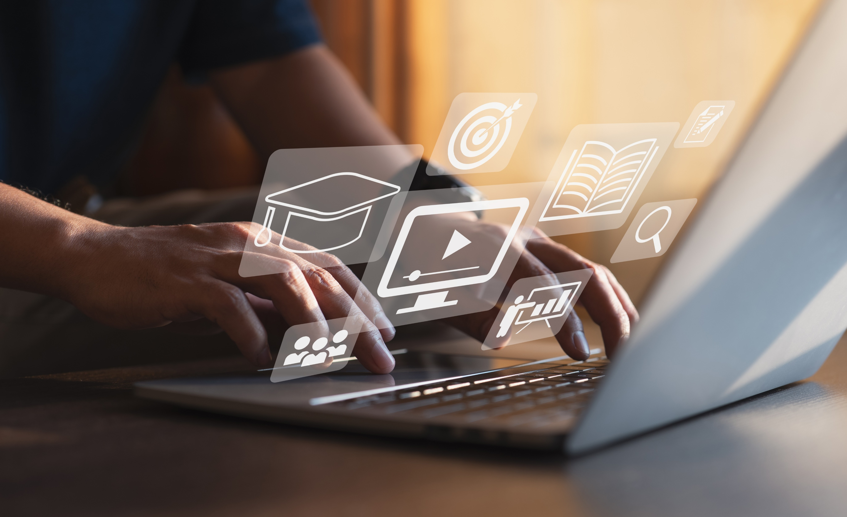
Digital Content
Direction
Intro Lecture
DGM 733
Prepared by:
Dr. Sherihan Mohamed

