Slide 1
HYBRID AI MODELS
for Intelligent Investment Advisory System
in the Saudi Stock Market
Meshal Manfi Alkhaldi
Academic ID: 251001992
Supervisor: Dr. Khaled Eskaf
College of Informatics · Midocean University · UAE
Master of Science in Artificial Intelligence

Slide 2
OVERVIEW
Agenda
1
Motivation & Problem
2
Research Objectives & Questions
Why AI advisory for Tadawul?
What this thesis sets out to answer
3
Literature Review
4
Proposed Framework
Four pillars: DL, Transformer, GNN, RL
End-to-end architecture
5
Methodology
6
Experimental Results
Data, models, evaluation protocol
Predictive + trading + multi-stock
7
Discussion & Contributions
8
Limitations & Future Work
Main findings and their meaning
Boundaries and next steps
Meshal Alkhaldi | Master Thesis Defense | Midocean University
2 / 25

Slide 3
CHAPTER 1
Motivation & Problem
THE CONTEXT
THREE OPEN GAPS
Modern financial markets are noisy, non-linear, and non-stationary — classical tools like ARIMA/GARCH struggle when regimes shift.
01
Saudi-specific studies
Most AI-finance work built on international exchanges — assumptions do not always survive.
Tadawul specifically shows strong sector co-movement (banking, materials, energy, telecom) — an ideal environment to study relational AI.
02
Per-stock modeling
Stocks are treated in isolation; sector and correlation structure is ignored.
03
Human-centered output
Raw predictions are hard to act on — investors need interpretable advice with confidence & risk.
Meshal Alkhaldi | Master Thesis Defense | Midocean University
3 / 25

Slide 4
SCOPE
Research Objectives & Questions
OBJECTIVES
RESEARCH QUESTIONS
1
Develop and evaluate DL & Transformer forecasting for selected Tadawul stocks.
RQ1
Which single-model baseline — Logistic, LSTM, or Transformer — provides the most balanced predictive foundation for a Saudi-market advisory system?
2
Specify a graph-based market representation with GNN embeddings as design.
RQ2
How much can a structured, non-learning trading strategy outperform Buy-and-Hold on Tadawul, as a decision-oriented benchmark for future RL work?
3
Specify an RL trading environment fed by hybrid predictive signals as design.
Specify an advisory layer (Buy/Sell/Hold + confidence + risk) as design.
RQ3
What architectural design fuses multiple AI outputs into a human-centered advisory format, and which components does it require?
4
5
Evaluate predictive and trading baselines on statistical and financial metrics.
RQ4
What profitability and drawdown control can the trading layer realistically achieve on out-of-sample data?
Scope note: RQs reframed to reflect delivered scope — predictive baselines and trading layer implemented; GNN, fusion, RL, and advisory engine specified as design (Sec. 3.3–3.6) and set as Future Work (Sec. 5.3).
Meshal Alkhaldi | Master Thesis Defense | Midocean University
4 / 25

Slide 5
CHAPTER 2
Literature Review — Four Pillars
DL
TX
GNN
RL
Deep Learning
Transformers
Graph Neural Nets
Reinforcement Learning
LSTM/GRU remain strong sequence baselines when paired with feature engineering.
Self-attention captures long-range dependencies and multivariate interactions.
Multi-relation stock graphs encode inter-stock dependencies missed by per-stock models.
Reframes trading as sequential decision-making with reward shaping for costs & risk.
Jayanth et al. 2024; Li et al. 2024
Friday et al. 2025
Ansari 2024
Ansari et al. 2022; Kabbani & Duman 2022
RESEARCH GAP
Prior work rarely targets the Saudi market and typically addresses only one or two of these dimensions at a time. This thesis unifies them for Tadawul.
Meshal Alkhaldi | Master Thesis Defense | Midocean University
5 / 25

Slide 6
SECTION 2.8
Research Gap — What This Thesis Fills
Four gaps emerge from the literature — this thesis addresses each one directly:
G1
Saudi-market perspective missing
G2
Isolated per-stock modeling
LITERATURE
LITERATURE
Most AI-finance studies built on non-Saudi datasets — Tadawul-specific dynamics under-studied.
Stocks treated as standalone time-series; sector co-movement and correlation ignored (Ansari 2024).
THIS THESIS FILLS
THIS THESIS FILLS
A Saudi-market experimental setup built on Sahmk-sourced Tadawul data (1202.SR, 2320.SR, 4300.SR).
GNN relational layer specified in Sec. 3.3 to encode inter-stock structure for Tadawul sectors.
G3
Forecasting vs Decision-making split
G4
Non-interpretable outputs
LITERATURE
LITERATURE
Prior work sits in either pure-prediction or automated-trading camp — rarely both (Kabbani & Duman 2022).
Raw predictions / opaque policies are unusable for real investors (Ansari et al. 2022).
THIS THESIS FILLS
THIS THESIS FILLS
Unified pipeline: predictive layer → trading layer → advisory output, with RL as decision policy.
Advisory engine specified in Sec. 3.6: Buy/Sell/Hold + confidence + risk context, human-centered by design.
Meshal Alkhaldi | Master Thesis Defense | Midocean University
6 / 25

Slide 7
CHAPTER 3
Proposed Framework — Pipeline Overview
1
2
3
4
5
6
Data
Preprocess
Features
Models
Fusion + RL
Advisory
▶
▶
▶
▶
▶
OHLCV
from Sahmk
Align, scale,
window (L=20)
9 technical
indicators
LR / LSTM /
Transformer
Hybrid signal
+ policy
Buy/Sell/Hold
+ confidence
Implemented in this thesis
Design-only · Future work
KEY DESIGN DECISIONS
Chronological split
Scaler fit on train only
Binary classification
70/15/15 — no random shuffling; time flows forward.
Prevents distribution leakage from validation/test.
Next-day up (>) vs down/flat — feeds Buy/Hold/Sell logic.
Meshal Alkhaldi | Master Thesis Defense | Midocean University
7 / 25

Slide 8
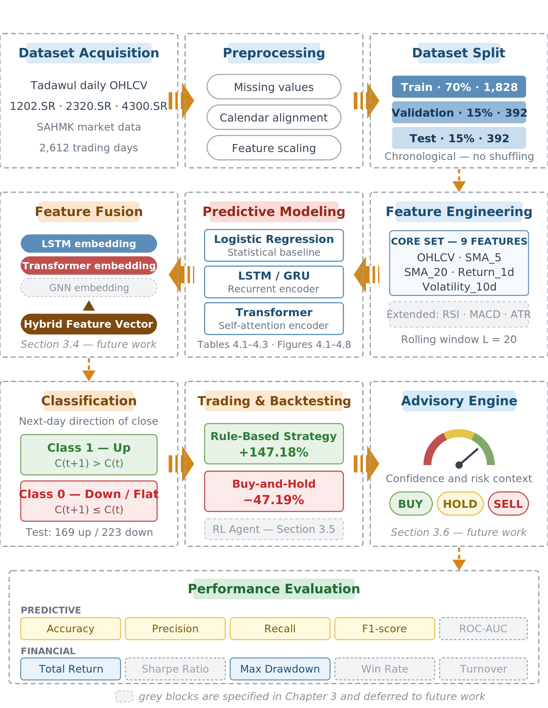
DETAILED VIEW
Figure 3.1 — Full Architecture (Hybrid Framework)
Solid blocks = implemented and evaluated in Chapter 4 · Grey dashed blocks = specified as design; deferred to future work
Meshal Alkhaldi | Master Thesis Defense | Midocean University
8 / 25

Slide 9
SECTION 3.2
Data — Tadawul via Sahmk
DATA SOURCE
SELECTED TICKERS
SAHMK market data service — primary source for Tadawul (.SR-suffixed tickers). Cross-verified against Yahoo Finance where coverage overlapped.
Ticker | Company | Sector | Role
1202.SR | Middle East Paper | Materials | Primary
2320.SR | Al Babtain Power | Capital Goods | Generalization
4300.SR | Dar Al Arkan | Real Estate | Generalization
2,612
9
trading days
(1202.SR)
features per day
(OHLCV + indicators)
CHRONOLOGICAL SPLIT (70 / 15 / 15)
20
3
Train
Validation
Test
1828
392
392
rolling window
(days)
sectors covered
(Materials, CapGoods, RE)
Meshal Alkhaldi | Master Thesis Defense | Midocean University
9 / 25

Slide 10
SECTION 3.3.1
Problem Formulation — Binary Classification
LABELING RULE
y(t) = 1 if C(t+1) > C(t) · y(t) = 0 otherwise
Unchanged closes are absorbed into class 0 (conservative choice — no upward evidence).
TWO CLASSES
Class | Label | Definition | Advisory interpretation
1 | Up movement | C(t+1) > C(t) — next-day close exceeds today | Positive signal → Buy or Hold
0 | Down/flat | C(t+1) ≤ C(t) — next-day close ≤ today | Negative/neutral → Sell or Hold
CLASS DISTRIBUTION IN TEST PARTITION (1202.SR)
Down/Flat · 223 (56.9%)
Up · 169 (43.1%)
Baseline accuracy from majority-class alone = 0.569
Meshal Alkhaldi | Master Thesis Defense | Midocean University
10 / 25

Slide 11
SECTION 3.3
Predictive Models — Three Baselines
LR
Logistic Regression
LSTM
LSTM
TX
Transformer
Statistical reference
Recurrent sequence baseline
Attention-based temporal
Linear, transparent, fast
Consumes flattened 20×9 window
Highest interpretability
Captures short-range temporal patterns
Hidden-state memory of past 20 days
Standard financial DL benchmark
Self-attention over the 20-day window
Captures long-range multivariate interactions
Motivated by Friday et al. (2025)
All three receive identical features, identical partitions, identical seeds — differences reflect model capacity alone.
Meshal Alkhaldi | Master Thesis Defense | Midocean University
11 / 25

Slide 12
SECTION 3.7
Evaluation — Two Axes
PREDICTIVE AXIS
FINANCIAL AXIS
Classification quality
Portfolio outcomes
Accuracy
Overall correctness — but misleading on imbalanced classes.
Total Return
Cumulative growth of capital over horizon.
Precision
Reliability of Buy signals.
Max Drawdown
Worst peak-to-trough decline.
Recall
Fraction of upward moves captured.
Sharpe Ratio
Excess return per unit of volatility.
F1 score
Primary criterion — harmonic mean of precision & recall.
Win Rate
Fraction of trades that closed profitable.
Macro-F1
Both classes weighted equally.
Turnover
Trading intensity (transaction-cost sensitivity).
Meshal Alkhaldi | Master Thesis Defense | Midocean University
12 / 25

Slide 13
CHAPTER 4
Results — Predictive Baselines (1202.SR)
The accuracy trap: highest accuracy ≠ best model. F1 tells the real story.
Model | Accuracy | Precision | Recall | F1
Logistic Regression | 0.5867 | 0.6667 | 0.0828 | 0.1474
LSTM | 0.5604 | 0.4545 | 0.1198 | 0.1896
Transformer | 0.5116 | 0.4343 | 0.4551 | 0.4444
Table 4.2 · Highlighted row = balanced choice for advisory use
KEY INSIGHT
Logistic Regression won on accuracy (0.5867) — but its recall of 0.0828 means it caught only ~1 in 12 upward movements. The Transformer sacrificed 8 pts of accuracy for 5.5× better recall and 3× better F1 — the more usable model for advisory downstream.
Meshal Alkhaldi | Master Thesis Defense | Midocean University
13 / 25

Slide 14
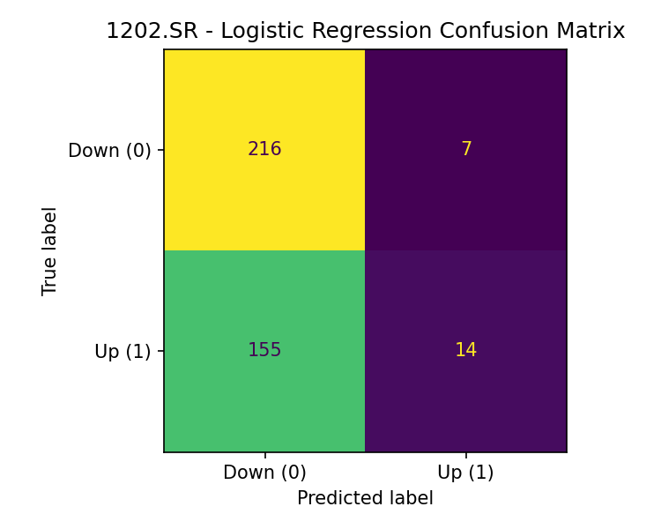

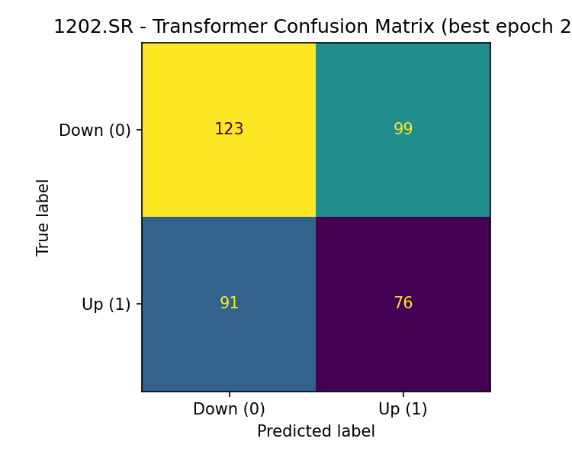
SECTION 4.3
Confusion Matrices — Visual Proof of the Accuracy Trap
The 3 models on the same 392-day test partition — same 169 Up days, same 223 Down days:
Logistic Regression
LSTM
Transformer
FN = 155 missed 155 of 169 Up days
Recall = 0.083 (~1 in 12)
FN = 147 still missing most Ups
Recall = 0.120
TP = 76, FN = 91 balanced
Recall = 0.455 (5.5× logistic)
Meshal Alkhaldi | Master Thesis Defense | Midocean University
14 / 25

Slide 15
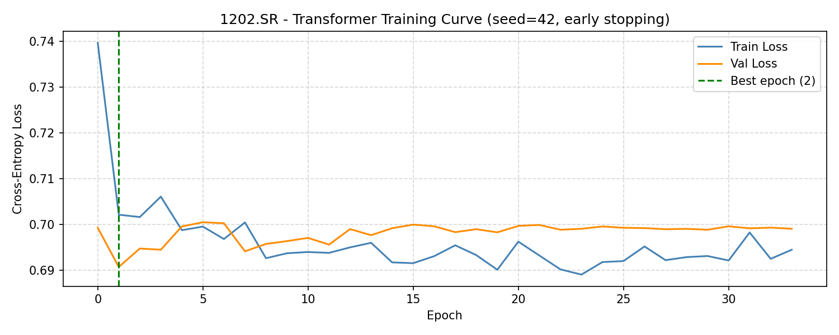
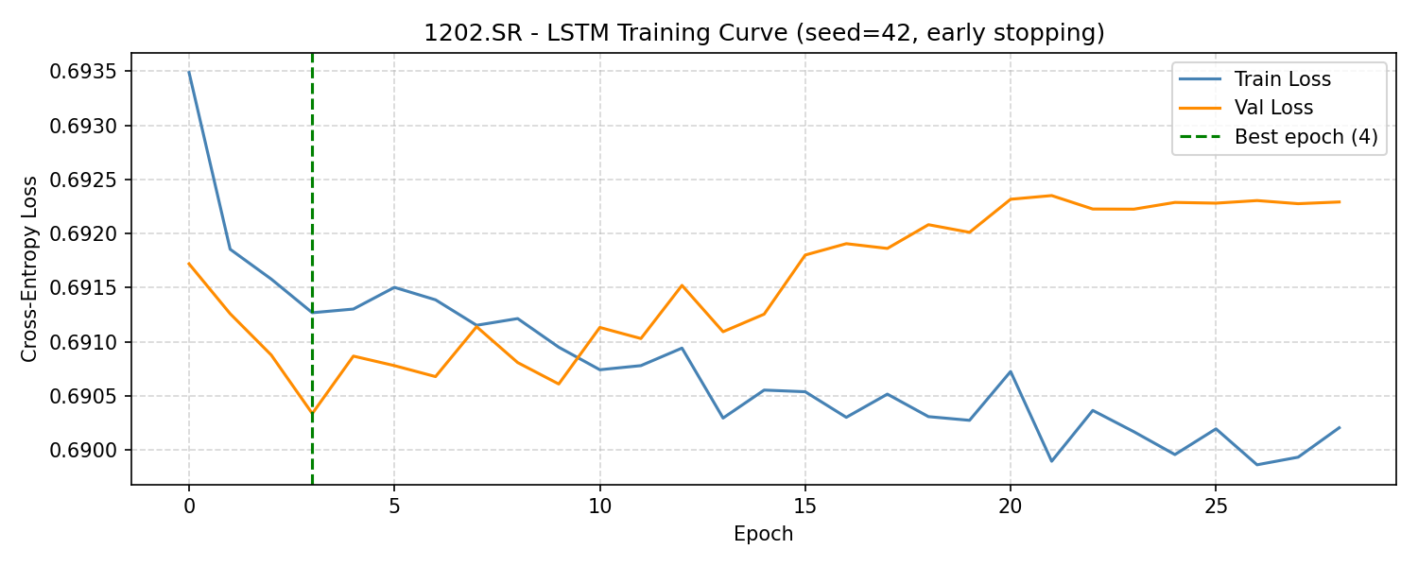
SECTION 4.3
Training Dynamics — Early Stopping in Action
Transformer · Best epoch = 2
LSTM · Best epoch = 4
WHY SO EARLY? · Best epoch = 2 is not a bug — it is the signal
1. Financial data is noise-heavy. Cross-entropy loss floor of ~0.69 for near-random binary problem — small dataset finds its best generalization fast.
2. Overfitting sets in quickly. Val loss diverges from train loss after epoch 2 (Transformer) / 4 (LSTM) — early stopping (patience) correctly picks the peak generalization epoch.
3. Consistent across architectures. Both LSTM and Transformer converge in single-digit epochs — evidence of a genuine signal-to-noise ceiling, not a training defect.
Meshal Alkhaldi | Master Thesis Defense | Midocean University
15 / 25

Slide 16
SECTION 4.4.2
Results — Multi-Stock Generalization
Does the ranking hold beyond a single stock? Extension across 2320.SR and 4300.SR.
Model | Ticker | Accuracy | Precision | Recall | F1
Logistic | 1202.SR | 0.5867 | 0.6667 | 0.0828 | 0.1474
LSTM | 1202.SR | 0.5604 | 0.4545 | 0.1198 | 0.1896
Transformer | 1202.SR | 0.5116 | 0.4343 | 0.4551 | 0.4444
Logistic | 2320.SR | 0.5037 | 0.5000 | 0.0923 | 0.1558
LSTM | 2320.SR | 0.5120 | 0.6111 | 0.0409 | 0.0767
Transformer | 2320.SR | 0.4991 | 0.4942 | 0.4758 | 0.4848
Logistic | 4300.SR | 0.5356 | 0.3103 | 0.0370 | 0.0662
LSTM | 4300.SR | 0.5588 | 0.0000 | 0.0000 | 0.0000
Transformer | 4300.SR | 0.5699 | 0.6875 | 0.0458 | 0.0859
Table 4.3 · Transformer is the most balanced overall — LSTM collapses on 4300.SR (0 recall)
Takeaway: Model performance varies by stock, but the Transformer stays the strongest balanced choice — validating it as the preferred temporal baseline.
Meshal Alkhaldi | Master Thesis Defense | Midocean University
16 / 25

Slide 17
SECTION 4.5
Results — Trading Baselines (aligned window)
Rule-Based strategy vs Buy-and-Hold · identical 2,612-day window from 2015-05-28 to 2025-11-17
Metric | Buy-and-Hold | Rule-Based
Start Date | 2015-05-28 | 2015-05-28
End Date | 2025-11-17 | 2025-11-17
Trading Days | 2,612 | 2,612
Total Return | −47.19 % | +147.18 %
Max Drawdown | −77.29 % | −34.76 %
Number of Trades | 1 | 272
Final Equity (SAR) | 52,811.84 | 247,184.47
THE MARGIN
+194 pp
outperformance of Rule-Based over Buy-and-Hold, on the aligned window.
4.7×
−42.5 pp
final equity multiple
lower max drawdown
Aligned window removes the 20-day warm-up bias — both strategies start from the same entry price for a scientifically fair comparison.
Table 4.4 (aligned)
Meshal Alkhaldi | Master Thesis Defense | Midocean University
17 / 25

Slide 18
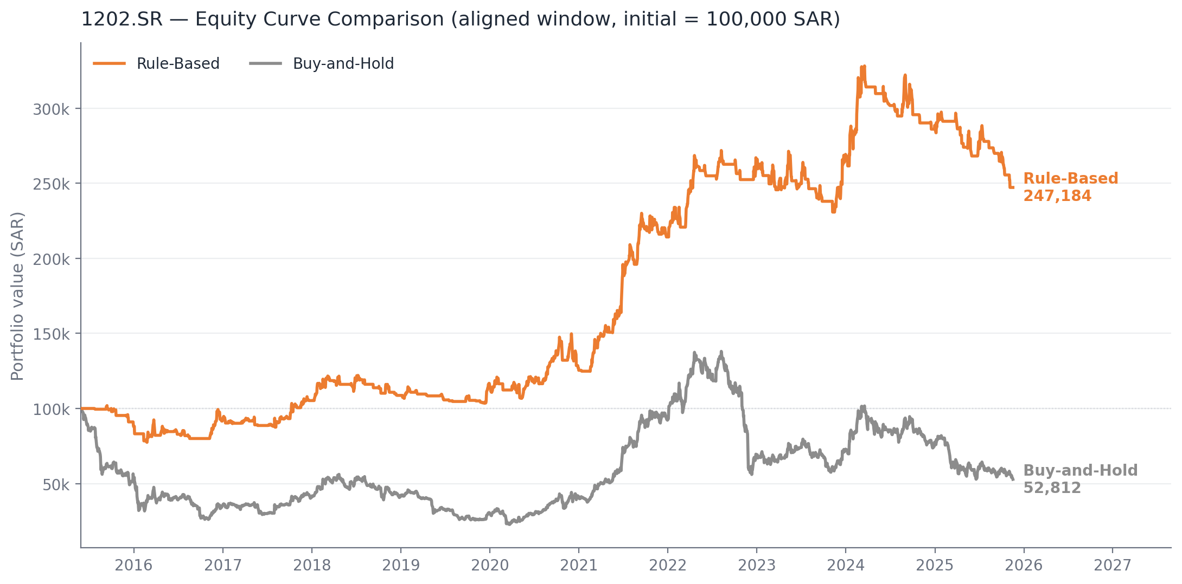
VISUAL EVIDENCE
Figure 4.9 — Equity Curves Comparison
Both curves start at 100,000 SAR on 2015-05-28. Rule-Based (orange) avoids the 2016-2020 decline that halves Buy-and-Hold (gray), then captures the 2021+ rally.
Figure 4.9 · Equity Curve Comparison, ticker 1202.SR, aligned window
Meshal Alkhaldi | Master Thesis Defense | Midocean University
18 / 25

Slide 19
SECTION 4.6.1
Application Validation — SAHMK API
Verifying that the framework operates end-to-end in a real application environment, not just offline.
GET
/api/v1/market/quote/{symbol}
GET
/api/v1/market/watchlist/quotes
Retrieves live quote for a single ticker.
Returns quotes for all watchlist tickers.
TEST
TEST
Called with symbol = 2222 (Saudi Aramco)
Called against configured watchlist
RESULT
RESULT
200 OK · Valid live quote returned
200 OK · Properly structured JSON list
Confirms real-time market data can flow into the framework — foundation for real deployment.
Meshal Alkhaldi | Master Thesis Defense | Midocean University
19 / 25

Slide 20
SECTION 4.7
Key Findings & Discussion
01
Accuracy alone is misleading
In imbalanced financial classification, a majority-class predictor achieves 0.569 without discriminating. F1 and Recall must be co-considered.
02
Transformer wins on balance, not accuracy
Sacrificing 8 pts of accuracy for 5.5× better recall makes the Transformer the more usable model for advisory downstream.
03
Decision-oriented > passive holding
Even a non-learning Rule-Based strategy delivered +194 pp over Buy-and-Hold with less than half the drawdown, on the same window.
04
Model ranking varies across stocks
On 4300.SR, LSTM collapses to zero recall while the Transformer preserves usable performance — validating the Transformer as the robust choice.
05
Framework operates end-to-end
Sahmk API integration confirms the system can pull live Tadawul data — bridges from offline experimentation to real deployment.
Meshal Alkhaldi | Master Thesis Defense | Midocean University
20 / 25

Slide 21
CHAPTER 5
Main Contributions
01
Saudi-oriented experimental setup
A reproducible predictive baseline for stock movement classification on Tadawul, built on OHLCV + curated technical indicators.
02
Three-model comparative analysis
Head-to-head evaluation of Logistic, LSTM, and Transformer under identical partitions — Transformer emerges as the most balanced.
03
Trading baseline evidence
A Rule-Based strategy delivering +147% (vs −47% for Buy-and-Hold) on an aligned window — ties predictive analysis to financially meaningful outcomes.
04
Multi-stock generalization
Extension across 1202.SR, 2320.SR, and 4300.SR — establishes the robustness of the Transformer choice beyond a single case study.
05
Full architectural specification
End-to-end design of the hybrid advisory system (GNN + fusion + RL + advisory), grounding future work in a concrete blueprint.
Meshal Alkhaldi | Master Thesis Defense | Midocean University
21 / 25

Slide 22
CHAPTER 5
Limitations & Future Work
LIMITATIONS
FUTURE WORK
!
Constrained Saudi historical data availability
→
Add GNN relational layer for sector co-movement
!
Class imbalance (56.9% down/flat vs 43.1% up)
→
Layer RL agent on top of predictive stream
!
Sensitivity to structural breaks and regime shifts
→
Implement fusion strategy across three model streams
!
RL training known to be hyperparameter-sensitive
→
Deploy interactive advisory dashboard
!
No statistical significance tests across folds
→
Add Sharia compliance filter for Saudi retail users
Meshal Alkhaldi | Master Thesis Defense | Midocean University
22 / 25

Slide 23
BIBLIOGRAPHY
References (1/2)
1
Ansari, Y. (2024). Multi-Cluster Graph (MCG): A novel clustering-based multi-relation graph neural networks for stock price forecasting. IEEE Access, 12.
2
Ansari, Y., Yasmin, S., Naz, S., Zaffar, H., Ali, Z., Moon, J., & Rho, S. (2022). A deep reinforcement learning-based decision support system for automated stock market trading. IEEE Access, 10, 127469-127492.
3
Friday, I. K., Pati, S. P., & Mishra, D. (2025). A multi-modal approach using a hybrid Vision Transformer and Temporal Fusion Transformer model for stock price movement classification. IEEE Access, 13.
4
Jayanth, T., & Manimaran, A. (2024). Developing a novel hybrid model double exponential smoothing and dual attention encoder-decoder based bi-directional gated recurrent unit enhanced with Bayesian optimization to forecast stock price. IEEE Access, 12.
5
Jayanth, T., Manimaran, A., & Siva, G. (2024). Enhancing stock price forecasting with a hybrid SES-DA-BiLSTM-BO model: Superior accuracy in high-frequency financial data analysis. IEEE Access, 12.
6
Kabbani, T., & Duman, E. (2022). Deep reinforcement learning approach for trading automation in the stock market. IEEE Access, 10.
7
Koo, E., & Kim, G. (2022). A hybrid prediction model integrating GARCH models with a distribution manipulation strategy based on LSTM networks for stock market volatility. IEEE Access, 10.
8
Li, Y., Chen, L., Sun, C., Liu, G., Chen, C., & Zhang, Y. (2024). Accurate stock price forecasting based on deep learning and hierarchical frequency decomposition. IEEE Access, 12.
Meshal Alkhaldi | Master Thesis Defense | Midocean University
23 / 25

Slide 24
BIBLIOGRAPHY
References (2/2)
9
Moody, F., Jahangard Rafsanjani, A., Zarifzadeh, S., & Zare Chahooki, M. A. (2024). Fusion of technical indicators and sentiment analysis in a hybrid framework of deep learning models for stock price movement prediction. IEEE Access, 12.
10
Sun, Y., Mutalib, S., Omar, N., & Tian, L. (2024). A novel integrated approach for stock prediction based on modal decomposition technology and machine learning. IEEE Access, 12.
11
Swetha, B., & Arya, K. (2025). Prediction of the stock market using a hybrid model based on feature expansion and LSTM-based algorithms. IEEE Access, 13.
12
Aroussi, R. (2024). yfinance: Download market data from Yahoo! Finance API (Version 0.2) [Computer software]. GitHub.
13
SAHMK (2026). SAHMK market data API documentation. https://app.sahmk.sa
14
Saudi Exchange (2026). Listed companies directory. https://www.saudiexchange.sa
15
Yahoo Finance (2026). Historical market data for Tadawul-listed equities [Data set]. https://finance.yahoo.com
References 12-15 are data sources; references 1-11 are peer-reviewed IEEE Access publications forming the core literature base.
Meshal Alkhaldi | Master Thesis Defense | Midocean University
24 / 25

Slide 25
THANK YOU
Questions & Discussion
Meshal Manfi Alkhaldi
Supervisor: Dr. Khaled Eskaf · Midocean University · College of Informatics
alamrimeshal16@gmail.com

