Slide 1



Master of Science in Artificial intelligent
Lecture 9
AI511
Foundations of Artificial Intelligence
Prepared by
Prof. Lamiaa Fattouh Ibrahim
www.midocean.ae

Slide 2
OUTLINES
Basics of PROLOG
Facts
Questions
Variables
Conjunction
Rules

Slide 3
OUTLINES
Recursion
to be able to write recursive rules in Prolog;
to be able to evaluate recursive rules.
to be able to recognize (and avoid) infinite recursion;
to appreciate the difference between declarative and procedural meanings for Prolog programs.

Slide 4
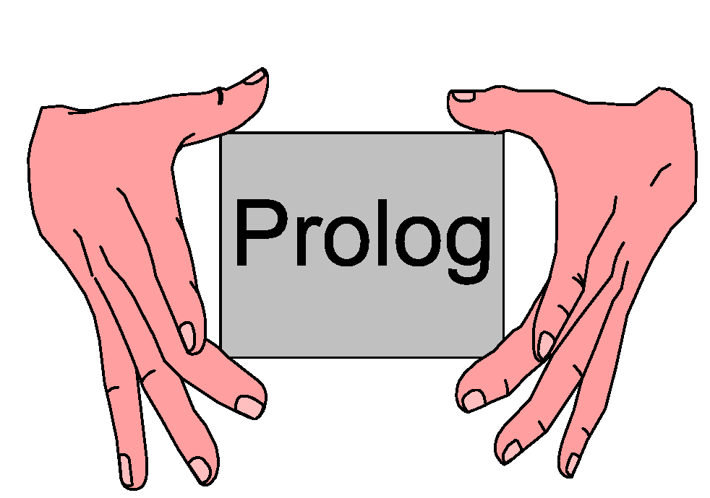
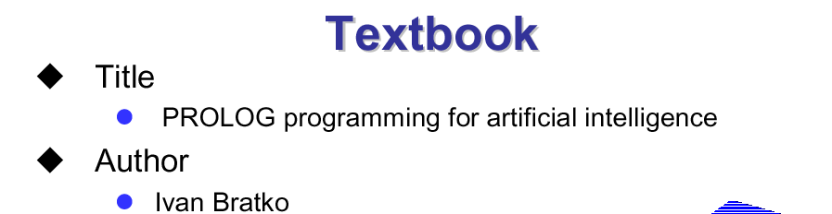

Slide 5
PROLOG | PREDICATE CALCULUS | ENGLISH
, | ˄ | and
; | ˅ | or
:- | ← | Only if
not | ¬ | not

Slide 6
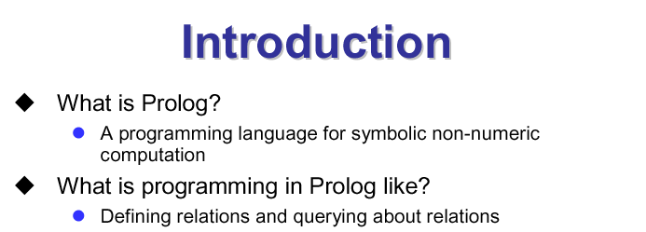

Slide 7
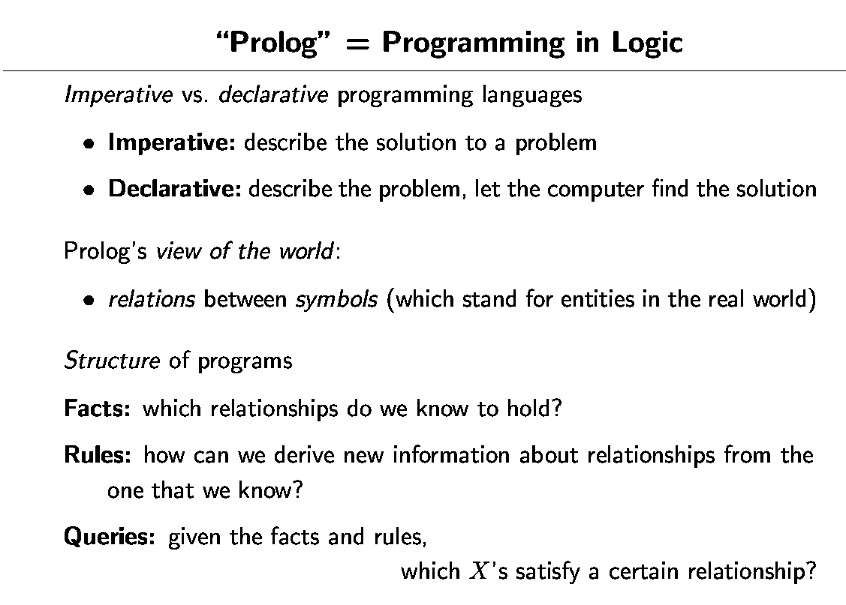

Slide 8
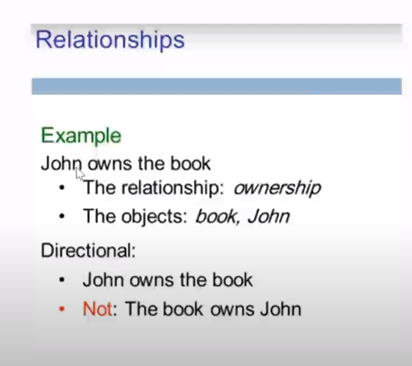

Slide 9
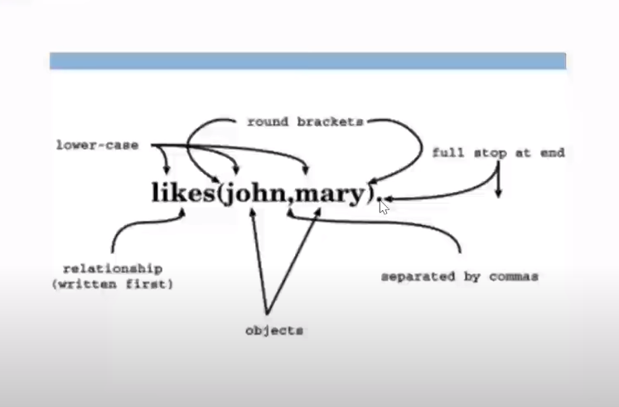

Slide 10
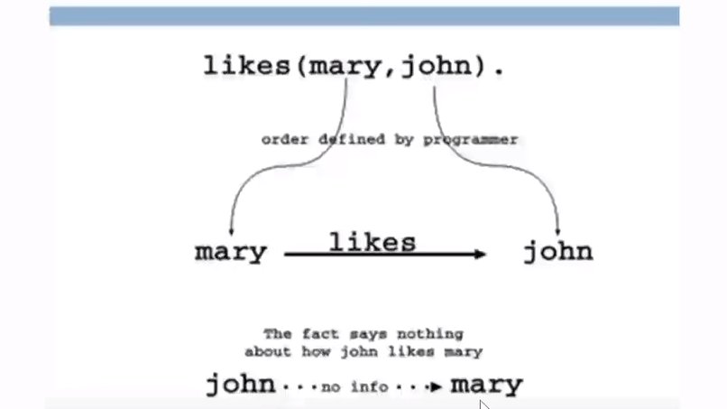

Slide 11
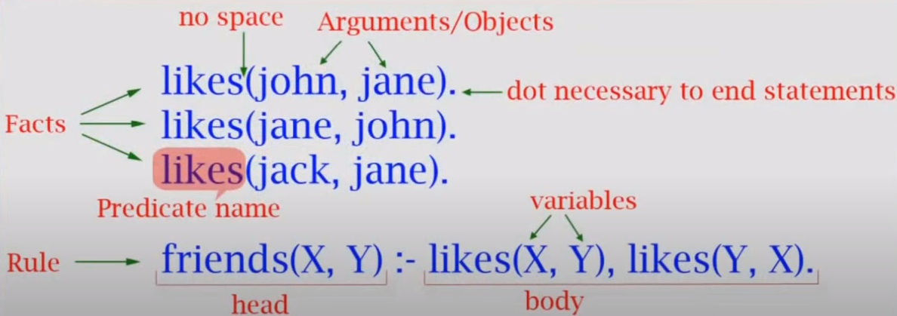

Slide 12
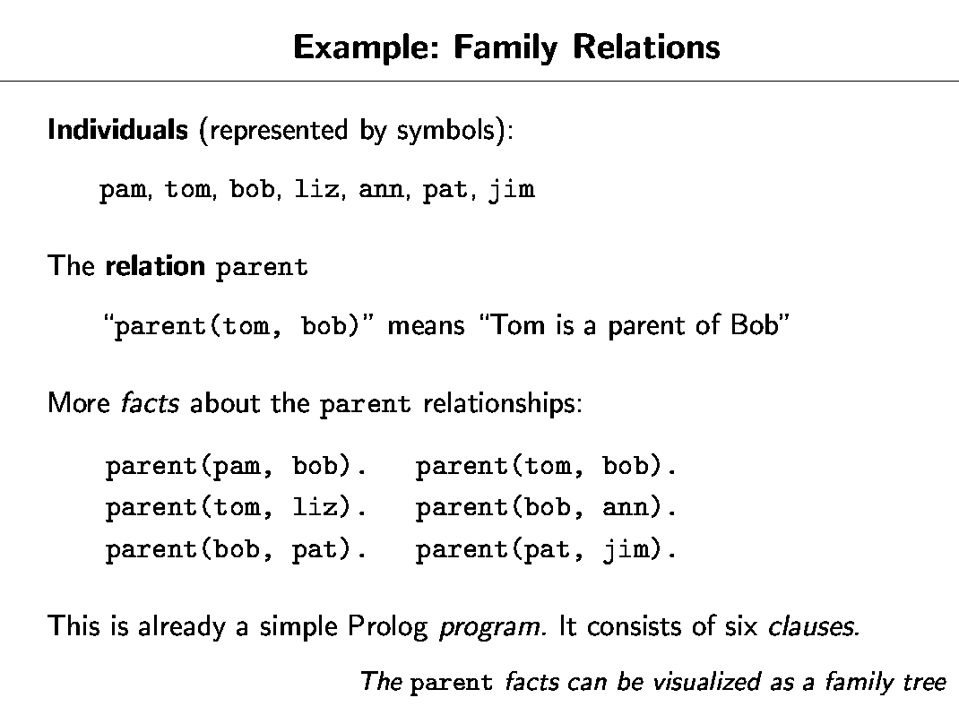

Slide 13
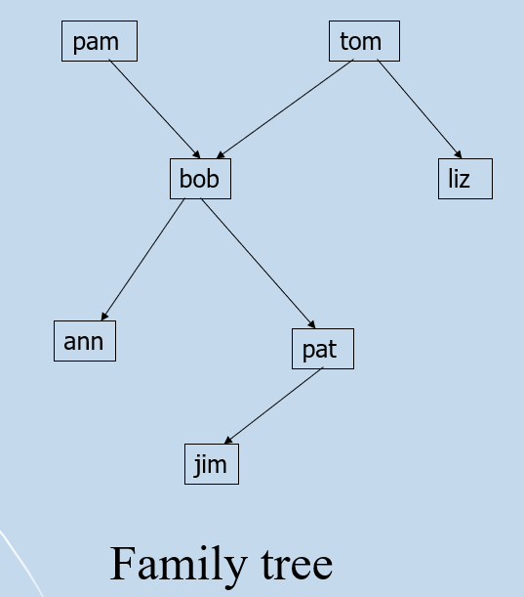

Slide 14
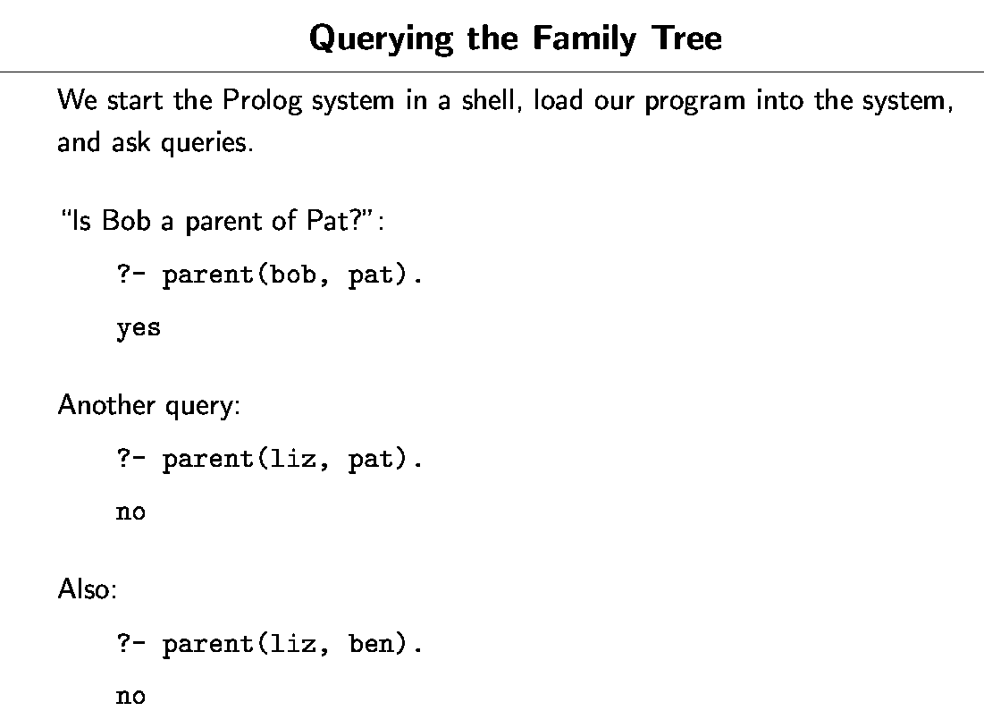

Slide 15
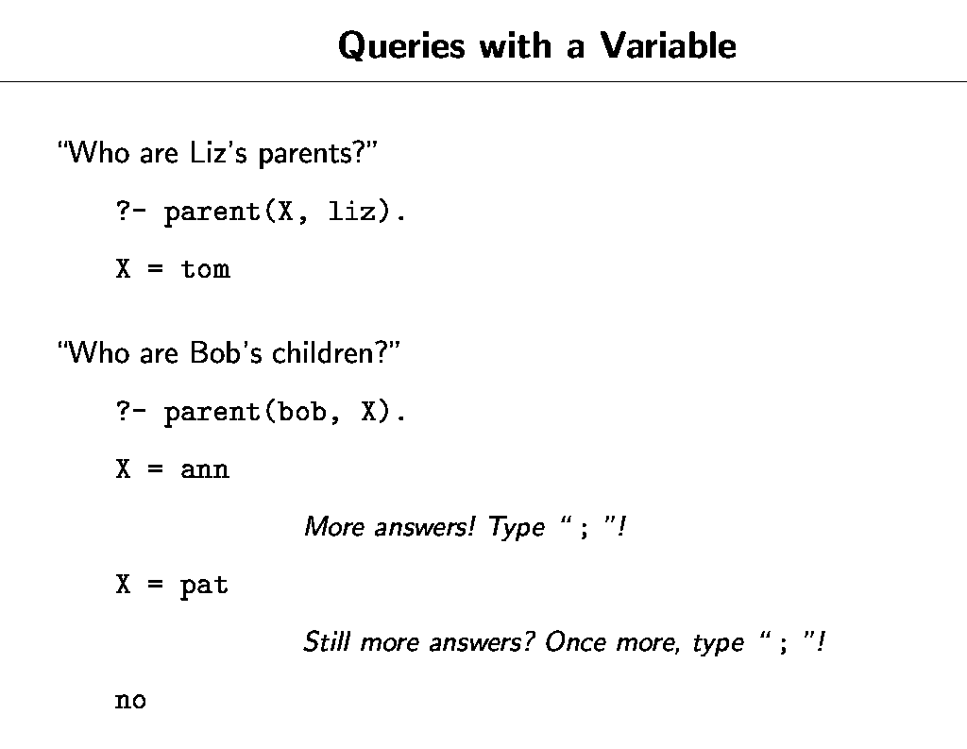

Slide 16
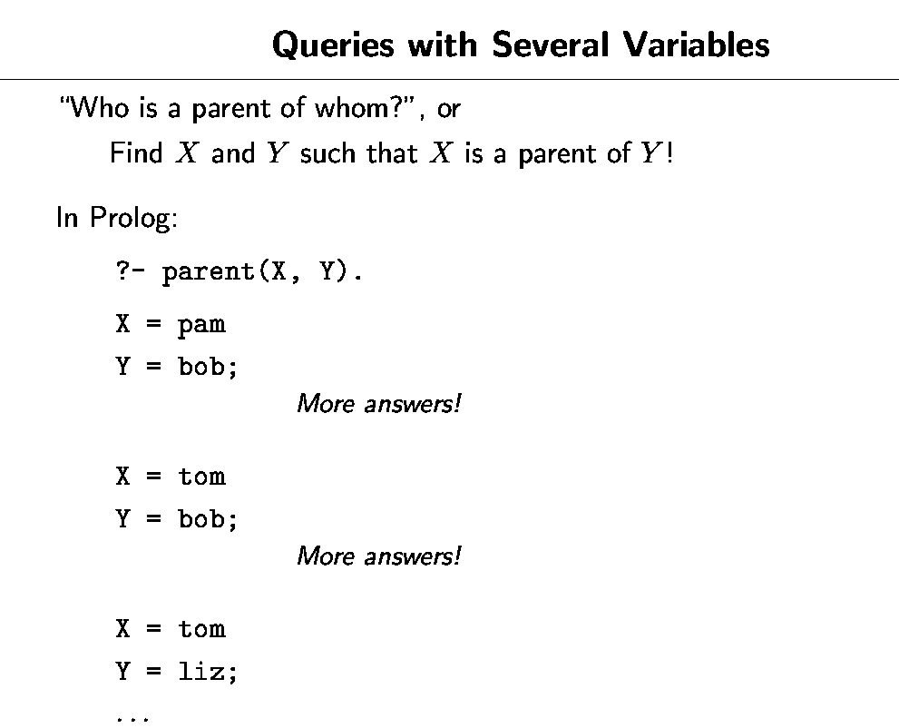
We can stop the stream of solutions by typing a return instead of a semicolon.

Slide 17
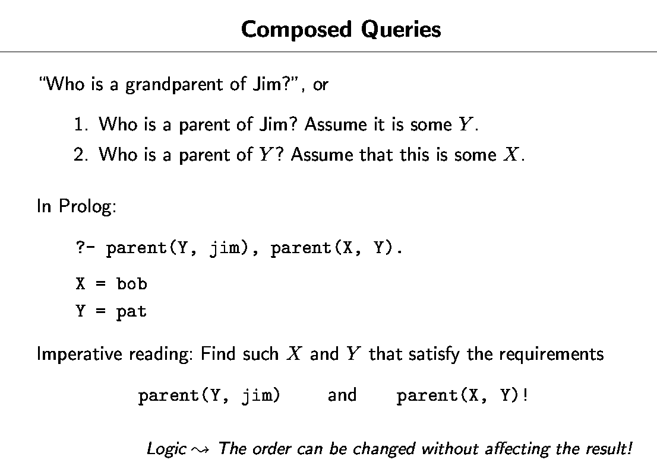

Slide 18
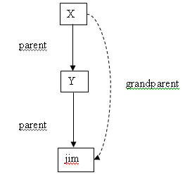

Slide 19
In a similar way we can ask: Who are Tom’s grandchildren?
?- parent(tom, X), parent(X, Y).
Prolog’s answer are:
X = bob
Y= ann;
X = bob
Y = pat;
no

Slide 20
Yet another question could be:
Do Ann and Pat have a common parent? This can be expressed again in two steps:
Who is a parent, X, of Ann?
Is (this same) X a parent of Pat?
The corresponding question to Prolog is then:
?- parent(X, ann), parent(X, pat).
The answer is:
X = bob

Slide 21
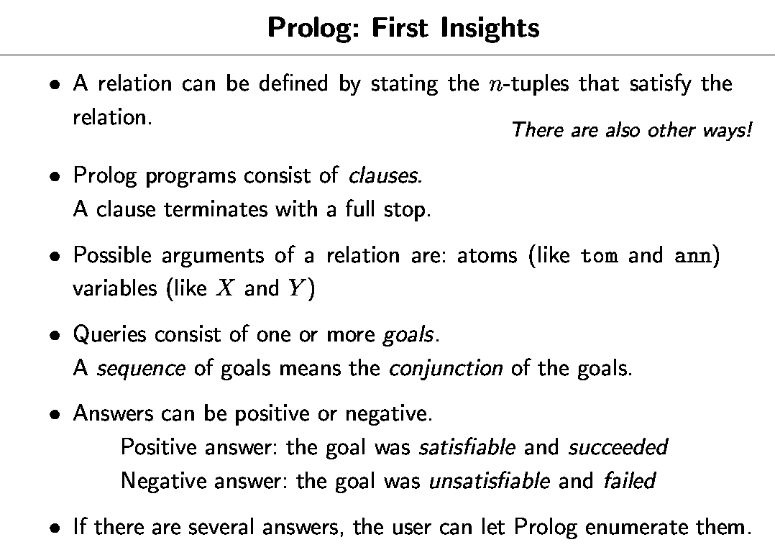

Slide 22
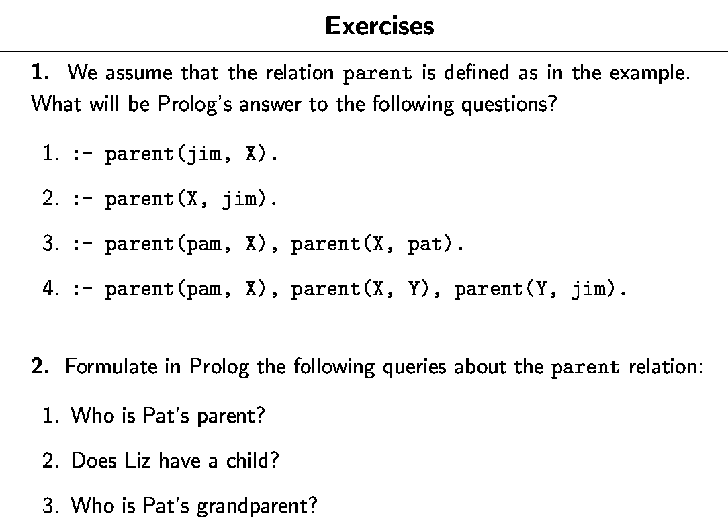

Slide 23
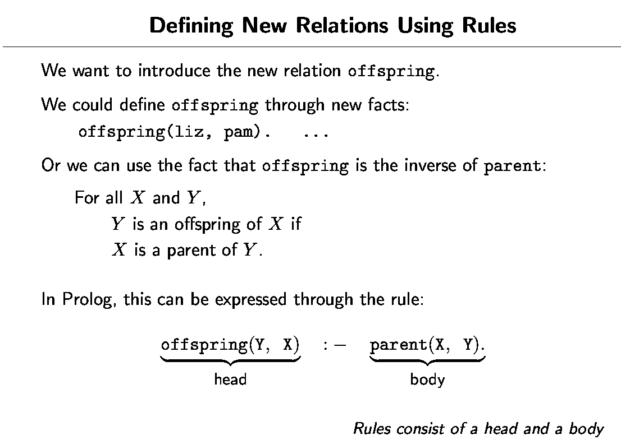

Slide 24
RULES
Rules have:
1- A condition part (body) in the right-hand side of the rule.
2- A conclusion part (head) in the left-hand side of the rule.
A comma between two conditions indicates the conjunction of the conditions, meaning that both conditions have to be true.

Slide 25
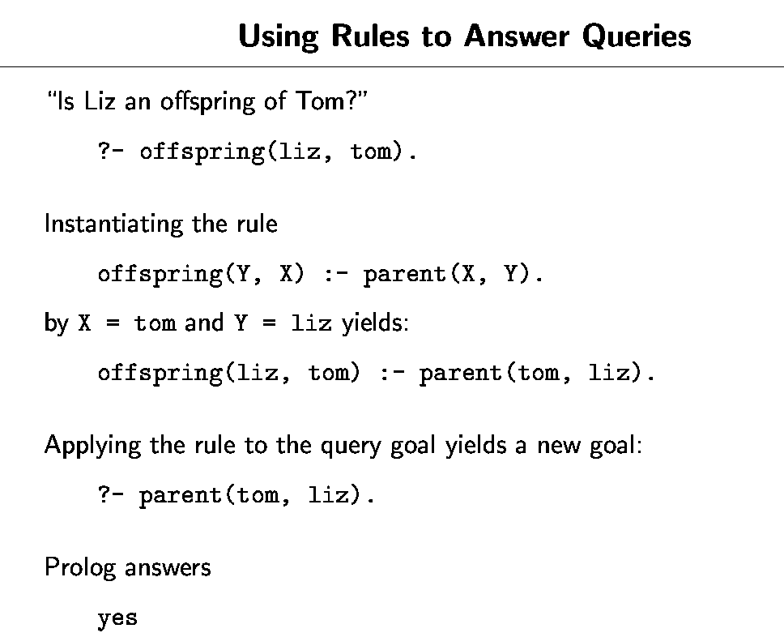

Slide 26
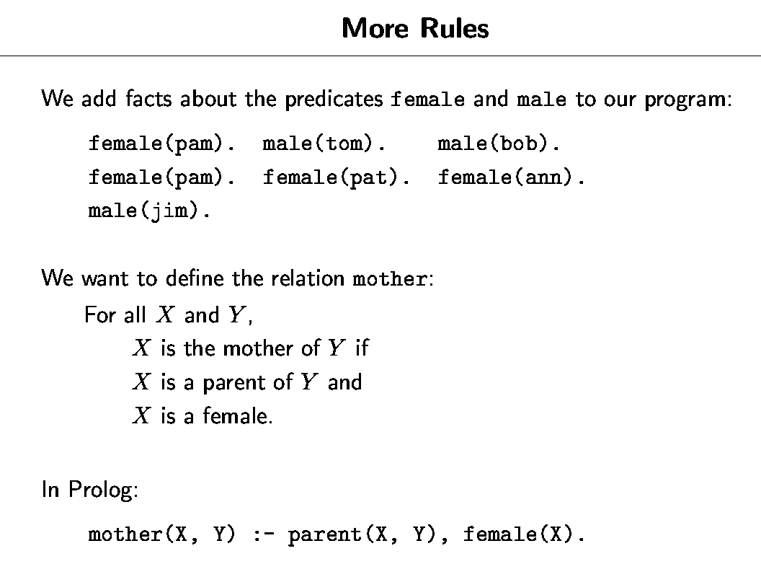

Slide 27
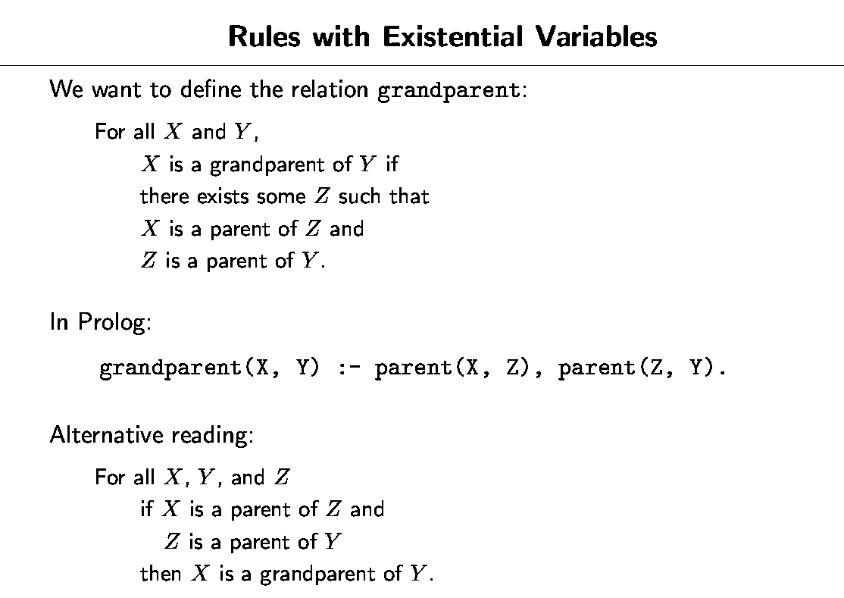

Slide 28
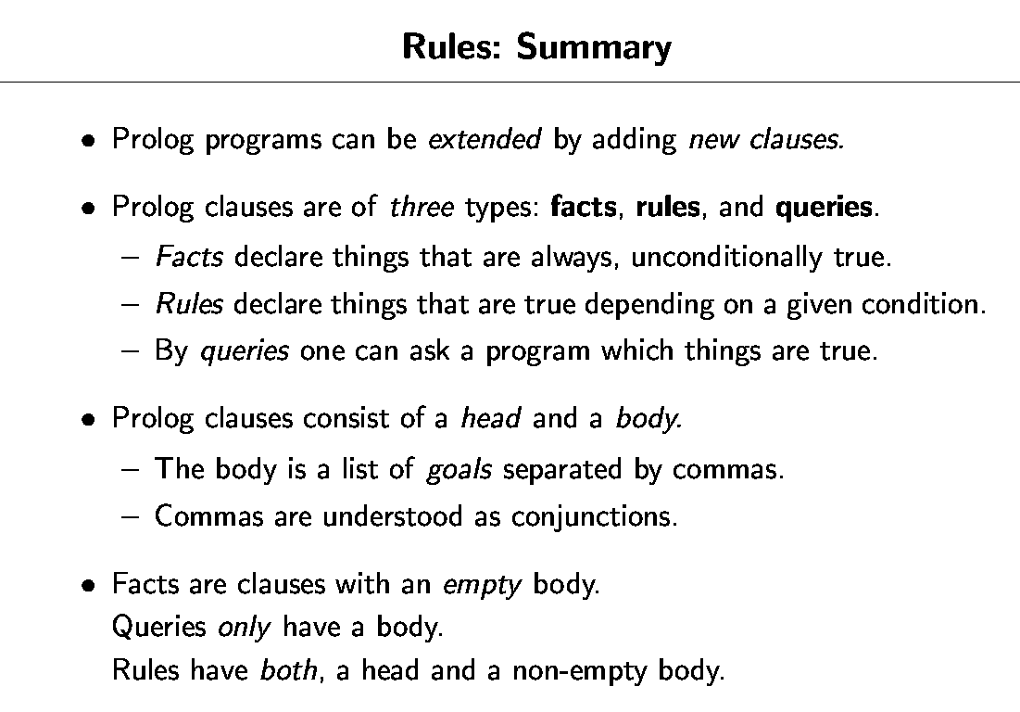

Slide 29
Prolog gives us almost full freedom in choosing the layout of the program. So we can insert spaces and new lines as it best suits our taste.
Relations such as female(pam) are unary (or one-place) relations.
Binary relation like parent(tom , liz) defines a relation between pairs of objects.
Unary relations can be used to declare simple yes/no properties of objects.
Queries are answered by instantiating variables, creating new subgoals from rules and matching with facts.

Slide 30
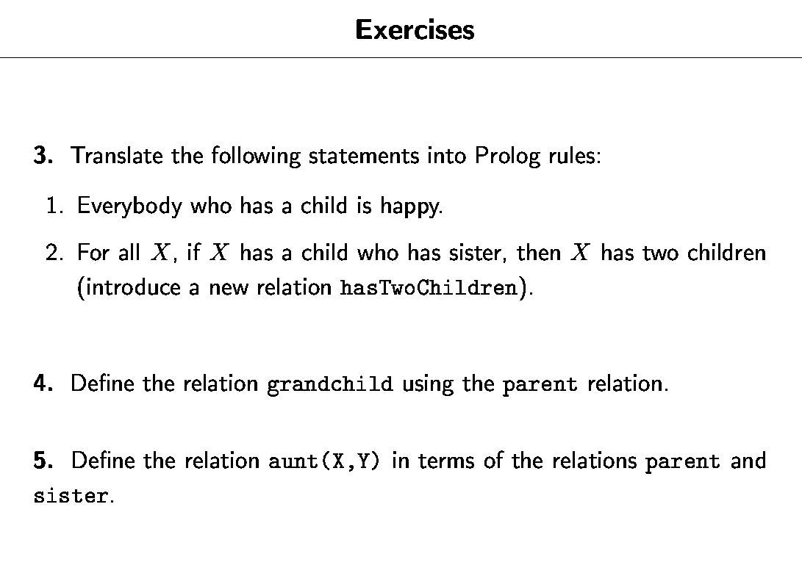

Slide 31


Slide 32
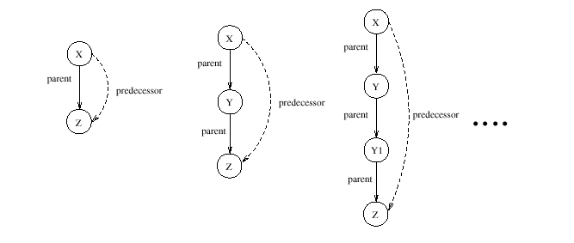
The Predecessor Relation
Consider the family tree. We'd like to be able to define predecessor:
a parent, or
a parent of a parent, or
a parent of a parent of a parent, or
. . .
(a) (b) ( c)
Examples of the predecessor relation: (a) X is a direct predecessor of Z; (b) and ( c) X is an indirect predecessor of Z

Slide 33
First Attempt
predecessor(X,Z) :- parent(X,Z).
predecessor(X,Z) :- parent(X,Y), parent(Y,Z).
predecessor(X,Z) :- parent(X,Y1), parent(Y1,Y2),
parent(Y2,Z).
...
Problems:
Lengthy (not important)
If we take the first two of these (or three or four etc) we get a finite depth on our search for predecessors.

Slide 34
Let's think...
Offspring's point of view:
You are my predecessor if either
you are my parent, or
you are a predecessor of my parent
Predecessor's point of view:
I am a predecessor of you if
I am your parent, or
I am a parent of your predecessor

Slide 35
Recursion
The predecessor's point of view can be expressed as
predecessor(X,Z):-
parent(X,Z).
predecessor(X,Z):-
parent(X,Y),
predecessor(Y,Z).
This type of definition is called a recursive definition . They are very important in Prolog.
A set of clauses referring to the same relation is known as a procedure.

Slide 36
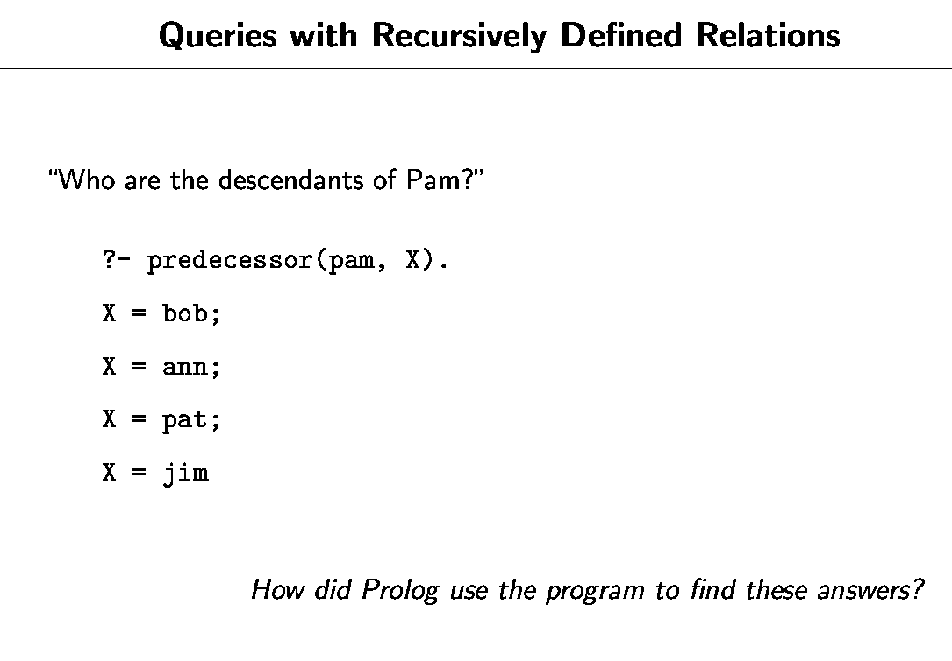

Slide 37
Defining the sister Relation
Z
sister(X, Y):- parent(Z, X), parent(Z, Y), female(X), different(X, Y).
parent
parent
X
Y
sister

Slide 38

Defining the mother Relation
X
female
parent
mother
Y

Slide 39
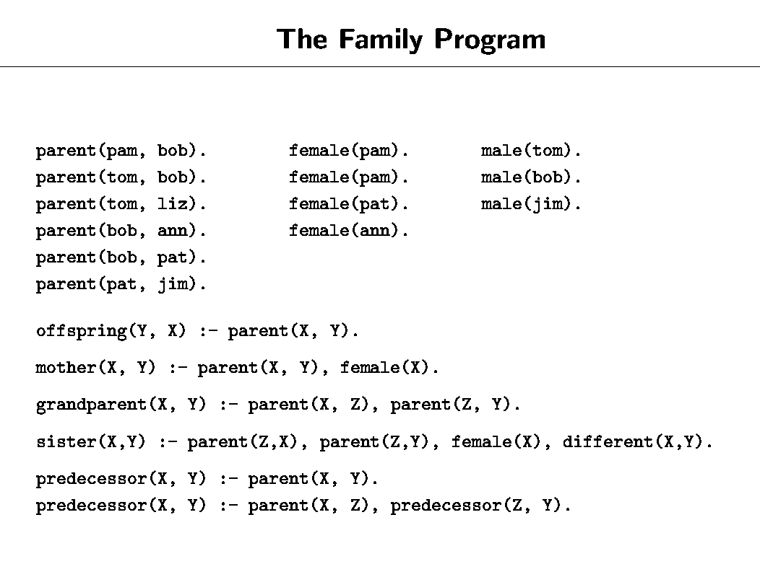

Slide 40
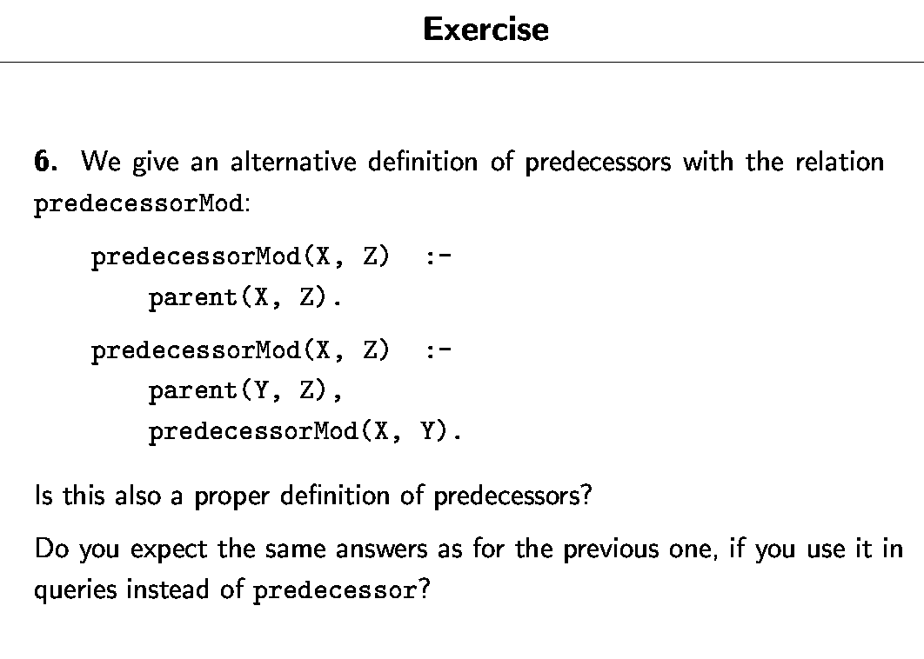

Slide 41
Programming with matching
vertical( line(point(X,Y), point(X,Z))).
horizontal( line(point(X,Y), point(Z,Y))).
?- vertical(line(point(1,1),point(1,3))).
yes
?-
21/44

Slide 42
Programming with matching
vertical( line(point(X,Y), point(X,Z))).
horizontal( line(point(X,Y), point(Z,Y))).
?- vertical(line(point(1,1),point(1,3))).
yes
?- vertical(line(point(1,1),point(3,2))).
no
?-
22/44

Slide 43
Programming with matching
vertical( line(point(X,Y), point(X,Z))).
horizontal( line(point(X,Y), point(Z,Y))).
?- horizontal(line(point(1,1),point(1,Y))).
Y = 1;
no
?-
23/44

Slide 44
Programming with matching
vertical( line(point(X,Y), point(X,Z))).
horizontal( line(point(X,Y), point(Z,Y))).
?- horizontal(line(point(2,3),Point)).
Point = point(Z,3); or Point = point(_554,3);
no
?-
24/44

Slide 45
Proof Search
Now that we know about matching, we are in a position
to learn how Prolog searches a knowledge base to see
if a query is satisfied.
In other words: we are ready to learn about Proof Search
25/44

Slide 46
Example
f(a).
f(b).
g(a).
g(b).
h(b).
k(X):- f(X), g(X), h(X).
?- k(Y).
26/44

Slide 47
Example: Search Tree
f(a).
f(b).
g(a).
g(b).
h(b).
k(X):- f(X), g(X), h(X).
?- k(Y).
?- k(Y).
27/44

Slide 48
Example: Search Tree
f(a).
f(b).
g(a).
g(b).
h(b).
k(X):- f(X), g(X), h(X).
?- k(Y).
Y=X
?- f(X), g(X), h(X).
?- k(Y).
28/44

Slide 49
Example: Search Tree
f(a).
f(b).
g(a).
g(b).
h(b).
k(X):- f(X), g(X), h(X).
?- k(Y).
Y=X
?- f(X), g(X), h(X).
X=a
?- k(Y).
?- g(a), h(a).
29/44

Slide 50
Example: Search Tree
f(a).
f(b).
g(a).
g(b).
h(b).
k(X):- f(X), g(X), h(X).
?- k(Y).
Y=X
?- f(X), g(X), h(X).
X=a
?- g(a), h(a).
?- k(Y).
?- h(a).
Fail
30/44

Slide 51
Example: Search Tree
f(a).
f(b).
g(a).
g(b).
h(b).
k(X):- f(X), g(X), h(X).
?- k(Y).
Y=X
?- f(X), g(X), h(X).
X=a
X=b
?- g(a), h(a).
?- g(b), h(b).
?- k(Y).
?- h(a).
Fail
31/44

Slide 52
Example: Search Tree
f(a).
f(b).
g(a).
g(b).
h(b).
k(X):- f(X), g(X), h(X).
?- k(Y).
Y=X
?- f(X), g(X), h(X).
X=a
X=b
?- g(a), h(a).
?- g(b), h(b).
?- k(Y).
?- h(a).
?- h(b).
Fail
32/44

Slide 53
Example: Search Tree
f(a).
f(b).
g(a).
g(b).
h(b).
k(X):- f(X), g(X), h(X).
?- k(Y).
Y=X
?- f(X), g(X), h(X).
X=a
X=b
?- g(a), h(a).
?- g(b), h(b).
?- k(Y).
Y=b
?- h(b).
?- h(a).
Fail
True
33/44

Slide 54
Example: Search Tree
f(a).
f(b).
g(a).
g(b).
h(b).
k(X):- f(X), g(X), h(X).
?- k(Y).
Y=X
?- f(X), g(X), h(X).
X=a
X=b
?- g(a), h(a).
?- g(b), h(b).
?- k(Y).
Y=b;
no
?-
?- h(a).
?- h(b).
Fail
True
34/44

Slide 55
Another example
loves(vincent,mia).
loves(marsellus,mia).
jealous(A,B):- loves(A,C), loves(B,C).
?- jealous(X,Y).
35/44

Slide 56
Another example
loves(vincent,mia).
loves(marsellus,mia).
jealous(A,B):- loves(A,C), loves(B,C).
?- jealous(X,Y).
?- jealous(X,Y).
36/44

Slide 57
Another example
loves(vincent,mia).
loves(marsellus,mia).
jealous(A,B):- loves(A,C), loves(B,C).
?- jealous(X,Y).
X=A
Y=B
?- loves(A,C), loves(B,C).
?- jealous(X,Y).
37/44

Slide 58
Another example
loves(vincent,mia).
loves(marsellus,mia).
jealous(A,B):- loves(A,C), loves(B,C).
?- jealous(X,Y).
X=A
Y=B
?- loves(A,C), loves(B,C).
A=vincent
C=mia
?- jealous(X,Y).
?- loves(B,mia).
38/44

Slide 59
Another example
loves(vincent,mia).
loves(marsellus,mia).
jealous(A,B):- loves(A,C), loves(B,C).
?- jealous(X,Y).
X=A
Y=B
?- loves(A,C), loves(B,C).
A=vincent
C=mia
?- jealous(X,Y).
X=vincent
Y=vincent
?- loves(B,mia).
True
B=vincent
39/44

Slide 60
Another example
loves(vincent,mia).
loves(marsellus,mia).
jealous(A,B):- loves(A,C), loves(B,C).
?- jealous(X,Y).
X=A
Y=B
?- loves(A,C), loves(B,C).
A=vincent
C=mia
?- loves(B,mia).
?- jealous(X,Y).
X=vincent
Y=vincent;
X=vincent
Y=marsellus
True
True
B=vincent
B=marsellus
40/44

Slide 61
Another example
loves(vincent,mia).
loves(marsellus,mia).
jealous(A,B):- loves(A,C), loves(B,C).
?- jealous(X,Y).
X=A
Y=B
?- loves(A,C), loves(B,C).
A=vincent
C=mia
A=marsellus
C=mia
?- jealous(X,Y).
X=vincent
Y=vincent;
X=vincent
Y=marsellus;
?- loves(B,mia).
?- loves(B,mia).
True
True
B=vincent
B=marsellus
41/44

Slide 62
Another example
loves(vincent,mia).
loves(marsellus,mia).
jealous(A,B):- loves(A,C), loves(B,C).
?- jealous(X,Y).
X=A
Y=B
?- loves(A,C), loves(B,C).
A=vincent
C=mia
A=marsellus
C=mia
….
X=vincent
Y=marsellus;
X=marsellus
Y=vincent
?- loves(B,mia).
?- loves(B,mia).
True
True
True
B=vincent
B=marsellus
B=vincent
42/44

Slide 63
Another example
loves(vincent,mia).
loves(marsellus,mia).
jealous(A,B):- loves(A,C), loves(B,C).
?- jealous(X,Y).
X=A
Y=B
?- loves(A,C), loves(B,C).
A=vincent
C=mia
A=marsellus
C=mia
….
X=marsellus
Y=vincent;
X=marsellus
Y=marsellus
?- loves(B,mia).
?- loves(B,mia).
True
True
True
True
B=vincent
B=marsellus
B=vincent
B=marsellus
43/44

Slide 64
Another example
loves(vincent,mia).
loves(marsellus,mia).
jealous(A,B):- loves(A,C), loves(B,C).
?- jealous(X,Y).
X=A
Y=B
?- loves(A,C), loves(B,C).
A=vincent
C=mia
A=marsellus
C=mia
….
X=marsellus
Y=vincent;
X=marsellus
Y=marsellus;
no
?- loves(B,mia).
?- loves(B,mia).
True
True
True
True
B=vincent
B=marsellus
B=vincent
B=marsellus
44/44

Slide 65
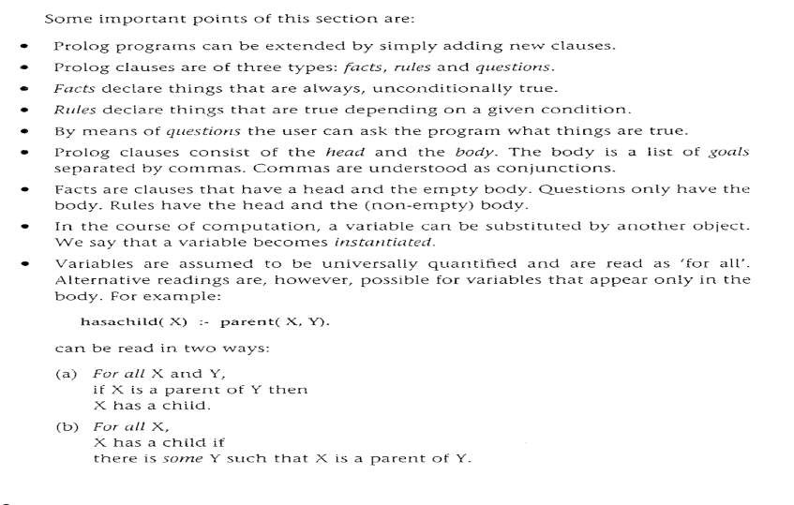
SUMMARY

Slide 66



Thank You

