Slide 1


College of Humanities
Master of Financial
Technology-
FinTech
Business Analysis
FNT613
5th Lecture
Prepared By:
Dr. Abeir Moussa

Slide 2



Stakeholder Analysis and Management
5th lecture
FNT613
Prepared By:
Dr. Abeir Moussa
www.midocean.ae

Slide 3


Stakeholder Analysis and Management
Week6
Chapter6
www.midocean.ae

Slide 4

Learning objectives
Understand the concept of stakeholder analysis and its importance in business management.
Learn how to identify and categorize stakeholders in a business context.
Gain knowledge of the different methods and tools used for stakeholder analysis.
Develop skills in conducting stakeholder mapping to visualize and prioritize stakeholders based on their level of influence and interest.
Understand the importance of stakeholder engagement and communication in managing relationships.
www.midocean.ae

Slide 5
Learning objectives Cont.
Learn how to develop effective stakeholder engagement strategies to address their needs and concerns.
Gain knowledge of how to assess stakeholder expectations and manage their perceptions.
Understand the role of power dynamics and influence in stakeholder management.
Learn how to manage conflicts and resolve issues among stakeholders.
Develop skills in building and maintaining positive relationships with stakeholders.
Understand the ethical considerations in stakeholder analysis and management.
www.midocean.ae

Slide 6
Learning objectives Cont.
Learn how to integrate stakeholder perspectives into decision-making processes.
Gain knowledge of how to monitor and evaluate stakeholder engagement initiatives.
Understand the role of technology and digital platforms in stakeholder analysis and management.
Develop skills in effectively communicating with stakeholders through various channels.
www.midocean.ae

Slide 7
Chapter outline
Introduction
Stakeholder Categories and Identification.
Analyzing Stakeholders.
Stakeholder Management Strategies.
Summary of Stakeholder Management Strategies.
Managing Stakeholders.
Defining Stakeholder involvement – RACI and RASCI Charts
Using Social Media in Stakeholder Management
Understanding Stakeholder Perspectives
www.midocean.ae

Slide 8
INTRODUCTION
Effective stakeholder management is absolutely crucial to the success of any business analysis project.
One of the major reasons why business analysis projects do not succeed – or do not succeed fully – is poor stakeholder management.
In fact, much of the groundwork for stakeholder management takes place before the business analysis project proper begins – during project inception and initiation – and that work must be revisited constantly during the project itself.
The basic steps involved are illustrated in Figure 6.1.
www.midocean.ae

Slide 9
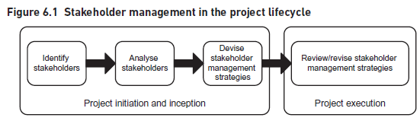
Introduction
www.midocean.ae

Slide 10
1. Stakeholder Categories and Identification
Customers
Partners
Suppliers
Competitors
Regulators
Owners
Employees
Managers
Other stakeholders
www.midocean.ae

Slide 11
1. Stakeholder Categories and Identification
As Figure 6.1 illustrates, the first step in stakeholder management involves finding out who the stakeholders are. A good working definition of a stakeholder is ‘anyone who has an interest in, or may be affected by, the issue under consideration’. This means, more or less, anyone affected by the project or who may be in a position to influence it.
Of course, each project will have its own distinctive set of stakeholders, determined by the nature of the project and the environment in which it is taking place. However, it could be identify some ‘generic’ stakeholder categories that may apply to many projects, as illustrated in Figure 6.2.
www.midocean.ae

Slide 12
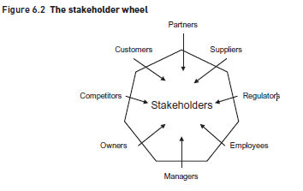
1. Stakeholder Categories and Identification
www.midocean.ae

Slide 13
1. Stakeholder Categories and Identification
Customers
These are the people or organizations for whom our organization provides products or services. They are stakeholders because anything we do in the way of change has a potential effect on them. We must consider how to manage that change most effectively so as not to lose customers that we wish to retain. It may be useful to subdivide this general category to reveal more detail about the stakeholders, for example into:
large or small;
regular or occasional;
wholesale or retail;
corporate or private;
commercial, non-profit or public-sector;
civilian or military;
domestic or export.
We may even have different categories that we simply label ‘good customers’ and ‘difficult’ customers’, however we define them.
www.midocean.ae

Slide 14
1. Stakeholder Categories and Identification
Partners
These are the organizations that work with our organization, for example, to provide specialist services on our behalf. Examples of partner organizations may be a reseller of our products or services or an outsourcing company that provides catering services.
Suppliers
These provide us with the goods and services that we use. Again, we may wish to subdivide them, perhaps into:
major or minor;
regular or occasional;
domestic or overseas.
Suppliers are stakeholders because they are interested in the way we do business with them, what we wish to buy, how we want to pay and so on. Many change initiatives have the effect of altering the relationships of organizations with their suppliers and, as with the customers, such changes need to be managed carefully to make sure that they achieve positive and mutually beneficial results.
www.midocean.ae

Slide 15
1. Stakeholder Categories and Identification
Competitors
Competitors vie with us for the business of our customers and they therefore have a keen interest in changes made by our organization. We have to consider what their reactions might be and whether they might try, for instance, to block our initiative or to produce some sort of counterproposal.
Regulators
Many organizations are now subject to regulation or inspection – either by statutory bodies like Ofcom (Office for Communications) and Ofsted (Office for Standards in Education), or by professional bodies like the General Medical Council. These regulators will be concerned that changes proposed by an organization are within the letter and spirit of the rules they enforce.
www.midocean.ae

Slide 16
1. Stakeholder Categories and Identification
Owners
For a commercial business, the owners are just that – the people who own it directly. The business may be, in legal terms, a sole trader or partnership. Or, it could be a limited company, in which case the owners are the shareholders. For public limited companies, the majority of shares are held by institutions like investment companies and pension funds and so the managers of these share portfolios become proxy owners.
Employees
The people who work in an organization clearly have an interest in the way it is run and in changes that it makes. In a small firm, the employees may be regarded as individual stakeholders in their own right but, in larger concerns, they are probably best considered as groups. Sometimes, employees belong to trades unions, whose officials therefore become stakeholders too.
www.midocean.ae

Slide 17
1. Stakeholder Categories and Identification
Managers
Finally, we have the professional managers of the organization, those to whom its direction is entrusted. In a large organization, there may be many layers of management and each may form a distinctive stakeholder grouping, for example:
board-level senior managers;
middle managers;
junior managers;
front-line supervisors.
As with many aspects of stakeholder management, it is an error to assume that a group like ‘managers’ is homogeneous in its views and concerns; junior managers may well have a very different perspective, and a different set of values and priorities, from those on the board who take the major strategic decisions.
www.midocean.ae

Slide 18
1. Stakeholder Categories and Identification
Managers
Finally, we have the professional managers of the organization, those to whom its direction is entrusted. In a large organization, there may be many layers of management and each may form a distinctive stakeholder grouping, for example:
board-level senior managers;
middle managers;
junior managers;
front-line supervisors.
As with many aspects of stakeholder management, it is an error to assume that a group like ‘managers’ is homogeneous in its views and concerns; junior managers may well have a very different perspective, and a different set of values and priorities, from those on the board who take the major strategic decisions.
www.midocean.ae

Slide 19
1. Stakeholder Categories and Identification
Other stakeholders
Of course, the groups shown in Figure 6.2 are generic and, in particular cases, there may well be other stakeholders. For example, the insurers of an organization may be interested in any areas that could affect the pattern of risk that is covered. Or perhaps the police might be interested in the law and order implications of some actions. In some organizations, the views of staff associations are also significant.
It is important, for each project that the identification of stakeholders is as complete as possible, as it will otherwise be impossible to develop and implement effective management strategies for them. It may be useful to conduct some sort of workshop with people knowledgeable about the organization and the proposed project to make sure that the coverage of stakeholders is comprehensive.
www.midocean.ae

Slide 20
2. Analyzing Stakeholders
Having identified the stakeholders, the next step is to make an assessment of the weight that should be attached to their issues. No stakeholder should be ignored completely but the approach to each will be different depending on (a) their level of interest in the project and (b) the amount of power or influence they wield to further or obstruct it.
One technique for analyzing stakeholders is the power/interest grid illustrated in Figure 6.3.
www.midocean.ae

Slide 21
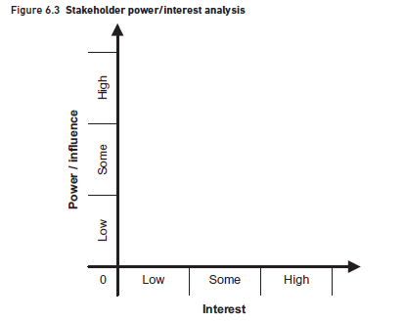
2. Analyzing Stakeholders
www.midocean.ae

Slide 22
2. Analyzing Stakeholders
In using the power/interest grid, it is important to plot stakeholders where they actually are, not where they should be or perhaps where we would like them to be. We can then explore strategies for managing them in their positions or, perhaps, for moving them to other positions that might be more advantageous for the success of our project.
www.midocean.ae

Slide 23
3. Stakeholders Management Strategies
There is, of course, an infinite number of positions that could be taken on the power/interest grid but it is probably sufficient here to consider the nine basic situations illustrated in Figure 6.4.
For practical purposes, they can be ignored as regards day-to-day issues on a project and there needs to be no special effort made to ‘sell’ them its benefits.
However, as stakeholders do change positions on the map (discussed below), it is probably wise to inform them occasionally about what is going on – perhaps through vehicles like organization newsletters.
www.midocean.ae

Slide 24
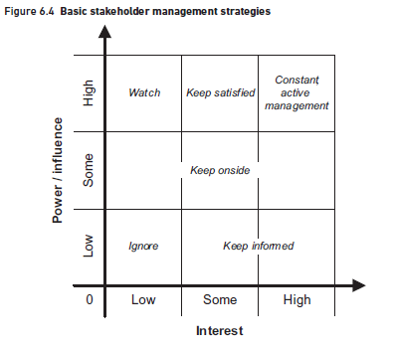
3. Stakeholders Management Strategies
www.midocean.ae

Slide 25
3. Stakeholders Management Strategies
Some or high interest but no or low power/influence
These groups can be very difficult to manage effectively as, although they may be directly affected by a change project, they feel powerless to shape its direction in any way.
This can best be done by being as honest as possible about the need for change; by highlighting the positive aspects of the change or the negative consequences of not making it; and by frequent and focused communication of progress.
www.midocean.ae

Slide 26
3. Stakeholders Management Strategies
No or low to high interest but some power/influence
It includes some stakeholders like middle or senior managers who do have some power or influence but who, because their interests are not directly affected, are not very concerned about the direction a project is taking.
Regulators may also fall into this category and they will only start to get involved if some breach of the rules is suspected when they could, in effect, squash an initiative.
The group can also include people with more interest in the project but, again, only some power or influence over it.
The best approach with this group is to keep them supportive of the project, possibly by frequent, positive communication with them but perhaps also by involving them more with the project.
www.midocean.ae

Slide 27
3. Stakeholders Management Strategies
No or low interest but high power/influence
These are probably very senior managers who, for one reason or another, have no direct interest in the project. This may be because it is too small or unimportant for them to bother with or it may be that it is in an area that doesn’t interest them; the Group Marketing Director, for instance, probably will not be concerned about a project to streamline the stationery purchasing procedures.
So, if a situation arises that might cause them to take a greater interest in the project, we might want to address their needs directly, via one-to-one meetings perhaps, in order to ensure that they do not start to raise concerns or even decide to exert their influence.
Where this is the case, we may need to highlight any aspects of the project that will have a direct impact upon the stakeholder’s business area; some form of discussion will be required which, with very influential stakeholders, would typically involve a meeting.
www.midocean.ae

Slide 28
3. Stakeholders Management Strategies
Some interest and high power/influence
These people have some interest in the project – probably an indirect one as it is happening within or affecting their empire – and they have real power. The usual stakeholder management strategy here is to keep them satisfied and, perhaps, to prevent them from taking a more direct (and hence, possibly, more obstructive) interest in the project.
For example, if the finance director of an organization can be persuaded to get positively involved in a project, they will often be a powerful force for success, since they can make resources available that would otherwise be hard to come by.
www.midocean.ae

Slide 29
3. Stakeholders Management Strategies
High interest and high power/influence
These are the key players, the people who are both interested in the project and have the power to make it work or not. Often, the key players are the managers of the functions involved in a project.
Initially, it is important to determine if individual key stakeholders are positive or negative in their approach to a project.
It is also important to appreciate the concerns and opinions of key stakeholders and you will need to take these into account when making any recommendations.
For example, if one of the key stakeholders has a particular solution in mind it is important to know about this as early as possible in order to ensure that, at the very least, the solution is evaluated as one of the options.
It is also vital that the key stakeholders understand the progress of the project and why certain decisions have been made.
www.midocean.ae

Slide 30
3. Stakeholders Management Strategies
High interest and high power/influence
Those key players who are negatively inclined towards a project can be managed in various ways, depending on the circumstances:
By far the best approach is to find some personal benefits for them in the proposed course of action. The stakeholder perspective analysis techniques described below can be very useful here.
Alternatively, a more powerful counterforce must be found to outweigh their negative influence. This may mean engaging the interest of someone in one of the high power areas of the grid.
www.midocean.ae

Slide 31
3. Stakeholders Management Strategies
Individuals and groups of stakeholders
An individual customer may not be of much concern to an organization such as a big supermarket chain. But if they post a negative review using social media, write to newspapers, organize petitions or complain to consumer groups, they can increase their level of power considerably.
Similarly, individual employees can be marginalized by an organization but, if they are members of a trade union, their power is greater.
A single government employee who objects to a policy may be relatively powerless but if they ‘blow the whistle’ to national newspapers, they can cause considerable difficulty.
These examples illustrate the dangers of ignoring the weakness of an individual or mistaking individual weakness for collective weakness.
www.midocean.ae

Slide 32
4. Summary of Stakeholders Management Strategies
The basic strategies for stakeholder management are summarized in Figure 6.4 but individual stakeholders will not fit neatly into one of the nine types and management approaches must be tailored for each. Also, as we shall discuss in the next section, stakeholders do not stay in the same place over time and so the ways they are managed must be adapted accordingly.
www.midocean.ae

Slide 33
5. Managing Stakeholders
Stakeholders’ positions on the framework in Figure 6.4 do not remain static during the life of a project. At the most obvious level, a manager may get promoted so that, from being in the high interest/low power situation, is now both interested and powerful.
Alternatively, the manager may lose interest in a project if promoted into a job with a wider remit.
This means that stakeholder analysis must be a continuing activity throughout the project – and even afterwards to find out what the stakeholders thought of the final outcome.
The project team and project manager should be constantly on the lookout for changes in stakeholders’ positions and should be re-evaluating their management strategies accordingly.
www.midocean.ae

Slide 34
5. Managing Stakeholders
Once stakeholders’ initial positions have been plotted, a plan should be drawn up for managing each of them and how to approach it. A one-page assessment can be made for each stakeholder but a more useful approach would be to see all stakeholders at a glance by setting up a spreadsheet using the following headings:
Name of stakeholder
It may also be useful to record their current job titles.
Current power/influence
From the grid.
Current interest
From the grid.
Issues and interests
This is a brief summary of what interests each stakeholder and what we believe their main issues with the project are likely to be.
www.midocean.ae

Slide 35
5. Managing Stakeholders
Current attitude
Here, we need to devise a classification scheme, perhaps using the following descriptions:
Champion: will actively work for the success of the project.
Supporter: in favor of the project but probably will not be very active in promoting it.
Neutral: has expressed no opinion either in favor or against the project.
Critic: not in favor of the project but probably not actively opposed to it.
Opponent: will work actively to disrupt, impede or derail the project.
Blocker: someone who will just obstruct progress, possibly for reasons outside of the project itself.
www.midocean.ae

Slide 36
5. Managing Stakeholders
Desired support
What we would ideally like from this stakeholder, perhaps using a simple scale of high, medium or low.
Desired role
We may wish to get this stakeholder actively involved in the project, perhaps as the project sponsor or as part of a steering committee.
Desired actions
What we would like the stakeholder to do, if at all possible, to advance the project.
Messages to convey
This is where we define the emphasis that should be put on any communications to this stakeholder. For example, we might need to identify and highlight any issues that are of particular interest to this stakeholder. The messages are likely to be tailored to each stakeholder and so the more we know about them and their concerns, the more effective our communications will be.
www.midocean.ae

Slide 37
5. Managing Stakeholders
Actions and communications
This is the most important part of the plan, where we define exactly what actions we will take with regard to this stakeholder. Where a strategy has been devised to change a stakeholder’s position – perhaps to encourage someone to take a closer interest – then its success must also be evaluated and other approaches developed if the desired results are not being achieved.
As mentioned earlier, the high interest/high power stakeholders are the key players and require positive management, such as frequent meetings and discussions about the direction the project is taking.
Perhaps just as important, we will understand when their opinions or issues have changed and will reflect this in the project direction and work as appropriate.
www.midocean.ae

Slide 38
6. Defining Stakeholder Involvement- RACI and RASCI Charts
Apart from deciding on the management strategy for the various stakeholders, it can also be very useful in a business analysis project to consider the tasks or deliverables and the extent to which the stakeholders are involved with them.
A RACI chart – more formally known as a ‘linear responsibility matrix’ – lists the main products/deliverables down the side and the various stakeholders along the top.
RACI chart is illustrated in Figure 6.5.
www.midocean.ae

Slide 39
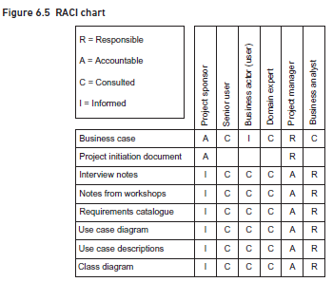
6. Defining Stakeholder Involvement- RACI and RASCI Charts
www.midocean.ae

Slide 40
6. Defining Stakeholder Involvement- RACI and RASCI Charts
Responsible: This is the person or role responsible for creating or developing the product or performing the task. In Figure 6.5, for example, a business analyst is responsible for creating the interview notes.
Accountable: The person or role who will ‘carry the can’ for the quality of the product or task. The project sponsor, for instance, must ultimately be accountable for the business case for a project.
Consulted: This person or role provides information that is input to the product or task. In Figure 6.5, the senior user, other business actors and the domain expert are shown as being consulted during the interviews and workshops.
Informed: These stakeholders are informed about a product or task, though they may not have contributed directly to them. For example, the project sponsor has the right to be kept informed about any of the products being produced during the project.
www.midocean.ae

Slide 41
6. Defining Stakeholder Involvement- RACI and RASCI Charts
A RASCI chart, shown in Figure 6.6 uses a similar approach but has an additional category S for ‘support’. This person (or role) will provide assistance, and sometimes resources, to whoever is responsible for the product/deliverable. For example, in Figure 6.6, the business analyst is shown as supporting the project manager in the creation of the project initiation document and the database administrator supports the business analyst in developing the class diagram.
www.midocean.ae

Slide 42
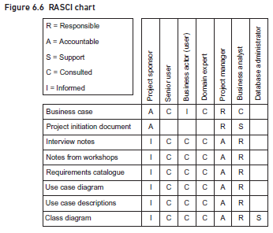
6. Defining Stakeholder Involvement- RACI and RASCI Charts
www.midocean.ae

Slide 43
7. Using Social Media in Stakeholder Management
Once upon a time, in stakeholder management, there really was no alternative to coming into an organization ‘cold’ with little understanding of who was who and where they fitted in. However, the availability of social media offers the business analyst additional resources to learn about stakeholders and to manage the relationships with them.
One obvious way of using social media is to use sites such as LinkedIn to carry out research about stakeholders.
Once the business analysis project is underway, other forms of social media might be considered for communicating with stakeholders.
However, resources such as Facebook and Twitter offer a cost-effective way of communicating with large groups of people on a frequent basis and keeping them informed.
www.midocean.ae

Slide 44
8. Understanding Stakeholder Perspectives
It is all very well knowing who the stakeholders are and what is likely to be their influence on a business analysis project.
But it is also vital to understand what they think, in other words what are their business perspectives?
For example, in a commercial organization, one stakeholder might feel that any activities are allowable as long as they are not actually illegal, whereas other stakeholders may feel that the organization has some responsibility towards society at large and therefore conclude that some activities should be avoided on ethical grounds.
To help us understand these stakeholder perspectives, and to model the different business systems that would fulfil them. we can utilize some of the elements from Peter Checkland’s Soft Systems Methodology (SSM; Checkland 1999).
www.midocean.ae

Slide 45
8. Understanding Stakeholder Perspectives
Soft Systems Methodology
Peter Checkland and his team at Lancaster University devised SSM in the 1980s as a way of understanding complex real-world situations. The basic premise underlying SSM is that real-world situations are rarely simple and are often very complex. An approach to business analysis, based upon elements and concepts from the SSM, is illustrated in Figure 6.7.
www.midocean.ae

Slide 46
8. Understanding Stakeholder Perspectives
When investigating business situations, it is often the case that stakeholders have different views about what the ‘problem’ is and also about what needs to be done. As Figure 6.7 shows, there are five main stages that should be applied:
1. The situation is identified, for example the loss of market share by a company or the poor public perception of a public body, and the issues and causes are investigated.
2. Stakeholders’ views – perspectives – are sought about what the organization is about, what it should be doing and so forth.
3. From each stakeholder’s perspective, a conceptual model is created to show what the organization should do to fulfil the perspective.
4. These conceptual models are compared with the real-world situation and a consensus model is generated, possibly by combining elements from various stakeholder’s perspectives.
5. Actions are defined to address the situation by implementing the consensus model in place of whatever is happening currently in the organization.
www.midocean.ae

Slide 47
8. Understanding Stakeholder Perspectives
Analyzing the perspectives – CATWOE
SSM provides us with a very useful tool that we can use to explore the stakeholders’ perspectives. Although the technique is known as CATWOE, experience shows that exploring the CATWOE elements is actually best done in the following order:
C = Customer(s) Stakeholders can differ, too, in their views of who their customers are (or should be). In our example, one view might be ‘anyone willing to buy wine from us’ whereas another might be ‘established regular customers who appreciate a personal touch’. Another way of thinking about customers is to ask ‘who is on the receiving end of the transformation?’
www.midocean.ae

Slide 48
8. Understanding Stakeholder Perspectives
Analyzing the perspectives – CATWOE
A = Actor(s) These are the people who carry out the transformation, for example telesales staff set challenging targets or knowledgeable salespeople and customer services staff capable of establishing long-term relationships with customers.
T = Transformation This is the principal business activity of the business system, in other words what lies at the heart of its operations. (Checkland used the term ‘transformation’ here because, at the highest level of abstraction, all systems exist to transform some form of input into some form of output.) In the case of our wine merchant, the Sales Manager’s worldview leads to a transformation that consists of making one-off ‘point sales’, whereas the Customer Services Manager thinks that it is about providing a high quality of service throughout the sales process, in order to establish relationships with customers.
www.midocean.ae

Slide 49
8. Understanding Stakeholder Perspectives
Analyzing the perspectives – CATWOE
W = Weltanschauung or worldview This summarizes a stakeholder’s beliefs about the organization or business system, which explain why it exists and what it should be doing. If we consider the wine merchant business that was discussed in Chapter 5, the newly appointed Sales Manager believes that success in the wine trade results from proactively contacting potential customers and convincing them to buy. However, the Customer Services Manager believes that success results from establishing close links with regular customers and providing them with excellent service.
www.midocean.ae

Slide 50
8. Understanding Stakeholder Perspectives
Analyzing the perspectives – CATWOE
O = Owner(s) The perspective is someone’s view of a business system, so the question is who ultimately controls that system and who could instigate change, or even closure, if necessary. Who, for example, could decide between the two competing worldviews about the wine merchant? In this case, the owner is the business’s chief executive but, in other situations, it could be a group, like a board of directors.
E = Environment Finally, all organizations operate within the constraints imposed by their environment. PESTLE – explored in Chapter 3 – can be used to identify the main external factors but, in some situations, things like organizational policies can also feature here.
Figure 6.8 presents CATWOE analyses of our wine merchants from the two stakeholders’ perspectives.
www.midocean.ae

Slide 51
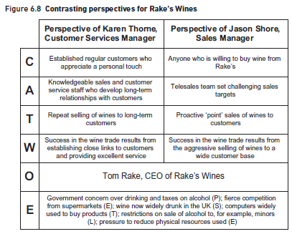
8. Understanding Stakeholder Perspectives
www.midocean.ae

Slide 52
8. Understanding Stakeholder Perspectives
In Figure 6.8, the owner and environment for both perspectives is the same. This can be the case when using CATWOE, although sometimes different perspectives may yield differences in these areas. For example, we might consider a further environment constraint to be the willingness of people to buy wine on receipt of an unsolicited telephone call.
www.midocean.ae

Slide 53
8. Understanding Stakeholder Perspectives
Illustrating the perspectives – business activity models
Business activity models (BAM) provide a conceptual model of what we would expect to see to fulfil a particular stakeholder perspective.
A BAM shows what the organization should be doing, as opposed to a business process model (discussed in Chapter 7) which explores how it does these things.
Creating a BAM requires the business analyst to think about the activities that each stakeholder’s perspective implies.
The approach for creating a BAM is as follows and a completed BAM for the wine merchants (drawn from the perspective of the Sales Manager) is shown in Figure 6.9:
www.midocean.ae

Slide 54
8. Understanding Stakeholder Perspectives
Illustrating the perspectives – business activity models
Identify the DOING activities that are at the heart of the model. These are derived from the transformation of CATWOE and reflect the organization's principal business activities. In the case of the wine merchant, there is one doing activity ‘sell wines’.
ENABLING activities are next added. These lead into the doing activities on the model and acquire or replenish the resources needed to carry them out. In Figure 6.9, for example, there are activities to recruit and train salespeople and to advertise the company’s products.
www.midocean.ae

Slide 55
8. Understanding Stakeholder Perspectives
Illustrating the perspectives – business activity models
3. All of the activities of the organization should follow from PLANNING activities.
Normally, on a BAM, we would not show the strategic planning activities – setting the general direction of the organization for instance – as we are interested in the planning required within this business system (which will support the strategy execution).
Planning activities also include setting targets, such as KPIs against which the performance of the business system can be measured.
4. The actual evaluation of the performance is done within the MONITORING activities, for example, in Figure 6.9 monitoring the performance of the salespeople.
5. Finally, if the monitoring activities reveal that performance is not what was expected in the plans, CONTROL activities may be required to institute the necessary remedial actions.
www.midocean.ae

Slide 56
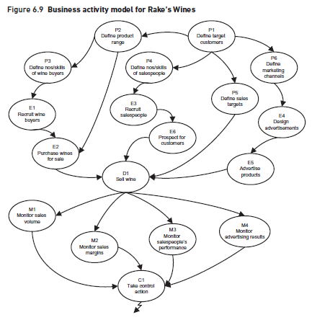
8. Understanding Stakeholder Perspectives
www.midocean.ae

Slide 57
8. Understanding Stakeholder Perspectives
With regard to the control activities, two observations are relevant:
On a BAM, we could associate a control activity with each monitoring activity and some users of the technique prefer to shown them this way. However, in the real world, managers often take action as a result of a range of measurements so a less cluttered model can be created by feeding all of the monitoring activities into one control activity, as in Figure 6.9.
The control actions themselves could feed back into any of the other activities on the model. Since trying to show this would create an impossible-to-understand diagram, the convention is to show a ‘lightning strike’ symbol emanating from the control activity which means that it feeds back into the model wherever it is relevant.
www.midocean.ae

Slide 58
8. Understanding Stakeholder Perspectives
With regard to the control activities, two observations are relevant:
The model shown in Figure 6.9 represents Rake’s Wines as seen from the perspective of Jason Shore, Sales Manager. As we have seen, though, the Customer Services Manager, Karen Thorne, sees the organization rather differently. Both managers agree that ‘Sell wine’ is at the heart of the business but, for Jason Shore, this means proactively contacting new customers and pushing them to buy Rake’s wines; Karen envisages selling to existing customers who contact Rake’s to ask for advice and guidance on what to buy.
If the model had been built from Karen’s perspective, it would probably not contain the enabling activity E6 ‘Prospect for customers’ but it would have included activities to recruit and train customer service staff, possibly as wine advisors.
www.midocean.ae

Slide 59
8. Understanding Stakeholder Perspectives
With regard to the control activities, two observations are relevant:
Having modelled the organization from the perspective of each stakeholder (or, at any rate, of each stakeholder with a different CATWOE), it is now necessary to achieve a consensus BAM that represents the agreed or idealized way forward.
This is less desirable than securing all the stakeholders’ agreement, as some people may not necessarily accept the agreed BAM but it may be the best that can be achieved in some situations.
www.midocean.ae

Slide 60
8. Understanding Stakeholder Perspectives
Examination of the difference between the current situation (perhaps reflected in a range of documents including meeting reports, a rich picture or fishbone diagram) and the conceptual view provided by the BAM, is an important part of gap analysis.
As part of the gap analysis, the business analyst may wish to explore how the activities are currently carried out, and how they should be performed in the future; this can be achieved through business process modelling.
www.midocean.ae

Slide 61
8. Understanding Stakeholder Perspectives
A note on notation for business activity models
There is no universally-agreed notation for BAMs. Many users of the technique like to use ‘cloud’ or ‘thought’ symbols to emphasize that this is a conceptual model and not a representation of what the organization looks like now.
It is probably not a good idea to use boxes, as then the models may be confused with business process models which, as we have shown, illustrate how an organization works rather than what it does.
www.midocean.ae

Slide 62
8. Understanding Stakeholder Perspectives
Activity ‘threads’ in business activity models
Sometimes, rather than considering individual business activities, it is more useful to group them into ‘threads’ of related activities.
For example, in Figure 6.10, we have extracted from Figure 6.9 those activities related to the recruitment, training and management of salespeople.
We may find, for example, that the jobs are poorly defined, ineffective recruitment processes are being used, salespeople are being set the wrong targets and so on.
www.midocean.ae

Slide 63
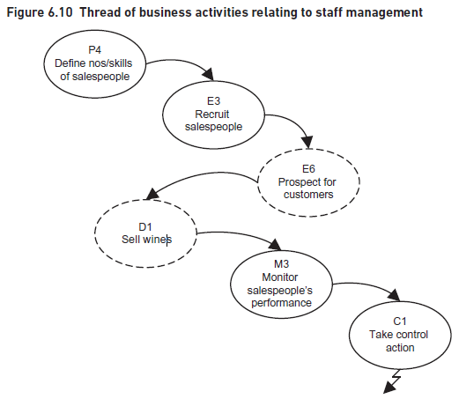
8. Understanding Stakeholder Perspectives
www.midocean.ae

Slide 64
CONCLUSION
Effective stakeholder management is key to the success of any business analysis project. It should begin before the project starts, at the inception stage, and be continued throughout the project – and even afterwards to ensure that the changes are implemented effectively.
Stakeholders can be assessed in terms of their interest in the project and their power or influence over it and strategies must be defined to actively manage them in accordance with this assessment.
Techniques such as CATWOE and BAM are extremely helpful in revealing where the stakeholders’ values and priorities lie, and exploring what should be done within the business system to fulfil their perspectives.
www.midocean.ae

Slide 65
REFERENCES
Required Reference:
Debra Paul and James Cadle, et al, (2020). “Business Analysis”. BCS, 4th Edition. ISBN:978-1-78017-5102
Recommended Reading
James Cadle, Debra Paul, Jonathan Hunsley, Adrian Reed, David Beckham, Paul Turner (2021). “Business Analysis Techniques” 3rd Edition, BCS. ISBN: 978-1-78017-5690
www.midocean.ae

Slide 66


The End of Lecture
Thank You

