Slide 1
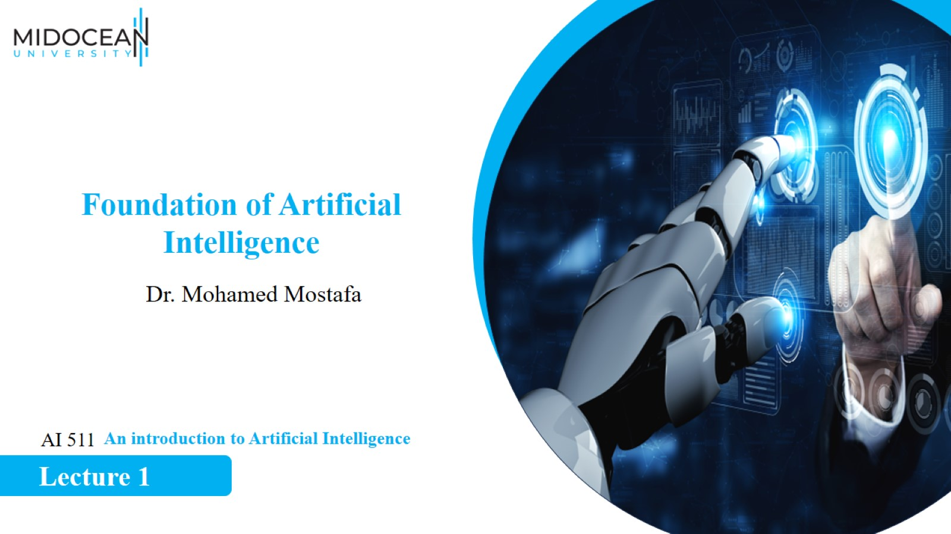

Slide 2
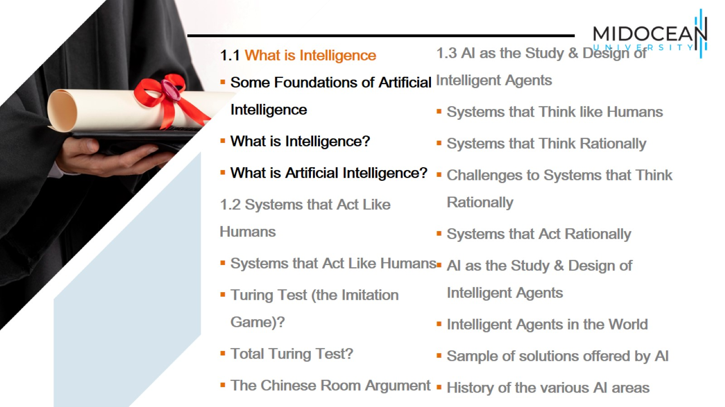

Slide 3
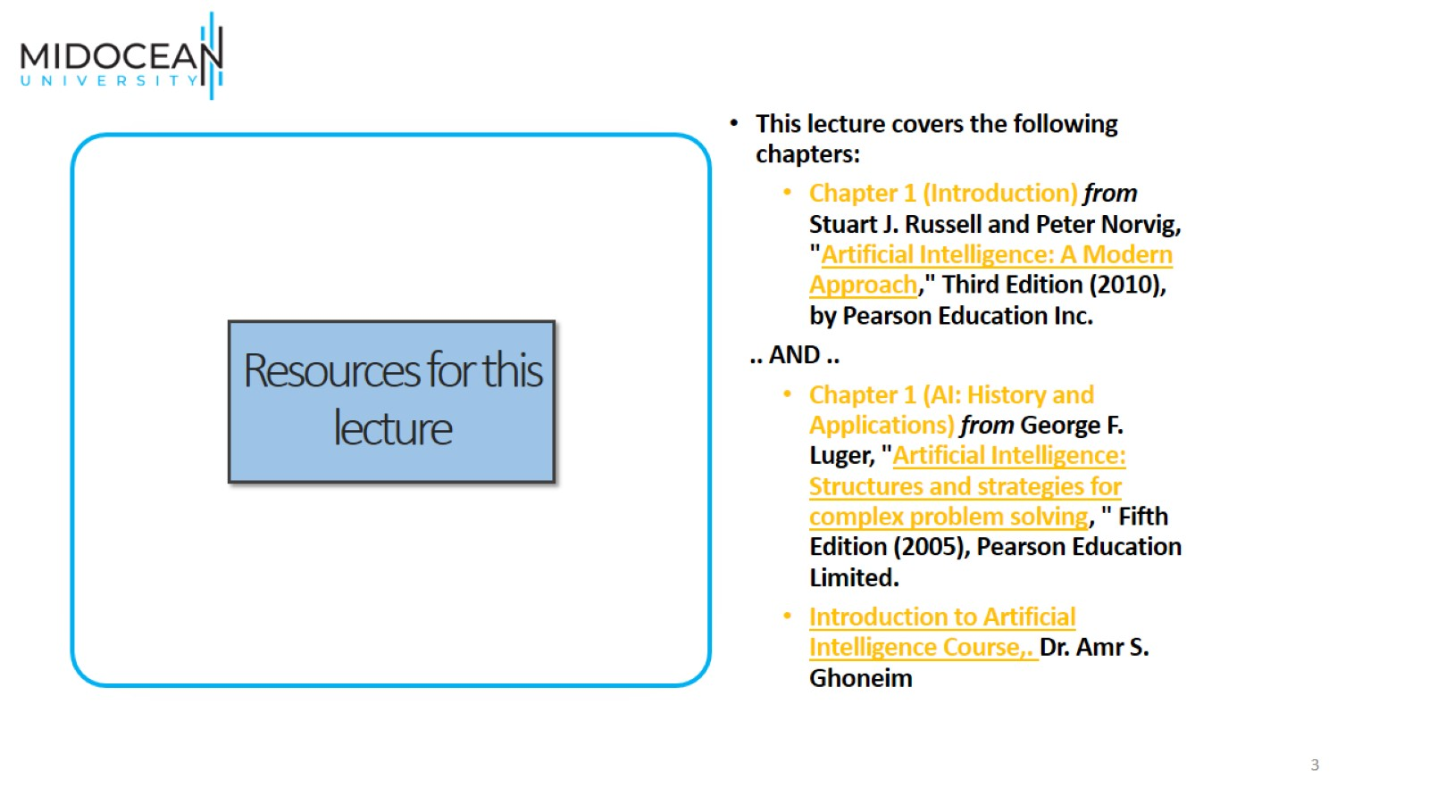
Resources for this lecture

Slide 4
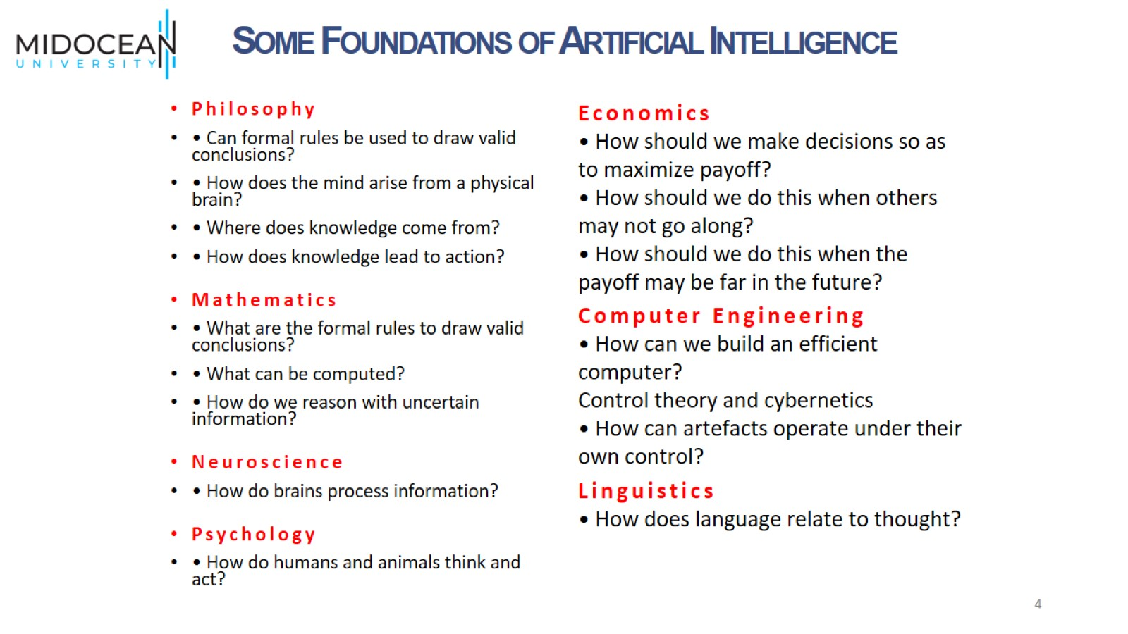

Slide 5
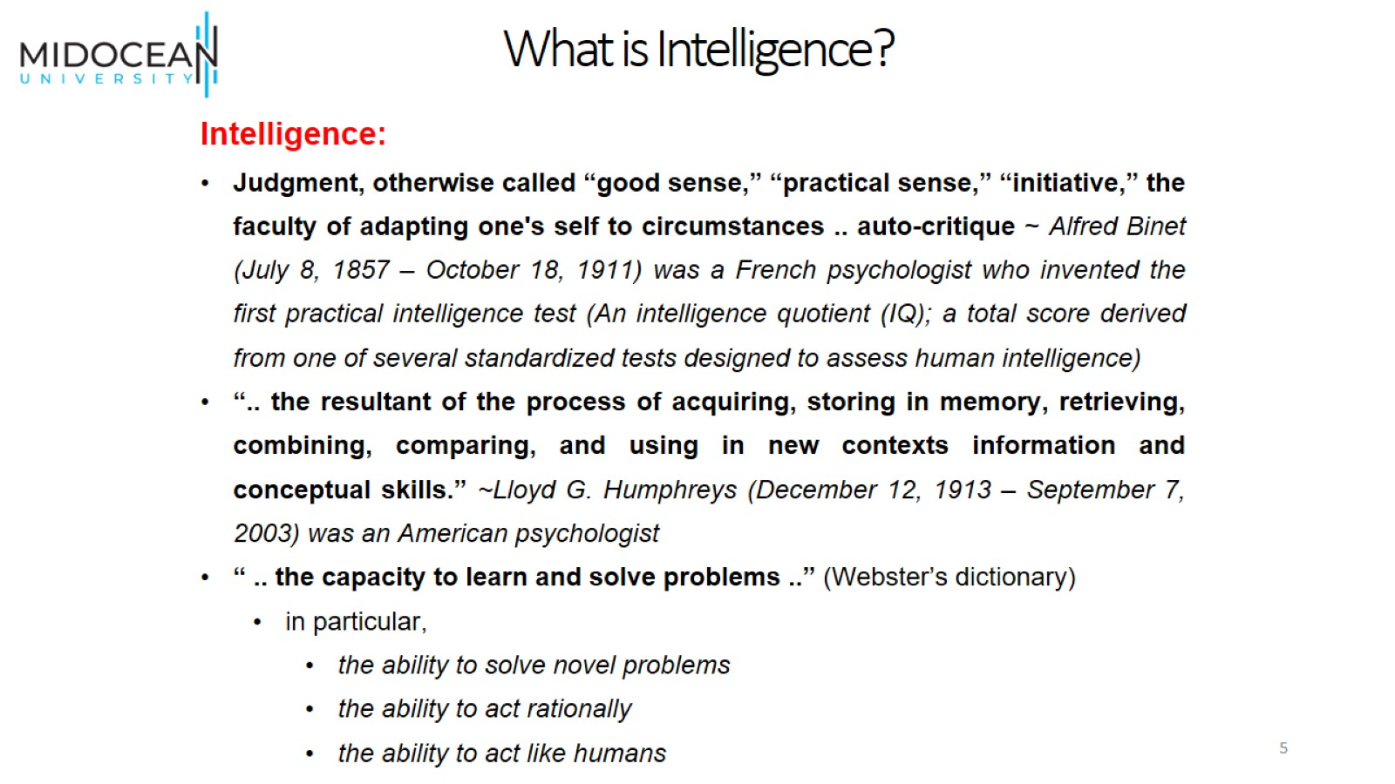
What is Intelligence?

Slide 6
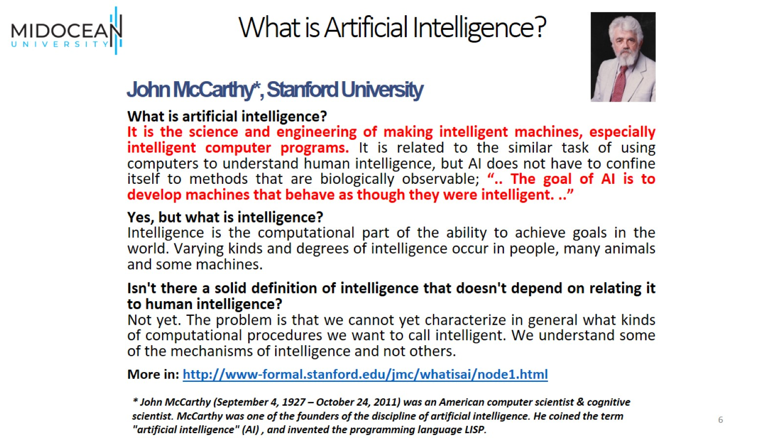
What is Artificial Intelligence?

Slide 7
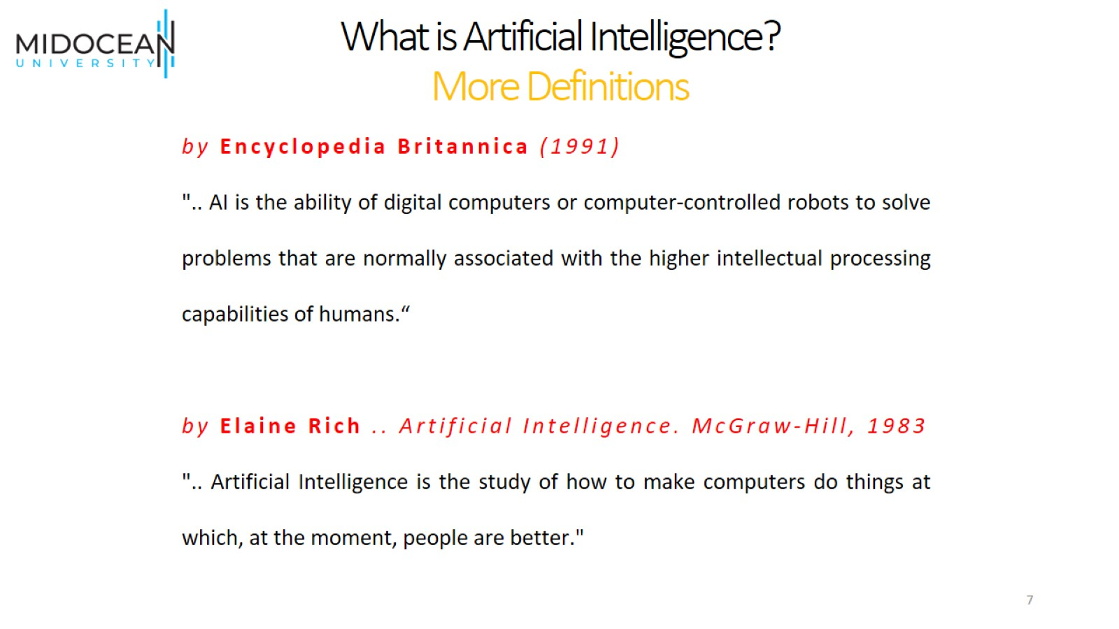
What is Artificial Intelligence?
More Definitions

Slide 8
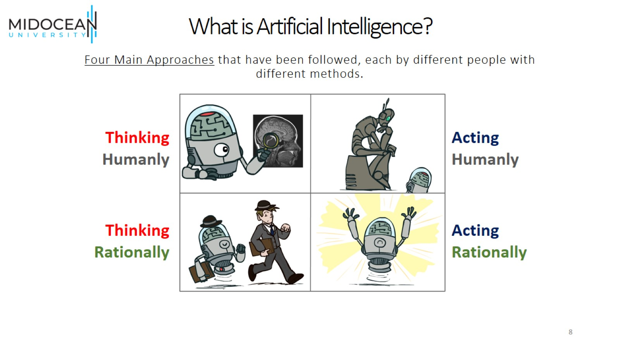
What is Artificial Intelligence?
Four Main Approaches that have been followed, each by different people with different methods.

Slide 9
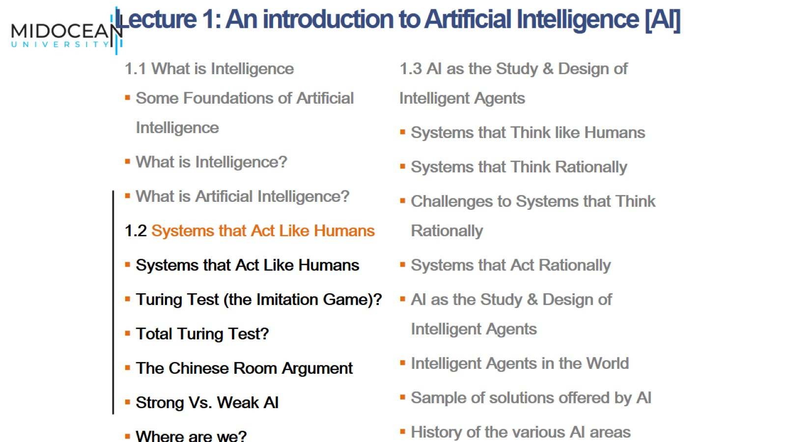

Slide 10
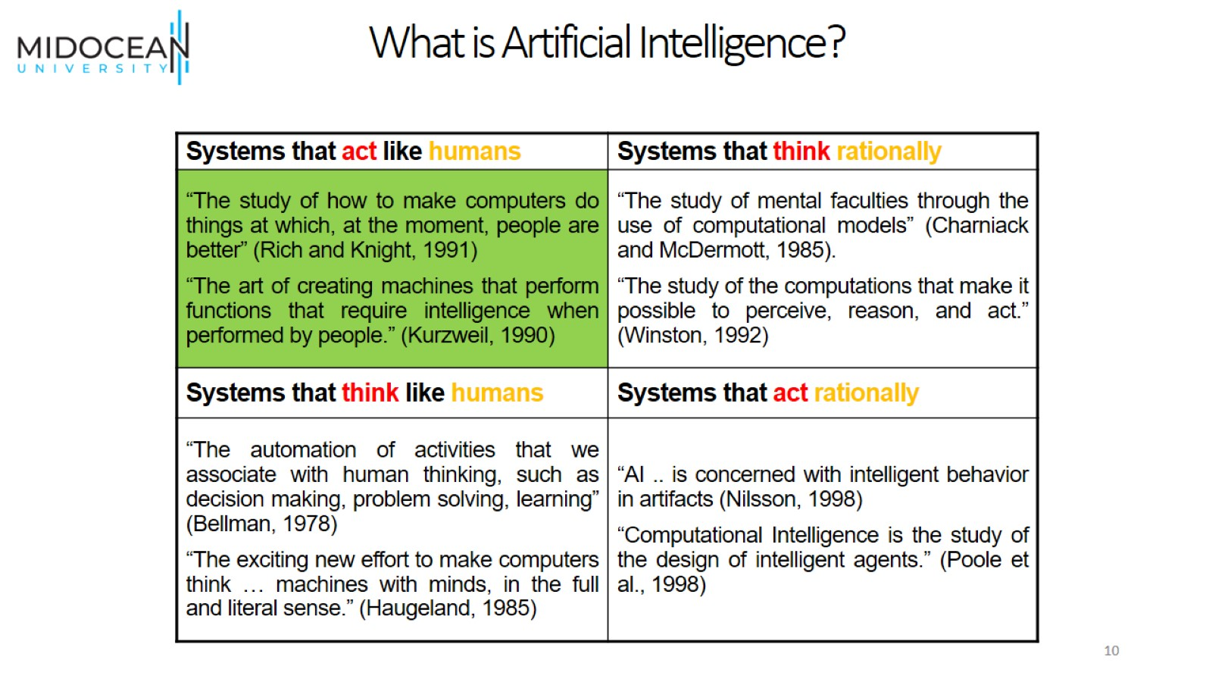
What is Artificial Intelligence?

Slide 11
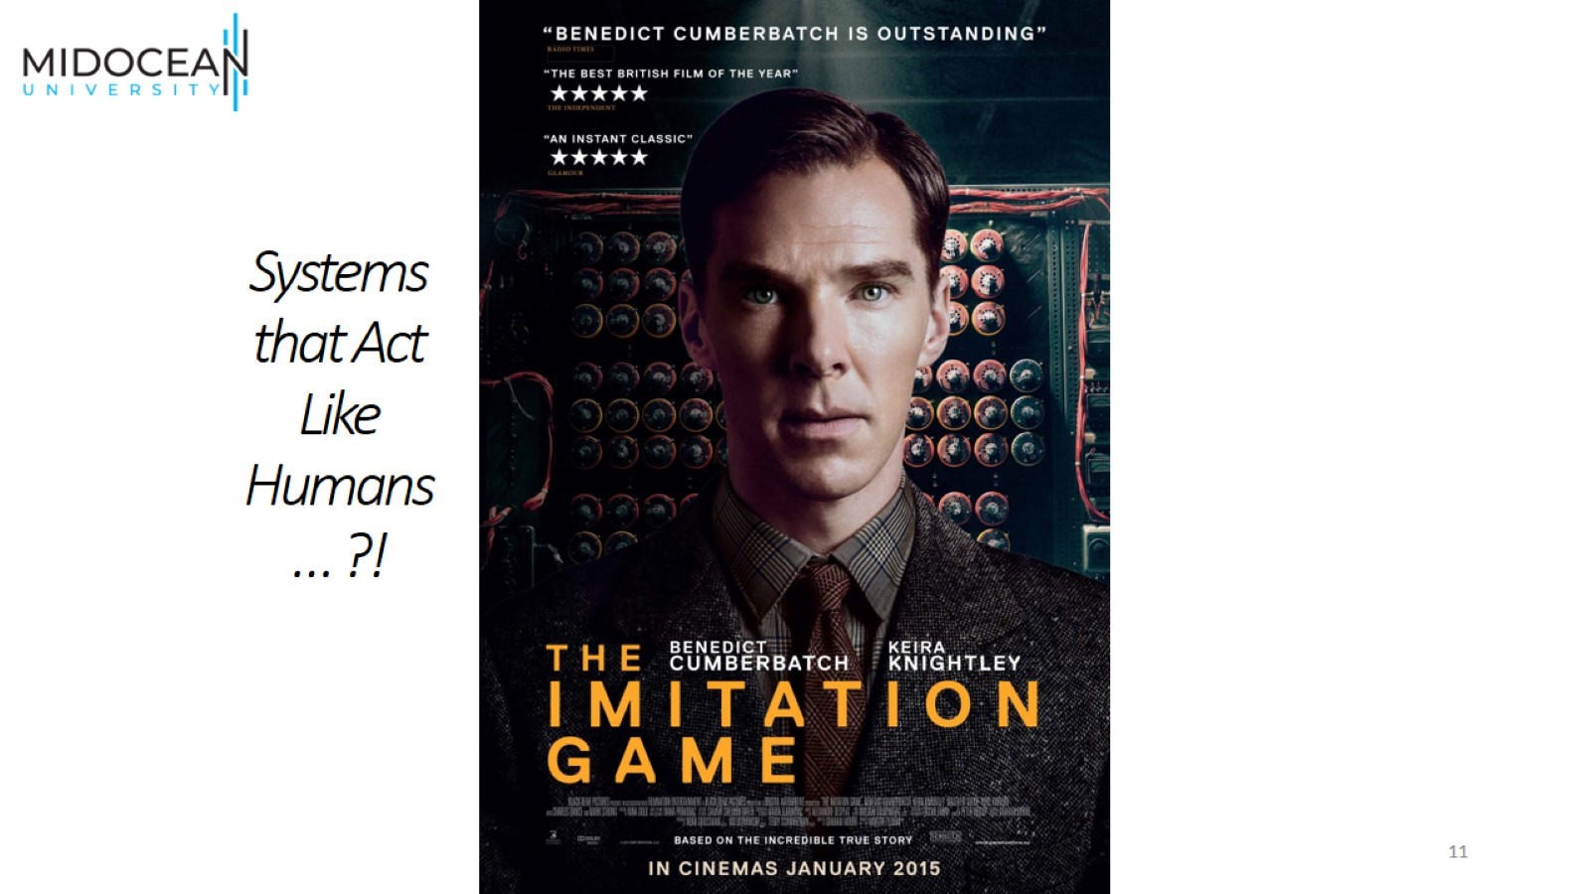
Systems that Act Like Humans … ?!

Slide 12
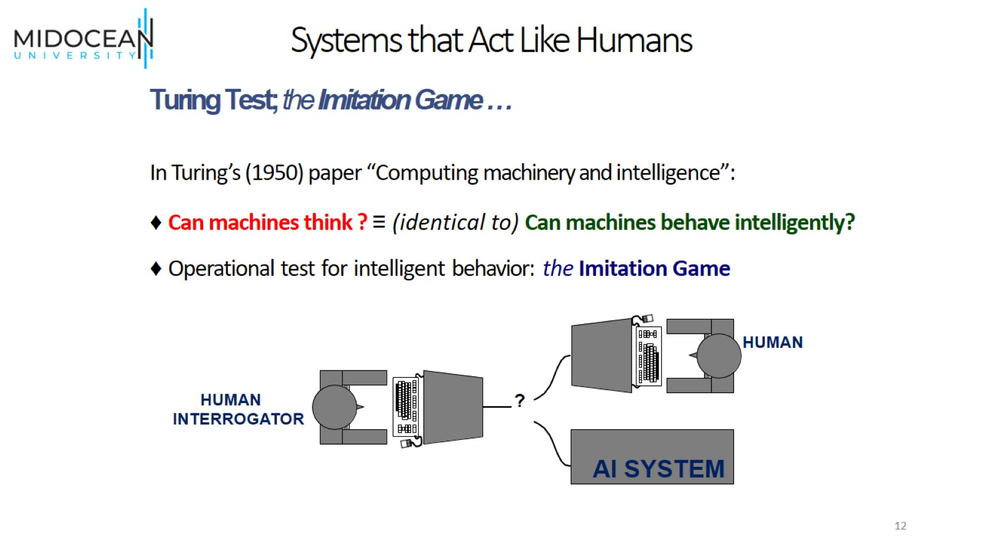
Systems that Act Like Humans

Slide 13
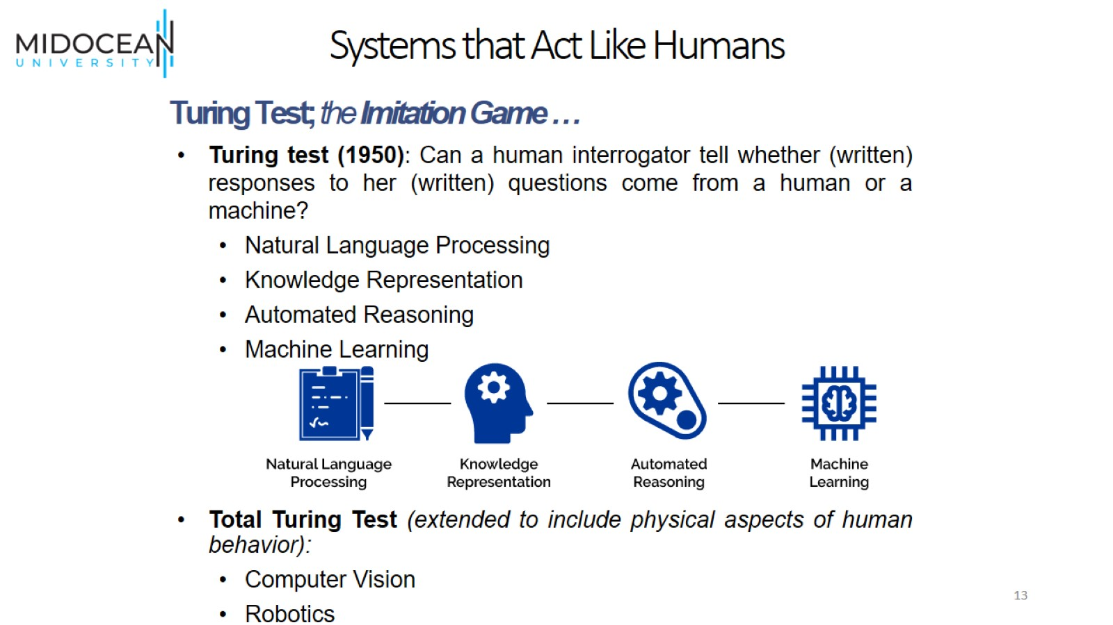
Systems that Act Like Humans

Slide 14
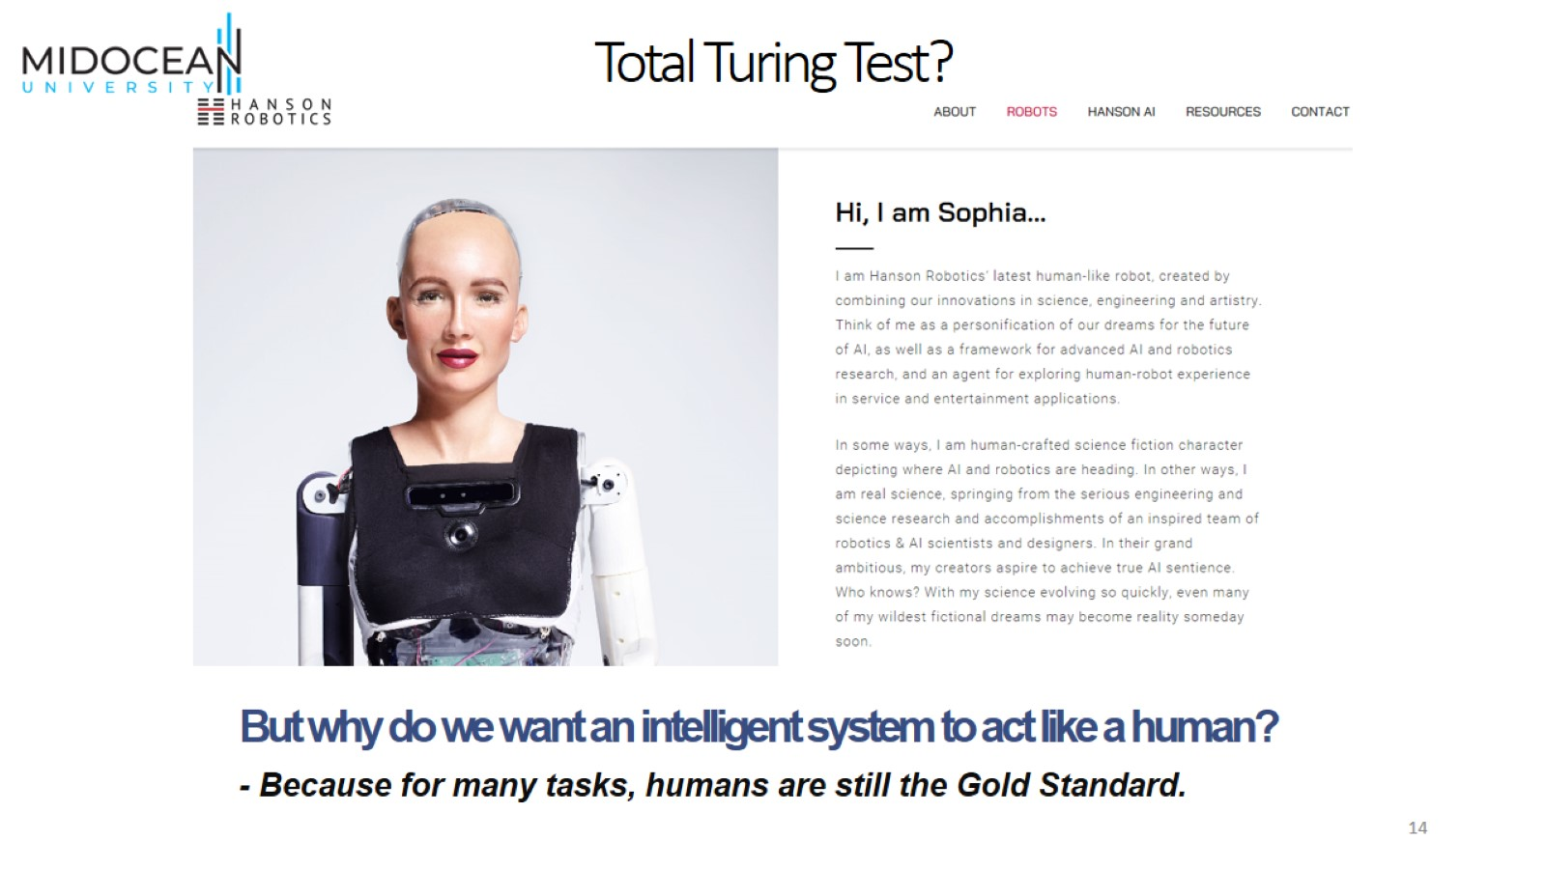
Total Turing Test?

Slide 15
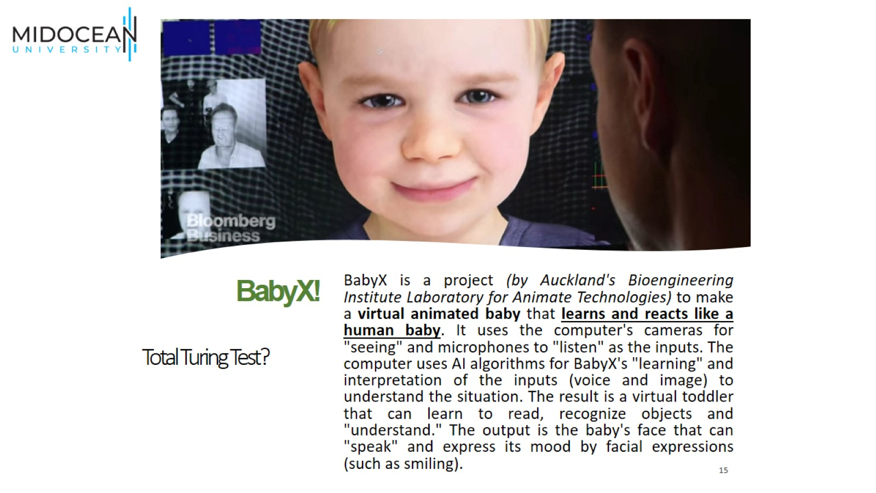
Total Turing Test?

Slide 16

Total Turing Test?

Slide 17
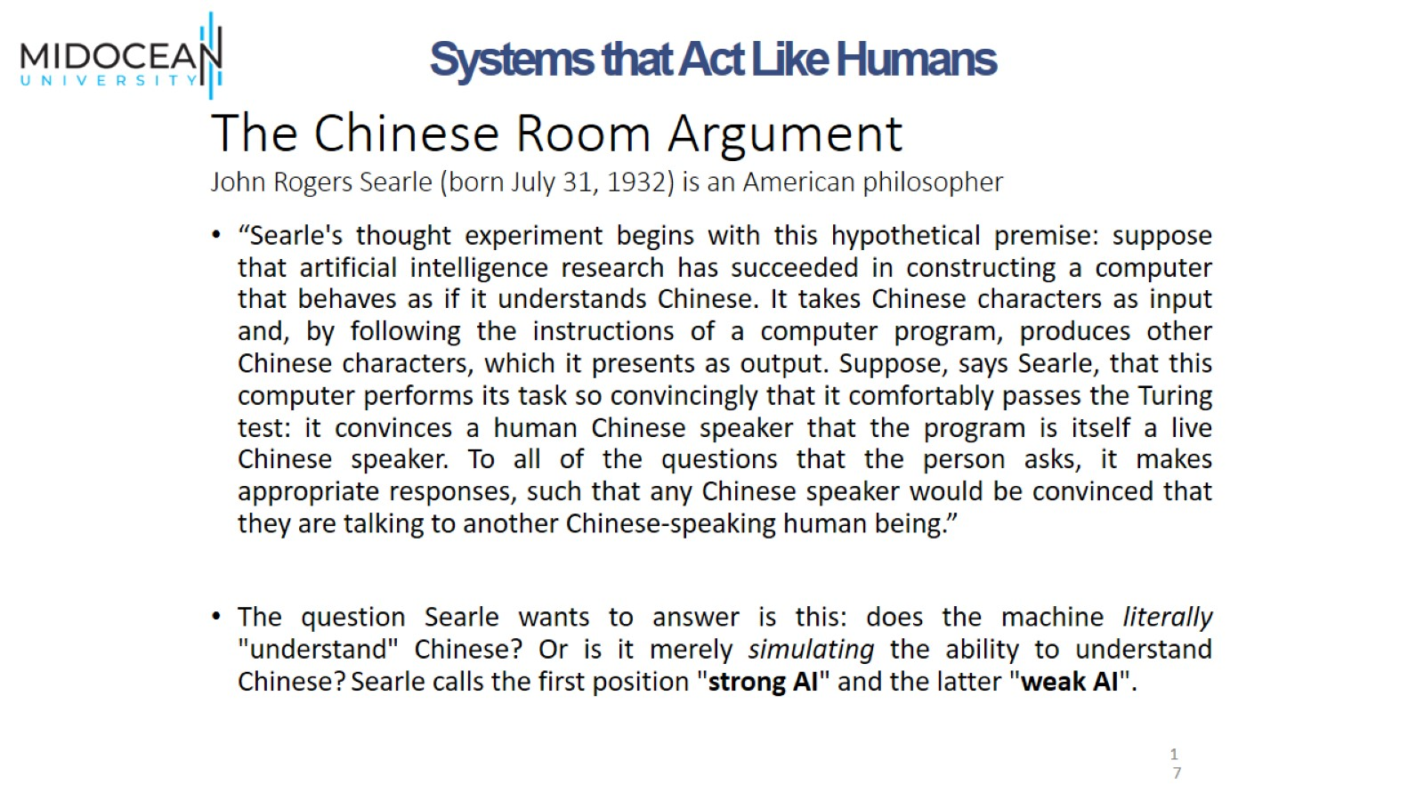
The Chinese Room Argument
John Rogers Searle (born July 31, 1932) is an American philosopher

Slide 18
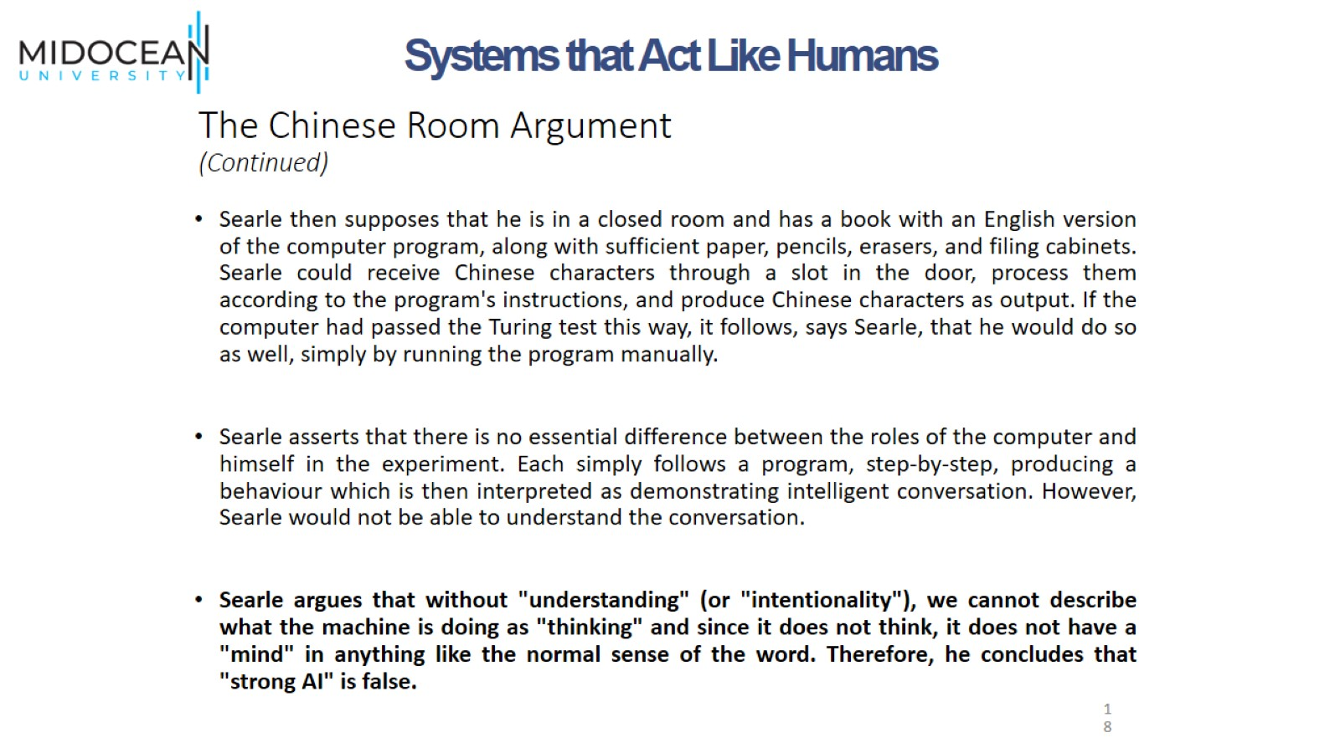
The Chinese Room Argument
(Continued)

Slide 19
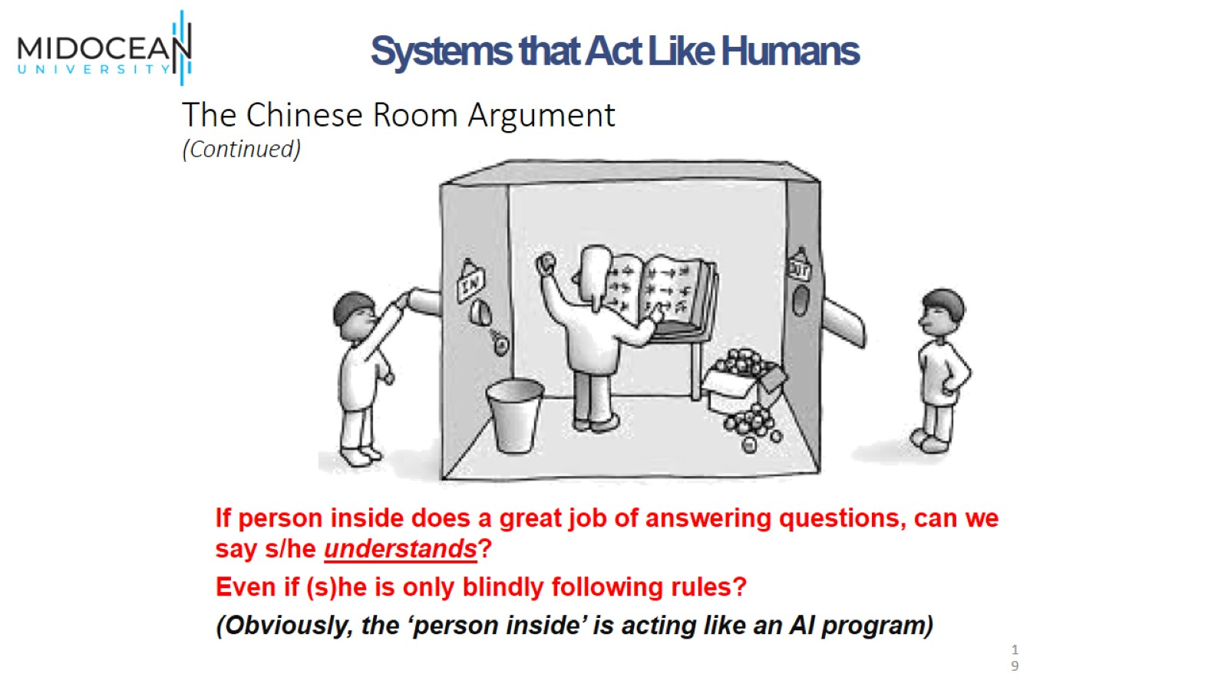
The Chinese Room Argument
(Continued)

Slide 20
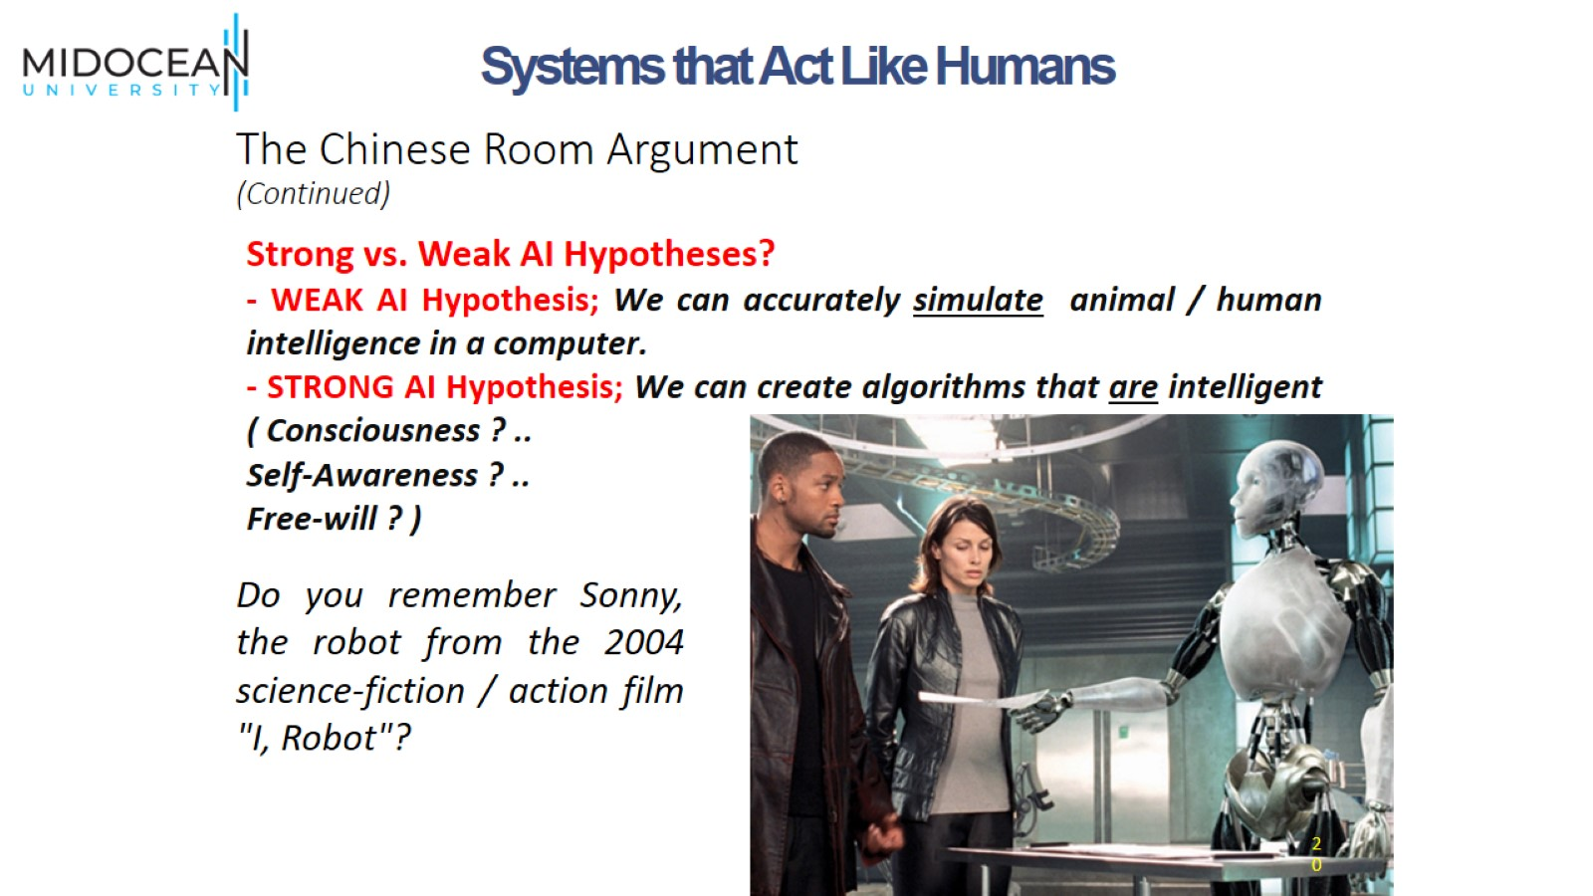
The Chinese Room Argument
(Continued)

Slide 21
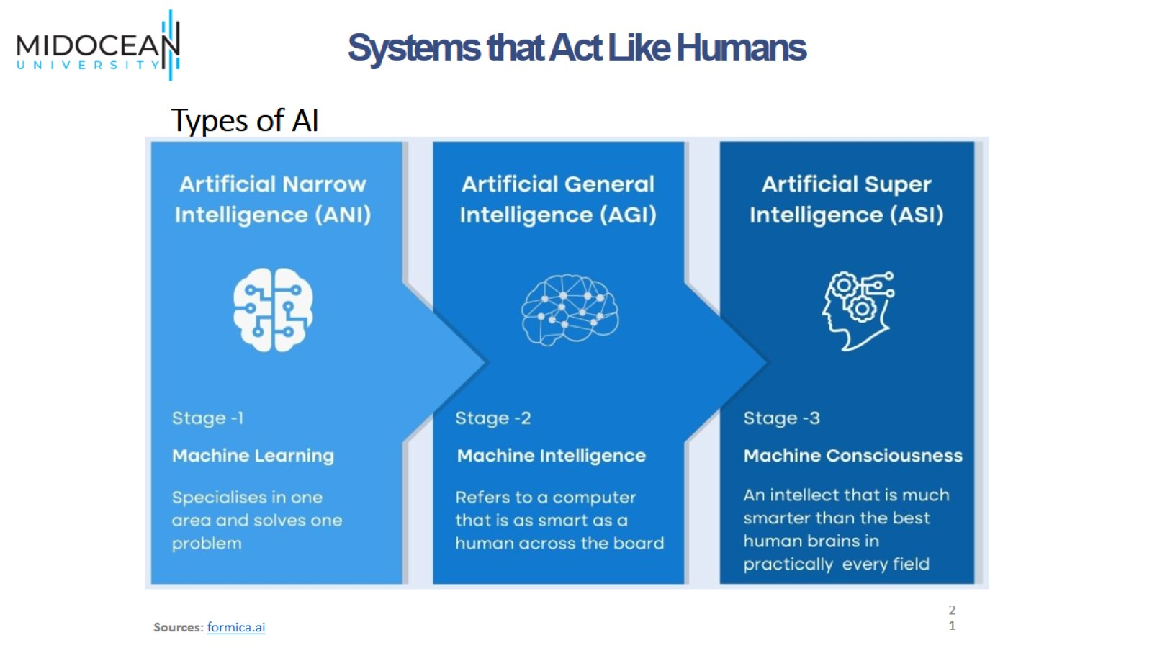
Types of AI

Slide 22
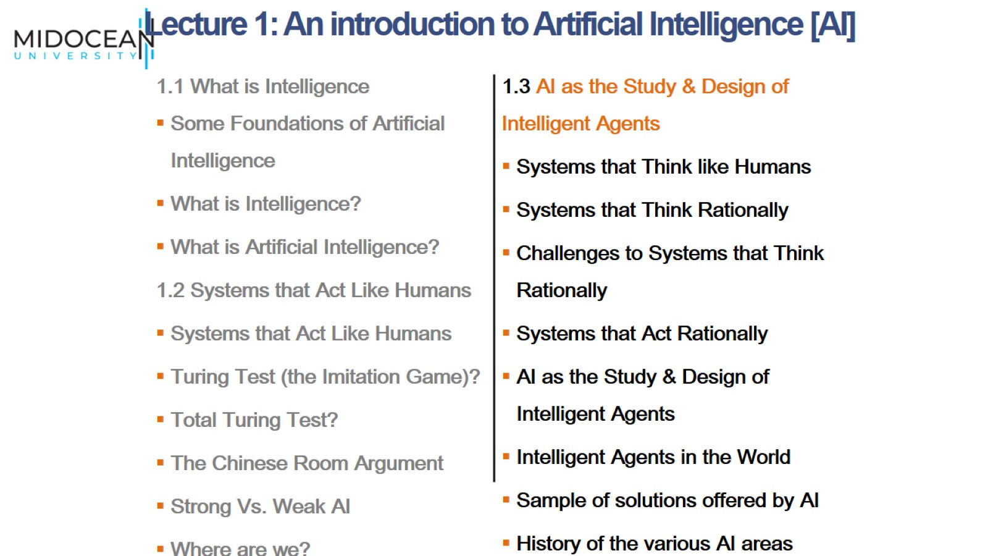

Slide 23
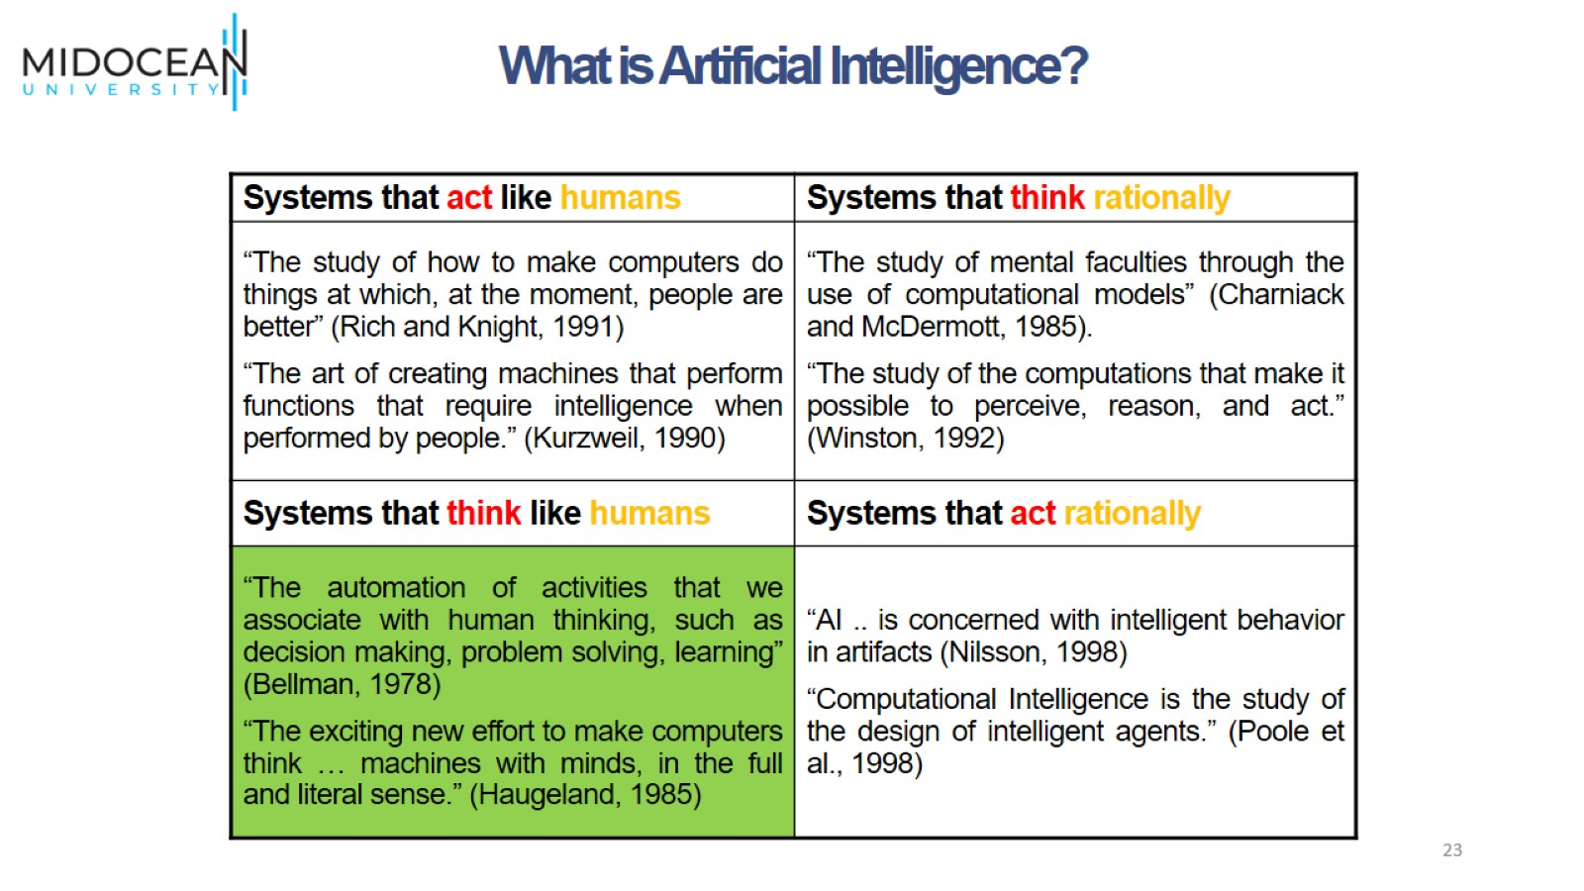

Slide 24
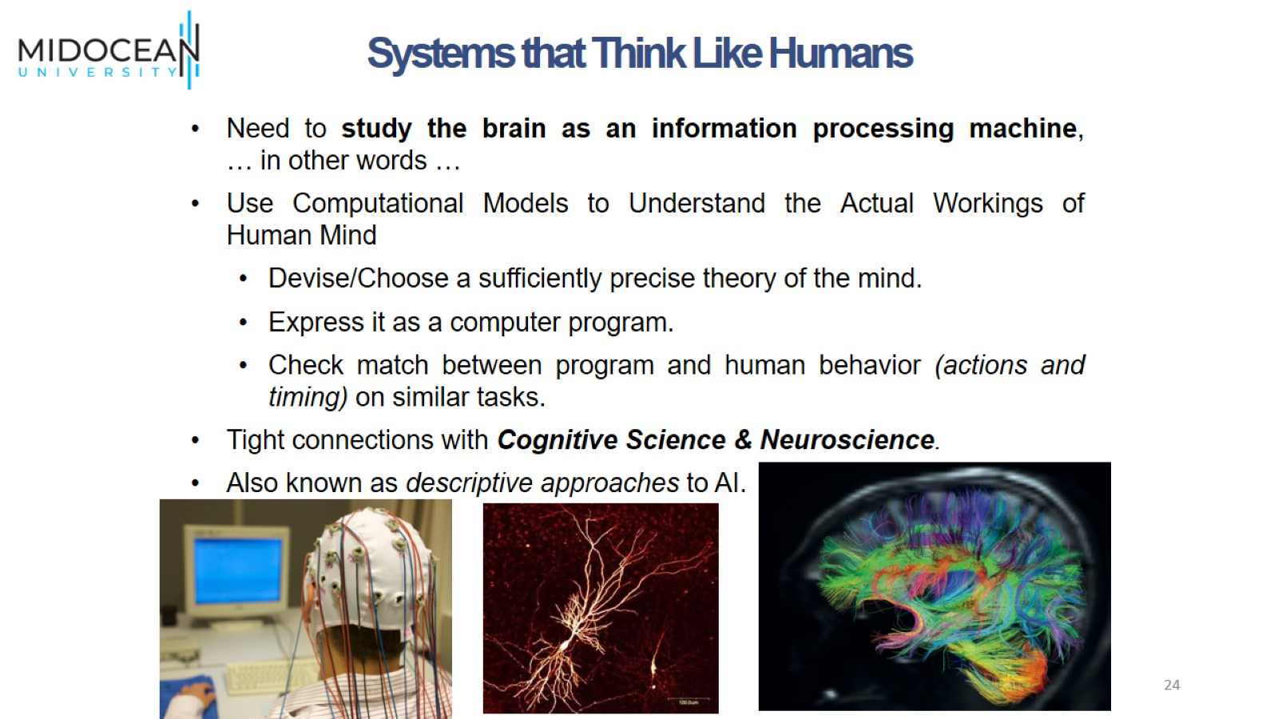

Slide 25
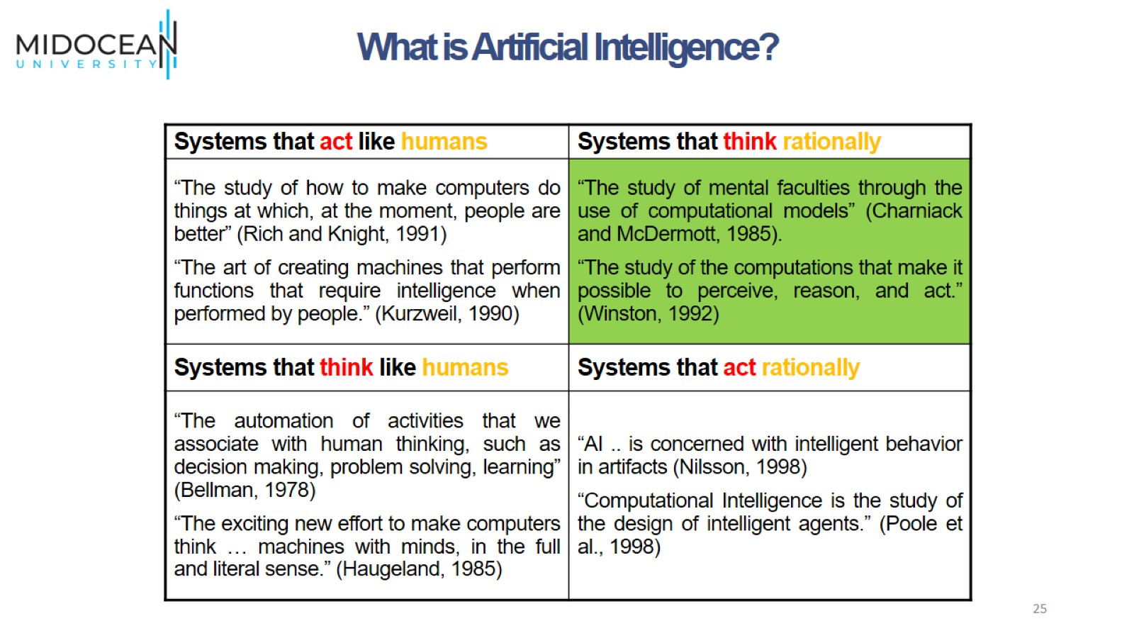

Slide 26
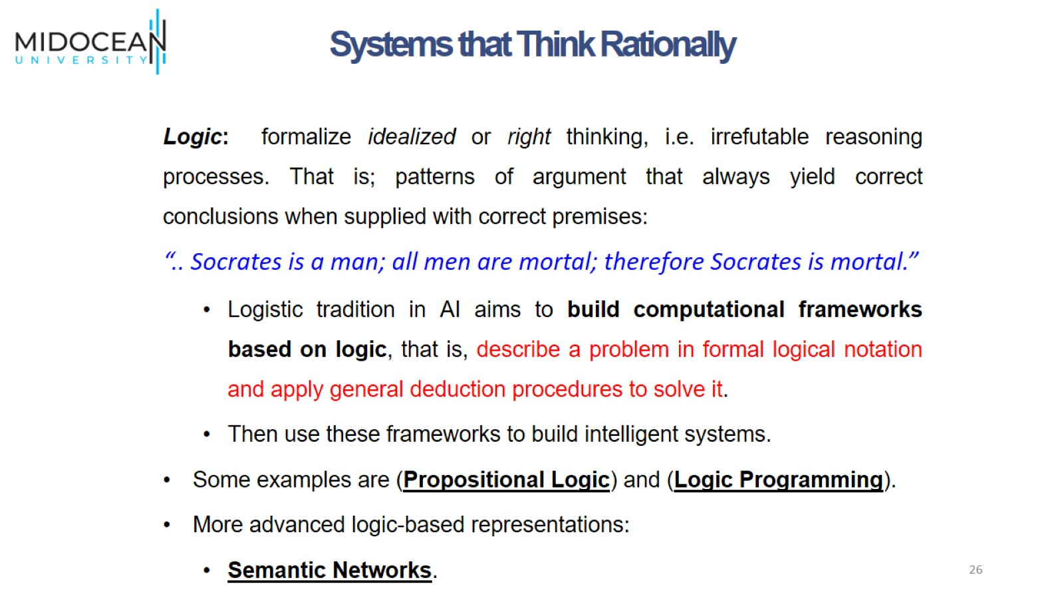

Slide 27
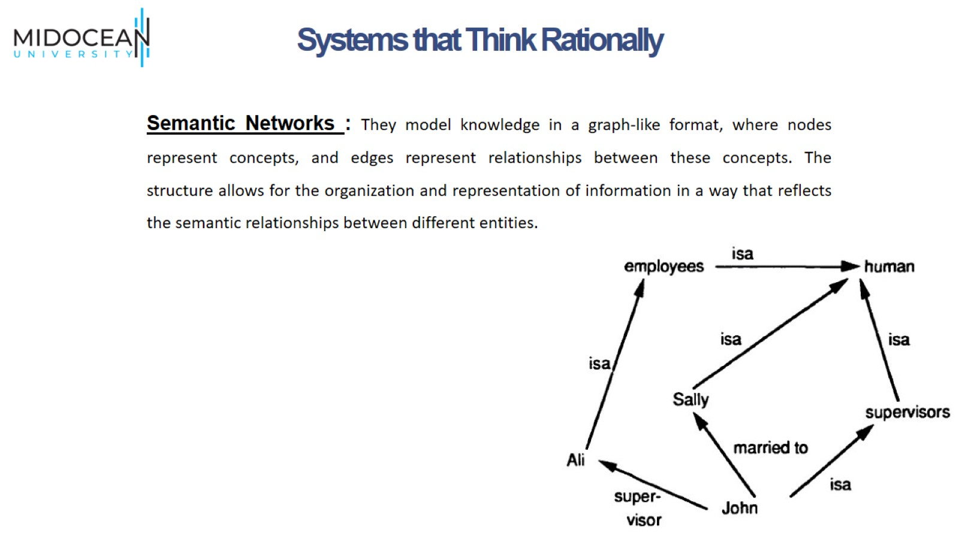

Slide 28
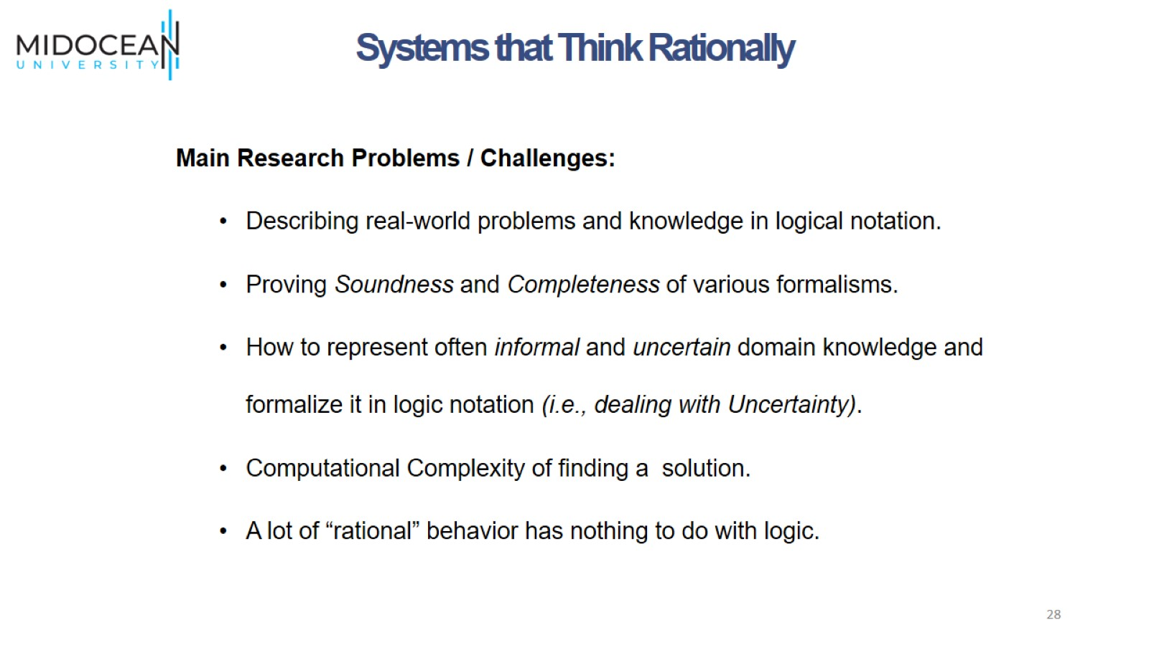

Slide 29
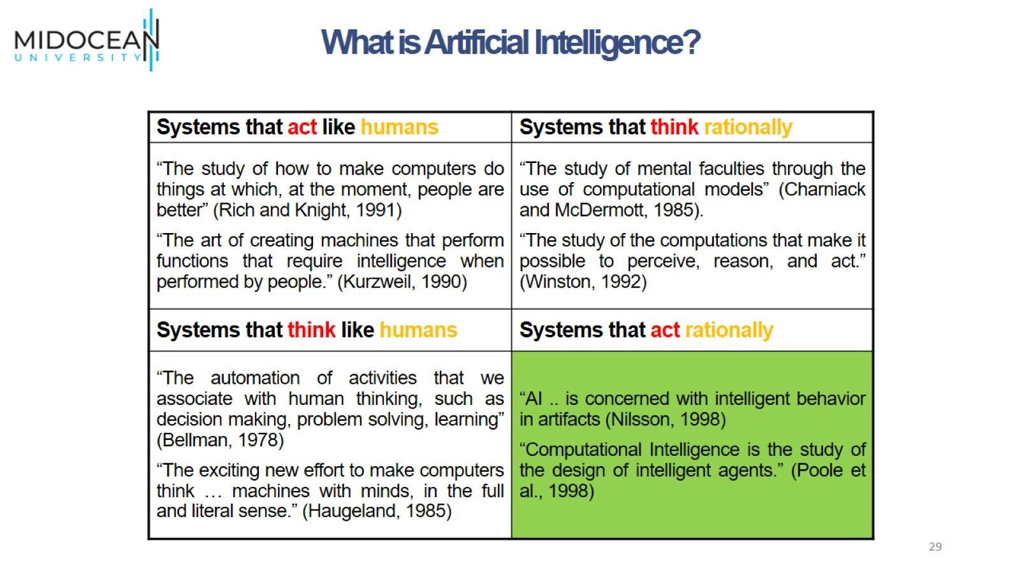

Slide 30
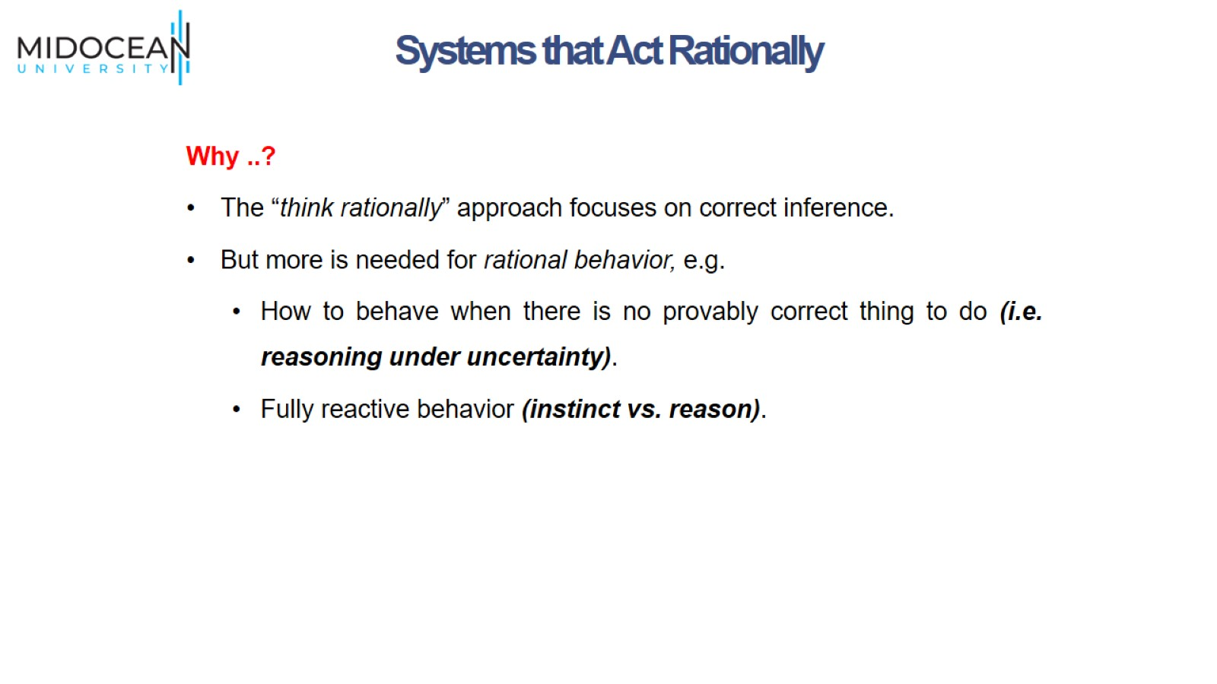

Slide 31
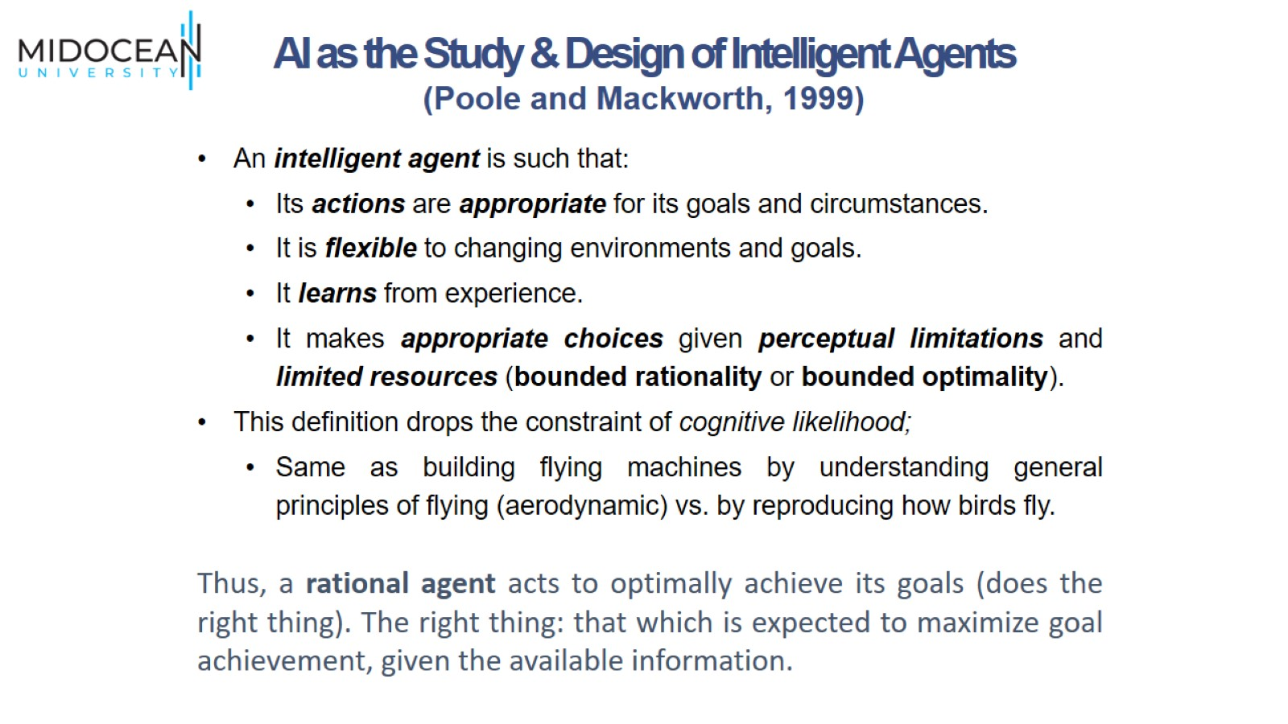

Slide 32
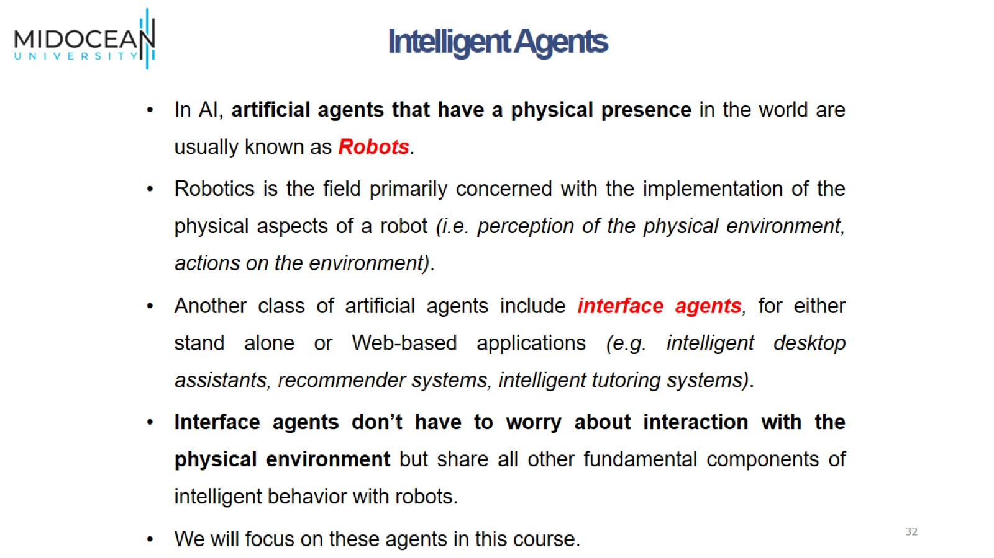

Slide 33
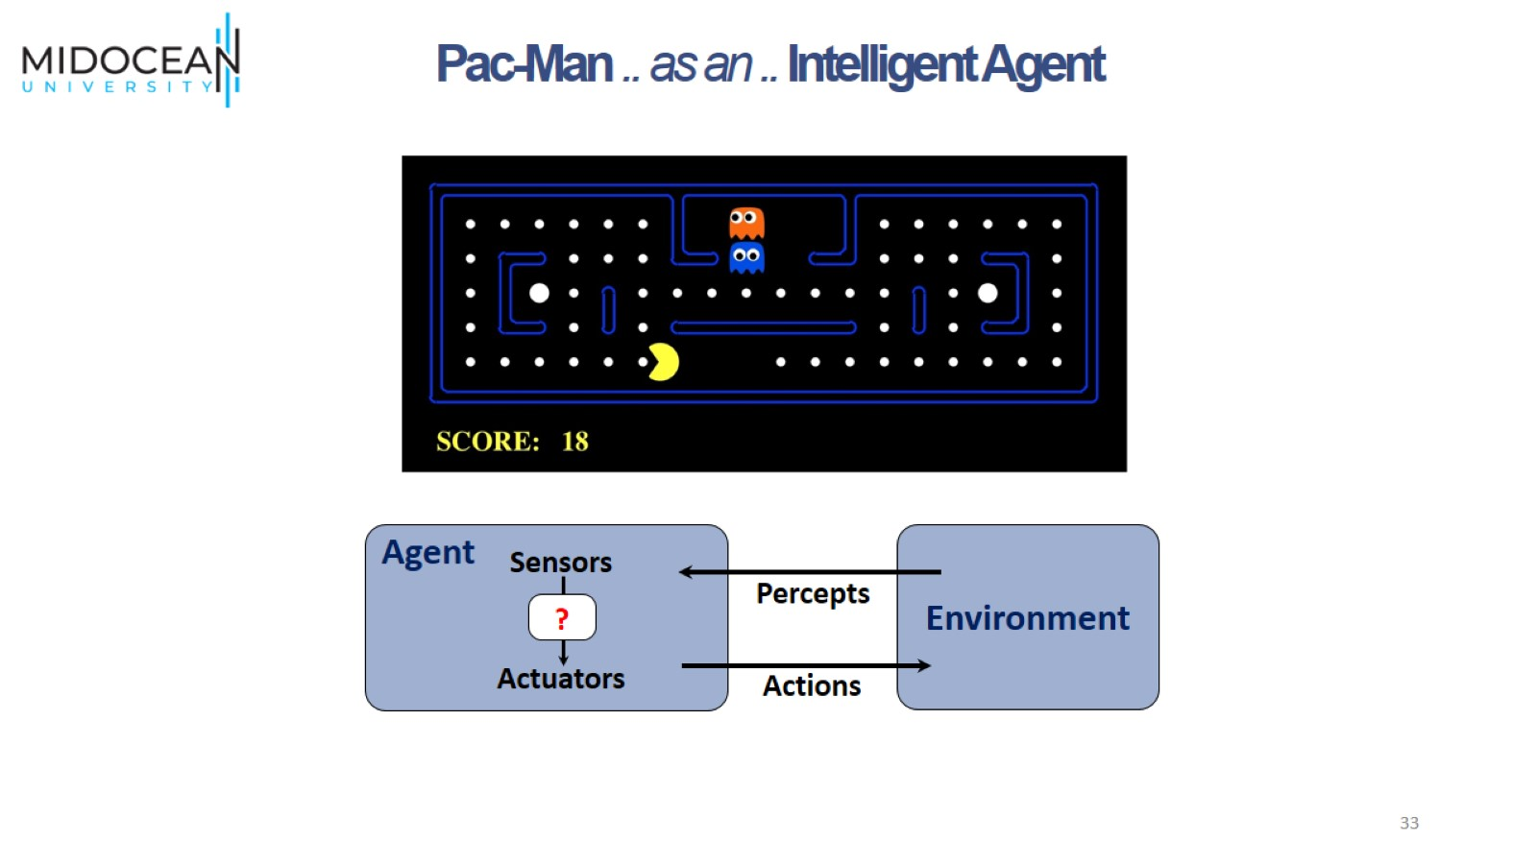

Slide 34
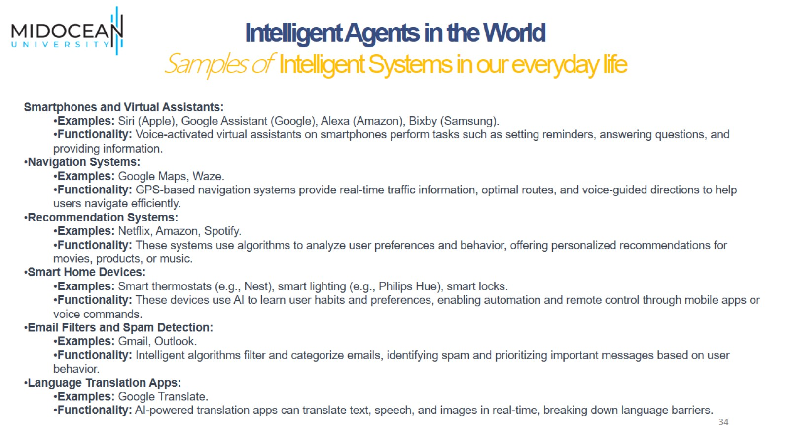

Slide 35
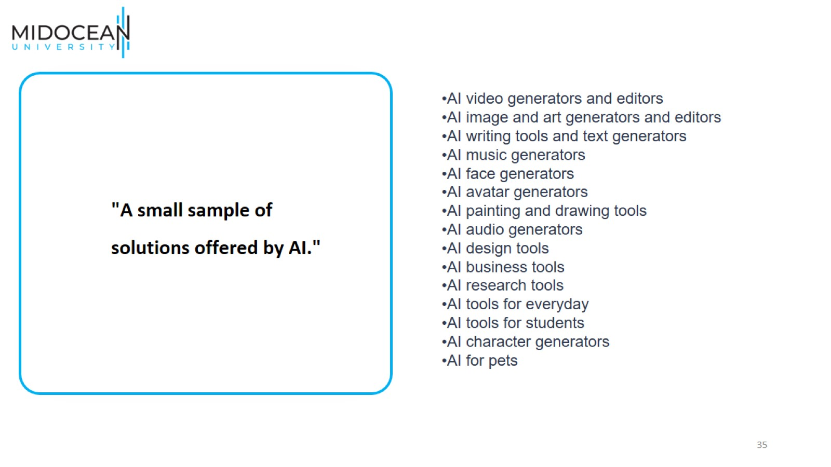

Slide 36


