Slide 1



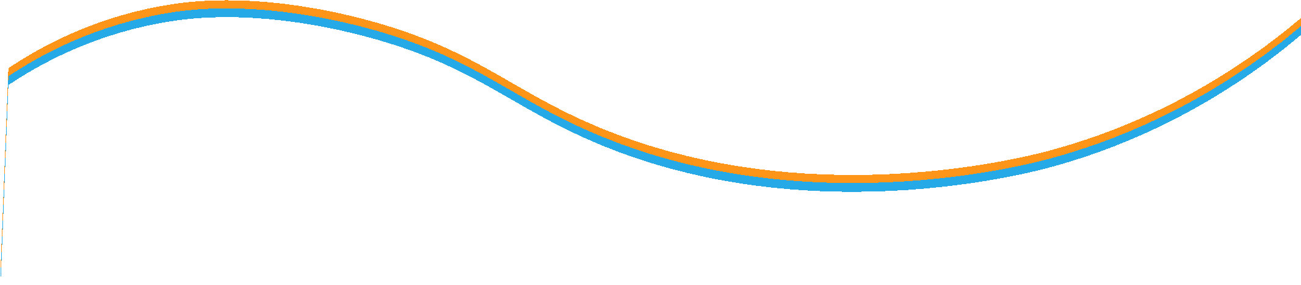

Financial return & risk concepts
Lecture 6
Prepared by Dr. Walaa Mohamed
MGM 237
Introduction to Finance

Slide 2
LEARNING OBJECTIVES
After studying this chapter, you should be able to do the following:
LO.1 calculate and interpret major return measures
LO.2 calculate and interpret the mean, variance, and covariance (or correlation) of asset returns based on historical data
LO.3 Types of investors
LO.4 Calculate Expected Return of a portfolio
LO.5 calculate and interpret portfolio standard deviation
LO.6 calculate and interpret beta
LO.7 explain return generating models and their uses
LO.8 Market efficiency

Slide 3

calculate and interpret major return measures
Return
Financial assets normally generate two types of return for investors. First, they may provide periodic income through cash dividends or interest payments. Second, the price of a financial asset can increase or decrease, leading to a capital gain or loss.
Holding Period Return
A holding period return is the return earned from holding an asset for a single specified period of time.
The period may be 1 day, 1 week, 1 month, 5 years, or any specified period.
For ease of illustration, we assumed that the dividend is paid at time t = 1. If the dividend was received any time before t = 1, our holding period return would have been higher because we would have earned a return by reinvesting the dividend for the remainder of the period.
The holding period return can be computed for a period longer than one year.
The holding period return can be computed for a period longer than one year. For example, you may need to compute a three-year holding period return from three annual returns. In that case, the holding period return is computed by compounding the three annual returns: R = [(1 + R1) × (1 + R2) × (1 + R3)] – 1, where R1, R2, and R3 are the three annual returns.

Slide 4


Arithmetic or Mean Return
The arithmetic average return is easy to compute and has known statistical properties, such as standard deviation. We can calculate its standard deviation to determine how dispersed the observations are around the mean or if the mean return is statistically different from zero.
Geometric Mean Return
The arithmetic mean return assumes that the amount invested at the beginning of each period is the same. In an investment portfolio, however, even if there are no cash flows into or out of the portfolio, the base amount changes each year.
Annualized Return
To annualize any return for a period shorter than one year, the return for the period must be compounded by the number of periods in a year. A monthly return is compounded 12 times, a weekly return is compounded 52 times, and a quarterly return is compounded 4 times. Daily returns are normally compounded 365 times. For an uncommon number of days, we compound by the ratio of 365 to the number of days.

Slide 5
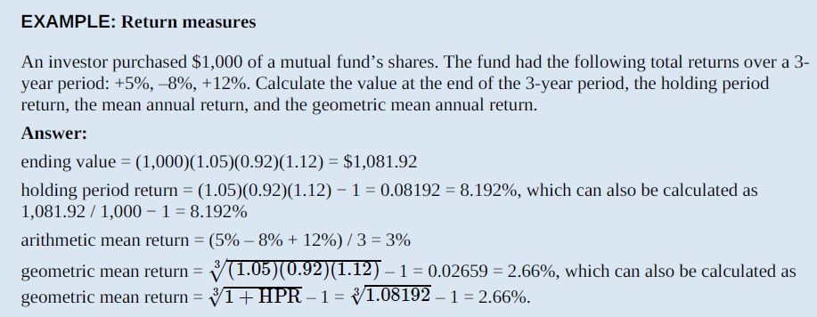
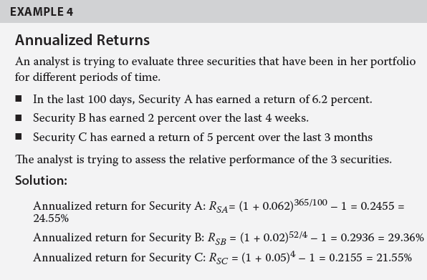

Slide 6
Other Major Return Measures and their Applications
Gross and Net Return
gross return is the return earned by an asset manager prior to deductions for management expenses, custodial fees, taxes, or any other expenses that are not directly related to the generation of returns but rather related to the management and administration of an investment.
Pre-tax and After-tax Nominal Return
All return measures discussed previously are pre-tax nominal returns—that is, no adjustment has been made for taxes or inflation. In general, all returns are pre-tax nominal returns unless they are otherwise designated.
Real Returns
A nominal return (r) consists of three components: a real risk-free return as compensation for postponing consumption (RF), inflation as compensation for loss of purchasing power (π), and a risk premium for assuming risk (RP).

Slide 7



calculate and interpret the mean, variance, and covariance (or correlation) of asset returns based on historical data;
Variance (Standard Deviation) of Returns for an Individual Security
We can calculate the population variance, σ2, when we know the return R for each period, the total number periods (T ), and the mean or expected value of the population’s distribution (μ), as follows:
In the world of finance, we are typically analyzing only a sample of returns data, rather than the entire population. To calculate sample variance, s2, using a sample of T historical returns and the mean, R¯, of the observations, we use the following formula:
Covariance and Correlation of Returns for Two Securities
Covariance measures the extent to which two variables move together over time. A positive covariance means that the variables (e.g., rates of return on two stocks) tend to move together. Negative covariance means that the two variables tend to move in opposite directions. A covariance of zero means there is no linear relationship between the two variables.

Slide 8


The covariance of the returns of two securities can be standardized by dividing by the product of the standard deviations of the two securities. This standardized measure of co-movement is called correlation and is computed as:
A correlation coefficient of +1 means that deviations from the mean or expected return are always proportional in the same direction. That is, they are perfectly positively correlated.
A correlation coefficient of –1 means that deviations from the mean or expected return are
always proportional in opposite directions. That is, they are perfectly negatively correlated.
A correlation coefficient of zero means that there is no linear relationship between the two stocks’ returns. They are uncorrelated. One way to interpret a correlation (or covariance) of zero is that, in any period, knowing the actual value of one variable tells you nothing about the value of the other.

Slide 9
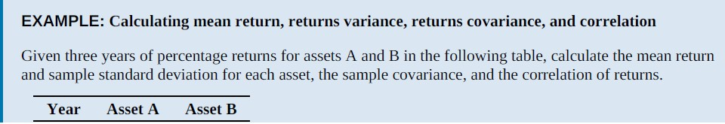
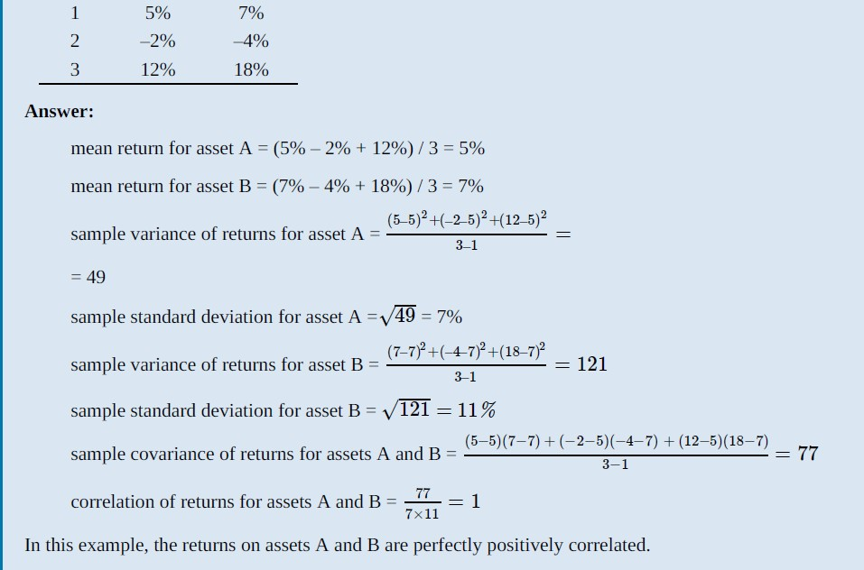

Slide 10
How to Calculate Expected Return of a portfolio
To calculate the expected return of a portfolio, the investor needs to know the expected return of each of the securities in their portfolio as well as the overall weight of each security in the portfolio.
Expected return = (w₁ * r₁) + (w₂ * r₂) + ………… + (w_{n} * r_{n})
w_{i} = weight of each investment in the portfolio
r_{i} = rate of return of each investment in the portfolio

Slide 11
c: Types of investors
A risk-averse investor is simply one that dislikes risk (i.e., prefers less risk to more risk). Given two investments that have equal expected returns, a risk-averse investor will choose the one with less risk (standard deviation, σ).
If expected returns are identical, a risk-averse investor will always choose the investment with the least risk. However, an investor may select a very risky portfolio despite being risk averse; a risk-averse investor will hold very risky assets if he feels that the extra return he expects to earn is adequate compensation for the additional risk.
A risk-seeking (risk-loving) investor actually prefers more risk to less and, given equal expected returns, will choose the more risky investment.
A risk-neutral investor has no preference regarding risk and would be indifferent between two such investments.

Slide 12

calculate and interpret portfolio standard deviation;
The variance of returns for a portfolio of two risky assets is calculated as follows:
where w1 is the proportion of the portfolio invested in Asset 1, and w2 is the proportion
of the portfolio invested in Asset 2. w2 must equal (1 − w1).
Substituting this term for Cov12 in the formula for the variance of returns for a portfolio of two risky assets, we have the following:

Slide 13
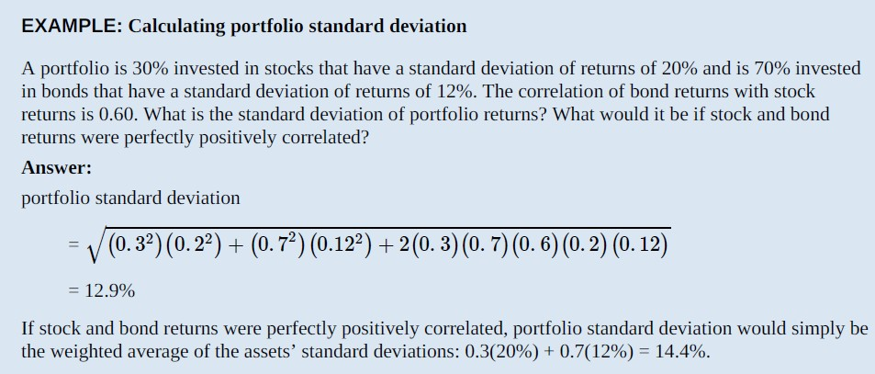

Slide 14
g: Describe the effect on a portfolio’s risk of investing in assets that are
less than perfectly correlated.
If two risky asset returns are perfectly positively correlated, ρ = +1, then the square root of portfolio variance (the portfolio standard deviation of returns) is equal to:
Focusing on returns correlation, we can see that the greatest portfolio risk results when the correlation between asset returns is +1. For any value of correlation less than +1, portfolio variance is reduced.
Note that for a correlation of zero, the entire third term in the portfolio variance equation is zero.
For negative values of correlation ρ, the third term becomes negative and further reduces portfolio variance and standard deviation.
The lower the correlation of asset returns, the greater the risk reduction (diversification)
benefit of combining assets in a portfolio.
If asset returns were perfectly negatively correlated, portfolio risk could be eliminated altogether for a specific set of asset weights.
Adding more assets to the portfolio with low correlation , standard deviation of the portfolio is decreased when they are equally weighted as correlation is the only determinant of risk reduction as weights are constant.

Slide 15
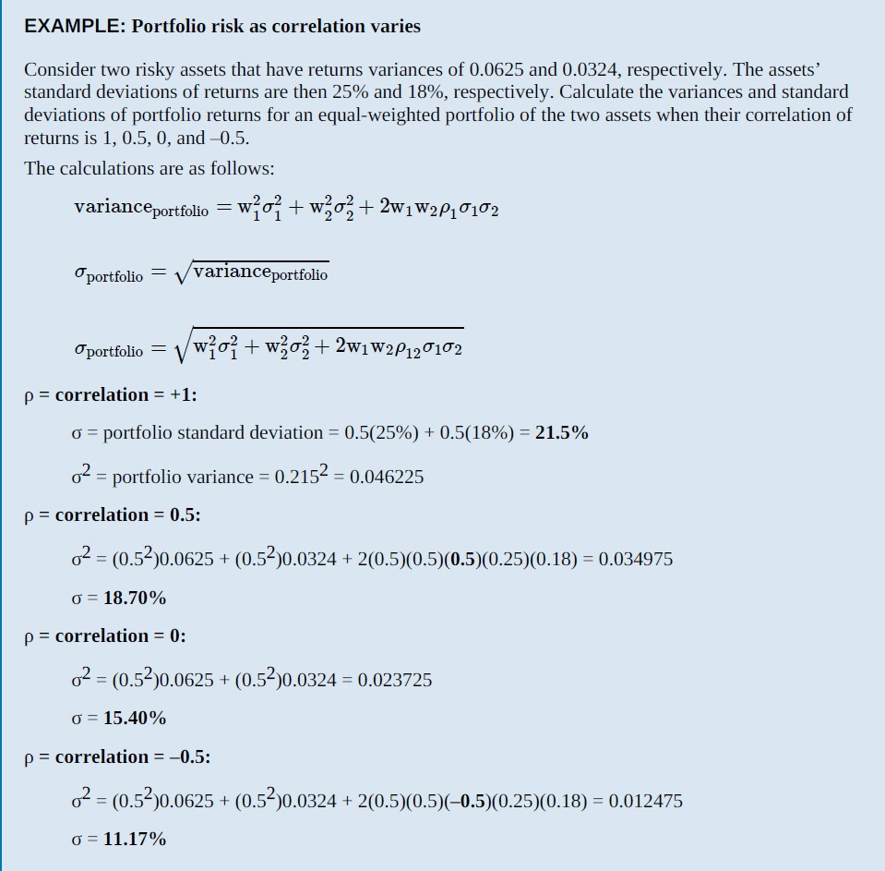

Slide 16
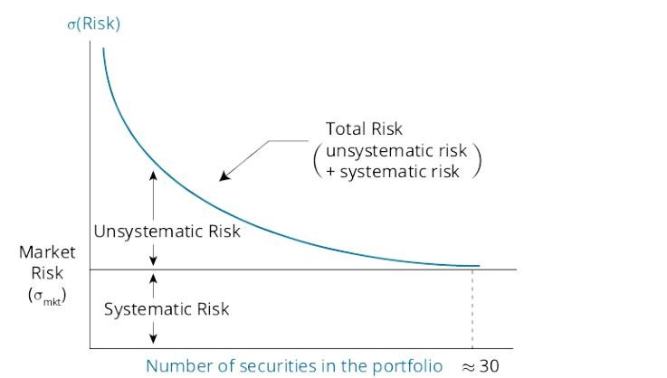
c. explain systematic and nonsystematic risk, including why an investor should not expect to
receive additional return for bearing nonsystematic risk;
Systematic Risk and Nonsystematic Risk
Systematic risk, also known as non-diversifiable or market risk, is the risk that affects the entire market or economy. In contrast, nonsystematic risk is the risk that pertains to a single company or industry and is also known as company-specific, industry-specific, diversifiable, or idiosyncratic risk.
Total variance = Systematic variance + Nonsystematic variance
total risk (as measured by standard deviation) total risk = systematic risk + unsystematic risk
Systematic or non-diversifiable risk is priced and investors are compensated for holding assets or portfolios based only on that investment’s systematic risk. Investors do not receive any return for accepting nonsystematic or diversifiable risk. Therefore, it is in the interest of risk-averse investors to hold only well-diversified portfolios.
One important conclusion of capital market theory is that equilibrium security returns depend on a
stock’s or a portfolio’s systematic risk, not its total risk as measured by standard deviation.

Slide 17
explain return generating models and their uses;
Return-Generating Models
A return-generating model is a model that can provide an estimate of the expected return of a security given certain parameters. If systematic risk is the only relevant parameter for return, then the return- generating model will estimate the expected return for any asset given the level of systematic risk.
A multi-factor model allows more than one variable to be considered in estimating returns and can be built using different kinds of factors, such as macroeconomic, fundamental, and statistical factors.
Macroeconomic factor models use economic factors that are correlated with security returns. These factors may include economic growth, the interest rate, the inflation rate, productivity, employment, and consumer confidence. Three-Factor and Four-Factor Models Like Fama French.
The Single-Index Model The simplest form of a return-generating model is a single-factor linear model, in which only one factor is considered. The most common implementation is a single-index model, which uses the market factor in the following form:
E(Ri) – Rf = βi[E(Rm) – Rf].

Slide 18

calculate and interpret beta;
Calculation and Interpretation of Beta
Because systematic risk depends on the correlation between the asset and the market, we can arrive at a measure of systematic risk from the covariance between Ri and Rm, where Ri is defined using the above equation.
As shown in the above equation, beta is a measure of how sensitive an asset’s return is to the market as a whole
A positive beta indicates that the return of an asset follows the general market trend, whereas a negative beta shows that the return of an asset generally follows a trend that is opposite to that of the market. In other words, a positive beta indicates that the return of an asset moves in the same direction of the market, whereas a negative beta indicates that the return of an asset moves in the opposite direction of the market. A risk-free asset’s beta is zero because its covariance with other assets is zero. In other words, a beta of zero indicates that the asset’s return has no correlation with movements in the market. The market’s beta can be calculated by substituting σm for σi in the numerator. Also, any asset’s correlation with itself is 1, so the beta of the market is 1
As we have shown, beta captures an asset’s systematic risk, or the portion of an asset’s risk that cannot be eliminated by diversification. The variances and correlations required for the calculation of beta are usually based on historical returns.

Slide 19
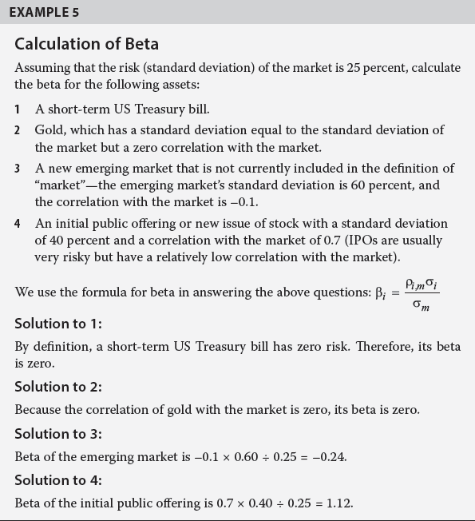

Slide 20
f. explain the capital asset pricing model (CAPM), including its assumptions
THE CAPITAL ASSET PRICING MODEL
The capital asset pricing model is one of the most significant innovations in portfolio theory. The model is simple, yet powerful; is intuitive, yet profound. The model provides a linear expected return–beta relationship that precisely determines the expected return given the beta of an asset.
E(Ri) = Rf + βi[E(Rm) – Rf]
Assumptions of the CAPM
Investors are risk-averse, utility-maximizing, rational individuals.
Risk aversion and utility maximization are generally accepted as reflecting a realistic view of the world. Yet, rationality among investors has been questioned because investors may allow their personal biases and experiences to disrupt their decision making, resulting in suboptimal investments.
Markets are frictionless, including no transaction costs and no taxes.
frictionless markets do not have transaction costs, taxes, or any costs or restrictions on short selling. We also assume that borrowing and lending at the risk-free rate is possible.
Investors plan for the same single holding period.
The CAPM is a single-period model, and all investor decisions are made on the basis of that one period.

Slide 21
This assumption implies that an individual can invest as little or as much as he or she
wishes in an asset.
All investments are infinitely divisible.
Investors are price takers.
The CAPM assumes that there are many investors, and that no investor is large enough to influence prices.
Investors have homogeneous expectations or beliefs.
This assumption means that all investors analyze securities in the same way using the same probability distributions and the same inputs for future cash flows. In addition, given that they are rational individuals, the investors will arrive at the same valuations.

Slide 22
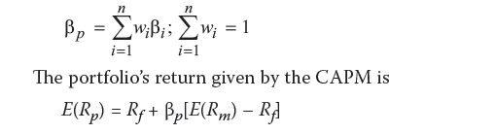
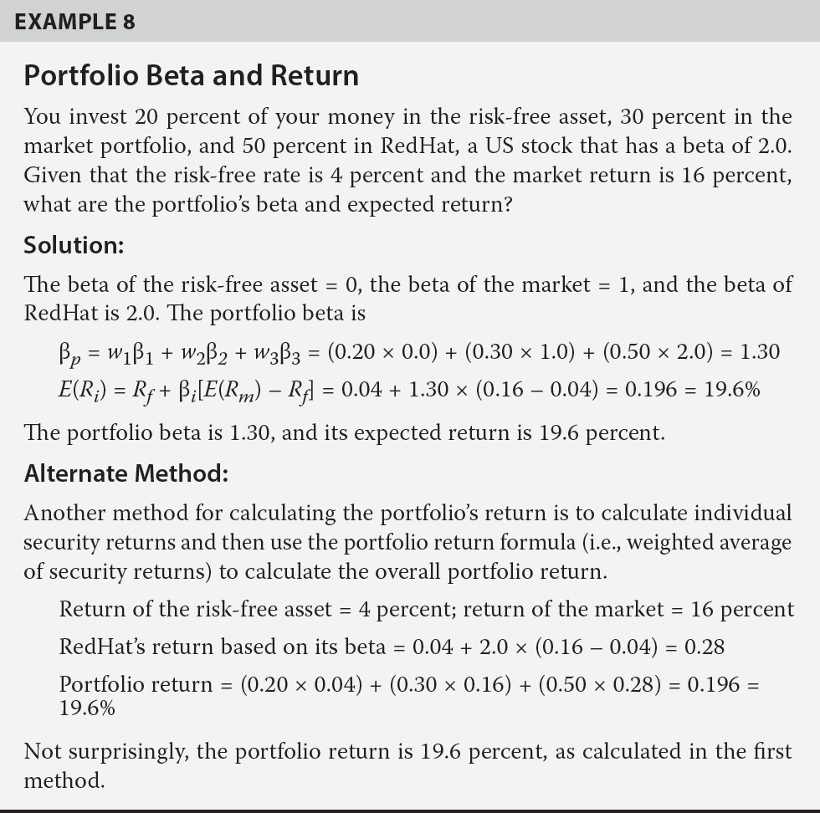
Portfolio Beta

Slide 23
Describe market efficiency
An informationally efficient capital market is one in which the current price of a security fully, quickly, and rationally reflects all available information about that security. This is really a statistical concept
An academic might say, “Given all available information, current securities prices are unbiased estimates of their values, so that the expected return on any security is just the equilibrium return necessary to compensate investors for the risk
(uncertainty) regarding its future cash flows.”
This concept is often put more intuitively as, “You can’t beat the market.” In a perfectly efficient market, investors should use a passive investment strategy (i.e., buying a broad market index of stocks and holding it) because active investment strategies will underperform due to transactions costs and management fees
However, to the extent that market prices are inefficient, active investment strategies can generate positive risk-adjusted returns
One method of measuring a market’s efficiency is to determine the time it takes for trading activity to cause information to be reflected in security prices (i.e., the lag from the time information is disseminated to the time prices reflect the value implications of that information)

Slide 24
Distinguish between market value and intrinsic value
The market value of an asset is its current price. The intrinsic value or fundamental value of an asset is the value that a rational investor with full knowledge about the asset’s characteristics would willingly pay for the asset
For example, a bond investor would fully know and understand a bond’s coupon, maturity, default risk, liquidity, and other characteristics and would use these to estimate its intrinsic value
In markets that are highly efficient, investors can typically expect market values to reflect intrinsic values. If markets are not completely efficient, active managers will buy assets for which they think intrinsic values are greater than market values and sell assets for which they think intrinsic values are less than market values
Intrinsic values cannot be known with certainty and are estimated by investors who will have differing estimates of an asset’s intrinsic value. The more complex an asset, the more difficult it is to estimate its intrinsic value. Furthermore, intrinsic value is constantly changing as new (unexpected) information becomes available

Slide 25
Explain factors that affect a market’s efficiency
Markets are generally neither perfectly efficient nor completely inefficient. The degree of informational efficiency varies across countries, time, and market types. The following factors affect the degree of market efficiency
  Number of market participants. The larger the number of investors, analysts, and traders who follow an asset market, the more efficient the market
    The number of participants can vary through time and across countries. For example, some countries prevent foreigners from trading in their markets, reducing market efficiency
  Availability of information. The more information is available to investors, the more efficient the market. In large, developed markets such as the New York Stock Exchange, information is plentiful and markets are quite efficient
    In emerging markets, the availability of information is lower, and consequently,
market prices are relatively less efficient.
    Some assets, such as bonds, currencies, swaps, forwards, mortgages, and money market securities that trade in over-the-counter (OTC) markets, may have less available information

Slide 26
Access to information should not favor one party over another. Therefore, regulations such as the U.S. Securities and Exchange Commission’s Regulation FD (fair disclosure) require that firms disclose the same information to the public that they disclose to stock analysts
Traders with material inside information about a firm are prohibited from trading on that information
Impediments to trading. Arbitrage refers to buying an asset in one market and simultaneously selling it at a higher price in another market
  This buying and selling of assets will continue until the prices in the two markets are equal. Impediments to arbitrage, such as high transactions costs or lack of information, will limit arbitrage activity and allow some price inefficiencies (i.e., mispricing of assets) to persist
Transaction and information costs. To the extent that the costs of information, analysis, and trading are greater than the potential profit from trading misvalued securities, market prices will be inefficient. It is generally accepted that markets are efficient if, after deducting costs, there are no risk-adjusted returns to be made from trading based on publicly available information

Slide 27
Contrast weak-form, semi-strong-form, and strong-form market efficiency
Professor Eugene Fama originally developed the concept of market efficiency and identified three forms of market efficiency. The difference among them is that each is based on a different set of information
Diﬀerent assumptions about how much information is reﬂected in prices give rise to diﬀerent types of market eﬃciency.
A market in which prices reﬂect all knowledge, including past and current publicly known and private information, is a strong-form eﬃcient market. In such an eﬃcient market, even corporate oﬃcers and other insiders cannot earn above-average, risk-adjusted proﬁts from buying and selling stock. Even their detailed, exclusive information is reﬂected in current stock prices according to the strong-form hypothesis. Few markets can pass the test of strong-form eﬃciency, and insiders can proﬁt from information not known by others. As discussed in the previous chapter, that is a reason why U.S. laws prohibit insider trading, or trading based on important, nonpublic information.

Slide 28
In a semi-strong-form eﬃcient market, all public information, both past and current, is reﬂected in asset prices. The U.S. stock market appears to be a fairly good example of a semi- strong-form eﬃcient market. News about the economy or individual companies appears to produce quick stock price changes without subsequent trends or price reversals.
A weak-form eﬃcient market is a market in which prices reﬂect all past market information, such as past prices, price trends, and trading volume.

