Slide 1


Supply Chain Risk Management: A Comprehensive Review
Prepared by
Dr. Badur elgasim
PMG 663
Lecture 1

Slide 2

Chapter
01
Learning Objectives
The Concept of Risk and Risk Management
Defining Supply Chain Risk Management
Why Focus on Supply Chain Risk Management?
Risk levels
Risk mitigation strategies

Slide 3
Chapter
Introduction
01
Recently, managing risk has become a crucial challenge for supply chain managers owing to several factors, such as growing global competition, rising cost pressures, increasing customer expectations, and ever-increasing complexity .
Due to the increasing complexity and interrelation of modern supply chains, the type and nature of uncertain developments and the impact of an action have become difficult, or even impossible, to predict .
Risks and uncertainties frequently interrupt the operational efficiency of the supply chain and hence adversely impact a firm’s profit.

Slide 4
Chapter
01
SCRM is gaining interest of researchers and practitioners because of the occurrence of major supply chain disruptions. Global sourcing and lean operations are the main drivers of supply chain disruptions
Floods, earthquakes, tsunamis, tornadoes, and billowing clouds of ash from obscure volcanoes all share something in common.
Over the last several years these events have been featured prominently in the news—and each has had the inevitable effect of disrupting the supply chains of entire industries

Slide 5
Chapter
THE CONCEPT OF RISK
01
A logical place to start is to explain what we mean by risk, particularly since this concept can be defined in various ways.
One common perspective simply says that risk is a situation involving exposure to danger or loss.
Another perspective takes this a step further by adding that risk is the probability or threat of damage, injury, liability, loss, or other negative occurrences that are caused by external or internal vulnerabilities and that may be avoided through preemptive action.

Slide 6
Chapter
01
Another view states that risk is the effect of uncertainty on objectives.
Risk can also be viewed, at least partly, as the inability to capitalize on an opportunity.
risk as the probability of realizing an unintended or unwanted consequence that leads to an undesirable outcome such as loss, injury, harm, or missed opportunity

Slide 7
Chapter
01
Each day every company and human being face risk situations.
At the individual level, did you drive a car or fly in a plane today?
Did you cross a busy street or share the road with cars while riding a bike?
Did you eat food at a restaurant where you did not see how the food was prepared?
Did you walk down a flight of stairs?
Did you step into the shower?
Do you have money in the stock market?
Did you take an exam without studying?
If the answer to even a few of these questions is yes, you have exposed yourself to risk, just like everyone else on the planet

Slide 8
Chapter
01
Risk Management Dimensions
Ritchie and Brindley (2007) pointed out three dimensions of risk as follows:
1. Likelihood/probability of the occurrence of particular events/outcomes;
2. Consequences/severity of the occurrence of particular events;
3. Causal pathways leading to these events (detection).
www.midocean.ae

Slide 9
Chapter
01
A risk matrix defines the various levels of risk, considering both risk probability and risk impact. This is a simple mechanism to increase the visibility of risks and assist management decision making. A risk matrix can be used for both qualitative and quantitative risk analyses of a supply chain, where probabilities and impacts are considered as subjective values and objective values, respectively.
The two main elements, which are probability of occurrence and impact of risk, are critical to determining the necessity of an action to combat a risk in a supply chain
www.midocean.ae

Slide 10
Chapter
01
Risk levels
In general, there are three levels. The safest condition for a supply chain is when either the probability of occurrence or the impact of risk (or both) are very low. This level is referred to as the low level risk and usually does not require any effort with respect to risk management. In contrast, when both the probability of occurrence and the impact of risk are high, immediate action is required. The third level is defined such that the probability of occurrence or the impact of risk, or both, are moderate or high. This level, although requiring careful management, the risk is not as critical.
www.midocean.ae

Slide 11
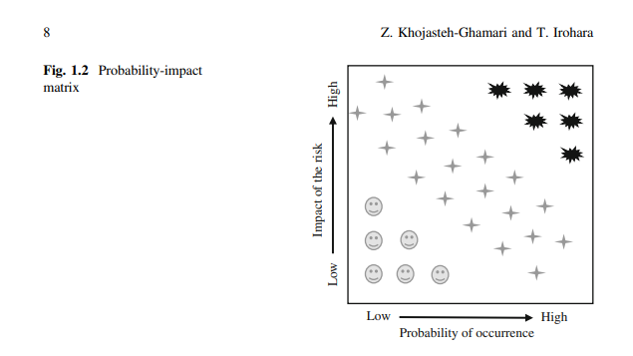
Chapter
01
the American culture has traditionally placed higher values on democratic than on authoritarian leadership, certain biases can be detected in the research on the effects of these leadership styles. A great deal of research is designed to prove that democracy is superior to autocracy, rather than to test that proportion.

Slide 12
Chapter
01
Risk Placement
Supply chain risk has been categorized in different ways. However, we categorize it exclusively into three components:
1. Supply risk: any risk that may occur on the supply side with regard to the input material, e.g., disruptions and delays in supply, inventory, and schedules, or delays in inbound logistics.
2. Demand risk: any risk that may occur on the customer side, e.g., variations in demand.
3. Process risk: any risk that may occur during manufacturing and warehousing, e.g., machine breakdowns, human resource errors, operations failures, and financial problems. The last component exists between supply and demand risks.

Slide 13
Chapter
01
Types of Risk
Micro risk" refers to the risks inherent in a business's internal operations or external factors affecting a specific company or segment of the market, such as loss of a major supplier or shifts in a local market.
It contrasts with "macro risk," which involves broader economic or political events affecting an entire economy or large sectors.
Micro risks require a business's constant focus to identify and manage them through systematic analysis and planning.

Slide 14
Chapter
01
Micro Risk
Examples of Micro Risks
Operational Risks: Losing a major client or supplier, or unexpected increases in business expenses.
Market Risks: Changes in local market dynamics or the need to adapt to new technologies.
Political Risks (Micro): Political actions in a specific host country that negatively impact a particular foreign operation or business.
Cash Flow Risks: The danger of cash flow drying up, or expenses creeping up unexpectedly.

Slide 15
Chapter
01
Macro risks
categorization, macro risks, such as natural disasters, terrorist attacks, financial crises, and other such events that have enormous consequence, can be placed into any of the abovementioned categories depending on whether the macro risk affects the supply, demand, or process.
Note that few papers considered macro risks, primarily because the probability of their occurrence is low compared to the supply, demand, and process risks, even though the impact of macro risks is enormous.
Therefore, industries do not invest huge amount of money in order to protect the supply chain from such macro risks with a low probability of occurrence.

Slide 16
Chapter
01
Decision Variables
selection is the optimal selection of material providers based on cost and quality. In contrast, facility location is the optimal placement of facilities to minimize transportation costs, while considering factors such as safety and distance from competitors’ facilities. The rest of the papers used other decision variables such as assembly line management, mitigation strategy selection, warehouse management, and stakeholder management. We found that the supplier selection problem is involved in considering supply risk

Slide 17
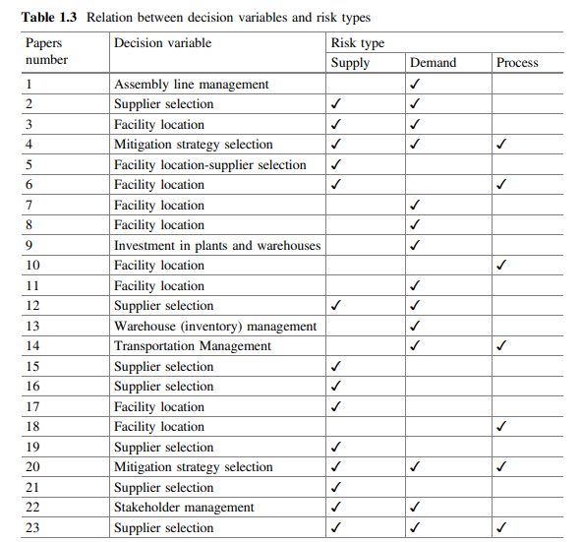
Chaterp
01
In our

Slide 18
Chapter
01
Risk management stages
Risk management involves important stages of risk identification, risk analysis, risk evaluation, risk treatment and risk monitoring .Supply chain risk management (SCRM) is gaining an increasing interest both from the researchers and practitioners .Complex interactions between supply chain risks ranging across the entire spectrum m of a supply network make it a challenging task to identify, assess and manage key risks.
Risk treatment is an important stage of the risk management process involving selection of appropriate strategies for mitigating critical risks

Slide 19
Chapter
01
Limited studies have focused on exploring causal interactions between supply chain risks and integrating the impact of risk mitigation strategies on associated risks within the modelling framework ,However, to the best of our knowledge, no attempt has been made to capture the manageability associated with implementing a mitigation strategy within the modelling framework.
Manageability relates to the concept of ease involved in managing a strategy. Besides capturing the manageability of risks (effectiveness of strategies) representing the potential for reducing the risk

Slide 20
Chapter
01
aim to address the decision problem of prioritizing risk mitigation strategies considering the cost, effectiveness and manageability of such strategies within an interconnected network of interacting supply chain risks and strategies.
The proposed method is deemed as contribution to the literature on Risk Management in general and SCRM in particular.
Existing models focusing on cost-effectiveness of strategies assume the same level of manageability for all strategies

Slide 21
Chapter
01
SCRM is gaining interest of researchers and practitioners because of the occurrence of major supply chain disruptions .
Global sourcing and lean operations are the main drivers of supply chain disruptions.
The likelihood of the occurrence of an (undesirable) event, and the negative implications of the event are the two common measures of risk.

Slide 22
Chapter
Risk mitigation strategies
01
are implemented in order to reduce the likelihood of occurrence and/or negative impact of risks .
Robust strategies must be developed in order to help firms reduce cost and/or improve customer satisfaction under normal conditions and to enable firms sustain operations during and after a disruption

Slide 23
Chapter
01
Examples
capacity risks can be reduced by outsourcing and building a flexible web of partners whereas operational hedging can help in reducing currency and political risks.
There are number of strategies including information accuracy, visibility, accessibility and responsive corrective actions.
It is recommended , that implementation of supplier improvement programs and mitigation of supply disruptions through creating business interruption plans, developing demand forecasts and modelling supply processes.

Slide 24
Chapter
01
Definition of Supply Chain Risk Management
SCRM defined as “the implementation of strategies to manage both everyday and exceptional risks along the supply chain based on continuous risk assessment with the objective of reducing vulnerability and ensuring continuity”.
The terms “risk” and “uncertainty” are frequently used interchangeably

Slide 25
Chapter
01
SCRM as “a discipline that addresses the threats and vulnerabilities of commercially acquired information and communications technologies within and used by government information and weapon systems.
Through SCRM, systems engineers can minimize the risk to systems and their components obtained from sources that are not trusted or identifiable as well as those that provide inferior material or parts.

Slide 26
Chapter
01
A third perspective, and the one that most closely aligns with our philosophy, says that supply chain risk management (SCRM) is “the implementation of strategies to manage everyday and exceptional
risks along the supply chain through continuous risk assessment with the objective of reducing vulnerability and ensuring continuity

Slide 27
Chapter
01
One way to view supply chain risk management is to think of it as the intersection of supply chain management and risk management.
One thing we know about SCRM is that no standard definition exists.
This is one indicator that SCRM is still an evolving discipline. Risk is embedded within so many business disciplines that it should come as no surprise that different groups perceive this concept differently.

Slide 28
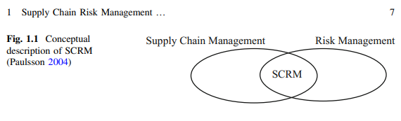
Chapter
01
Supply Chain Risk Management (SCRM) Although numerous discussions and studies have considered the definition of SCRM, there is still no consensus on the definitions of ‘supply chain risk’ and ‘SCRM’ . SCRM can be described as the intersection of supply chain management and risk management2

Slide 29
Chapter
A classic example of supply chain risk involves:
01
a fire that destroyed an electronics supplier in New Mexico that supplied Nokia and Ericsson with critical components for their phone businesses.
The response to this risk event shows the strategic implications of effective (or ineffective) risk management.
Nokia’s ability to quickly secure components from other sources, compared with Ericsson’s lack of preparation for responding to this event, resulted in a dramatic industry shift.
Ericsson’s supply disruption not only cost the company several hundred million dollars in lost sales, but it essentially ended the company’s position as a player in the growing wireless phone business.

Slide 30
Chapter
01
A U.S. producer of power tools was surprised to find that the Asian supplier it contracted with to produce its lower-end products began selling those products under its own label in Asia.
The U.S. company was further surprised to find that the supplier shared its product designs with other Asian companies.
The U.S. producer eventually found itself competing in North America with its own products.

Slide 31
Factors That Make Supply Chains Riskier
Chapter
01
Increased globalization through outsourcing, which stretches end-to-end supply chains
Additional regulatory compliance imposed by government entities, further complicating international trade (such as C-TPAT and SEC conflict mineral reporting requirements)
Increased levels of economic uncertainty and market volatility, which create additional variability in demand and supply and make it more difficult to accomplish demand–supply planning
Shorter product life cycles and rapid rates of technology change, which increase the risk of inventory obsolescence

Slide 32
Chapter
01
Demanding customers that create additional time-to-market pressures by requiring better on-time delivery, higher order fill rates, and improved service level efficiencies
Supply side capacity constraints, making it more difficult to meet demand requirements
Natural disasters and external environmental events, which affect global supply chains
Complex networks of suppliers and third-party service providers, as well as large interdependencies among multiple firms, which increase the need to coordinate risk

Slide 33
Chapter
01
Cost-Effectiveness Based Prioritization of Strategies
Problem Statement Given different options of implementing risk mitigation strategies within a probabilistic network of interconnected supply chain risks and strategies, how do we priorities these strategies keeping in view the cost, effectiveness and manageability of strategies?
we aim to priorities risk mitigation strategies yielding maximum weighted summation of normalized expected utility for loss and normalized utility for manageability weighted mitigation cost

Slide 34
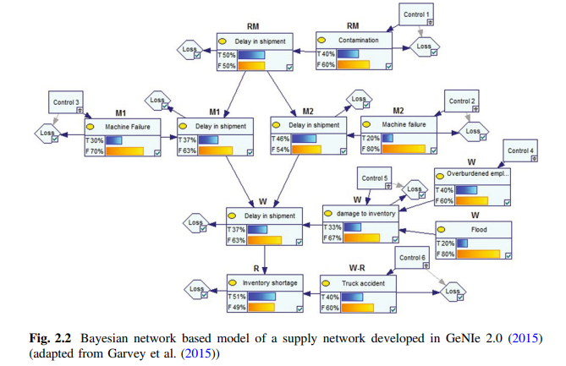
Chapter
a simple supply network
01
a simple supply network as shown in Fig. 2.2. comprises a raw material source (RM), two manufacturers (M1 and M2), a warehouse (W) and a retailer (R).
We also consider a transportation link between the warehouse and retailer (W-R). Risks are represented by nodes comprising bar charts whereas resulting losses and mitigation strategies are represented by diamond and rectangular shaped nodes, respectively. Though each domain of the supply network may comprise a number of risks and corresponding sources,

Slide 35
Chapter
01
Each risk and mitigation strategy is represented by binary states of ‘True (T)’ or ‘False (F)’ and ‘Yes’ or ‘No’, respectively

Slide 36
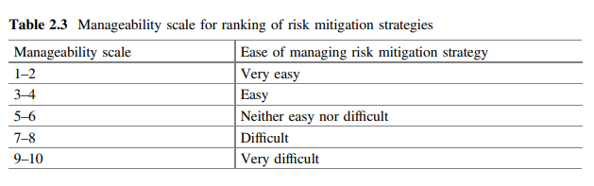
Chapter
01

Slide 37
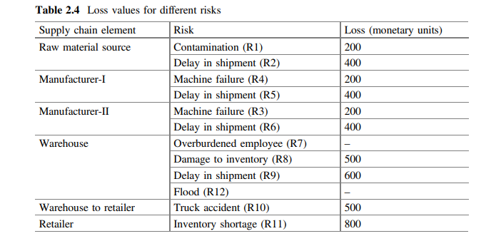
Chapter
01

Slide 38

Chapter
01
Considering the cost-benefit analysis, strategies resulting in maximum improvement in the risk network expected loss (less mitigation cost) must be selected. Such strategies are represented by the peak points appearing in Fig. 2.4.

Slide 39
Chapter
01
It is interesting to note that there is only one cost-effective combination of 5 strategies, however, implementation of all 6 strategies does not result in achieving the net gain.
Moreover, the value of net improvement increases up to 2 strategies and declines beyond that point.

Slide 40
Chapter
01
Reference:
Supply Chain RiskManagementAn Emerging DisciplineGregory L. SchlegelRobert J. Trent
Supply Chain Risk Management Advanced Tools, Models, and Developments
By: Yacob Khojasteh -ISBN 978-981-10-4106-8 (eBook)
Chapter 1

Slide 41



Thank You

