Slide 1


Accounting for Managers
Prepared by Dr. Emad Zaher
Assistant Professor of Accounting
MGM341
Lecture 4
(Cost behavior &cost management systems)

Slide 2

Chapter (1) Introduction to Financial Accounting
  Learning outcomes
LO 1 Identify the value chain.
Lo 2 Describe the core differences between cost ,expense ,&loss.
LO 3 Explain the different cost classifications.
LO 4 State the product cost versus period cost.
LO 5 Describe manufacturing cost in the income statement.
LO 6 Explain the types of inventories in the manufacturing industry.
LO 7 Explain the cost statement and computing the cost of goods manufactured.

Slide 3

The Value Chain
Research
and
Development
Service
Product
And
Service
Process
Design
Customer
Focus
Distribution
Production
Marketing
Prepared by Dr. Emad Zaher

Slide 4
Cost
Resources consumed for long term benefit to gain product or service
Expense
Resources consumed for short term benefit to achieve revenue.
Loss
Resources consumed without any benefit
Cost Classifications
Cost Object
Cost behavior
Manufacturing Cost
Prepared by Dr. Emad Zaher

Slide 5
(1) Cost Object:
Cost object is anything you desire to measure its cost.
Example: Products, services, activities, Department.
Direct cost | Indirect cost
Direct cost can be traced directly to cost object. | Indirect cost can not be easily traced to cost object.
Example | Example
Cost of the cans for bottles can be easily traced to drink. | The salaries of supervisors who oversee production of other products.
Note:
Direct cost traced (assigned) to cost object
Indirect cost allocated to cost object
Note:
Cost assignment includes tracing direct cost and allocating indirect cost.
Prepared by Dr. Emad Zaher

Slide 6
Factors Affecting Direct/Indirect Cost Classification
Cost materiality
Availability of information-gathering technology
Operational design

Slide 7
Prepared by Dr. Emad Zaher

Slide 8
Relevant Range Visualized
Relevant range usually refers to a normal range of volume or normal amount of activity in which the total amount of a company’s fixed costs will not change as the volume or amount of activity changes
Prepared by Dr. Emad Zaher

Slide 9
3. Classification of Manufacturing Cost(Product cost)- (Inventoriable cost)
Direct Material |  | Direct labor |  | Manufacturing (Factory) Overhead
↓ |  | ↓ |  | ↓
Are the acquisition costs of all material that become part of the cost object. Lumber Steel Tires Spokes Handelbars |  | Such as wages for production workers or benefits for persons who work Directly on manufactured product. |  | It includes all indirect costs such as: Indirect material (Glue-Screws). Indirect labor (Service workers). Factory rent. Factory utilities. Salary of plant Manager & Supervisors. Depreciation for factory plant assets. Maintenance for factory Equipment. Property tax of factory building.
Prepared by Dr. Emad Zaher

Slide 10
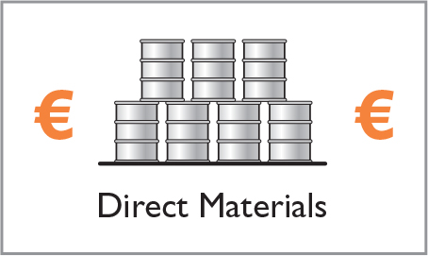


Manufacturing consists of activities and processes that convert raw materials into finished goods.

Slide 11
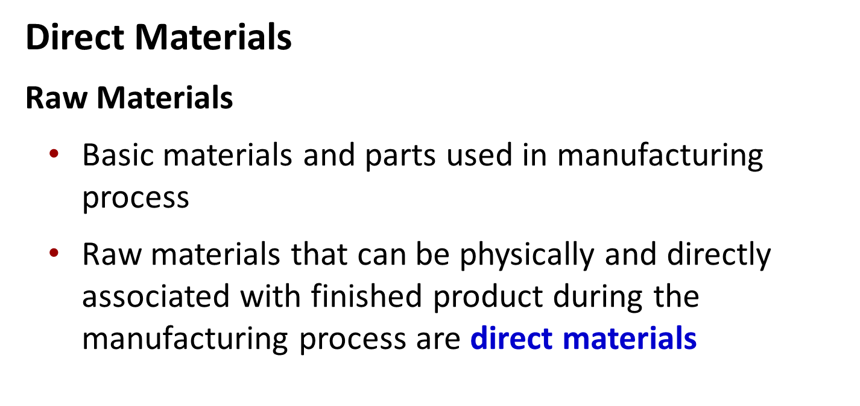
Manufacturing Costs

Slide 12
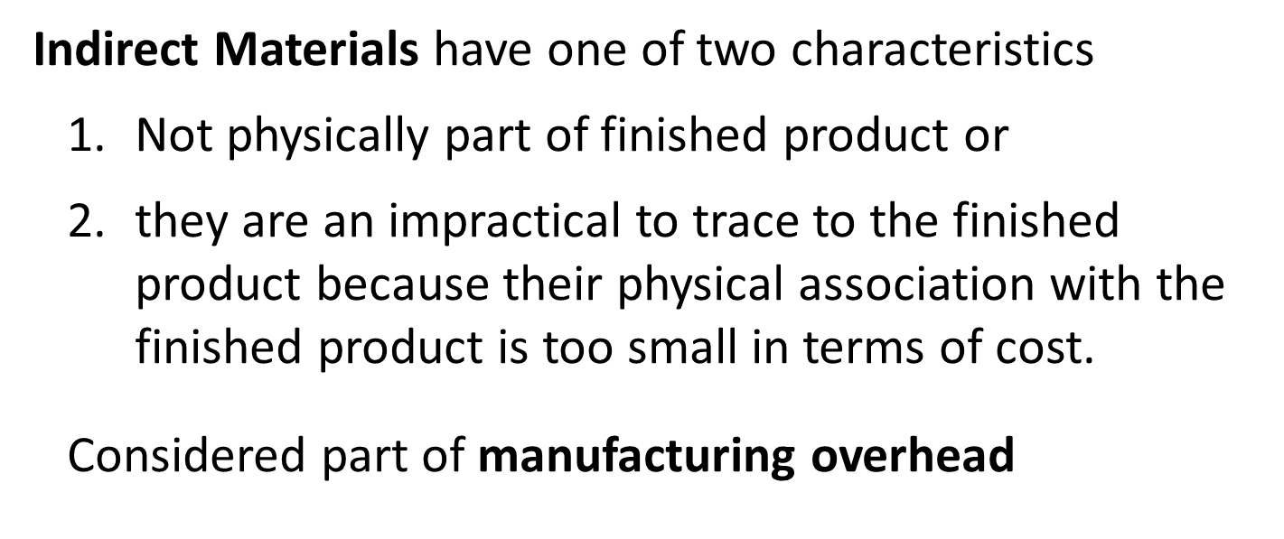
Manufacturing Costs

Slide 13
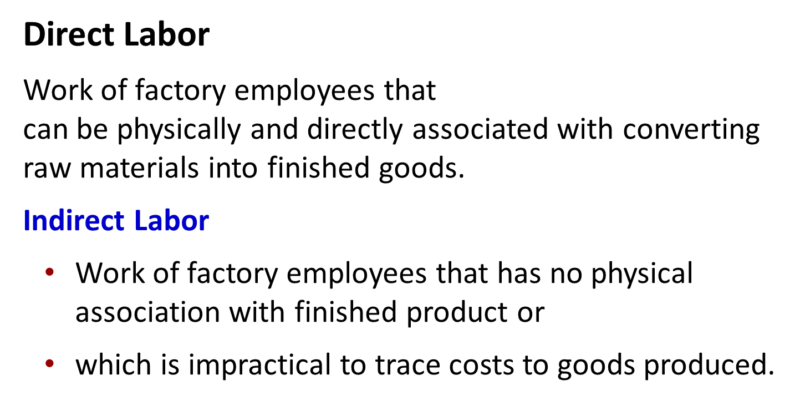
Manufacturing Costs

Slide 14
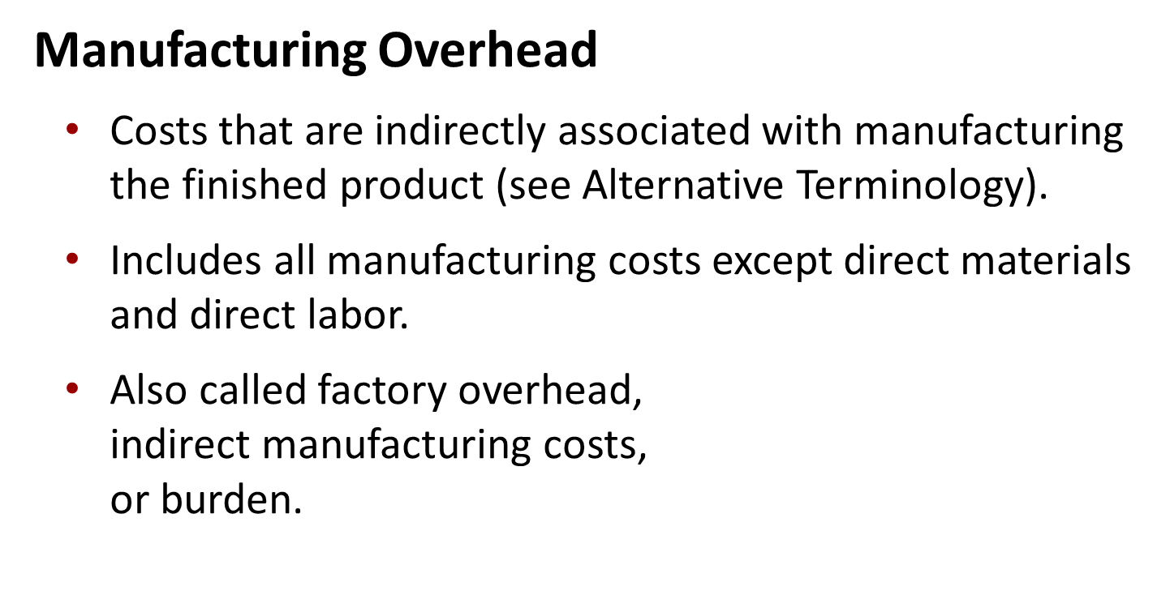
Manufacturing Costs

Slide 16
Product Versus Period Costs
Product Costs
Manufacturing Costs
Period Costs
Non-Manufacturing Costs
Direct Materials
Marketing Expenses
Direct Labor
Selling Expenses
Manufacturing Overhead
Indirect materials
Indirect labor
Other indirect costs
Administrative Expenses
General Expenses
Research& Development
Prepared by Dr. Emad Zaher

Slide 17
  DO IT - 1
Classify the Following items in to direct material, direct labor or factory overhead.
Material
Lumber |  | 10.000
Glue |  | 800
Screws |  | 1000
Supervisors |  | 20.000
Others
Factory Rent |  | 70.000
Factory utilities |  | 20.000
Depreciation of factory equipment |  | 21.000
Salaries (Factory) |  | 80.000

Slide 18
Cost item | Direct material | Direct labor | Factory overhead
Lumber | √
Glue |  |  | √
Screws |  |  | √
Supervisors |  |  | √
Factory Rent |  |  | √
Factory utilities |  |  | √
Depreciation of factory equipment |  |  | √
Salaries |  |  | √
Prepared by Dr. Emad Zaher

Slide 19
DO IT - 2 Suppose you started your own snowboard factory,. Here are some of the costs that your snowboard factory would incur. Assign the following costs:
 |  | Product Costs
Cost Item |  | Direct Materials |  | Direct Labor |  | Manufacturing Overhead |  | Period Costs
1. Material cost (€30 per board) |  | X
2. Labor costs (€40 per board) |  |  |  | X
3. Depreciation on factory equipment (€25,000 per year) |  |  |  |  |  | X
4. Property taxes on factory building (€6,000 per year) |  |  |  |  |  | X

Slide 20
 |  | Product Costs
Cost Item |  | Direct Materials |  | Direct Labor |  | Manufacturing Overhead |  | Period Costs
5. Advertising costs (€60,000 per year) |  |  |  |  |  |  |  | X
6. Sales commissions (€20 per board) |  |  |  |  |  |  |  | X
7. Maintenance salaries (factory facilities, €45,000 per year) |  |  |  |  |  | X
8. Salary of plant manager (€70,000 per year) |  |  |  |  |  | X
9. Cost of shipping boards (€8 per board) |  |  |  |  |  |  |  | X

Slide 21
If the factory produces 10,000 snowboards the first year, what would be the total manufacturing costs?
Cost Number and Item |  | Manufacturing Cost
1. Material cost (€30 × 10,000) |  | €300,000
2. Labor cost (€40 × 10,000) |  | 400,000
3. Depreciation on factory equipment |  | 25,000
4. Property taxes on factory building |  | 6,000
7. Maintenance salaries (factory facilities) |  | 45,000
8. Salary of plant manager |  | 70,000
Total manufacturing costs |  | €846,000

Slide 22
DO IT - 3
A bicycle company has these costs: tires, salaries of employees who put tires on the wheels, factory depreciation, advertising expenditures, lubricants, spokes, salary of factory manager, salary of accountant, handlebars, and salaries of factory maintenance employees. Classify each cost as direct materials, direct labor, overhead, or a period cost.
Direct Materials
Direct Labor
Overhead
Tires
Spokes
Handlebars
Salaries of employees who put tires on the wheels
Factory depreciation
Factory lubricants
Factory manager salary
Factory maintenance employees salary
Advertising expenditures and salary of accountant are period costs.

Slide 23
DO IT - 4
Assume that you have the following cost data for the period ended Dec.31.2023 about one of manufacturing company which produces plastic products:
Material costs L.E. 100,000 (60% direct)
Labor costs L.E. 60,000 ( L.E. 45,000 direct)
Other Factory overhead L.E. 11250 - selling expenses L.E 27000 -R&D L.E 6750
1. prime cost equal………….. .............
a) 108000 b) 104000 c)105000 d) 102000
2. conversion cost of the item produced equal………….
a)111250 b) 110300 c)112150 d) 103400
3. The amount of period cost equal ………..
a) 32450 b) 30500 c)33750 d) 33570
4. product cost equal ………………...
a)171000 b) 157300 c)161200 d) 171250

Slide 24
1- What is the prime cost of the item produced?
Prime cost = Direct materials+ Direct Labor
Prime cost = (60% * 100,000) + 45,000+0
Prime cost= 60,000 + 45,000 = 105.000
2- What is the conversion cost of the item produced?
Conversion cost = Direct Labor + Manufacturing overhead .
Conversion cost= 45,000 + (40,000 + 15,000 + 11,250) = 111,250
3 - What is the period cost of the item produced?
Period cost = selling expenses + R & D
Period cost = 27.000 + 6.750 – 33750
4 - What is the product cost of the item produced?
Product costs = Direct material + Direct labor + Manu. Overhead
Product costs = 60.000 + 45.000 + (40.000 + 15.000 + 11.250)
Products costs = 171.250

Slide 25
Manufacturing Costs in Financial Statements
Income Statement
Under a periodic inventory system, the income statements of a merchandiser and a manufacturer differ in the cost of goods sold section.
“COGS”

Slide 26
Income Statement
Merchandiser
Beginning Inventory
+
Cost of Goods Purchased
-
Ending
Inventory
=
Cost of
Goods Sold
Manufacturer
Beginning
Finished Goods
Inventory
+
Cost of Goods Manufactured
-
Ending
Finished Goods Inventory
=
Prepared by Dr. Emad Zaher

Slide 28
Computing cost of goods manufactured
Prepared by Dr. Emad Zaher

Slide 29
Computing cost of goods sold
Cost of goods manufactured | xx
+ Beginning finished goods inventory | xx
Cost of goods available for sale | xx
- Ending finished goods inventory | (xx)
Cost of good sold (COGS) | xx
Computing gross profit
Sales | xx
- Cost of goods sold | (xx)
Gross Profit | xx
Prepared by Dr. Emad Zaher

Slide 30
DO IT! 5
The following information is available for Kim Ltd. (amounts are in thousands). March 1 March 31
Raw materials inventory $12,000 $10,000
Work in process inventory 2,500 4,000
Materials purchased in March $90,000
Direct labor in March 75,000
Manufacturing overhead in March 220,000
Compute the cost of goods manufactured for the month of March 2020.
Prepared by Dr. Emad Zaher

Slide 31
Cost of Goods Manufactured Schedule
For the Month Ended March 31, 2020
Direct materials
Raw materials, March 1 $ 12,000
Raw materials purchases 90,000
Total raw materials available for use 102,000
Less: Raw materials, March 31 10,000
Direct materials used $ 92,000
Direct labor 75,000
Manufacturing overhead 220,000
Total manufacturing costs 387,000
+ Work in process, March 1 $ 2,500
Less: Work in process, March 31 4,000
Cost of goods manufactured $385,500
In case of automation, direct labor is declined from the components of product cost

Slide 32
DO IT - 6
Prepared by Dr. Emad Zaher

Slide 33
Prepared by Dr. Emad Zaher

Slide 34
DO IT - 7
 | Beginning of 2023 | Ending of 2023
Direct material inventory | 22000 | 26000
Work-in-process inventory | 21000 | 20000
Finished goods inventory | 18000 | 23000
Purchase of direct material |  | 75000
Direct manufacturing labor |  | 25000
Indirect manufacturing labor |  | 15000
Plant insurance |  | 9000
Depreciation of equipment (plant) |  | 11000
Repair and maintenance …. Plant |  | 4000
Marketing distribution and customer service cost |  | 93000
Required:
1) Compute the cost of goods manufactured for 2023.

Slide 35
Direct material inventory (Jan. 1) | 22000
+
Purchase of direct material | 75000
Direct material available for use | 97000
ـــ
Direct material ending inventory (Dec. 31.2023) | (26000)
Direct material used |  | 71.000
+ Direct manufacturing labor |  | 25.000
+ Indirect manufacturing cost:
Indirect labor | 15000
Plant insurance | 9000
Depreciation-plant | 11000
Repair and maintenance-plant | 4000 | 39000
Total manufacturing cost |  | 135000
Beginning work-in process inv. |  | 21000
ـــ
Ending work-in-process inv. |  | (20000)
Cost of goods manufactured |  | 136000

Slide 36
DO IT - 8
Prepared by Dr. Emad Zaher

Slide 37
Cost of goods manufactured
Direct material inventory | -
+
Purchase of direct material | 100000
Direct material available for use | 100000
ـــ
Direct material ending inventory | (30000)
Direct material used | 70000
+
Direct manufacturing labor | 100000
+
Indirect manufacturing cost: | 60000
Total manufacturing cost incurred | 230000
Beginning work-in process inv. | -
ـــ
Ending work-in-process inv. | (40000)
Cost of goods manufactured | 190000

Slide 38
prime cost
Direct material used | 70000
Direct manufacturing labor | 100000
Total prime cost | 170000
Conversion cost
Direct labor | 100000
Indirect manufacturing overhead | 60000
Conversion cost | 160000
Prepared by Dr. Emad Zaher

Slide 39
DO IT - 9
Use the following information to answer the next tow questions :
The estimated unit costs for a company using absorption ( full ) costing and planning to produce and sell at a level of 20.000 units per month are as follows
Prime cost L.E 52 ( Direct materials L.E 32 )
Manufacturing overhead L.E 21 ( Fixed manufacturing overhead L.E 6 )
Variable selling L.E 4
1. Estimated conversion costs per unit are :
a) L.E 35 b ) L.E 41 c ) L.E 48 d ) L.E 67
2. Estimated total variable costs per unit are :
a) L.E 38 b ) L.E 18 c ) L.E 71 d ) L.E 70
Prepared by Dr. Emad Zaher

Slide 40
Prime cost = Direct materials+ Direct Labor
Direct labor = Prime cost – Direct material
Direct labor = 52 - 32 = L.E 20
Conversion cost = Direct Labor + Manufacturing overhead .
Conversion cost= 20 + 21 = L.E 41
2. Estimated total variable costs per unit=
Direct material + direct labor +Variable overhead + Variable Selling
=32+20+15+ 4 = L.E 71
Prepared by Dr. Emad Zaher

Slide 41
DO IT
1. Cost assignment is the process of tracing direct cost and allocating indirect costs to a cost object.
True
2. Total manufacturing cost contains all types of manufacturing and non-manufacturing costs.
False
3. Costs are resources consumed for a short term benefit to gain product or service.
false
4. Total Conversion costs include all direct manufacturing cost only
False
5. Product cost are called as manufacturing overhead
False
6. Conversion costs are the sum of direct labor and manufacturing overhead
True

Slide 42



Thank You

