Slide 1




Fundamentals of
Risk Management
Lecture 3
PMG510
Prepared by
Dr. Usama Al-Fendi

Slide 2

Lecture 3
Course Outlines
Origins of Risk Management
Representation of Risk Management
Enterprise Risk Management
Levels of risk management sophistication
Principles of risk management
Implementing risk management
Project Risk Management Planning

Slide 3
Lecture 3
Chapter 4 Scope of Risk Management
Organizations realized that purchasing insurance was insufficient if there was inadequate attention to the protection of property and people.
Insurance buyers therefore became concerned with the quality of property protection, the standards of health and safety, product liability issues and other risk control concerns
This combined approach to risk financing and risk control developed in Europe during the 1970s and the concept of total cost of risk became important.
As this approach became established, it also became obvious that there were many risks facing organizations that were not insurable. The tools and techniques of risk management were then applied to other disciplines

Slide 4
Lecture 3
Chapter 4 Scope of Risk Management
Origins of Risk Management:
Definitions of risk management
Organization | Definition of risk management
ISO Guide 73 BS 31100 | Co-ordinated activities to direct and control an organization with regard to risk
Institute of Risk Management (IRM) | Process which aims to help organizations understand, evaluate and take action on all their risks with a view to increasing the probability of success and reducing the likelihood of failure
HM Treasury | All the processes involved in identifying, assessing and judging risks, assigning ownership, taking actions to mitigate or anticipate them, and monitoring and reviewing progress
London School of Economics | Selection of those risks a business should take and those which should be avoided or mitigated, followed by action to avoid or reduce risk

Slide 5
Lecture 3
Chapter 4 Scope of Risk Management
Simple Representation of Risk Management:
Risk management has well-established stages that make up the risk management process.
These stages build into valuable risk management activities, each of which makes an important contribution
This basic explanation of the risk management process is referred to as the 8Rs and 4Ts of hazard risk management. The activities associated with risk management are as follows:

Slide 6
Lecture 3
Chapter 4 Scope of Risk Management
Simple Representation of Risk Management:
Recognition of risks | Rating of risks;
Ranking against risk criteria | Responding to significant risks; (Tolerate – Treat – Transfer – Terminate)
Resourcing controls; | Reaction (and event) planning;
Reporting of risk performance | Reviewing the risk management system

Slide 7
Lecture 3
Chapter 4 Scope of Risk Management
Recognition of risks - The first step is identifying the risks and their nature and the potential circumstance that could come from the risk.
Rating of risks - The risk needs to be evaluated based of the magnitude and likelihood of it occurring so the full risk profile is understood.
Ranking against risk criteria - The risk then must be ranked based on the level of risk it has compared to the risk criteria/appetite of the organization.

Slide 8
Lecture 3
Chapter 4 Scope of Risk Management
Responding to significant risks - An organization must respond appropriately and make decisions on what action to take by either tolerating, treating, transferring, or terminating the risk.
Resourcing controls - This involves making arrangements to introduce and sustain control activities to work against the risk.
Reaction planning - Also called event management, this includes disaster recovery if the worst case scenario occurs or business continuity planning.

Slide 9
Lecture 3
Chapter 4 Scope of Risk Management
Reporting of risk performance - The risk should be monitored for risk performance/actions and communicating on risk issues by the risk architecture of the organization.
Reviewing the risk management system - The risk must be reviewed including an internal audit procedure or arrangements to review and update the risk architecture, strategy, and protocols.

Slide 10
Lecture 3
Chapter 4 Scope of Risk Management
Tolerate - An organization can choose to tolerate a risk, and essentially do nothing about it, if it is decided the risk does not need further attention.
Treat - An organization can treat a risk by making and following a treatment plan to lower the chances of the risk. An example of a flooding risk to a house would be to make a retaining wall to lower the risk of flooding.
The 4Ts: Typically seen as part of the Responding area of the 8Rs

Slide 11
Lecture 3
Chapter 4 Scope of Risk Management
Transfer - An organization can transfer the risk to someone else, like insurance or a third party, to lower the personal risk of the event.
Terminate - An organization can terminate a risk by removing any attachment to the risk. Again, an example over the risk of a house flooding would be to move to a house that has no risk of flooding, thus terminating the risk.
The 4Ts: Typically seen as part of the Responding area of the 8Rs

Slide 12
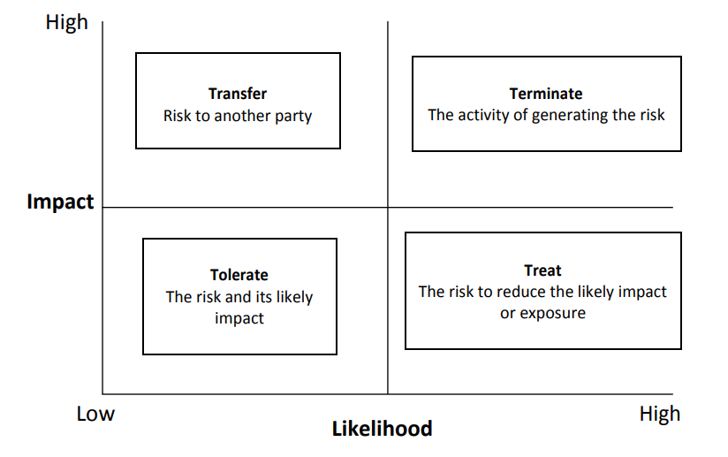
Lecture 3
Chapter 4 Scope of Risk Management

Slide 13
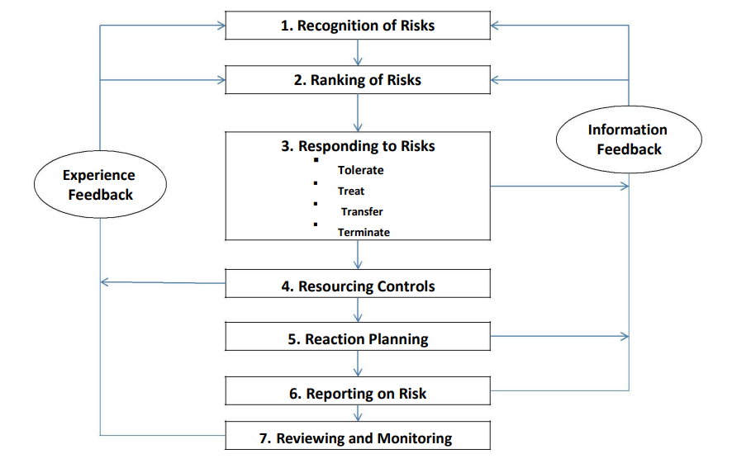
Lecture 3
Chapter 4 Scope of Risk Management

Slide 14
Lecture 3
Chapter 4 Scope of Risk Management
At first, an organization may be unaware of the legal and contractual obligations that it faces. In that case, it will be necessary to inform the organization of its obligations in relation to the risk.
Risk identification stage
Levels of risk management sophistication:

Slide 15
Lecture 3
Chapter 4 Scope of Risk Management
As the level of sophistication develops, the organization will become aware of the need to comply with obligations and the more general need for improved risk management. Once it is aware of obligations, there will be a need for the organization to reform in response to the hazard risks.
Risk Treatment or mitigation stage
Levels of risk management sophistication:

Slide 16
Lecture 3
Chapter 4 Scope of Risk Management
As the organization responds to the risk, it will seek to conform to the appropriate risk control standards. (Insuring the adherence and commitment to the controls adopted )
Or the organization will comply to the regulations levied from the authorities.
Levels of risk management sophistication:

Slide 17
Lecture 3
Chapter 4 Scope of Risk Management
After this stage, the organization may realize that there are benefits to be obtained from the risk. The organization will then have the ability to perform and view the risk as an opportunity risk, as illustrated in next Figure.
A proactive approach that convert the threats to opportunities.
Levels of risk management sophistication:

Slide 18
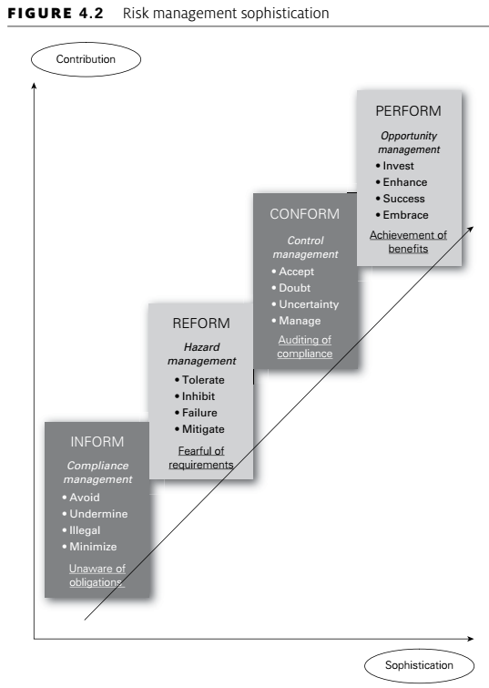
Lecture 3
Chapter 4 Scope of Risk Management

Slide 19
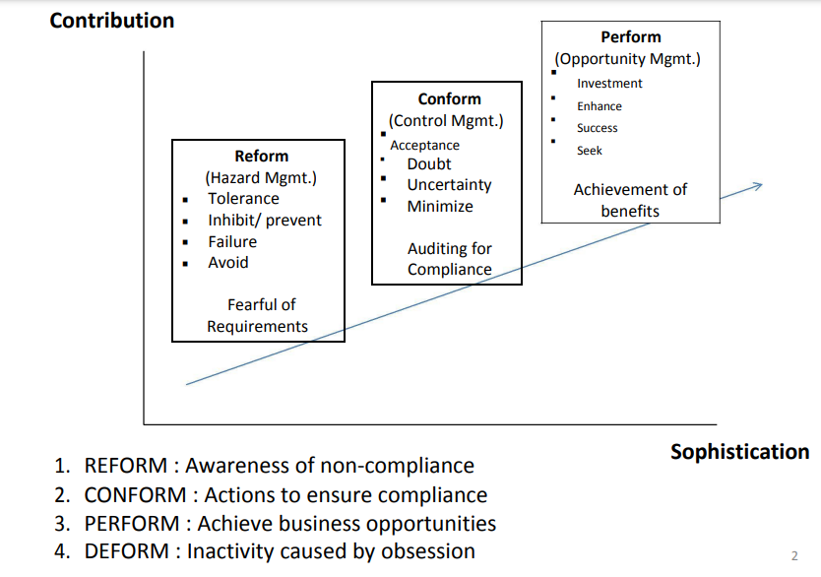
Lecture 3
Chapter 4 Scope of Risk Management

Slide 20
Lecture 3
Chapter 4 Scope of Risk Management
Although the four levels of risk management sophistication represent an improved approach to risk management, there is a danger that organizations will become obsessed with risk management to the point that important decisions are not taken.
At this point, it may be said that too much attention and concern about risk and risk management will cause the organization to deform its operations.
Levels of risk management sophistication:

Slide 21
Lecture 3
Chapter 4 Scope of Risk Management
In summary:
unaware of obligations – INFORM;
awareness of non-compliance – REFORM;
actions to ensure compliance – CONFORM;
achieve business opportunities – PERFORM;
inactivity caused by obsession – DEFORM
Levels of risk management sophistication:

Slide 22
Lecture 3
Chapter 4 Scope of Risk Management
As the level of sophistication increases and risk management professionals become aware of the alternative approaches to risk management, they should value the contribution that can be made by other approaches.
Levels of risk management sophistication:

Slide 23
Lecture 3
Chapter 5 Principles and aims of risk management
It is suggested that a successful risk management initiative (and framework) will be:
Proportionate to the level of risk within the organization;
Aligned with other business activities;
Comprehensive, systematic and structured;
Embedded within business procedures and protocols;
Dynamic, iterative and responsive to change.
This provides the acronym PACED and provides a very good set of principles that are the foundations of a successful approach to risk management within any organization.
Principles of risk management:

Slide 24
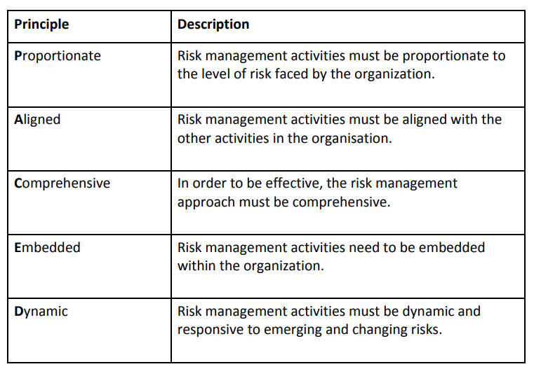
Lecture 3
Chapter 5 Principles and aims of risk management

Slide 25
Lecture 3
Chapter 5 Principles and aims of risk management
Mandatory obligations placed on the organization;
Assurance regarding the management of significant risks;
Decisions that pay full regard to risk considerations;
Effective and Efficient core processes
What it should deliver by risk management

Slide 26
Lecture 3
Chapter 5 Principles and aims of risk management
Objective | Description
Mandatory | The basic objective for any risk management initiative is to ensure conformity with applicable rules, regulations and mandatory obligations.
Assurance | The board and audit committee of an organization will require assurance that risk management and internal control activities comply with PACED.
Decision making | Risk management activities should ensure that appropriate risk-based information is available to support decision making.
Effective and efficient core processes | Risk management considerations will assist with achieving effective and efficient strategy, tactics, operations and compliance to ensure the best outcome with reduced volatility of results.

Slide 27
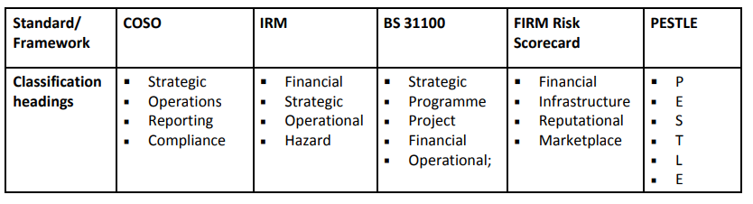
Lecture 3
Chapter 5 Principles and aims of risk management

Slide 28
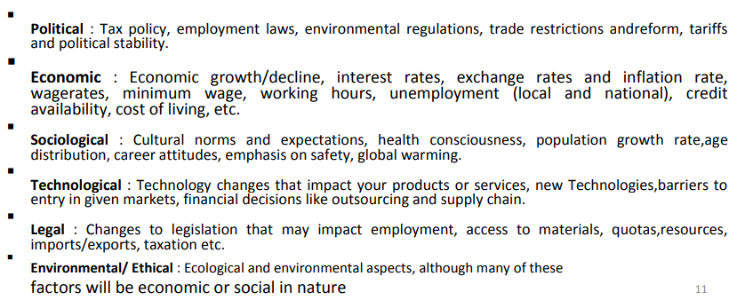
Lecture 3
Chapter 5 Principles and aims of risk management

Slide 29
Lecture 3
Chapter 5 Principles and aims of risk management
Benefits for Implementing risk management:
Financial benefits arising from better allocation of funds, monitoring of expenditure and reduced exposure to fraud;
Infrastructure benefits that have included fewer failures of the IT systems and reduced staff absence rates;
Reputational benefits from ethical sourcing policies and use of organic food in the restaurant, as well as successful niche productions in the theatre;
Marketplace benefits resulting in 89 per cent occupancy rates, up from 83 per cent three years ago, as well as increased spend in the theatre by patrons.

Slide 30
Lecture 3
Chapter 5 Principles and aims of risk management
Implementing risk management:
Using the structure of the FIRM risk scorecard, an organization will be able to demonstrate the benefits that it has obtained from a risk management initiative.
It is likely that the following benefits will have been delivered to a theatre that has been pursuing a structured proactive enterprise risk management approach for about three years:

Slide 31
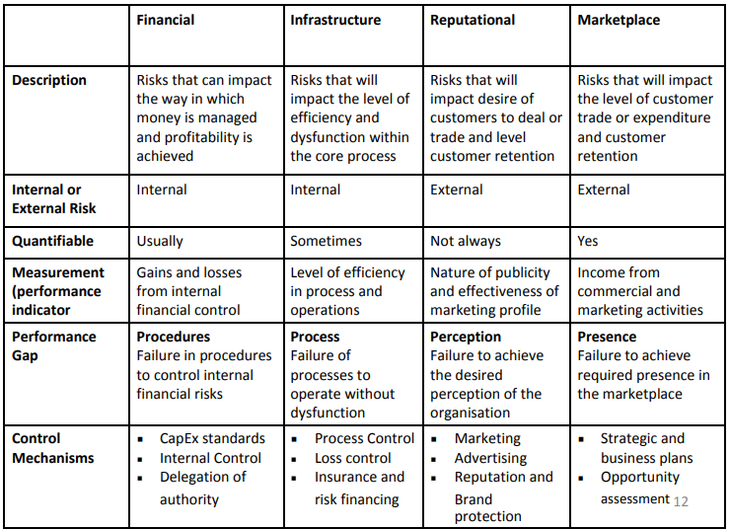
Lecture 3
Chapter 5 Principles and aims of risk management

Slide 32
Lecture 2
Conclusion

Slide 33


Thank You

