Slide 1

Project Management Technologies
Prepared by Lecturer Waseem Tabbaa
Section four - Chapter 9
PMG 312
S4 - Tools and techniques for developing the project plan
Ch. 9 - Creating the project schedule

Slide 2

Section four
Ch.9
Introduction
Section IV: Tools and techniques for developing the project plan
Learning objectives........................................................................................ 143
Overview......................................................................................................... 143
Model schedule and cost view..................................................................... 144
Chapter sequence........................................................................................... 147
Chapter 9 Creating the project schedule............................................... 149
Introduction .................................................................................................... 149
Work activities ................................................................................................ 149
Sequencing activities ..................................................................................... 150
Software modeling......................................................................................... 151
Predecessor relationship codes .................................................................... 152
Work unit resources....................................................................................... 153
Estimating activity durations....................................................................... 154
Developing the project schedule.................................................................. 154
MSP schedule generation mechanics (stage one) ...................................... 156
Sample first cut schedule problem .............................................................. 156
Results for the first cut plan.......................................................................... 158
Critical path..................................................................................................... 158
Discussion questions ................................................................................ 159
Summary......................................................................................................... 159
Supplementary technical reference............................................................. 159
Plan status mechanics .............................................................................. 160
Forward path calculations ........................................................................161
Backward pass calculation........................................................................162
MSP equivalent output............................................................................. 164
References ....................................................................................................... 168

Slide 3
Section
four
Tools and techniques for developing the project plan
Learning objectives
Upon completion of this section, the following mechanics and concepts should be understood regarding why they are required as part of the core schedule and cost planning process:
  Identify mechanics for translating the WBS into a first cut schedule.
  Identify mechanics for translating the first cut schedule into a first cut budget through resource allocation.
  Understand management concepts for tweaking a plan’s scope, time, and cost to better satisfy the key stakeholders.
  Understand the general processes required to obtain management approval for the derived project plan.

Slide 4
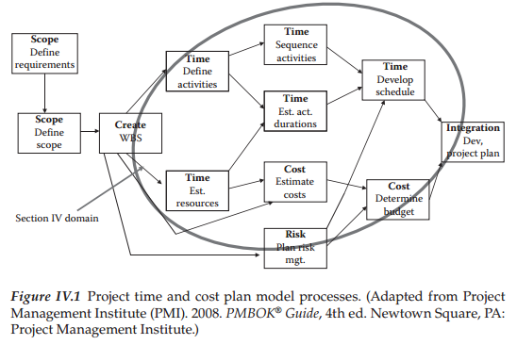
Section
four
Tools and techniques for developing the project plan

Slide 5
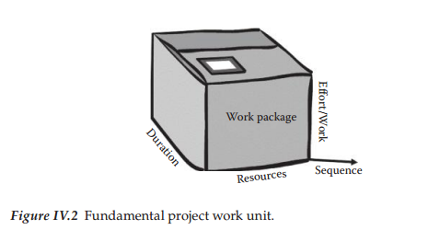
Section
four
Tools and techniques for developing the project plan

Slide 6
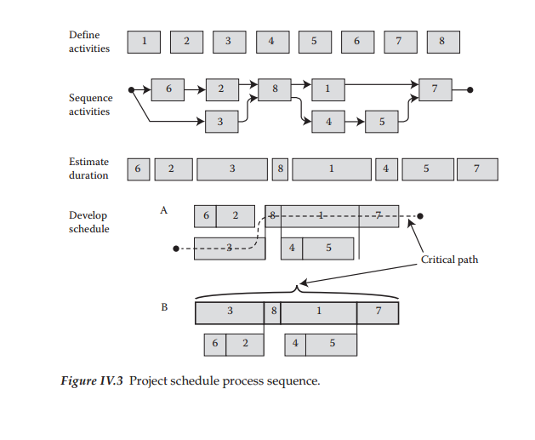
Section
four
Tools and techniques for developing the project plan

Slide 7
Section
four
Tools and techniques for developing the project plan
At the conclusion of this section, the resulting project plan version has been balanced in regard to varying stakeholder perspectives and the required modifications communicated to appropriate stakeholders.
At this point, it is important for the plan to be formally approved by the management.
That approved version is then baselined and moved into the execution stage.
This final modified version represents a view that satisfies technical, economic, and political viability.
It is common to describe this as the approved baseline plan.
These defined baseline performance goal values will be used in the monitoring and control process for plan versus actual status comparison and performance reporting.

Slide 8
Chapter
09
Creating the project schedule
Introduction
Recognize that a schedule overrun is one of the most recognizable negative events for a project.
One of the best foundation planning events to minimize this outcome is a clearly defined scope definition.
Chapters 7–10 focus, respectively, on each of the holy trilogy management aspects of a project.
Chapter 7 has covered the scope definition mechanics and this chapter will cover the second leg of the planning journey in developing the first cut schedule to match that scope.
In this discussion, the reader should take careful note of the relationship between the WBS boxes and the resulting project schedule.
As we move this description through the scheduling phase into the corresponding budget recognize that these three chapters represent the core focus of project management.
However, it is also important to point out that future chapters will add more dimensions to this core view.
The primary scope-to-schedule knowledge linkages are the work packages and other elements outlined in the WBS.
As discussed earlier, the WBS and its associated dictionary of lower level data contain the primary support data for creating the project schedule (PMI 2001).
In a properly defined WBS, the box structure will pass through into the subsequent schedule and work plans.
In this regard, it is important to emphasize that if the work is not reflected in the WBS, then “it is not considered to be in the project scope, schedule or budget.”
For this scheduling discussion, there will be clear visibility of scope boxes in the plan and identified by their WBS IDs.
This translation process is the main chapter goal.

Slide 9
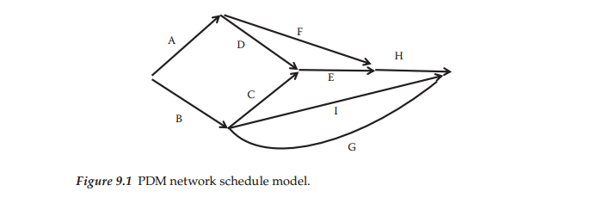
Chapter
09
Work activities and Sequencing activities
The view shown in Figure 9.1 is called a Predecessor Diagram Model (PDM).
Figure 9.1 illustrates a sample PDM network.
This format is useful for examining a sequence plan and evaluating it both technically and managerially.
However, as the project grows in size, the graphical method becomes harder to maintain and other computer-based methods then become preferable.
In this case, a graphical WBS view has to be “flattened” into a list containing WBS ID, task, duration, and predecessor.
At some high level of detail, it is still easier to visualize sequence graphically.
The rule of thumb says that a graphical network becomes unwieldy as the size grows beyond 50 or so work units.
Maturation of supporting desktop PC tools has greatly aided this planning activity over the last few years.

Slide 10
Chapter
09
Software modeling
Computer software does not handle arrows or graphics well, so in order to move the problem into a computer-centric model, it is necessary to translate this schematic view into a more data-oriented format.
The data shown in Table 9.1 mirror the network model shown in Figure 9.1 and this is much closer to a required computer data input format.
Note that this shorthand form for sequence coding defines how the various activities are linked to each other.
In this way, the defined task sequencing can be correctly modeled by the software.
In order to test your understanding of these concepts, the list below contains a few sample interpretations of the activity relationships in Table 9.1.
  Activity A has no predecessor constraint, therefore it start immediately.
  Activity C can start after B is finished.
  A more complex coding example occurs with activity H. In this case, activities E and F have to be finished before H can start.
To accomplish the sequencing step successfully, the project team must understand the required technical process sequence as well as other operational and environmental factors related to the execution process.
The interaction of these two factors makes the sequencing specification more than just defining a technical sequence.
When translating this information into a computer model, the activity linkages are converted into reference line numbers rather than the activity name as shown in Table 9.1. Thus, the code for activity C residing on line 3 would have a value of “2.” This is simply a shorthand technique to reflect the same decision and save keystrokes.
If another linkage is identified, then this can be easily changed as required.
As an example of an arbitrary relationship, it is often desirable to group common skill activities to better manage that work group schedule.

Slide 11
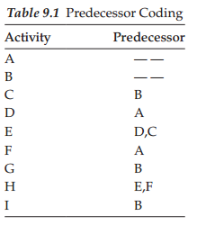
Chapter
09
Software modeling
For example, if a WBS task defines that a room is to be painted and an adjacent room also needs to be painted, the scheduling sequence could be changed to specify painting the two rooms in sequence rather than simply linking the task to construction of the wall or room.
This in effect changes the technical linkage.
Logically, once the painters are working in an area, it would be more efficient to just have them move next door and continue working rather than pack up their equipment and come back another time.
Likewise, inside activities may be changed to avoid outside bad weather, or a host of other discretionary logic options.
These points illustrate that the predecessor coding is not just a technical work linkage.
Predecessor coding represents the creative part of the schedule development exercise and as illustrated is both a technical and art-oriented process.

Slide 12
Chapter
09
Predecessor relationship codes
The linking process described thus far is called FS, meaning finish−start (FS).
This is the end-to-end activity (arrow) relationship specifying that the predecessor work unit has to be finished before its successor can start.
However, there are other task relationship options that can be coded to better model the desired work sequences.
The other sequencing options are:
  Start/Start (SS)—this indicates that the two linked activities would start at the same time. So, a code of SS6 would define that the activity would start at the same time as the activity on line 6.
  Finish/Finish (FF)—this code indicates that the named activity would need to finish at the same time as its reference activity. So, a code of FF6 would define that the activity should finish at the same time as the activity on line 6.
  Start/Finish (SF)—this is a little used relationship for most projects. Its interpretation is that the successor task cannot be completed until the predecessor begins. This format basically fits the Just-in-Time manufacturing approach designed to “pull” the predecessor activity rather than a “push” relationship like the other options reflect.
  Lag—this is a supplementary relationship to each of the four basic codes above. The term lag means that the coded task obeys one of the basic relationships, but then must wait for some further specified time. One easy way to remember this logic is to recall again the concrete pouring example. In this case, the required technical sequence for these two events is to pour the concrete slab (task A) and then paint the surface of the slab (task B). There is an obvious required technical sequence between these two tasks; however, in this case the concrete must also be allowed to dry first and this drying time represents a required lag. If we assume the concrete must dry for 5 days, then the predecessor code for task B would be A + 5.

Slide 13
Chapter
09
Predecessor relationship codes
  Lead—a lead relationship is just the opposite of a lag in that the linked task can start before the predecessor is finished. So, the code A-5 would say that B could start 5 days prior to completion of A.
It should also be obvious that the predecessor coding activity has the potential to stretch or compress a schedule depending upon the lead, lag, or other predecessor codes.
Think about the impact of changing a relationship from FS to SS, which in effect shortens the total sequence for the two activities involved.
The project team must understand the implications of these options and their cumulative impact on the resulting schedule.

Slide 14
Chapter
09
Work unit resources
Our model theory has defined the project scope as being represented by a collection of work elements consisting of Work Packages (target sized at 2 weeks duration and 80 work hours), planning packages (not decomposed yet), and summary groups of lower level boxes.
Review a WBS layout and verify that you understand how these three box types would be represented in the structure. Once these work units are defined, the following steps are required to allocate the specific resources necessary to produce the defined output for each unit:
  The initial step in the process involves the decision for allocating various human resource skills required to execute each defined work unit in the WBS. As an example, a work package estimate would specify the total work hours required for a carpenter, plumber, and an engineer.
  Material resource estimates are defined for each work unit based on the technical specifications.
  Other supplementary costs are estimated for each work unit. One common example for this category is travel costs or common equipment needed by the work unit.
Techniques of work estimating are unique to each industry (will be described in Chapter 8).
Regardless of the local approach for deriving activity work estimates, translation of that decision into the schedule requires specific resource quantities be assigned to generate duration estimates.
To help refine the plan as it evolves all of the estimates and associated assumptions related to this activity should be captured in the WBS dictionary for use in subsequent steps.

Slide 15
Chapter
09
Estimating activity durations
Duration estimates are driven by decisions related to work effort by various labor skills.
To translate work into activity duration, it is necessary to define the number of actual bodies by skill type to be allocated into that work unit.
This in turn yields the planned work duration of the activity.
To illustrate this point, assume that the work package activity is defined to be 160 hours of work.
Assuming the skill required is defined, the next step in the sequence involves the actual work schedule of the resource.
A typical work schedule assumption is 40 hours per week (standard 8 × 5 work week).
So, if one person was allocated to this task, the activity duration would be 20 days or 4 work weeks.
However, the Project Manager may decide that he wants this done in 5 days, if possible.
In concert with the work unit supervisor, it is decided to allocate four full-time resources and they believe this will accomplish the desired 5-day goal.
This second scenario shows how the resource allocation decision impacts the duration estimate and resulting project schedule.
From this discussion, it should be obvious that the complexity of the resource allocation process is significant.
Finding the balance among available resources, optimum task times, and compressed schedules is one of the most stressful parts of planning and executing the project.
It is important to note at this point that the planned resource allocations are really ideal scenarios.
There is no assurance that the defined skills and quantities are available since the actual time period for the work is not yet defined.
This issue will need to be dealt with before the plan is approved, but that will be deferred for now.

Slide 16
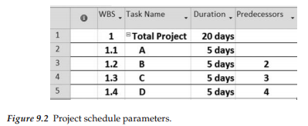
Chapter
09
Developing the project schedule
There are essentially four decision variables necessary to create a first cut schedule.
These are:
  WBS code ID
  Work unit name
  Estimated duration (work days)
  Predecessor code
To develop a simple example, assume that we have only four activities in our sample project and each activity is estimated at 5 days duration.
The data setup for translating this into MS Project (MSP) is outlined in Figure 9.2.

Slide 17
Chapter
09
Developing the project schedule
This set of data can be cut and pasted directly from Excel into MSP with the result shown in Figure 9.3.
Notice that the project schedule is essentially derived from the raw data described.
However, there are two additional less obvious scheduling parameters embedded in the computer version.
  First, the resource work schedule has to be defined since the software uses this to translate how a particular work unit can be executed within the resource’s work schedule.
  Second, the start date for a project must be set in order for the sequence to properly be shown on a calendar view.
Observe in Figure 9.3 how the software recognizes nonwork time (gray columns in the Gantt bar area).
These nonworking times affect the completion date.
For the schedule calculation to be accurate, the calendar must reflect nonworking times such as holidays and vacations for the assigned workers.
These two internal components allow a calculation of calendar dates to be added to the raw work duration values that a simple PDM-type network would show.
This is another advantage of using a computer model over manual processes.
This first cut version of the plan is quite easy to derive, but it would not be fair to call this the final project schedule.
However, it does represent a significant starting place for the project planning model. Because of various other project dynamics and stakeholder pressure, we should expect to go through more decision iterations of this plan before finally getting an approved package of tasks, schedule, and budget that is acceptable to the various decision-makers.
It should be anticipated that some stakeholder groups will not like the schedule produced by this initial calculation.
Some will think the cost is excessive, whereas others will want more or less functionality (scope).

Slide 18
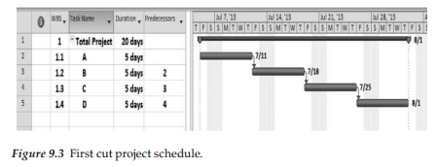
Chapter
09
Developing the project schedule
In essence, all of the triple constraints will be challenged in conflicting ways. This will necessitate manipulation of activities, durations, and resources until a suitable combination is achieved.
For now, we will just deal with the basic mechanics to better illustrate the model schedule generation process.
The good news in all this is that any needed future changes to this view can be made quickly by changing the respective driver data and the results will be automatically translated from that.

Slide 19
Chapter
09
MSP schedule generation mechanics (stage one)
The introductory stage one keystrokes described in Appendix B are primarily mechanical in nature, but it will take a little practice to become proficient.
To accomplish this, the recommended approach is to review the ProjectNMotion website video tutorials (www.tech.uh.edu/projectnmotion) and also extract a copy of the MSP keystroke documentation from either Appendix B or from the Supplemental Documents section of the website.
Various video lessons in the Scope and Time sections will help to illustrate specific keystroke details for translating data from a WBS format into a first cut plan.
The keystroke summary list will offer more specific mechanical guidance.
It will be worthwhile to execute the steps outlined in Section I of this checklist with sample project data to ensure that you understand this initial set of planning mechanics.
Following that, test your competence with one of the sample problems from this chapter.

Slide 20
Chapter
09
Sample first cut schedule problem
This example problem is designed to illustrate basic mechanics for translating scope-oriented data into a first cut project schedule.
A spreadsheet with this table data are stored on the publisher’s website for your use under the file name Table 9.2 First cut plan parameters.
Table 9.2 represents that file.
Note that the data is in WBS flattened format.
The goal of this example is to manipulate this data using the keystroke checklist.
The following note list will help guide you through this process:
  The top of the WBS is line #1
  Bolded line numbers are summary tasks (i.e., 2, 6, 11, etc.)
  Line 19 is a summary task for #20 and #21 (they must be indented)
  Task #33 is a milestone (zero duration)
  Load the scope data into MSP and set the start date to April 1, 2014
  Indent the data to mirror the WBS structure defined
  Once the activity data are loaded and the first cut schedule produced, insert a recurring task after #30 defined as “Project Management” (see the MSP checklist)
Load the table data below into MSP and manipulate these data using the “Stage One Keystroke” checklist described earlier.
Also, review the companion video tutorials that cover these specific commands.
Both of these sources are helpful in learning these important steps. Once accomplished, this represents basic MSP scheduling competency.

Slide 21
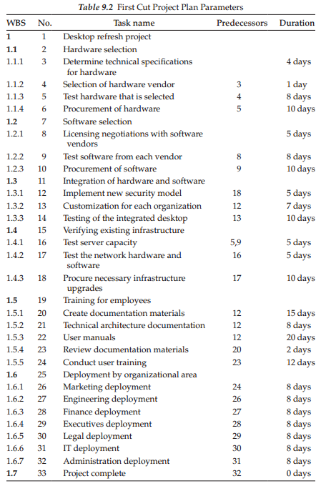
Chapter
09
Sample first cut schedule problem

Slide 22
Chapter
09
Results for the first cut plan
The WBS resulting from Table 9.2 manipulation is shown in Figure 9.4 (this example is created by WBS Chart Pro).
It would be a good learning exercise to compare the original table view and the resulting WBS schematic.
This offers reinforcement that the resulting plan is tightly linked to the WBS scope definition and that all defined work is included in the plan.
If your output WBS does not match that shown in Figure 9.4, the most likely source of error is either activity indention for WBS structure or predecessor code values.

Slide 23
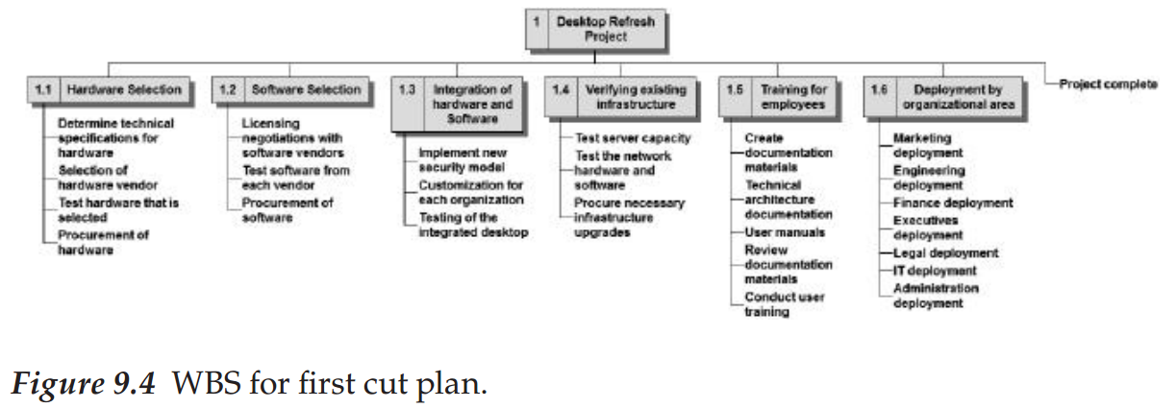
Chapter
09
Critical path
One of the most important plan status elements is to define which tasks are constraining the overall schedule.
Opening up a table variable called Total Slack will show how long that activity can be delayed without affecting the project schedule.
Also, red Gantt bars indicate those tasks with zero slack.
This is created by selecting the critical path option check box (see checklist).
All non-red Gantt bars have some amount of idle time and do not limit the schedule as defined.
Activities that have positive total slack would generally require less rigorous monitoring since a slippage in these will not affect the planned completion date so long as slack remains.

Slide 24
Chapter
09
Critical path
Understanding both critical path and slack concepts is vital for effective time management and requires that the PM keep these parameter values in mind as the project unfolds.
Also, recognize that errors in duration estimates will cause the slack values to change during project execution, so this is not a static view by any stretch.
Understanding activity slack or float gives the PM flexibility in scheduling the start of a particular activity (Uher 2003).
This also helps to facilitate prioritization of resource allocations across the project plan.
For example, if there are two activities occurring within the same time range, one critical and one noncritical that are competing for the same resource, the Project Manager can allocate the resource to the critical activity first, then use the slack or float time on the other to delay the start of the noncritical activity.

Slide 25
Chapter
09
QUESTIONS
Discussion questions
  What is the critical path of this plan?
  How long will this project last?
  What is the calendar date for completion?
  Which activity has the most slack time?
  When will the project be complete according to the model?
  Open up a new data column for total slack. What does this indicate?
  What is the most logical strategy to reduce cycle time in this plan?
  If you have either the WBS Chart Pro or Visio WBS add-ins loaded, produce a graphical WBS from the first cut model. Add additional data parameters to the WBS structure to help communicate the overall project schedule data.

Slide 26
Chapter
09
Summary
This chapter has explored the basic mechanics required to create a first cut project schedule.
Also, important core vocabulary has been introduced.
Both of these items represent basic skills needed in various other project scenarios.
Remember, as good as the first cut plan looks it is important to recognize that there are other steps required before it can be considered a viable plan ready to receive management approval and move into execution.
Our final goal is to produce a plan with this basic structure that is agreed upon by key stakeholders and can then be used as a road map through its lifecycle and serve as a baseline for status analysis.
The mechanics are now in place, but now the approval remains a forward goal.

Slide 27
Chapter
09
Supplementary technical reference
Some readers may not wish to go through this upcoming set of more technical schedule calculations since MSP performs similar calculations.
However, the manual graphical view offers more insights into the actual mechanics involved, so this section is defined as an optional technical reference.
Manipulation of the project network sequence diagram involves a fundamental set of calculations used to produce both the critical path and noncritical path (slack) calculations embedded in the project network plan

Slide 28
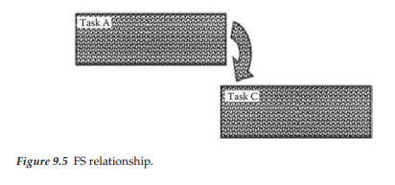
Chapter
09
Plan status mechanics
After supplying the basic activity, duration, and predecessor parameters for defining the network plan, there are seven management-oriented parameters that can be calculated from these data.
These are:
  ES or T(E)—early start; earliest time the activity can commence.
  LS or T(L)—late finish; latest time the activity can start and not affect project schedule.
  EF—earliest time that an activity can finish.
  LF—latest time the activity can finish and not affect project schedule.
  Total slack (float)—the difference between the earliest date that the activity can start and the latest date the activity can start before delaying the completion date (LS–ES).
  Free float—the amount of time an activity can be delayed before any successor activity will be delayed (EF−ES).
For the sample network exercise, we will assume that all activity relationships are Finish−Start (see Figure 9.1),meaning that each predecessor activity has to completely finish before the successor activity can commence.
A schematic view of this type of relationship is shown in Figure 9.5.

Slide 29
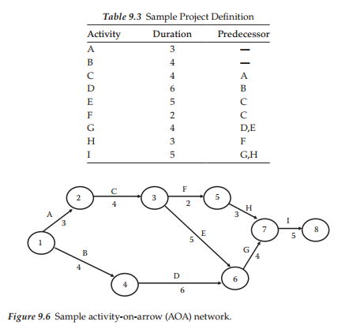
Chapter
09
Plan status mechanics
Table 9.3 defines a sample project activity list that will be used to show the manual network mechanics.
From this definition, the following arrow-on-arrow network shown in Figure 9.6 can be produced.
Review the network setup to be sure that this setup step makes sense as it is the base for the remainder of the mechanics.

Slide 30
Chapter
09
Forward path calculations
Step 2 of the mechanical plan calculation is to perform what is defined as a forward pass.
This process basically adds the arrow lengths to calculate the total duration time moving from left to right through the network, while obeying the predecessors.
Early times to reach each node (end of arrow) are recorded by the format of “T(E)/,” which is the notation for earliest time to reach that point in the network.
Figure 9.7 shows the calculated values for each of the nodes.
These example calculations are quite straightforward except for nodes 6 and 7.
For node 6, two incoming activity paths have to be considered for the activities D and E.
Node 4 has a T(E) value of 4 and activity D has a duration time of 6, therefore, the resulting value for node 6 would be 10.
However, the other parallel path coming into node 6 starts at node 3 with a value of 7 and an activity E time of 5, so that path value is 12.
For forward path calculations, the highest value among multiple incoming paths is selected for such parallel paths, thus we assign the value 12 for T(E) at node 6.
This calculation indicates that the earliest we can claim completion of these project activities at this point is 12.
The same type logic applies to node 7 where a value for T(E) of 16 is calculated.
The calculation rule for the forward pass is to remember to take the highest value for multiple input paths at the node.
T(E) values at each node represent the earliest time that these points in the project can be reached from a schedule viewpoint.
This calculation process also shows that the final node (8) can be reached at time period 21.

Slide 31
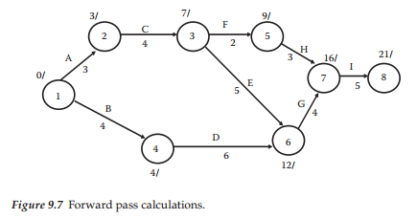
Chapter
09
Forward path calculations
The final node value defines that the project duration is 21 given this set of parameters.
The forward pass then defines a crude project time schedule (Figure 9.7).
However, even though this is an interesting value, there are other more worthwhile parameters that need to be defined.
We will see these in the next step.

Slide 32
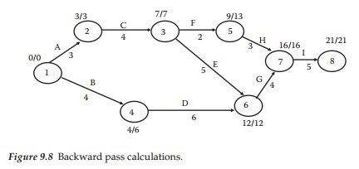
Chapter
09
Backward pass calculation
Step 2 of the calculation process involves performing a backward pass on the network model.
The rationale for needing this is not clear as yet, but let us first describe the mechanics of the calculations before attempting to describe the function of these values.
The backward pass generates a variable defined as T(L) and it is formatted on the network node as “T(E)/T(L).”
Notice that the nodes in Figure 9.8 now show two such numeric values above each node.
For this basic network, the assumption is made that the planned time at termination is equal to the forward pass calculated time shown (i.e., 21 time units for the example).
Stated another way, we are saying that the forward plan specified that the project would take 21 time units and we are accepting that value for the backward pass.

Slide 33
Chapter
09
Backward pass calculation
To calculate T(L) values, we start at the completion node (8) and insert the same time as calculated for the forward pass—which is 21 in the sample case.
From this starting value, work backwards to the front of the network one node at a time. For node 7, the T(L) value would be 21 minus 5 (for activity I), or 16.
Node 6 would be calculated as 16 minus 4 (for activity G), or 12. As described in the forward pass mechanics, the T(L) calculations are straightforward until a node that has multiple paths coming back into it such as node 3 is encountered.
In this case, the T(L) calculations would compare the two paths for activities F and E yielding a 13 minus 2, or 11 for activity F, versus 12 minus 5, or 7 for activity E.
The calculation rule for the backward pass is to take the lower value of the two reverse paths and record that as the nodal T(L) time.
This same process is required for node 1 and at that final node the value should be zero since we started with 21/21 at node 8.
Failure to return with a zero value indicates that an error was made in the return path.
Review the values shown in Figure 9.8 to be sure that you understand the basic idea of T(E)
and T(L) mechanical values.
Once the values for T(E) and T(L) are calculated, it is possible to analyze two additional important time management factors.
These are the longest path through the network (critical path) and slack time details.
The simplest item to calculate of these two is nodal slack time.
This is simply the difference in T(L) and T(E).

Slide 34
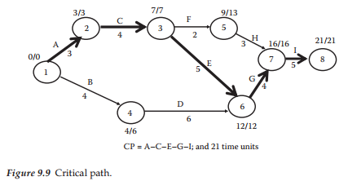
Chapter
09
Backward pass calculation
So, node 3 would have a slack value of zero (7 minus 7), while node 5 has a slack value of 4 time units (13 minus 9).
Each of these values defines the amount of time that this node can set idle without affecting the planned project completion date.
Also, note that the computed slack for the start and finish of the network will be zero from using the assumption of 21/21, that is, this says that we are happy with the original computed project duration.
You might be thinking about what you would do if some other value for T(L) was desired.

Slide 35
Chapter
09
Backward pass calculation
Several other slack-type status parameters can be derived from this view.
The most interesting ones are Total Float, Free Float, and Late Finish.
Each of these relates to activity views rather than node calculations, but this same value set can be derived from the node values.
Total Float relates to the amount of activity slack (variability) before project completion is impacted, while Free Float deals with the same view only for the successor activity.
Late Finish describes the latest time that the activity can be completed without impacting the schedule.
Since these arrows represent required project work, the various slack views represent vital schedule information for the Project Manager.
MSP can also generate this type of information with its internal calculations.
To find the network critical path activities, the key mechanic involves checking any activity bounded between zero slack nodes to see if in fact that path is a critical activity.
In some more complex networks, parallel paths can both appear to be on the critical path, whereas only one actually is.
In this sample case, the critical path definition is straightforward and is outlined as bold arrows in Figure 9.9.
Note that the critical path passes through nodes 1−2−3−6−7−8 and the critical path activities are A−C−E−G−I.
Specifically the critical path should be thought of as a vector containing both the activity list and the total duration value, so it would be more proper to state the critical path as A−C−E−G−I, and 21 time units.
To reiterate, this is the longest path through the network and represents a critical management issue for the Project Manager (Brown 2002).

Slide 36
Chapter
09
MSP equivalent output
To see how the schematic network output compares to an MSP Gantt view, it will be instructive to compare the two views.
The equivalent MSP core output is shown in Figure 9.10 and the associated network slack calculation parameters in Figure 9.11.
There are several items to examine in the MSP view of its associated Gantt bar schematic.
It would now be worthwhile to review the status parameters shown below to ensure that the meaning of the terms are
understood:
  Note that the total project duration is correct at 21 days and the critical path is correctly defined.
  Total slack and free slack calculations are correctly shown, although they are converted into calendar dates rather than duration equivalents. This is more meaningful for the management aspects related to slack. The example is set to start the project on December 9, 2013, so it is possible to manually check the calendar versus raw duration results.
  The MSP model also shows nonworking periods and corrects the completion date based on that. The network model does not deal with this level of granularity.
  The other early and late activity calculations are shown in Figure 9.11 as calendar dates.
Hopefully, this comparative review is sufficient and convincing that the software is easier to use than manually creating a schematic view of the schedule and then performing the same calculations.
The rest of the chapter will revert back to the software approach based on this belief.
Think of the software view this way—MSP is doing nothing other than building the relationship defined and describing the resulting output based on the input parameters.

Slide 37
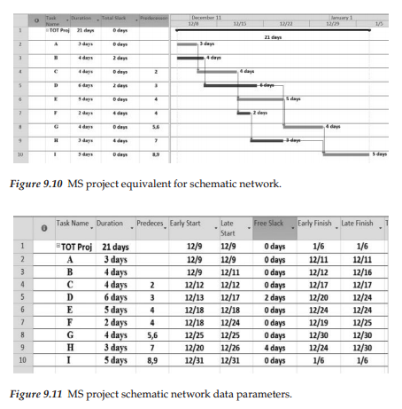
Chapter
09
MSP equivalent output

Slide 38
Chapter
09
QUESTIONS
Review questions
  What is the process sequence necessary to move a work package estimate into a schedule?
  What are the four predecessor types used to model work unit sequencing?
  What is the role of a PDM in the schedule development process?
  What does a milestone signify in a project plan?
  To generate a schedule using MSP what are the four basic data items required?
  If we wished to delay the time between two work units, what is the vocabulary term for this?
In-class questions
  If a schedule is longer than desired, what would be the simplest method to shorten it?
  What are the implications of not having actual resources defined in the plan?
  Provide some examples to illustrate how a well thought out plan will in fact not be met?
  Discuss some of the methods that might be effective in making the actual project outcome more closely match the approved plan.

Slide 39
Chapter
09
EXERCISE
An activity list for the car development project is shown in Table 9.4.
This data file will also be stored in the publisher website as Table 9.4 Car project activities.
Translate this structure into a first cut project schedule in order to test your understanding of the schedule creation process, then answer the same status questions outlined for the earlier example problem.
Check page 167 in the book to see Table 9.4 Car Problem Activity List

Slide 40
Chapter
09
Reference
Brown, K.L. 2002. Program Evaluation and Review Technique and Critical Path Method—Background, Reference for Business: http://www.referenceforbusiness.com/management/Pr-Sa/Program-Evaluation-and-Review-Technique-andCritical-Path-Method.html (accessed March 17, 2008).
PMI. 2001. Project Management Institute Practice Standard for Work Breakdown Structures. Newtown Square, PA: Project Management Institute.
Uher, T.E. 2003. Programming and Scheduling Techniques. Sidney: University of New South Wales.

Slide 41
Thank You
The End..
Thank You

