Slide 1




Introduction to Finance
Prepared by Dr. Mohamed Hamouda
Lecture 1
Introduction to finance

Slide 2



Introduction to the course

Slide 3

Learning Platform
IT MUST be checked frequently
Include All course material and information
  Lectures’ Videos and PDF/PPT files
  Course grades distribution
  Quizzes/Assignments/Exams Dates
  Regulations for accepted excuses
  weekly meeting link (same link is used for all meetings)

Slide 4
Brief Description of The Course
The course provides an overview of financial decision-making from the perspective of the corporate financial manager. Students discover how managers maximize shareholders’ wealth by choosing the optimal allocation of capital and the optimal financial structure of the firm. Topics include risk-return relationships, the time value of money, the valuation of stocks and bonds, capital budgeting, the cost of capital and a brief introduction to financial markets. Parts of the material are quantitative.

Slide 5
Topics
▪ Financial Statements
▪ Investing and Financing Decisions
▪ Operating Decisions and the Income Statement
▪ Communicating and Interpreting Accounting Information
▪ Cost of Goods Sold and Inventory
▪ Property, Plant, and Equipment Natural Resources
▪ Reporting and Interpreting Liabilities
▪ Reporting and Interpretation

Slide 6

Course Learning Outcomes
Students will learn how to:
•Evaluate investment opportunities.
•Analyze a company’s financial statements to answer business questions.
•Use financial formulas to evaluate cost of capital for decisions related to financing the operations of a corporation.
•Anticipate corporate financial needs through budgeting and forecasting techniques.
•Explain working capital concepts.

Slide 7
Lecture one agenda
Describe the primary forms of business organization.
Identify the users and uses of accounting information.
Explain the three principal types of business activity.
Describe the content and purpose of each of the financial statements.
Explain the meaning of assets, liabilities, and stockholders’ equity, and state the basic accounting equation.
Describe the components that supplement the financial statements in an annual report.

Slide 8
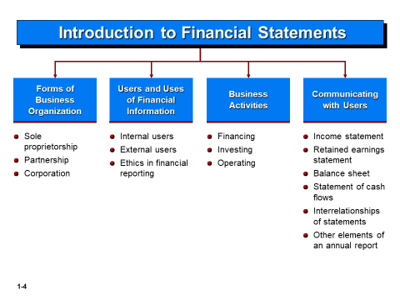
Introduction to Financial Statements

Slide 9
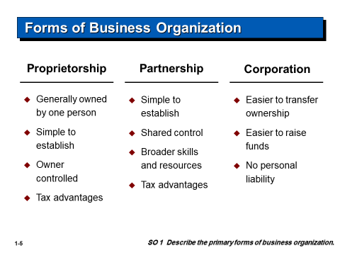
Forms of Business Organization

Slide 10
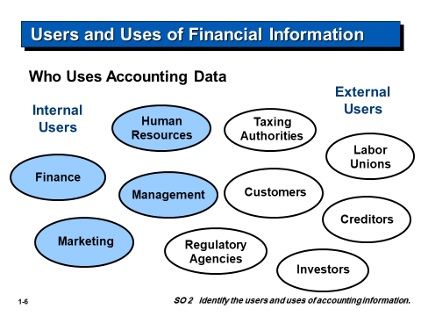
Users and Uses of Financial Information

Slide 11

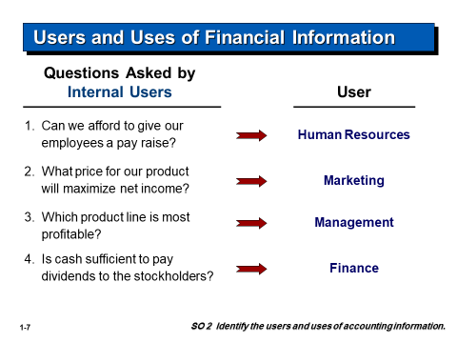
Users and Uses of Financial Information

Slide 12
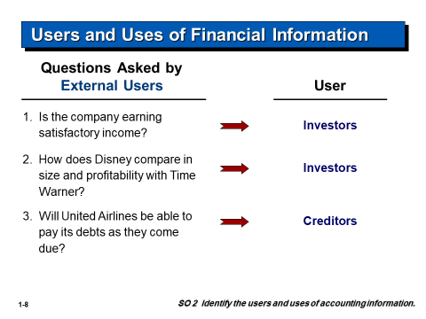
Users and Uses of Financial Information

Slide 13
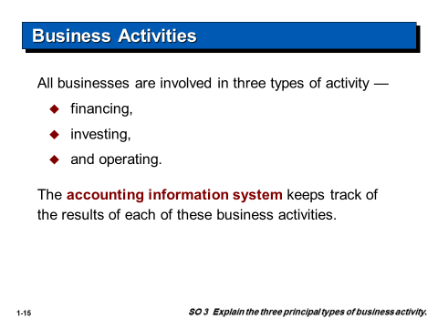
Business Activities

Slide 14
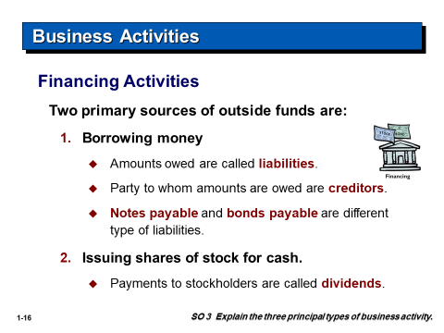
Business Activities

Slide 15
Business Activities

Slide 16
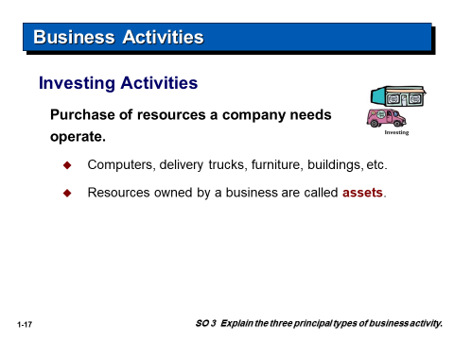
Business Activities

Slide 17
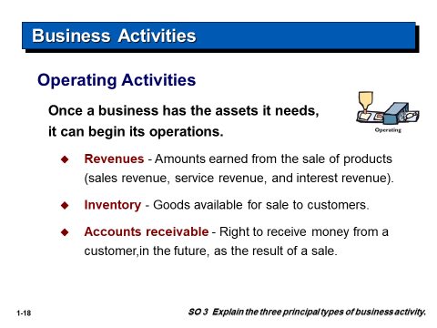
Business Activities

Slide 18
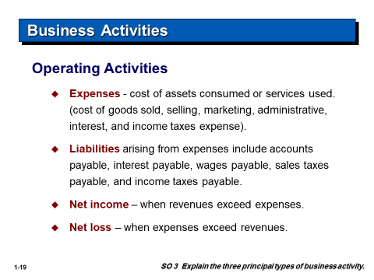
Business Activities

Slide 19
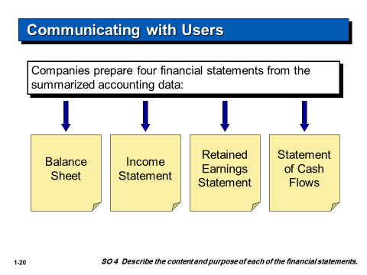
Communicating with Users

Slide 20
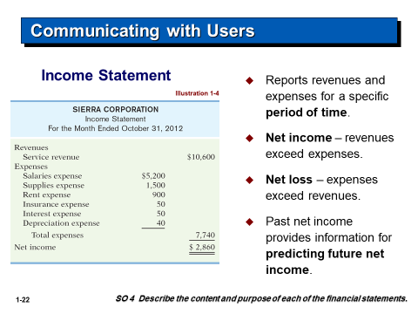
Communicating with Users

Slide 21
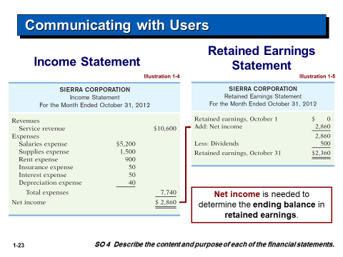
Communicating with Users

Slide 22
Communicating with Users

Slide 23
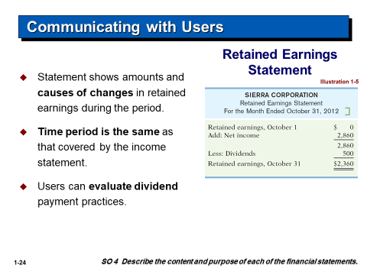
Communicating with Users

Slide 24
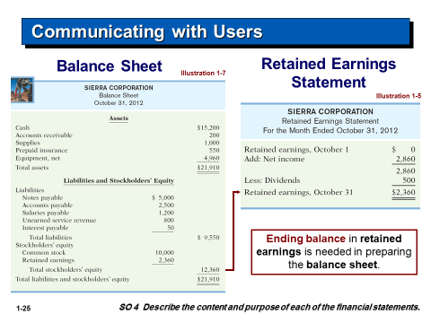
Communicating with Users

Slide 25
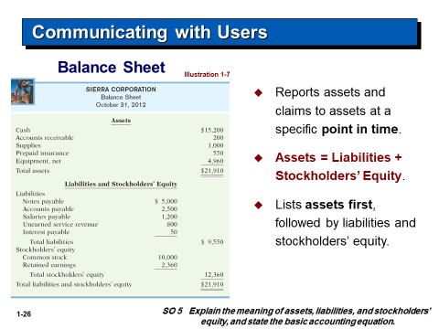
Communicating with Users

Slide 26
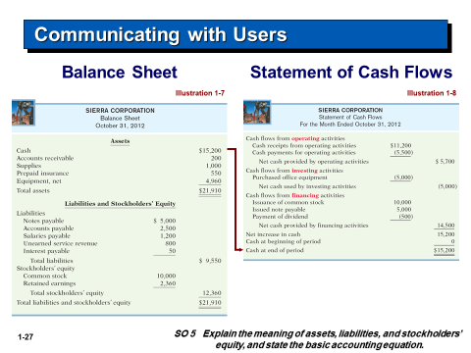
Communicating with Users

Slide 27
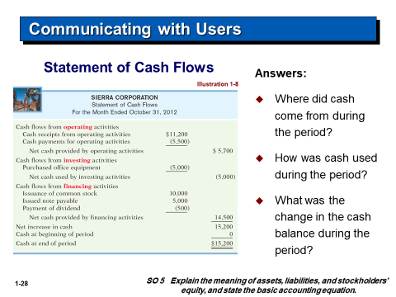
Communicating with Users

Slide 28
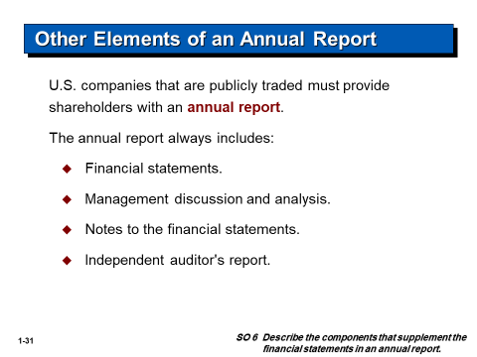
Other Elements of an Annual Report

Slide 29
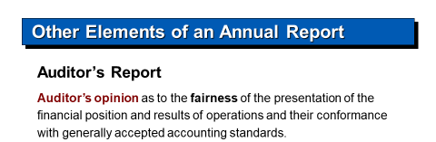
Other Elements of an Annual Report

Slide 30



Thank You

