Slide 1

  Master of Financial Technology
FNT 615
Finance Concepts

Slide 2

Capital Budgeting
Chapter 6
www.midocean.ae

Slide 3

Chapter
Intended Learning Outcomes
06
After reading this chapter, you should be able to:
  Discuss the difficulty encountered in finding profitable projects in competitive markets and the importance of the search.
  Determine whether a new project should be accepted or rejected using the payback period, the net present value, the profitability index, and the internal rate of return.
  Explain how the capital-budgeting decision process changes when a dollar limit is placed on the capital budget.
www.midocean.ae

Slide 4
Capital Budgeting
Capital budgeting is the process a business undertakes to evaluate potential major projects or investments. Construction of a new plant or a big investment in an outside venture are examples of projects that would require capital budgeting before they are approved or rejected.
As part of capital budgeting, a company might assess a prospective project's lifetime cash inflows and outflows to determine whether the potential returns that would be generated meet a sufficient target benchmark.
The capital budgeting process is also known as investment appraisal.

Slide 5
Capital-Budgeting Decision Criteria
When deciding whether to accept a new project, we focus on cash flows because cash flows represent the benefits generated from accepting a capital-budgeting proposal.
In this chapter we assume a given cash flow is generated by a project and work on determining whether that project should be accepted.
We consider four commonly used criteria for determining the acceptability of investment proposals. The first one is the least sophisticated in that it does not incorporate the time value of money into its calculations; the other three do take it into account.
For the time being, the problem of incorporating risk into the capital-budgeting decision is ignored.

Slide 6

Capital Budgeting Techniques
Payback Period
Discounted Pay Back Period
Net Present Value (NPV)
Profitability Index ( PI)
Internal rate of Return (IRR)

Slide 7
Pay Back period

Slide 8

Payback Period
When deciding whether to accept a new project, we focus on cash flows because cash flows represent the benefits generated from accepting a capital-budgeting proposal.
In this chapter we assume a given cash flow is generated by a project and work on
determining whether that project should be accepted. We consider four
commonly used criteria for determining the acceptability of investment proposals.
The first one is the least sophisticated in that it does not incorporate the time value of money into its calculations; the other three do take it into account. For the time being, the problem of incorporating risk into the capital-budgeting decision is ignored.

Slide 9
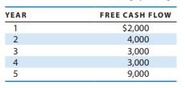
Payback Period
For example, if a firm’s maximum desired payback period is 3 years, and an investment proposal requires an initial cash outlay of $10,000 and yields the following set of annual cash flows, what is its payback period? Should the project be accepted?

Slide 10
Payback Period
In this case, after 3 years the firm will have recaptured $9,000 on an initial investment of $10,000, leaving $1,000 of the initial investment to be recouped. During the fourth year $3,000 will be returned from this investment, and, assuming it will flow into the firm at a constant rate over the year, it will take one-third of the year ($1,000/$3,000) to recapture the remaining $1,000.
Thus, the payback period on this project is 3½ years, which is more than the desired payback period. Using the payback period criterion, the firm would reject this project without even considering the
$9,000 cash flow in year 5.

Slide 11
Payback Period
Although the payback period is used frequently, it does have some rather obvious drawbacks that are best demonstrated through the use of an example.
Consider two investment projects, A and B, which involve an initial cash outlay of $10,000 each and produce the annual cash flows shown in Table -1.
Both projects have a payback period of 2 years; therefore, in terms of the payback criterion both are equally acceptable. However, if we had our choice, it is clear we would select A over B, for at least two reasons.
First, regardless of what happens after the payback period, project A returns more of our initial investment to us faster within the payback period ($6,000 in year 1 versus
$5,000).
Thus, because there is a time value of money, the cash flows occurring within the payback period should not be weighted equally, as they are. In addition, all cash flows that occur after the payback period are ignored.

Slide 12
Payback Period
This violates the principle that investors desire more in the way o f benefits rather than less—a principle that is difficult to deny, especially when we are talking about money.
Finally, the choice of the maximum desired payback period is arbitrary.
That is, there is no good reason why the firm should accept projects that have payback periods less than or equal to 3 years rather than 4 years.
Although these deficiencies limit the value of the payback period as a tool for investment evaluation, the payback period has several positive features.
First, it deals with cash flows, as opposed to accounting profits, and therefore focuses on the true timing of the project’s benefits and costs, even though it does not adjust the cash flows for the time value of money.

Slide 13
Payback Period
Second, it is easy to visualize, quickly understood, and easy to calculate. Third, the payback period may make sense for the capital-constrained firm, that is, the firm that needs funds and is having problems raising additional money.
These firms need cash flows early on to allow them to continue in business and to take advantage of future investments.
Finally, although the payback period has serious deficiencies, it is often used as a rough screening device to eliminate projects whose returns do not materialize until later years.
This method emphasizes the earliest returns, which in all likelihood are less uncertain, and provides for the liquidity needs of the firm.
Although its advantages are certainly significant, its disadvantages severely limit its value as a discriminating capital-budgeting criterion.

Slide 14
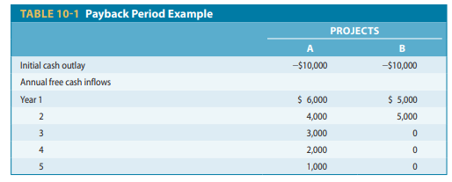
Payback Period – Example 1

Slide 15
Payback Period – Example 2
For example, if a firm’s maximum desired payback period is 3 years, and an investment proposal requires an initial cash outlay of $10,000 and yields the following set of annual cash flows, what is its payback period? Should the project be accepted?

Slide 16
Major Drawbacks
Ignoring the time value of money.
Ignoring any cash flow after the payback period.

Slide 17
Discounted Payback Period
To deal with the criticism that the payback period ignores the time value of money, some firms use the discounted payback period approach.
The discounted payback period method is similar to the traditional payback period except that it uses discounted free cash flows rather than actual undiscounted free cash flows in calculating the payback period.
The discounted payback period is defined as the number of years it takes to recapture a project’s initial outlay from the discounted free cash flows.

Slide 18
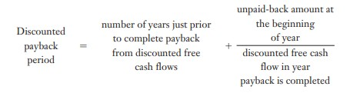
Discounted Payback Period

Slide 19
Discounted Payback Period
“ Decision Rule”
The accept/reject criterion then becomes whether the project’s discounted payback period is less than or equal to the firm’s maximum desired discounted payback period.

Slide 20
Discounted Payback Period
2. On project A, after 3 years, only $74 of the initial outlay remains to be recaptured, whereas year 4 brings in a discounted free cash flow of
$1,068. Thus, if the $1,068 comes in at a constant rate over the year,
it will take about 7/100 of the year ($74/$1,068) to recapture the remaining $74. The discounted payback period for project A is 3.07 years, calculated as follows: Discounted payback periodA = 3.0 +
$74/$1,068 = 3.07 years

Slide 21
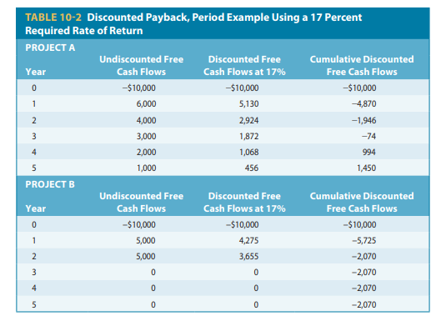

Slide 22
Discounted Payback Period
If project A’s discounted payback period was less than the firm’s maximum desired discounted payback period, then project A would be accepted. Project B, however, does not have a discounted payback period because it never fully recovers the project’s initial cash outlay and thus should be rejected.
The major problem with the discounted payback period comes in setting the firm’s maximum desired discounted payback period. This is an arbitrary decision that affects which projects are accepted and which ones are rejected.
In addition, cash flows that occur after the discounted payback period are not included in the analysis. Thus, although the discounted payback period is superior to the traditional payback period, in that it accounts for the time value of money in its calculations, its use is limited by the arbitrariness of the process used to select the maximum desired payback period.
Moreover, as we will soon see, the net present value criterion is theoretically superior and no more difficult to calculate.

Slide 23
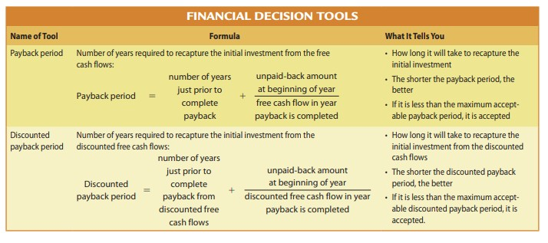

Slide 24
Concept Check
Calculate
1- Pay Back Period
2- Discounted Payback period if the discount rate is 7%
Year | Cash Flow
0 | 80,000
1 | 30,000
2 | 20,000
3 | 25,000
4 | 20,000
5 | 15,000
6 | 15,000

Slide 25
Payback Period
Year | Cash Flow | Cumulative Cash Flow
0 | 80,000 | -80,000
1 | 30,000 | -50,000
2 | 20,000 | -30,000
3 | 25,000 | -5,000
4 | 20,000 | 15,000
5 | 15,000 | 30,000
6 | 15,000 | 45,000
3 years | 0.25 * 12 months
3 Years | 3 Months

Slide 26
Discounted Payback Period
Step 1: get the discounted cash flow
Year | Cash Flow | Discount Factor (1/ (1+r)^t) | Discounted Cash Flow
0 | 80,000 | 1.0000 | 80000
1 | 30,000 | 0.9346 | 28037
2 | 20,000 | 0.8734 | 17469
3 | 25,000 | 0.8163 | 20407
4 | 20,000 | 0.7629 | 15258
5 | 15,000 | 0.7130 | 10695
6 | 15,000 | 0.6663 | 9995

Slide 27
Discounted Payback Period
Year | Cash Flow | Discount Factor (1/ (1+r)^t) | Discounted Cash Flow | Cumulative DCF
0 | 80,000 | 1.0000 | 80000 | -80000
1 | 30,000 | 0.9346 | 28037 | -51963
2 | 20,000 | 0.8734 | 17469 | -34494
3 | 25,000 | 0.8163 | 20407 | -14086
4 | 20,000 | 0.7629 | 15258 | 1172
5 | 15,000 | 0.7130 | 10695 | 11866
6 | 15,000 | 0.6663 | 9995 | 21861
3 years + (0.923 x 12) = 3 years and 11 months

Slide 28
Net Present Value - NPV

Slide 29

The net present value (NPV)
The net present value (NPV) of an investment proposal is equal to the present value of its annual free cash flows less the investment’s initial outlay. The net present value can be expressed as follows:
where FCFt = the annual free cash flow in time period t (this can take on either positive or negative values)
k = the firm’s required rate of return or cost of capital1
IO = the initial cash outlay
n = the project’s expected life

Slide 30
The net present value (NPV)
If any of the future free cash flows (FCFs) are cash outflows rather than inflows, say for example that there is another large investment in year 2 that results in the FCF2 being negative, then the FCF2 would take on a negative sign when calculating the project’s net present value.
In effect, the NPV can be thought of as the present value of the benefits minus the present value of the costs,
NPV = PV benefits – PV costs

Slide 31
The net present value (NPV)
A project’s NPV measures the net value of the investment proposal in terms of today’s dollars. Because all cash flows are discounted back to the present, comparing the difference between the present value of the annual cash flows and the investment outlay recognizes the time value of money.
The difference between the present value of the annual cash flows and the initial outlay
determines the net value of the investment proposal.
Whenever the project’s NPV is greater than or equal to zero, we will accept the project; whenever the NPV is negative, we will reject the project. If the project’s NPV is zero, then it returns the required rate of return and should be accepted. This accept/reject criterion is represented as follows:
  NPV more than 0: accept
  NPV les than 0: reject
Realize, however, that the worth of the NPV calculation is a function of the accuracy of the cash- flow predictions

Slide 32
The net present value (NPV)
ski-Doo is considering new machinery that would reduce manufacturing costs associated with its Mach Z snowmobile for which the free cash flows are shown in Table 10-3. If the firm has a 12 percent required rate of return, what is the NPV of the project? Should the company accept the project?
STEP 1: FORMULATE A SOLUTION STRATEGY
The net present value (NPV) of an investment proposal is equal to the present value of its annual free cash flows less the investment’s initial outlay. Given the company’s free cash flows information, the NPV can be calculated as:

Slide 33
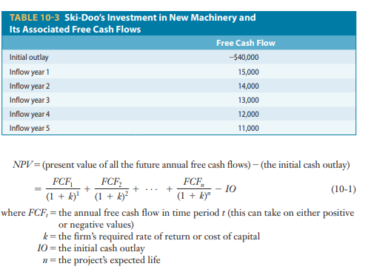
The net present value (NPV)

Slide 34
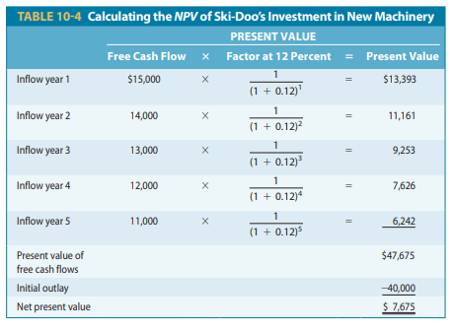
STEP 2: CRUNCH THE NUMBERS
If the firm has a 12 percent required rate of return, the present value of the free cash flow is $47,675, as calculated in Table 10-4. Subtracting the $40,000 initial outlay leaves an NPV of $7,675.

Slide 35
STEP 3: ANALYZE YOUR RESULTS
The NPV tells us how much value is created if the project is accepted, and if the NPV is positive, value is created; if the NPV is negative, the project destroys value.
In this case because this value is greater than zero, this project creates value and should be accepted

Slide 36
The net present value (NPV)
The NPV criterion is the capital-budgeting decision tool we find most favorable for several reasons. First of all, it deals with free cash flows rather than accounting profits. In this regard it is sensitive to the true timing of the benefits resulting from the project.
Moreover, recognizing the time value of money allows the benefits and costs to be compared in a logical manner.
Finally, because projects are accepted only if a positive NPV is associated with them, the acceptance of a project using this criterion will increase the value of the firm, which is consistent with the goal of maximizing the shareholders’ wealth. The disadvantage of the NPV method stems from the need for detailed, long-term forecasts of the free cash flows accruing from the project’s acceptance.
Despite this drawback, the NPV is the most theoretically correct criterion that we will examine.

Slide 37
Concept Check
Calculate
1- NPV if discount rate is 7 %
Year | Cash Flow
0 | 80,000
1 | 30,000
2 | 20,000
3 | 25,000
4 | 20,000
5 | 15,000
6 | 15,000

Slide 38
Concept Check
Year | Cash Flow | Discount Factor (1/ (1+r)^t) | Discounted Cash Flow
0 | 80,000 | 1.0000 | -80000
1 | 30,000 | 0.9346 | 28037
2 | 20,000 | 0.8734 | 17469
3 | 25,000 | 0.8163 | 20407
4 | 20,000 | 0.7629 | 15258
5 | 15,000 | 0.7130 | 10695
6 | 15,000 | 0.6663 | 9995
Cash outflows
Cash Inflows
NPV = Sum of all discount CASHINFLOWS – intial cash outflows
= 101,861 – 80,000
= 21,861

Slide 39
Bonus Question
Year | Cash Flow - Project A | Cash Flow - Project B
0 | 100,000 | 100,000
1 | 30,000 | 60,000
2 | 20,000 | 40,000
3 | 10,000 | 20,000
4 | 70,000 | 10,000
5 | 30,000 | 10,000
6 | 10,000 | 15,000
 | The Company has 2 projects and you are required to perform an investment appraisal to both project using payback period, discounted payback period, and NPV to help the company select the optimal project given that the company required payback period is 4 years and the discount rate is 8 %

Slide 40
Payback Period
Project A |  |  | Project B
Year | Cash Flow | Cumulative Cash Flow | Year | Cash Flow | Cumulative Cash Flow
0 | 100,000 |  | 0 | 100,000
1 | 30,000 |  | 1 | 60,000
2 | 20,000 |  | 2 | 40,000
3 | 10,000 |  | 3 | 20,000
4 | 70,000 |  | 4 | 10,000
5 | 30,000 |  | 5 | 10,000
6 | 10,000 |  | 6 | 15,000

Slide 41
Pay Back Period
Payback Period
Project A |  |  | Project B
Year | Cash Flow | Cumulative Cash Flow | Year | Cash Flow | Cumulative Cash Flow
0 | 100,000 | -100,000 | 0 | 100,000 | -100,000
1 | 30,000 | -70,000 | 1 | 60,000 | -40,000
2 | 20,000 | -50,000 | 2 | 40,000 | 0
3 | 10,000 | -40,000 | 3 | 20,000 | 20,000
4 | 70,000 | 30,000 | 4 | 10,000 | 30,000
5 | 30,000 | 60,000 | 5 | 10,000 | 40,000
6 | 10,000 | 70,000 | 6 | 15,000 | 55,000
 |  |  |  | 2 YEARS
3 YEARS | 6.857142857

Slide 42
Discounted Pay Back Period & NPV
Discounted Payback Period
Project A |  |  |  |  | Project B
Year | Cash Flow | Discount Factor | DCF | Cumulative DCF | Year | Cash Flow | Discount Factor | DCF | Cumulative DCF
0 | 100,000 | 1.0000 | 100,000 | -100,000 | 0 | 100,000 | 1.00 | 100,000 | -100,000
1 | 30,000 | 0.9259 | 27,778 | -72,222 | 1 | 60,000 | 0.93 | 55,556 | -44,444
2 | 20,000 | 0.8573 | 17,147 | -55,075 | 2 | 40,000 | 0.86 | 34,294 | -10,151
3 | 10,000 | 0.7938 | 7,938 | -47,137 | 3 | 20,000 | 0.79 | 15,877 | 5,726
4 | 70,000 | 0.7350 | 51,452 | 4,315 | 4 | 10,000 | 0.74 | 7,350 | 13,076
5 | 30,000 | 0.6806 | 20,417 | 24,732 | 5 | 10,000 | 0.68 | 6,806 | 19,882
6 | 10,000 | 0.6302 | 6,302 | 31,034 | 6 | 15,000 | 0.63 | 9,453 | 29,334
 |  | NPV | 31,034 |  |  |  | NPV | 29,334
 |  |  |  |  |  | 2 YEARS
3 YEARS | 8.08065

Slide 43
Conclusion
 | Project A | Project B
Pay Back Period | 3 Years & 6 months | 2 years
Discounted Payback Period | 3 years & 8 monthd | 2 years & 7 months
NPV | 31,034 | 29,334

Slide 44


Thank You

